Slide 1
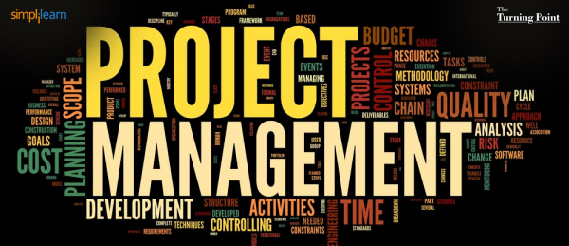
Instructor: NGUYEN ANH MINH, MSc, PMP

Slide 2
Project Quality Management

Slide 3
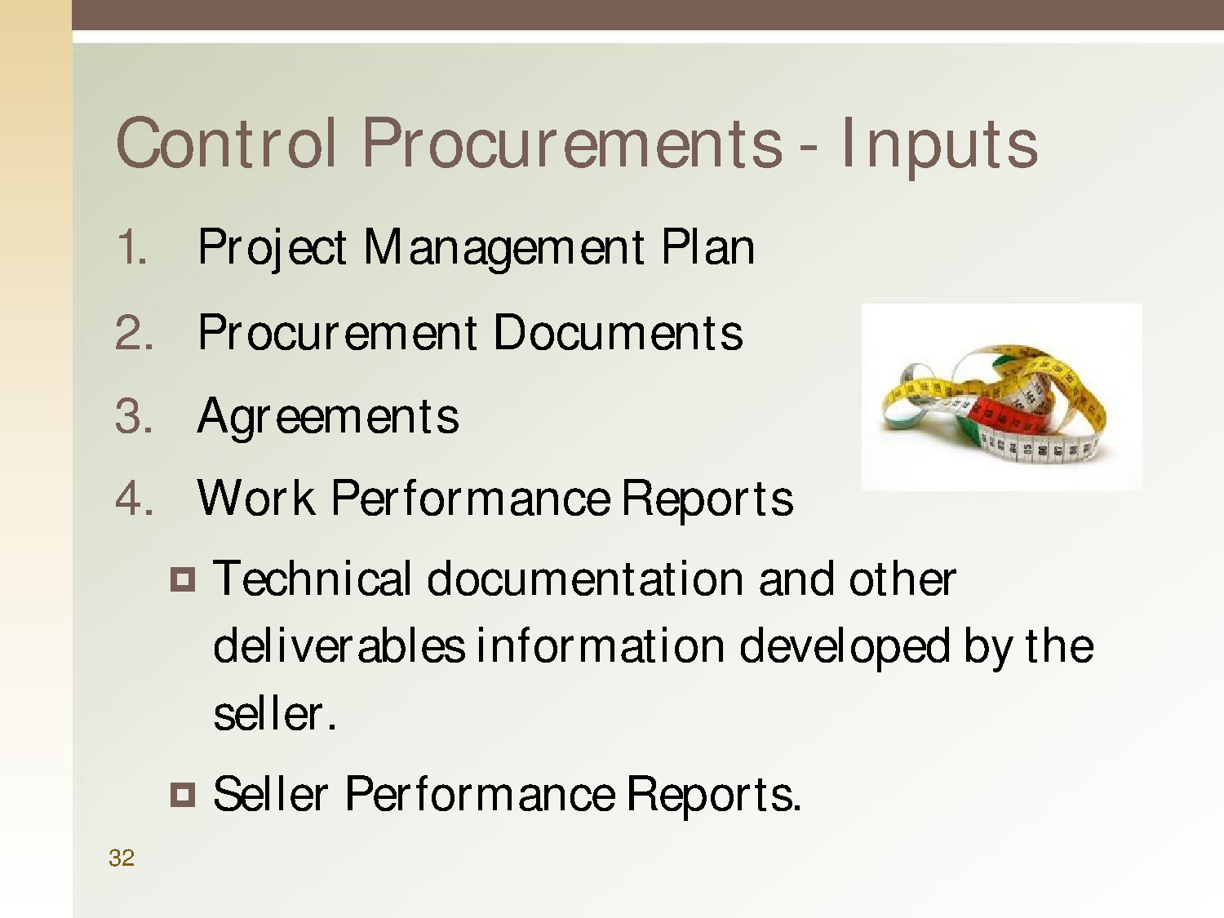

Slide 4

Agenda
Quality Theories
Evolution of Quality Management
8.1 Plan Quality Management
8.2 Perform Quality Assurance
8.3 Control Quality

Slide 5
Quality Management
Quality is the degree to which the project fulfills requirements.
Quality Management includes creating and following policies and procedures in order to ensure that a project meets the defined needs it was intended to meet.

Slide 6
Quality Theorists
Joseph Juran: 80/20 principle, top management involvement. Quality is fitness for use.
W. Edwards Deming: 14 steps of total Quality Management, Plan-Do-Check-Act cycle.
Philip Crosby: Cost of poor quality, prevention
over inspection and zero defects. Quality is “conformance to requirements”
4

Slide 7
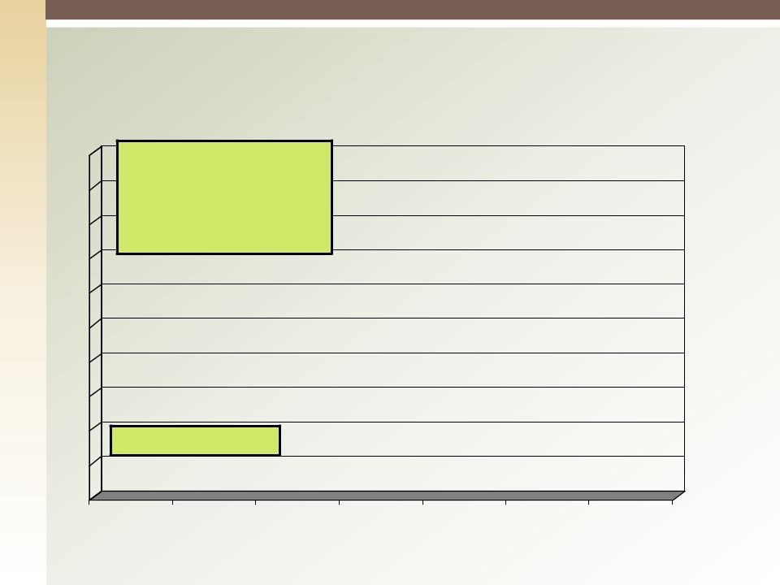
Evolution of Quality Management
Quality is separating good from bad parts without feedback to the production
;
Quality Control
1950
1960
1970
1980
1990
2000
2007
PMP - Project Quality Plan
https://www.facebook.com/waleed.naggar
5

Slide 8
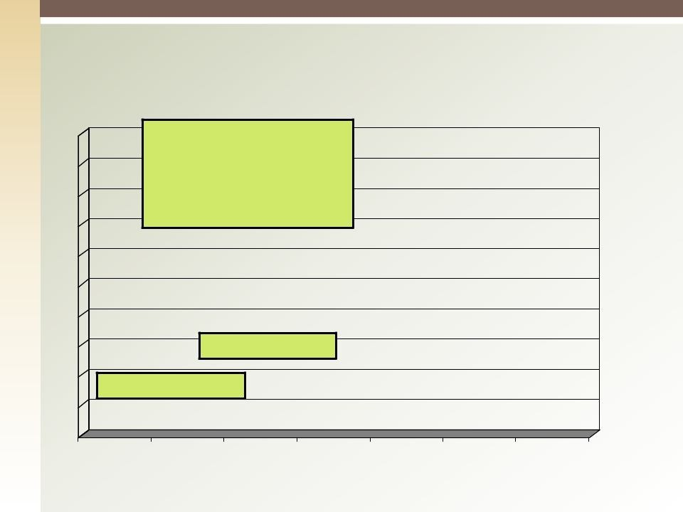
Evolution of Quality Management
production process; Inspection
shifted into to the production process, prevention, process
orientation
Quality Assurance
 | Quality Control
Quality develops during the
1950
1960
1970
1980
8
1990
2000
2007

Slide 9
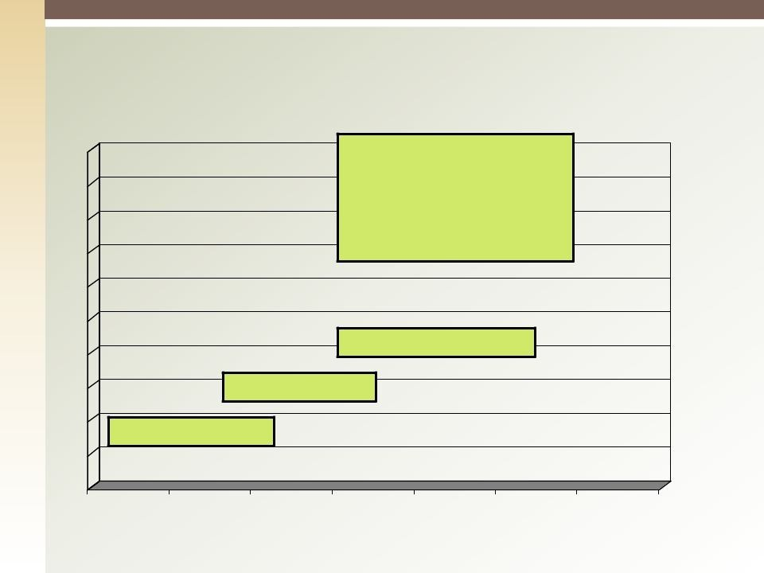
Evolution of Quality Management
supervised company-wide;
commitment of management, participation of employees, step
by step improvement.
ISO 9000
Quality Assurance
 | Quality Control
Quality is defined, planned and
1950
1960
1970
1980
9
1990
2000
2007

Slide 10
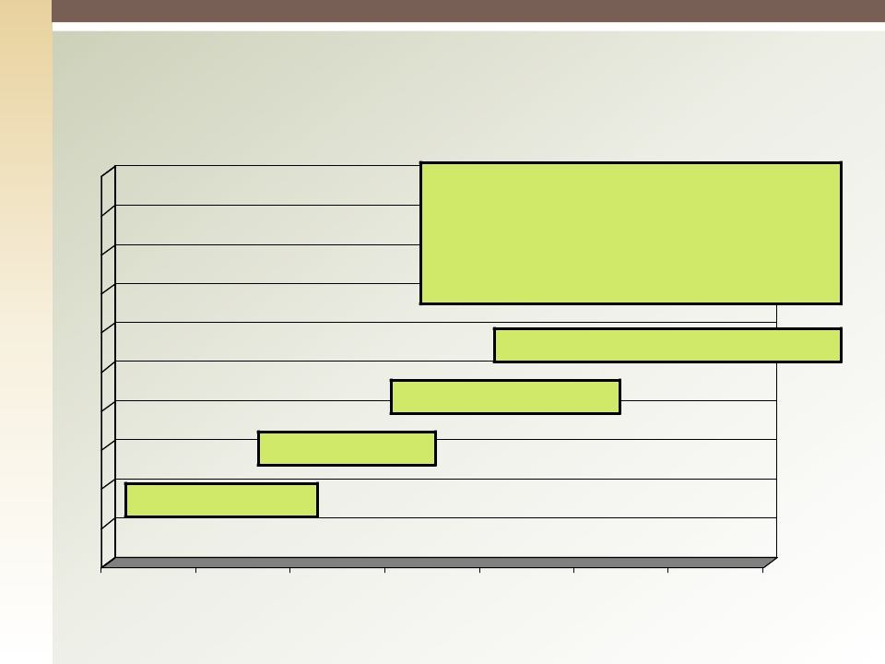
Evolution of Quality Management
Total Quality management: Customer, employees, process, society & stakeholder orientated. A
philosophy that enc^{S}o^{i}u^{x}ra^{S}g^{ig}e^{m}s ªcompanies and their employees to focus on finding ways to continuously improve the quality of their business practices and products.
Total quality Management
ISO 9000
Quality Assurance
Quality Control
1950
1960
1970
1980
1990
2000
2007
8

Slide 11
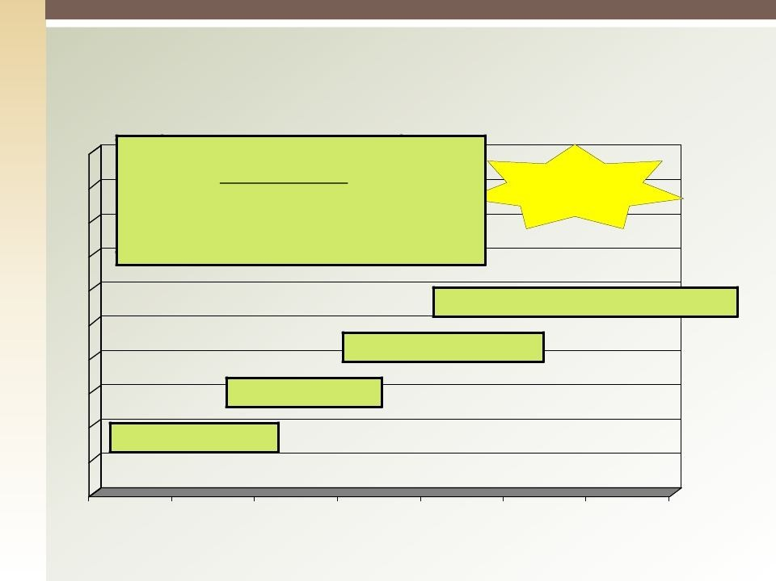
Evolution of Quality Management
Quality devSeilxopsSdigumrinag, the
Quality is separating good
_{from b}p_{a}r_{d}do _{p}u_{a}ct_{r}io_{ts}n_{w}p_{it}r_{h}o_{o}ce_{ut}ss; Inspection
_{feedbac}s_{k}h_{t}if_{o}te_{th}d_{e}in_{p}to_{ro}t_{d}o_{uc}th_{ti}e_{on}production
Six Sigma
proces^{b}s,^{u}p^{sin}re^{e}v^{s}e^{s} n^{im}tio^{p}n^{r},ºp^{ve}ro^{m}c^{e}e^{n}s^{t}s.
DMAIC process : Define,^{orientation}Measure, Analyze, Improve &
Control
Total quality Management
ISO 9000
Quality Assurance
Quality Control
1950
1960
1970
1980
9
1990
2000
2007

Slide 12
ISO Compatibility
Customer Satisfaction
Prevention over inspection
Continuous improvement
Management Responsibility
Cost of Quality (COQ)
10

Slide 13
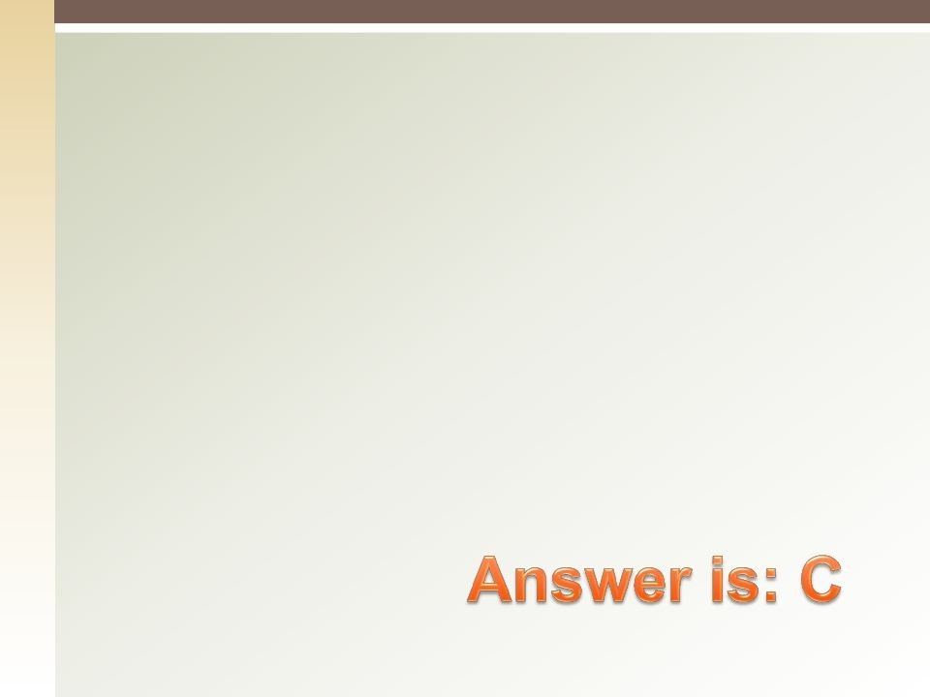

Quiz:
Quality is:
Meeting & exceeding customer needs.
Adding extra to make customer happy.
Conformance of requirements and fitness of use
Conformance to management’s requirements
11

Slide 14
8.1 Plan Quality Management
Identifying quality requirement and/or standards for the project and its deliverables, and documenting how the project will demonstrate compliance with the relevant quality requirements.

Slide 15
Plan Quality: Inputs (1)
1. Project Management Plan, includes but not limited to
◉
Scope baseline
Work Breakdown Structure WBS Dictionary
Schedule baseline Cost baseline
Other management Plans
◉
◉
◉
◉
◉

Slide 16
Plan Quality: Inputs (2)
Stakeholder Register
Risk register
Requirements Documentation
Enterprise environmental factors
Organizational process assets

Slide 17
Plan Quality: T & T
Cost-benefit Analysis
Cost of Quality (COQ)
Seven Basic Quality Tools
Cause-and-Effect Diagram
Flowcharts
Check-sheet
Pareto Diagram
Histograms
Control Charts
Scatter Diagram

Slide 18
Plan Quality: T & T
Benchmarking
Design of Experiments
Statistical Sampling
Additional Quality Tools
Brainstorming
Force field analysis
Nominal Group Technique
Quality Management and control tools
Meetings

Slide 19
Cost-benefit Analysis
The primary benefit of meeting quality
requirements is less rework, i.e., higher productivity, lower costs and increased stakeholder satisfaction.
The primary cost of meeting quality requirements is the expenses associated with quality management activities.

Slide 20
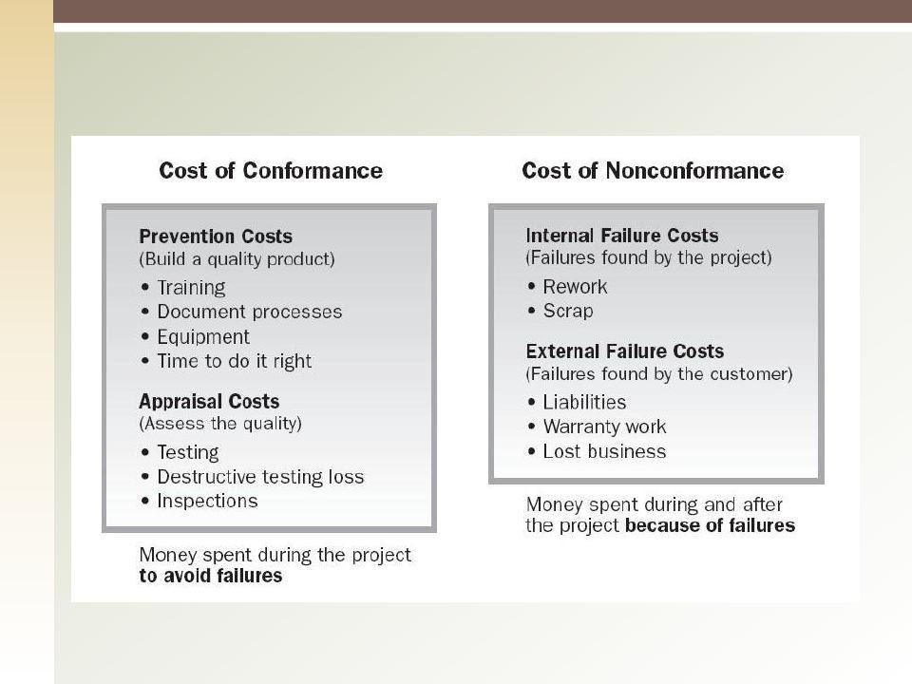
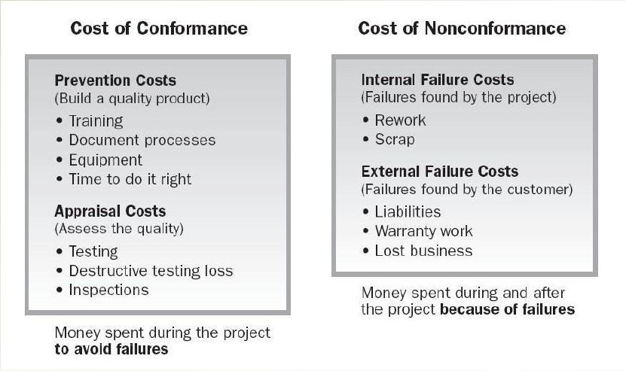
Cost of Quality

Slide 21
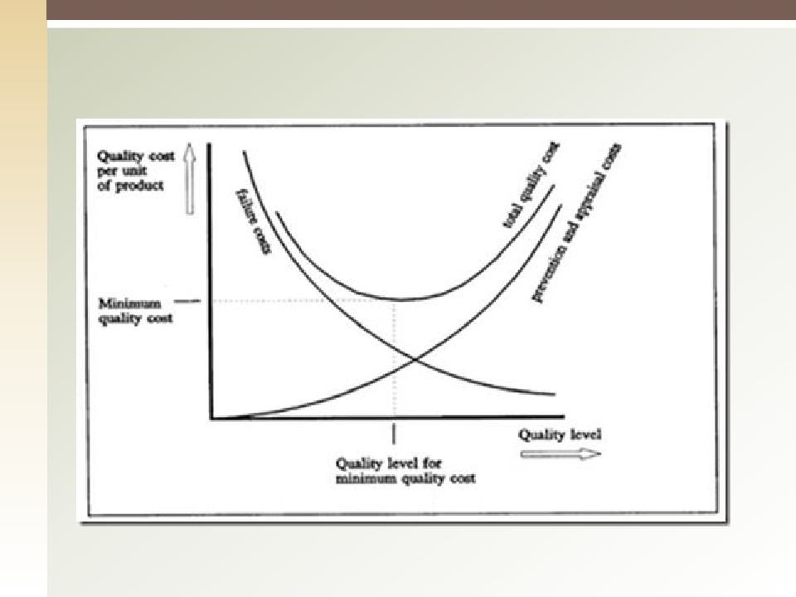
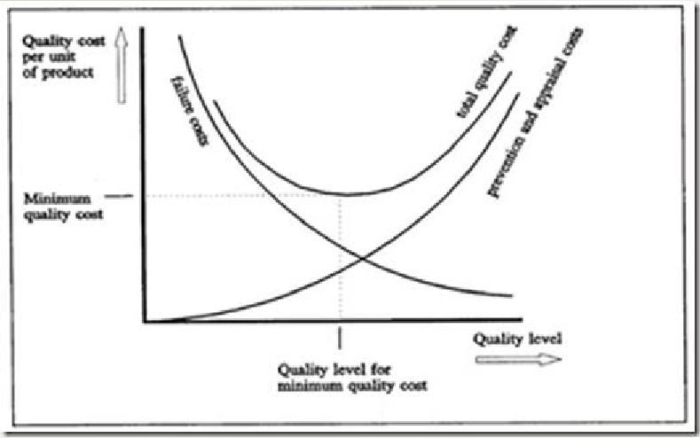
Cost of Quality
PMP - Project Quality Plan
https://www.facebook.com/waleed.naggar
19

Slide 22
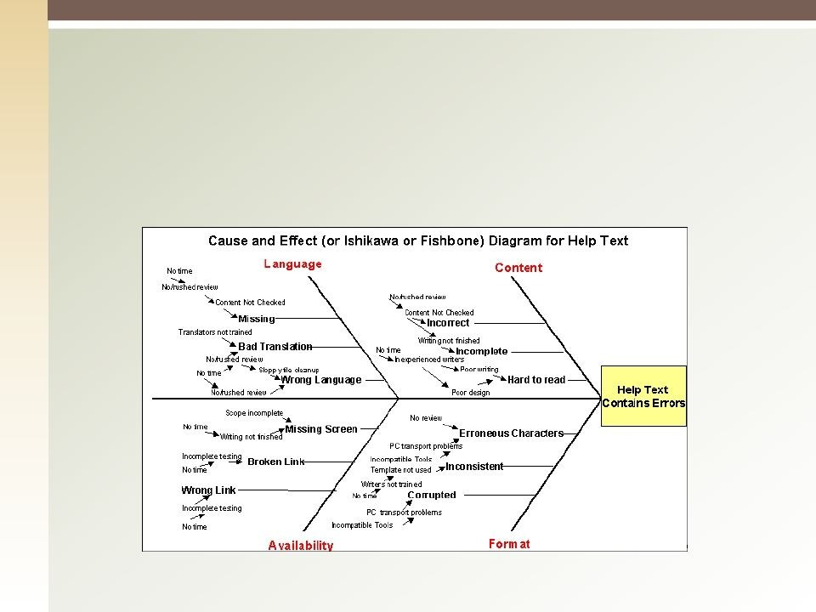
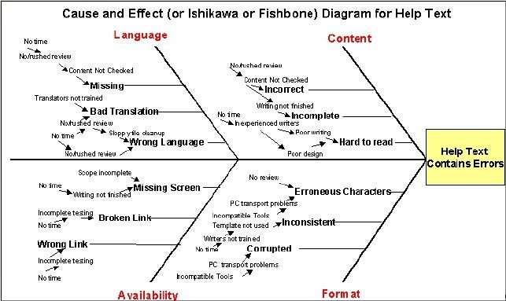
Cause and Effect Diagram
Trace the problem’s source back to its “actionable root cause”

Slide 23
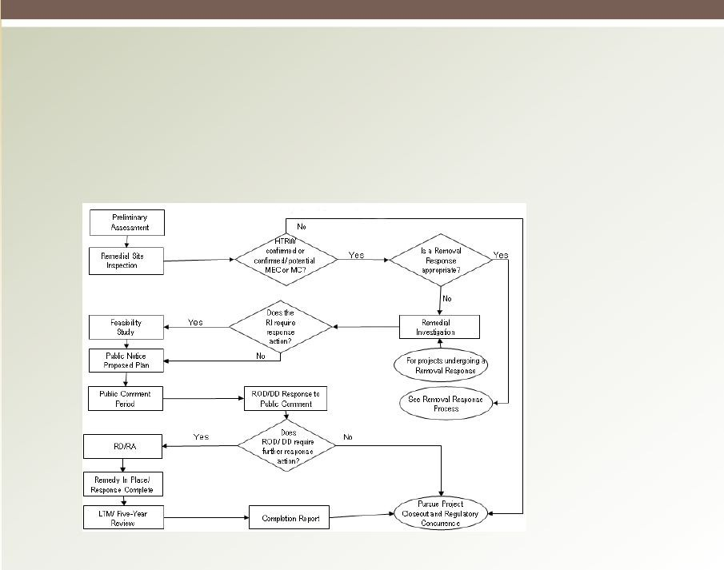
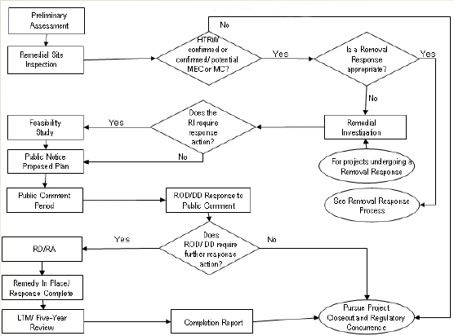
Flowcharting
A graphical representation of a process showing the relationships among process steps.

Slide 24
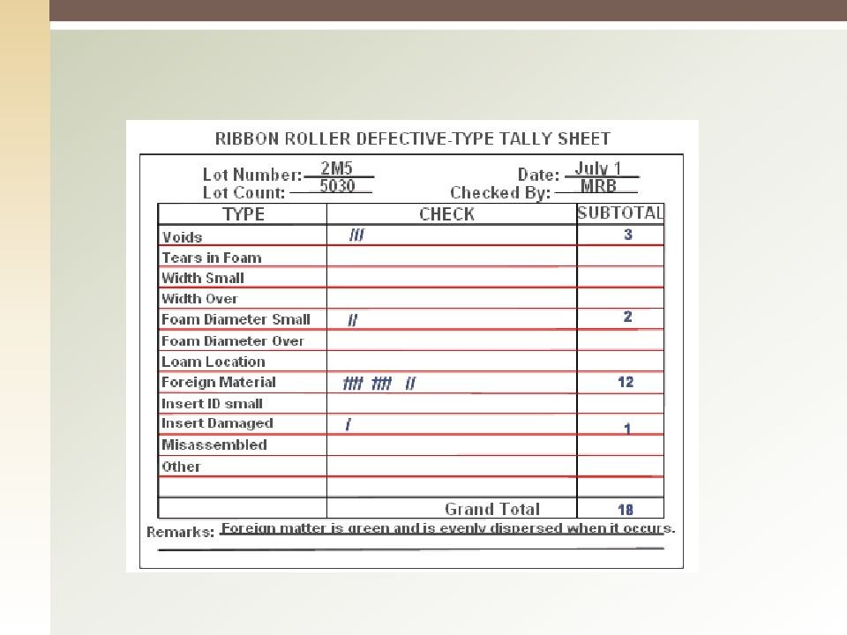
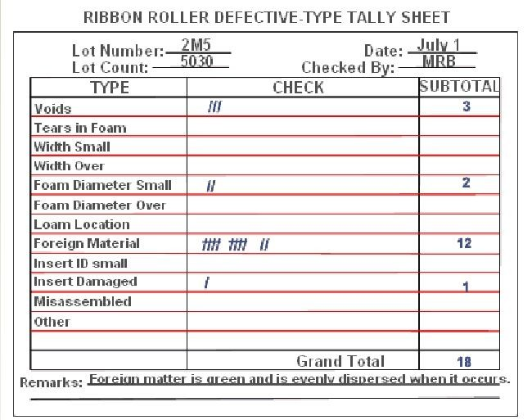
Tally Sheets

Slide 25
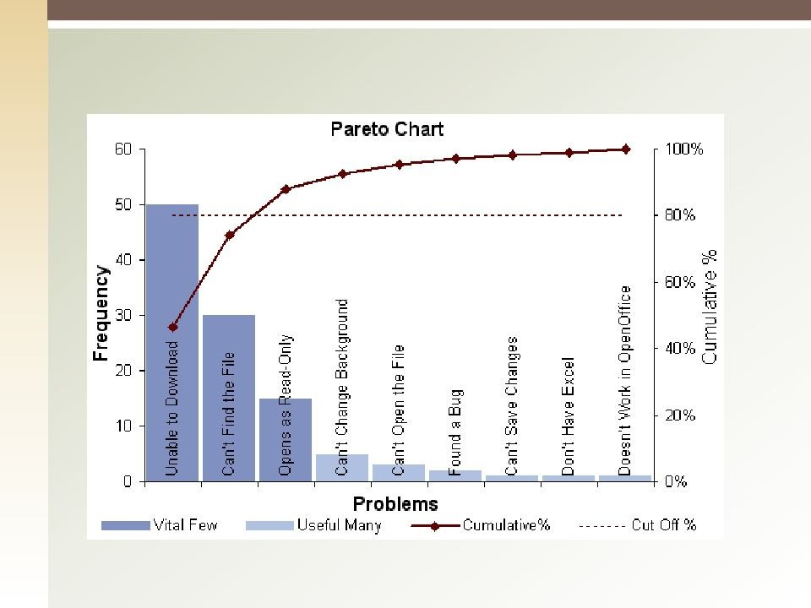
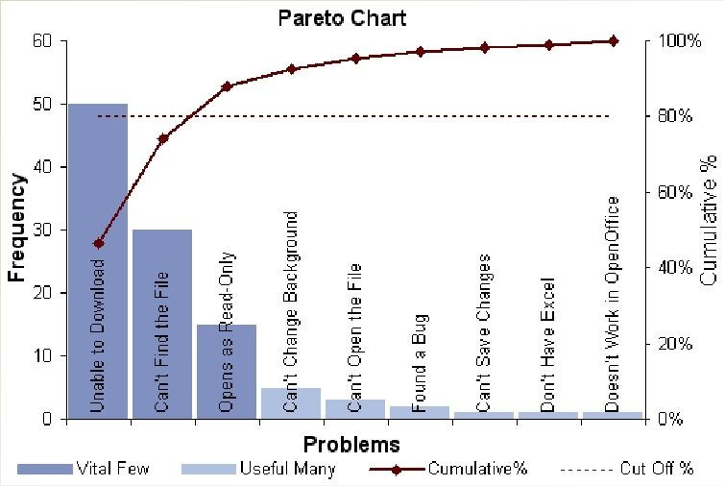
Pareto Diagram

Slide 26
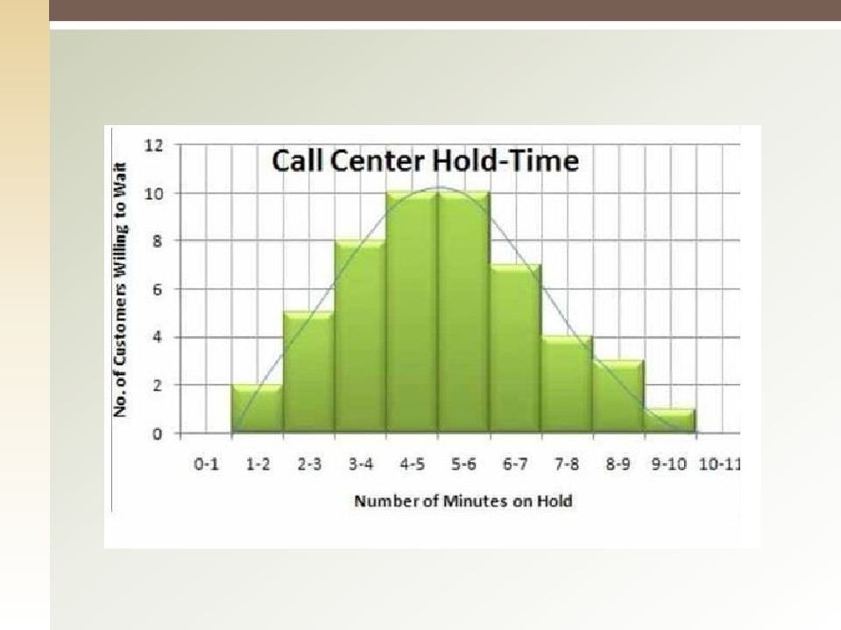
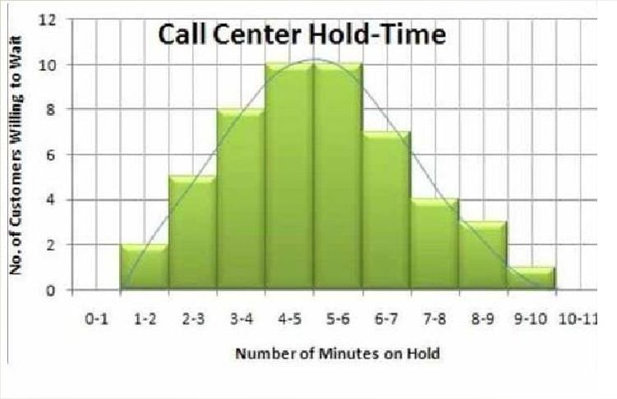
Histogram

Slide 27
Control Charts
Graphic displays of the results, over time, of a process; used to assess whether the process is “in control”
Rule of Seven – Run of seven points toward upper or lower control limit may indicate that process is out of control
Assignable causes – Variations may be caused by differences in machines, workers overtime, etc. Identify the root cause.

Slide 28
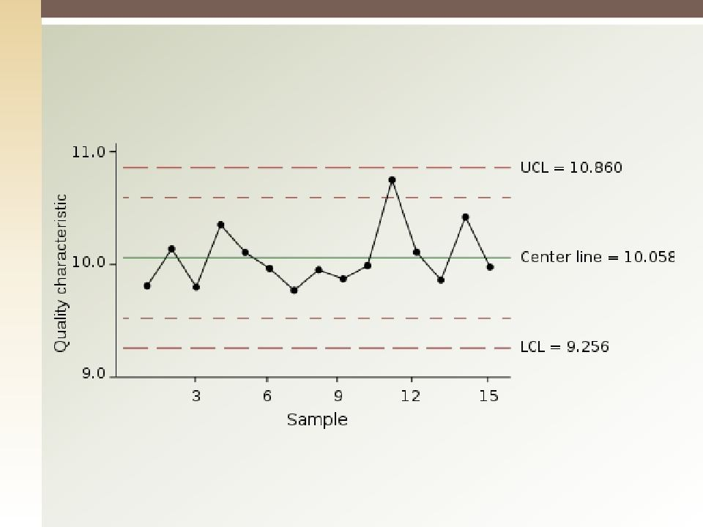
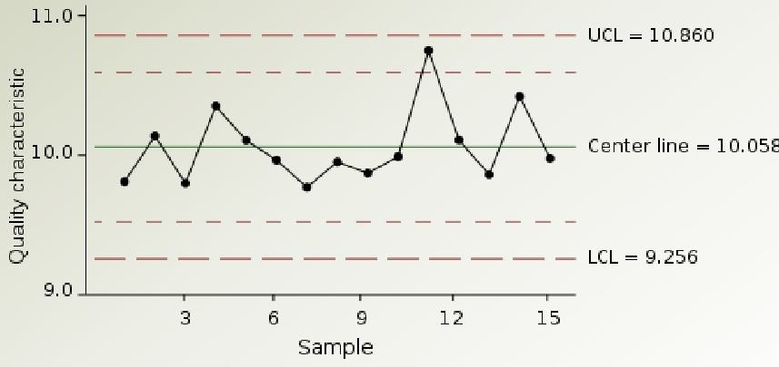
Control Chart – contd.

Slide 29
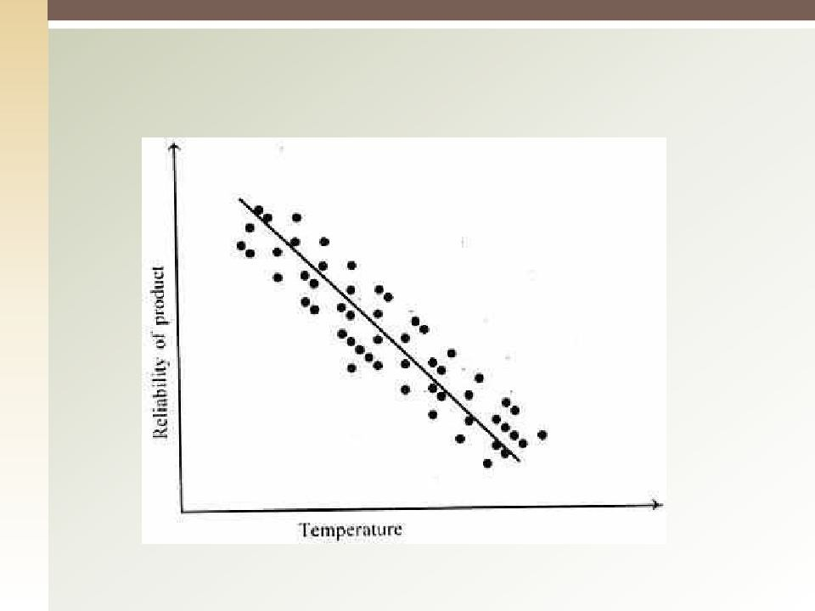
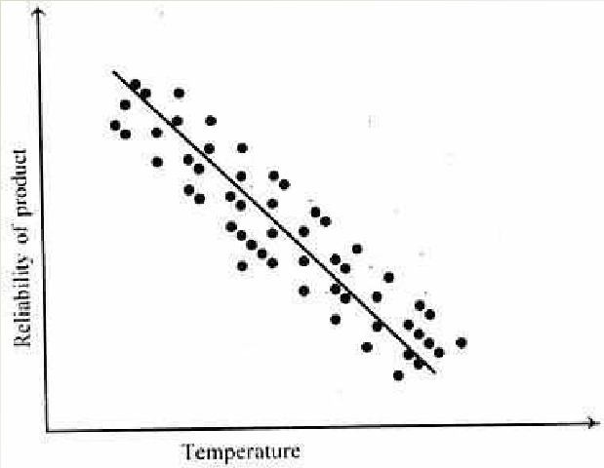
Scatter Diagram

Slide 30
Benchmarking
Benchmarking involves comparing actual or
planned project practices to those of other projects in order to generate ideas for improvement and to provide a standard by which to measure performance.
These other projects may be within the performing organization or outside of it, and may be within the same or in another application area.

Slide 31
Design of Experiment
Design of experiments is a statistical method
that helps identify which factors might influence specific variables. It also plays a role in the optimization of products or processes.

Slide 32
Statistical Sampling
Statistical sampling involves choosing part of a population of interest for inspection (e.g., selecting 10 samples of 75 electronic components).
Appropriate sampling can often reduce the cost of quality control.
There is a substantial body of knowledge on statistical sampling; in some application areas, it is necessary for the project management team to be familiar with a variety of sampling techniques.

Slide 33
Plan Quality Management: Outputs
Quality Management Plan
Process Improvement Plan
Process Boundaries
Process Configuration
Process Metrics
Targets for Improved Performance
Quality Metrics
Quality Checklist
Project Documents Updates
31

Slide 34
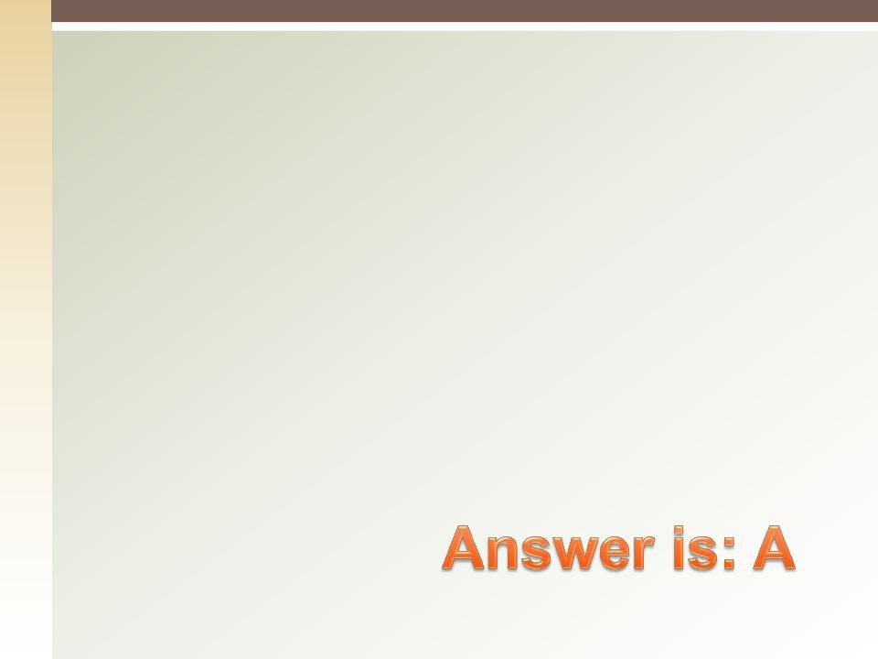

Quiz:
Training costs are part of:
Prevention costs
Appraisal costs.
Internal failure costs.
External failure costs.
32

Slide 35
8.2 Perform Quality Assurance
Auditing the quality requirements and the results from quality control measurement to ensure that appropriate quality standards and operational definitions are used.
The key benefit of this process is that it facilitates the improvement of quality processes
33

Slide 36
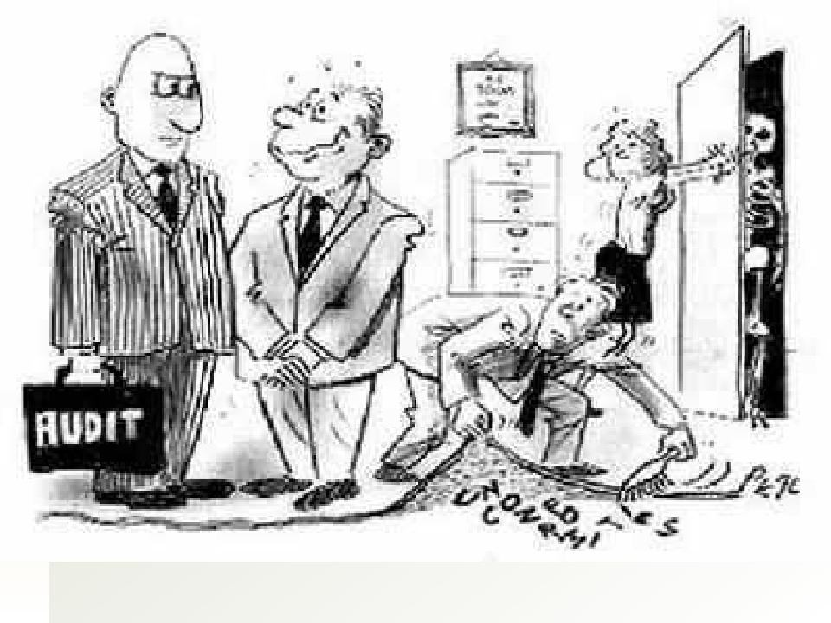
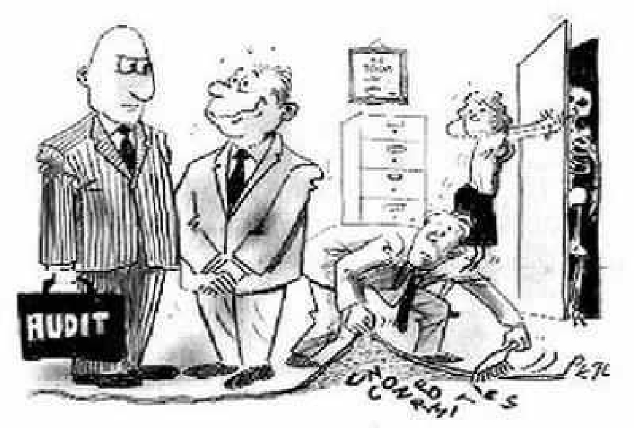
34

Slide 37
Perform Quality Assurance: Input
Quality Management Plan
Process Improvement Plan
Quality Metrics
Quality Control Measurements
Project Documents

Slide 38
Perform Quality Assurance: T & T
Quality Management and Control Tools
Affinity Diagrams
Process Decision Program Charts
Interrelationship Digraphs
Tree Diagrams
Prioritization Matrices
Activity Network Diagram
Matrix Diagrams
Quality Audits
Process Analysis

Slide 39
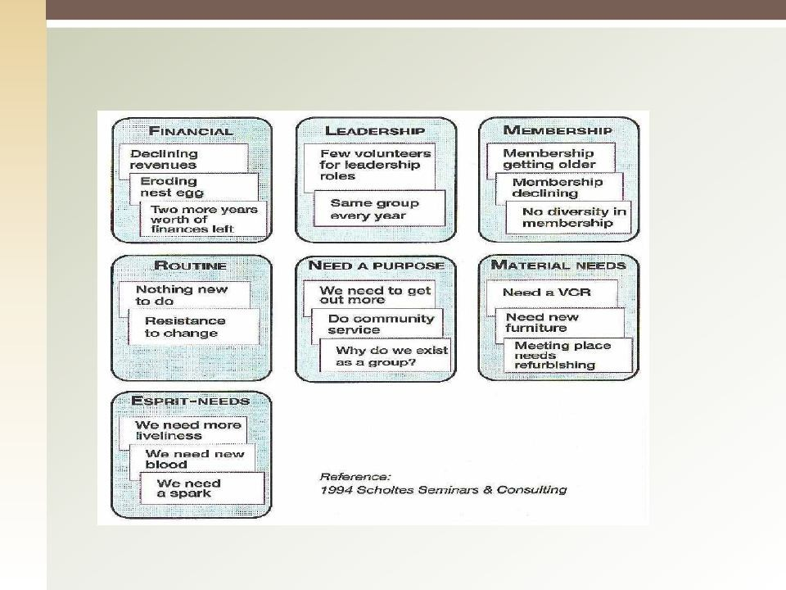
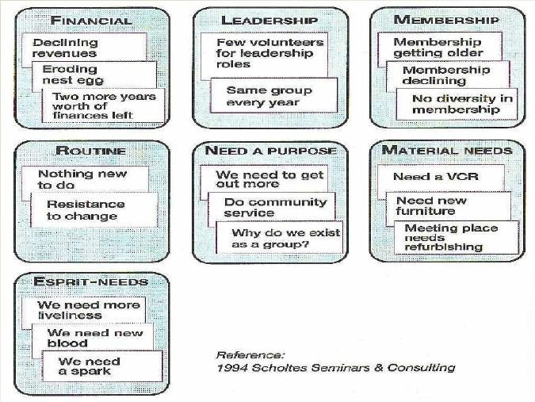
Affinity Diagrams

Slide 40
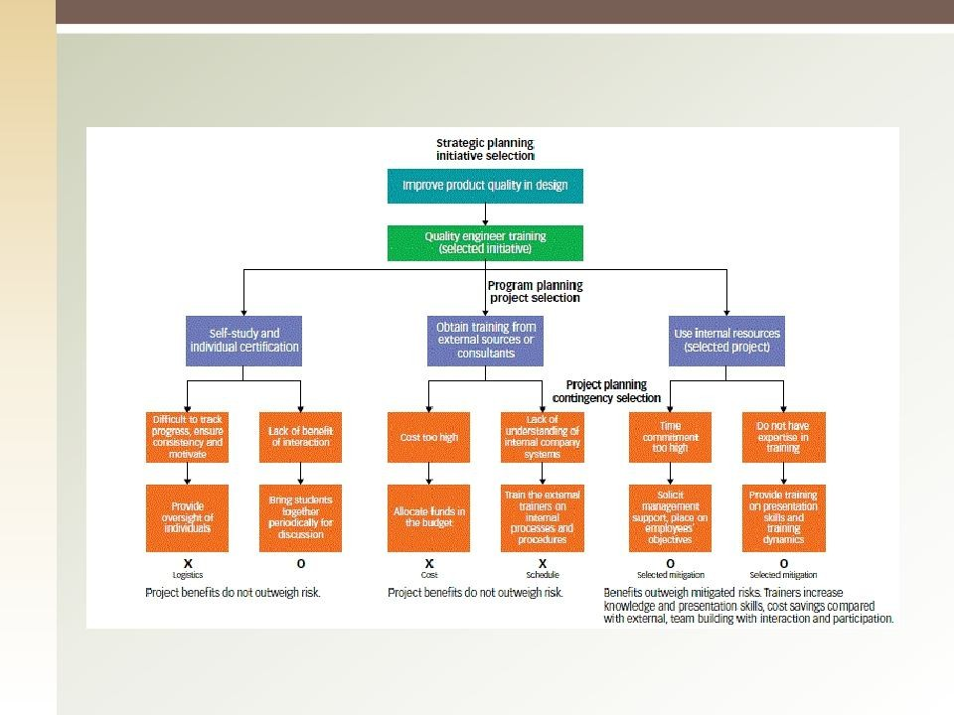
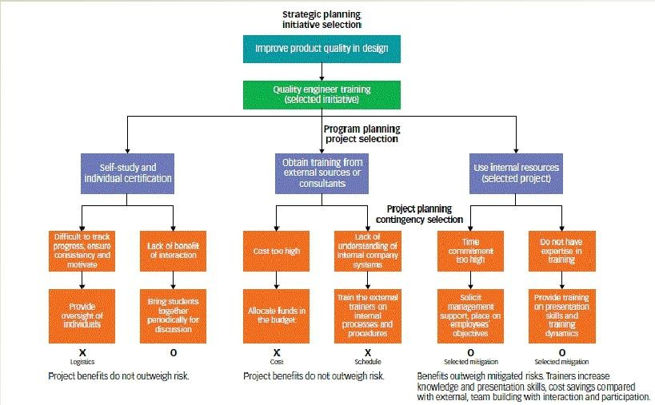
Process Decision Program Charts (PDPC)

Slide 41
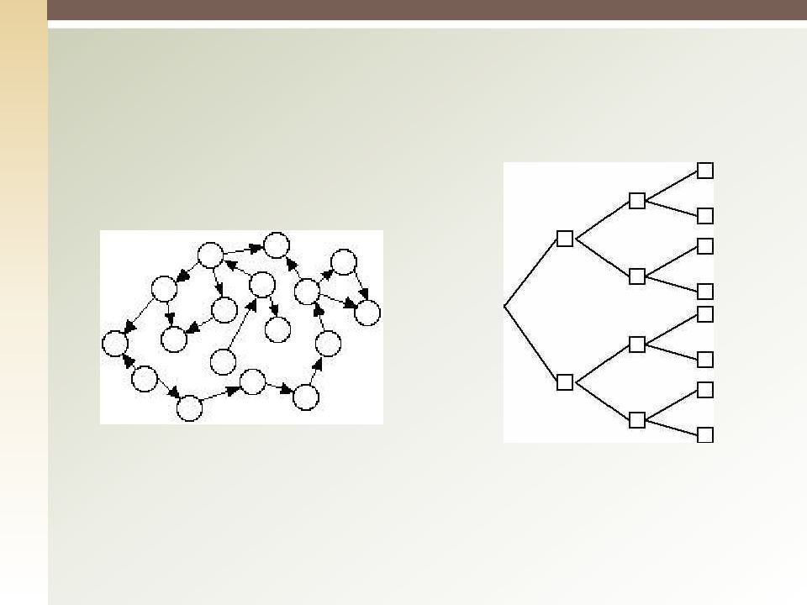
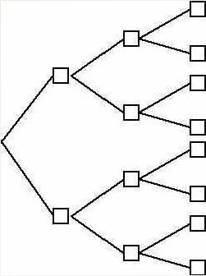
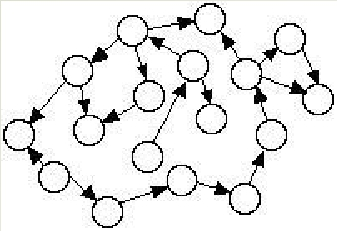
Tree Diagrams
Interrelationship Digraph

Slide 42
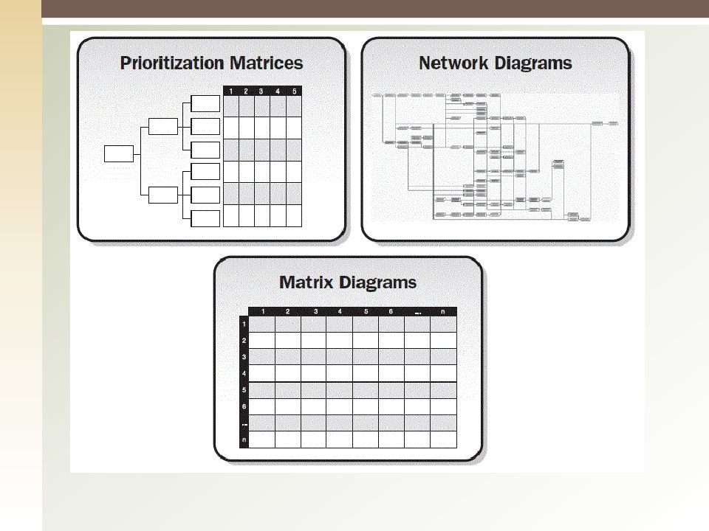
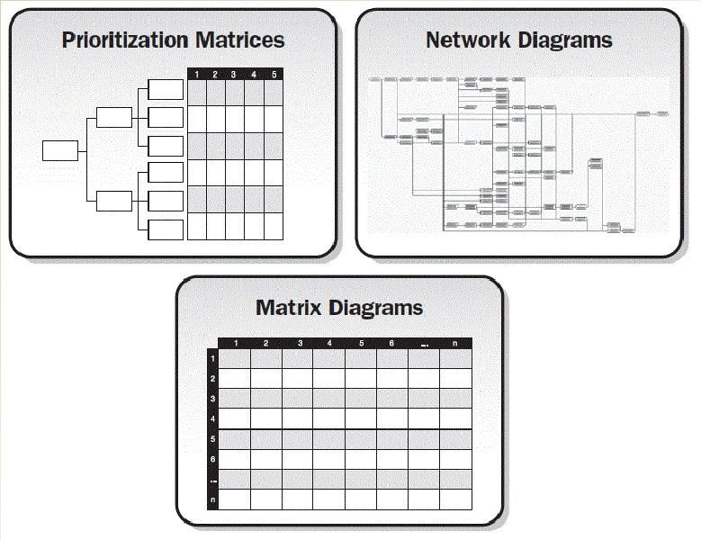

Slide 43
Perform Quality Assurance: Output
Change Requests
Project Management Plan Updates
Project Documents Updates
Organizational Process Assets

Slide 44


Quiz:
Who is responsible of the quality management in the project:
Project Quality Manager.
Project Manager
Project Team members.
Quality Assurance Department.

Slide 45
8.3 Control Quality (1)
Perform Quality Control is the process of monitoring and recording results of executing the quality activities to assess performance and recommend necessary changes
The key benefits of this process include
Identifying the causes of poor quality
Validating that project deliverables and work meet the requirements

Slide 46
8.3 Control Quality (2)
Important Quality terms
Prevention (Keeping errors out of the process) vs. Inspection (Keeping errors out of the hands of the customer).
Attribute sampling (either conform or doesn't) vs. Variables sampling (degree of conformity)
Tolerance (range of acceptable results) and control limits (thresholds which may indicate out of control)

Slide 47
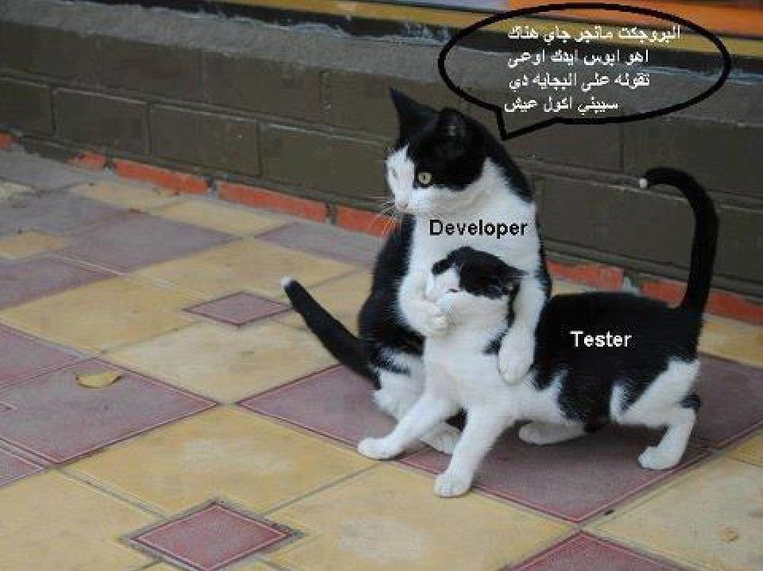

Slide 48
Control Quality: Input
Project Management Plan
Quality Metrics
Quality checklists
Work Performance Data
Approved Change Requests
Deliverables
Project Documents
Organizational Process Assets

Slide 49
Control Quality: T & T
Seven Basic Quality Tools
Statistical Sampling
Inspection
Approved Change Request Reviews
47

Slide 50
Control Quality: Output
Quality Control Measurements
Validated Changes
Verified Deliverables
Work Performance Information
Change Requests
Project Management Plan Updates
Project Document Updates
Organizational Process Assets Updates (Completed checklists, lessons learned documentation, etc.)

Slide 51
Quiz:
When a process considered to be in control, it:
Should not be adjusted
May not be changed to provide improvements.
Shows differences caused by expected causes.
Should not be inspected or reworked for any reason.

Slide 52


Thank you
50

