Slide 1
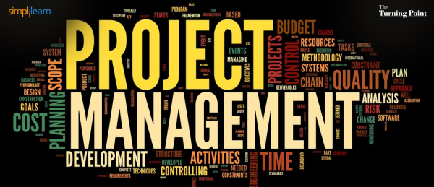
Instructor: NGUYEN ANH MINH, MSc, PMP

Slide 2
Project Human resource
Management

Slide 3
Agenda
9.1 Plan HR Management
9.2 Acquire Project Team
9.3 Develop Project Team
Motivation Theories
9.4 Manage Project Team
Conflict Management

Slide 4
Human Resources Management
Project Human Resource Management includes the processes that organize, manage and lead the project team. The project team is comprised of the people with assigned roles and responsibilities for completing the project.

Slide 5
9.1 Plan HR Management
Identifying and documenting project roles, responsibilities, required skills, reporting relationships, and creating a staff management plan.
The key benefit of this process is that it established project roles and responsibilities, project organization charts, and staffing management plan including the timetable of resource acquisition and release.

Slide 6
Plan HR Management: Input
Project Management Plan
Activity Resource Requirements
Enterprise Environmental Factors
Organizational Structure and culture
Existing human resources
Geographical dispersion and team members
Personnel administration policies
Marketplace Conditions
Organizational Process Assets

Slide 7
Plan HR Management: T & T
Organizational Charts and Position Descriptions
Hierarchical-type Charts
Matrix-based Charts
Text Oriented Formats
Networking
Organizational Theory
Expert Judgment
Meetings

Slide 8
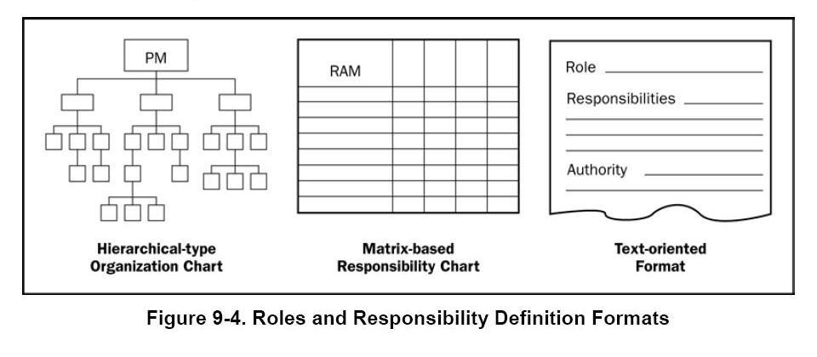
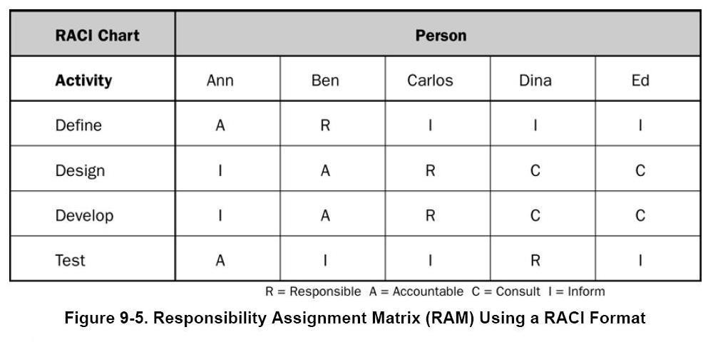

Slide 9

Plan HR Management: Outputs (1)
Human Resource Plan
Roles and Responsibilities: Project Manager,
Team Members, Functional Manager, Business
Analyst, Sponsor, … etc.
Role
Authority
Responsibility
Competency

Slide 10
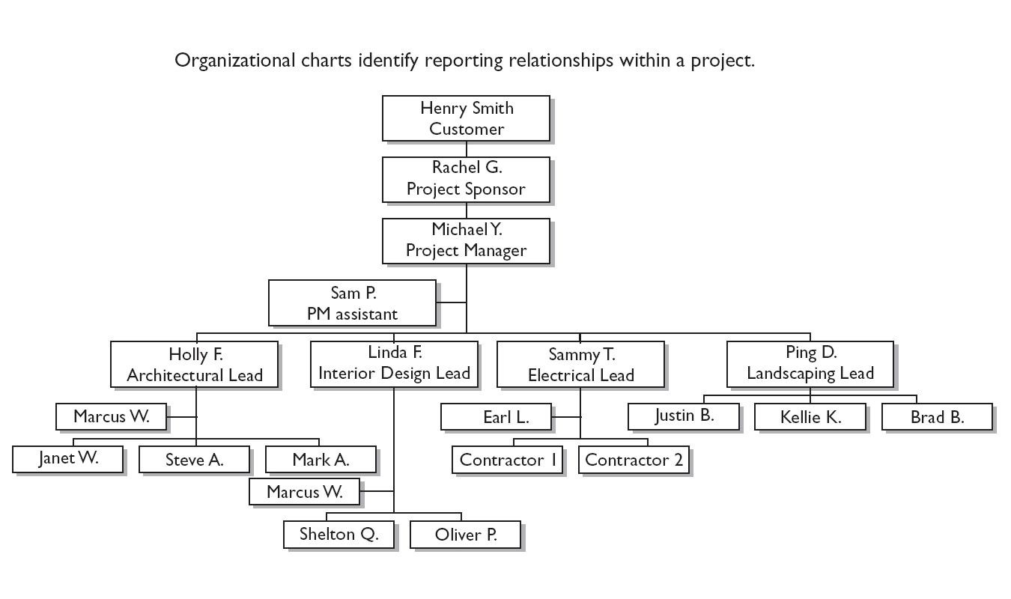
Plan HR Management: Outputs (2)
B. Project Organization Charts

Slide 11
Plan HR Management: Outputs (3)
Staffing Management Plan:
Describes the entrance and release criteria human resources into the project.
Includes:
Staff Acquisition
Resource Calendars
Staff Release Plan
Training Needs
Recognition and rewarding system
Compliance
Safety
10

Slide 12
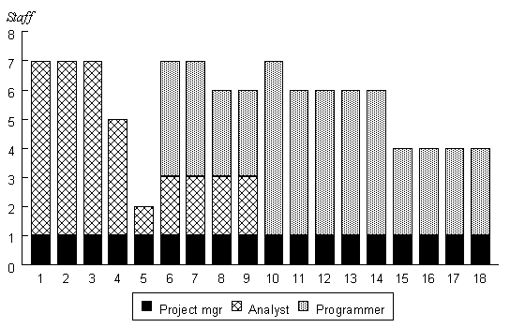


Slide 13
Exam Spotlights
Understand the key environmental factors and the five constraints that can impact the Human Resource Planning process
Using templates and checklists is one way to ensure that you don’t miss any key responsibilities when planning the project and will help reduce the amount of time spent in planning

Slide 14


Quiz
You have been assigned as a project manager for a software development project. The project team consists of 15 team members. You want to understand who is responsible for doing what in the project. Where can you find this information?
Responsibility Assignment Matrix
Resource Histogram
Bar Chart
Project Organization Chart

Slide 15

Quiz
What type of organization is BEST for managing complex projects involving cross disciplinary efforts?
Projectized
Functional
Line
Matrix

Slide 16
9.2 Acquire Project Team
Attain & assign human resources to the project.
Staff may come from inside or outside the
organization
Project Manager does not always have control over team members selection.
Beware of Halo Effect: “You are a great programmer, so when we hire you as a project manager we expect you to be great”.

Slide 17
Acquire Project Team: Inputs
Human Resource Management Plan
Roles & Responsibilities
Project Organization Chart
Staffing Management Plan
Enterprise Environmental Factors
Organizational Structure
Availability, competency levels, prior experience and interest
Personnel administration policies and cost
Location or multiple locations
Organizational Process Assets

Slide 18
Acquire Project Team T&T
Pre-Assignment
Negotiation
Acquisition
Virtual Teams
Multi-criteria Decision Analysis (Examples
of selection criteria: availability, cost,
experience, ability, knowledge, skills,
attitude and international factors).

Slide 19
Acquire Project Team Outputs
Project Staff Assignment
Resource Calendar: documents the time periods each project team member can work on the project.
Project Management Plan Updates.

Slide 20
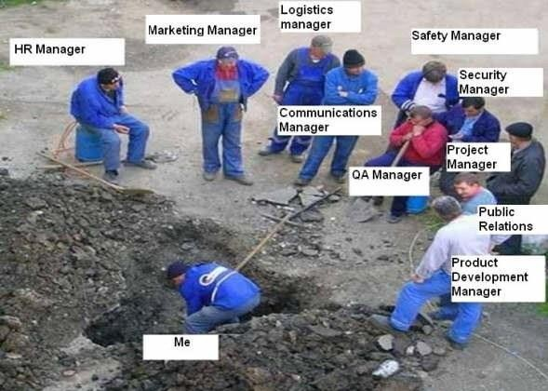

Slide 21


Quiz
The MOST common causes of conflict are
project schedules, project priorities and:
Personalities
Resources
Cost
Management
20

Slide 22

Quiz
During project planning in a matrix organization, the project manager determines that additional human resources are needed. From whom would he/she request these resources?
Functional Manager
Team
Project Sponsor
Human Resources Department

Slide 23
Quiz
A project manager must publish a project schedule.
Activities, start/end times and resources are identified. What should the project manager do NEXT?
Distribute the schedule according to communication plan.
Confirm availability of resources
Refine the project plan to reflect more accurate cost
information.
Publish a bar chart illustrating the timeline.

Slide 24
9.3 Develop Project Team
Creating and open, encouraging environment
for your team
Developing & enhancing the team into an
effective, functioning, and coordinated group.
It’s complicated in matrix structures where there are dual reporting relationships.

Slide 25
Develop Project Team: Inputs
Human Resource Management Plan
Project Staff Assignments
Resource Calendar

Slide 26
Develop Project Team: T&T (1)
Interpersonal Skills (Soft Skills): Understand sentiments of TMs, anticipate actions, acknowledge concerns and follow up their issues.
Training:
Technical
Soft skills

Slide 27
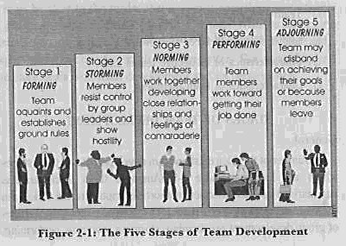
Develop Project Team: T&T (2)
3. Team Building Activities: to improve interpersonal relationships and team cohesiveness, may be by involving team members in planning.

Slide 28
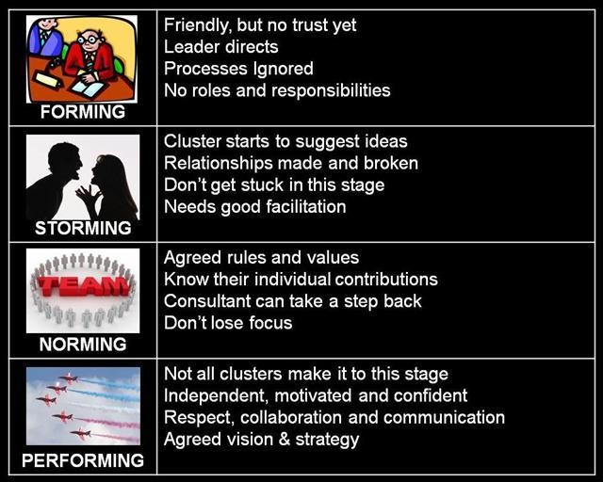

Slide 29
Develop Project Team: T&T (3)
Ground Rules: decreases conflicts and increases
productivity.
Colocation: Placing team members or most of them in the same location.
Recognition & Reward: Formal actions to promote high performance and involve effective systems to link between performance & reward.
Personnel Assessment Tools

Slide 30
Motivational Theory
1. McGregor’s Theory : X and Y
Theory X : Workers need to be watched, hate work and responsibility. Managers must use coercion, threats & various control schemes to get workers to meet objectives.
Theory Y : Workers can work without supervision, they want to achieve, and can make their own decisions. Workers enjoy the satisfaction of esteem and self- actualization needs.
Ouchi’s Theory Z: based on the participative management style of the Japanese. workers are motivated by a sense of commitment, opportunity & advancement.

Slide 31
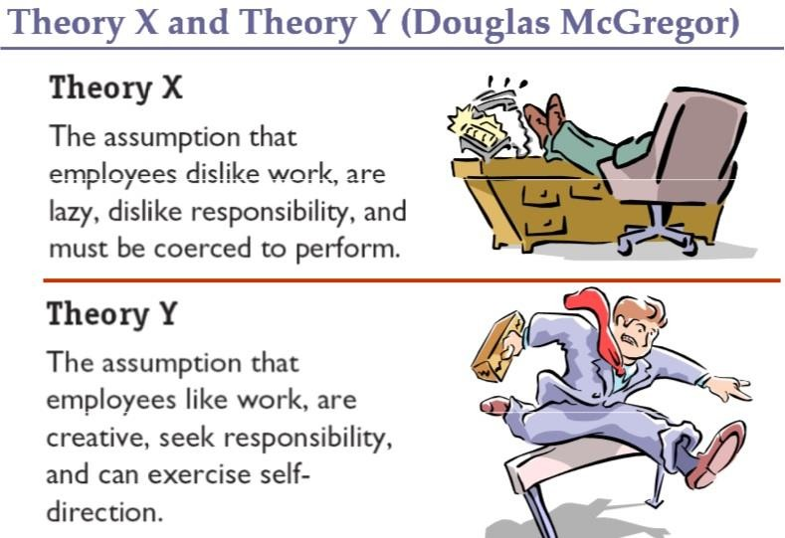
30

Slide 32
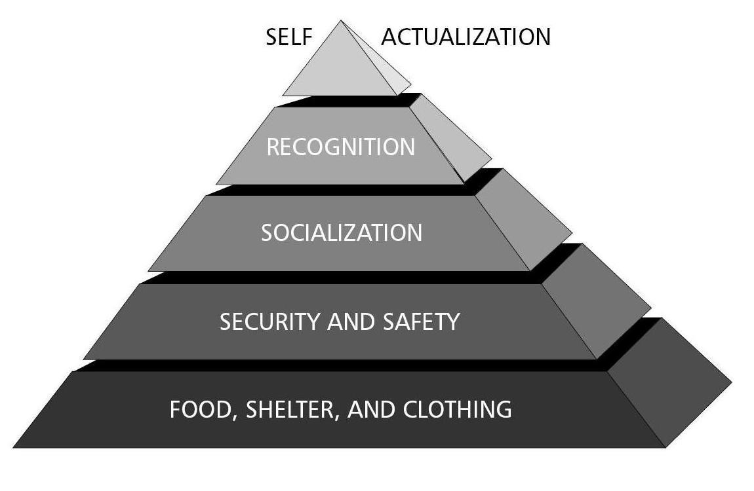
Motivational Theory
2. Maslow’s Hierarchy of Needs

Slide 33
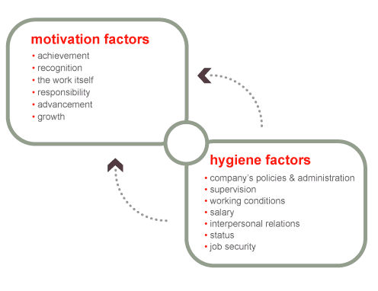
Motivational Theory
3. Hygiene Theory
There are two factors that contribute to motivation:
Hygiene factors deal with work environment issues. Those factors prevent dissatisfaction but do not necessarily bring satisfaction.
Motivational factors: factors
produce job satisfaction

Slide 34
Motivational Theory
4. Expectancy Theory
The expectation of a positive outcome drives motivation. People will behave in certain ways if they think there will be good rewards for doing so
This theory also says that people become what you
expect of them.

Slide 35
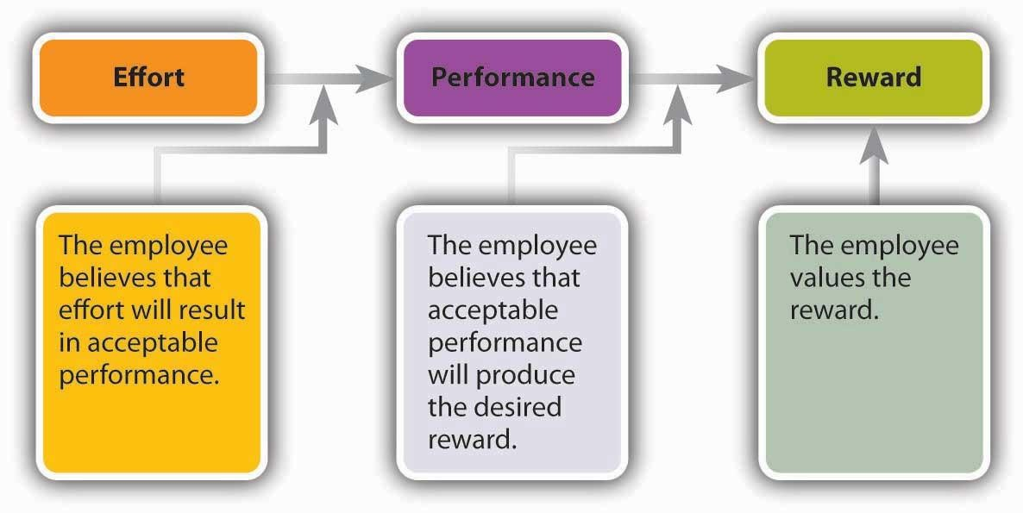

Slide 36
Motivational Theory
Achievement Theory
Achievement Theory says that people are motivated by the
need for three things: achievement, power, and affiliation.
The achievement motivation is obviously the need to
achieve or succeed.
The power motivation involves a desire for influencing the behavior of others.
The need for affiliation is relationship oriented. Workers want to have friendships with their coworkers and a sense of camaraderie with their fellow team members. The strength of your team members’ desire for each of these will drive their performance on various activities.

Slide 37
Powers of the Project Manager
Power is the potential ability to influence behavior to get people to do things they would not otherwise do.
Types of power include:
Coercive power (Penalty)
Legitimate power (Formal)
Expert power
Reward power
Referent power

Slide 38
Develop Project Team: Outputs
Team Performance Assessment:
Improvement in skills to allow for higher
performance.
Improvement in competencies and moral.
Reduced turnover rates
Enterprise Environmental Factors Updates

Slide 39
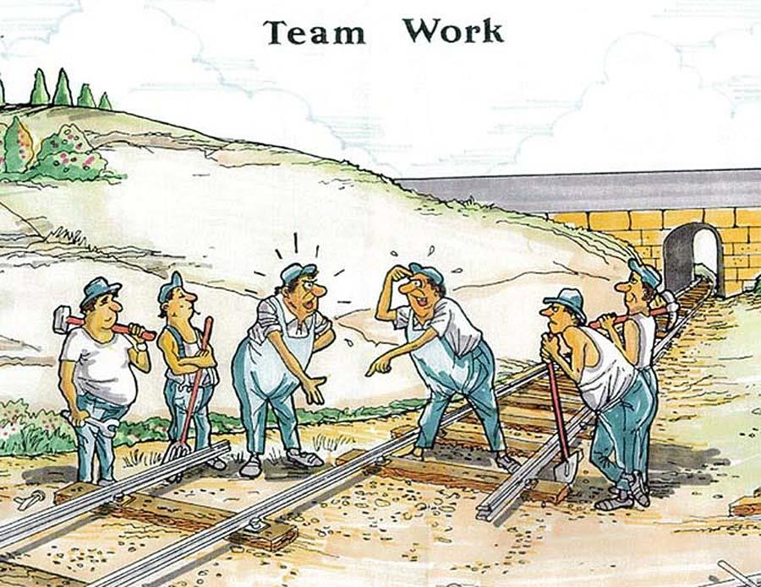

Slide 40
Exam Spotlights
Different teams progress through the stages of development at different rates. When new team members are brought onto the team, the development stages start all over again.
Remember that Herzberg was the inventor of the Hygiene Theory and that this theory claims that hygiene factors prevent dissatisfaction while motivators lead to satisfaction
Understand the theories of motivation.
Understand the different types of project manager powers

Slide 41
Quiz
Project performance appraisals are different from team performance assessment in that project performance appraisals focus on:
How an individual team member is performing on the project
An evaluation of the project team’s effectiveness
A team building effort
Reducing the staff turnover rate
40

Slide 42
9.4 Manage Project Team
Tracking & reporting on the performance of
individual team members. Performance appraisals are prepared and conducted, issues are identified and resolved & feedback is given to the team members

Slide 43
Manage Project Team: Inputs
Human Resource Management Plan
Project Staff Assignments.
Team Performance Assessment: formal and
informal.
Issue Log
Work Performance Reports: e.g. CPI & SPI.
Organizational Process Assets.

Slide 44
Manage Project Team: T&T (1)
Observation and Conversation
Project Performance Appraisals: Evaluation of
employees from people who supervise them.
Conflict Management
Interpersonal Skills
Leadership
Influencing
Effective Decision Making

Slide 45
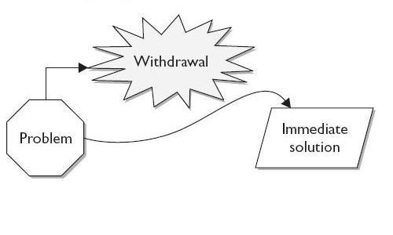
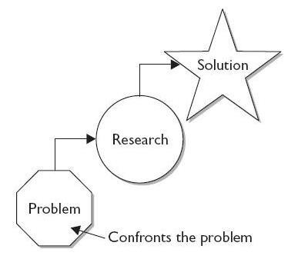
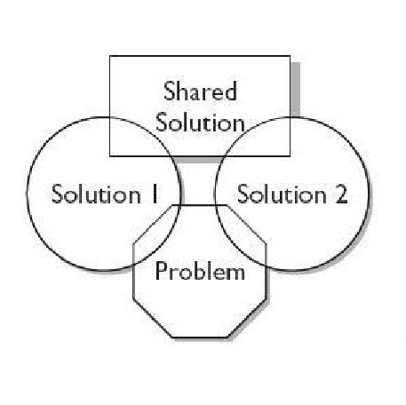
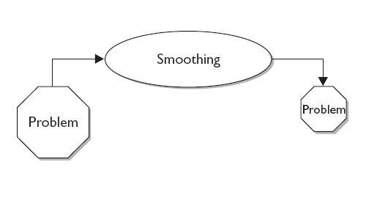
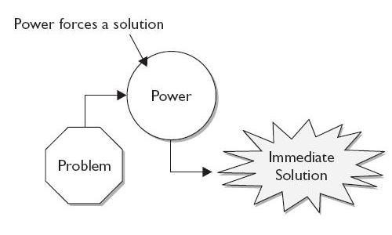
Conflict Management

Slide 46
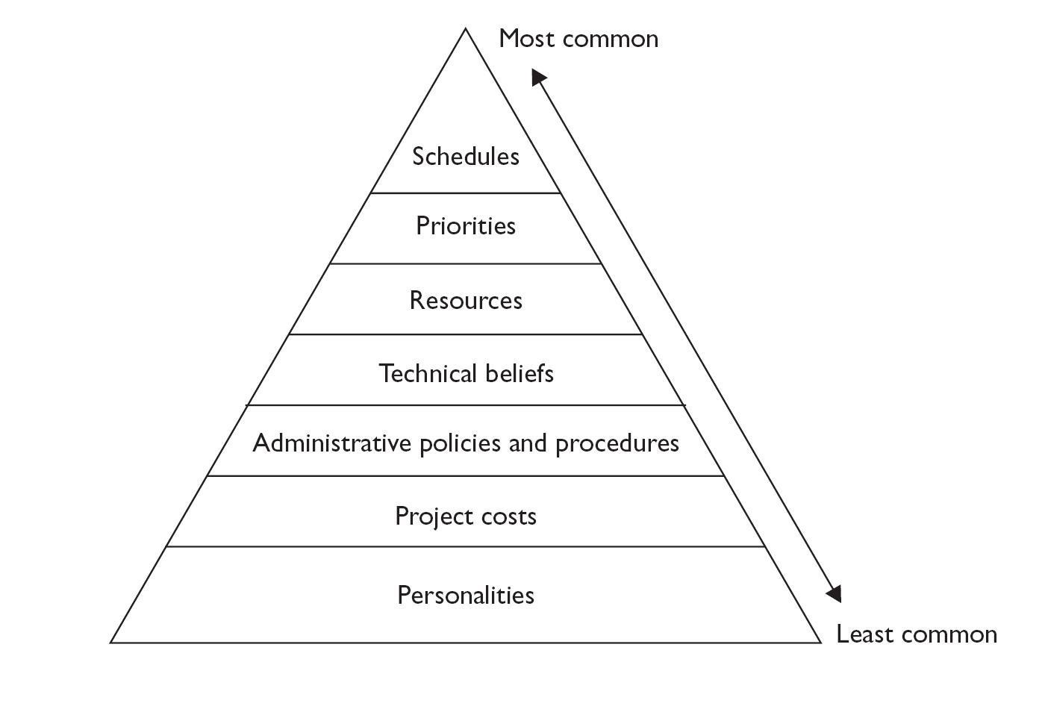
Sources of Conflict

Slide 47
Manage Project Team: Outputs
Change Requests
Project Management Plan Updates
Project Document Updates
Enterprise Environmental Factors Updates
Organizational Process Assets Updates

Slide 48
Exam Spotlights
Take note that the PMBOK states that one of the outcomes or results of the Manage Project Team process is an update to the staffing management plan. However, staffing management plan updates are not listed as an output of this process
Understand the different conflict resolution
techniques

Slide 49
PM HRM Responsibilities
Create a project team directory
Negotiate with resource managers for the best available resources.
Understand the team members’ needs for training
related to the project and make sure they get it.
Create a formal staffing plan.
Prepare reports for team members’ performance.
Make sure team members are motivated.
Create a reward system.

Slide 50

Quiz
What conflict Resolution technique is a project manager using when he says, “ I cannot deal with this issue now!”
Problem Solving
Forcing
Withdrawal
Compromising

Slide 51






Quiz
A PM is trying to settle a dispute between team members. One says the systems should be integrated before testing, and the other wants each system be tested before integration. The project involves 12 systems that need to be integrated and deadline of the project is of high priority. What is the BEST statement the PM can make to resolve the conflict?
Do it my way
Let’s calm down and get the job done
Let’s discuss this issue in our next meeting.
Let’s do some limited testing before integration and finish the testing after the integration.
50

Slide 52

Quiz
All the following forms of powers are derived from the
project manager’s position except:
Formal
Reward
Penalty
Expert

Slide 53

Thank you

