Slide 1

Instructor: NGUYEN ANH MINH, MSc, PMP

Slide 2
Project Communication
Management

Slide 3

Agenda
What is Communications
10.1 Plan Communications Management
10.2 Manage Communications
Types of Communications and Communications Barriers
◻
10.3 Control Communications
3

Slide 4
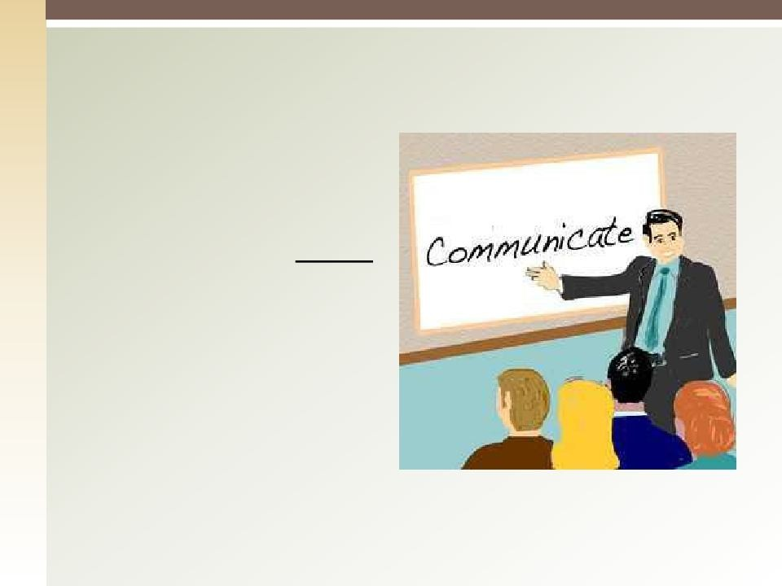
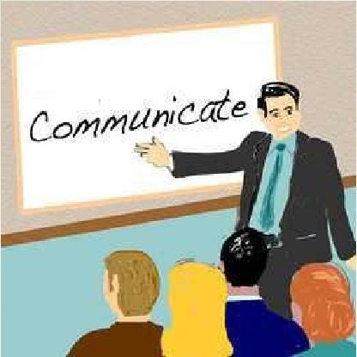
Communication is Important!
Why?
It consumes 90% of a Project Manager’s time.
4

Slide 5
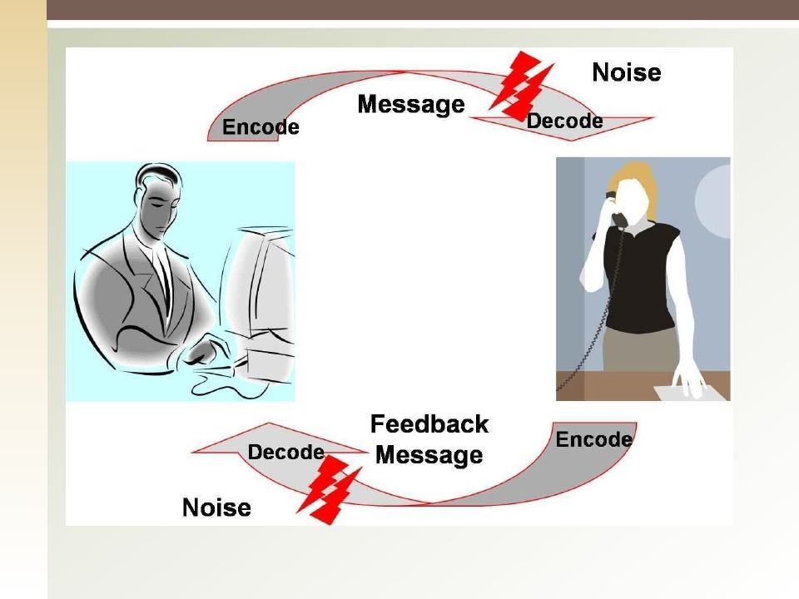
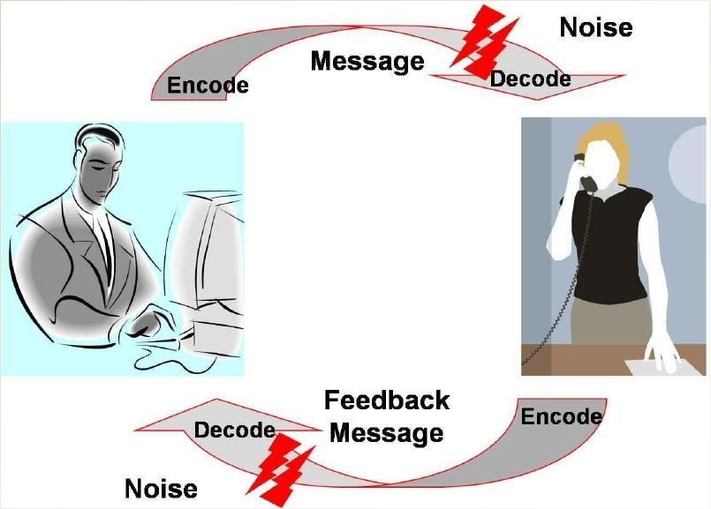
4

Slide 6

10.1 Plan Communication Management
Determining Stakeholder s’ information needs and defining communication approach:
Who needs What When he/she needs it Who will deliver
How will it be delivered (report, email, verbal, … etc.)
■
■
■
■
Should be planned early and revised through the whole project life.
Improper communication planning will lead to significant problems
◻
5

Slide 7
Plan Communications: Inputs
Project Management Plan
Stakeholder Register
Enterprise Environmental Factors: Company’s culture, infrastructure, market conditions etc.
Organizational Process Assets: Historical records- lessons learned – templates- guidelines & Procedures.
6

Slide 8
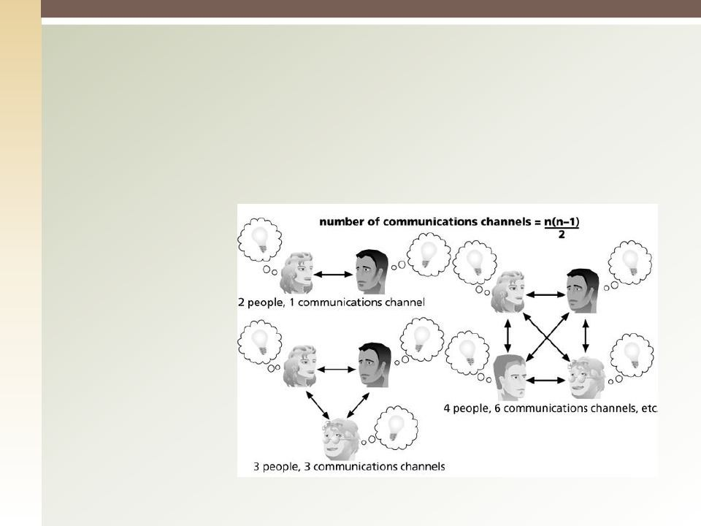
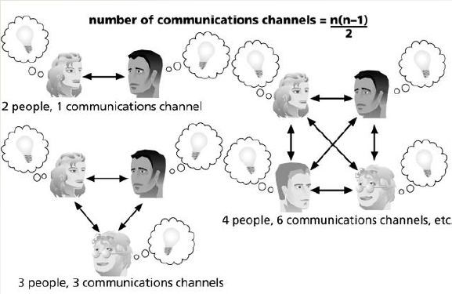
Plan Communication Mgmt.: T & T (1)
1. Communication Requirements Analysis: Determine information needs of the project stakeholder. (Number of communications channels)
N(N-1)/2
8

Slide 9
Plan Communication Mgmt.: T & T (2)
Communication Technology: affected by
The urgency of the need for the information
Expected Project staffing (experience, training, … etc.)
Availability of Technology
Ease of Use
Project environment
Sensitivity and confidentiality of information
9

Slide 11
Plan Communication Mgmt.: T & T (3)
3. Communication Models.
10

Slide 12
Plan Communications: T & T (4)
Communication Methods:
Interactive (meetings, phone calls, video conferences, … etc.)
Push Communications (letters, memos, reports, emails, faxes, … etc.)
Pull communications (Intranet, knowledge repositories, … etc.)
Meetings
11

Slide 13
Plan Communications: Outputs
Communications Management Plan:
Communications item: information for distribution
Purpose: The reason of the distribution
Start/end dates.
Medium and formality
Responsibility: who will distribute the information
Escalation Procedures
Glossary of Terminology
Project Documents Updates.
12

Slide 14
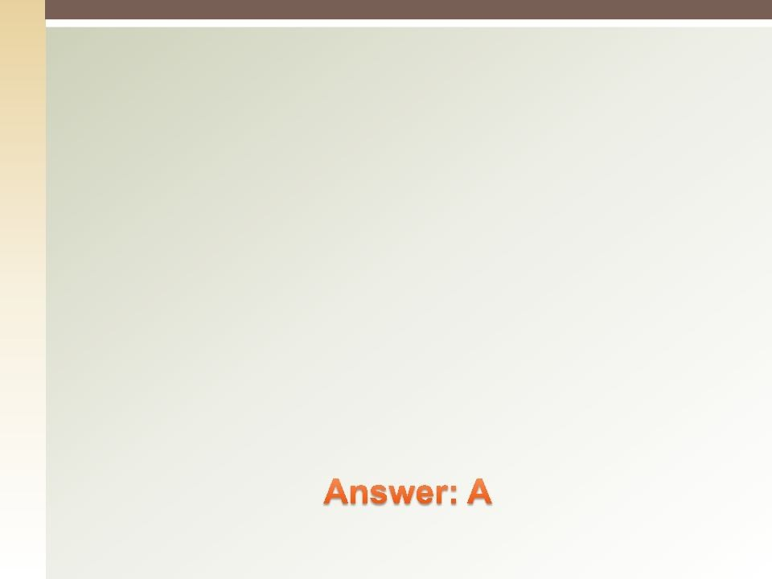

Quiz
One Purpose of the Communication Management plan is to offer:
Methods about how to gather, store and distribute information.
Measure the level of experience of each team
member.
Organize the project and the relationships of stakeholder responsibilities.
Provide methods of releasing team members after they are no longer needed.
13

Slide 15
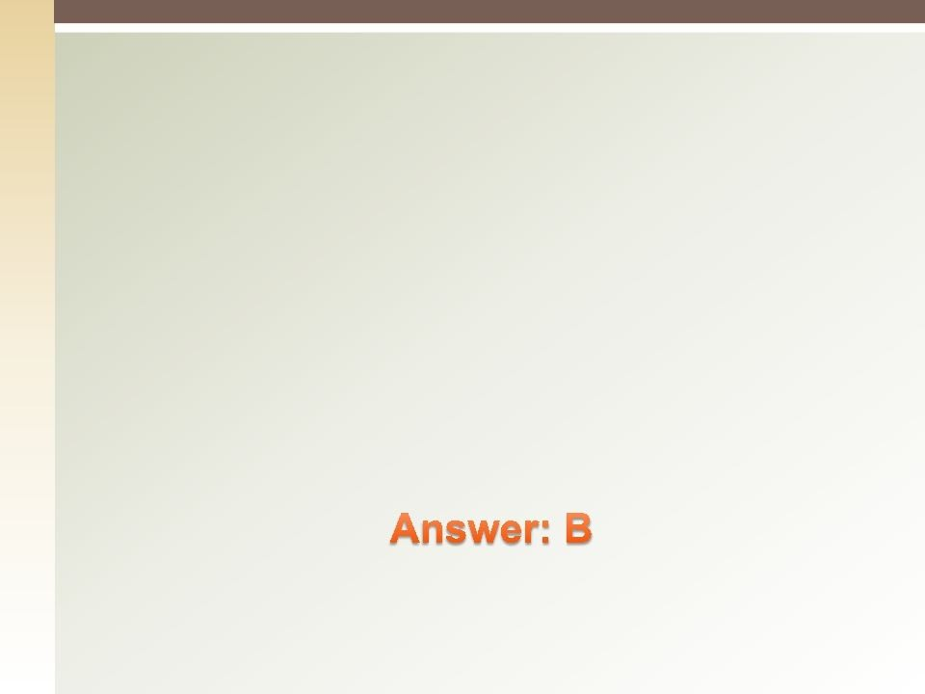


Quiz
Q: The team has 5 team members as well as the project manager. How many communication channels?
A. 10.
B. 15.
6
30
14

Slide 16
10.2 Manage Communication
Creating, collecting, distributing, storing, retrieving, and ultimate disposition of project information according to the communication management plan.
Effective information distribution incudes several techniques such as:
◉
Sender-receiver models (feedback, barriers, … etc.) Choice of media
Writing style
Meeting management techniques Presentation techniques Facilitation Techniques
Listening Techniques
◉
◉
◉
◉
◉
◉
15

Slide 17
Manage Communication: Inputs
Communication Management Plan.
Work Performance Reports
Enterprise Environmental Factors
Organizational Process Assets
◉
Guidelines
◉
Templates
◉
Historical Information

Slide 18
Manage Communication: T & T
Communication Technology
Communication Models
Communication Methods:
Information Management Systems
•
•
•
Hard copies
Electronic communication Management Electronic Project Management Tools
5. Performance Reporting

Slide 19
Manage Communication: Outputs
Project Communication
Project Management Plan Updates
Project Document Updates
Organizational Process Assets Updates;
Stakeholder Notifications
Project Reports
Project Presentations
Project Records (correspondences, memos, project notebooks).
Feedback from stakeholders
Lessons Learned Documentation

Slide 20
Types of Communication
Non verbal Communication: 55% of conveying
the message, composed of behavior & Physical Mannerisms.
Verbal Communication
Formal (Presentations- Speeches)
Informal (Meetings Conversations)
Importance of:
Para-lingual: Pitch & Tone of Voice
Active Listening
Effective Listening: Watching physical gestures of the speaker.
19

Slide 21

Written
Formal : In project plan, charter, long distances & complex problems.
Informal : Memos, emails, notes.
Communication skills allow information to flow:
Internally
Externally
Vertically (up and down hierarchies)
Horizontally (along peers)
20

Slide 22

Take care if the question is asking you
what is the total number of channels or what is the additional number of channels.

Slide 23


Communication Barriers (1)
◻
Noise
Distance
◻
Hostility
◻
Language
◻
Culture
◻
Evaluative tendency
◻
Improper Decoding
◻

Slide 24


Communication Barriers (2)
Personality and interest Position and status
◻
◻
Lack of responsive feedback
◻
Withholding information
◻
Mixed messages
◻
Stereotyping
◻

Slide 25


WHATEVER YOUR MESSAGE
is;
Keep it clear and simple

Slide 26
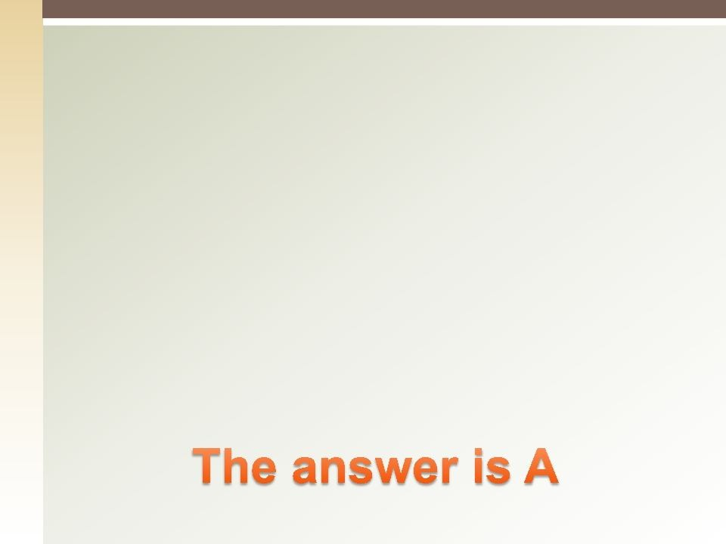

Quiz
The most common negotiation problem that occurs during negotiation is:
Each side might misinterpret what the other side has said
Each side may give up on the other side
One side may try to confuse the other side
One side may be too busy thinking about what to say next to hear what is being said

Slide 27
10.3 Control Communication
Monitoring and controlling communication throughout the entire project life cycle to ensure the information needs of the project stakeholders are met.
26

Slide 28


Control Communication: Inputs
Project Management Plan
Project Communications
Issue Log
Work Performance Data
Organizational Process Assets

Slide 29
Control Communications: T & T
Information Management Systems
Expert Judgment
Meetings

Slide 30
Control Communications: Output
Work Performance Information
Change Requests
Project Management Plan Updates
Project Document Updates
Organizational Process Assets Updates
29

Slide 31
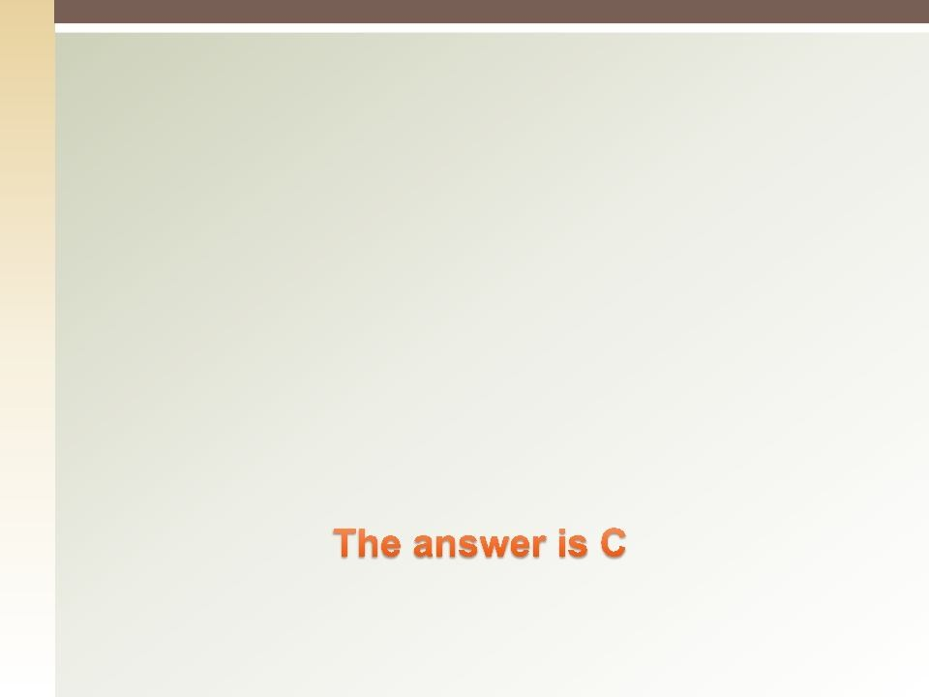

Quiz
Of the Various tools & Techniques on Performance Reporting, which one integrates scope, cost & schedule information as key elements?
Trend Analysis
Variance Analysis
Earned Value Analysis
Schedule/ Cost Analysis
30

Slide 32
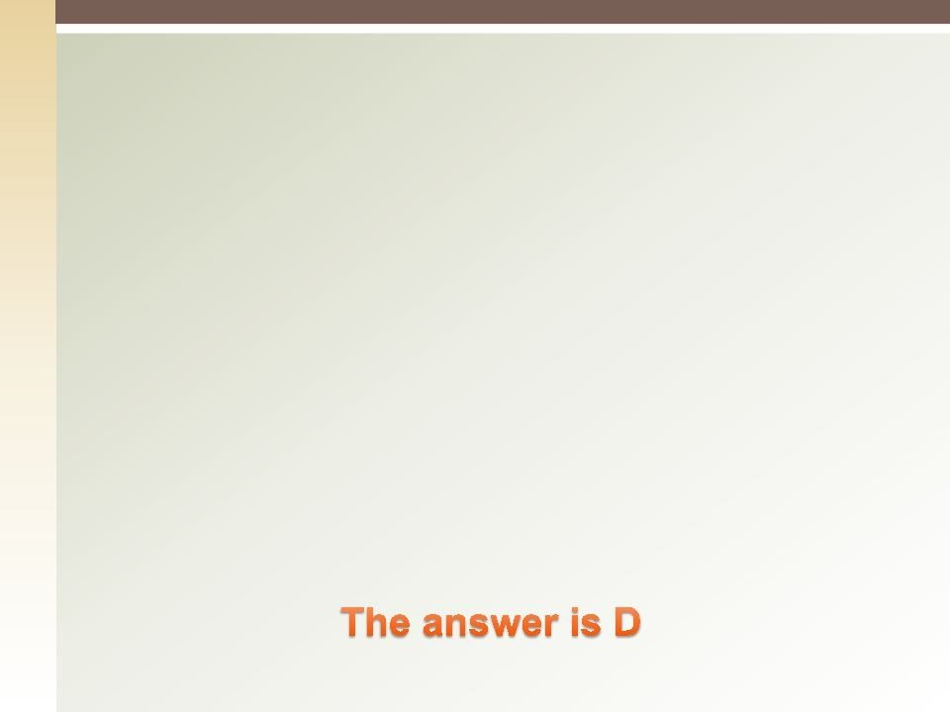

Quiz
At the end of each project, the project team should
prepare a lessons learned summary that focuses on all of the following except:
Sharing Best Practices with other teams in the organization
Warning others of potential problems
Suggesting methods to mitigate risks effectively to ensure success
Sharing only the positive aspects of the project for future replication elsewhere in the organization
32

Slide 33


Quiz
Extensive use of communication is most likely in client communication
Verbal
Written
Formal
Nonverbal
33

Slide 34
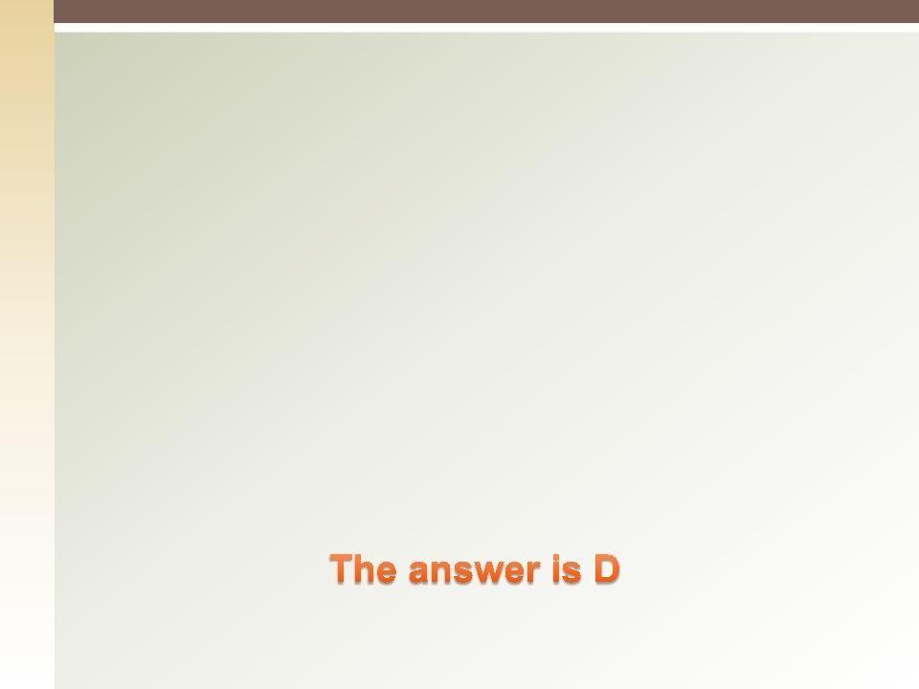

Quiz
The WBS can be an effective aid for communication in which situation?
Internal within the project
Internal within the organization
External with the customer
Internal and external to the project
33

Slide 35
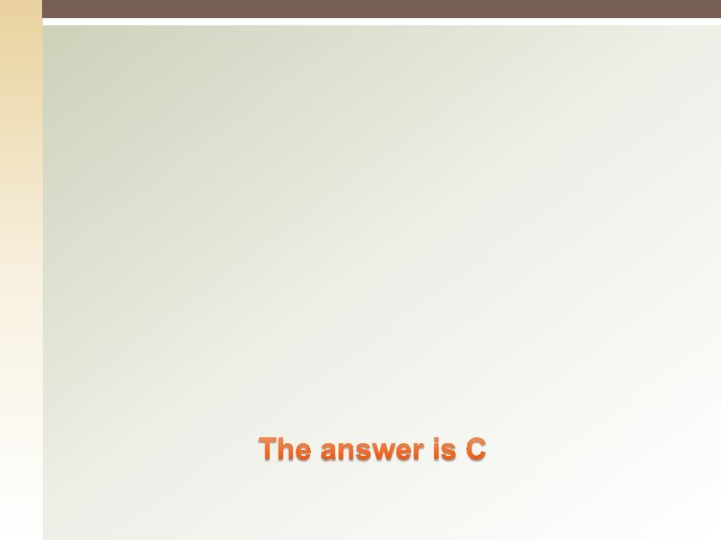

Quiz
The Most Likely results of Communication blockers is that:
The project is delayed
Trust level is enhanced
Conflict occurs
Senior management is displeased
34

Slide 36
Thank you
35

