Slide 1
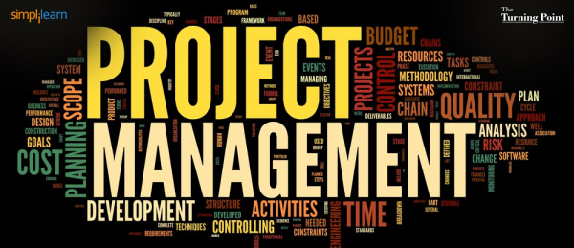
Instructor: NGUYEN ANH MINH, MSc, PMP

Slide 2
Project Risk Management

Slide 3

Project Risk Management
The processes of conducting risk management planning, identification, analysis, response planning and monitoring and control on a project
Objectives are to increase the probability and impact of positive events and decrease the probability and impact of negative events In the project
2

Slide 4
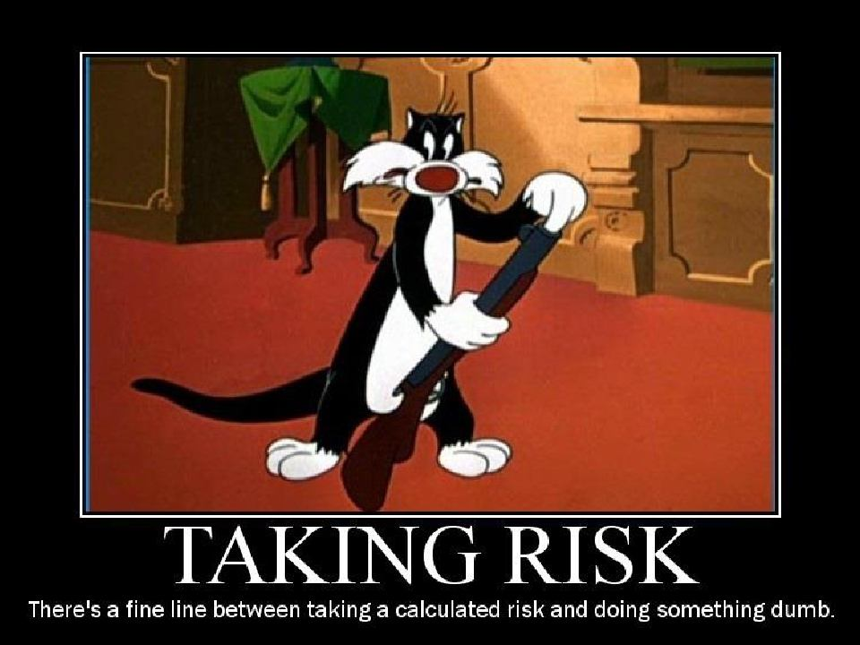
PMP - Project Risk Management
https://www.facebook.com/waleed.naggar 3

Slide 5
11.1 Plan Risk Management
The process of defining how to conduct risk management activities for a project
Important to provide sufficient resources and time for risk management activities, and to establish an agreed upon basis for evaluating risk.
5

Slide 6
Plan Risk Management: Inputs (1)
Project Management Plan
Project Charter
Stakeholder Register
Enterprise Environmental Factors
6

Slide 7
Plan Risk Management: Inputs (2)
Organizational Process Assets, include but not limited to:
Risk Categories
Common definitions of concepts and terms
Risk statement formats
Standard templates
Roles and responsibilities
Authority levels for decision making
Lessons learned
7

Slide 8
Plan Risk Management: T & T
Analytical Techniques
Expert Judgment
Meetings

Slide 9


Plan Risk Management: Outputs
Risk Management Plan
Methodology
Roles and Responsibilities
Budgeting
Timing
Risk Categories
Definition of probability and impact
Probability and Impact Matrix
Revised stakeholders’ tolerance
Reporting format
Tracking

Slide 10
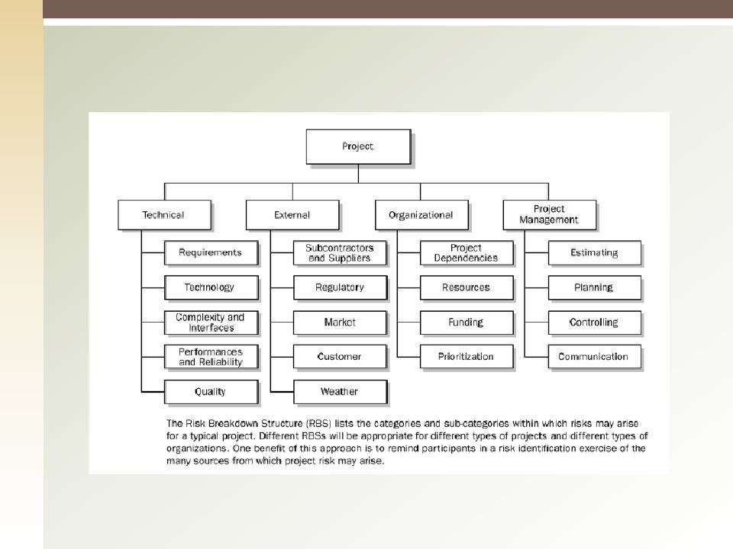
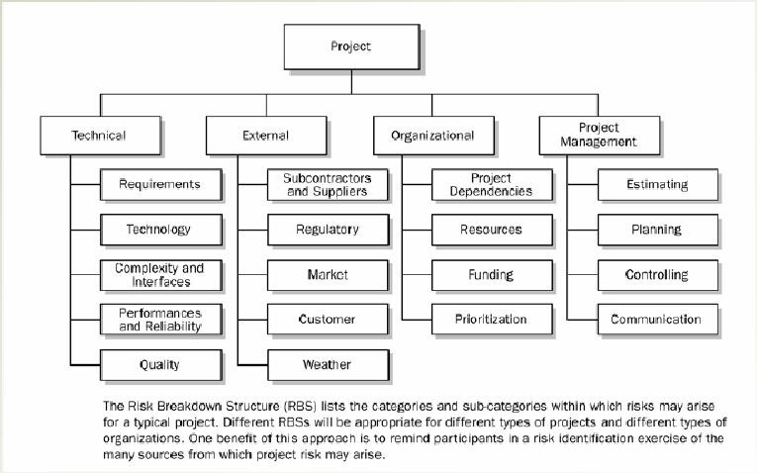
Risk Categories

Slide 11
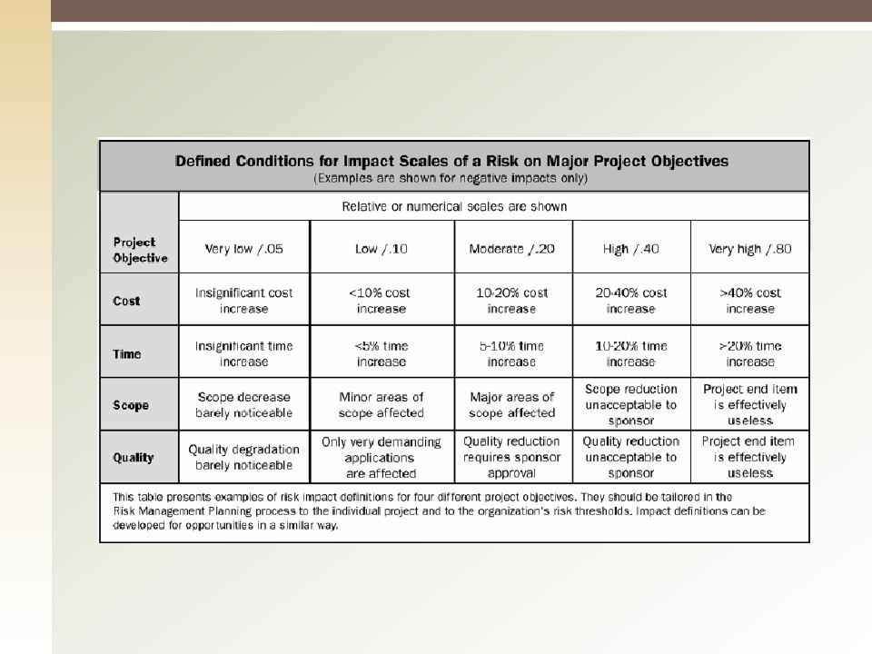
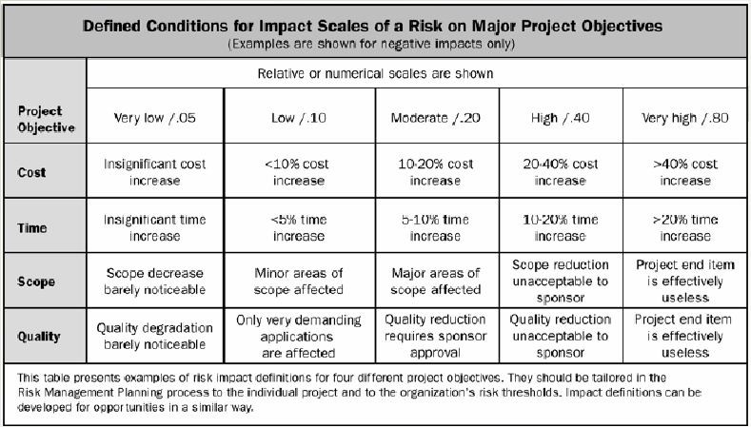
Definition of Risk Probability and Impact
10

Slide 12
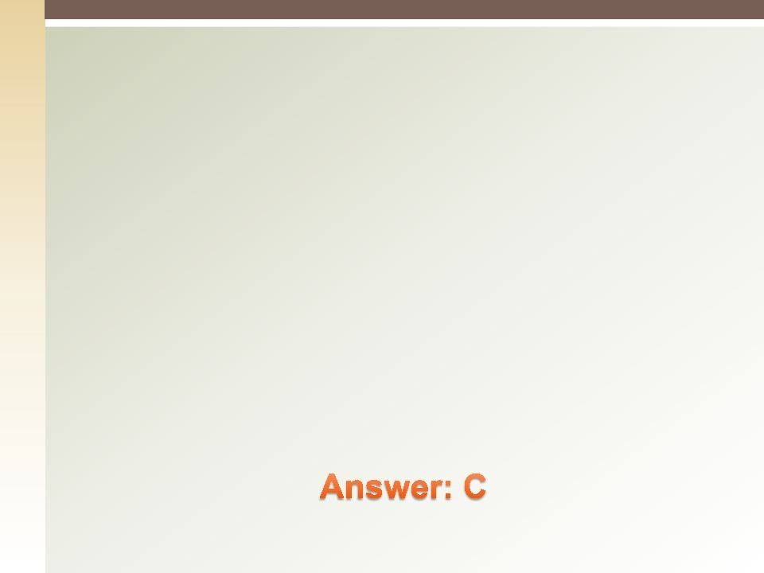

Quiz
“ An uncommon state of nature, characterized by the absence of any information related to a desired outcome”,
is a common definition for:
An act of God
An amount at stake
Uncertainty
Risk aversion
11

Slide 13
11.2 Identify Risks
Identify Risks is the process of determining
which risks may affect the project and documenting their characteristics

Slide 14
Identify Risks: Inputs (1)
Risk Management Plan
Cost management Plan
Schedule Management Plan
Quality Management Plan
Human Resource Management Plan
Scope Baseline

Slide 15
Identify Risks: Inputs (2)
Activity Cost Estimates
Activity Duration Estimates
Stakeholder Register
Project Documents
Procurement Documents
Enterprise Environmental Factors
Organizational Process Assets

Slide 16
Identify Risks: T & T (1)
Documentation Reviews
Information Gathering Techniques
◉
Brainstorming
◉
Delphi Technique
◉
Interviewing
◉
Root Cause Analysis
3. Checklist Analysis

Slide 17
Identify Risks: T & T (2)
Assumptions Analysis
Diagramming Techniques
◉
Cause-and-effect diagrams
◉
System or process flow charts
◉
Influence diagrams
6. SWOT Analysis (Strength, Weakness, Opportunities, Threats)
7.
17
Expert Judgment

Slide 18
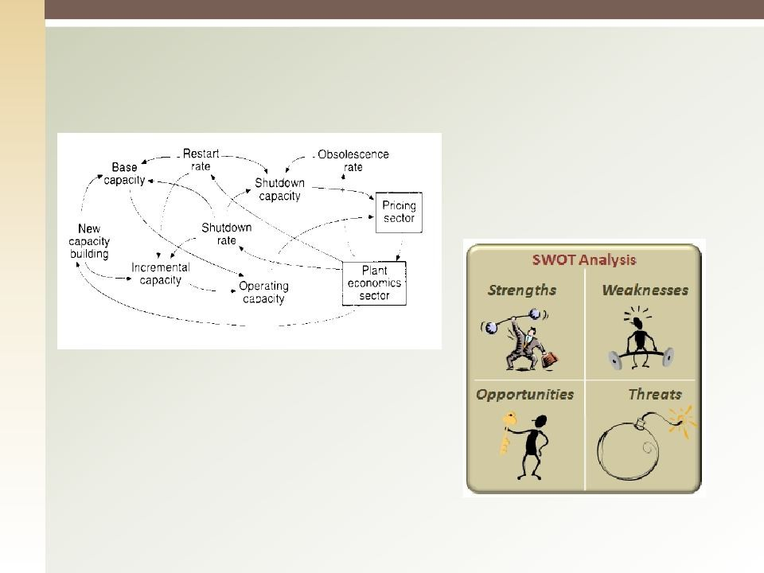
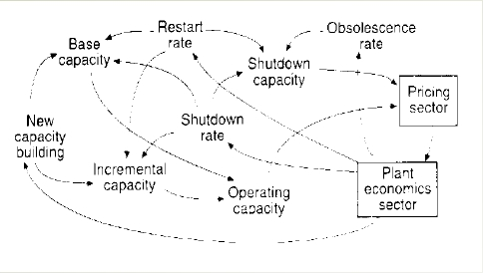
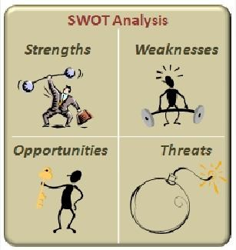
Influence Diagram
SWOT Analysis
17

Slide 19
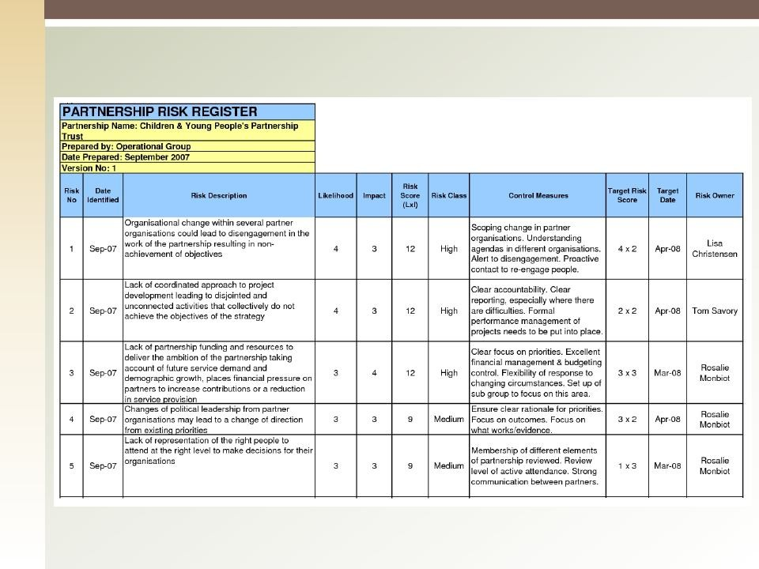
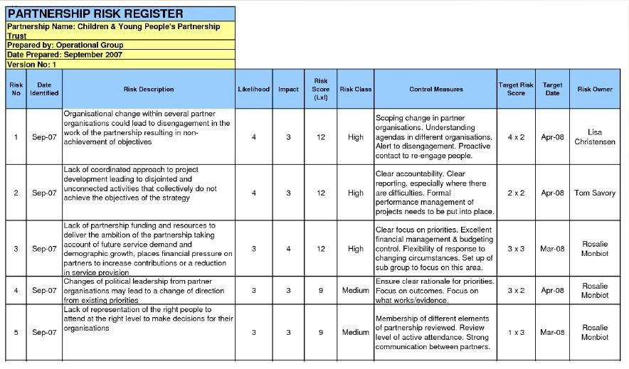
Identify Risks: Outputs
1. Risk Register
18

Slide 20
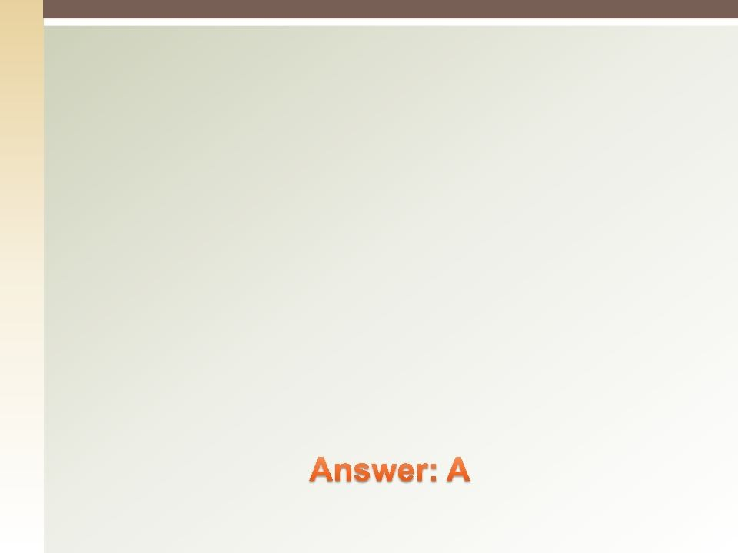

Quiz
Risk tolerances are determined in order to help:
The team rank the project risks
The project manager estimate the project
The team schedule the project
Management know how other managers will act to the project
19

Slide 21
11.3 Perform Qualitative Risk Analysis
The process of prioritizing risks for further
analysis or action by assessing and combining their probability of occurrence and impact
21

Slide 22
Perform Qualitative Risk Analysis: Inputs
Risk Management Plan
Scope Baseline
Risk Register
Enterprise Environmental Factors
Organizational Process Assets
22

Slide 23
Perform Qualitative Risk Analysis: Tools & Techniques
1. Probability and Impact Matrix
23

Slide 24
Perform Qualitative Risk Analysis: T & T
Risk Probability and Impact Assessment
Risk Data Quality Assessment
Risk Categorization
Risk Urgency Assessment
Expert Judgment
24

Slide 25
Perform Qualitative Risk Analysis: Outputs
Risk Register Updates
Relative ranking or priority list of project risks
Risks grouped by categories
Causes of risk or project areas requiring particular attention
List of risks requiring response in the near-term
List of risks for additional analysis and response
Watch lists of low-priority risks
Trends in qualitative risk analysis results
25

Slide 26
11.4 Perform Quantitative Risk Analysis
The process of numerically analyzing the effect of identified risks on overall project objectives.
Quantitative analysis is performed on risks that have been prioritized by the qualitative risk analysis process as potentially and substantially impacting the project's competing demands.
25

Slide 27
Perform Quantitative Risk Analysis: Inputs
Risk Management Plan
Cost Management Plan
Schedule Management Plan
Risk Register
Enterprise Environmental Factors
Organizational Process Assets

Slide 28
Perform Quantitative Risk Analysis: Tools & Techniques (1)
Data Gathering and Representation
Techniques
Interviewing
Probability Distribution

Slide 29
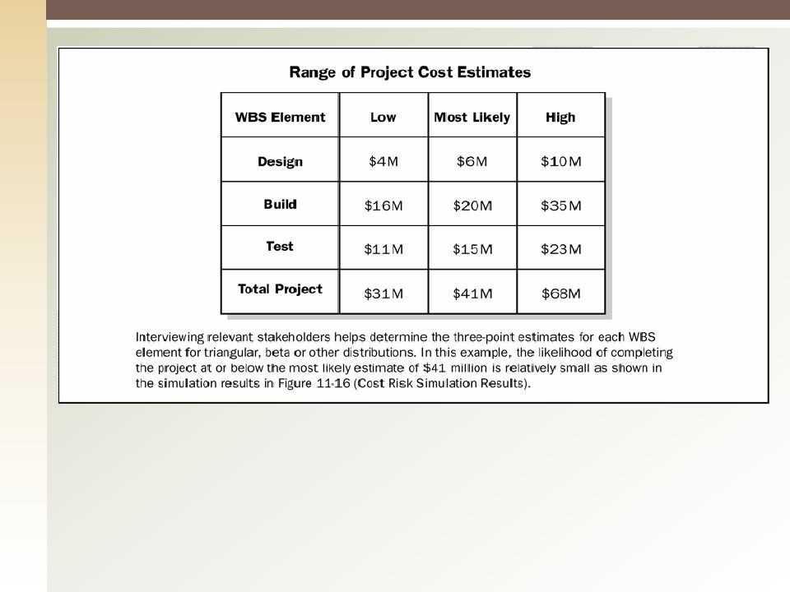
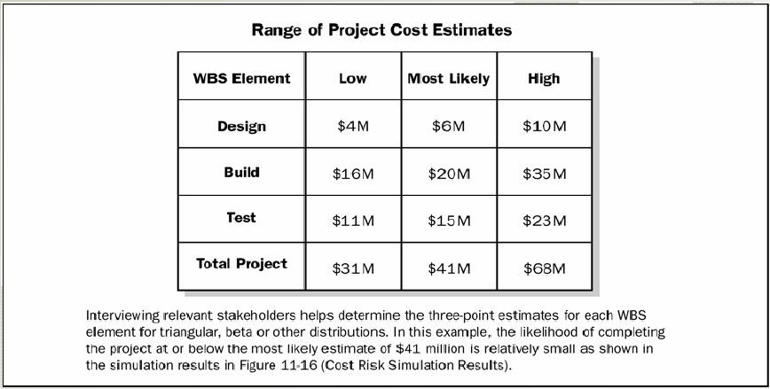
Range of Project Cost Estimates Collected During the Risk Interview

Slide 30
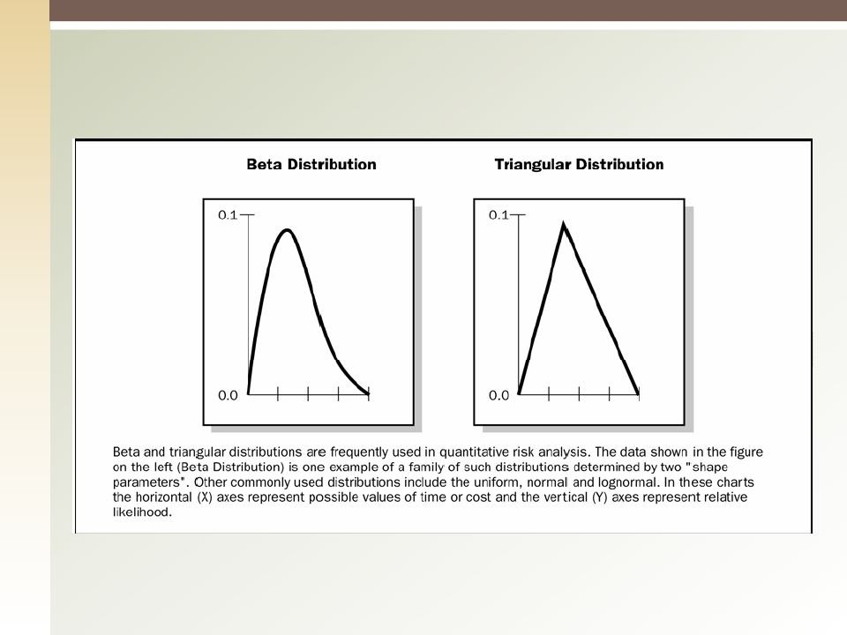
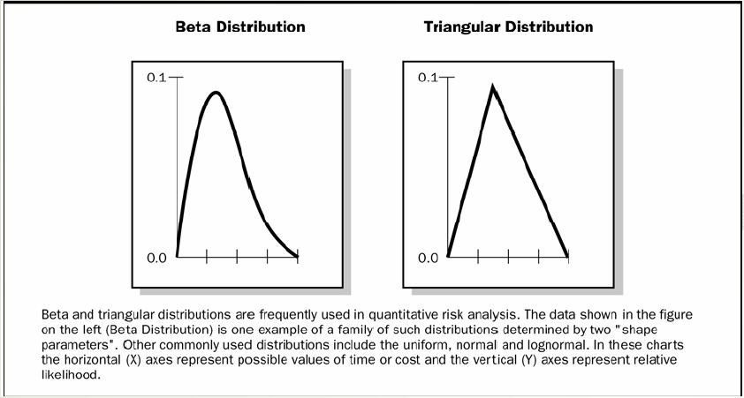
Probability Distribution
29

Slide 31
Perform Quantitative Risk Analysis: Tools & Techniques (2)
Quantitative Risk Analysis and Modeling Techniques
Sensitivity analysis
Expected monetary value analysis
Modeling and Simulation
Expert Judgment

Slide 32
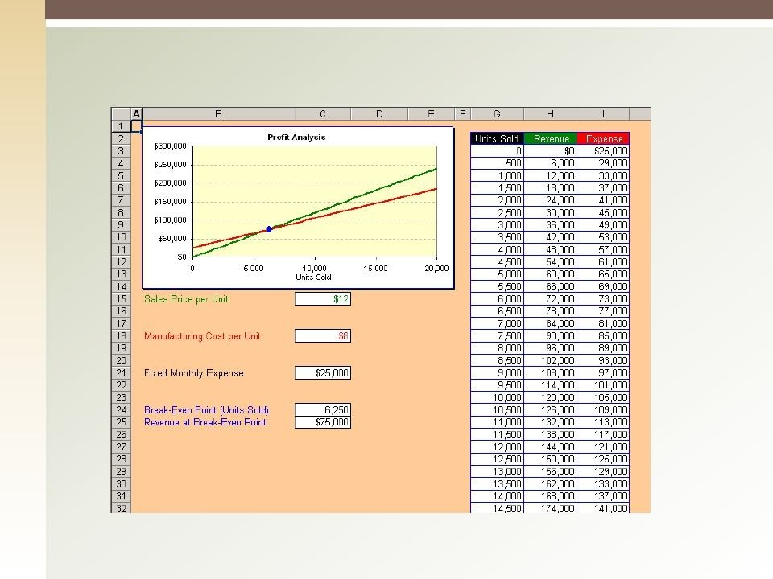
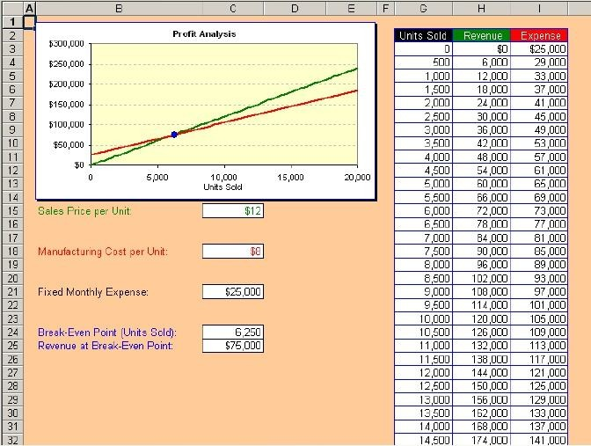
Sample Sensitivity Analysis

Slide 33
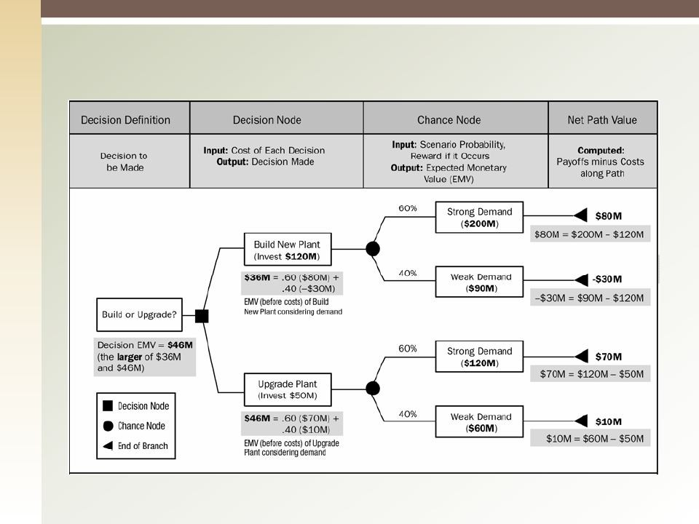
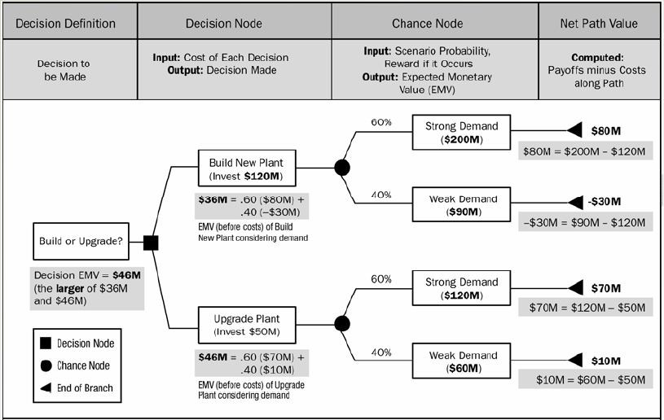
Expected monetary value analysis (Decision tree)

Slide 34
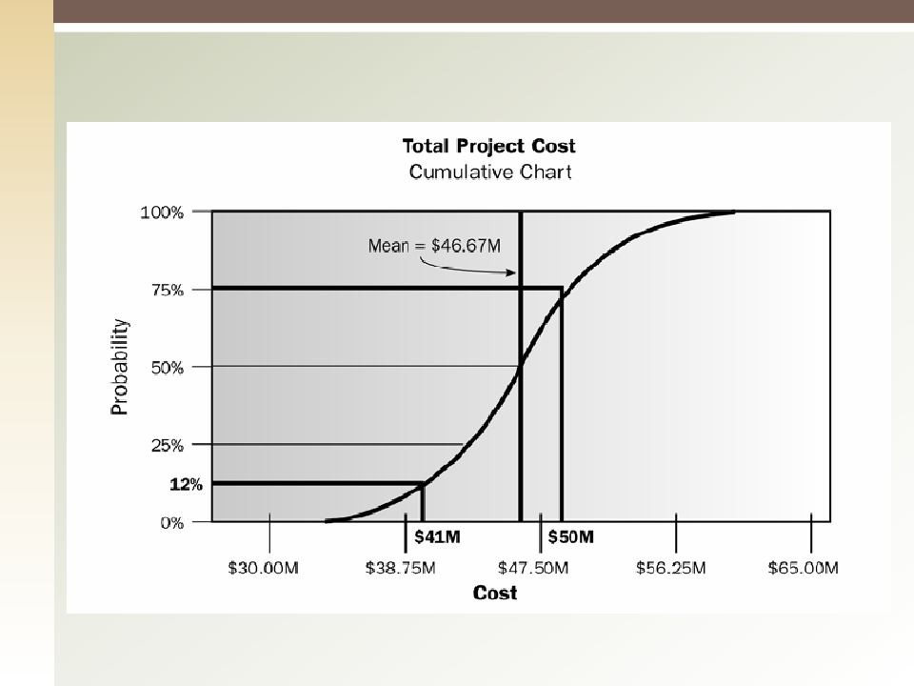
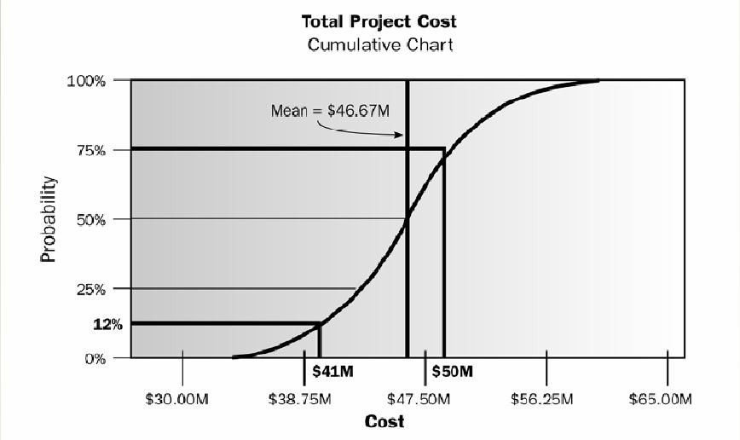
Modeling And Simulation

Slide 35
Perform Quantitative Risk Analysis: Outputs
Project Document Updates
Probabilistic analysis of the project
Probability of achieving cost and time objectives
Prioritized list of quantified risks
Trends in quantitative risk analysis results

Slide 36


Quiz
If a project has a 60% chance of a US $ 100,000 profit and a 40% chance of a US $ 100,000 loss, the expected monetary value for the project is :
A. $ 100,000 profit B. $ 60,000 loss
C. $ 20,000 profit D.$ 40,000 loss

Slide 37
11.5 Plan Risk Responses
The process of developing options and actions to enhance opportunities and to reduce threats to project objectives.
The key benefit is to address the risks by their priority, have strategies to handle the risks and assigned resources & budget to handle those risks
36

Slide 38
Plan Risk Responses: Inputs
Risk Management Plan
Risk Register

Slide 39
Plan Risk Responses: Tools & Techniques (1)
Strategies for negative risks or threats
Avoid
Transfer
Mitigate
Accept

Slide 40

Response Strategies for Threats
Avoidance:
Risk prevention
Changing the plan to eliminate a risk by avoiding the cause/source of risk
Protect project from impact of risk
Examples:
Change the implementation strategy
Do it ourselves (do not subcontract)
Reduce scope to avoid high risk deliverables
Adopt a familiar technology or product
39

Slide 41

Response Strategies for Threats
Mitigation
Seeks to reduce the impact or probability of the risk event to an acceptable threshold
Be proactive: Take early actions to reduce impact/probability and don’t wait
until the risk hits your project
Examples:
Staging - More testing - Prototype
Redundancy planning
Use more qualified resources
40

Slide 42

Response Strategies for Threats
Transfer
Shift responsibility of risk consequence to another party
Does NOT eliminate risk
Most effective in dealing with financial exposure
Examples:
Buy/subcontract: move liabilities
Selecting type of Procurement contracts: Fixed Price
Insurance: liabilities + bonds + Warranties

Slide 43

Response Strategies for Threats
Acceptance
Used when project plan cannot be changed & other risk response strategy cannot be used
Active Acceptance
■
■
Develop a contingency plan to execute if the risk occur Contingency plan = be ready with Plan B
Passive Acceptance
■
Deal with the risks as they occur = No Plan B prepared
Contingency allowance/ reserve
Established amount of reserve (e.g.: time and/or money) to account for the identified known risks.
Amount is decided based on probability and impact
◻

Slide 44
Plan Risk Responses: T & T (2)
Strategies for Positive Risks or Opportunities
Exploit: Ensure opportunity is realized
Ex: Assigning organization most talented resources to the project to reduce cost lower than originally planned.
Share: Allocating some or all of the ownership to third part best able to capture the opportunity
Ex: Joint ventures, special-purpose companies
Enhance: Increase the probability and/or the positive impact of the opportunity
Ex: Adding more resources to finish early
Accept: Welling to take advantage of opportunity if it comes, but not actively pursuing it.
43

Slide 45
Plan Risk Responses: Tools & Techniques (3)
Contingent Response Strategies
Expert Judgment
44

Slide 46
Plan Risk Responses: Outputs (1)
Project management Plan Updates
Schedule Management Plan
Cost Management Plan
Quality Management Plan
Procurement Management Plan
Human Resource Management Plan
Scope Baseline
Schedule Baseline
Cost Baseline
46

Slide 47
Plan Risk Responses: Outputs (2)
Project Documents Updates
Assumptions log updates
Technical Documentation Updates
Change Requests
47

Slide 48


Quiz
Purchasing insurance is BEST considered an example of risk:
Mitigation
Transfer
Acceptance
Avoidance
47

Slide 49
11.6 Control Risks
The process of implementing risk response plans,
tracking identified risks, monitoring residual risks, identifying new risks, and evaluating risk
process effectiveness throughout the project.
48

Slide 50
Monitor and Control Risks: Inputs
Risk Register
Project Management Plan
Work Performance Data
Work Performance Reports

Slide 51
Monitor and Control Risks: Tools & Techniques
Risk Reassessment
Risk Audits
Variance and Trend Analysis
Technical Performance Measurement
Reserve Analysis
Meetings

Slide 52
Monitor and Control Risks: Outputs
Work Performance Information
Change Requests
Recommended corrective actions
Recommended preventive actions
Project management Plan Updates
Outcome of risk reassessment, risk audits, and periodic risk reviews
Actual outcome of the project’s risks and the risk’s response
Project Document Updates
5.
51
Organizational Process Assets Updates

Slide 53
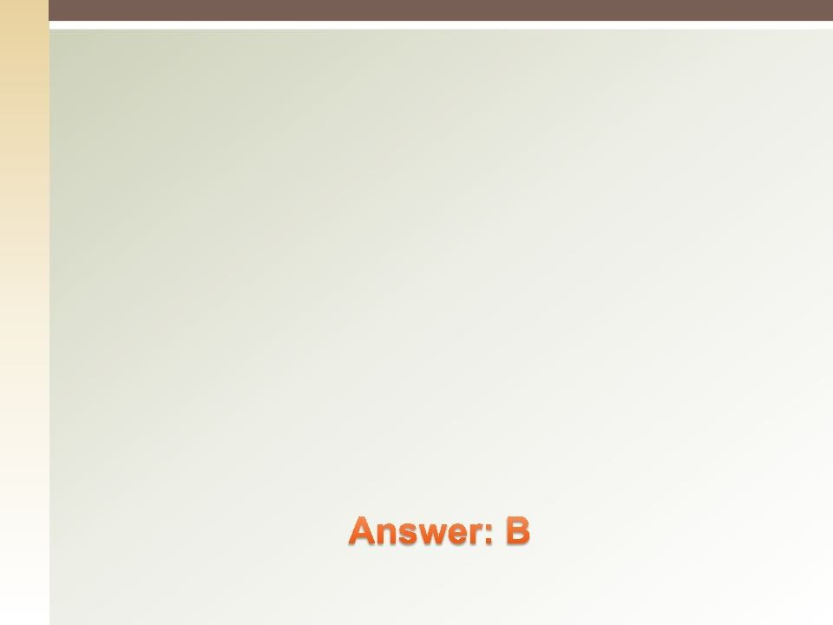

Quiz
What should be done with a non-critical Risk?
Document them for historical use on other projects
Document them and revisit during project execution
Document them & set them aside because they are already covered in your contingency plans
Document them and give them to the customer
52

Slide 54


Thank you
53

