Slide 1
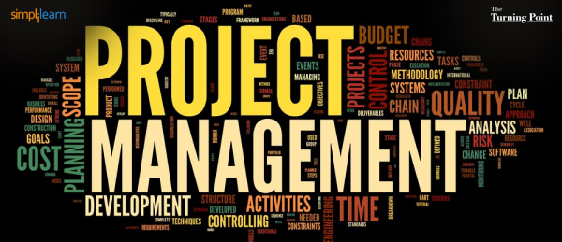
Instructor: NGUYEN ANH MINH, MSc, PMP

Slide 2
Project Procurement
Management

Slide 3

Agenda
What is a Contract
12.1 Plan Procurement
Types of Contracts
12.2 Conduct Procurements
12.3 Control Procurements
12.4 Close Procurements
2

Slide 4
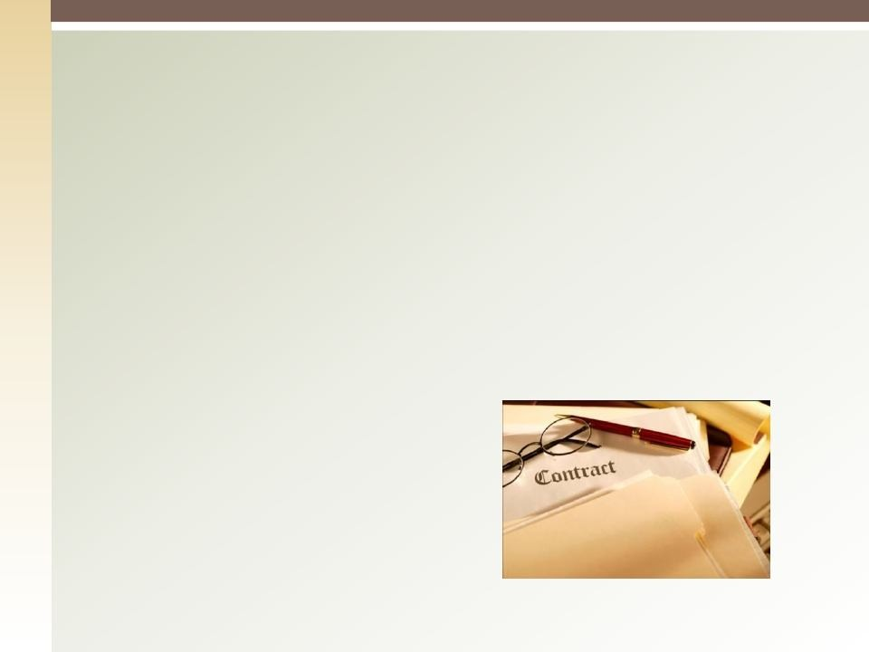

What is Procurement Management?
Includes the processes required to acquire goods or services from outside the project team.
It also includes Contract Management and Change Control Processes.
Includes controlling an contract issues by an outside organization
3

Slide 5
What is a “CONTRACT”
A Contract is a Legally binding detailed formal document that refers to an entire agreement between 2 or more parties.
All terms & conditions of a Contract must be met.
◻
Anything not mentioned in the Contract is not Legally Binding to anyone.
4

Slide 6


12.1 Plan Procurement
Identifies products or services that can be acquired from outside the project organization Vs needs that can be accomplished by the project team.
Involves consideration of potential sellers.
Can influence project schedule, resource estimating and make or buy decisions.
Includes reviewing the risks involved and type of contract to be used.
5

Slide 7
Plan Procurement - Inputs
Project Management Plan
Project Scope Statement
WBS
WBS Dictionary
Requirements Documentation
Including legal and contractual requirements
Risk Register
Activity Resource Requirements

Slide 8
Plan Procurement - Inputs
Project Schedule
Activity Cost Estimates (Internal Cost Estimates for activities being procured)
Stakeholder Register
Enterprise Environmental Factors
Organizational Process Assets

Slide 9
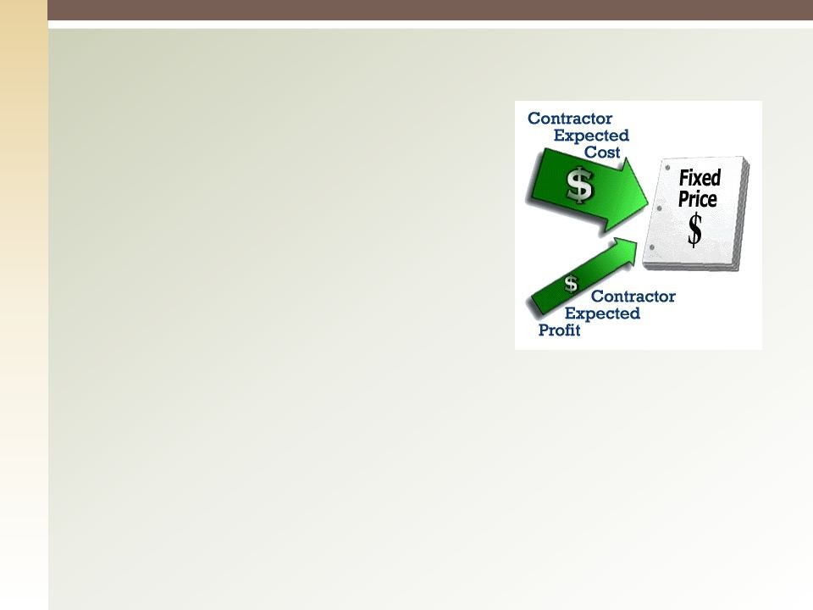
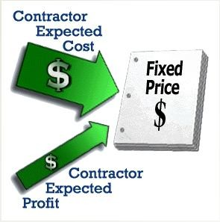
Types of Contracts (1)
Fixed Price (Lump Sum):
Well defined scope/ product.
Fixed total Price.
Risk is on the seller.
Firm Fixed Price (FFP)
Fixed Price Incentive Fees Contract (FPIF)
Fixed Price with Economic Price Adjustment Contracts (FP-EPA)

Slide 10
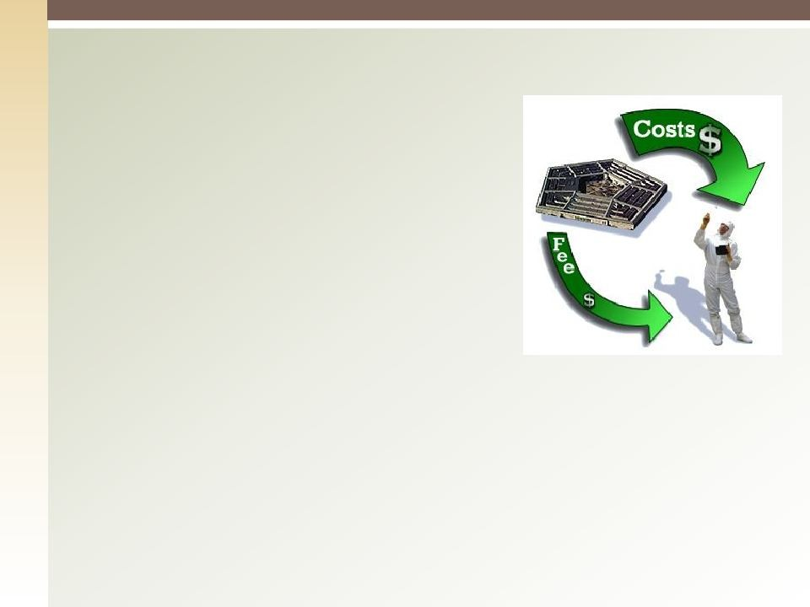
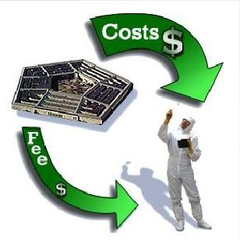
Types of Contracts (2)
Cost Reimbursable Contract:
Scope is not exactly defined.
Price is open based on the final costs the product will incur.
Risk is on the buyer.
Cost Plus Fixed Fees Contracts (CPFF)
Cost Plus Incentive Fees Contracts (CPIF)
Cost Plus Award Fee Contracts (CPAF)

Slide 11
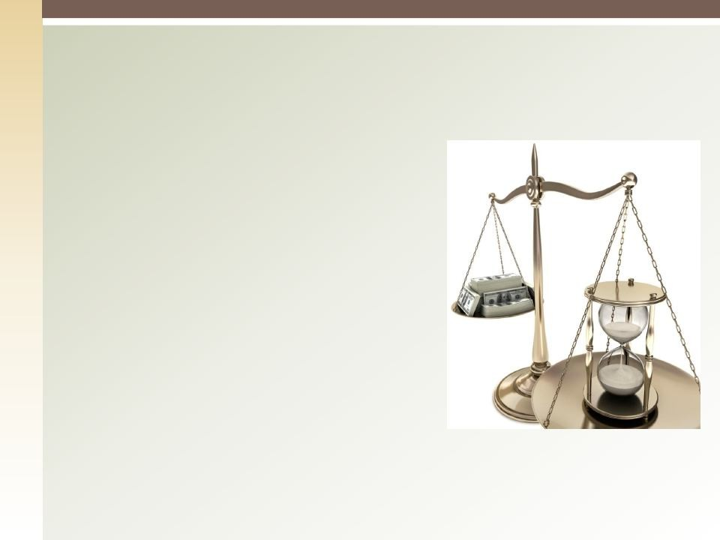

Types of Contracts (3)
Time and Material:
Cost is charged to identified tasks of an on going activity, ex. research.
Scope per unit is defined.
Risk is on the buyer. (seller has no incentive to control costs)
10

Slide 12
Fixed Price vs. Cost Reimbursable

Slide 13

Contract Type Selection
HIGH
BUYER’S RISK
LOW
CPFF
Cost Plus Fixed
Fee
CPIF
Cost Plus Incentive
Fee
FPI
Fixed Price
Incentive
FFP
Firm Fixed
Price
SELLER’S RISK
LOW

Slide 14


Plan Procurement – T & T
1. Make or Buy Analysis:
◉
Determine whether a product or service needs to be procured or can be produced by the project team.
Purchase or make - Purchase or renting/leasing
◉
Reasons to Buy:
Capacity and Capability Exploit Opportunity
Shift risk (cost, time, or scope)
◉
◉
◉
Reasons to Make:
Idle resources Want to control
Confidential information
◉
◉
◉

Slide 15
Plan Procurement – T & T
Expert Judgment
Market Research
Meetings

Slide 16
Plan Procurement – Outputs
1. Procurement Management Plan: includes but not
limited to:
Types of contracts to be used Risk Management Issues Procurement Processes
Standardized Procurement Documents Responsibilities
Pre-qualified sellers
Scheduled dates for deliverables Managing multiple providers
◉
◉
◉
◉
◉
◉
◉
◉

Slide 17
Plan Procurement – Outputs
2. Procurement Statement of Work: includes
Specifications, quality levels, quantity desired and other requirements.
Describes the procurement item in sufficient detail to allow sellers to determine if they are capable of providing the item.
◉
◉

Slide 18
Plan Procurement – Outputs
Procurement Documents: are used to solicit proposals, quotes, and bids from sellers
Request for Information
Request for Proposal (Tender), RFP: request a price and detailed proposal on how the work will be accomplished.
Request for Bid, RFB: Request price of all the work
Request for Quotation: price quote per item, hour, or foot (T&M contracts).
Terminology may vary by industry.
17

Slide 19


Plan Procurement – Outputs
4. Source Selection Criteria: The project team must be prepared to compare the proposals received in an unbiased manner based on identified & documented selection criteria to rate or score proposals.
◉
Includes but not limited to:
Past performance Understanding of need
Overall or life cycle cost References
Technical capability and approach Risk
Management approach Financial stability and capacity
■
■
■
■
■
■
■
18

Slide 20
Plan Procurement – Outputs
Make or Buy Decision
Change Requests
Project Document Updates
19

Slide 21
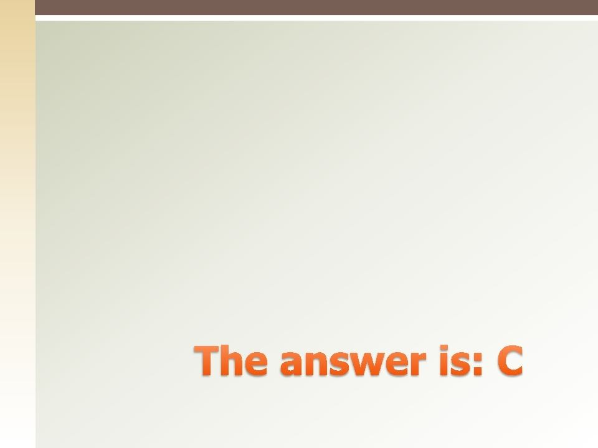

Quiz
With a clear scope of work a seller completes work as specified, but the buyer is not pleased with the results. The contract is considered to be:
Cancelled (void)
Incomplete
Complete
Waived
20

Slide 22
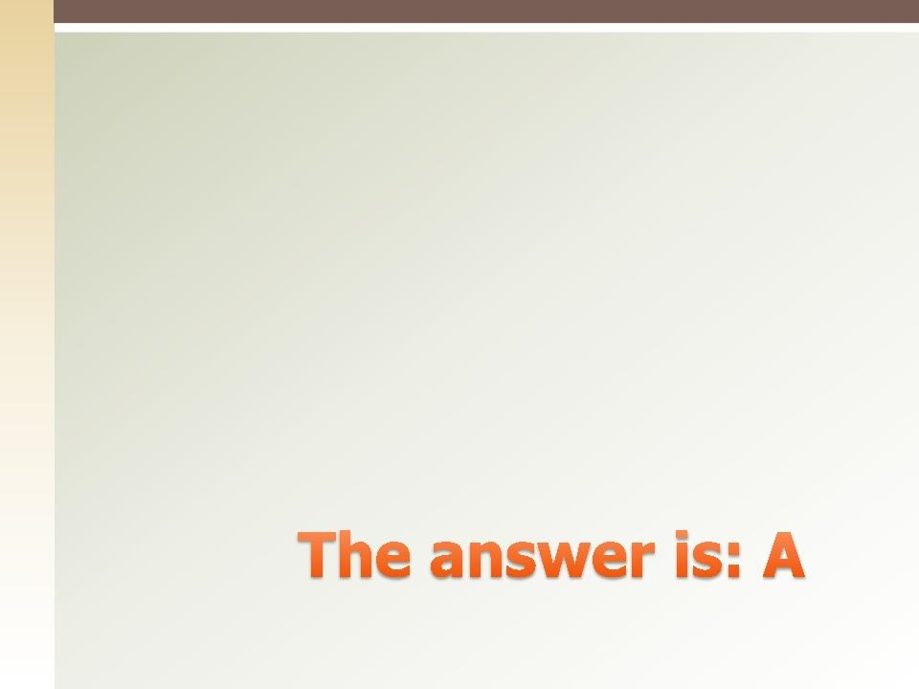

Quiz
At the start of a fixed price contract, the actual profit is:
Unknown
Part of the negotiation involved in paying every invoice
Applied as a line item in every invoice
Determined at the end of the project
21

Slide 23
12.2 Conduct Procurement
Obtaining seller responses, selecting a seller, and awarding a contract.
The key benefit is to provide alignment of internal and external stakeholder expectations through established agreements.
22

Slide 24
Conduct Procurement - Inputs
Procurement Management Plan
Procurement Documents
Source Selection Criteria
Seller Proposals
Project Documents
Make or Buy Decisions
Procurement Statement of Work
Organizational Process Assets
23

Slide 25
Conduct Procurements – T & T
Bidder Conferences
Also known as contractor, vendor, or pre-bid conferences.
The purpose of these conferences is to clarify any of the information not clearly stated in the RFP.
Creates a clear and common understanding of the procurement.
Proposals received will be more clearly aligned with project requirements, due to the fact that bidder conferences make the requirements clear.
24

Slide 26
Conduct Procurements – T & T
Proposal Evaluation Techniques (agreed by Evaluation Committee)
Independent Estimates (benchmark, help
uncover SOW deficiencies & ambiguities)
Expert Judgment
Advertising, Increase the number of potential sellers

Slide 27
Conduct Procurements – T & T
Analytical Techniques
Procurement Negotiations
Negotiations can cover the following areas:
Responsibilities and authorities Applicable terms and law
Scope, technical & business management approaches
Contract financing (Payment Schedule) Price
◉
◉
◉
◉
◉

Slide 28


Conduct Procurement – Outputs
Selected Sellers
Agreements
Includes, but not limited to:
SOW Pricing Warranty | Change requests Payment product support | Roles & responsibilities Acceptance criteria Performance bonds
Penalties Schedule | Insurance Incentives | Termination mechanisms

Slide 29
Conduct Procurement – Outputs
Resource Calendars
Change Requests
Project Management Plan Updates (Scope, Cost, Schedule, Procurement Management Plan…etc.)
Project Document Updates (SOW and Requirements Documentation)

Slide 30
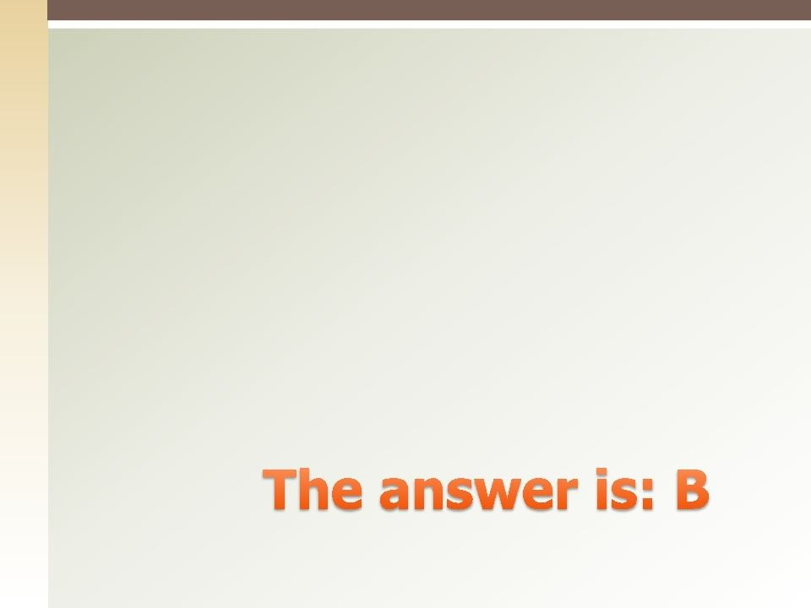

Quiz
Bidder Conferences are part of :
Plan Procurements
Conduct Procurements
Control Procurements D.Conduct Purchasing

Slide 31
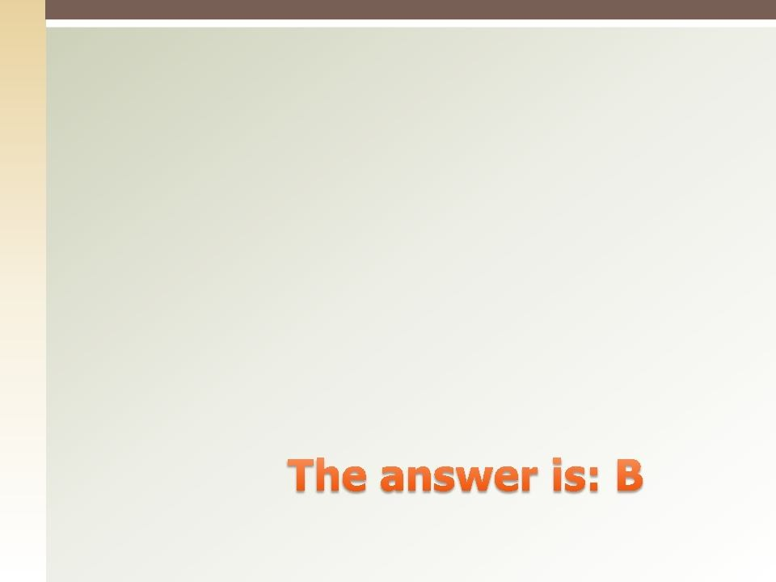

Quiz
The project team is arguing about whether they should complete a work package themselves or outsource the work. What part of the procurement process are they in:
Contract administration
Plan Procurements
Conduct Procurements
Select sellers

Slide 32
12.3 Control Procurements
Manage procurements relationships, monitor contract performance and make changes and corrections as needed.
32

Slide 33


Control Procurements - Inputs
Project Management Plan
Procurement Documents
Agreements
Work Performance Reports
Technical documentation and other deliverables information developed by the seller.
Seller Performance Reports.
33

Slide 34
Control Procurements - Inputs
Approved Change Request.
Work Performance Information: Includes;
The extent to which quality standards are being met.
Indicates which deliverables have been completed.
Identifies which costs have been incurred.
Seller invoices: submitted from time to time to request payment for work performed.
34

Slide 35
Control Procurements – T & T
Contract Change Control System
Defines the process how the contract may be modified.
Includes the paperwork, tracking systems, dispute resolution procedures, and approval levels necessary for authorizing changes.
Should be integrated with the integrated change control system.
Procurement Performance Review; A structured review
on the sellers’ progress to deliver as per planned scope
– quality – schedule – quality, etc..
35

Slide 36
Control Procurements – T & T
Inspections and Audits; required by the buyer and supported by the seller to identify any weaknesses in the seller’s work performance or deliverables.
Performance Reporting.
Payment Systems: Handled by the accounts payable department of the performing organization. Must include reviews and approvals of seller invoices by the project team prior to issuing a payment to a seller.
36

Slide 37
Control Procurements – T & T
Claims Administration: (disputes or appeals)
Where buyer and seller cannot agree on compensation for the change, or that a change has even occurred.
Should be documented and managed in accordance with the terms of the contract.
Might involve arbitration or litigation.
Record Management System:
A set of processes and automation tools consolidated into the project Management Information System to manage contract documentation and records.

Slide 38
Control Procurements – Outputs
1. Work Performance Information, includes but not limited to:
Updated Schedules Invoices
Technical documentation Performance reports
◉
◉
◉
◉
2. Change Requests

Slide 39
Control Procurement – Outputs
Project Management Plan Updates
Project Documents Updates
Organizational Process Assets Updates: including
Correspondence: communication between buyer & seller.
Payment Schedules and requests.
Seller performance evaluation documentation: The buyer document s seller’s ability to continue to perform work on the project or to be allowed to work on future projects.
Basis for early termination
Update the qualified seller lists in the organization.
39

Slide 40
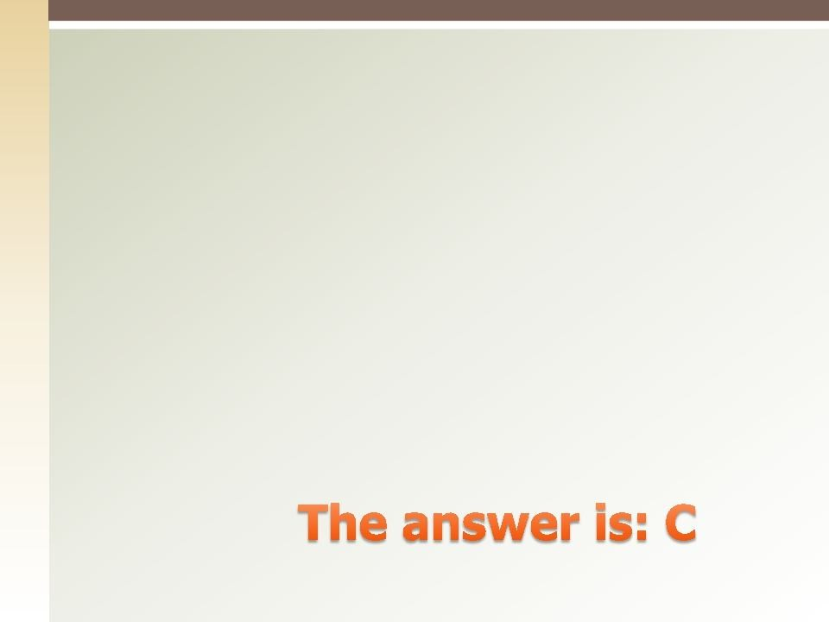

Quiz
All of the following statements about change control are incorrect EXCEPT:
A fixed price contract will minimize the need for change control.
Changes seldom provide real benefits to the project
Contracts should include procedures to accommodate changes.
More detailed specifications eliminate the causes of changes.
40

Slide 41
12.4 Close Procurements
The process of completing each project procurement.
Involves verification that all of the procurement work was completed and accepted. (Product Verification)
◻
41

Slide 42
Close Procurement - Inputs
Project Management Plan
Procurement Documentation
The contract. Supporting schedules
Requested and approved changes Technical documentation Performance reports
Financial reports
◉
◉
◉
◉
◉
◉
42

Slide 43
Close Procurement – T & T
Procurement Audits:
A structured review of the procurement process from Plan Procurements to Control Procurements.
The objective is to identify the successes & failures that warrant recognition.
Procurement Negotiations
Records Management System.
43

Slide 44
Close Procurement – Output
Closed Procurements: Formal written notice that the contract has been completed.
Organizational Process Assets Updates:
◉
Contract File:
■
A complete set of indexed contract documentation.
◉
Deliverable Acceptance:
■
A formal written notice from the buyer that the contract has been accepted.
Requirements should be defined in the contract.
■
◉
Lessons Learned documentation
44

Slide 45
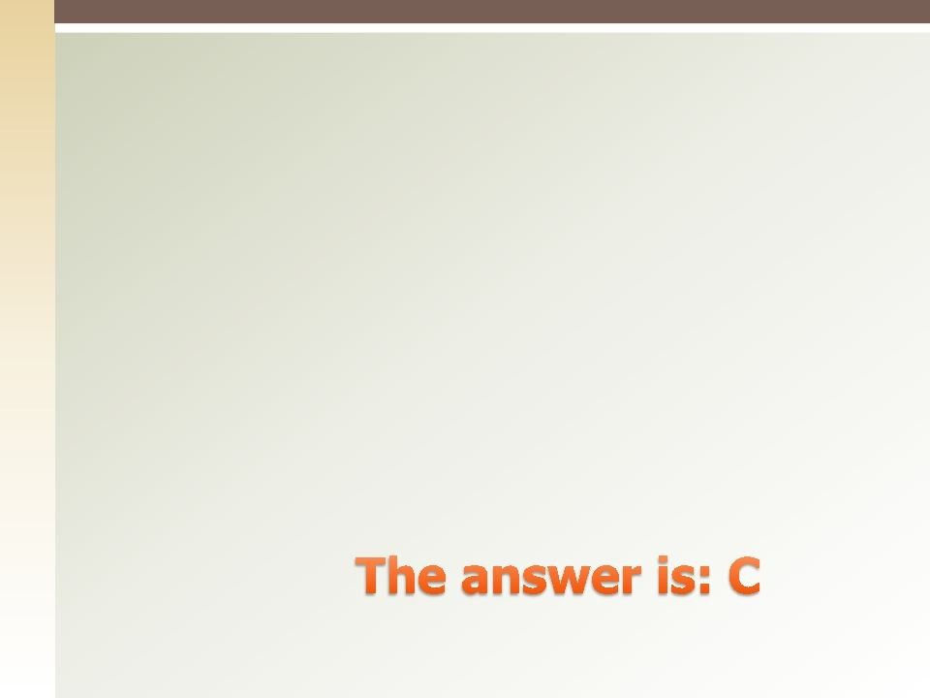

Quiz
Once signed, a contract is legally binding unless:
One party is unable to perform
One party is unable to finance its part of the work
It is in violation of applicable law
It is declared null and void by either party’s legal council
45

Slide 46
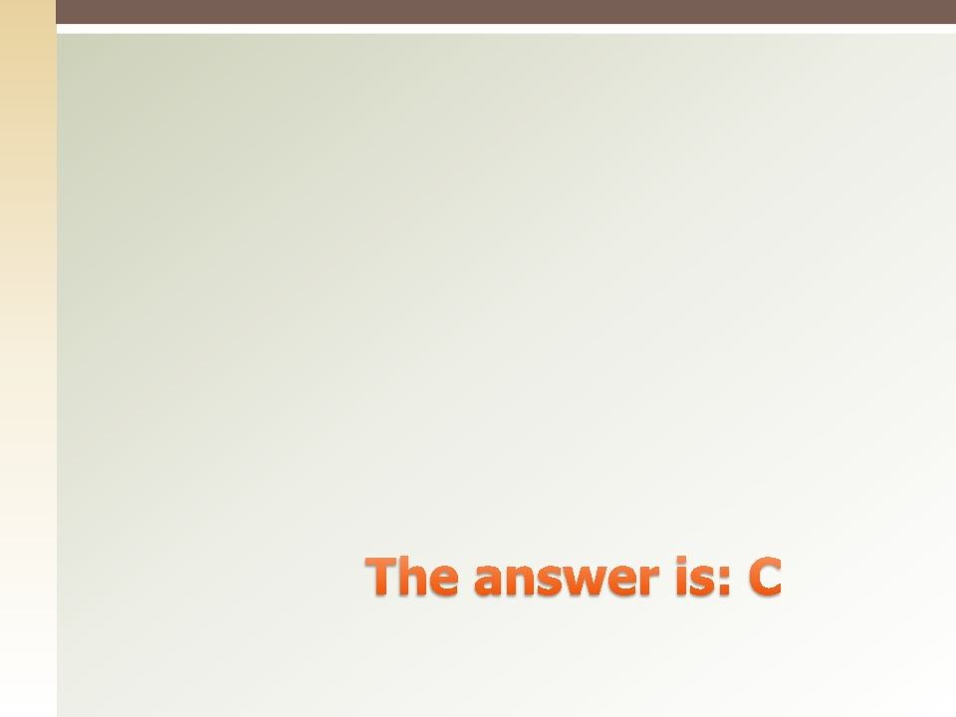

Quiz
All the following MUST be present to have a contract EXCEPT:
Contract statement of work
Acceptance
Address of the seller D.Buyer’s signature
45

Slide 47
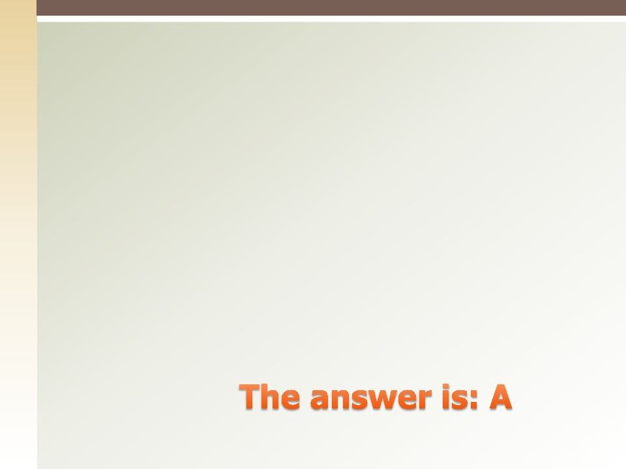

Quiz
With which type of contract is the seller MOST concerned about project scope:
Fixed price
Cost plus fixed fees
Time & Material D.Purchase order
46

Slide 48


Q&A
47

