Slide 1

Instructor: NGUYEN ANH MINH, MSc, PMP

Slide 2
Project Stakeholder
Management

Slide 3

Agenda
13.1 Identify Stakeholder
13.2 Plan Stakeholder Management
13.3 Manage Stakeholder Engagement
13.4 Control Stakeholder Engagement
3

Slide 4

What is Stakeholder Management?
Includes the processes required to:
Identify the people, groups, or organizations that could impact or be impacted by the project. Analyze stakeholder expectations and their impact on the project
Develop appropriate management strategies for effectively engaging stakeholders in project decision and execution
◻
◻
◻
4

Slide 5


13.1 Identify Stakeholders
Identify all people or
organizations impacted by the project: e.g., Customers, Sponsors, Team Members, Suppliers (Internal & External), and Labor unions
5

Slide 6
Identify Stakeholders: Inputs
Project Charter (provides information about
internal & external involved parties
Procurement Documents
Enterprise Environmental Factors (e.g., organizational culture, industry standards, … etc)
Organizational Process Assets (stakeholders register templates, lessons learned, old project documents, … etc)
6

Slide 7
Identify Stakeholders: Tools & Techniques
Stakeholder Analysis: gathering & analyzing information to determine stakeholder in 3 steps:
Identify all potential stakeholders & relevant information (roles, departments, interests, knowledge levels, expectations & influence levels).
Identify potential impact or support each stakeholder could generate (power-interest)
Assess how key stakeholders are likely to react or respond to various situations.
7

Slide 8
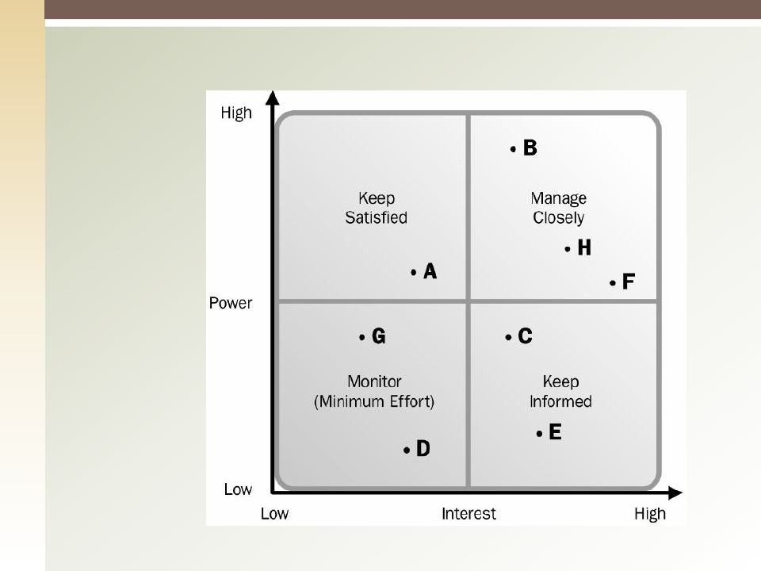
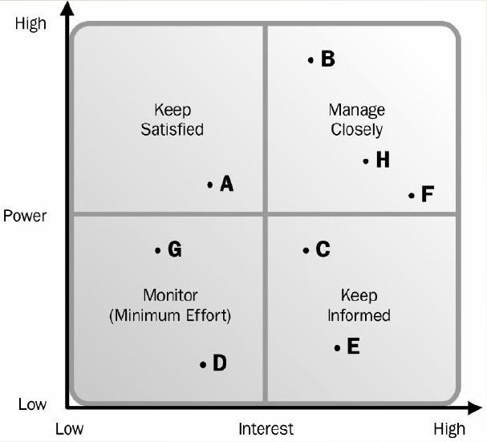
Power-Interest Grid
7

Slide 9
Identify Stakeholders: T & T (2)
Expert Judgment: groups or individuals specialized in certain areas such:
Senior management
Subject matter experts
Industry groups and consultants
Professional and technical associations
Project managers with experience in similar projects
Identified stakeholders.
Meetings
9

Slide 10
Identify Stakeholders: Outputs
Stakeholder Register: it contains
Identification Information: name, organizational position, location, role in project, … etc.
Assessment Information: major requirements, expectation, potential influence in project … etc.
Stakeholder Classification: Internal/External, supporter, neutral, resistor, … etc.
10

Slide 11
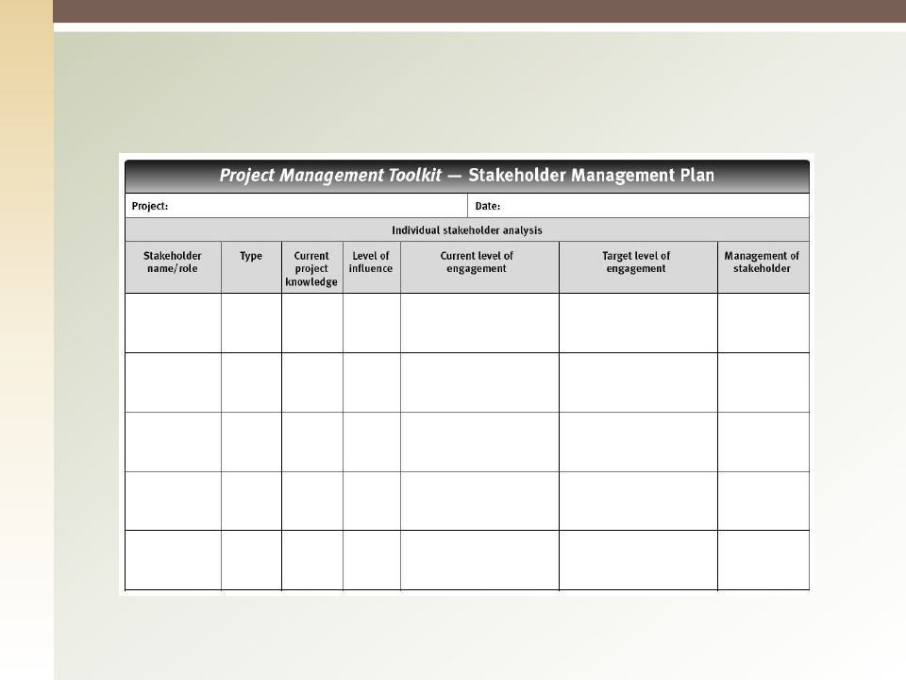
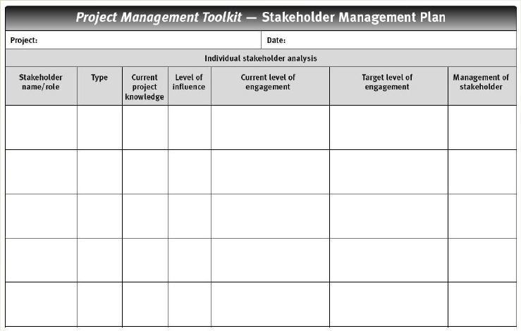
Sample Stakeholder Mgmt Plan
10

Slide 12
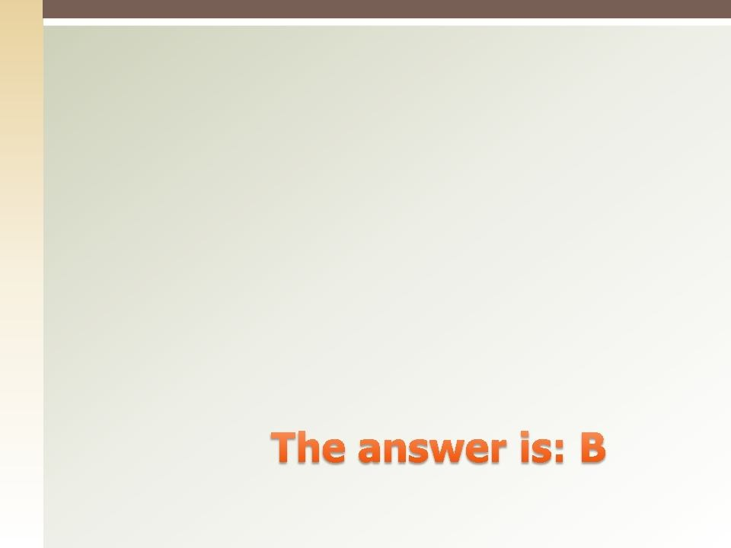

Quiz
How should the project manager manage the stakeholders with high power in high interest in the project?
Keep them satisfied
Manage Closely
Treat them equally to other stakeholders
Give their request a high priority
11

Slide 13
13.2 Plan Stakeholder Management
Developing appropriate management strategies to effectively engage stakeholders throughout the project lifecycle.
Provides clear, actionable plan to interact with project stakeholders to support the project’s interests.
◻

Slide 14
Plan Stakeholder Management - Inputs
Project Management Plan
Stakeholder Register
Enterprise Environmental Factors
Organizational Process Assets

Slide 15
Plan Stakeholder Management – T & T
Expert Judgment
Senior Management
Team Members
Other units or individuals
Identified stakeholders
Project managers of similar projects
Industry experts
Meetings

Slide 16
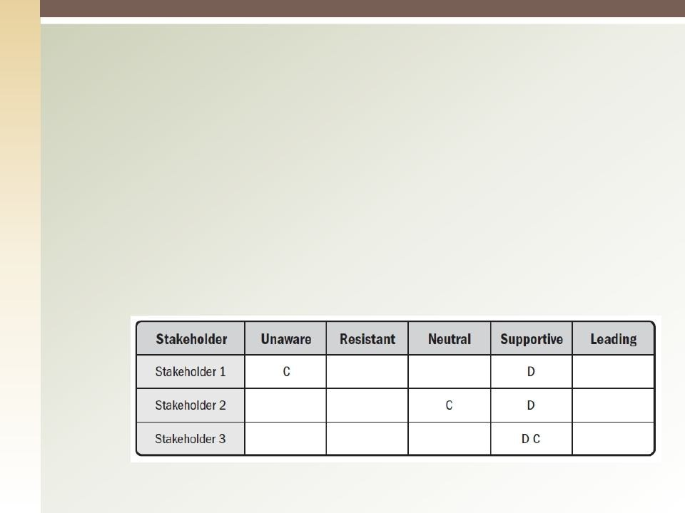
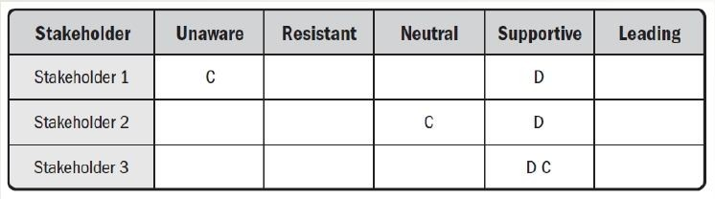
Plan Stakeholder Management – T & T
Analytical Techniques, engagement levels:
Unaware
Resistant
Neutral
Supportive
Leading

Slide 17
Plan Stakeholders Management: Outputs
Stakeholder Management Plan:
Desired and current engagement levels of key stakeholders
Interrelationship and potential overlap between stakeholders
Stakeholder communication requirements
Project Document Updates
16

Slide 18
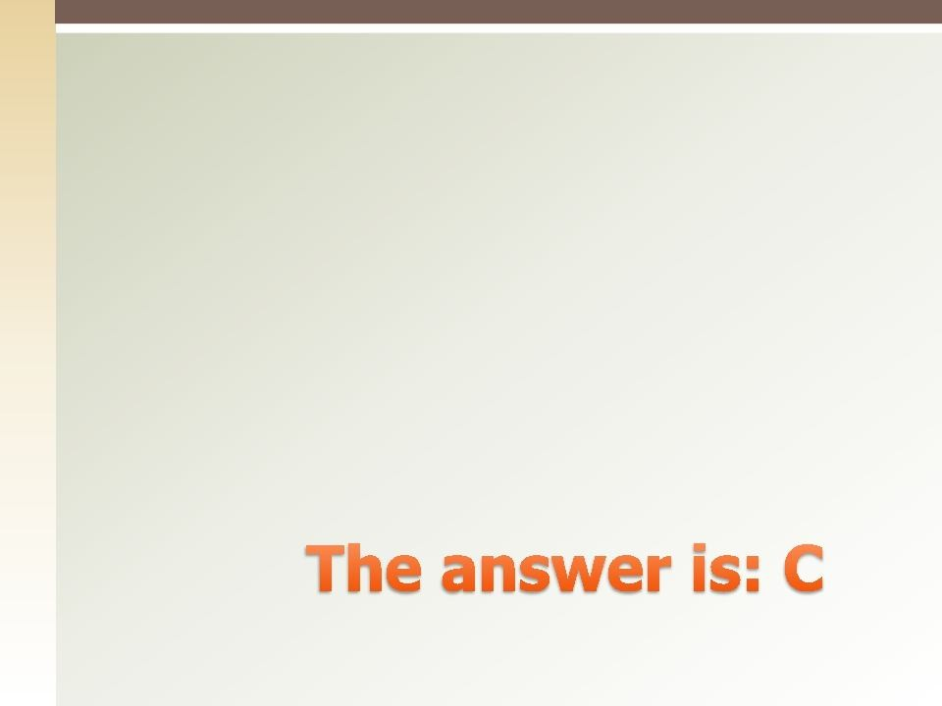

Quiz
One of the following is not part of the stakeholder management plan
Desired engagement level
Current engagement level
Communication method
Communication needs

Slide 19
13.3 Manage Stakeholder Engagement
Communicating and working with stakeholders to meet their needs/expectations, address issues as they occur, and foster appropriate stakeholder engagement in project activities throughout the project lifecycle.
The key benefit is to allow the project manager to increase support and minimize resistance from stakeholders.

Slide 20
Manage Stakeholder Engagement - Inputs
Stakeholder Engagement Plan
Communication Management Plan
Change Log
Organizational Process Assets

Slide 21
Manage Stakeholder Engagement T & T
Communications Methods
Interpersonal Skills
Building trust
Resolving conflict
Active listening
Overcoming resistance to change
Management Skills
Influence people to support project
Negotiate agreements
Modify organizational behavior

Slide 22
Manage Stakeholder Engagement Outputs
Issue Log
Change Requests
Project Management Plan Updates
Project Document Updates
22

Slide 23
Manage Stakeholder Engagement Outputs
Organizations Process Assets Updates
Stakeholder notifications
Project Reports
Project presentations
Project records
Feedback from stakeholders
Lessons Learned Documentation
23

Slide 24
13.3 Control Stakeholder Engagement
Monitoring overall stakeholder relationships and adjusting strategies and plans for engaging stakeholders.
The key benefit is to maintain or increase the efficiency and effectiveness of stakeholder
engagement activities.

Slide 25
Control Stakeholder Engagement - Inputs
Project Management Plan
Issue Log
Work Performance Data
Project Documents

Slide 26
Control Stakeholder Engagement T & T
Information Management Systems
Expert Judgment
Meetings

Slide 27
Control Stakeholder Engagement Outputs
Work Performance Information
Change Requests
Project Management Plan Updates
Project Document Updates
27

Slide 28
Control Stakeholder Engagement Outputs
Organizations Process Assets Updates
Stakeholder notifications
Project Reports
Project presentations
Project records
Feedback from stakeholders
Lessons Learned Documentation
28

Slide 29


Q&A
28

