Slide 1


11Tips on
problem solving
skills
/// simplify your life \\\

Slide 2

Being able to solve problems quickly and efficiently without hesitance or difficulties is every person’s dream

Slide 3
Being able to solve problems quickly and efficiently without hesitance or difficulties is every person’s dream
There is not a fixed formula to solve every problem in daily life or at work

Slide 4
Being able to solve problems quickly and efficiently without hesitance or difficulties is every person’s dream
There is not a fixed formula to solve every problem in daily life or at work
However, there are skills that help us get out of difficult situations easilya

Slide 5





Indentify
your problems

Slide 6





Slide 7

If you try to ignore your problems, you will not be able to find good
solutions to them

Slide 8

“Running away from any problem only increases the distance from the
solution”

Slide 9


Analyze
problems

Slide 10

Analyzing problems thoroughly is
one of the most helpful tips on
problem solving skills

Slide 11

It is important to know the main causes of your problems so that you can solve
them from the root

Slide 12



Slide 13
Solve
important problems
First

Slide 14

Important problems are problems that can
cause big effects on your life or work

Slide 15

Try to figure them out and resolve them as soon as possible no matter how hard they are

Slide 16



Slide 17

Do not hesitate to ask for
help from other people if you cannot solve problems on your own

Slide 18
Learn more about this tip
click
http://vkool.com/11-tips-on-problem-solving-skills

Slide 19


Generate
potential solutions

Slide 20

Do not stick to popular solutions as they may not suit your problems

Slide 21

Find out new solutions that
can best solve your issues

Slide 22



Slide 23


Make
plans

Slide 24

“A goal without a plan is just a wish”

Slide 25

After choosing solutions, make a
specific and detailed plan to carry them out.

Slide 26

Your plan on carrying out solutions should be as specific and concrete as possible

Slide 27
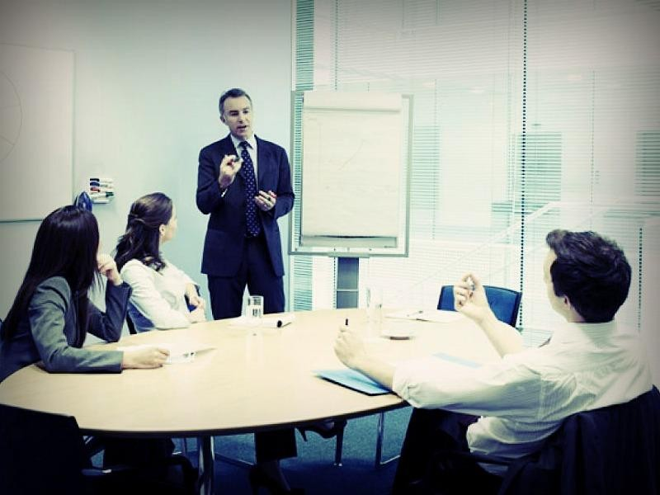
You should also prepare to cope with things that may go wrong during problem solving process.

Slide 28


Carry Out
solutions

Slide 29

Try your best to do it step by step
Just focus on acting out for good results without worrying about anything

Slide 30

“A positive attitude may not solve every problem but it makes solving any problem a more pleasant experience“

Slide 31

you need to “Fix the problem, not the blame”
“All life is problem solving”

Slide 32
Learn more about this tip
click
http://vkool.com/11-tips-on-problem-solving-skills

Slide 33


Slide 34


Slide 35


