Slide 1
Comparison between PMBOK4 and PMBOK5
Created by:
Saqib Javed John
(PMP, ACP, ITIL, SCJP, SCWCD)

Slide 2
High Level Comparison
PMBOK 4
PMBOK 5
Released in 2008
5 Process Groups
9 Knowledge Areas
42 Processes
Released in 2013
5 Process Groups
10 Knowledge Areas
47 Processes

Slide 3
Addition in Knowledge Areas
PMBOK 4
PMBOK 5
Integration Management
Scope Management
Time Management
Cost Management
Quality Management
Human Resource Management
Communication Management
Risk Management
Procurement Management
Integration Management
Scope Management
Time Management
Cost Management
Quality Management
Human Resource Management
Communication Management
Risk Management
Procurement Management
Stakeholder Management

Slide 4
Addition in Processes
PMBOK 4
PMBOK 5
 | I | P | E | M&C | C
Integration | 1 | 1 | 1 | 2 | 1
Scope |  | 3 |  | 2
Time |  | 5 |  | 1
Cost |  | 2 |  | 1
Quality |  | 1 | 1 | 1
Human Resource |  | 1 | 3
Communications | 1 | 1 | 2 | 1
Risk |  | 5 |  | 1
Procurement |  | 1 | 1 | 1 | 1
Processes (42) | 2 | 20 | 8 | 10 | 2
 | I | P | E | M&C | C
Integration | 1 | 1 | 1 | 2 | 1
Scope |  | 4 |  | 2
Time |  | 6 |  | 1
Cost |  | 3 |  | 1
Quality |  | 1 | 1 | 1
Human Resource |  | 1 | 3
Communications | 0 | 1 | 1 | 1
Risk |  | 5 |  | 1
Procurement |  | 1 | 1 | 1 | 1
Stakeholder | 1 | 1 | 1 | 1
Processes (47) | 2 | 24 | 8 | 11 | 2
I=Initiation
P=Planning
E=Execution
M&E=Monitoring & Controlling
C=Closing

Slide 5
Integration Management
 | Initiation | Planning | Execution | Monitoring & Controlling | Closing
PMBOK 4 | Develop Project Charter | Develop Project Management Plan | Direct & Manage Project Execution | Monitor & Control Project Work Perform Integrated Change Control | Close Project or Phase
PMBOK 5 | No Change and its same as in PMBOK4

Slide 6
Scope Management
 | Initiation | Planning | Execution | Monitoring & Controlling | Closing
PMBOK 4 |  | Collect Requirements Define scope Create WBS |  | Verify Scope Control Scope
PMBOK 5 |  | Plan Scope Management Collect Requirements Define scope Create WBS |  | Validate Scope Verify Scope Control Scope

Slide 7
Time Management
 | Initiation | Planning | Execution | Monitoring & Controlling | Closing
PMBOK 4 |  | Define Activities Sequence Activities Estimate Activity Resources Estimate Activity Duration Develop Schedule |  | Control Schedule
PMBOK 5 |  | Plan Schedule Management Define Activities Sequence Activities Estimate Activity Resources Estimate Activity Duration Develop Schedule |  | Control Schedule

Slide 8
Cost Management
 | Initiation | Planning | Execution | Monitoring & Controlling | Closing
PMBOK 4 |  | Estimate Costs Determine Budget |  | Control Costs
PMBOK 5 |  | Plan Cost Management Estimate Costs Determine Budget |  | Control Costs

Slide 9
Quality Management
 | Initiation | Planning | Execution | Monitoring & Controlling | Closing
PMBOK 4 |  | Plan Quality | Perform Quality Assurance | Perform Quality Control
PMBOK 5 |  | Plan Quality Management | Perform Quality Assurance | Perform Quality Control Quality

Slide 10
Human Resource Management
 | Initiation | Planning | Execution | Monitoring & Controlling | Closing
PMBOK 4 |  | Develop HR Plan | Acquire Project Team Develop Project Team Manage Project Team
PMBOK 5 |  | Develop HR Plan Plan HR Management | Acquire Project Team Develop Project Team Manage Project Team

Slide 11
Communication Management
 | Initiation | Planning | Execution | Monitoring & Controlling | Closing
PMBOK 4 | Identify Stakeholders | Plan Communication | Distribute Information Manage Stakeholders Expectations | Report Performance
PMBOK 5 | Identify Stakeholders | Plan Communication Management | Distribute Information Manage Stakeholders Expectations Manage Communication | Report Performance Control Communication

Slide 12
Risk Management
 | Initiation | Planning | Execution | Monitoring & Controlling | Closing
PMBOK 4 |  | Plan Risk Management Identify Risks Perform Qualitative Risk Analysis Perform Quantitative Risk Analysis Plan Risk Responses |  | Monitor and Control Risks
PMBOK 5 |  | Plan Risk Management Identify Risks Perform Qualitative Risk Analysis Perform Quantitative Risk Analysis Plan Risk Responses |  | Monitor and Control Risks Control Risks

Slide 13
Procurement Management
 | Initiation | Planning | Execution | Monitoring & Controlling | Closing
PMBOK 4 |  | Plan Procurement | Conduct Procurements | Administer Procurement | Close Procurement
PMBOK 5 |  | Plan Procurement Management | Conduct Procurements | Administer Procurement Control Procurement | Close Procurement

Slide 14
Stakeholder Management
 | Initiation | Planning | Execution | Monitoring & Controlling | Closing
PMBOK 4 | Stakeholder Management as a separate knowledge area was not the part of PMBOK4
PMBOK 5 | Identify Stakeholder | Plan Stakeholder Management | Manage Stakeholder Engagement | Control Stakeholder Management

Slide 15
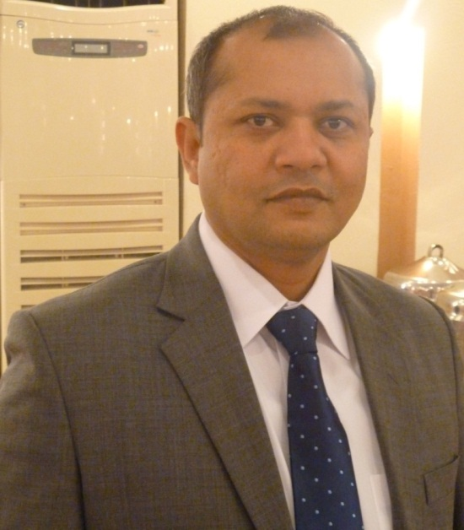
Thanks……
Created by:
Saqib Javed John (MSc CS, PMP, ACP, ITIL v3F, SCJP, SCWCD
Email: saqib.jav@gmail.com
Skype: saqibjohn76
LinkedIn: pk.linkedin.com/pub/saqib-javed-john/b/125/1b1

