Slide 1





RUZI
David
Search

Slide 2

RUZI
David
Search

Slide 3

RUZI
David
Search

Slide 4

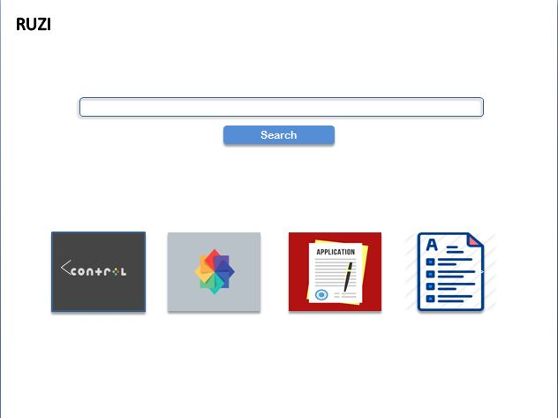
RUZI
Result Management
Get a student result
Publish result
Result Statistics
Data sheet
Cognitive data sheet
Pyschomotor /Affective areas

Slide 5









RUZI
Records
vo
Cognitive
max
min
Desk
Records
Primary one
Hand writing
Adiele chika
Spelling and detation
Adiele Chika
edit
Primary Four
Assignment
infography
view
Exam
Guidelines
Next
Back
UNAPPROVED

Slide 6


RUZI
Result Management
vo
Cognitive
max
min
search
sn
name
test 1
test 2
Exam
total
grade
Desk
Primary one
Hand writing
Spelling and detation
Primary Four
infography
view
Guidelines
UNAPPROVED

Slide 7
RUZI
Result Management
Search
max
min
First term of 2020/2021 Academic Session
Pre-nursery unapproved view
Filter
Class
Term
session
Nursery one unapproved view
Mesage
Sjhdjks ksnjkndkls kjnmd kjs js jjs s dm sd sk ksmldksn j kdsnjdndsmldksmlkdm
Nursery two unapproved view
A
B
Sjhdjks ksnjkndkls kjnmd kjs js jjs s dm sd sk ksmldksn j kdsnjdndsmldksmlkdm
G
Sjhdjks ksnjkndkls kjnmd kjs js jjs s dm sd sk ksmldksn j kdsnjdndsmldksmlkdm
Primary one unapproved view
R
Sjhdjks ksnjkndkls kjnmd kjs js jjs s dm sd sk ksmldksn j kdsnjdndsmldksmlkdm
J
Sjhdjks ksnjkndkls kjnmd kjs js jjs s dm sd sk ksmldksn j kdsnjdndsmldksmlkdm
Primary three unapproved view

Slide 8
RUZI
Result Management
Search
max
min
search
sn
name
test 1
test 2
Exam
total
grade
pos
Agricultural Science
Filter
Class
Term
session
Avg performane | 77.5
Highest score | 98 | Alphonsus Nwa
Lowest score | 43 | Anonnymous
Record above avg | 55
Record below avg | 20
Teacher | Mr Benson Fright
Status | Pending
Mesage
A
Sjhdjks ksnjkndkls kjnmd kjs js jjs s dm sd sk ksmldksn j kdsnjdndsmldksmlkdm
B
Sjhdjks ksnjkndkls kjnmd kjs js jjs s dm sd sk ksmldksn j kdsnjdndsmldksmlkdm
G
Sjhdjks ksnjkndkls kjnmd kjs js jjs s dm sd sk ksmldksn j kdsnjdndsmldksmlkdm
R
Sjhdjks ksnjkndkls kjnmd kjs js jjs s dm sd sk ksmldksn j kdsnjdndsmldksmlkdm
J
Sjhdjks ksnjkndkls kjnmd kjs js jjs s dm sd sk ksmldksn j kdsnjdndsmldksmlkdm
I agree to this result
Verify

Slide 9
RUZI
Result Management
Search
max
min
search
sn
name
English
Math
Physic
chem
bio
lite
avg
pos
Filter
Class
Term
session
Avg performane | 77.5
Highest Average | 98 | Alphonsus Nwa
Lowest Average | 43 | Anonnymous
Records above avg | 55
Records below avg | 20
Class Teacher | Mr Benson Fright
Status | unverified
Mesage
A
Sjhdjks ksnjkndkls kjnmd kjs js jjs s dm sd sk ksmldksn j kdsnjdndsmldksmlkdm
B
Sjhdjks ksnjkndkls kjnmd kjs js jjs s dm sd sk ksmldksn j kdsnjdndsmldksmlkdm
G
Sjhdjks ksnjkndkls kjnmd kjs js jjs s dm sd sk ksmldksn j kdsnjdndsmldksmlkdm
R
Sjhdjks ksnjkndkls kjnmd kjs js jjs s dm sd sk ksmldksn j kdsnjdndsmldksmlkdm
J
Sjhdjks ksnjkndkls kjnmd kjs js jjs s dm sd sk ksmldksn j kdsnjdndsmldksmlkdm
I agree to this result
Verify

Slide 10
RUZI
Result Management
Search
max
min
AGALA VICTORIA
REG NO: MGIS/NUR/0001
TOTAL SCORE OBTAINED |  |  |  |  | OUT |  | OF
AVERAGE PERCENTAGE
GRADE |  |  | A
Affective Areas
Filter
Class
Term
session
Pshycomotor skills
G
Sjhdjks ksnjkndkls kjnmd kjs js jjs s dm sd sk ksmldksn j kdsnjdndsmldksmlkdm
R
Sjhdjks ksnjkndkls kjnmd kjs js jjs s dm sd sk ksmldksn j kdsnjdndsmldksmlkdm
J
Sjhdjks ksnjkndkls kjnmd kjs js jjs s dm sd sk ksmldksn j kdsnjdndsmldksmlkdm

Slide 11

RUZI
Result Management
vo
Affective/Psyco
max
min
Desk
Records
Primary one
Agala Victoria
Primary Four
Agala Victoria
Agala Victoria
edit
infography
view
Guidelines
UNAPPROVED

Slide 12
RUZI
Result Management
Search
max
min
First term of 2020/2021 Academic Session
Publish all
Pre-nursery view
publish
Filter
Class
Term
session
Nursery one view
publish
Mesage
Nursery two view
publish
A
Sjhdjks ksnjkndkls kjnmd kjs js jjs s dm sd sk ksmldksn j kdsnjdndsmldksmlkdm
B
Sjhdjks ksnjkndkls kjnmd kjs js jjs s dm sd sk ksmldksn j kdsnjdndsmldksmlkdm
Primary one view
publish
G
Sjhdjks ksnjkndkls kjnmd kjs js jjs s dm sd sk ksmldksn j kdsnjdndsmldksmlkdm
Sjhdjks ksnjkndkls kjnmd kjs js jjs s dm sd sk ksmldksn j kdsnjdndsmldksmlkdm
Primary three view
publish
R
J
Sjhdjks ksnjkndkls kjnmd kjs js jjs s dm sd sk ksmldksn j kdsnjdndsmldksmlkdm

