Slide 1
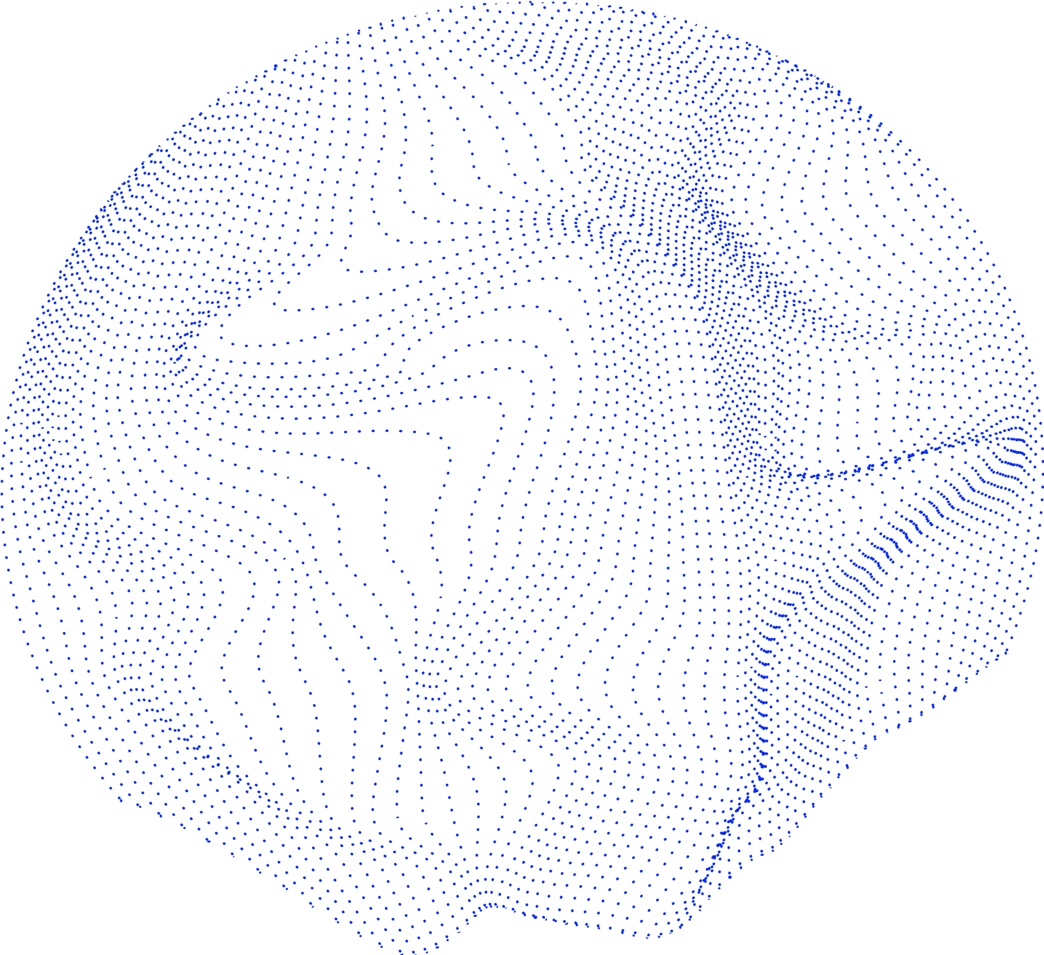

Slide 3
Data Poisoning

Slide 4
Data Poisoning

Slide 5
Data Poisoning
Trustworthy ML

Slide 6
Data Poisoning
Trustworthy ML
Submodular Optimization

Slide 7
Data Poisoning
Trustworthy ML
Submodular Optimization
Non-convex Optimization

Slide 8
Data Poisoning
Trustworthy ML
Submodular Optimization
Non-convex Optimization
Computational Neuroscience

