Slide 1
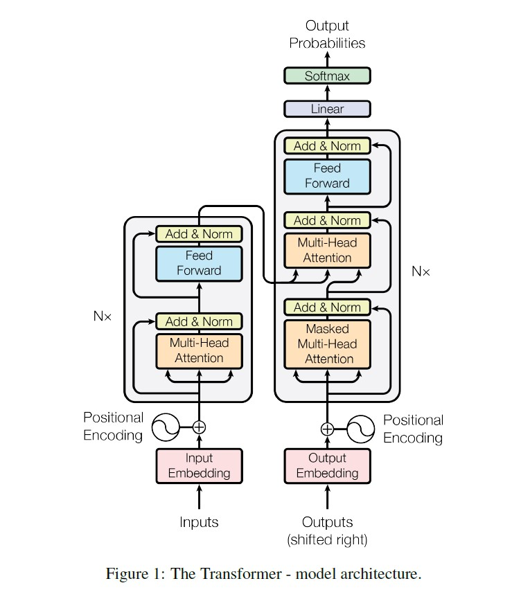
Transformer
A transformer model is a neural network can take an input sentence in the form of a sequence of vectors, and converts it into a vector called an encoding, and then decodes it back into another sequence.
An important part of the transformer is the attention mechanism.

Slide 2
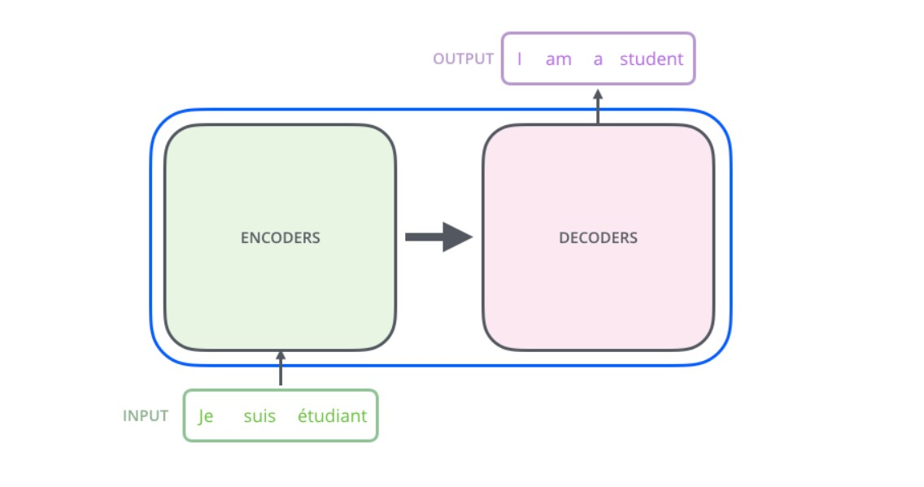
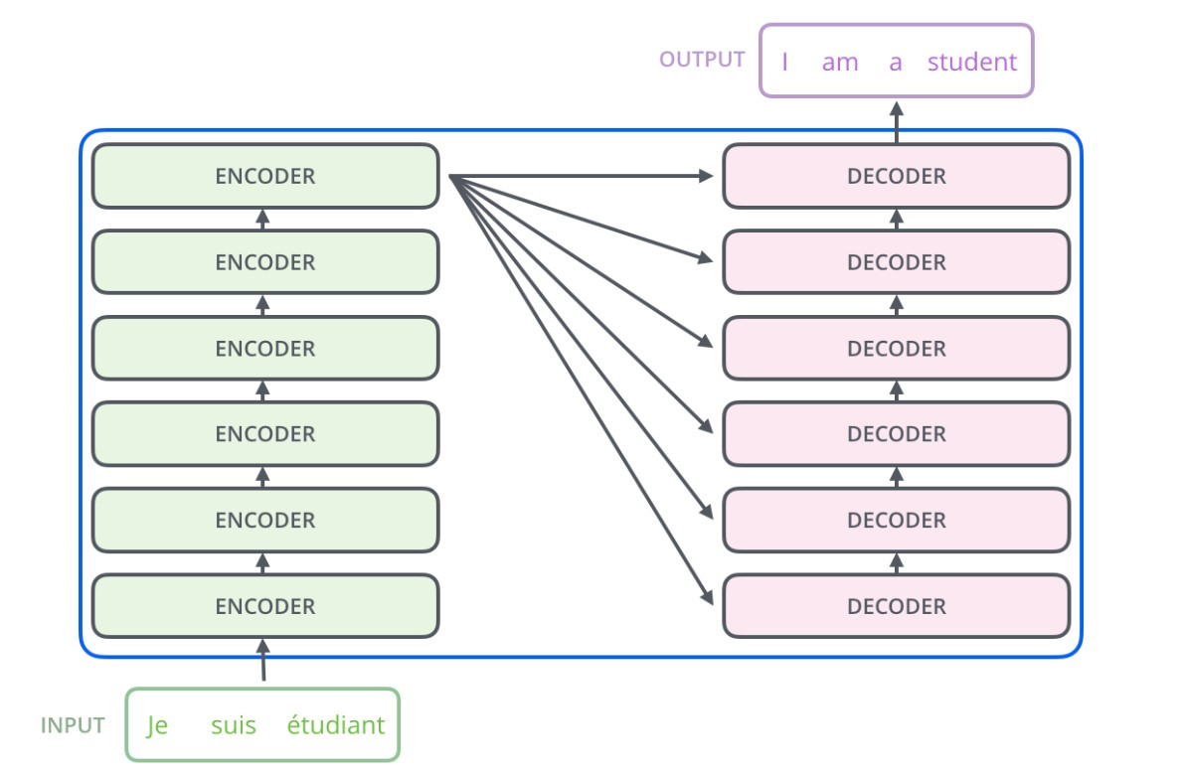

Slide 3
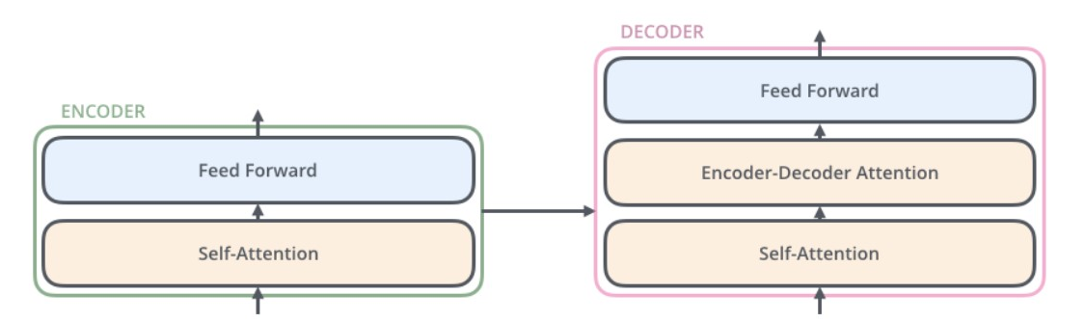
(1) Self-attention in the encoder. This allows an encoder to attend to all parts of the encoding output from the previous encoder.
(2) Encoder-decoder attention, An attention mechanism allowing a decoder to attend over the input sequence when generating the output sequence.
(3) Self-attention in the decoder. This allows a decoder to attend to all parts of the sequence inside the decoder.

Slide 4
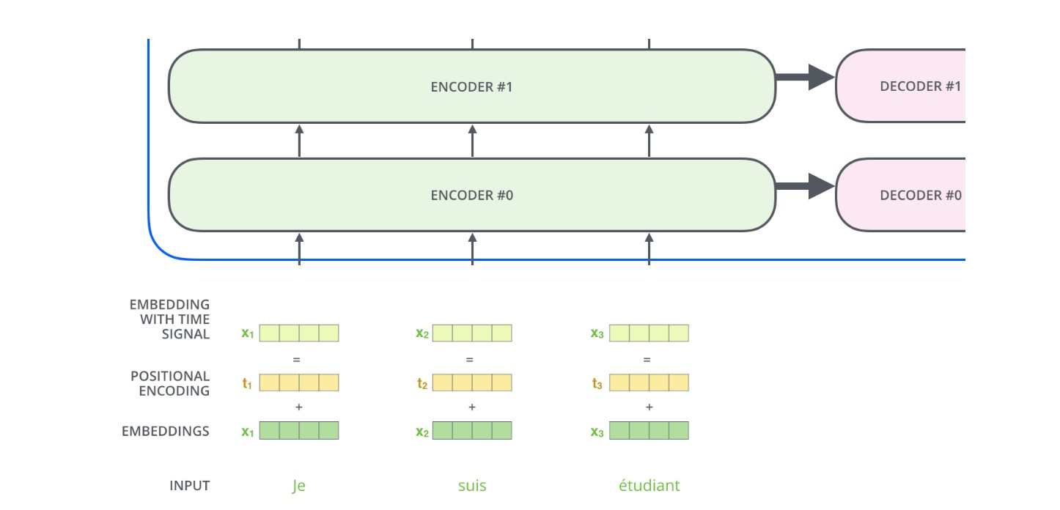
Word → Embedding → Positional Embedding → Final Vector, our input is ready, now it goes to the encoder block.

Slide 5
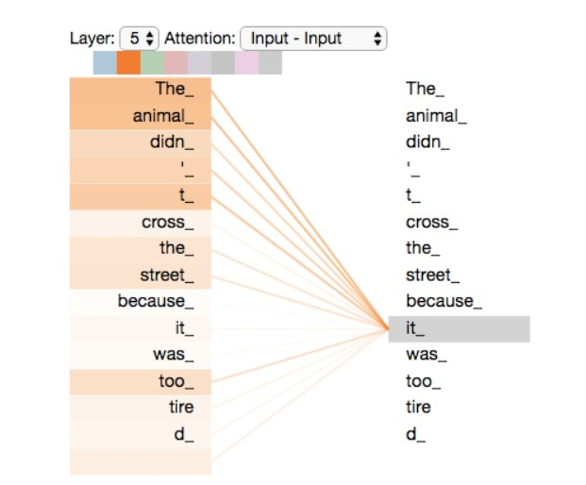
Self attention
What does “it” in this sentence refer to?
”The animal didn't cross the street because it was too tired”
When the model is processing the word “it”, self-attention allows it to associate “it” with “animal”.
As the model processes each word self attention allows it to look at other positions in the input sequence for clues that can help lead to a better encoding for this word.

Slide 6

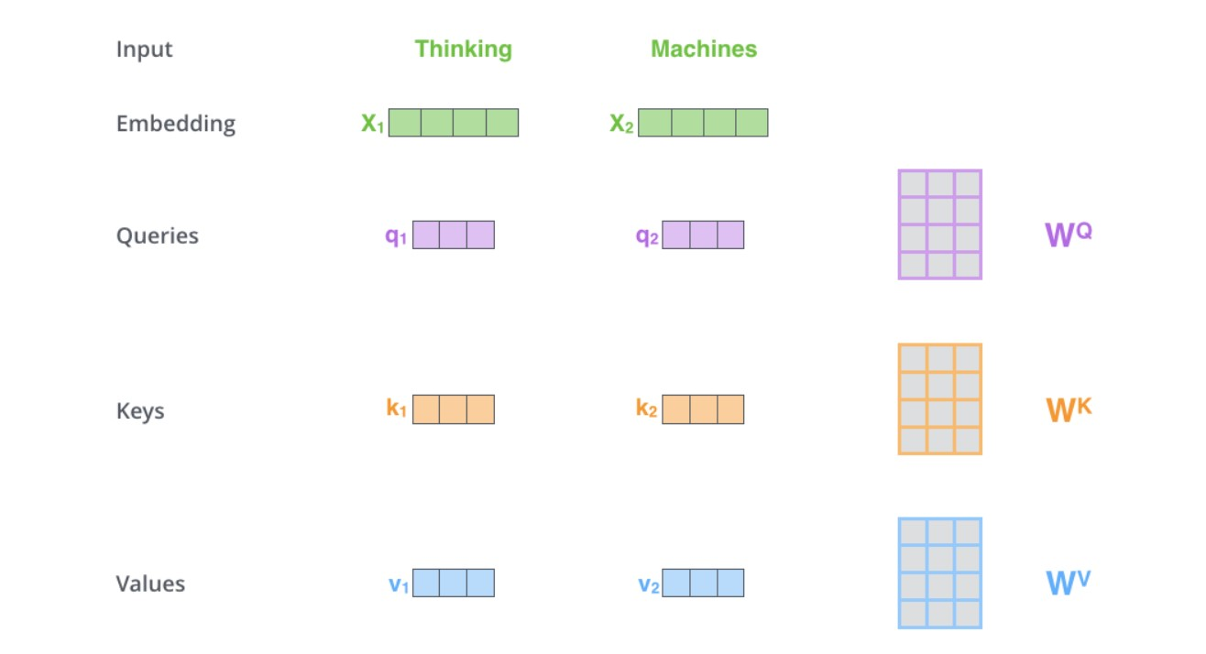
Self attention details
For every word, we can have an attention vector generated, which captures the contextual relationship between words in that sentence.

Slide 7
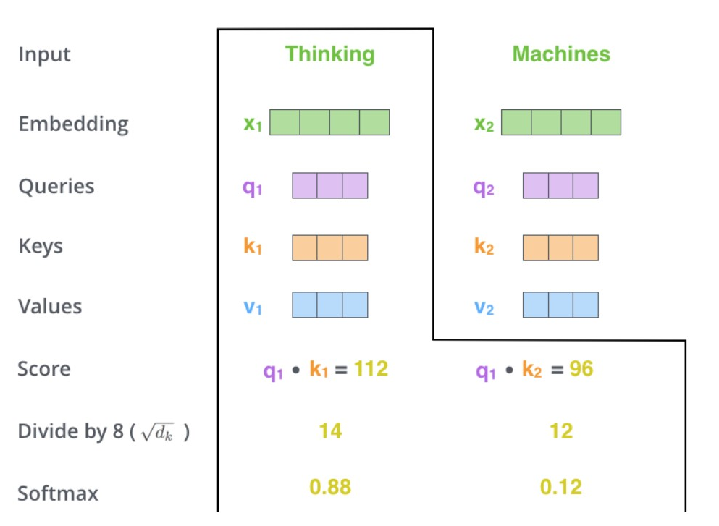
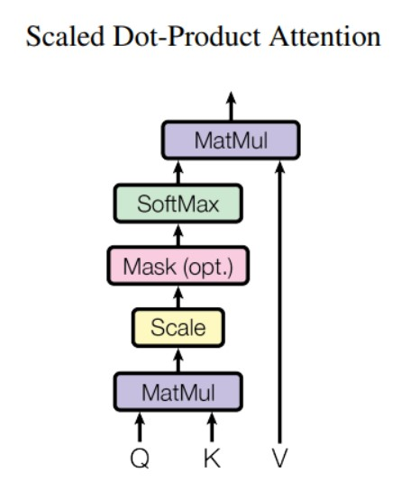
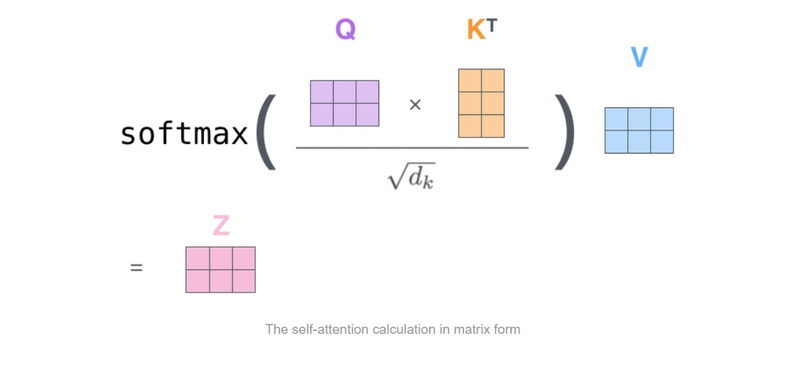
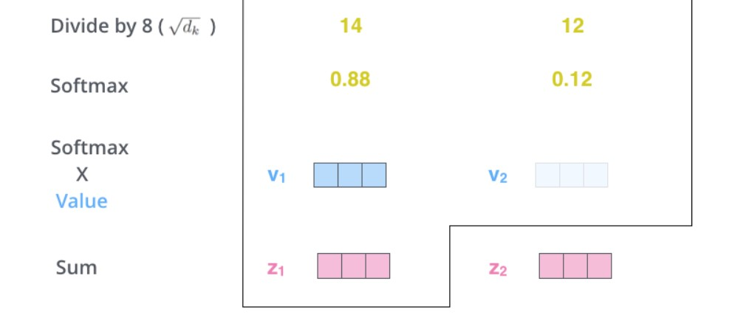

Slide 8
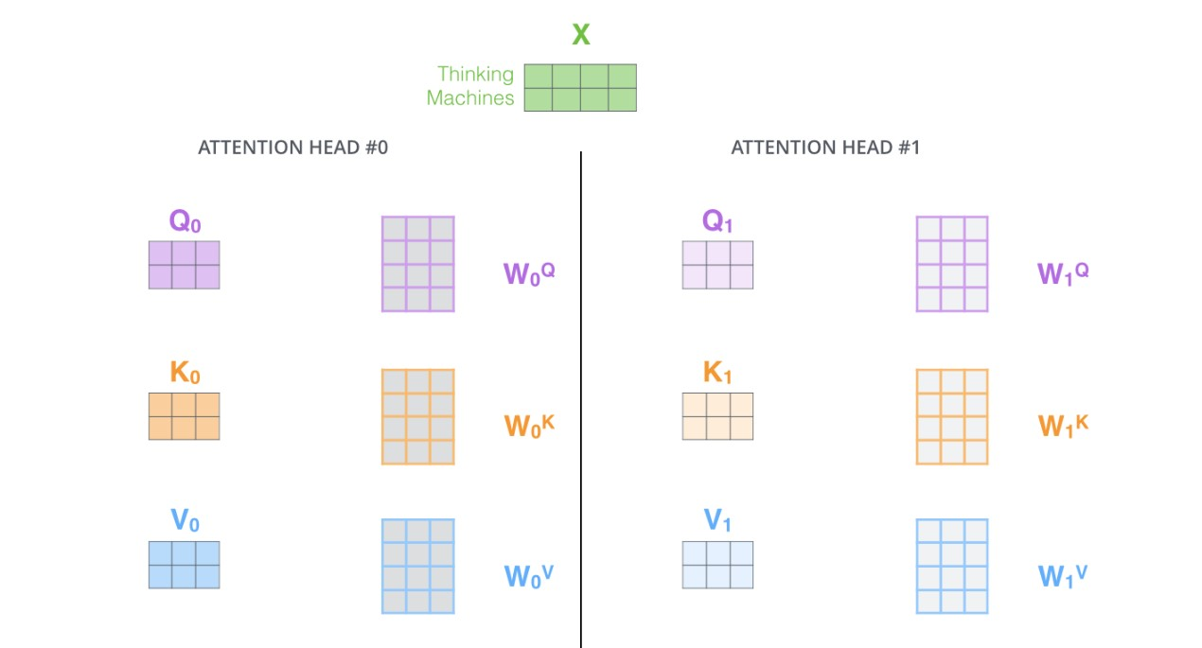
Multi-head attention

Slide 9
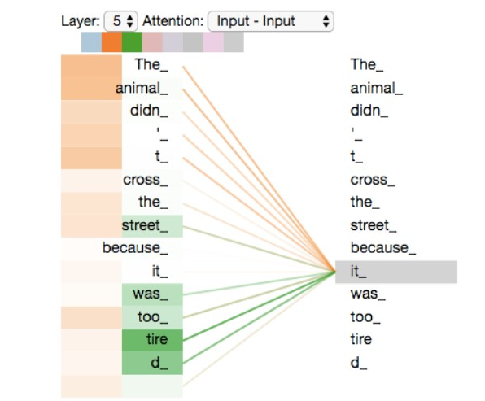
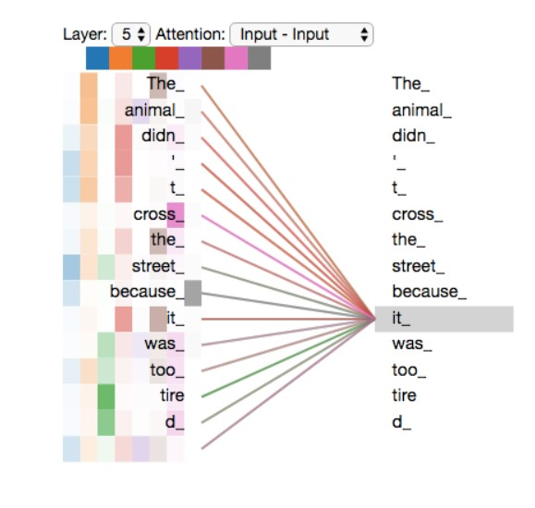
Multi-head attention
As we encode the word "it", one attention head is focusing most on "the animal", while another is focusing on "tired" -- in a sense, the model's representation of the word "it" bakes in some of the representation of both "animal" and "tired".

Slide 10
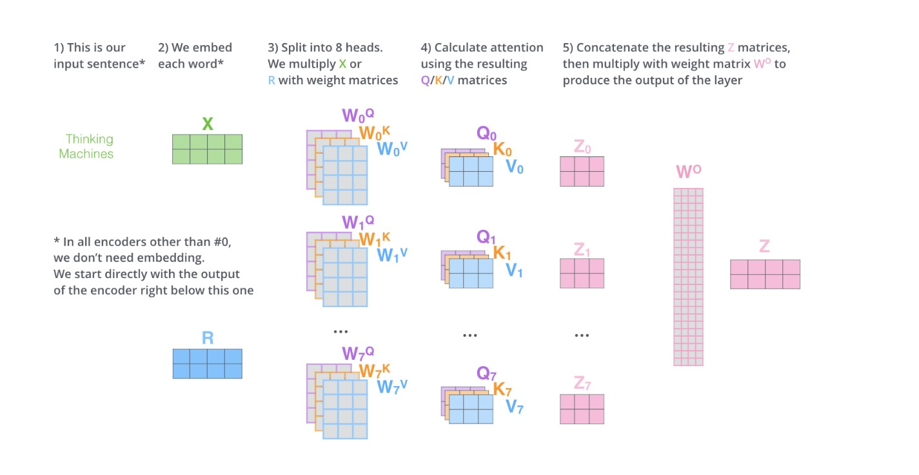

Slide 11
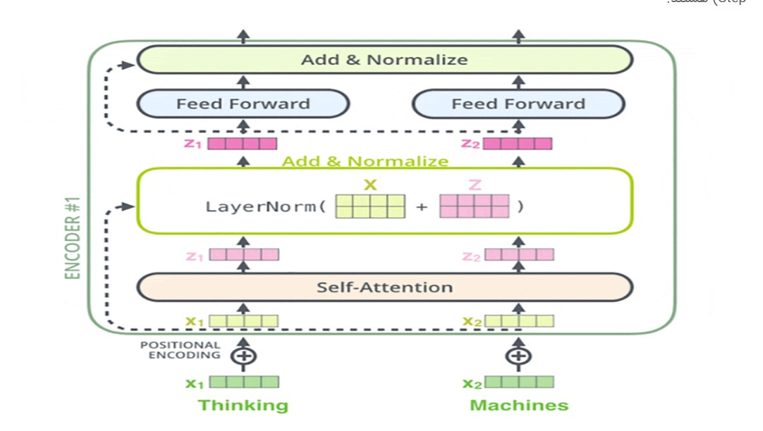

Slide 12
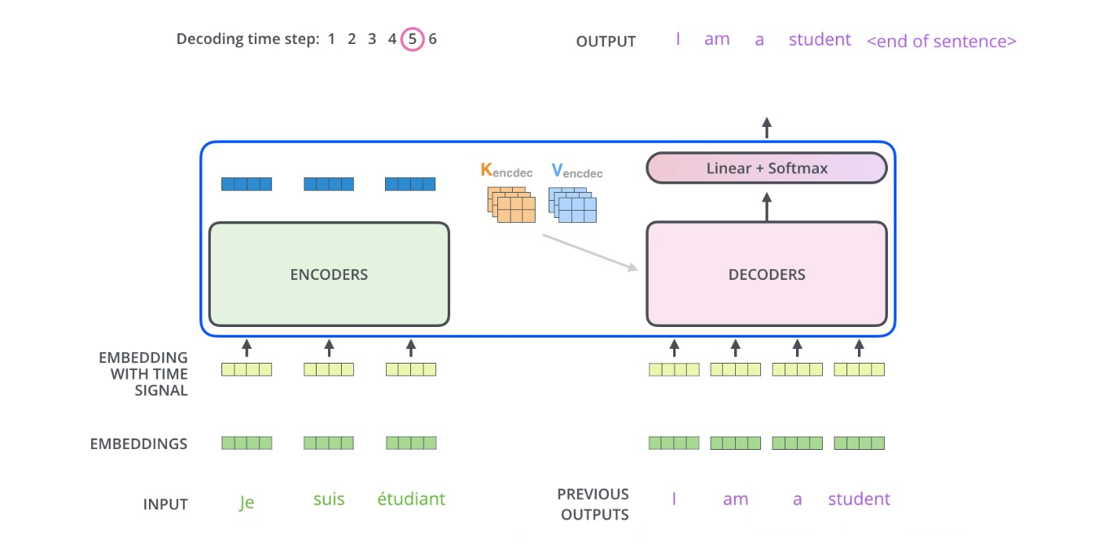

Slide 13
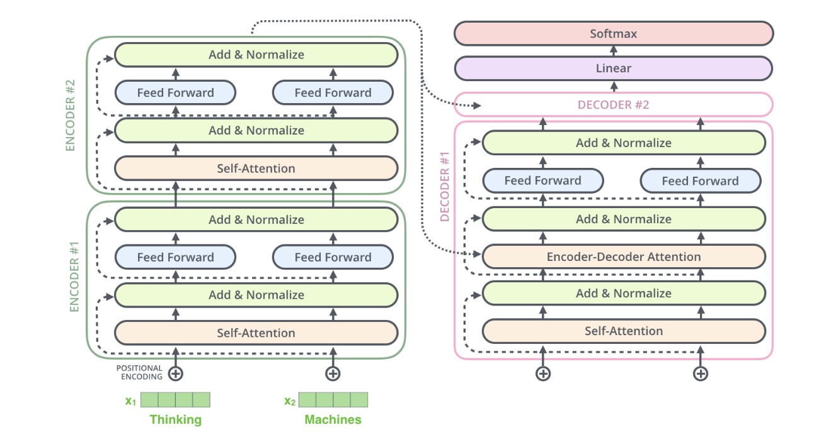

Slide 14
