Slide 1
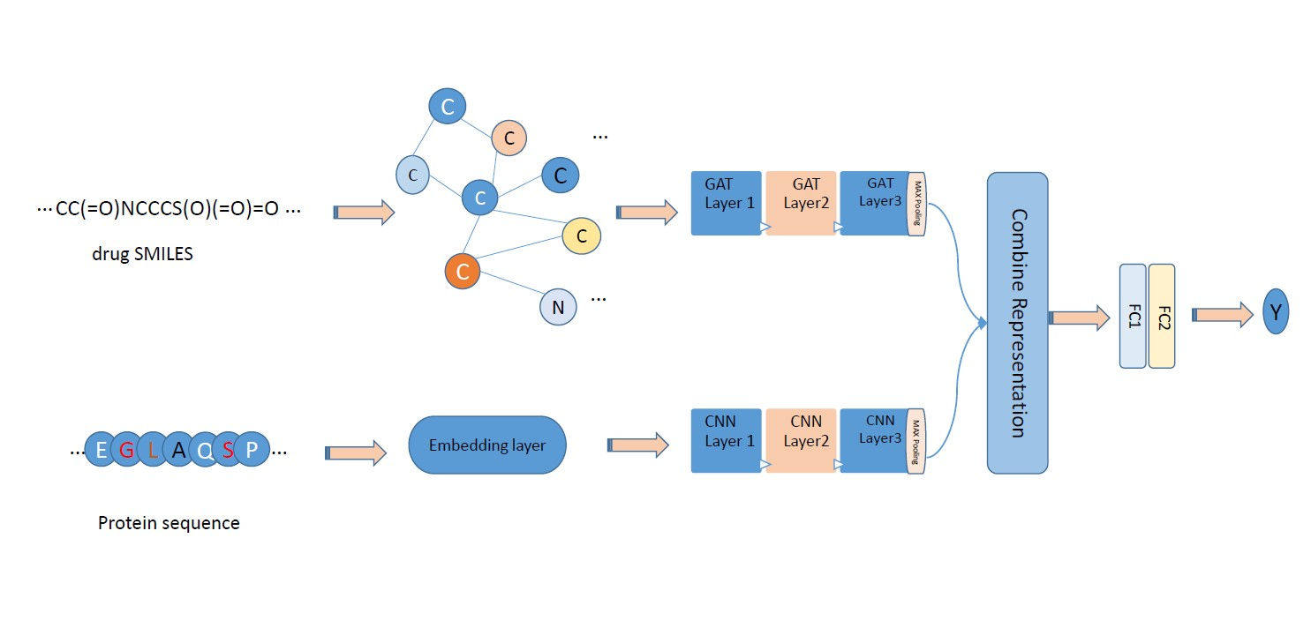
Drug-Target Affinity Prediction with Graph Attention network
Abstract
Method
Results
Drug discovery is a challenging and costly process that involves finding effective and safe compounds. One of the key tasks in drug discovery is drug-target affinity prediction, which can help identify potential candidates for drug development and reduce the cost and time of drug discovery. In recent years, Graph Neural Networks (GNNs) have been used for drug-target affinity prediction, as they can represent the drugs as molecular graphs and capture their structural features. In this paper, we propose a model for drug-target affinity prediction that uses the graph attention network (GAT) to predict the binding strength of a drug molecule to a target protein.
We propose a model for DTA prediction that uses the graph attention network (GAT) to represent the drugs as molecular graphs and predict their binding affinities to target proteins. GAT is a graph attentional operator that computes a weighted sum of neighboring node features for each node. The weights are computed by a learnable attention mechanism that allows the model to focus on the most relevant information for each node. GAT can handle large and complex graphs with varying degrees and node attributes.
Our model consists of two parts: one for encoding the protein sequences and one for encoding the drug graphs. For protein sequences, we use an embedding layer followed by three 1D convolutional layers to learn different levels of features from the input. We then apply max pooling layer to get a representation vector. This approach is similar to the existing baseline models like DeepDTA and GraphDTA.
For drug graphs, we use three GAT layers to perform graph attention on the input features. We concatenate the outputs of the first two GAT layers before passing them to a linear layer. We then use ReLU activation and dropout after the linear layer. The linear layer takes the output of the third GAT layer as input, and produces a scalar output that represents the predicted affinity score.
We then combine the features of drug and protein and pass them through two fully connected layers to get an output for each drug-target pair.
Our model has several advantages over existing models. By using graph attention network, we can capture more information from the graph structure and node features than conventional graph convolutional networks. By adding more GAT layers, we can increase the expressiveness and complexity of our model. By concatenating features from different GAT layers, we can enhance the representation learning of our model. By using ReLU activation and dropout, we can introduce non-linearity and sparsity, and prevent overfitting.
We use the same dataset and metrics as the state-of-the-art models KronRLS, SimBoost, DeepDTA and WideDTA to compare our model with them. The dataset is from Davis et al. [9], which contains 68 drugs and 442 targets with 30056 drug-target pairs. The metrics are the concordance index (CI) and the mean squared error (MSE). A higher CI and a lower MSE indicate a better performance of the prediction model.
Table 3 shows the performances of various methods on the Davis dataset:
method | MSE | CI
KronRLS | 0.379 | 0.871
SimBoost | 0.282 | 0.871
DeepDTA | 0.261 | 0.878
WideDTA | 0.262 | 0.886
Our model
Introduction
Drug-target affinity (DTA) prediction is a computational task that aims to estimate the binding strength of a drug molecule to a target protein. This task is important for drug discovery and development, as it can help to identify potential drug candidates and optimize their properties. DTA prediction can also facilitate drug repurposing, which is the process of finding new therapeutic uses for existing drugs.
DTA prediction can be formulated as a regression task, where the goal is to predict a continuous value that reflects the binding affinity. There are different methods for DTA prediction, which can be classified into two categories: structure-based and sequence-based methods.
Structure-based methods use the three-dimensional (3D) structures of drugs and targets to model their interactions and calculate their binding affinities. However, 3D structures are not widely available for most targets, and these methods are computationally expensive and complex.
Therefore, many methods use non-structure-based approaches that only require the one-dimensional (1D) sequences of the drugs and targets as inputs. These approaches can overcome the limitations of structure-based methods and handle large-scale data.
Sequence-based methods use the 1D sequences of drugs and targets and do not rely on 3D structures as inputs. These methods include similarity-based methods such as SimBoost[1] and KronRLS[2], network-based methods such as DNNGP[3] and GeneralizedDTA[4], and deep learning methods such as DeepDTA[5], WideDTA[6], AttentionDTA[7], and GraphDTA[8].
In recent years, Graph Neural Networks (GNNs) have been used for DTA prediction, as they can effectively model molecular structures as graphs. Molecular structures can be represented as graphs, where atoms are nodes and chemical bonds are edges. GNNs can analyze these graphs and learn the structural features that are important for predicting the affinity of a drug to a target.
Conclusion
We presented a model for predicting drug-target binding affinity based on graph attention networks. Our model takes the 1D representations of drugs and targets as inputs and learns their features using graph attentional operators. Our model does not need any 3D structures or 2D features of drugs and targets, which makes it more suitable and scalable for large-scale datasets. We evaluated our model with several state-of-the-art methods on a public dataset and showed that our model outperforms them in terms of CI and MSE metrics. Our results indicate that graph attention networks are effective and powerful tools for modeling molecular structures and protein sequences for drug discovery.
References
[1]He, Tong, et al. "SimBoost: a read-across approach for predicting drug–target binding affinities using gradient boosting machines." Journal of cheminformatics 9.1 (2017): 1-14
[2]Nascimento, André CA, Ricardo BC Prudêncio, and Ivan G. Costa. "A multiple kernel learning algorithm for drug-target interaction prediction." BMC bioinformatics 17 (2016): 1-16.
[3] Wang, Kelin, et al. "DNNGP, a deep neural network-based method for genomic prediction using multi-omics data in plants." Molecular Plant 16.1 (2023): 279-293.
[4] Lin, Shaofu, Chengyu Shi, and Jianhui Chen. "GeneralizedDTA: combining pre-training and multi-task learning to predict drug-target binding affinity for unknown drug discovery." BMC bioinformatics 23.1 (2022): 1-17.
[5] Öztürk, Hakime, Arzucan Özgür, and Elif Ozkirimli. "DeepDTA: deep drug–target binding affinity prediction." Bioinformatics 34.17 (2018): i821-i829.
[6] Öztürk, Hakime, Elif Ozkirimli, and Arzucan Özgür. "WideDTA: prediction of drug-target binding affinity." arXiv preprint arXiv:1902.04166 (2019).
[7]Zhao, Qichang, et al. "AttentionDTA: prediction of drug–target binding affinity using attention model." 2019 IEEE international conference on bioinformatics and biomedicine (BIBM). IEEE, 2019.
[8] Nguyen, Thin, et al. "GraphDTA: predicting drug–target binding affinity with graph neural networks." Bioinformatics 37.8 (2021): 1140-1147.
[9] Davis, Mindy I., et al. "Comprehensive analysis of kinase inhibitor selectivity." Nature biotechnology 29.11 (2011): 1046-1051.
Datasets
two public benchmark datasets are used for DTA prediction to evaluate the performance of the model, including Davis[9] and KIBA[10]:
 | protein | compunds | interaction
DAVIS | 442 | 68 | 30056
KIBA | 229 | 2111 | 118254

