Slide 1
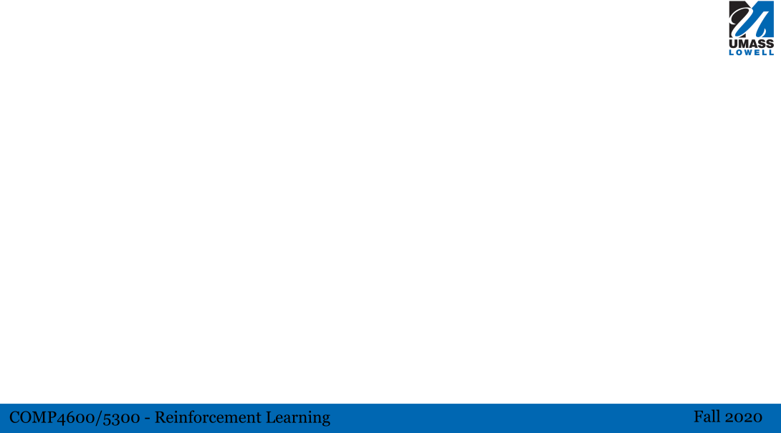
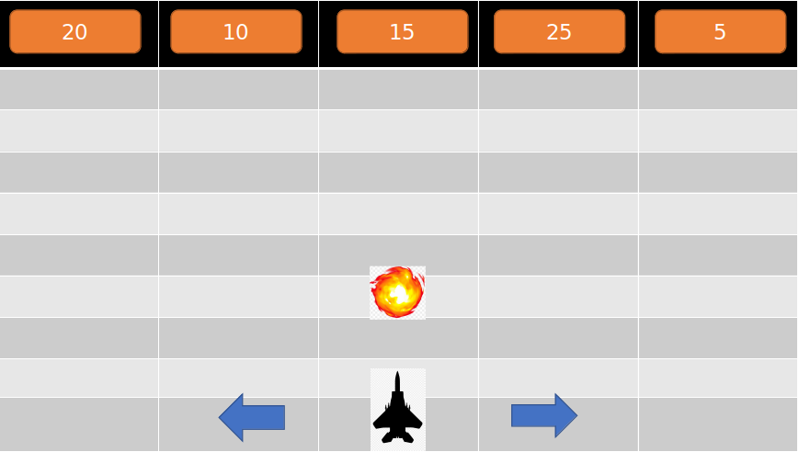
survival
My environment consists of 30 rows and 5 columns. At first there are 5 boxes on top of columns. The value for each of those boxes are 5,10,15,20 and 25 and the boxes are randomly placed in the columns. Our agent is in the bottom of the screen in one of the columns. In each step the agent picks an action from shooting to its front box, moving to the left column or moving to the right column. If the agent shoots, the value of front box drops by one. After each step the row of boxes move one row down
Actions: right, left, shoot
States: front box row * front box column * front box value = 30 * 5 * 25
Rewards: -20 for loose , +10 for destroying box
The game is episodic and it continues until agent looses. If the agent destroy one of the boxes, he wins that part and the new row of boxes will be spawn again but in one row down whit respect to previous boxes’ row. Our goal is to maximize the total reward that agent receives.

