Slide 1
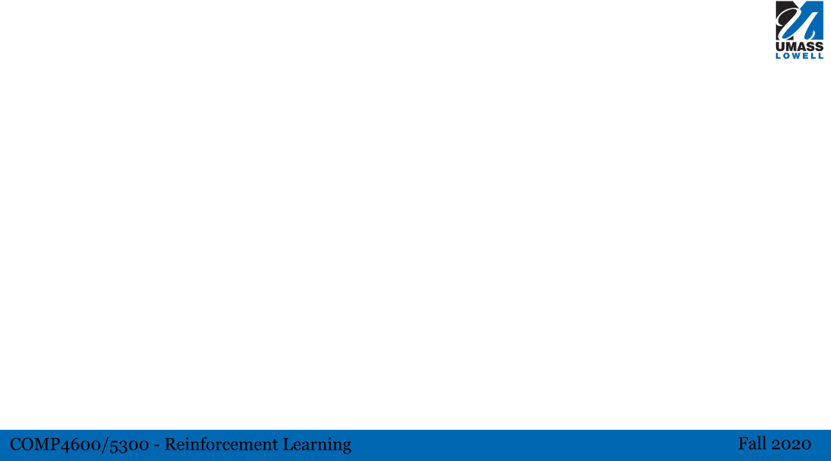
Title
A picture or video of your task could be useful
Any graph that can help explain the task better.
Description: include the rules of the game, states, actions, rewards, transition function, simulation details, etc.
What libraries does it use? Pygame?
Is this an episodic task? How long an episode could be?
Can the task be scaled up or down? For instance, we have 3x3, 4x4, 6x6, and 8x8 versions of tic tac toe.
What is your expected result from this task?

