Slide 1
Logic Gates & Use of Boolean Algebra
By Amila Giragama,
IT Systems,
Polgahamula.

Slide 2
Main Target Area
Boolean Algebra
Basic Laws in Boolean Algebra
Logic Gates
The Greek philosopher
Aristotle
is the founder
Please Turn Off Your Mobil Phones

Slide 3
Find The Answer
=8
=9
=10
=11
7
=12
12
=13
=14
=15
15
=16
6
=17
=18
=Other
14
8
17
11
13

Slide 4
Algebraic Expression
When numbers, letters, digits, mathematical operators, variables and plus or minus signs are arranged to get a mathematical or logical idea we call it an algebraic expression.
They Should not contain an equal Sign
4a+5b
3l+2m+n
X=Y+3
-7x+y-2z

Slide 5
Algebraic Equation
Two algebraic expressions connected by an equal sign
v=u+ft
2
2
2
(x−h)+(y−k)=r
Profit=Income-Expenditure

Slide 6
Boolean Algebra
Boolean Values
To express Boolean values
‘True’ or ‘False’
‘1’ or ‘0’
Boolean Expression
If any expression gives only logical values as a result, it is defined as a Boolean Expression
The sun is a cold object
3 > 4
Boolean Variables
Variable can take only logical variables

Slide 7
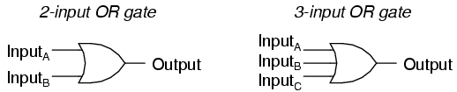
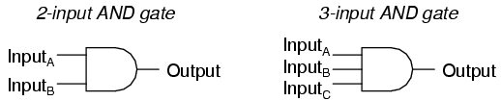

Boolean Operations
OR – Boolean Addition
AND - Boolean Multiplication
NOT - Boolean Complementation

Slide 8

OR – Boolean Addition ( + )
+ sign is use for the addition operation in Boolean Algebra. This is known as “OR”.
If A and B are Boolean variables, let us consider the expression ‘A+B’ (A OR B)
If and only if the values of both variables A and B are 0, A + B is 0.
In all other situations A + B =1
Truth Table
A | B | A+B (A OR B)
0 | 0 | 0
0 | 1 | 1
1 | 0 | 1
1 | 1 | 1

Slide 9

AND – Boolean Multiplication ( . )
We user “.” sign or ‘AND’ operation
If A and B are two Boolean variables, let us consider the expression ‘A.B’ (A AND B)
If and only if the values of both variables A and B are 1, A . B is 1.
In all other situations A . B = 0
Truth Table
A | B | A+B (A OR B)
0 | 0 | 0
0 | 1 | 0
1 | 0 | 0
1 | 1 | 1

Slide 10

NOT – Logic Complement ( -/’ )
For ‘NOT’, operation we user “-” (bar) or “ ’ ”
If A is the Boolean variable, let us consider the expression NOT A.
For the operation NOT only one variable is used
Truth Table
A | NOT A (Ā)
0 | 1
1 | 0

Slide 11
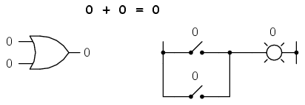
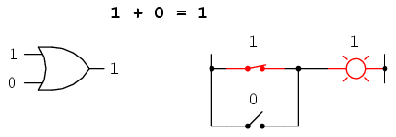
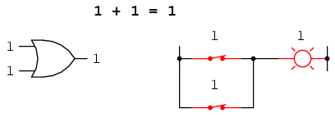
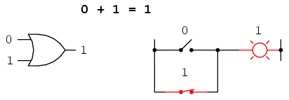
OR Gate

Slide 12
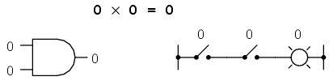
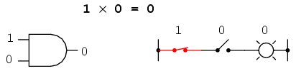
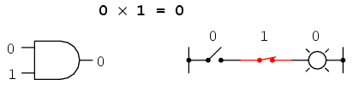
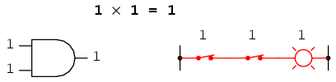
AND Gate

Slide 13
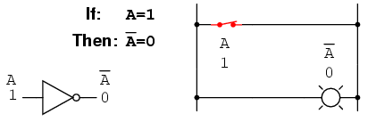
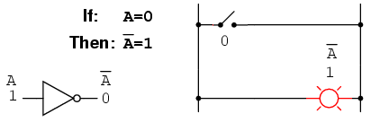
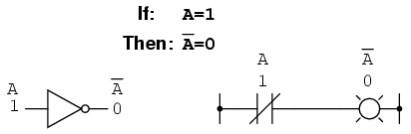
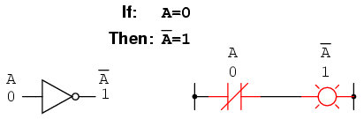
NOT Gate

Slide 14
Review
Boolean addition is equivalent to the OR logic function, as well as parallel switch contacts.
Boolean multiplication is equivalent to the AND logic function, as well as series switch contacts.
Boolean complementation is equivalent to the NOT logic function, as well as normally-closed relay contacts.

Slide 15
Simplification of Boolean Expression
Start from the left and move towards the right.
First simplify operation within brackets.
After then do all NOT operations (¯) from left to right
Then do AND operation (.) from left to right
Finally do OR operation (+) from left to right

Slide 16
Construct Truth Table for the fallowing Boolean expression
A.B+A.Ā
(A.B).A +(A.B).B
A+Ā.B
Find the values of fallowing Boolean Expressions
1.1.0 + 1.1.1+0.1+1
-----

Slide 17
Basic laws of Boolean Algebra
Let X, Y and Z be Boolean variables.
X=0, if and only if X ≠1
X=1, if and only if X ≠0
X+0=X
X.0=0
X+1=1
X.1=X
Commutative Law
X+Y=Y+X
X.Y=Y.X
Distributive Law
X.(Y+Z)=X.Y+X.Z
X+Y.Z=(X+Y).(X+Z)
Associative Law
X+(Y+Z)=(X+Y)+Z
X.(Y.Z)=(X.Y).Z
Idempotent Law
X+X=X
X.X=X

Slide 18
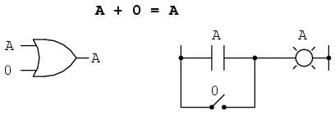
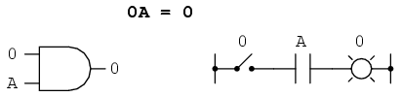
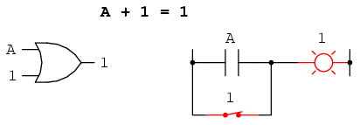
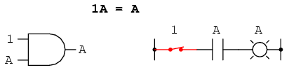
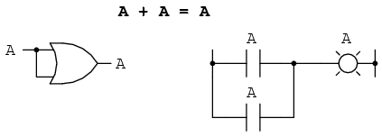
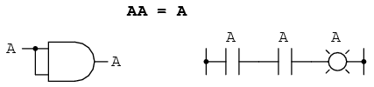
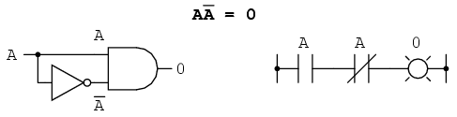
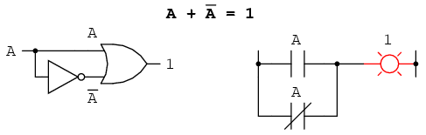
Basic Laws Cont……

Slide 19
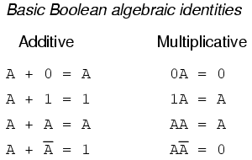
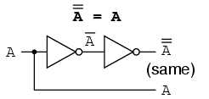
Another identity having to do with complementation is that of the double complement:

Slide 20
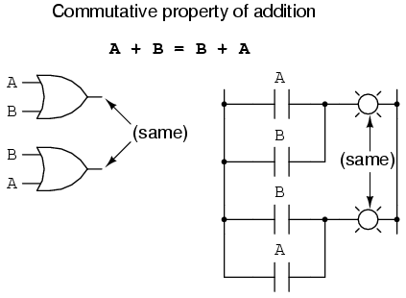
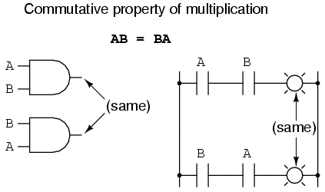

Slide 21
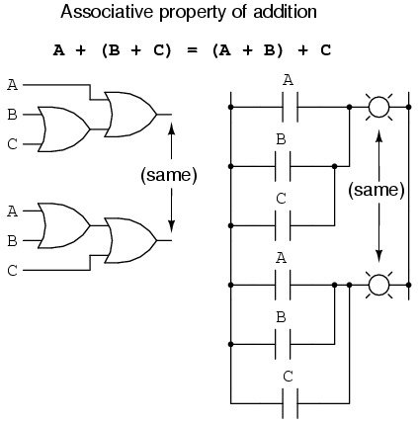
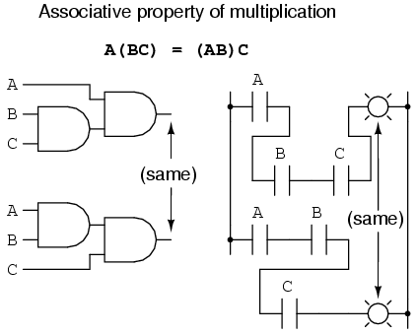

Slide 22
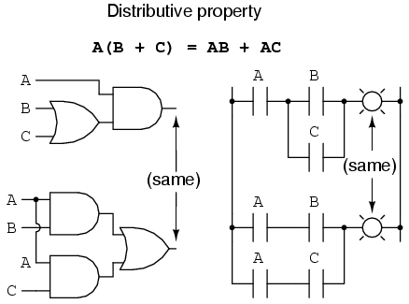
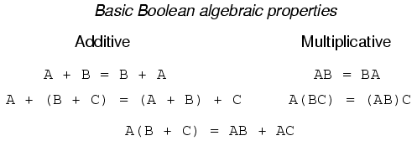

Slide 23
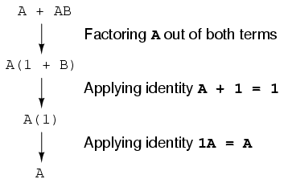
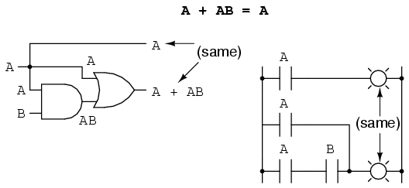
Simplification

Slide 24
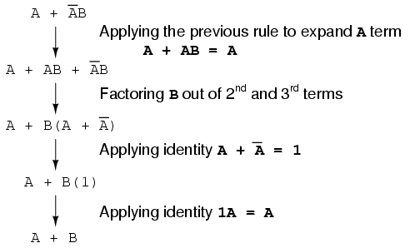
Simpi…….

Slide 25
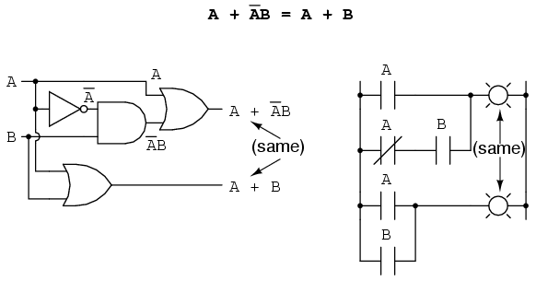
Simpi…….

Slide 26
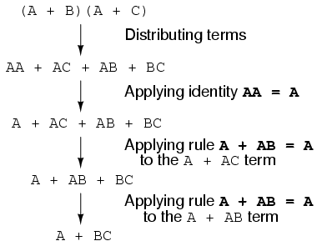
Simpi…….

Slide 27
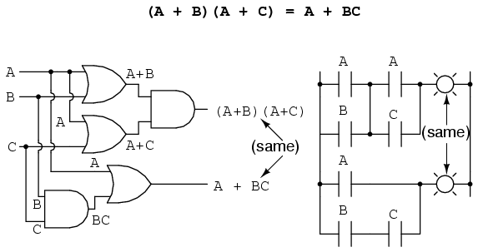
Simpi…….

Slide 28
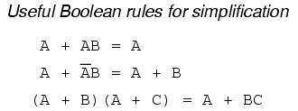
Simpi…….

Slide 29
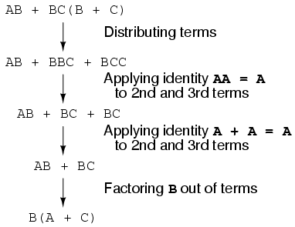
Simpi…….

Slide 30
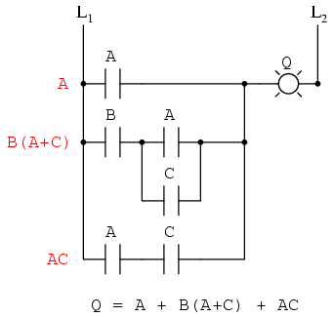
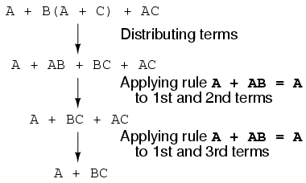
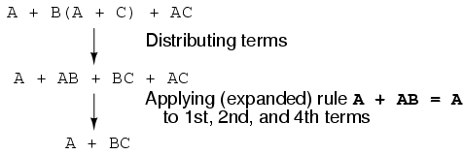
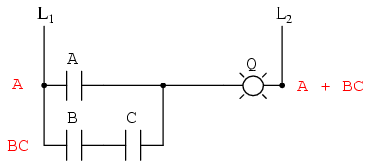

Slide 31
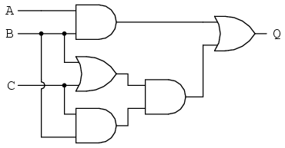
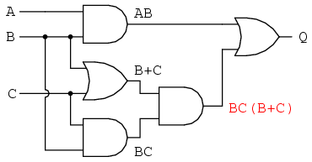
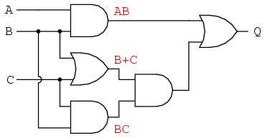
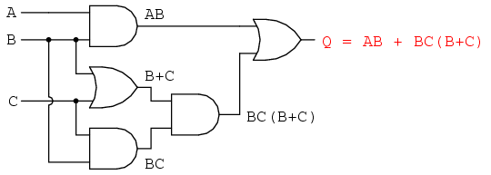
Create Boolean Expression for given circuits
1)
3)
2)
4)

Slide 32
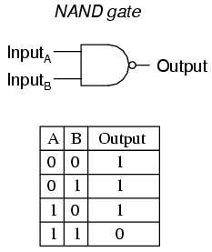
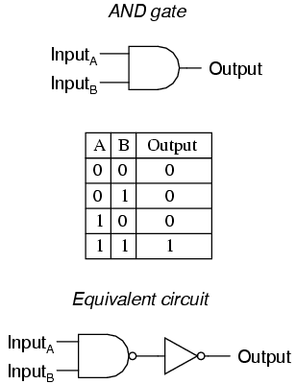
NAND Gate (NOT AND)

Slide 33
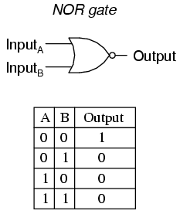
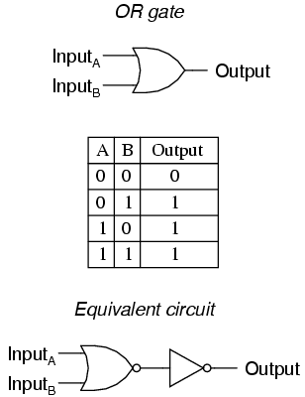
NOR Gate (NOT OR)

Slide 34



Construct Truth Table for fallowing circuits

Slide 35

Exclusive-OR (XOR)
A | B | A XOR B
0 | 0 | 0
0 | 1 | 1
1 | 0 | 1
1 | 1 | 0

Slide 36


De Morgan's Theorems
X+Y=X . Y
X.Y=X+Y

Slide 37




Use of De Morgan's Law

Slide 38



Use of De Morgan's Law

Slide 39
Simplification Examples Simplification Note

Slide 40
Thank
You

