Slide 1
GAN-based Synthetic Medical Image Augmentation
for increased CNN Performance
in Liver Lesion Classification
Muhammad Amin Rahimi

Slide 2

introduction
The greatest challenge in the medical imaging domain is how to cope with the small datasets and limited amount of annotated samples
Researchers attempt to overcome this challenge by using data augmentation. The most common data augmentation methods include simple modifications of dataset images such as translation, rotation, flip and scale.
Synthetic data augmentation of high quality examples is new, sophisticated type of data augmentation. Synthetic data examples learned using a generative model enable more variability and enrich the dataset to further improve the system training process.

Slide 3
Generative
Adversarial Networks (GAN)
One such promising approach inspired by game theory for training a model that syntheses images is known as Generative Adversarial Networks (GANs).
The model consists of two networks that are trained in an adversarial process where one network generates fake images and the other network discriminates between real and fake images repeatedly.
GANs have gained great popularity in the computer vision community and different variations of GANs were recently proposed for generating high quality realistic natural images

Slide 4
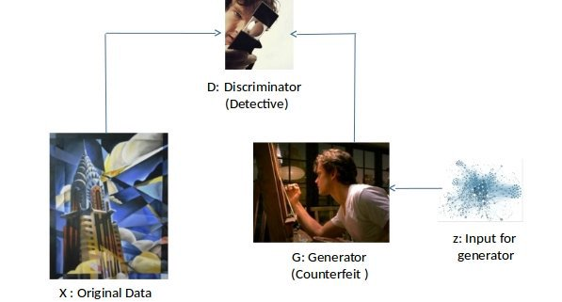
Generative
Adversarial Networks (GAN)

Slide 5
Generative
Adversarial Networks (GAN)

Slide 6
The contributions of this work
1) Synthesis of high quality focal liver lesions from CT images using generative adversarial networks (GANs).
2) Design of a CNN-based solution for the liver lesion classification task, with comparable results to state-ofthe-art methods.
3) Augmentation of the CNN training set, using the generated synthetic data - for improved classification results.

Slide 7
Data
The dataset was made up of 182 portal phase 2-D CT scans, 53 cysts, 64 metastases, 65 hemangiomas. An expert radiologist marked the margin of each lesion and determined its corresponding diagnosis which was established by biopsy or a clinical follow-up. This serves as our ground truth.
Liver lesions vary considerably in shape, contrast and size (10 - 102mm). They also vary within categories. In addition, they are located in interior sections of the liver or near its boundary where the surrounding parenchyma tissue of the lesions changes.

Slide 8
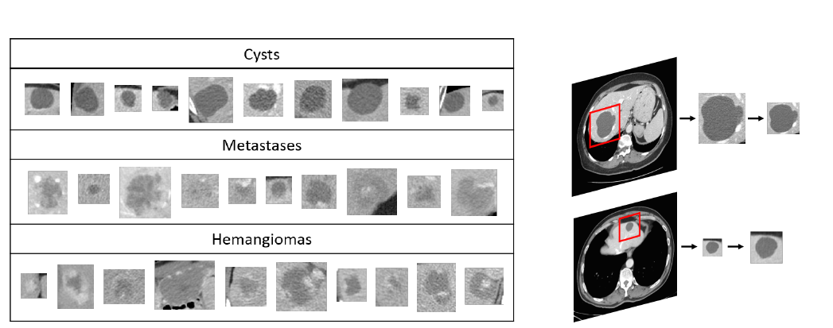
Data

Slide 9
CNN Architecture
CNN architectures for medical imaging have also been introduced, usually containing fewer convolutional layers because of the small datasets and smaller input size.
Our classification CNN gets fixed size input ROIs of 64x64, with an intensity range rescaled to (0; 1).
three pairs of convolutional layers where each convolutional layer is followed by a max-pooling layer, and two dense fully connected layers ending with a soft-max layer.
We use ReLU as activation functions.
For training we used a batch size of 64 with a learning rate of 0.001 for 150 epochs.
We used stochastic gradient descent optimization

Slide 10
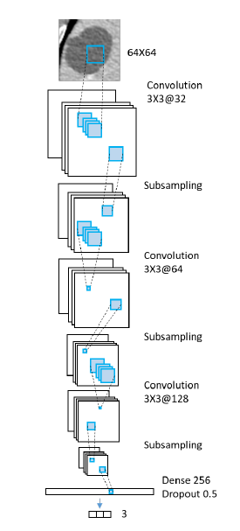
CNN Architecture

Slide 11
augmenting the data
1) Classic augmentation that includes varieties of known image
manipulations on given data examples;
2) Synthesis of new examples which are learned from the data examples using generative models.

Slide 12
Classic Data Augmentation
Classic augmentation techniques on gray-scale images include mostly affine transformations.
Each lesion ROI was first rotated Nrot times at random angles
[0; :::; 180] .
each rotated ROI was flipped Nflip times (up-down,left-right).
Finally the ROI was scaled Nscale times from a stochastic range of scales s = [0:1d; 0:4d] .

Slide 13
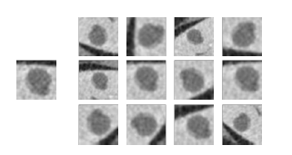
Classic Data Augmentation

Slide 14
Generative Adversarial Networks for Lesion Synthesis
The generative model aims to implicitly learn the data distribution pdata from a set of samples x(1); :::; x(m) (e.g. images) to further generate new samples drawn from the learned distribution.
We followed the architecture proposed by Radford et al, where both the G and D networks are deep CNNs.
The first network is termed the discriminator and is denoted D. The role of the discriminator is to discriminate between the real and fake samples.
The second network is termed the generator and is denoted G. The generator synthesizes samples that D will consider to be real samples with high probability.
G gets input samples z(1); :::; z(m) from a known simple distribution pz , usually a uniform distribution, and maps G(z) to the image space of distribution pg . The goal of G is to achieve pg=pdata .

Slide 15
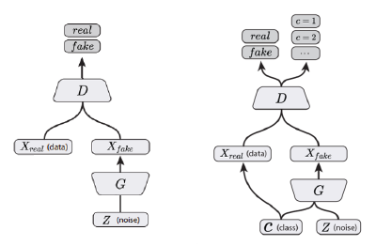
DCGAN architecture ACGAN architecture

Slide 16
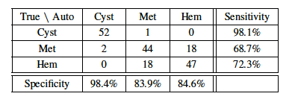
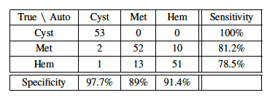
Performance of models

Slide 17
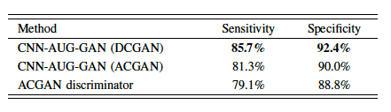
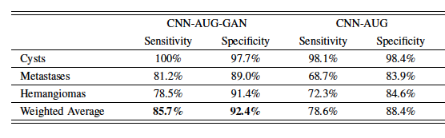
Performance of models

