Slide 1
PPE Detection
Fine-tuned YOLOv8m · SH17 + APD · Baseline vs Extended (20 epochs)

Slide 2
Project overview
Goal: detect Personal Protective Equipment (PPE) in images with a production-oriented stack.
Model: YOLOv8m initialized from COCO-pretrained weights, adapted to domain-specific classes.
Data: SH17 (17 PPE classes) as baseline; APD (Roboflow) merged in for Face-shield → 18 classes.
Training: unified script with TaskAlignedAssigner patches for stable MPS training.
Delivery: validation metrics (JSON), rubric comparison, FastAPI + JWT inference API, Docker.

Slide 3
Datasets & preprocessing
Sources
SH17 — ~8.1k images, 17 classes, native YOLO boxes, CC BY 4.0.
APD v22 — face shield + aligned classes; polygons and boxes.
Merge & resize
APD classes remapped to SH17 IDs; new class 17 = Face-shield.
"Negative" APD classes (no mask, no shield, …) dropped.
Polygon segments → axis-aligned boxes (min/max x,y), then YOLO-normalized.
resize_dataset.py: longest side capped (--max-dim); boxes transformed
orig pixels → scaled pixels → re-normalized to new W×H.
Resized roots: sh17_baseline_resized, merged_resized (YAML path: configs).

Slide 4
Model architecture & freezing
YOLOv8m: CSP-style backbone → PAN-FPN neck → decoupled detection head (classification + box regression).
Input during train/val: letterboxed RGB, effective size 640×640 → tensor shape N×3×640×640.
Head outputs: per-grid multi-scale predictions; decoded to boxes, scores, then NMS (IoU overlap).
This project: --freeze 22 → first 22 layers frozen; only the final detection head updates (Ultralytics API).
Rationale: tiny head-only adaptation on top of strong COCO features; faster training, less forgetting risk.
Augmentations toned down for stability: mosaic=0 (see train.py).

Slide 5
YOLO & fine-tuning
How YOLO detects
One-stage: one forward pass, multi-scale grid predictions.
Per cell: class logits + box params (v8 uses DFL for boxes).
TAL assigns training positives to ground truth.
Composite loss: cls + box + distribution focal terms.
Inference: score filter + NMS to deduplicate boxes.
This project’s fine-tune
yolov8m.pt (COCO) → new head for 17 or 18 classes.
lr0=0.01, cosine LR, batch 32, imgsz 640, AMP off, freeze=22.
baseline_20ep: resized SH17 val; extended_20ep: merged 18-class val.
Val every 5 epochs; mosaic=0 in train.py.
Run train.py from repo root (tal_patch for MPS).

Slide 6
Checkpoints compared
Pretrained: yolov8m.pt — COCO weights, evaluated on SH17 val for illustration (taxonomy mismatch).
baseline_20ep: best.pt — 17 SH17 classes, joint training on resized baseline split.
extended_20ep: best.pt — SH17 + APD merge, 18 classes including Face-shield.
Head output width scales with class count (more cls channels); backbone tensors unchanged (same 'm' width).

Slide 7
Validation metrics (same eval settings in JSON)
Model | Val data | mAP@0.5 | mAP@0.5:0.95 | Precision | Recall | F1 | ms/img (pre/inf/post)
yolov8m.pt (COCO) | SH17 resized (17) | 0.0537 | 0.0478 | 0.0524 | 0.0519 | 0.0521 | 0.22 / 19.90 / 13.82
baseline_20ep | SH17 resized (17) | 0.5052 | 0.3220 | 0.5556 | 0.4205 | 0.4576 | 0.22 / 19.78 / 13.60
extended_20ep | Merged resized (18) | 0.5161 | 0.3257 | 0.5680 | 0.4233 | 0.4574 | 0.21 / 20.57 / 14.34

Slide 8
mAP@0.5 comparison (bar shapes) · Face-shield AP@0.5 (extended_20ep): 0.4016
COCO pretrained → SH17 val
0.054
baseline_20ep
0.505
extended_20ep
0.516

Slide 9
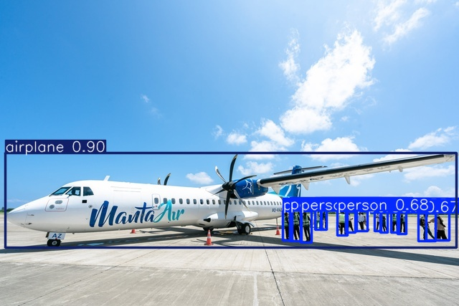
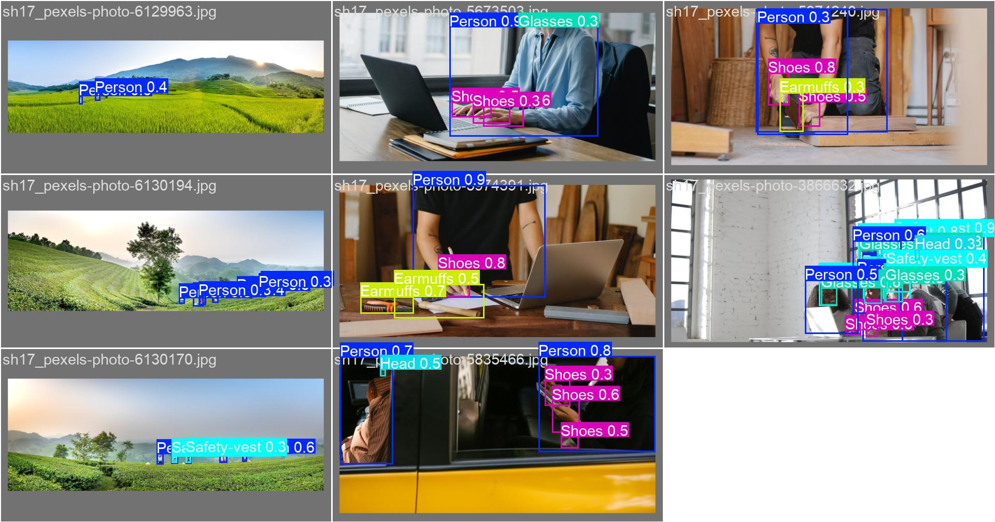
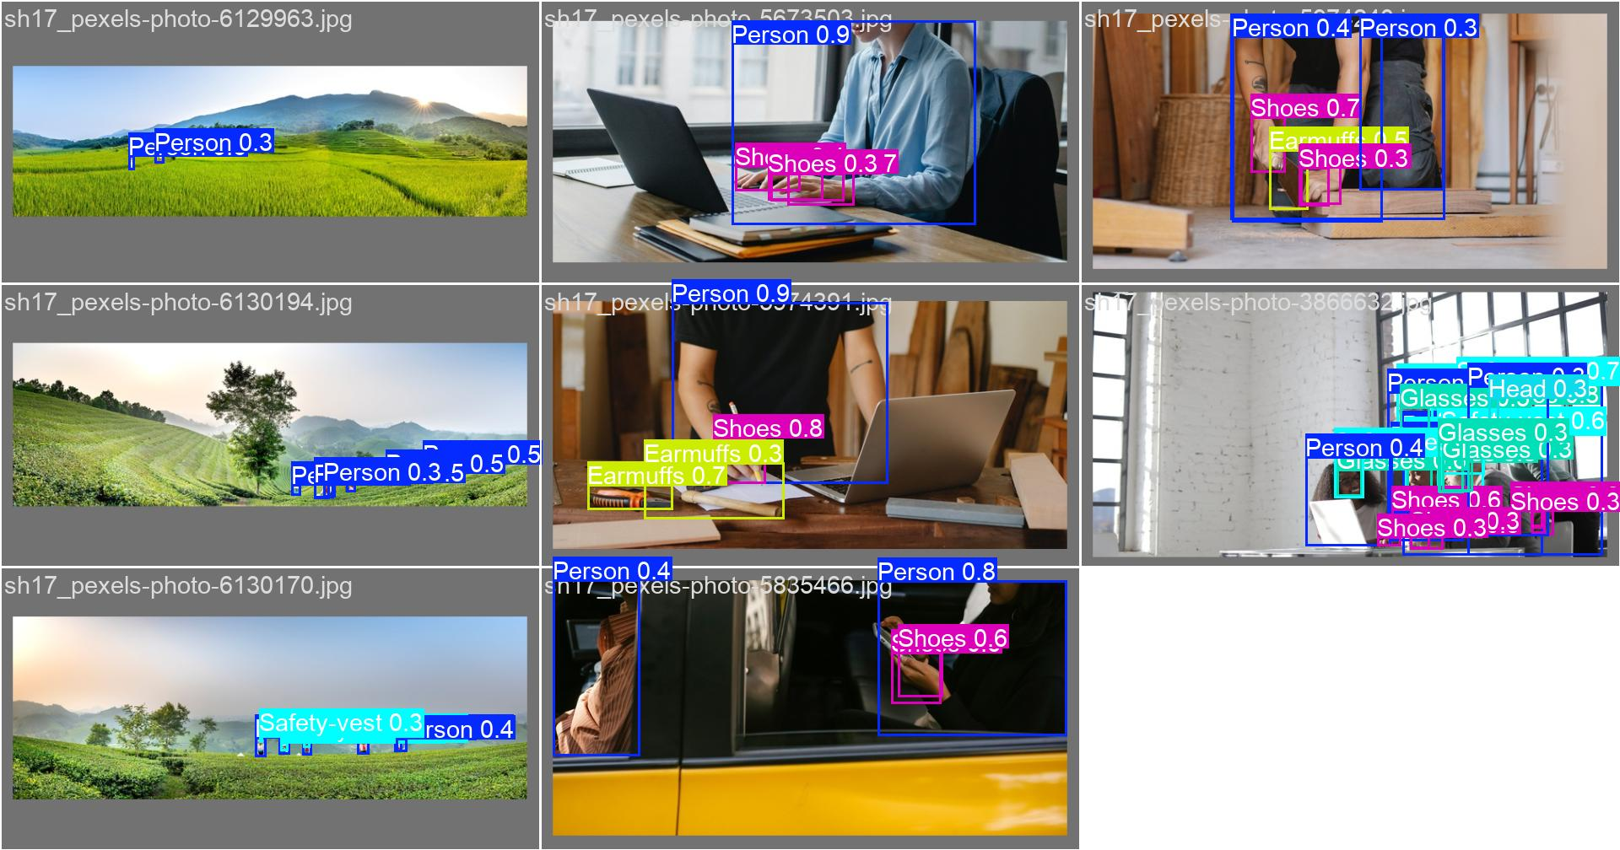
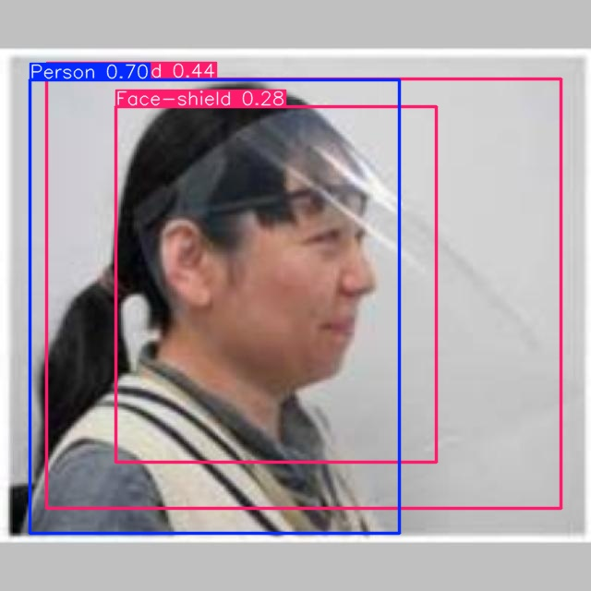
Images through YOLO (val / curated samples)
COCO weights on PPE frame
baseline_20ep val batch
extended_20ep val batch
Extended fine-tuned sample

Slide 10
Summary
Fine-tuning lifts mAP@0.5 from ~0.05 (misaligned COCO eval) to ~0.51 on domain val.
extended_20ep slightly improves overall mAP vs baseline_20ep on its 18-class val; Face-shield is learnable but still below a strict 0.65 rubric target.
Inference API: JWT, /predict/image, /predict/batch, /health, /metrics; Docker via docker-compose.
Regenerate metrics: python -m inference.infer … ; figures: python -m inference.sample_predictions …

