Slide 1

SP1 Transcription Factor DNA Binding Site Prediction
DATA SCIENCE
Presenter: Amin Sharifi

Slide 2
Question:
Can we predict transcription factor binding site?
Importance:
Enrich our knowledge in biology of diseases
Important for drug discovery with new targets

Slide 3
Introduction:
Transcription Factors are proteins that bind to specific sequence motifs on the DNA in order to regulate DNA activity. SP1 transcription factor binds to GC (Nucleobase: Building blocks of DNA) rich motifs.
SP1 Transcription factor Protein

Slide 4
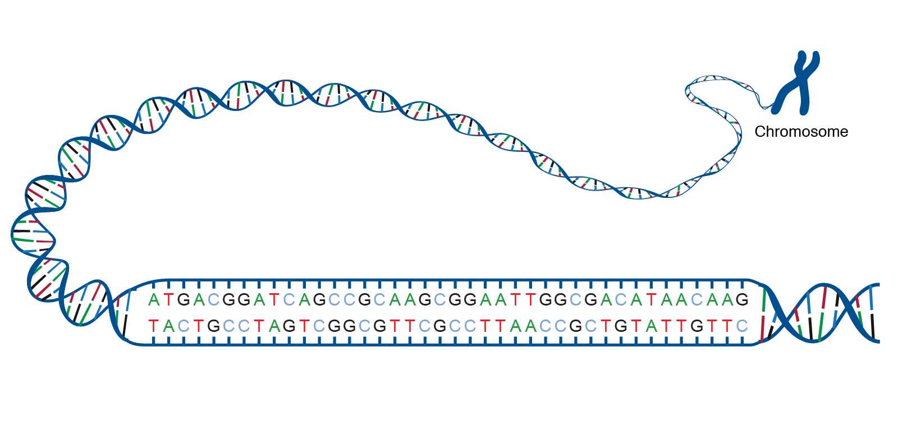
Introduction:
Transcription Factors are proteins that bind to specific sequence motifs on the DNA in order to regulate DNA activity. SP1 transcription factor binds to GC (Nucleobase: Building blocks of DNA) rich motifs.
SP1 Transcription factor Protein
Binding
DNA

Slide 5
Introduction:
Transcription Factors are proteins that bind to specific sequence motifs on the DNA in order to regulate DNA activity. SP1 transcription factor binds to GC (Nucleobase: Building blocks of DNA) rich motifs.
SP1 Transcription factor Protein
Binding
DNA
Regulation of DNA activity

Slide 6

Introduction:
Transcription Factors are proteins that bind to specific sequence motifs on the DNA in order to regulate DNA activity. SP1 transcription factor binds to GC (Nucleobase: Building blocks of DNA) rich motifs.
SP1 Transcription factor Protein
Binding
DNA
Regulation of DNA activity
Question: Can we predict the binding sites of a transcription factor

Slide 7
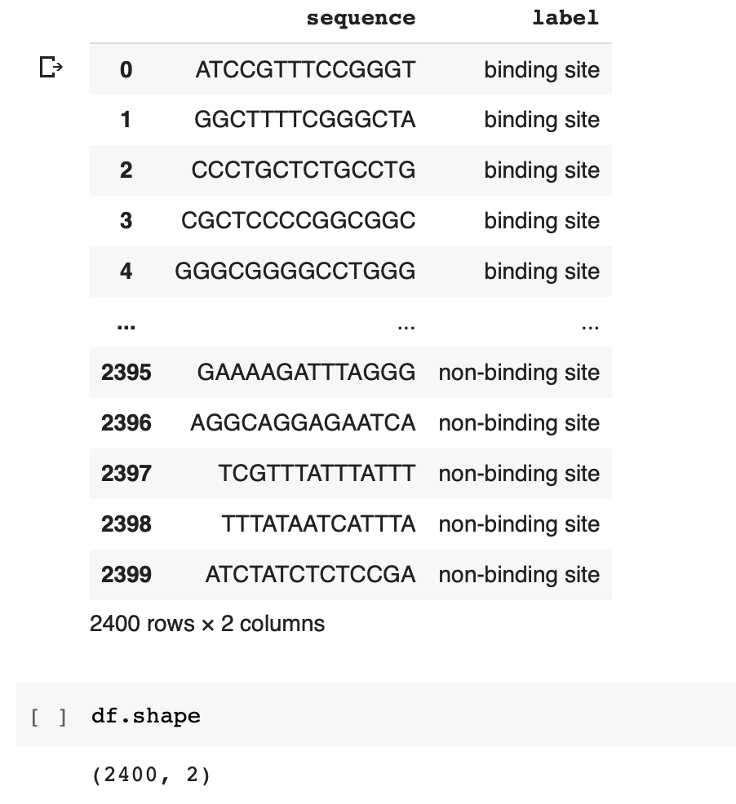
Creating a Prediction Model:
Data Frame:

Slide 8
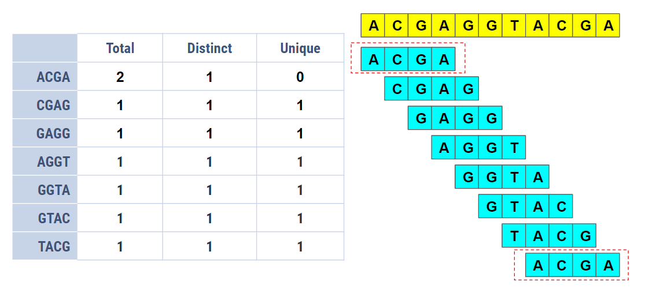
Creating a Prediction Model:
Data Frame:
Pipeline:
Fragmentize DNA seq
to lengths of N
N = 4

Slide 9
Creating a Prediction Model:
Data Frame:
Pipeline:
Fragmentize DNA seq
to lengths of N
N = 4
Count each fragment occurrence in each sequence
Count Vectorizer from SKLearn

Slide 10
Creating a Prediction Model:
Data Frame:
Pipeline:
Fragmentize DNA seq
to lengths of N
N = 4
Count each fragment occurrence in each sequence
Count Vectorizer from SKLearn
Building the machine learning model with:

Slide 11
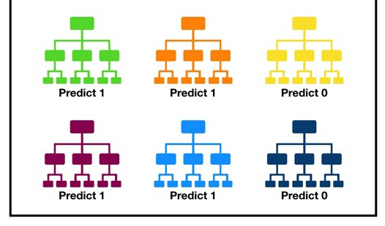
Creating a Prediction Model:
Data Frame:
Pipeline:
Fragmentize DNA seq
to lengths of N
N = 4
Count each fragment occurrence in each sequence
Count Vectorizer from SKLearn
Building the machine learning model with:
Random Forest Classifier

Slide 12
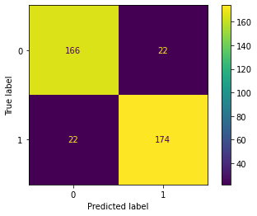
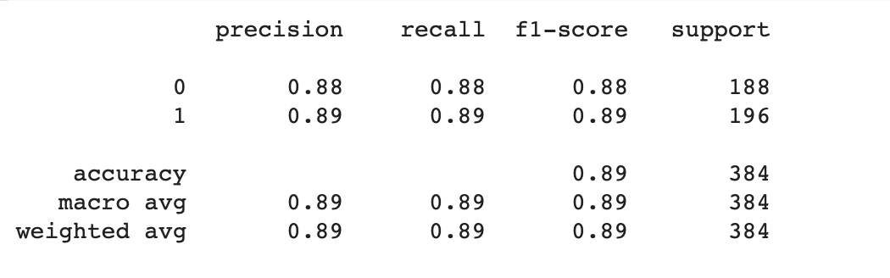
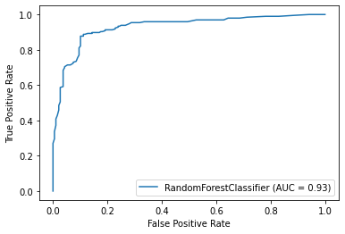
Classification Performance:
Investigating the performance of the classification model with different methods:
Confusion Matrix
Classification Report
ROC (receiver operating characteristic) Curve

Slide 13
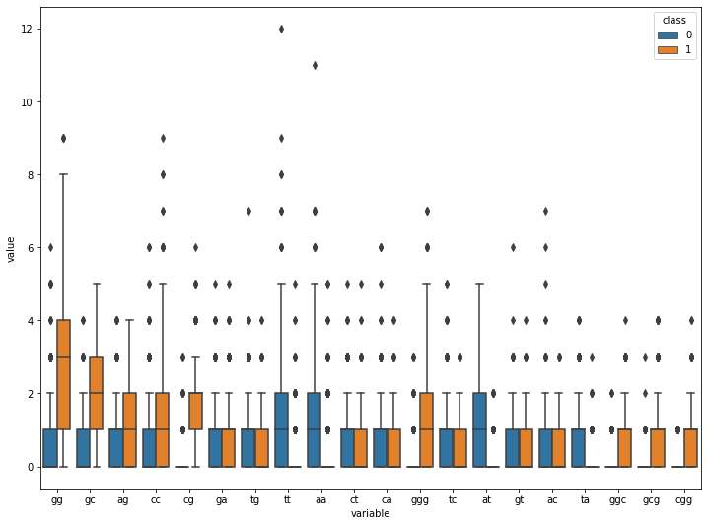
Classification Performance:
Feature Importance of different fragments in determining a binding/non-binding sequence: Higher GC content for binding sequences
Box-plot of N-mer fragments occurrences

Slide 14
Classification Performance:
Feature Importance of different fragments in determining a binding/non-binding sequence: Higher GC content for binding sequences
Model
high
performance
Confirmation
Box-plot of N-mer fragments occurrences

Slide 15
Thank you / Danke!
Amin Sharifi
DATA Science

