Slide 1


TDS 3651
VISUAL INFORMATION PROCESSING
Arabic Sign Language Comparative Analysis
22 FEBRUARY 2024

Slide 2

Group 10
Kamel Mojtaba
Amin Ahmed
Obai
Ali
Ahmed Alnasri
1191301456
1191302190
1171103208
1211300174

Slide 3
Overview
01
Introduction
02
Literature review
Implementation
03
04
Conclusion

Slide 4


Introduction
Implement comparative analysis using
CNN, LSTM and RestNet models
Problem Statement
To develop and evaluate deep learning models for efficient Arabic Sign Language recognition to enhance accessibility for the deaf community.
Objective

Slide 5
Literature review

Slide 6

Background
Arabic Sign Language (ArSL) is essential for the deaf community in Arab regions, but recognizing its complex gestures is challenging. Recent deep learning advancements offer promising solutions. This project compares different deep learning models, such as CNNs, LSTMs, and pre-trained models like ResNet, for ArSL gesture recognition. The aim is to identify the most effective model, contributing to better communication tools for the deaf and hard-of-hearing in the Arabic-speaking world.

Slide 7
Literature Review Highlights
LSTM in Sign Language :
Boondamnoen et al. (2023): Enhanced Indian Sign Language recognition using LSTM and MediaPipe.
Yin (2020): Stressed the importance of hand and non-manual features for comprehensive recognition.
CNN in Sign Language:
Pandian et al. (2023): Focused on American Sign Language recognition with CNN.
Sharma & Singh (2021): Explored deep CNN models for translation, highlighting their effectiveness.

Slide 8
Literature Review Highlights
ResNet & 3D-ResNet for Improved Accuracy:
Abu-Jamie & Abu-Naser (2022), Wang et al.: Demonstrated ResNet models' effectiveness in recognizing complex gestures through spatial and temporal dimensions.
Comparative Analysis:
Papatsimouli et al. (2022): Compared LSTM and Transformer architectures, providing insights into sign language translation strengths.

Slide 9



Methodology
3. Model Training and Validation
1. Data Pre-processing
2. Dataset Partitioning
4. Prediction and Evaluation

Slide 10

Implementation

Slide 11
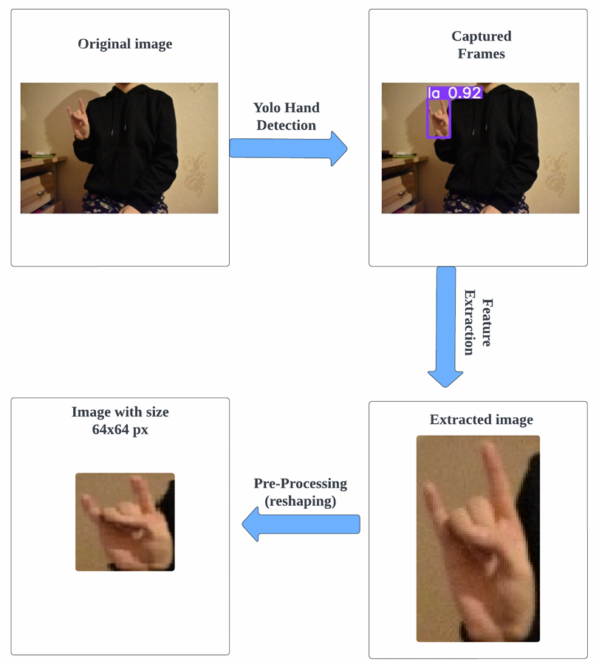
Pre-processing
Employ YOLOv5 model to detect hand region in images.
Crop image to boundaries of detected hand region.
Generate clean hand-only images, removing irrelevant background elements.
Acquire images and resize them to 64x64 pixels for consistency.

Slide 12
Dataset Partitioning
The data has been divided into three distinct sets:
20%
Training set
Validation set
60%
Testing set
20%

Slide 13
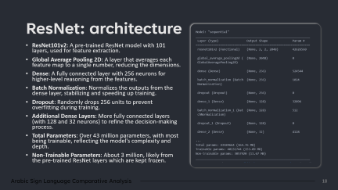
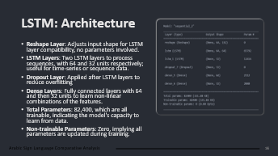
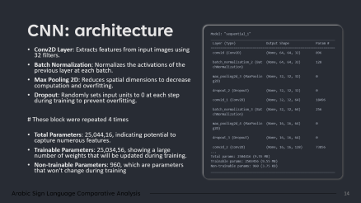
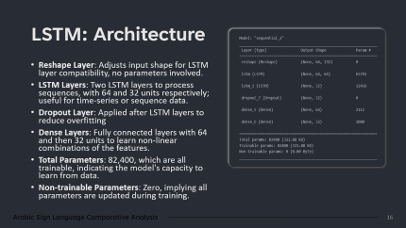
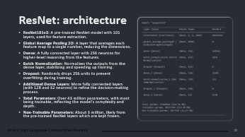
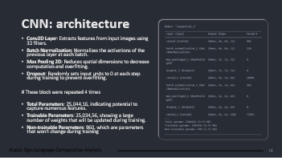
Models:
CNN
LSTM
RestNet

Slide 14
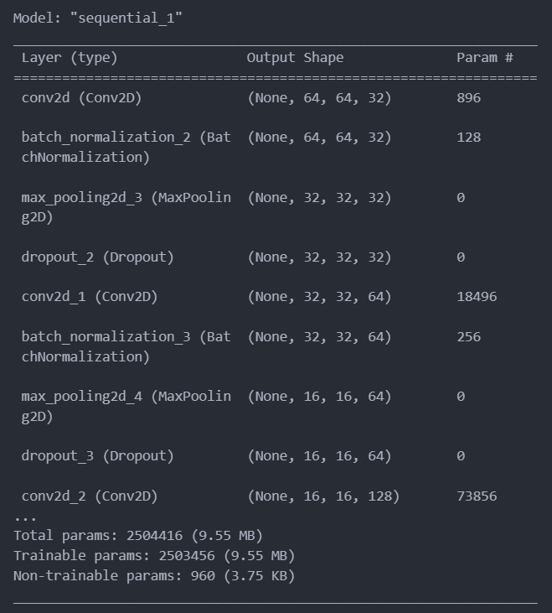
CNN: architecture
Conv2D Layer: Extracts features from input images using 32 filters.
Batch Normalization: Normalizes the activations of the previous layer at each batch.
Max Pooling 2D: Reduces spatial dimensions to decrease computation and overfitting.
Dropout: Randomly sets input units to 0 at each step during training to prevent overfitting.
# These block were repeated 4 times
Total Parameters: 25,044,16, indicating potential to capture numerous features.
Trainable Parameters: 25,034,56, showing a large number of weights that will be updated during training.
Non-trainable Parameters: 960, which are parameters that won't change during training

Slide 15
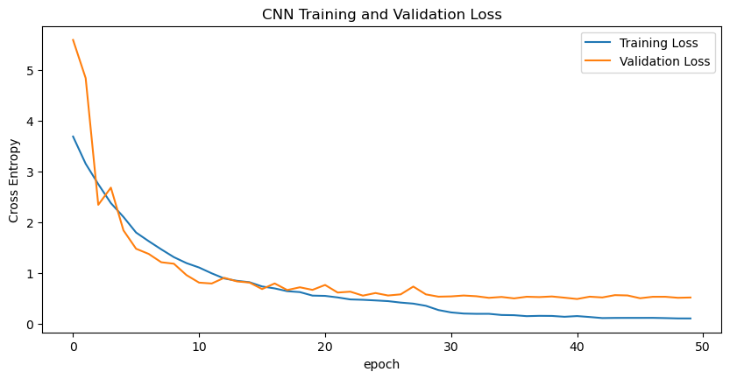
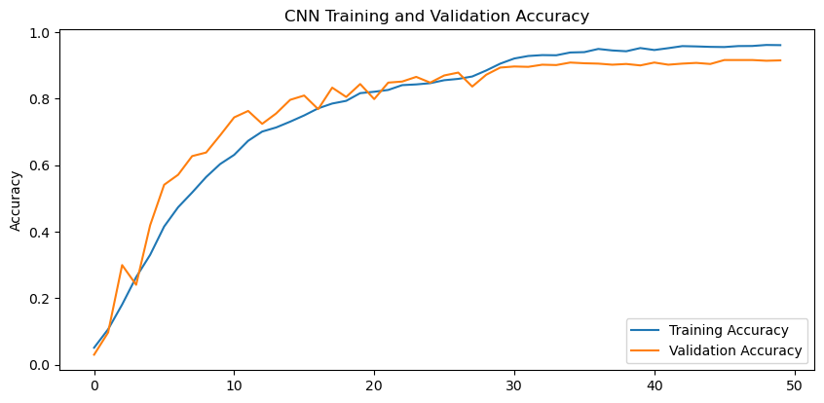
CNN: Training VS Validation

Slide 16
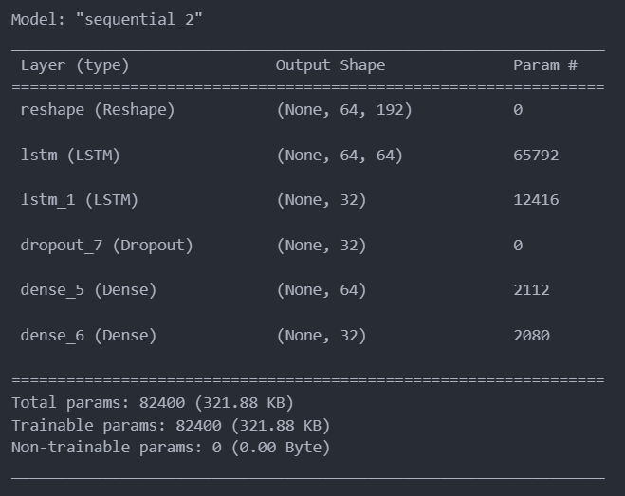
LSTM: Architecture
Reshape Layer: Adjusts input shape for LSTM layer compatibility, no parameters involved.
LSTM Layers: Two LSTM layers to process sequences, with 64 and 32 units respectively; useful for time-series or sequence data.
Dropout Layer: Applied after LSTM layers to reduce overfitting
Dense Layers: Fully connected layers with 64 and then 32 units to learn non-linear combinations of the features.
Total Parameters: 82,400, which are all trainable, indicating the model's capacity to learn from data.
Non-trainable Parameters: Zero, implying all parameters are updated during training.

Slide 17
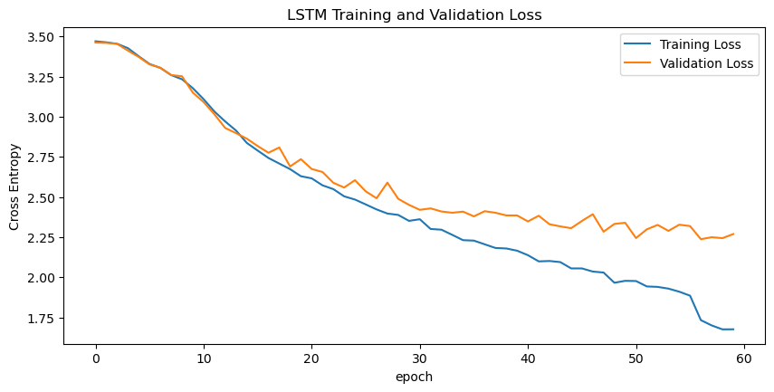
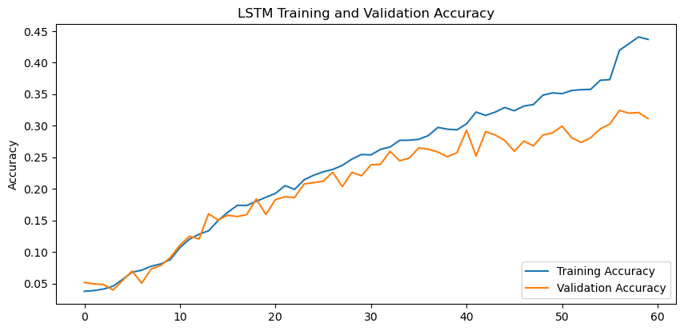
LSTM: Training VS Validation

Slide 18
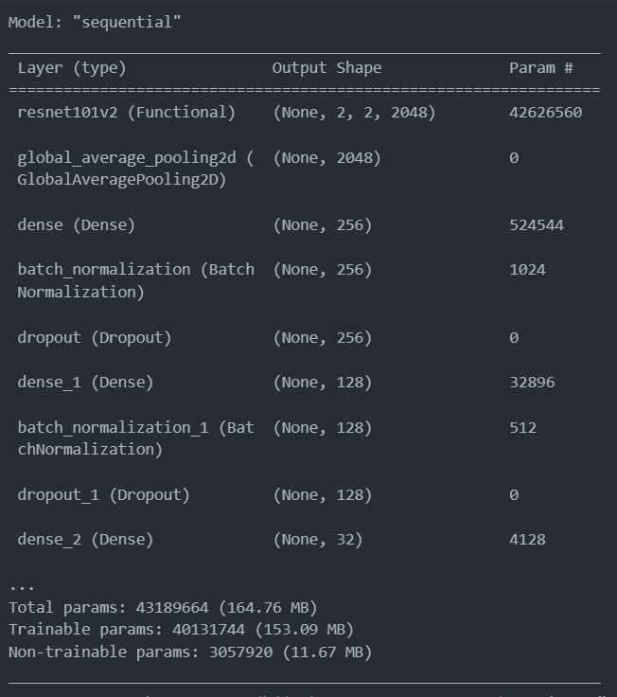
ResNet: architecture
ResNet101v2: A pre-trained ResNet model with 101 layers, used for feature extraction.
Global Average Pooling 2D: A layer that averages each feature map to a single number, reducing the dimensions.
Dense: A fully connected layer with 256 neurons for higher-level reasoning from the features.
Batch Normalization: Normalizes the outputs from the dense layer, stabilizing and speeding up training.
Dropout: Randomly drops 256 units to prevent overfitting during training.
Additional Dense Layers: More fully connected layers (with 128 and 32 neurons) to refine the decision-making process.
Total Parameters: Over 43 million parameters, with most being trainable, reflecting the model's complexity and depth.
Non-Trainable Parameters: About 3 million, likely from the pre-trained ResNet layers which are kept frozen.

Slide 19
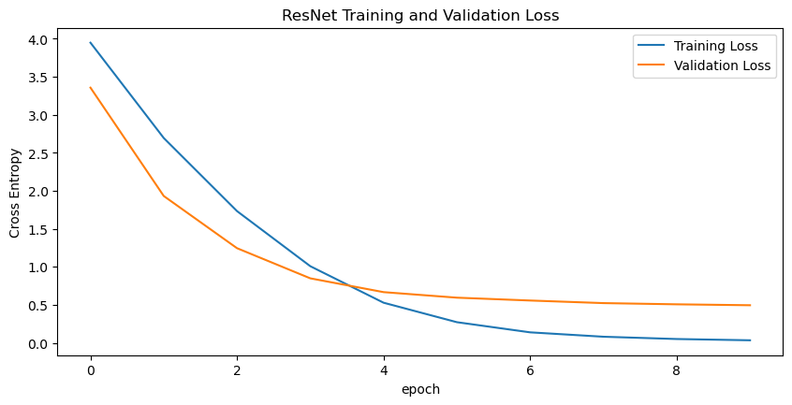
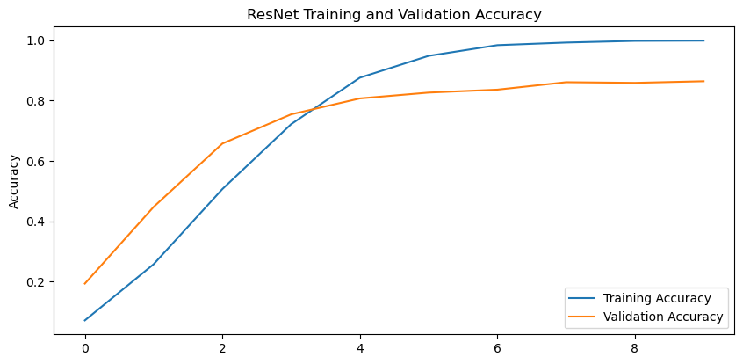
RestNet: Training VS Validation

Slide 20
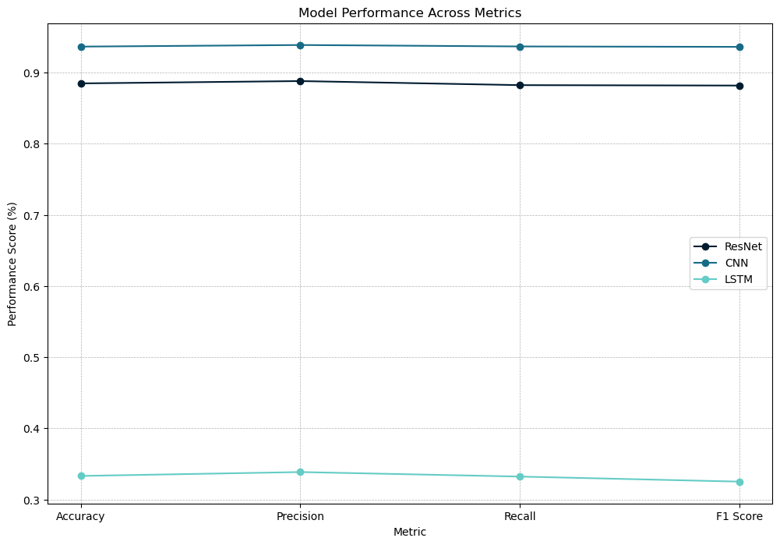
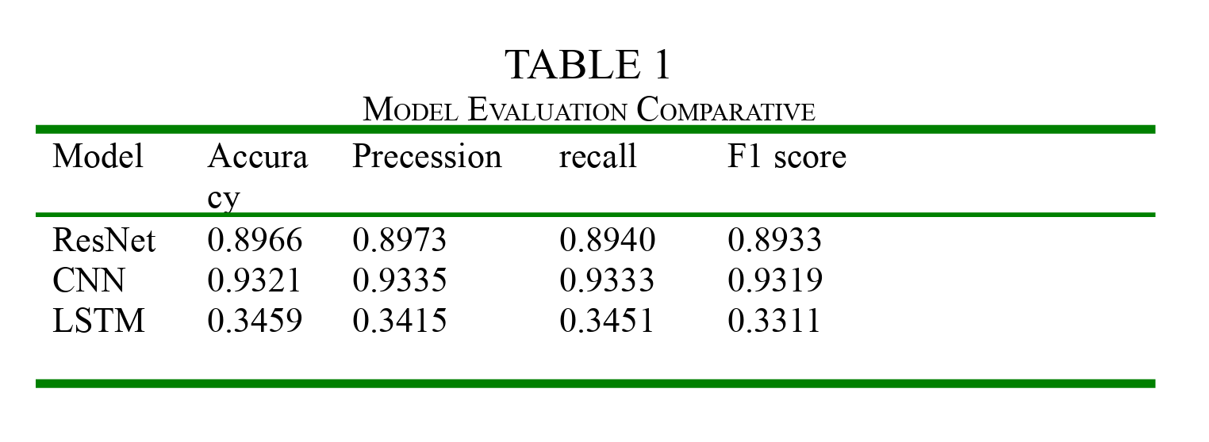
Evaluation and Results
MODEL EVALUATION COMPARATIVE
MODEL PERFORMANCE MATRIX

Slide 21
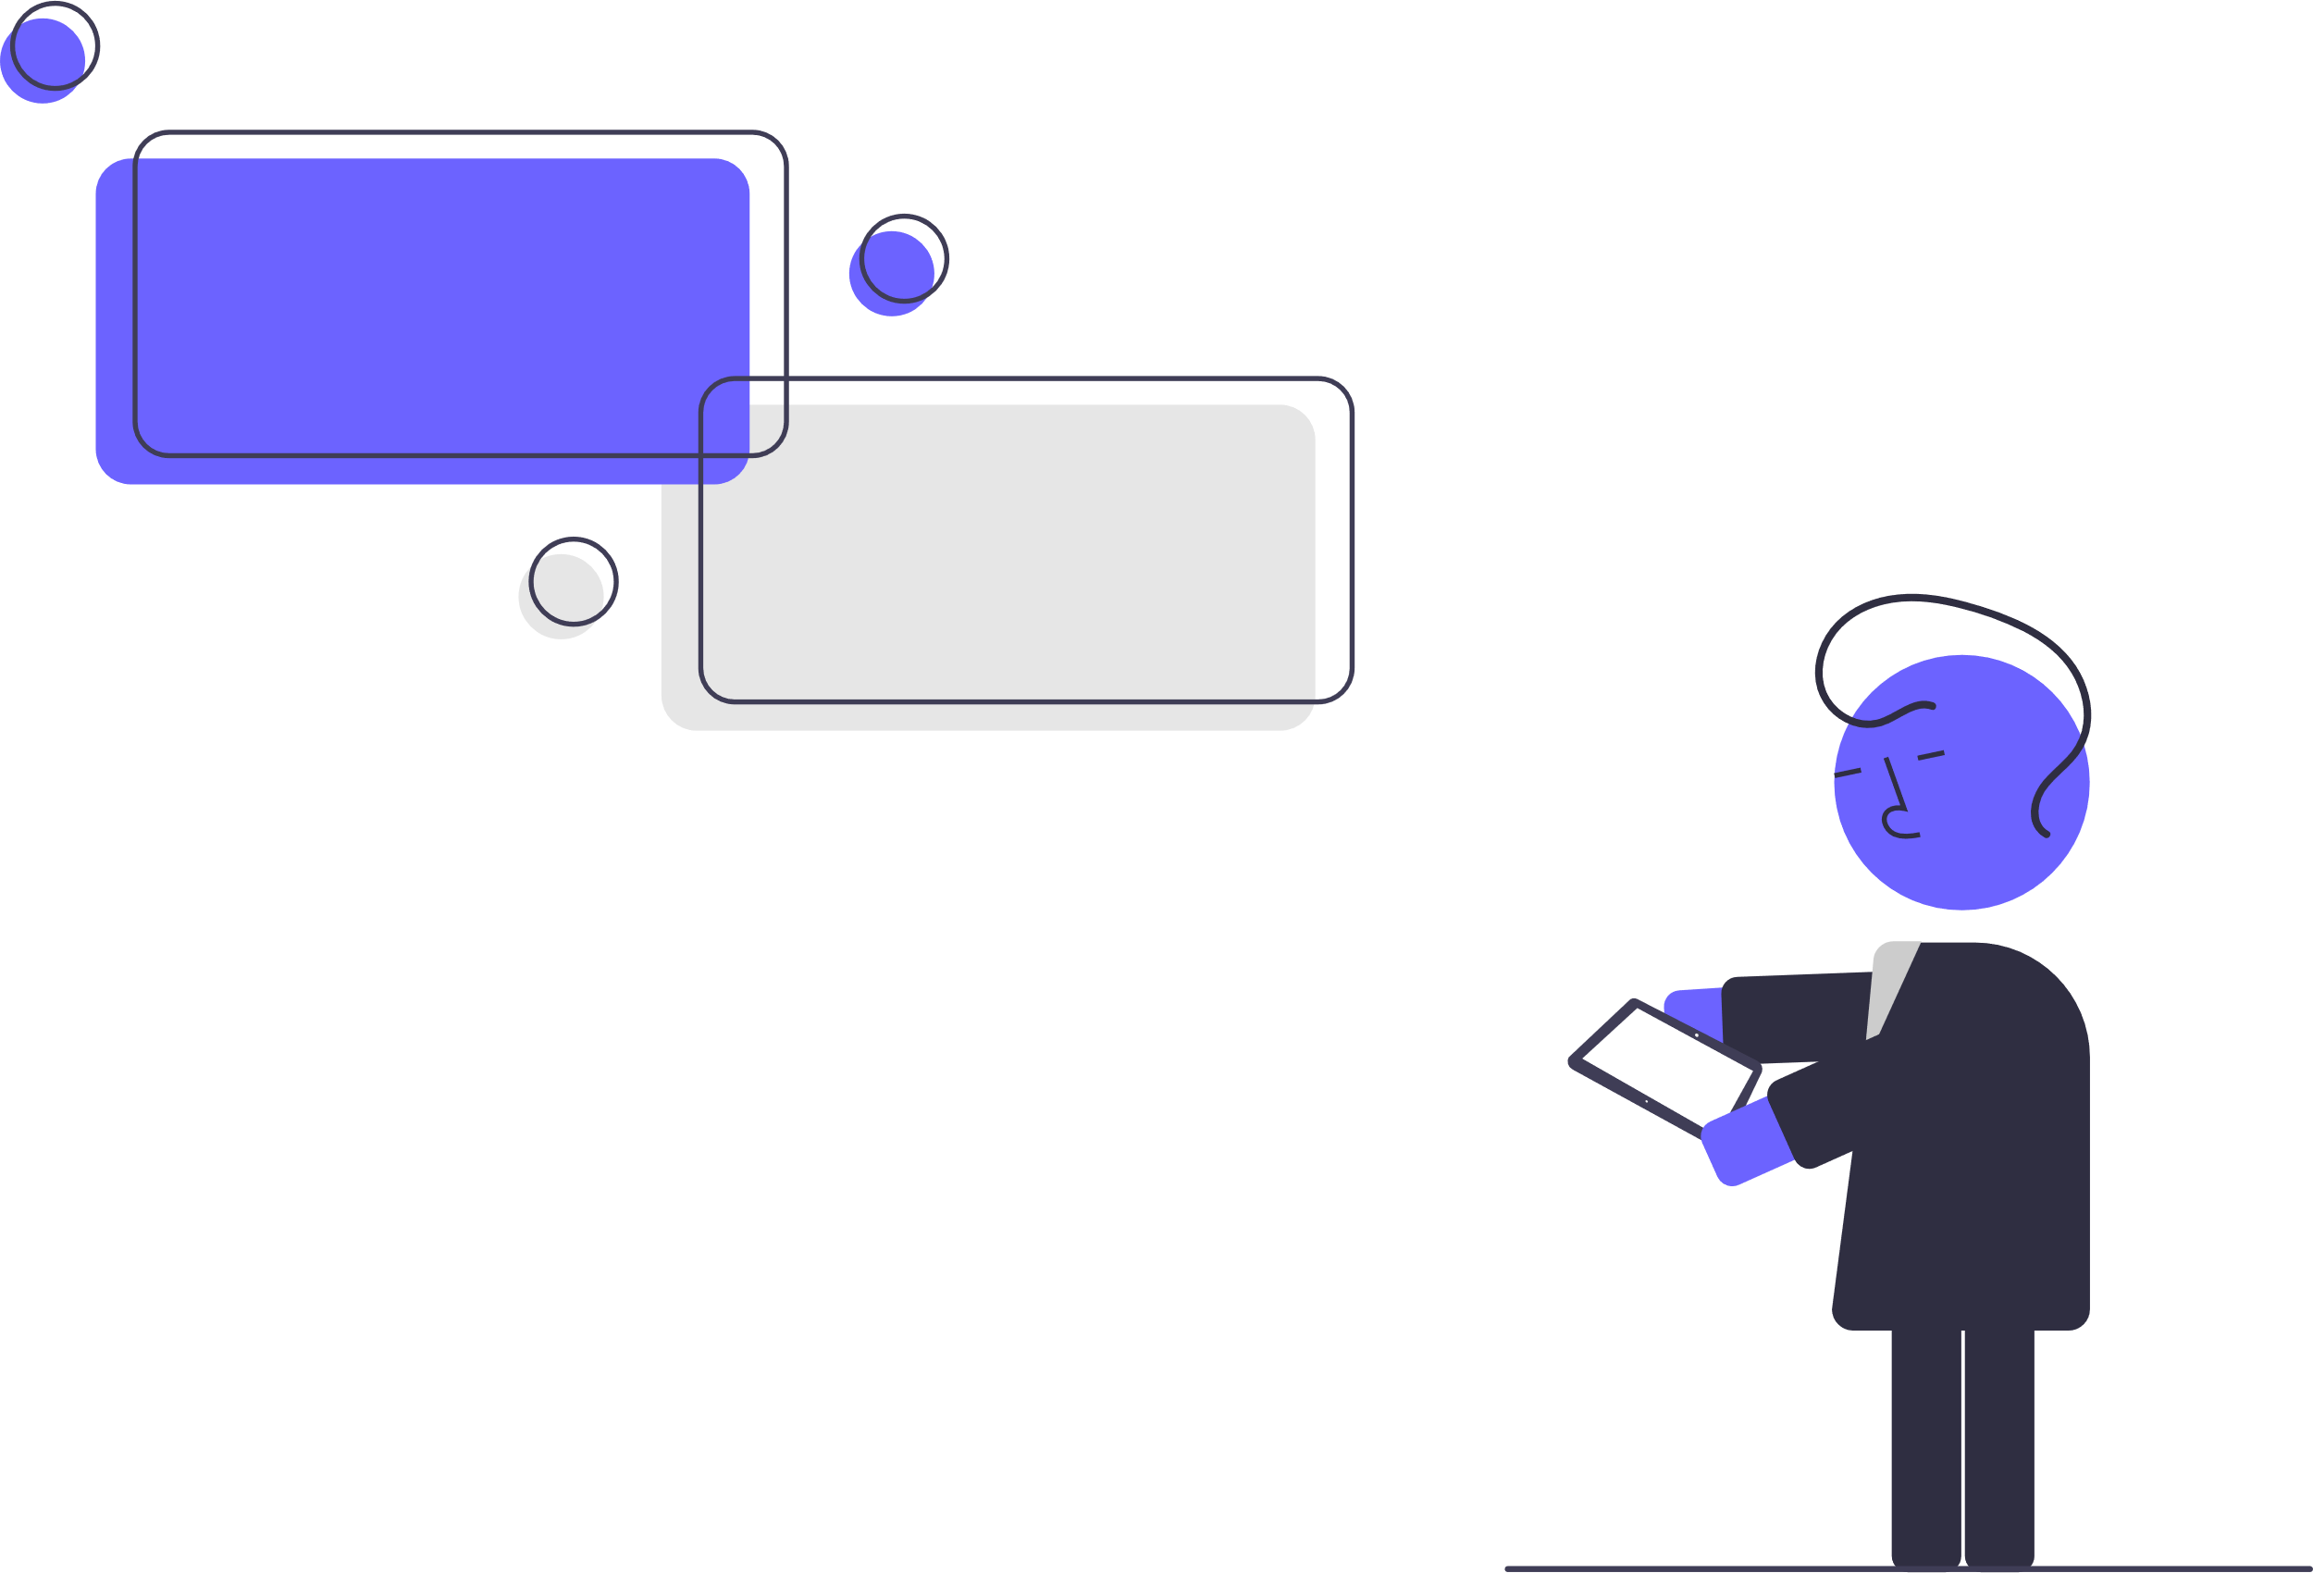
Conclusion

Slide 22

Conclusion
Analyzed CNNs, ResNets, and LSTMs for image classification.
CNNs: Strong at capturing spatial patterns.
ResNets: Enable deeper networks via skip connections.
LSTMs: Handle sequential data, showing neural network adaptability.
Challenges identified: overfitting, computational demands, and generalization.

Slide 23
Future Enhancement
Goal: Improve model efficiency, interpretability, and application in AI.
Outlook: Continuous innovation aimed at overcoming current limitations.
Next Steps: Focus on attention mechanisms and transformer models.
Learning Methods: Leverage unsupervised and semi-supervised techniques.

