Slide 1


FYP T2310
Final Year Project
Automatic Text summarization Application
28 FEBRUARY 2024

Slide 2



STUDENT
SUPERVISOR
MODERATOR
Amin Ahmed
1191302190
Mr. Sharaf El-Deen Al- Horani
Ts. Goh Chien Le

Slide 3


Introduction
Literature Review
Design
The number of scientific studies is growing fast, making it hard for researchers to keep up. They need simple tools to help summarize and understand these detailed texts better
Problem
Statement
To create a web application with Large Language Models for summarizing scientific research, enhancing literature review efficiency and broadening knowledge accessibility for everyone.
Implementation
Objective
01
Conclusion
02
03
04

Slide 4
Overview
01
Literature Review
02
Design
03
Implementation
04
Conclusion

Slide 5

Overview
Literature Review
5
The main objective of an ATS system is to produce a summary that includes the main ideas in the input document in less space
Text summarization is a critical technique for managing the vast volumes of information generated daily, efficiently condensing lengthy documents into concise summaries.
This technology, essential for enhancing decision-making and knowledge dissemination, has evolved significantly, leveraging advanced algorithms to meet the growing demand for quick and accessible information
01
  (Radev, Hovy, & McKeown, 2002)
02
  Cajueiro et al., 2023
03
04

Slide 6
Introduction to Text Summarization
Literature Review
Text summarization is a critical technique for managing the vast volumes of information generated daily, efficiently condensing lengthy documents into concise summaries.
This technology, essential for enhancing decision-making and knowledge dissemination, has evolved significantly, leveraging advanced algorithms to meet the growing demand for quick and accessible information
The main objective of an ATS system is to produce a summary that includes the main ideas in the input document in less space
  (Radev, Hovy, & McKeown, 2002)
  Cajueiro et al., 2023
Notes:
We're starting our journey with a brief look back at how summarization has evolved. It's a path from early manual efforts to today's AI sophistication. Our focus will explore two main strategies: extractive and abstractive summarization, highlighting their differences and uses. We'll also touch on the significant role of Large Language Models, which have truly changed the game in generating smart, relevant summaries. Lastly, we'll address the challenges, especially when dealing with complex scientific content. This background sets the stage for understanding the depth and breadth of our project's foundation.

Slide 7
Evolution of Summarization
1.
Pre-Digital Era:
Summarization performed manually by scholars, focusing on extracting and condensing key information from texts.
3.
Rise of NLP (1980s-2000s):
With advancements in natural language processing (NLP), summarization techniques became more sophisticated, enabling analysis beyond surface-level statistics to understand semantic content.
2.
Early Digital Computing (1950s-1970s):
Introduction of automated text summarization, primarily extractive, relying on statistical methods to identify important sentences.

Slide 8
4.
5.
Era of Large Language Models (2020s-Present):
The development of LLMs, capable of understanding and generating human-like text, has significantly advanced abstractive summarization, allowing for the creation of coherent and contextually relevant summaries.
Introduction of Transformer Models (2017):
Vaswani et al. introduced transformer models, revolutionizing NLP by facilitating more effective training of models on large datasets, improving both extractive and abstractive summarization capabilities.

Slide 9
Summarization Techniques
Feature | Extractive | Abstractive
Definition | Selects and concatenates sentences directly from the source text. | Generates new sentences and phrases to capture the essence of the source text.
Techniques | Relies on statistical methods to identify key sentences based on features like frequency and positioning. | Utilizes natural language generation techniques to paraphrase, rephrase, and condense content into new text.
Challenges | May miss nuanced information not explicitly stated in the key sentences; struggles with creating a coherent overall summary. | Requires deep understanding of the source material, making it challenging to ensure accuracy and maintain the original intent of the text.
Advantages | Simpler to implement; more likely to retain accurate facts directly from the source. | Capable of producing more coherent and concise summaries by manufacture information and presenting it in a new form.

Slide 10
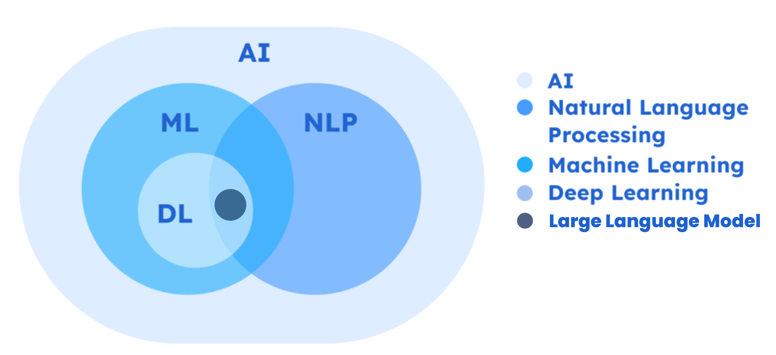
Large Language Models (LLMs)
in
Large Language Models (LLMs) are advanced AI systems trained on vast datasets, capable of understanding and generating human-like text. They mark a pivotal advancement in text summarization, offering unparalleled proficiency in generating coherent and contextually relevant summaries
Text Summarization
(Zheng et al., 2023)

Slide 11
Fine-tuning
LoRA
Fine-tuning refers to the process of adjusting a pre-trained Large Language Model (LLM) to perform better on a specific task. This involves continuing the training of the LLM on a smaller, task-specific dataset to refine its understanding and generation capabilities tailored to the nuances of the desired output.

Slide 12
Fine-tuning
LoRA
LoRA (Low-Rank Adaptation) introduces a refined approach to fine-tuning Large Language Models (LLMs) by adjusting a specific subset of parameters, enhancing efficiency without compromising model performance. This method allows for effective model adaptation with minimal parameter updates, crucial for applications requiring quick adjustments or limited computational capabilities
(Hu et al., 2021).

Slide 13
Fine-tuning
LoRA
LoRA (Low-Rank Adaptation) introduces a refined approach to fine-tuning Large Language Models (LLMs) by adjusting a specific subset of parameters, enhancing efficiency without compromising model performance. This method allows for effective model adaptation with minimal parameter updates, crucial for applications requiring quick adjustments or limited computational capabilities
(Hu et al., 2021).
Evaluating Summarization
  Evaluating summarization effectiveness in scientific contexts involves both quantitative and qualitative methods. Quantitative metrics like ROUGE assess the overlap between the generated summaries and reference texts, providing a measure of information retention.
  However, they might not fully capture the complexity of scientific information. Therefore, Qualitative assessments, such as expert reviews, are crucial for evaluating the accuracy, coherence, and readability of summaries. This dual approach ensures a comprehensive evaluation, highlighting areas for improvement and ensuring the summarization tools effectively communicate complex scientific concepts

Slide 14
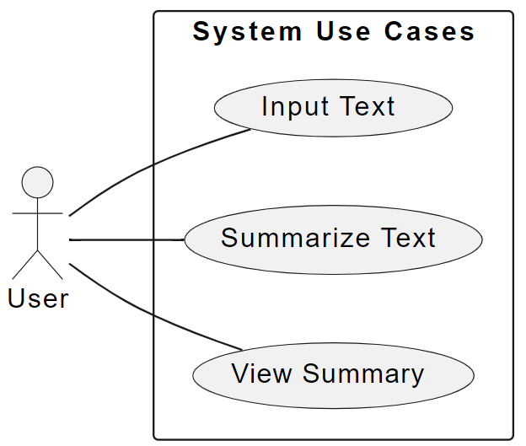
Design
Usecase

Slide 15
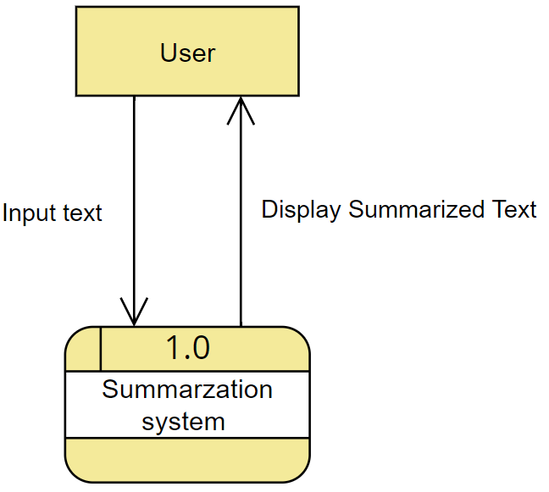
Usecase

Slide 16

DFD : State
Usecase

Slide 17
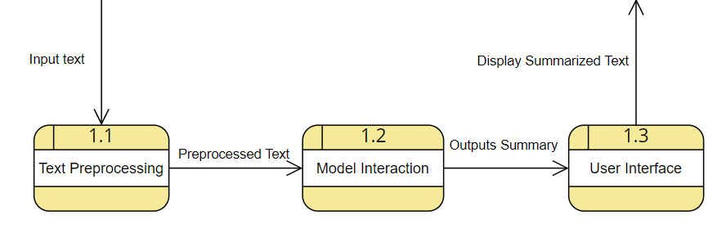



DFD 1 : Summarization system

Slide 18
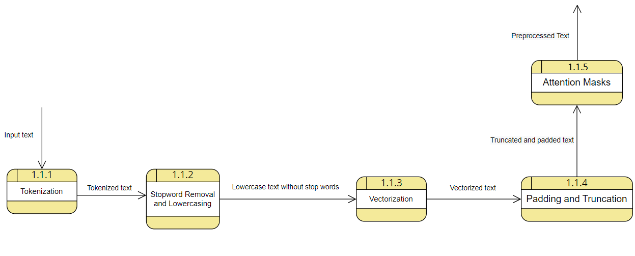
DFD 1.1: Text Preprocessing

Slide 19
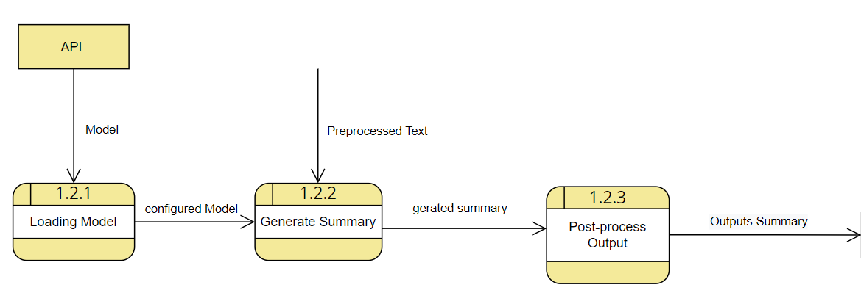
DFD 1.2: Model Interaction

Slide 20
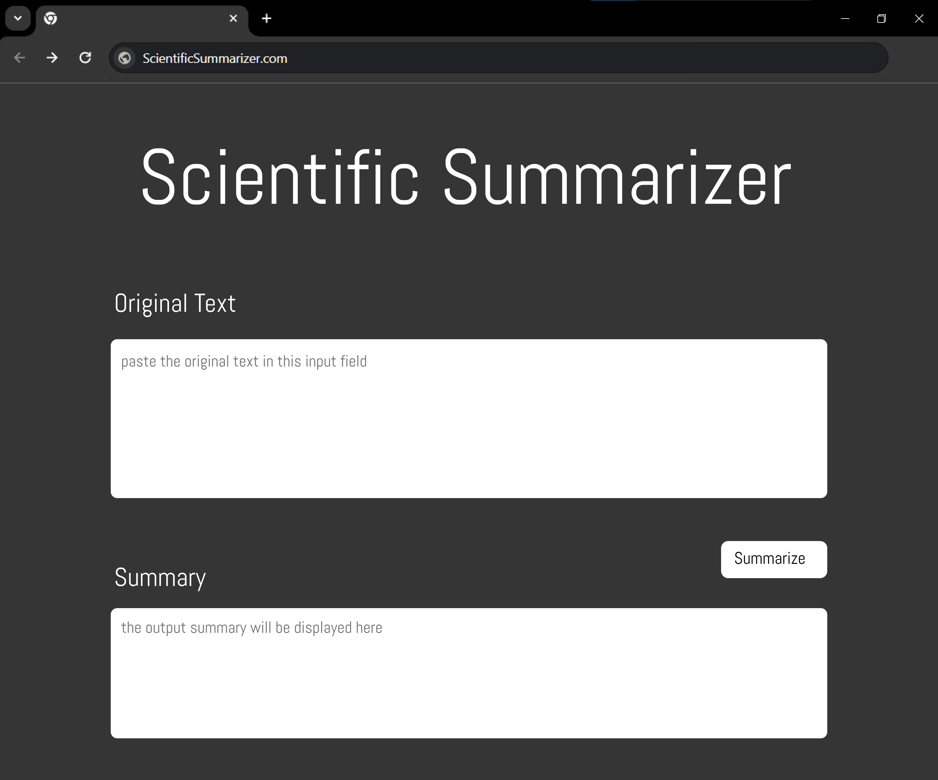
Screen design
Simple
Direct
Modern
Minimalistic

Slide 21
Implementation

Slide 22
Pipeline
3. Environment Setup
2. Model Selection
1. Data Preparation:
Cleaning.
Tokenization.
Stopword Removal.
Lemmatization.

Slide 23
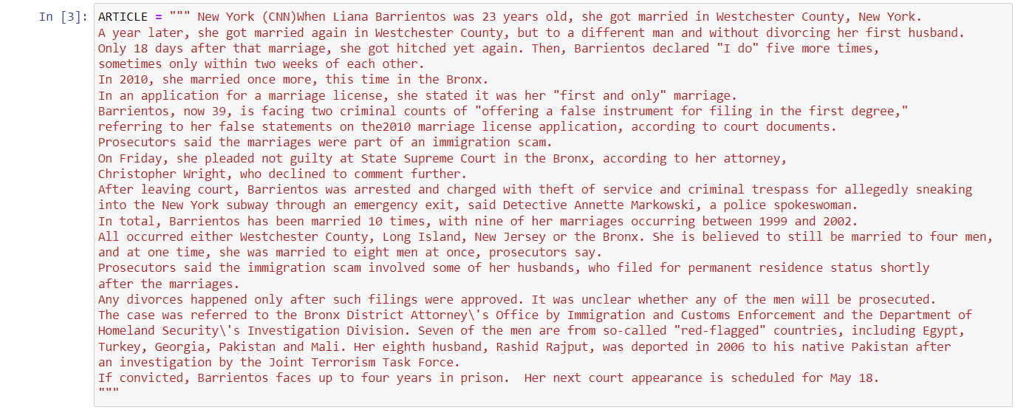
Implementation Pipeline
3. Environment Setup
4. Fine-Tuning Process
6. Testing and Evaluation
2. Model Selection
1. Data Preparation:
Cleaning.
Tokenization.
Stopword Removal.
Lemmatization.
5. Web Application Integration
Prototype

Slide 24
Implementation Pipeline
3. Environment Setup
2. Model Selection
6. Testing and Evaluation
1. Data Preparation:
Cleaning.
Tokenization.
Stopword Removal.
Lemmatization.
4. Fine-Tuning Process
5. Web Application Integration
Prototype

Slide 25
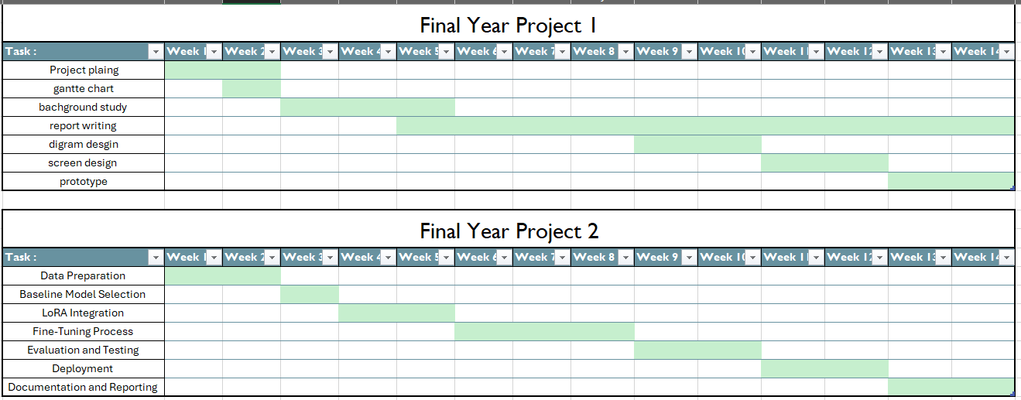
Timeframe

Slide 26
Conclusion
Adaptation and Fine-Tuning: Explores the use of (LoRA) for efficient fine-tuning of LLMs for specific summarization tasks,
Future Implementation: Outlines the planned development and integration into a user-friendly interface, in the application's next phase.
Theoretical Background: Provides a comprehensive review of text summarization technologies.
Technological Foundations: Highlights the role of large language models (LLMs) in abstractive summarization.

