Slide 1


Bioinformatics
the collection, classification, storage, and analysis of biochemical and biological information using computers especially as applied to molecular genetics and genomics.
Soroush H. Zargarbashi
Isfahan Univ. of Tech.
Dec 2015

Slide 2

Biological background
Notes:
Words and Berberis Voulgaris …

Slide 3

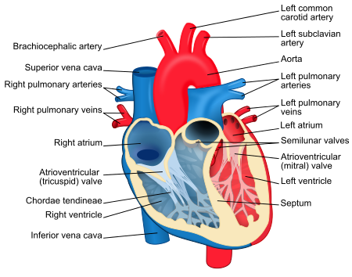
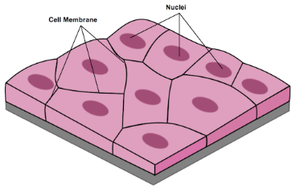
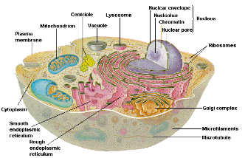
Humans (and other Organisms)
Organs
Tissues
Cells
Notes:
What we do in labs. Samples are taken from tissues.
Cell is a city!!

Slide 4
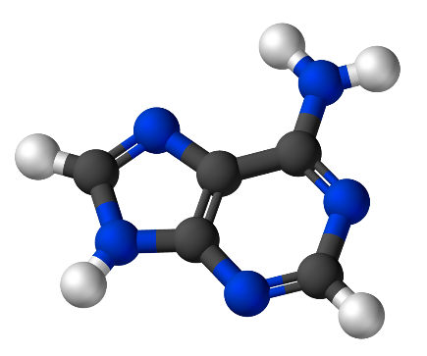
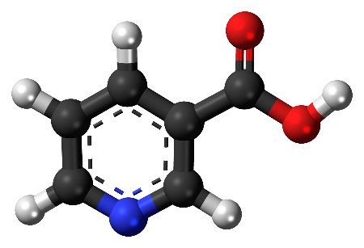
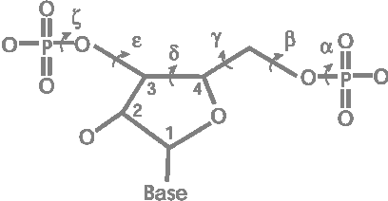
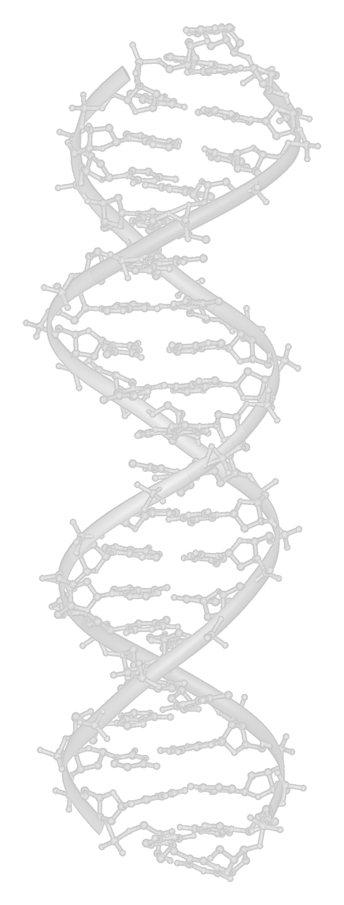
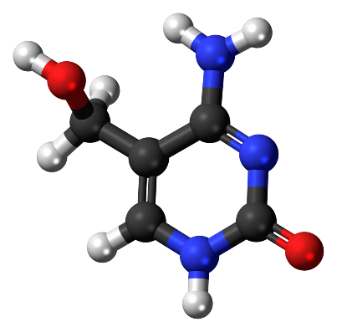
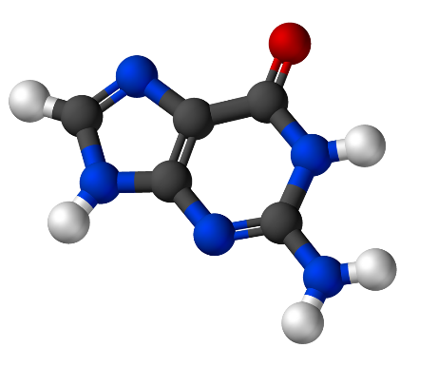
DeoxyriboNucleic Acid
Adenine
Thymine
Cytosine
Guanine
Notes:
Double Stranded like a nardeboon!
Size of the DNA more than Our height
Definition of Nucleotide
Like a book
Genome
Gene
We call it ATCG

Slide 5
DNA to Protein Pathway
rRNA
DNA
mRNA
tRNA
Ribosome
Protein

Slide 6
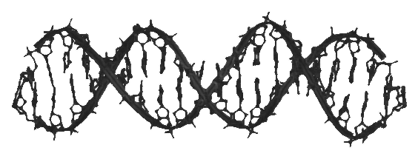
DNA to Protein Pathway
rRNA
DNA
mRNA
tRNA
Ribosome
Protein

Slide 7
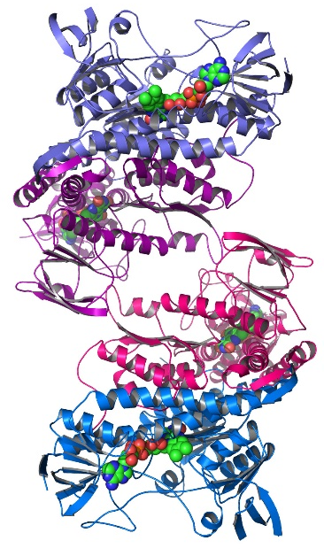
DNA to Protein Pathway
rRNA
DNA
mRNA
tRNA
Ribosome
Protein

Slide 8
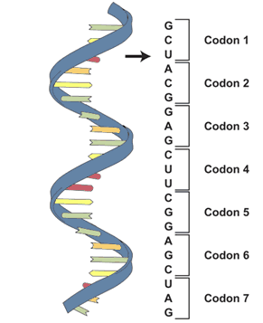
DNA to Protein Pathway
rRNA
DNA
mRNA
tRNA
Ribosome
Protein

Slide 9
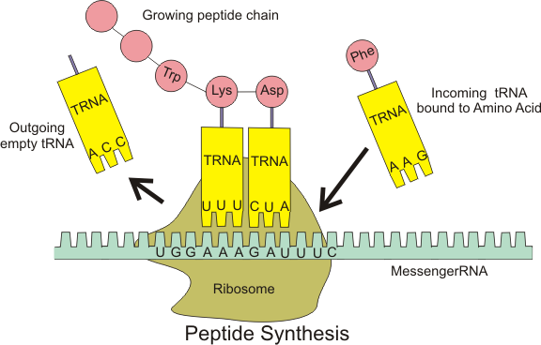
DNA to Protein Pathway
rRNA
DNA
mRNA
tRNA
Ribosome
Protein

Slide 10
DNA to Protein Pathway
Transcription
Translation
rRNA
DNA
mRNA
tRNA
Ribosome
Protein

Slide 11
HGP (Human Gnome Project)

Slide 12
Human Genome Project
Started: 1995
Finished: 2003
Found By US Government via National Institute of Health

Slide 13
Human Genome Project
Started: 1995
Finished: 2003
Found By US Government via National Institute of Health
Goal: Determining the sequence of chemical base pairs in human DNA, and of identifying and mapping all of the genes of the human genome from both physical & functional standpoint.
Notes:
Japan Story

Slide 14
Human Genome Project

Slide 15
Human Genome Project

Slide 16
Human Genome Project

Slide 17
Results of The Human Gnome Project

Slide 18
Results of The Human Gnome Project
Whose DNA was sequenced for the Human Genome Project?
This is intentionally not known to protect the volunteers who provided DNA samples for sequencing. The sequence is derived from the DNA of several volunteers.

Slide 19
Results of The Human Gnome Project
Is the human genome completely sequenced?
Small gaps that are unrecoverable in any current sequencing method remain, amounting for about 1 percent of the gene-containing portion of the genome, or euchromatin. New technologies will have to be invented to obtain the sequence of these regions.

Slide 20
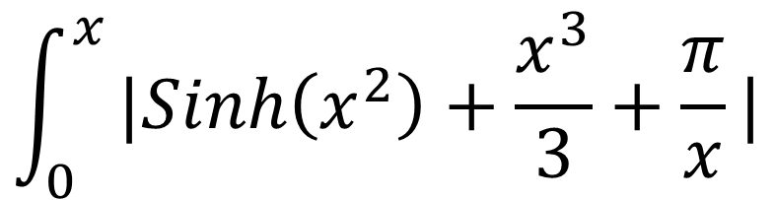
Results of The Human Gnome Project
$$\int_{0}^{x}{|Sinh\left(x^{2}\right)+\frac{x^{3}}{3}+\frac{π}{x}|}$$

Slide 21
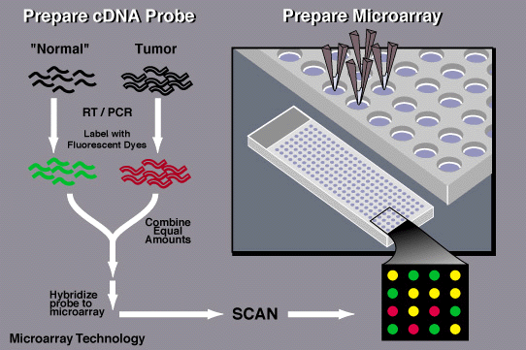
Results of The Human Gnome Project
New Technologies
Next Generation Sequencing
Microarray Chips

Slide 22
Sequence Alignment Problem

Slide 23
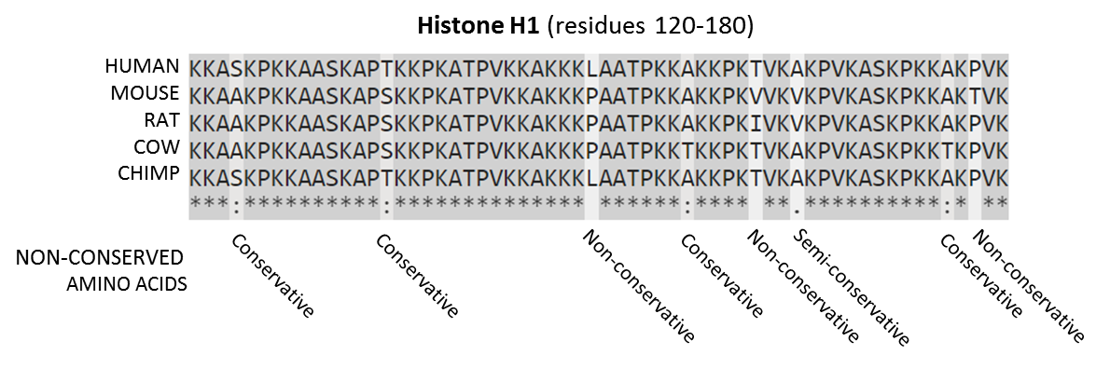
Sequence Alignment Problem

Slide 24
Sequence Alignment Problem
An alignment for two sequence S and T:
NEEDLEMAN
WUNSCH

Slide 25
Sequence Alignment Problem
An alignment for two sequence S and T:
NEEDLEMAN
W--UN-SCH

Slide 26
Sequence Alignment Problem
An alignment for two sequence S and T:
NEEDLEMAN
W--UN-SCH
Or
NEEDLE-M-AN
W----NSCH--

Slide 27
Sequence Alignment Problem
An alignment for two sequence S and T:
NEEDLEMAN
W--UN-SCH
Or
NEEDLE-MA-N
W-----NSCH-

Slide 28
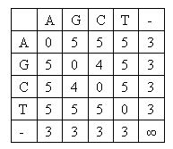
Sequence Alignment Problem
Scoring function
Maximization Optimization Problem

Slide 29
Sequence Alignment Applications
Predicting the biological functions of genes
Finding the evolution distance
Helping Genome Assembly
Finding SNPs
Phylogenetic Trees

Slide 30
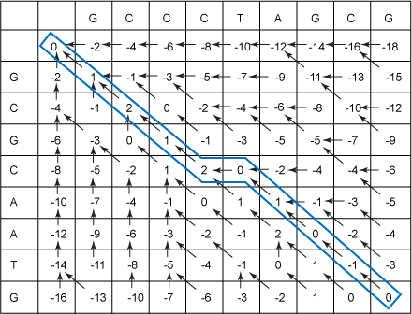
Sequence Alignment Algorithm
Pairwise Sequence Alignment
Needleman-Wunsch Algorithm

Slide 31
Sequence Alignment Algorithm
Pairwise Sequence Alignment
Needleman-Wunsch Algorithm
Problem in Time and Space
99% Similarity in humans
Branch and Bound Approach
d-limited Distance

Slide 32
Thank U ☺

