Slide 1
Communication Based Rail Traffic Control with Cab Signaling
Team Name: Team Cygnus
Team Members: Aminul Haque Chowdhury
Sriman Bidhan Baray
Shahamat Mustavi Tasin

Slide 2
More or less 100 train accidents occur in Bangladesh each year
72% of these accidents are caused by human error
Technical failures also contribute to this problem

Slide 3
Key Problems
Human Dependency
Shortage of Manpower
Technical Problems
Maintenance Problems

Slide 4
Our Solution
Microcontroller based system
Signalling using programmable RF module
Introducing IoT
Robotics based Emergency Braking System

Slide 5
Our solution is comprised of 2 levels
Level 1: Basic cab signaling system
Level 2: Modified form of CBTC

Slide 6
Features
On-board System
Easy to Implement
3-Level Safety System
Predictive Maintenance System
Wireless System
2 way communication

Slide 7

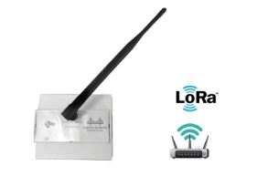
Station System Design(Level-1)
Graphical Interface to control CPU
Multiple Coloured Signal
Central Processing Unit
(Raspberry Pi)
Programmable RF Transceiver (LoRa)-SX1278
Wayside signal Post
Remotely Switching System
Track Circuit
Station Master Control Panel

Slide 8
On board System Block Design for Loco Master(Level-1)
Programmable RF equipped Wayside Signal Post
Maximum Safe Speed display
Transceiver
(LoRa)
GPS Module
(Location)
Light Signaling panel
Microcontroller Unit(MCU)
Speedometer
(Speed)
Automatic Brake System
Track circuit Signal
(Station Command)
Electromechanical switch
Technical Failure Warning System
Over speed Control System
GSM Module

Slide 9


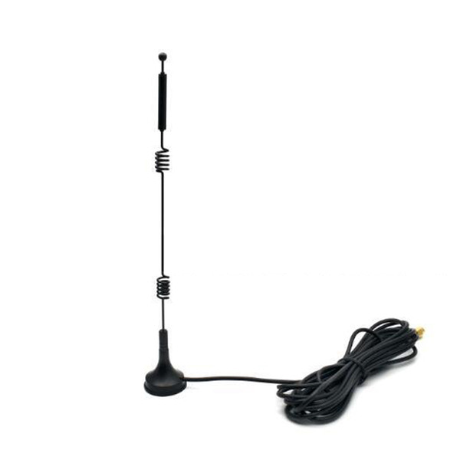
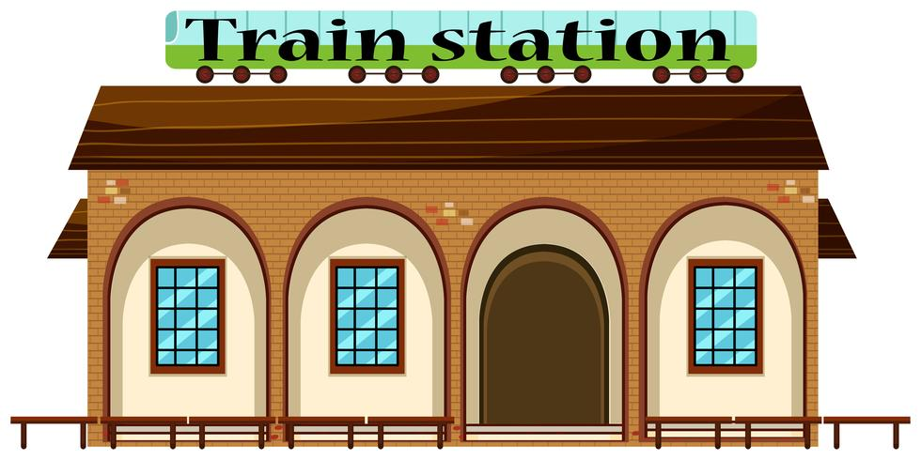
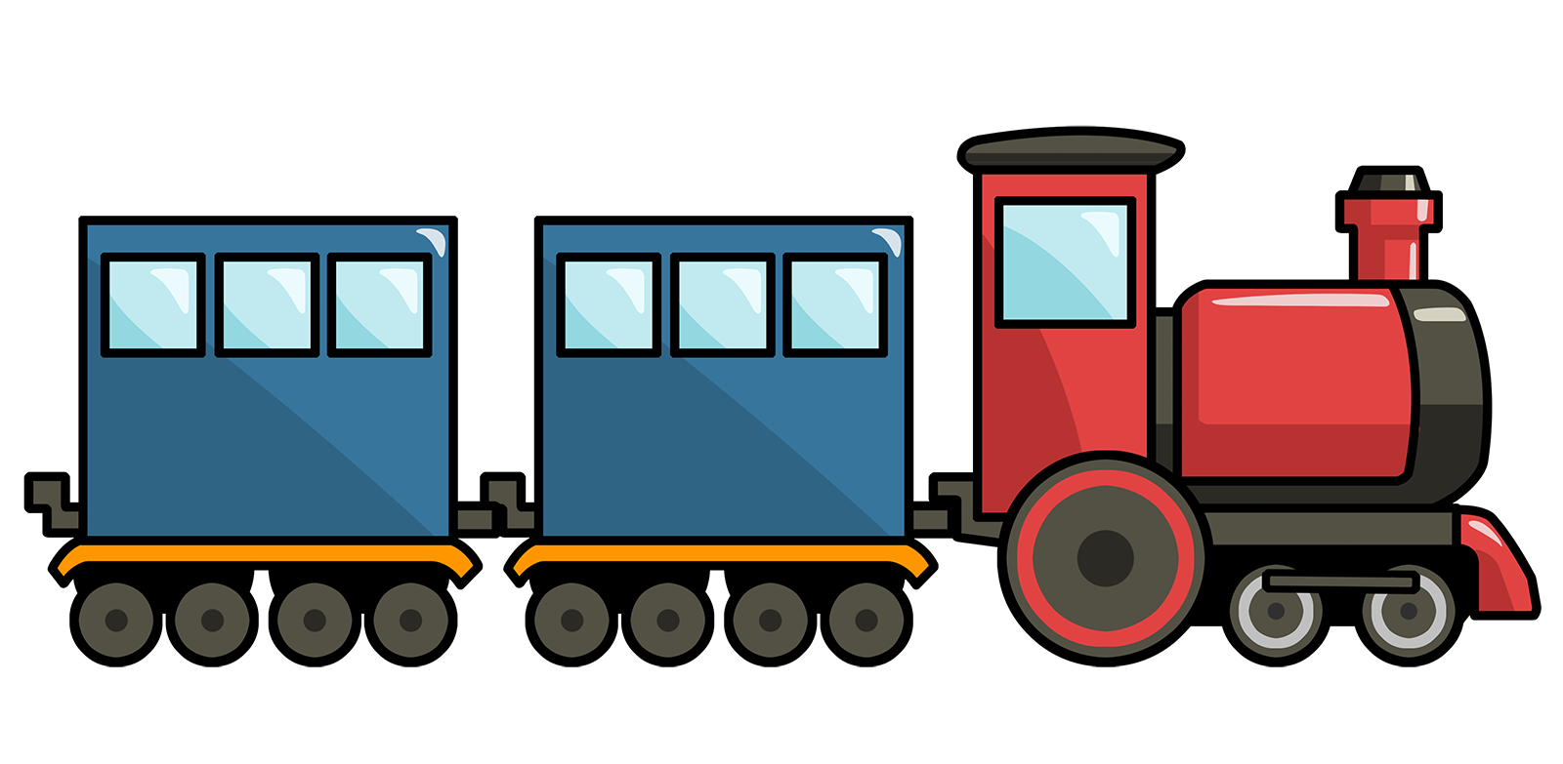
Guard’s room
Outer
Home
Loco Master’s interface
Station Master’s interface
Current Speed
Automated Emergency
Brake System
Train Forecasting
Suggested Signal
Alarm System
Send Light Signal and Speed limit
Next signal
Alarm System
Receive Signal from Trains via LoRa
Alarm System

Slide 10
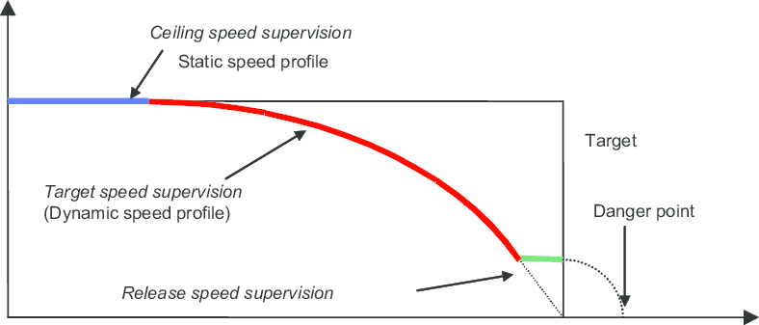
Error Check:
Braking Curve is updated at specific intervals
Detection of connection failure
Alarming the Loco Master, Guard and Station Master
Manual Overwrite

Slide 11
Detection of Connection failure
The train will check for signals at specific intervals and update the braking curve accordingly
Is there any signal?
YES
NO
Update the braking curve
Warn the locomaster and the station master

Slide 12
Detection of Connection Failure
Loco master’s Transceiver will communicate with Guard’s Transceiver
Is the connection okay?
YES
NO
Check again in 5 seconds
Warn the Locomaster and the Guard

Slide 13
What if the signal is overlooked?
Alarm the Locomaster
Alarm the Guard
Send signal to onboard guard system

Slide 14
On board System Block Design for Guard(Level-1)
RF Transceiver
Microcontroller Unit(MCU)
If no response from guard
Alarm System
Automated Hand Brake

Slide 15
Automatic Braking System
Introducing robotics
MCU
Emergency detected
Trigger Alarm
If no response from guard
Trigger automated brake
Speed dependent robotics system using Servo Motor

Slide 16
Upgrade from Level-1 to Level-2
Introducing IoT
Loco Master’s On Board System
Wayside signalling system
Server
On Board system for Guard
Station System

Slide 17
Smart On-board System
Added Key Features
Live location and Speed share
Dynamic Maximum Allowable Speed Display
Live Train Forecasting
Dynamic Information about ahead track

Slide 18
The Central Control System
Live location map of all trains
Interlinked track
Switching decision to stations
Fast wireless communication across the train network
Wireless communication between train and control system reducing setup cost and difficulties
Dividing rail network into regions to reduce server complexity and increasing speed
Safe maximum speed for each train increasing overall efficiency of rail system
Optimized decision to stations and safety check of rail switches
Key Features
Anti-collision auto routing
Optimized train traffic control
Maximums safe speed calculation for each train

Slide 19
Budget
Estimated Cost up to Level-1 per Station and Locomotive
BDT 20K
Station System
BDT 15K
Total
BDT 35K
Cab Device
Estimated for Level-2
BDT 35K
BDT 15K
BDT 135K
BDT 185K
BDT 35K
BDT 15K
BDT 135K
Cab Device
Station System
Central Server
Total

Slide 20
Thank You

Slide 21
Appendix

Slide 22
Central Control System flowchart
Start
Corresponding train(s)
Get location and speed
Wireless comm.
Update Live map
1
Check for conflict using safe routing algorithm
Immediate Red signal to train(s)
Any conflict?
Yes
1
Calculate max safe speed using AI model
Immediate notifications to the station(s)
Send speed limits
Calculate optimized route for each train using AI model
Send switching suggestion to the stations
Feedback from stations on switching
Corresponding station(s)
Wireless comm.
Check for conflict using safe routing algorithm
Any conflict?
Start(again)

Slide 23
Budget defined
Name | Specs | Cost
Server PC | Intel Xeon 4114 Deca-core (10 Core) 2.20 GHz Processor ($1,084.34) 2x 500GB SSD (130$) 64GB RAM ($213) | (1427$) 121104.02 BDT
Rail Road modifications(per 10km)) Optional | Inductive proximity sensor x4 , Solar panel(100W 12V)x 4, Railroad insulation, Power | 83200 BDT
Control room in station | pi, Network module(2G/3G), Switching connection, signalling connection,Track circuit connection | 150000 BDT
Device on Locomotive | GPS, Network module, MCU, Servo motor LCD screen, LED panel, buzzer, | 10000 BDT

