Slide 1
Online Business Site

Slide 2
Group members
SK. Tanvir Ahmed – 172-15-9614
Shaibal Barman – 163-15-8472
Fahim Ahmed Turza – 163-15-784
MD. Aminul Islam – 163-15-8539
Nurnoshin sultana – 153-155-6674

Slide 3
Introduction
As we all know now the world has become online. Everything can be done online. Even business. As a matter of fact online business has become much more efficient than offline business. People like to do their shopping or any kind of marketing through online. That’s why we have come with this online business site. As the world is progressing everything is becoming online. So in time online business will be very much successful in any kind of field.

Slide 4
Scope
The user can registration by their own email with return a verification mail.
User can easily shop through our site and also in reasonable price.
They can customize their favourite list as per their choice.
They can verify and reset password with strong security.
User can view the Profile data and can update it by using his own account.

Slide 5
Purpose
To help start up companies to do branding and selling product.
To make an easier and effective online business platform.
To make it as user friendly as possible.
To present products with reasonable price as possible to save cost

Slide 6
Overall Description
At first user should do the registration by their own email with a return verification mail. If any user forget their password then they can reset their password .A verification email will go to their account and then they can reset their password. User can see the login page after they register. Then they can see the home page of the website. Then they can see all the product that are up for sale. When the click on the product they like the full details about the product including the original price tag of the product will be shown. If they like the product and want to buy or order the product they will be directed to another page where more information will be asked such as their location, phone number, billing options. Every customer that want to buy anything will have to fill up all the information. User can see some more option when they press their account avatar. They can update their account password from the change password screen. They can Update their old password with a strong verification email. User can delete their own account from the account screen. A logout button will be provided to logout from the webpage.

Slide 7
Tools
HTML
CSS
Java Script

Slide 8
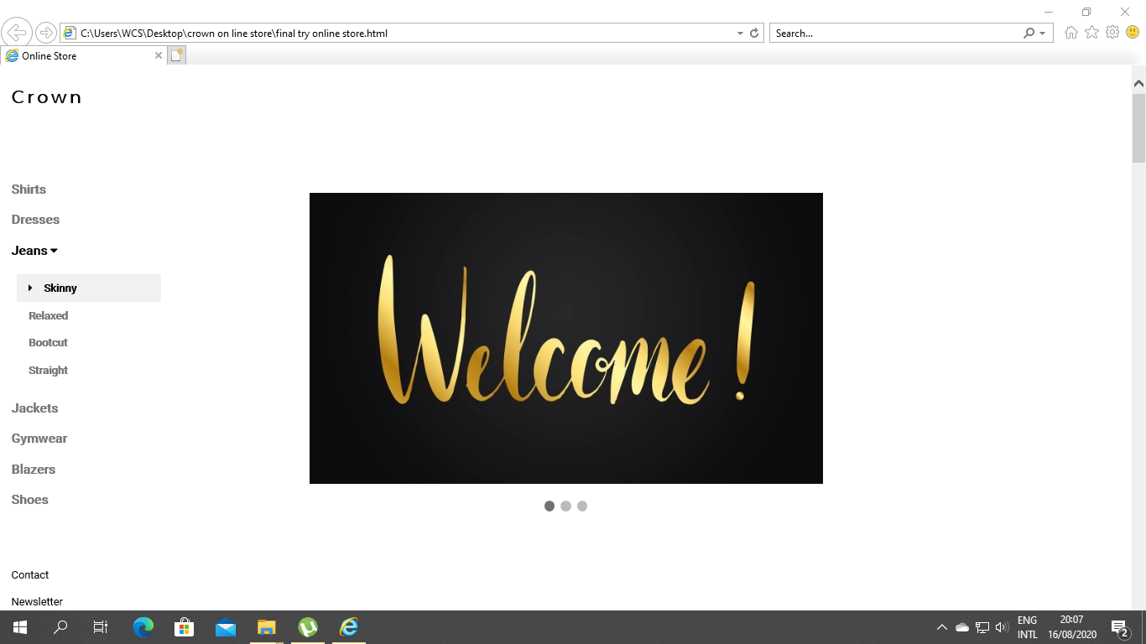
Screenshots of website

Slide 9
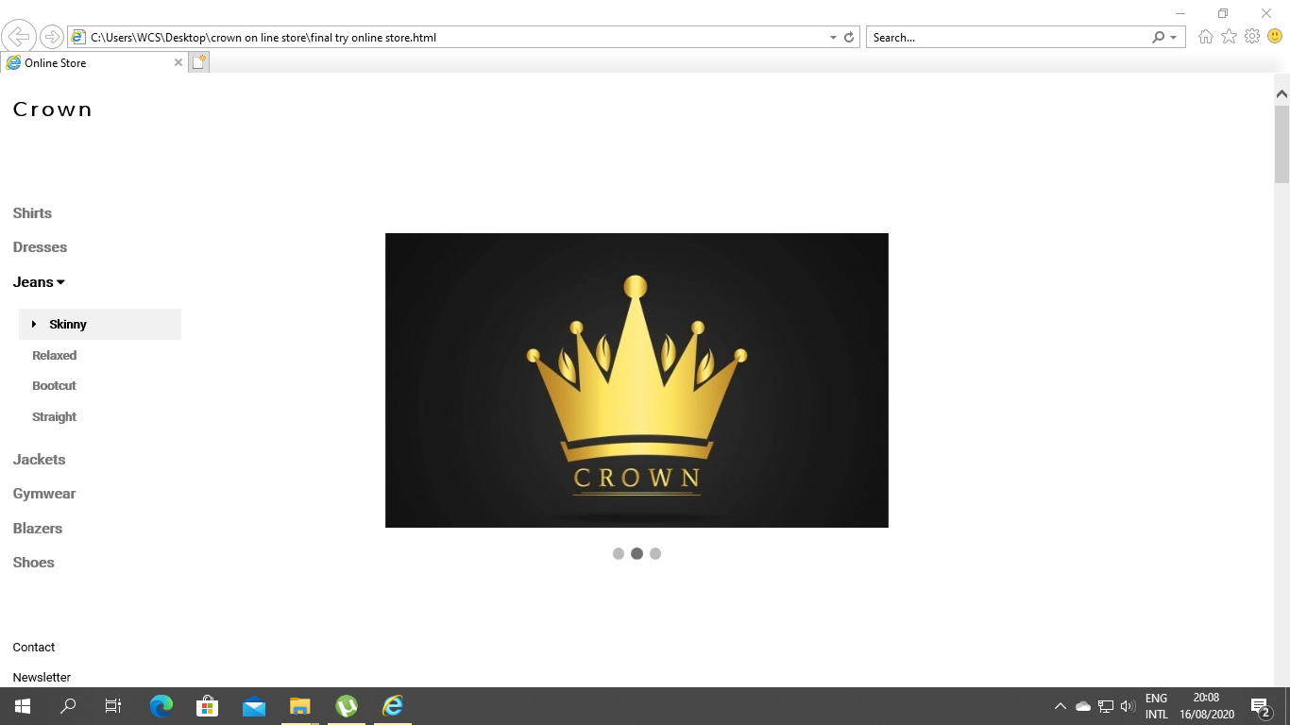
Front page

Slide 10
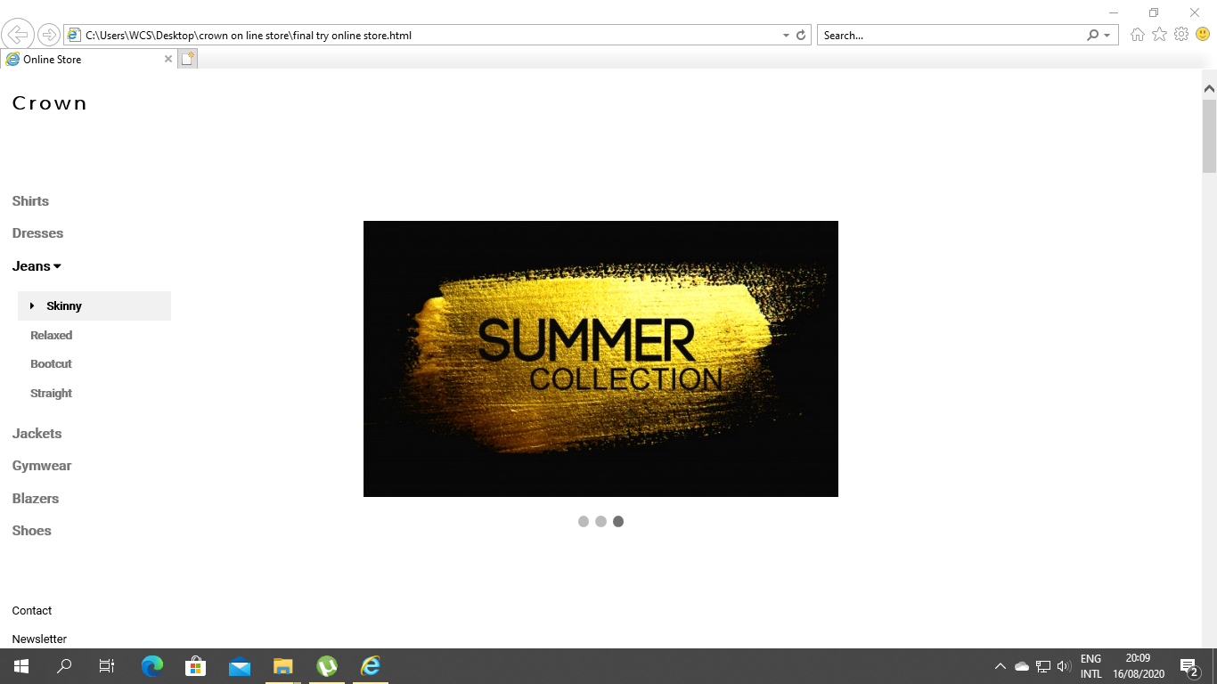
Collection page

Slide 11
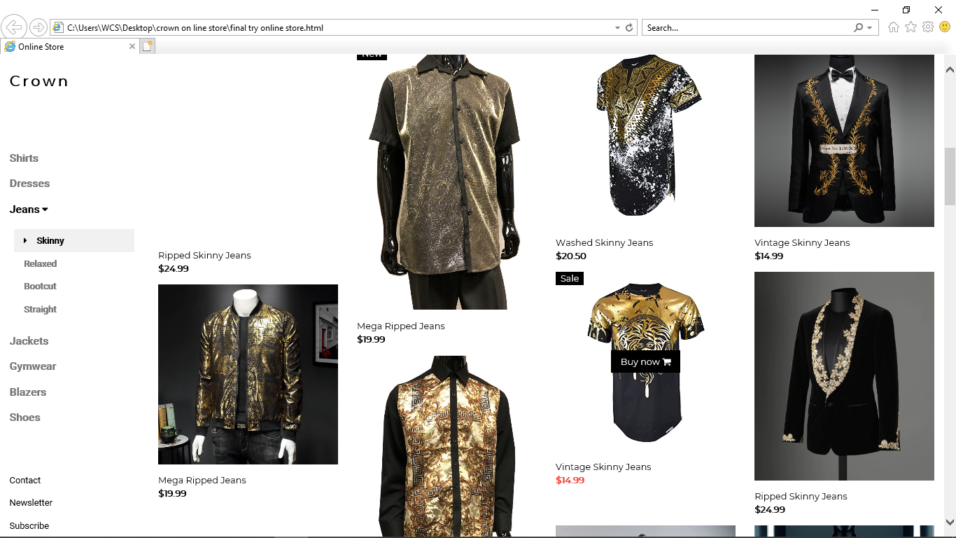
Product page

Slide 12
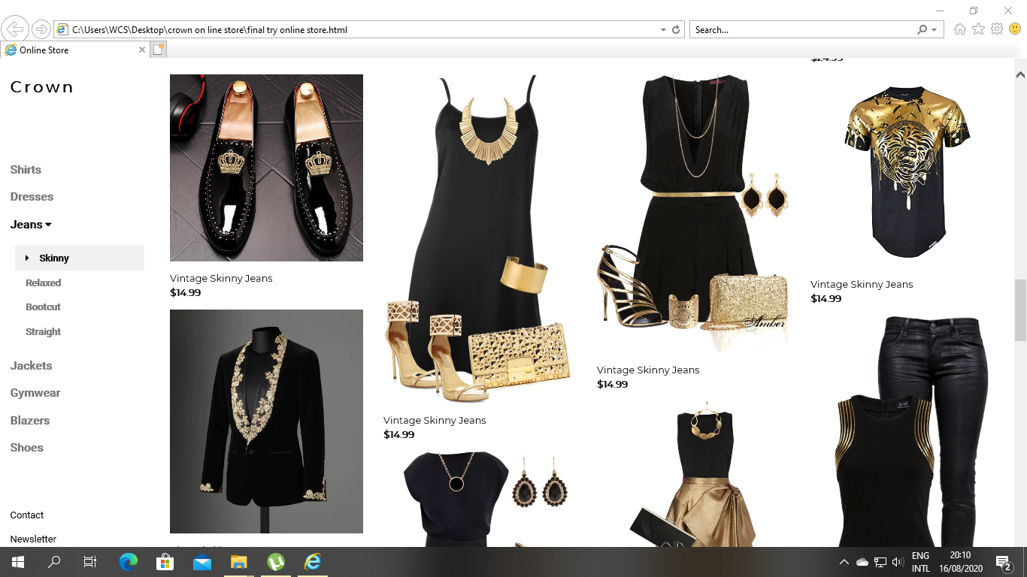
Product page

Slide 13
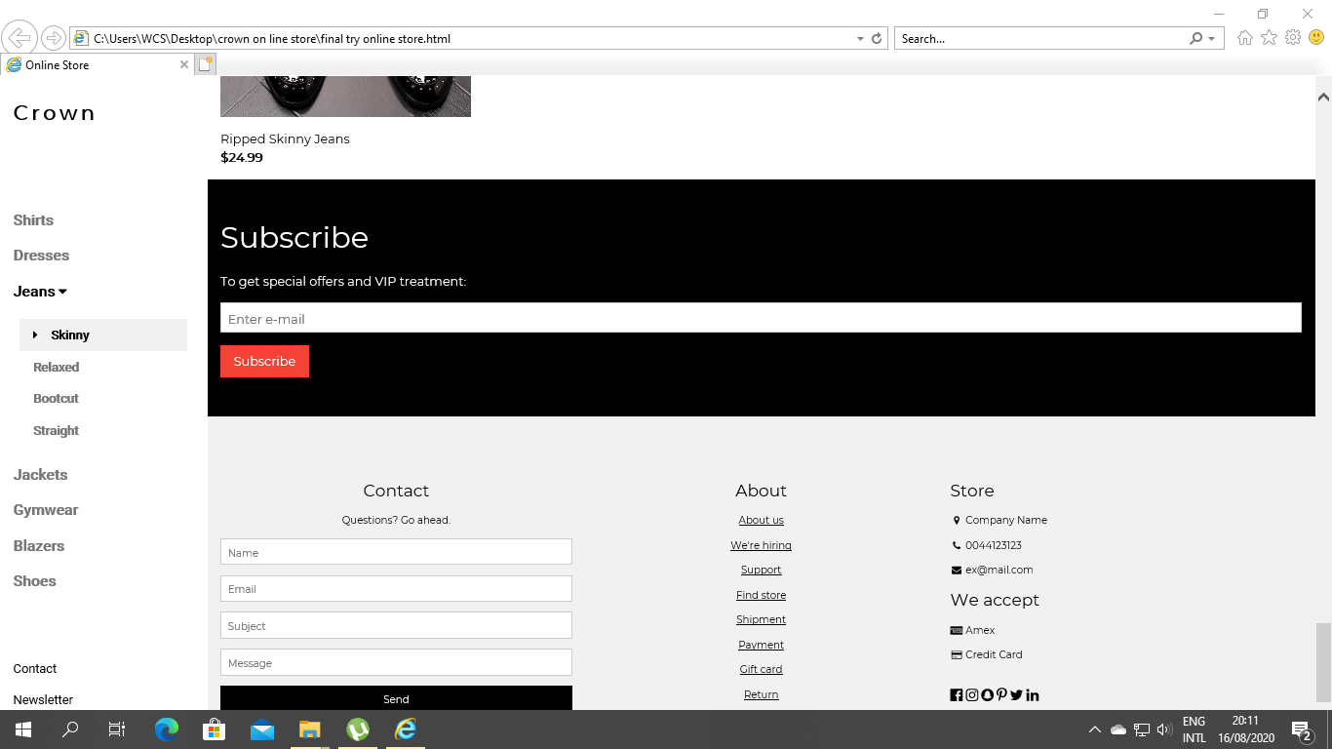
Subscription page

Slide 14
Thank you

