Slide 1
بسم الله Bismi'Allah
English | ⛔❌ | ✅🟢
I eat | Ma-kanakul-š مَا كَنَاكُلْشْ | Kanakul كَنَاكُلْ
I want/ I like | Ma-bgit-š مَا بْغِيتْشْ | Bgit/ kanbgi بْغِيتْ
I drink | Ma-kanšrub-š مَا كَنَشْرُبْشْ | Kanšrub كَنْشْرُبْ
I wear | Ma-kanlbs-š مَا كَنْلْبَسْشْ | Kanlbs كَنْلْبَسْ
I have | Ma-عandi-š مَا عَنْدِيش | عandi عَنْدِي

Slide 2
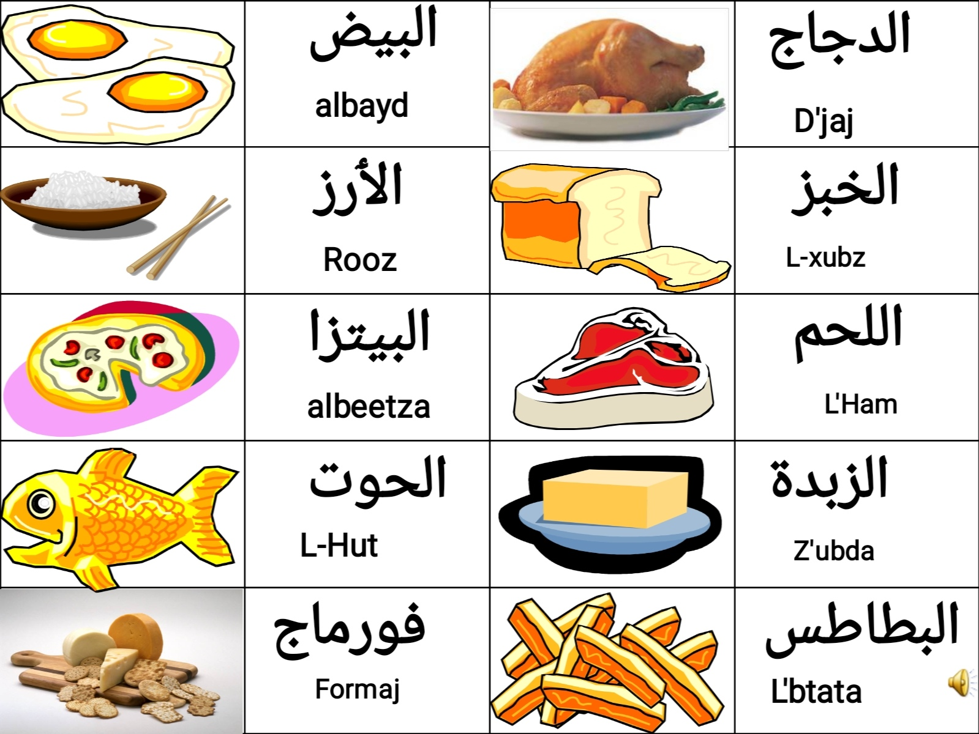










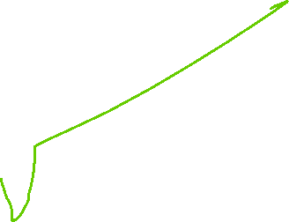





Slide 3
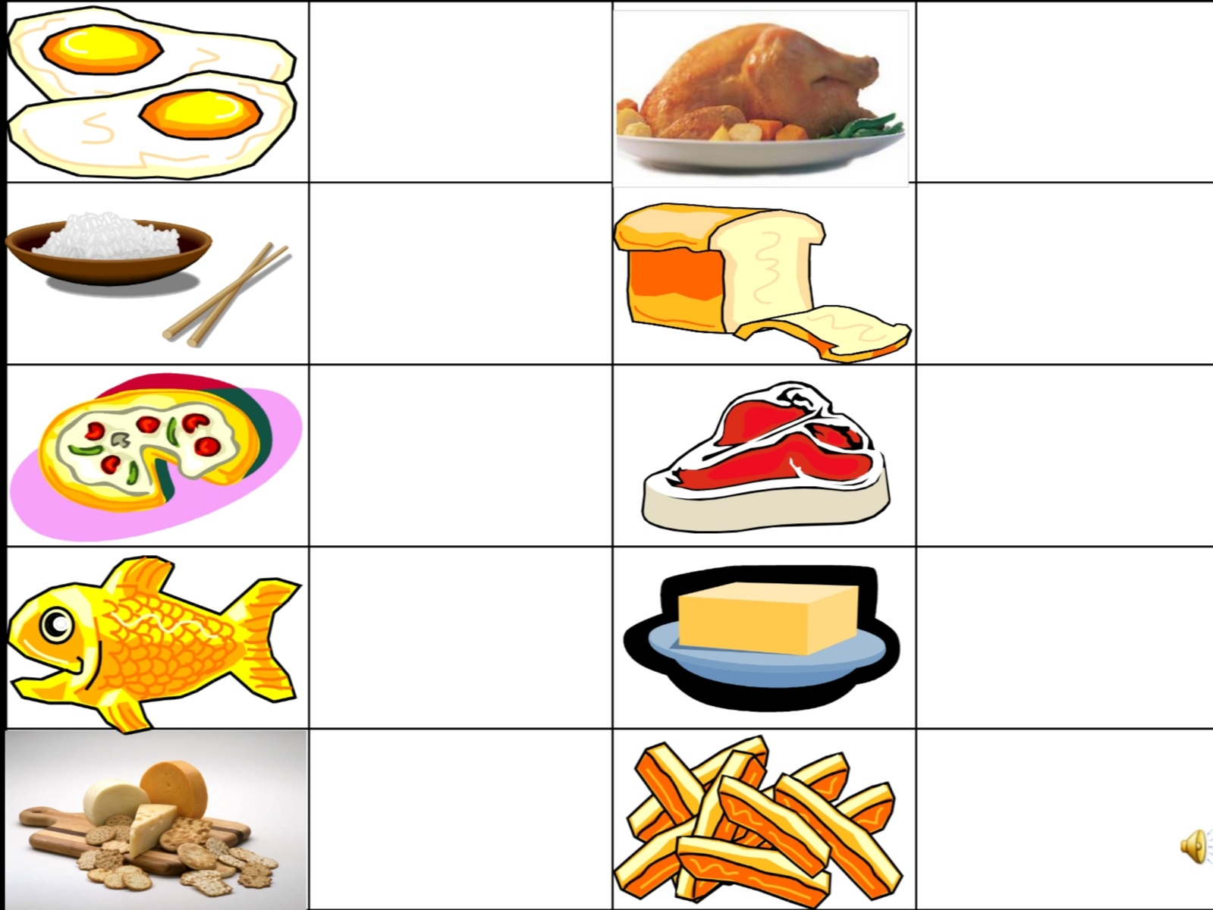

Slide 4
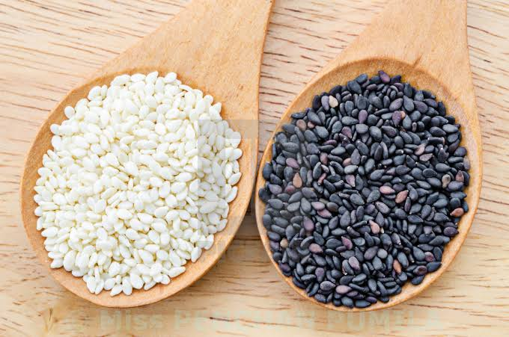
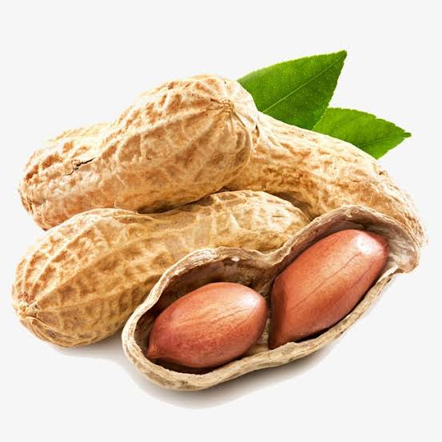
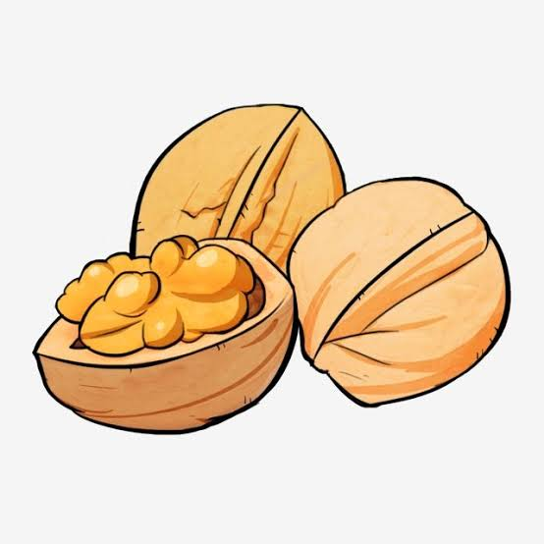
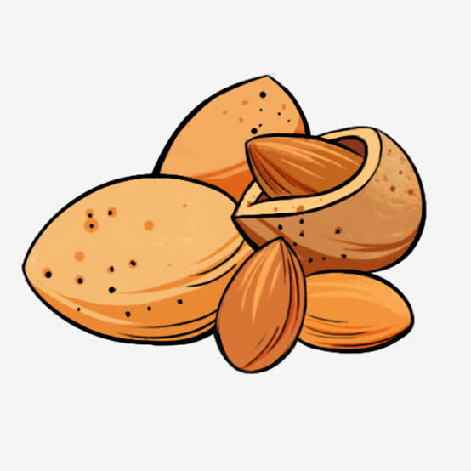
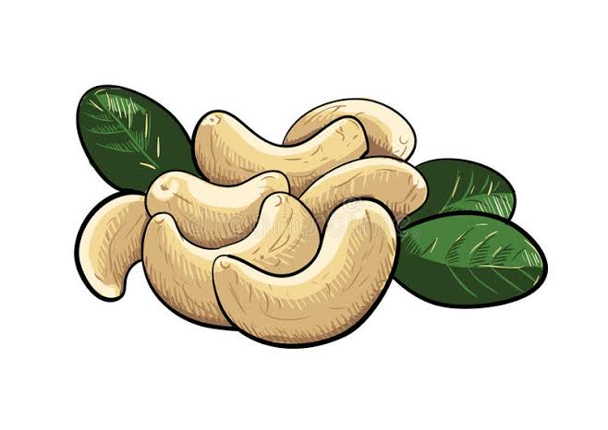
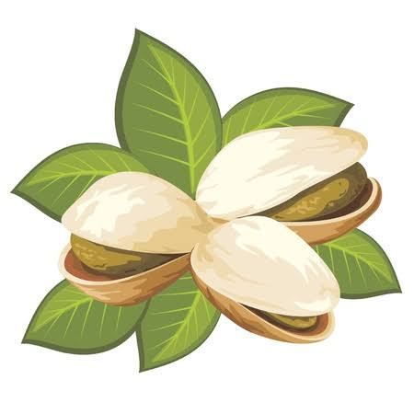
زنجلان
كاو كاو
Kaw-kaw
Zanjlan
الگرگاع
اللوز
L'gargaع
L-luz
الأكاجو
البيسطاش
Akaajo
L'ppistash

Slide 5
Wesh fih........? Does it have.....?

Slide 6



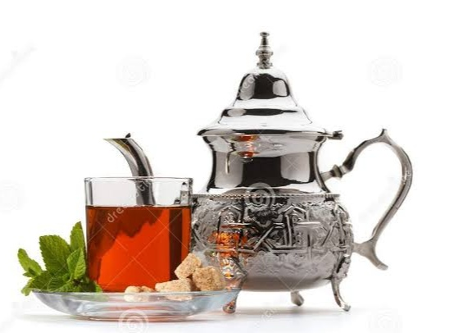
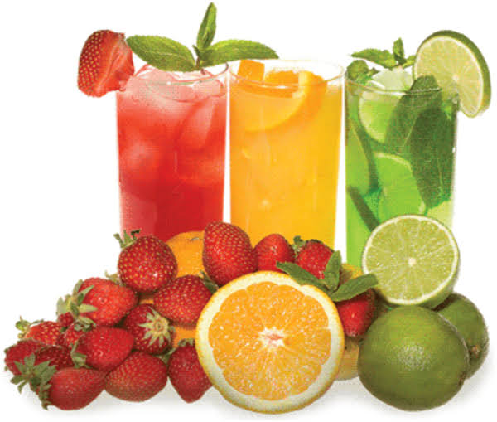
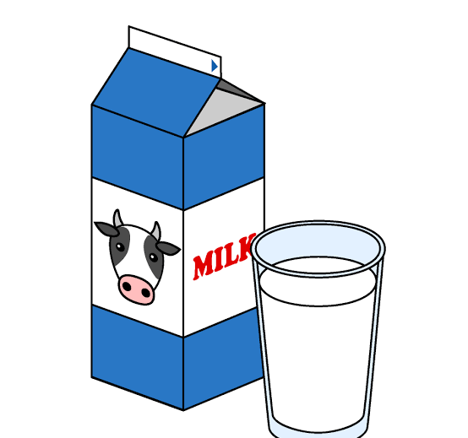



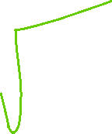


القَهْوَة
المَا
L-qahwa
L’maa
عَصِيرْ اللَّيْمُونْ
أَتَايْ
عasseer Limoon
Ataay
العَصِيرْ
الحَلِيبْ
L’H-leeb
L’عasseer

Slide 8


Bgit kanšuf tbeeb/tbeeba ْبغيت نْشُوفْ طَبِيب
I want to see the doctor
T'beeb/ طبيب
T'beeba/ طبيبة

Slide 9










S'tta
WaHd
S'bعa
juuj
T'manya
T'lata
T'sعud
R'bعa
ع'shra
khamsa

Slide 11
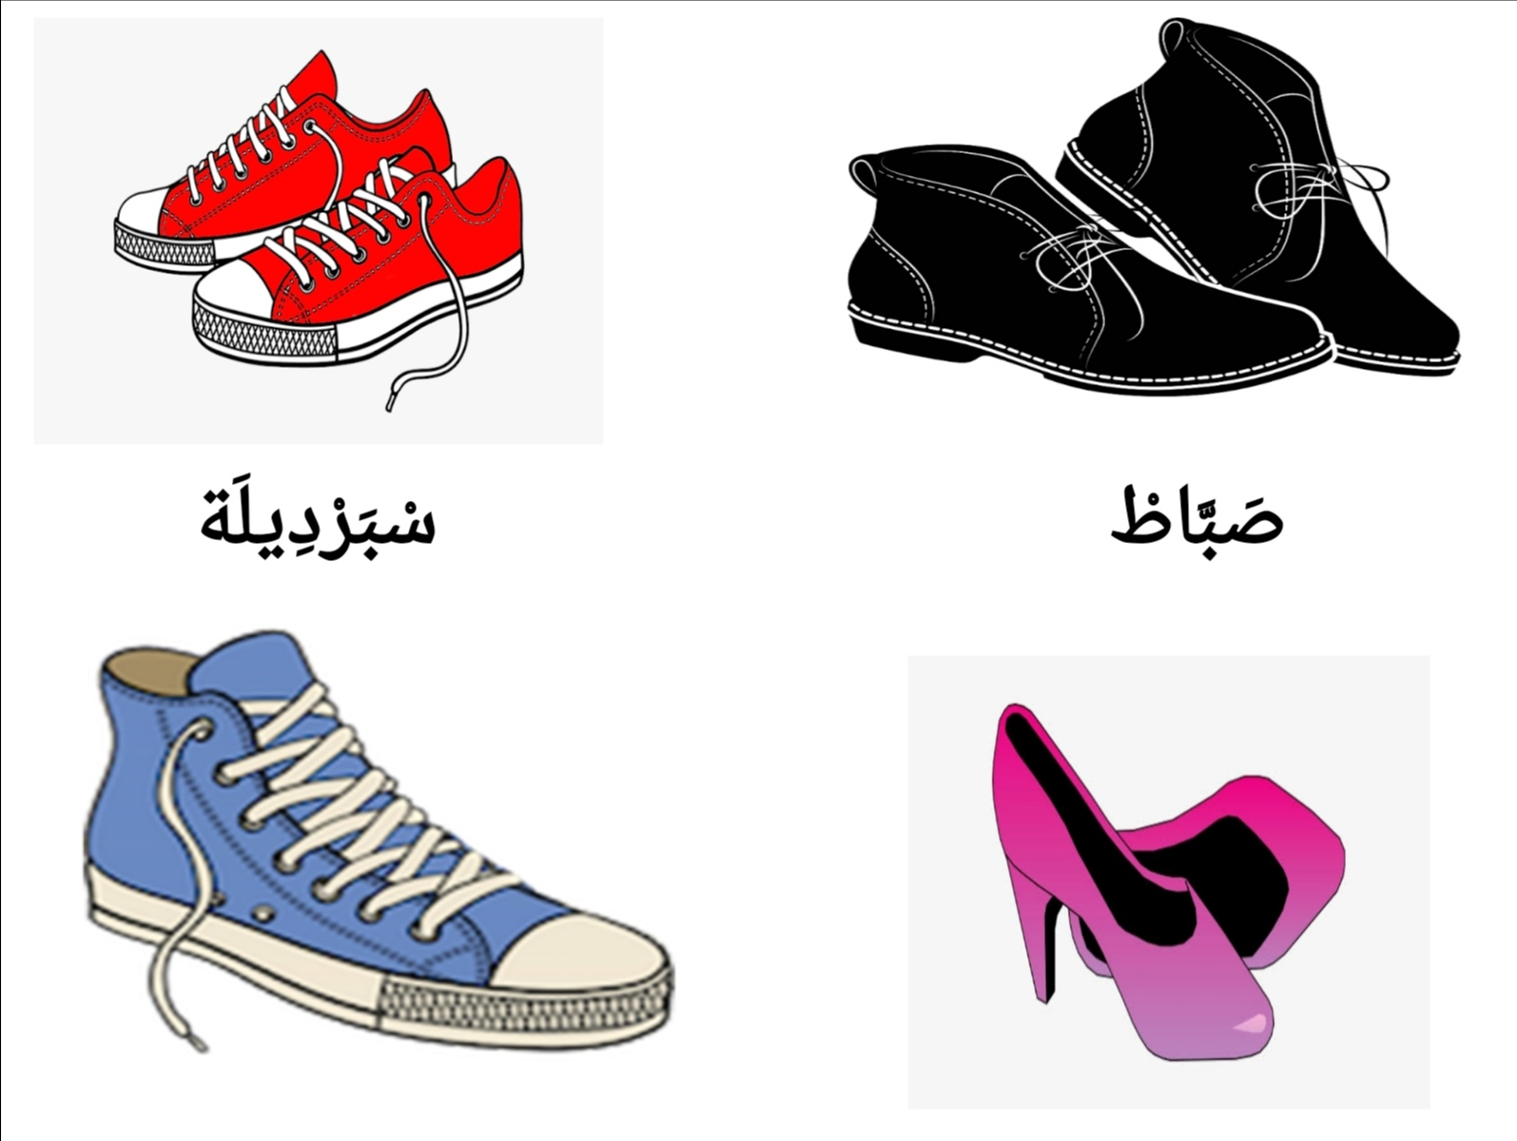
Sbardila
Sbbaat

Slide 12
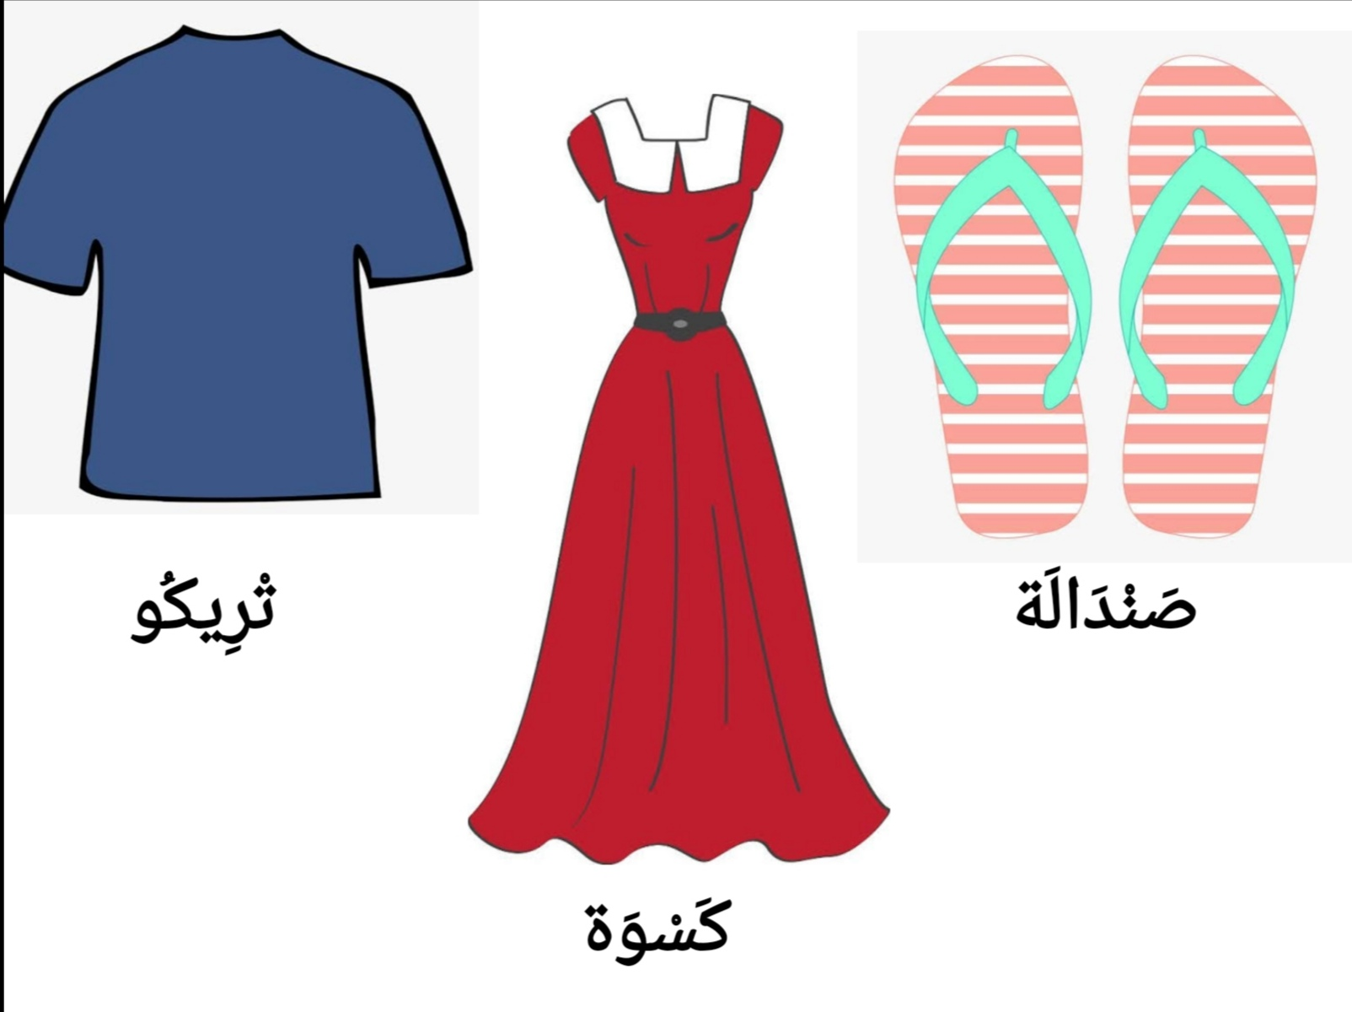
Trikoo
Sandala
Kaswa

Slide 13
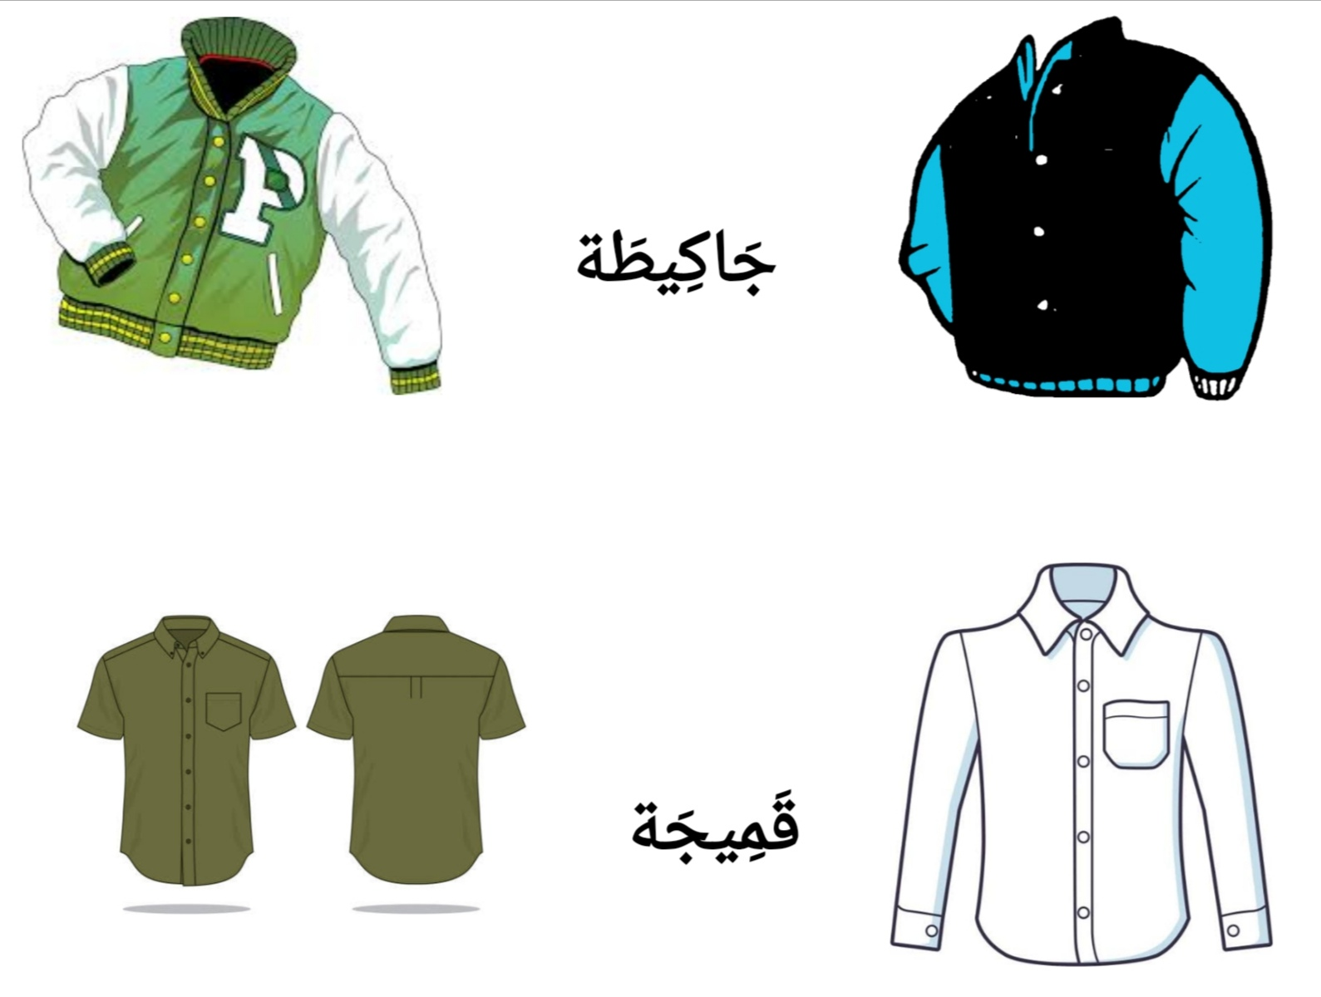
Jackeeta
Qameeja

Slide 14
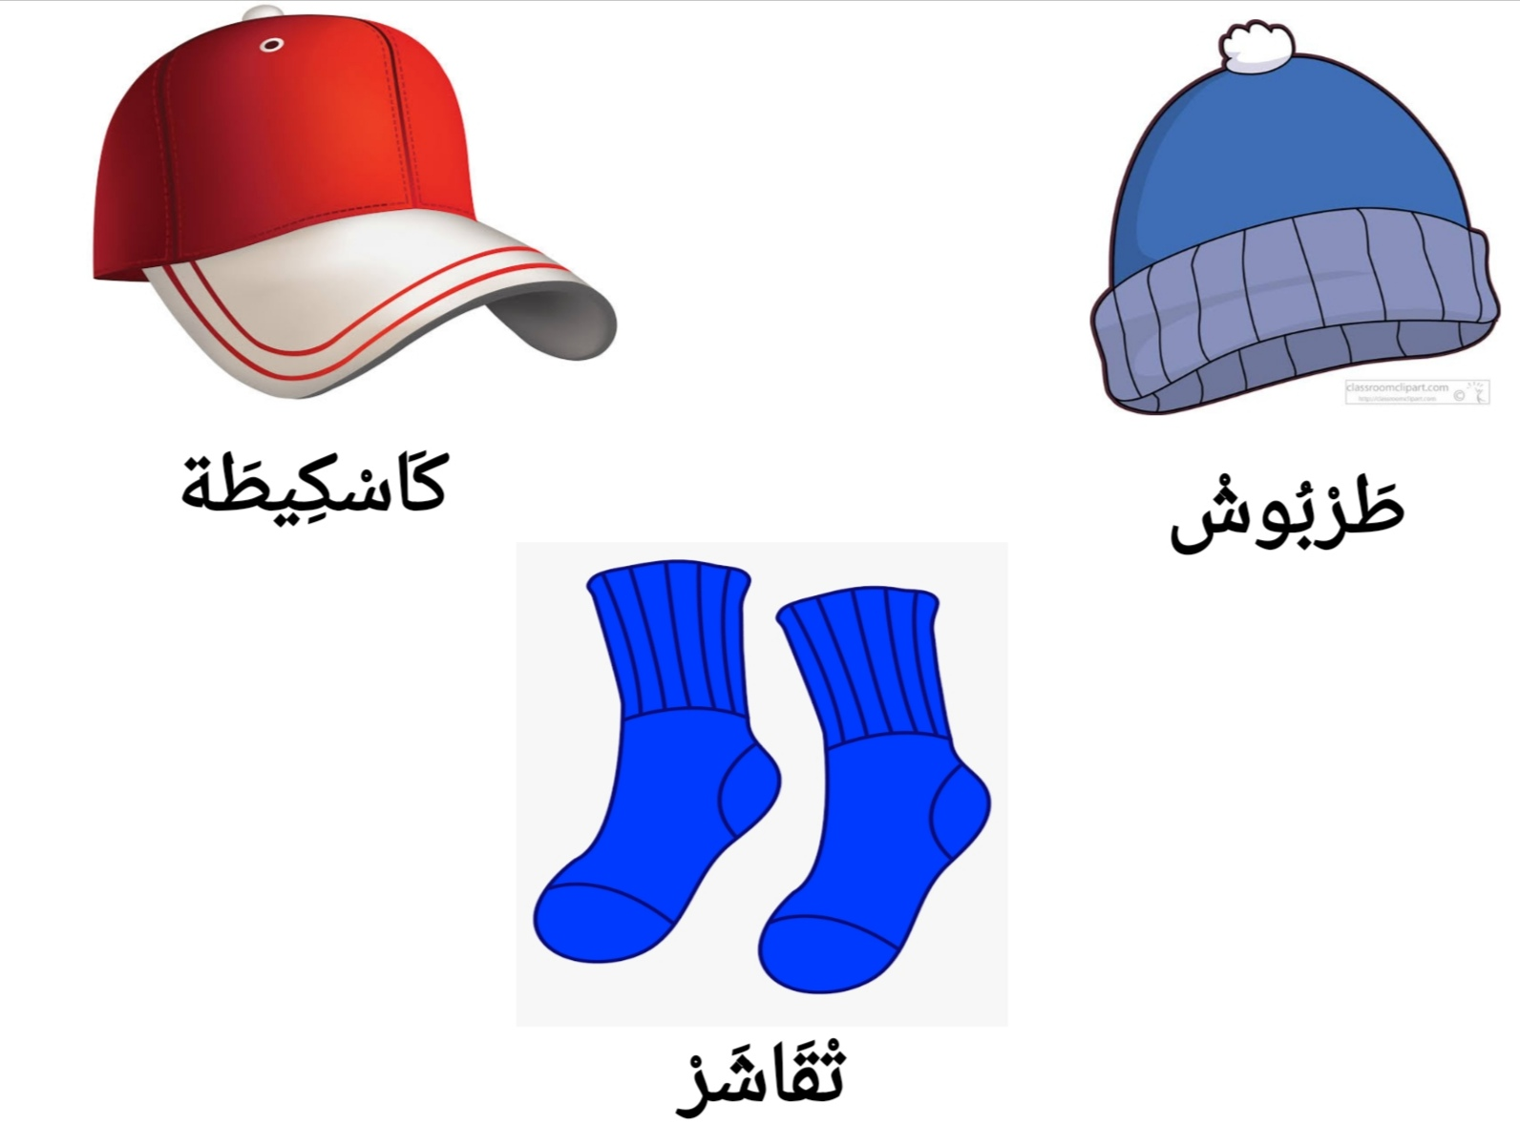
Kaskita
Tarboosh
Tqasher

Slide 15
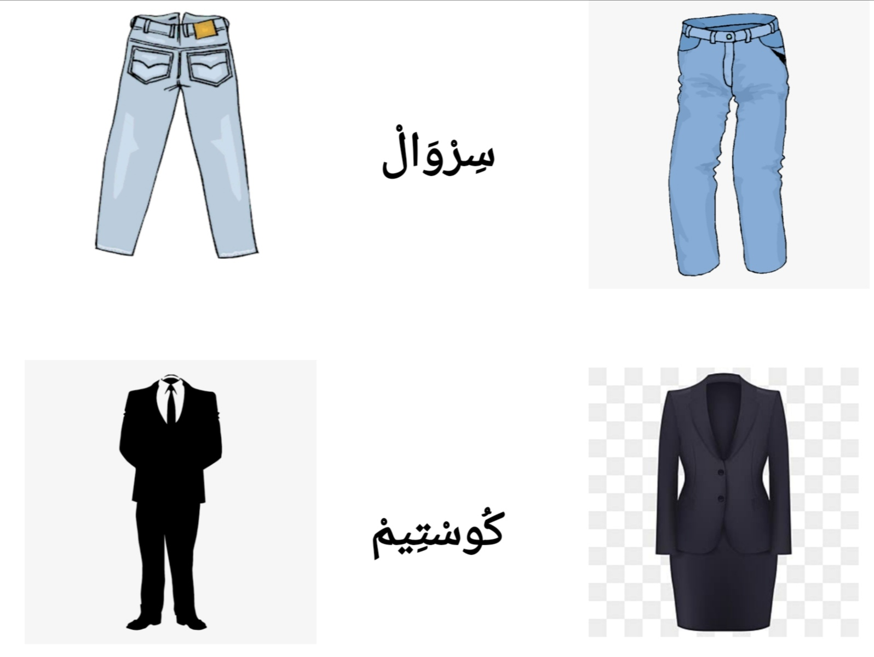
Sarwaal
Kusteem

Slide 16
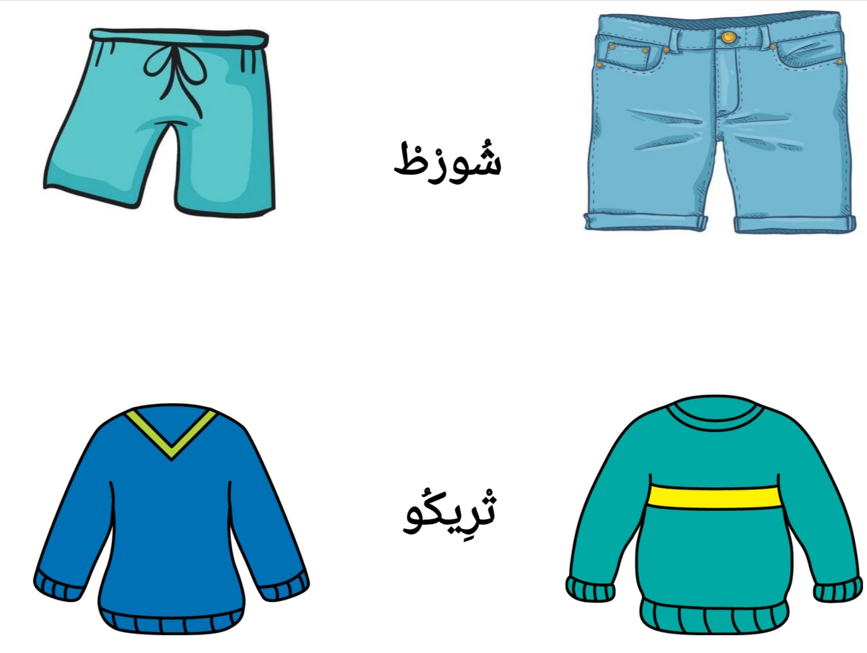
Short
Trikoo

Slide 17
Kan-safr / I travel
Kan-mshi/ I go
Kan-nعs/ I sleep
Kan-xdm/ I work
Kan-dir/ I do/ I make
Kan-tkallm/ I talk / I speak
Kan-akul/ I eat
Kan-shrub/ I drink
Kan-skn / I live
Kan-shri / I buy
Kan-shuf/ I see/ watch
kan-fiq/ I wake up
Kan-tعllm / I learn
Kan-gls/ I stay/ I sit
Dars/ lesson
Luġa/ Luġaat =Language
Daba/ now
Souq / market
Ġdda/ tomorrow
BoHdi/ Alone/
Verb want
Bġit = I want
Bġiti= u want
Bġa= he wants
Bġat= she wants
Bġina= we want
Bġitu= u want
Bġau= they want
Gadi= will
Ymken= Can
Xss= need to
Question
Fin/ where
Shnu/ what
Kif / how
Mnin/ from where
Dyal mn= whose
Sh-Hal mn
Bsh-Hal= price
Sh-Hal= amount
Ashmn= which
Imta=when
Mعa mn=with who
Wesh
Mعa= with
Bash= in order
Hitash= because
L-ftoor - Lġdda- Laعsha
Breakfast - Lunch - Dinner

Slide 18
كَــنْسَافْر / we travel
كَــنْمْشِي/ I go
كَـنْعَسْ/ I sleep
كَـيْخْدَمْ/ he works
كَـنْدِيرْ/ I do/ I make
كَنْتْكَلَّمْ/ I talk / I speak
كَنْتْعَـلَّمْ/ I learn
كَنَاكُــلْ/ I eat
كَنْشْرُبْ/ I drink
Verb want
بْغِيتْ = I want
بْغِيتِي= you want
بْغَا= he wants
بْغَاتْ= she wants
بْغِينَا= we want
بْغِيتُو= you want [pl]
بْغَاوْ= they want
غَادِي= will/going to
يَمْكَنْ= Can/might
خَاصْ= need to
Question
فِينْ/ where
شْنُو/ what
كِيفْ/ how
مْنِينْ/ from where
دْيَالْ مَنْ= whose
شْحَالْ مَنْ
بْشْحَالْ= price
شْحَالْ= amount
أَشْمَنْ= which
إِمْتَا=when
مْعِ مَنْ=with who
وَاشْ
مْعَ= with
بَاشْ= in order
حِيتَاشْ= because
Kan= I / We + u at the end
Kat= You+ i for you female you / She / You plural + u
Kay = He / They + u at the end
الفْطُورْ – العشا الغدا
Breakfast - Lunch - Dinner

Slide 19
We are very happy and proud of your children’s success
Hna farHanin bzaaf b najaH dyal wladkum u Hna faxoorin b natija dyalhum
We wish for them a good future and we thank you for coming to this event
Kan-tmanau li+hum Mustaqbal mazyan
U kan-škru+kum عla L-Hudoor dyalkum mعana.

Slide 20
safrt / I travelled
mšit/ I went
nعst/ I slept
xdmt/ I worked
drt/ I did/ I made
tkallmt/ I talked / I spoke
klit/ I ate
šrbt/ I drank
sknt / I lived
šrit / I bought
šft/ I saw/ watched
fqt/ I woke up
tعllmt / I learnt
glst/ I stayed/ I sat
qrit/ I read/ I studied
Wslt/ I arrived
Tlaqit/ I met
Salit/ I finished
Dars/ lesson
Luġa/ Luġaat =Language
Daba/ now
Souq / market
Ġdda/ tomorrow
BoHdi/ Alone
Mعa= with
Baš= in order
Hitaš= because
Simana lli fatt/ last week
Lعam lli fat/ last year
lbarH/ yesterday
Walo = nothing
Bakri= early
Question
Fin
šnu
Kif
Weš
Mnin
Shkun/ who
Dyal mn= whose
š-Hal mn= amount
Bsh-Hal= price
š-Hal= amount
Ašmn= which
Imta=when
Mعa mn=with who
L-ftoor - Lġdda- Laعša
Breakfast - Lunch - Dinner

Slide 21
Bga yšuf film lyum = He wants to see a movie today
Bgat t-safr lmagreb = she wants to travel to Morocco
Bgina n-mšiu l suq gadda = we want to go to the supermarket tomorrow
Kay-aklu lftoor bakri f lweekend = They eat breakfast early on the weekeends
Kat-lعb lkoora mعa SHabha f tiran dyal lmadrassa = She plays football with her friends at the stadium of the school
Wladi kay-bgiu djaaj u lbtata f lgda
Ana kan-bgi lqahwa u lxubz f lftoor
Lyum gadi n-mši lxadma bakri
Ana bgit n-skn f lmagreb
Lfamila dayli ma-kay-šrbu-š LHleeb
Ana bgit n-safr bzaaf had lعam
Gadda gadi nšuf SaHbi f lxadma
Lyum bgit nakul LHam f lgda
Wladi bgau y-šufu film dyal lcomedia lyum
Tomorrow we will go to eat at the restaurant
Gdda gadi n-mšiu nakulu f restora
Gadda ma-bgina-š n-akulu Lhut

Slide 22
Verb to have in the present
عndi = I = have
عndk = You =
عndha = She =
عndu = He =
عndna = We =
عndkum = You=
عndhum= They =
Verb to be in the past
knt = I = was
knti = You = were
kant= She = was
kan = He = was
knna = We = were
kntu= You= were
kanu= They = were
Examples

Slide 23
Kan-safr / I travel
Kan-mši/ I go
Kan-nعs / I sleep
Kan-xdm/ I work
Kan-dir/ I do/ I make
Kan-tkallm/ I talk / I speak
Kan-tعllm / I learn
Kan-akul / I eat
Kan-šrub/ I drink
Kan-skn / I live
Kan-bgi/ I like
Kan-šri / I buy
Kan-šuf/ I see/ watch
kan-fiq/ I wake up
Kan-gls/ I stay/ I sit
Kan-qra/ I study
Kan-lqa/ I find
Kangul= I say
Kan-lعb/ I play
Kanzur/ I visit
Kan-kmi/ I smoke
Kan-suwl/ I ask
Kan-jawb/ I answer
Verb want
Bġit = I want
Bġiti= you want
Bġa= he wants
Bġat= she wants
Bġina= we want
Bġitu= you want [pl]
Bġau= they want
Gadi= will/going to
Ymken= Can/ might/ could
Xss= need to
Baš= in order
Question
Fin/ where
šnu/ what
Kif / how
Škun/ who
Mnin/ from where
Dyal mn= whose
š-Hal mn- amount
Bš-Hal= price
š-Hal= amount
Ašmn= which
Imta=when
Mعa mn=with who
Weš= do/ yes no
Mعa= with
Baš= in order
Hitaš= because
wesh kayakul Lhut
Kan= I / We + u at the end
Kat= You+ i for you female you / She / You plural + u
Kay = He / They + u at the end
L-ftoor - Lġdda- Laعsha
Breakfast - Lunch - Dinner

