Slide 1
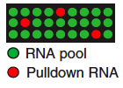
RBP
Single binding reaction
Identification of bound RNA
RNA pool

