Slide 2
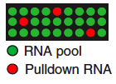
RNA pool
single binding reaction
RBP
identification of bound RNA

