Slide 1
MASTER THESIS DEFENSE
Battery Re-X Digital Twin and Robotic Sorting System
Computer Vision, SOH Prediction, and Lifecycle Decision Support
Prepared by: Project Owner
Date: 18 June 2026
Project: Battery Re-X Control Twin
AI vision
SOH ML
Re-X route
Unity twin
Project defense deck | public datasets + implemented backend + Unity prototype
01
Notes:
Open with the core idea: an automated decision-support pipeline for battery reuse, remanufacturing, recycling, and quarantine.
Emphasize that the project combines computer vision, battery health prediction, backend APIs, and a Unity digital twin.
Suggested animation: title first, then subtitle, then the four pipeline pills.

Slide 2
PROBLEM
Problem & Motivation
Battery reuse decisions need more than visual inspection.
Waste pressure
Safety risk
Decision complexity
Lithium-ion batteries create growing end-of-life streams. Manual sorting is slow and inconsistent when form factor, condition, and route must be assessed together.
Unknown SOH, high temperature, abnormal voltage, and high resistance can turn a reuse candidate into a quarantine case.
A visual battery type is not enough. A defensible Re-X route needs health data, risk rules, and traceable decisions.
Engineering challenge: combine image-based identification with sensor-based health prediction and robotic sorting.
Motivation slide: circular economy, safety, and sorting risk
02
Notes:
Frame the problem around safety and material recovery.
Make clear that the project addresses decision support, not full industrial certification.
Suggested animation: reveal the three problem cards one by one.

Slide 3
VISION
Project Vision
Battery enters the digital twin, is classified, health-scored, routed, and sorted.
BAT
Battery intake
CV
AI detection
ML
SOH prediction
RX
Re-X decision
3D
Unity twin
BOT
Robot sort
Unknown cell on conveyor
Cylindrical / pouch / prismatic
ML from health parameters
Reuse / reman / recycle / quarantine
State, color, UI panel
Move to target bin
Design principle
Image determines physical type. Health parameters determine SOH. Safety rules override unsafe cases.
Concept pipeline
03
Notes:
Walk through the end-to-end pipeline from the unknown battery to the sorting bin.
Stress the separation of responsibilities: CV for form factor, ML for health, rules for safety.
Suggested animation: follow the arrows from left to right.

Slide 4
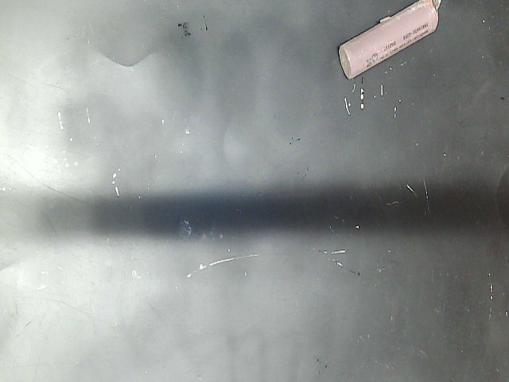
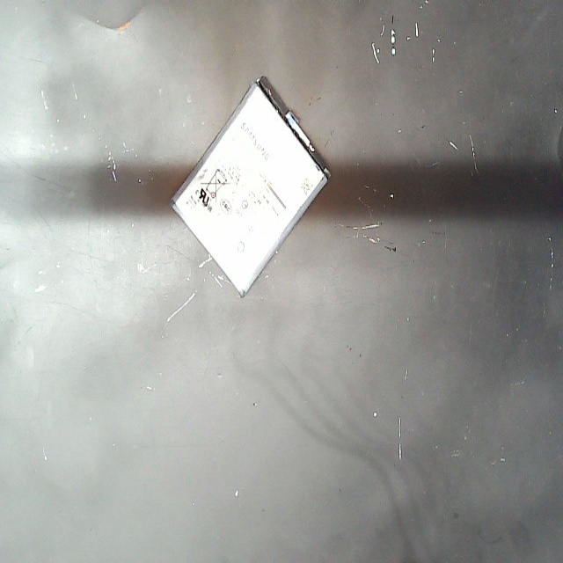
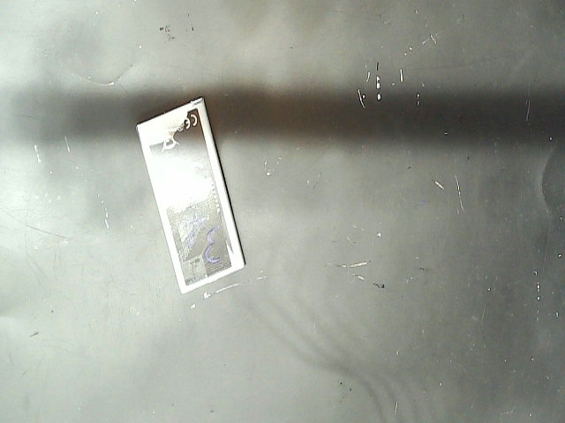
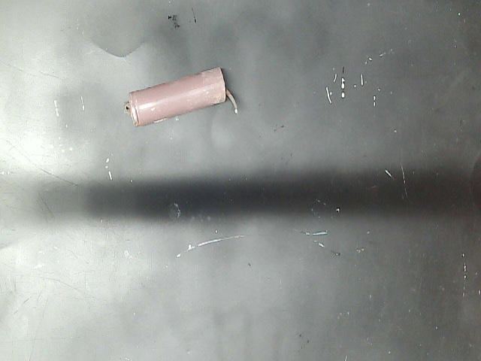
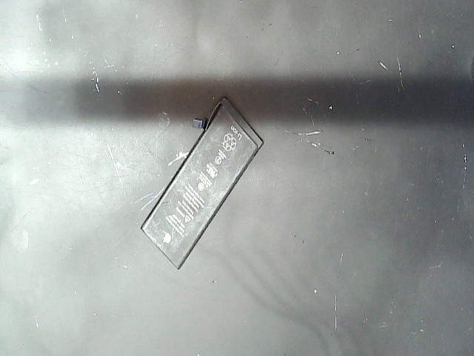
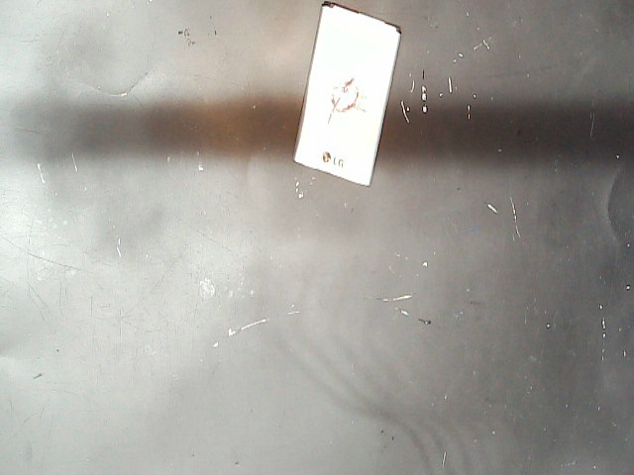
DATASET 1
RecyBat24 Image Dataset
Real battery images are used for visual shape classification.
Public dataset
Runtime subset
90 images total: 30 cylindrical, 30 pouch, 30 prismatic.
Implemented
Use in project
Training/evaluation labels come from folders. Runtime prediction uses image pixels, not filenames.
Evaluated
Selected CV model
HOG features + Linear SVM. 5-fold CV accuracy: 98.89%; holdout accuracy: 96.30%.
Sources: RecyBat24 subset in data/images; project evaluation report
04
Notes:
Explain that RecyBat24 provides the visible battery form factor data.
Clarify that filenames are not used for runtime prediction, avoiding label leakage.
Mention that the dataset is useful for a prototype but small for production.

Slide 5
DATASET 2
Battery Aging Data for SOH
Capacity-based SOH training uses NASA-derived battery aging records.
Public dataset
Implemented
Capacity based
Honest scope
Selected data
Rows used
Target
Limit
NASA PCoE Li-ion aging subset extracted from raw .mat files.
636 clean discharge-cycle rows from B0005, B0006, B0007, B0018.
SOH is calculated from measured capacity divided by rated capacity.
Current calibration is cylindrical-heavy.
Feature
Meaning
Used by ML?
Source
cycle_count
aging progression
yes
NASA discharge cycles
temperature_c
thermal condition
yes
measured discharge data
internal_resistance_mohm
electrical degradation proxy
yes
nearest impedance cycle
voltage
operating condition
yes
measured discharge data
capacity
SOH label generation
target only
measured capacity
Sources: NASA PCoE Battery Data Set; data/nasa_health/battery_health_lookup.csv
05
Notes:
Explain why NASA was selected: available, capacity-based, and useful for SOH.
Be honest that CALCE and Oxford are future extensions for broader form-factor coverage.
Suggested animation: show selected data, rows, target, limitation.

Slide 6
DATA BOUNDARY
Why Image Alone Is Not Enough
The image classifies form factor; health measurements estimate SOH.
TYPE
Battery type
cylindrical / pouch / prismatic
IMG
Image data
Shape, visible form factor, visual capture
RX
Re-X decision
SOH + safety rules + type context
DATA
Health data
SOH
Predicted SOH
cycle, temp, resistance, voltage
ML regression output in %
A camera can see geometry. It cannot measure electrochemical aging.
Design rationale
06
Notes:
This is a key defense slide.
Make the technical boundary very explicit: image for shape, sensors for health, combined data for route.
Suggested animation: image path, health path, then decision node.

Slide 7
ARCHITECTURE
System Architecture
Unity, backend AI, passport data, ML SOH, decision rules, and robot sorting.
3D
Unity Simulation
CAM
Camera Image
CV
AI Vision Backend
DB
Battery Passport
conveyor, camera, robot, UI
uploaded battery photo
HOG + Linear SVM
id + metadata + log
SIM
Sensor Stage
ML
SOH ML Model
RX
Re-X Engine
RB
Robot Sort
mock health readings
RandomForestRegressor
threshold + safety rules
target bin command
Project architecture diagram
07
Notes:
Explain the system as coupled services rather than a monolithic demo.
Mention the main implemented files if asked: backend/main.py, backend/model.py, backend/ml/soh_model.py, Unity C# scripts.
Suggested animation: top row first, then bottom row.

Slide 8
COMPUTER VISION
AI Vision Pipeline
Runtime classification uses image pixels, not file names.
01
Input image
02
Preprocessing
03
HOG features
04
Linear SVM
05
Type output
Unity camera sends selected battery image
resize + grayscale / feature extraction
shape gradients and edge directions
best evaluated classifier
cylindrical / pouch / prismatic
Model
Feature set
5-fold acc.
Holdout acc.
Status
Linear SVM
HOG
98.89%
96.30%
selected
Logistic Regression
color + shape
96.67%
96.30%
baseline
RBF SVM
hybrid
95.56%
96.30%
compared
Random Forest
color + shape
92.22%
85.19%
rejected
Sources: scripts/train_compare_cv_models.py; backend/model.py
08
Notes:
Walk through the CV pipeline from image to class output.
Emphasize that HOG is appropriate because the classes differ by geometry and edge structure.
Note dataset size as a limitation.

Slide 9
DIGITAL PASSPORT
Digital Battery Passport
A structured record keeps identity, sensor values, prediction, and decision traceable.
BATTERY PASSPORT
Why it matters
battery_id
DXB-REAL-BAT-001
Passport-style records make each Re-X decision auditable and explainable.
type
cylindrical
cycle_count
430
Mock/simulated
temperature
31.2 C
Current prototype
voltage
3.72 V
Identity and inspection history are implemented; some fields are simulated because no real BMS is connected.
resistance
52.0 mOhm
predicted_soh
94.49%
Future work
timestamp
API response time
Industrial extension
Replace mock readings with BMS, lab tester, or line-sensor data.
Sources: backend/passport.py; logger outputs
09
Notes:
Show the passport as the data contract around a battery.
Explain that it is useful for traceability, audit, and operator confidence.
Be clear that some values are mock in this prototype.

Slide 10
SOH METHOD
SOH Prediction Method
Training uses capacity-derived SOH; inference uses health parameters.
SOH (%) = current capacity / rated capacity × 100
Implemented
Implemented
Implemented
Training target
Inference inputs
Prediction output
NASA rows include measured capacity. I calculate SOH directly from capacity for supervised learning.
At runtime Unity sends cycle count, temperature, resistance, voltage, and battery type.
Backend returns predicted SOH percentage, confidence estimate, risk score, and Re-X route.
Important: the model does not predict SOH from image pixels.
Sources: docs/soh_ml_pipeline.md; scripts/train_soh_models.py
10
Notes:
Explain the SOH formula first, then the machine learning inference problem.
Clarify that capacity is available in training but not always at sorting-line inference.
Suggested animation: formula, training target, inference inputs, output.

Slide 11
MODEL COMPARISON
ML Model Comparison
Five regressors were trained and compared on NASA-derived SOH rows.
Model
MAE
RMSE
R2
MAPE
Notes
RandomForestRegressor
0.5348
0.7761
0.9946
0.6617%
selected; lowest RMSE
SupportVectorRegression
0.6487
0.8919
0.9929
0.8095%
strong small-data model
GradientBoostingRegressor
0.6524
0.9097
0.9926
0.8131%
boosted tree comparison
MLPRegressor
0.8880
1.2145
0.9869
1.0899%
simple neural network
LinearRegression
1.3367
1.7185
0.9737
1.6764%
baseline
Implemented
Selected automatically by lowest RMSE, then MAE.
Source: outputs/model_evaluation/soh_model_comparison.json
11
Notes:
This slide answers how many models were tested and why.
Mention that XGBoost/LightGBM are optional in the script if installed, but not present in this environment.
Do not overclaim production accuracy because the data is limited.

Slide 12
DECISION ENGINE
Re-X Decision Engine
The route combines predicted SOH thresholds with safety overrides.
SOH >= 80%
Reuse
Implemented
Safety override
Missing data, unknown type, abnormal voltage, high resistance, or very high temperature routes to quarantine.
60% <= SOH < 80%
Remanufacture
30% <= SOH < 60%
Recycle
Implemented
Backend output
Route, target bin, risk score, risk level, confidence estimate, and explanation string.
SOH < 30%
Quarantine
Sources: backend/ml/soh_model.py
12
Notes:
Explain that SOH thresholds are simple and transparent by design.
Stress that safety rules override high SOH when measurements are abnormal.
Suggested animation: reveal thresholds top to bottom, then safety override.

Slide 13
UNITY TWIN
Unity Digital Twin
The simulation visualizes classification, sensor updates, SOH, route, and bin assignment.
CV
Shape update
UI
Sensor UI
ML
SOH response
3D
Route color
3D battery object changes to classified form factor
floating panel shows voltage, temp, cycles, resistance
backend ML result updates each battery record
material/bin color follows Re-X decision
Unity element
Status
Source
Notes
Conveyor sequence
Implemented
ConveyorController.cs
classification -> sensors -> ML
Floating panel per battery
Implemented
BatteryFloatingInfoPanel.cs
updates while moving
Selected battery panel
Implemented
BatterySelectionDetailPanel.cs
tap/click details
Sensor values
Simulated
BatteryInspectionClient.cs
mock until hardware exists
Sources: Unity scripts in Assets/Scripts
13
Notes:
Describe how the Unity scene communicates the AI state visually.
Be honest: the sensor values are mock readings, but the API call and UI update path are implemented.
Mention the per-battery UI panels added to support multiple batteries.

Slide 14
ROBOTICS
Robotic Sorting Workflow
The robot receives the target bin after the backend Re-X decision.
01
Inspection
02
Decision
03
Robot pick
Reuse
camera + sensors
SOH + rules
gripper action
Reman
Recycle
Quarantine
Sources: RobotSorter.cs; ABBCRBArmController.cs
14
Notes:
Explain the robot as the physical output stage of the decision engine.
Clarify that the robot is simulated in Unity, not a real hardware arm yet.
Suggested animation: conveyor, decision gate, robot arc, bins.

Slide 15
BACKEND API
Backend API
FastAPI endpoints connect Unity, CV, SOH prediction, logs, and passports.
Endpoint
Purpose
Status
Notes
/classify-battery
image -> type
Implemented
Unity sends camera image; backend returns type and confidence
/predict-soh
health -> SOH + route
Implemented
Unity sends mock sensor values; backend returns Re-X category
/soh-model-metrics
model report
Implemented
Returns selected model and evaluation metrics
/inspect-battery
legacy full inspection
Implemented
Older combined image + lookup flow remains available
/train-soh-model
train via API
Planned
Training currently runs as scripts/train_soh_models.py
{
"cycle_count": 430,
"temperature": 31.2,
"resistance": 0.052,
"voltage": 3.72
}
{
"predicted_soh": 94.49,
"rex_category": "reuse",
"model_used": "RandomForestRegressor"
}
Sources: backend/main.py
15
Notes:
Show that the backend is not just a placeholder; routes exist and were smoke-tested.
Be clear that train-soh-model is not an API endpoint yet; training is a script.
Suggested animation: request JSON, arrow, response JSON.

Slide 16
CASE STUDY
Example End-to-End Case
A real API smoke test routes BAT_001 to reuse.
BAT_001
IN
Input
image classified as cylindrical + sensor data
Type
Cylindrical
Cycle Count
430
Temperature
31.2 C
ML
ML prediction
Resistance
0.052 ohm
RandomForestRegressor predicts SOH 94.49%
Voltage
3.72 V
Predicted SOH
94.49%
Decision
Reuse
OUT
Unity output
Target Bin
reuse_bin
green material + reuse bin command
Source: backend /predict-soh smoke test
16
Notes:
Use this as the concrete proof that the endpoint returns a complete Re-X decision.
Say this is a smoke-test example, not a physical battery measurement.
Suggested animation: input, ML prediction, Unity output.

Slide 17
RESULTS
Results / Demo Outputs
Current outputs combine model evaluation and backend smoke-test routing.
Battery ID
Type
SOH
Re-X Category
Risk
Unity/Backend Output
BAT_001
cylindrical
94.49%
reuse
low
reuse_bin / green
BAT_002
pouch
94.52%
reuse
low
reuse_bin / green
BAT_003
prismatic
67.91%
remanufacture
medium
remanufacture_bin / yellow
BAT_004
pouch
94.60%
quarantine
high
safety override: high_temperature
Evaluated
Evaluated
Placeholder
Vision result
SOH result
Demo video
Selected CV model: HOG + Linear SVM, 98.89% mean 5-fold CV accuracy.
Selected SOH model: Random Forest, RMSE 0.7761 SOH percentage points.
No project video file found. Insert Unity demo recording here after capture.
Sources: model reports and backend smoke tests
17
Notes:
Explain that these are software validation outputs, not industrial validation results.
The quarantine case demonstrates the safety override logic.
The video slot is intentionally marked as a placeholder because no video exists in the project.

Slide 18
STATUS
Implementation Status
Each claim is labeled by current evidence in the repository.
Feature
Status
Evidence/File
Notes
RecyBat24 image subset
Implemented
data/images; data/image_sources.csv
90 images, balanced classes
CV classifier
Implemented
backend/model.py; trained_models/battery_type_classifier.joblib
HOG + Linear SVM
SOH ML model
Implemented
backend/ml/soh_model.py; soh_predictor.joblib
Random Forest selected
Mock health sensors
Simulated
BatteryInspectionClient.cs
Unity generates sensor values
Re-X routing
Implemented
backend/ml/soh_model.py
SOH thresholds + safety rules
Unity digital twin
Implemented
Assets/Scripts/*.cs
visual workflow and panels
Real BMS/robot hardware
Planned
future work
not connected in prototype
Defense rule: implemented means code/artifact exists; simulated means software behavior exists without real hardware; planned means future scope.
Sources: project files and generated model artifacts
18
Notes:
Use this slide if an examiner asks what is actually implemented.
Avoid exaggeration: real hardware and BMS are planned, not implemented.
Suggested animation: none; keep this slide clear and static.

Slide 19
LIMITATIONS
Limitations
The prototype is technically functional, but not an industrial validation system yet.
Image cannot determine SOH
Dataset generalization
Mock health data
Images support shape detection and visible condition only. SOH requires health measurements.
NASA SOH training data is cylindrical-heavy and limited to 636 clean rows.
Unity uses random mock sensor inputs because no real sensor/BMS data stream is connected.
Safety certification
Robot hardware
Uncertainty
Industrial routing would require validated safety rules, calibration, and hazardous material procedures.
The sorting workflow is simulated in Unity; real robot control is future work.
Confidence is based on residual error estimate; production uncertainty needs stronger calibration.
Project limitations
19
Notes:
Use this slide to build examiner trust.
State limitations clearly before future work.
Suggested animation: reveal limitations in two rows.

Slide 20
FUTURE WORK
Future Work
The next stage is real sensor integration, broader data, and hardware-grade robotics.
Future work
Future work
Future work
Real BMS integration
Chemistry-specific models
CALCE + Oxford expansion
replace mock sensor data
NMC / LFP / LCO calibration
pouch/prismatic aging coverage
Future work
Future work
Future work
ROS 2 / Gazebo
Thermal / X-ray inspection
Edge AI deployment
robot control stack integration
safety and internal damage sensing
factory-line latency and robustness
Future roadmap
20
Notes:
Present future work as a credible engineering roadmap.
Tie each item back to a limitation from the previous slide.
Suggested animation: one roadmap card at a time.

Slide 21
CONCLUSION
Conclusion
A proof-of-concept for circular battery lifecycle decision support.
I designed and implemented a modular Re-X decision pipeline that connects vision, health prediction, backend reasoning, Unity visualization, and robotic sorting logic.
Technically honest
Working prototype
Clear next step
Image = shape; health data = SOH; route = ML + safety rules.
Models, API endpoints, Unity panels, and sorting flow are integrated.
Connect real BMS/sensor data and extend aging datasets.
Project conclusion
21
Notes:
Summarize the project as an integrated proof-of-concept.
End on the clear contribution: traceable lifecycle decision support.
Suggested animation: main sentence, then three cards.

Slide 22
Q&A
Questions?
Battery Re-X Digital Twin and Robotic Sorting System
CV + SOH ML + Re-X Decision + Unity Digital Twin
Q&A | References: RecyBat24, NASA PCoE, project repository artifacts
22
Notes:
Invite questions and be ready to defend the separation between image classification and SOH prediction.
If asked about limitations, point back to slides 18 and 19.
If asked about the next experiment, propose real BMS data integration and CALCE/Oxford expansion.

