Slide 1

AriZon — Smart PDS
Next-Generation Ration Stock Visibility & Sovereign AI Governance
"Know the stock before you travel. Track the supply. Verify the transaction."

Slide 2

The Broken Last Mile in Food Security
The Blind Journey
Citizens travel to Fair Price Shops without knowing if their quota is even in stock — wasted trips, wasted days.
Asymmetric Information
Only shopkeepers know when stock arrives. Elders and daily wage earners are the last to find out — and the first to miss out.
Inwarding Discrepancies
Dispatches suffer transit losses and weighbridge errors that dealers silently absorb, creating untraceable leakage.
Siloed Administration
Officers discover pilferage weeks later during manual audits — never in real-time, always too late.

Slide 3
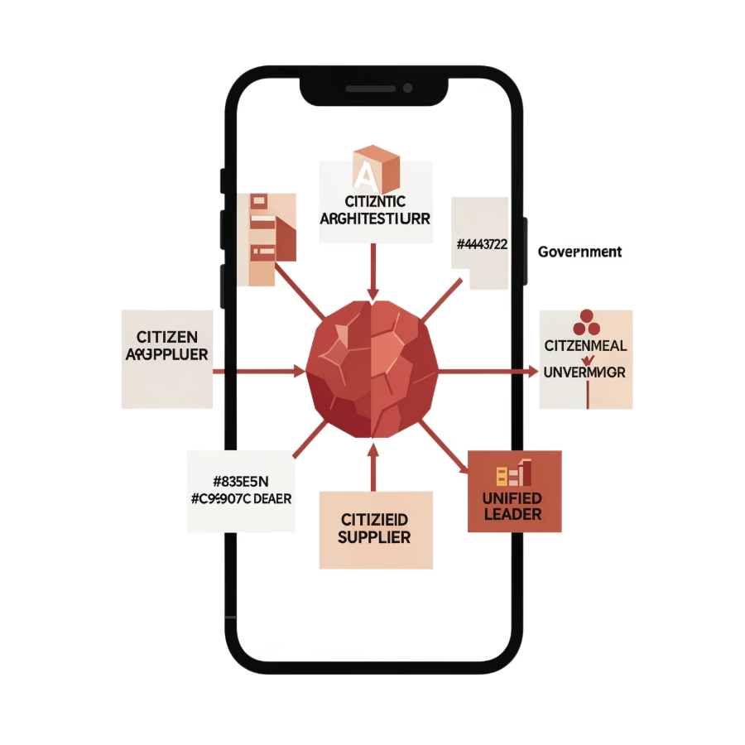
The Unified Agentic Architecture
One Brain. Four Portals. Zero Hallucinations.
1
Single AI Agent Core
One shared brain orchestrating 12 role-scoped tools with strict access control across every stakeholder.
2
4 Seamless Portals
Citizen, Ration Dealer, Taluk Supplier, and Government — all connected to one unified ledger.
3
Live Ground-Truth Pre-Prompting
Every AI query is injected with exact database facts — zero hallucinations, always grounded.
4
Multi-Signal Trust Engine
Scale variance, citizen confirmation, and biometric velocity combine for targeted anomaly review.

Slide 4
The Citizen Portal: Zero Friction, Total Dignity
Passwordless Authentication
Real-Time Stock Availability
'Notify Me' Stock Watchdog
Live indicators for Boiled Rice, Raw Rice, Wheat, Sugar, and Kerosene — with distance markers to your nearest FPS.
Automated SMS alerts the moment out-of-stock items arrive at your shop. No more guesswork, no wasted journeys.
Log in with your 10-digit Ration Card ID + OTP. Supports Yellow AAY, Pink PHH, Blue Non-Priority, and White General categories.
Grouped Family Security
Full Malayalam & English
All registered household members notified simultaneously — preventing fraud, ghost draws, and duplicate claims.
Complete bilingual localization ensures high accessibility for seniors and non-English speakers across Kerala.

Slide 5

Fair Price Shop Ledger & Supply Verification
Dealer Tools Built for Ground Reality
1
2
Inward Delivery Inspection
Three Trust Signals
Compare dispatched weight vs. received scale weight with instant tolerance checks — discrepancies flagged immediately.
S1 scale-weight variance · S2 citizen confirmation ratio · S3 biometric transaction velocity — combined into one explainable trust score.
3
4
Real-Time e-POS Simulator
Offline-Resilient
Record sales to specific ration cards with auto-quota deduction and balance calculation — live, accurate, auditable.
Upload monthly stock sheets via Excel/CSV when internet connectivity fluctuates — no data ever lost.

Slide 6




End-to-End Grain Movement
Supplier Dispatch
Truck, driver, waybill tracking
Government Allocation
FPS Receipt
Issue consignment and waybill
Weighbridge check and sign-off
Government Allocation
Supplier Dispatch
FPS Receipt
Issue consignment and waybill
Truck, driver, waybill tracking
Weighbridge check and sign-off
Consignment Tracking
Weighbridge Reconciliation
Two-Man Approval Rule
Capture Vehicle Number, Driver Contact, Waybill ID, and Net Weight at every handoff point.
Auto-detects transit leakage between state dispatch and taluk weighing — every kilogram accounted for.
Strict dual-officer authorization for any anomalous delivery or quota redistribution — no unilateral overrides.

Slide 7
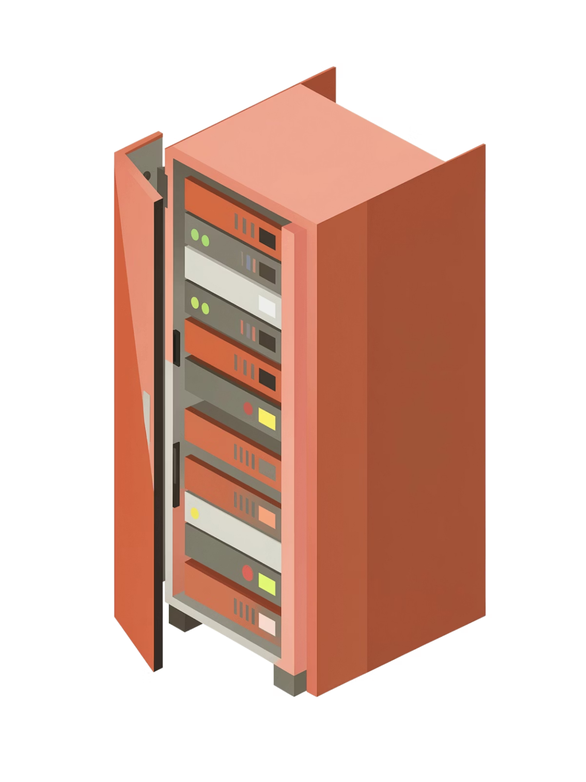
Pluggable AI Gateway & Data Sovereignty
Data Sovereignty First
Sensitive PDS beneficiary data and biometric logs never leave state borders. Kerala's citizens, Kerala's data.
Kerala Sovereign Indic LLM
Direct integration with state-hosted local edge inference via Ollama / vLLM / C-DAC Malayalam models — fully on-premise.
10+ Pluggable LLM Backends
Switch between Kerala Sovereign Local Indic LLM, OpenRouter, or Grok in real-time — zero server restarts required.
Zero-Downtime Hot-Swapping
Change models and API keys live from the Government UI — maximum flexibility, zero disruption to operations.

Slide 8

Automated Audit & Statewide Impact
85%
28%
100%
Fewer Wasted Trips
National Diversion Rate
NFSA Audit Readiness
Reduction in citizens traveling to empty Fair Price Shops across Kerala.
Documented national PDS diversion problem — now detectable in real-time, not weeks later.
Full compliance audit readiness with automated reconciliation and tamper-evident ledger trails.
How the Reconciliation Works
Expected Stock = Opening Balance + Inward Receipts − Total e-POS Sales
Any discrepancy greater than 50 kg or 5% automatically freezes the dealer's trust score and triggers a field inspection — no human intervention required to catch the alert.
Family-grouped SMS auditing by Ration Card ID eliminates duplicate notifications and proves zero wasted telecom spend — every rupee of the system's operating cost is justified.

