Slide 1
The Event Management System
Presented by: Patel Ami
Guide by: Dr D.B.Choksi

Slide 2
Project Profile
Project Title | The Event Management System
Purpose | To automate event creation, registration, payment, and ticket generation
Developer | Patel Ami
Organization | 7Sisters Tech
Organization Address | Skywalk the element,511,Jagatpur Rd,Gota,Ahemedabad,Gujarat 382481
Technologies | React JS, HTML5,CSS3,Axios,React , Bootstrap,PHP,MySQL
Development Tools | Visual Studio Code, XAMPP(server)
Objective | The objective of this project is to Simplify and manage event operations efficiently.
Project Type | Web application
Project Guide | Dr.D.B.Choksi

Slide 3
Hardware and Software Configuration
Hardware Configuration:
Processor: Intel Core i3 or above
RAM: 4GB or higher
System Type: 64-bit Operating System
Input Devices: Keyboard, Mouse
System: Laptop/Computer
Internet Connection
Software Configuration:
Operating System: Windows 11
Frontend: ReactJS
Backend: PHP
Database: MySQL
Server: XAMPP,Localhost,Apache
Code Editor: Visual Studio Code(VS Code)
Browser: Google Chrome / Edge
Payment Gateway: Razorpay
Notification Service: Firebase Cloud Messaging (FCM)

Slide 4
Salient features
Role-based login (Admin, Organizer, Customer).
City-wise event filtering.
Event creation and approval system.
Secure user authentication.
Notification system.
Payment and ticket generation.
QR code ticket PDF ticket download .
Dashboard for each role.
Contact and review system

Slide 5
Introduction
Event Management System is a web-based application to manage events digitally.
It helps organize seminars, workshops, conferences, and cultural programs easily.
The system reduces manual work like paper registration and ticket management.
It provides role-based access for Admin, Organizer, and Customer.
Organizers can create events and admin approves them.
Customers can search, register, and pay for events online.
System generates tickets with QR code and PDF download.
Notifications and city-wise event filtering improve user experience.
Built using React, PHP, and MySQL for secure and efficient management.
Overall, the system makes event management simple, fast, and organized.

Slide 6
Modules
Event Management System is divided into three main modules.
Admin Module manages and controls the entire system.
Organizer Module creates and manages events.
Customer Module allows users to browse and register for events.
Admin Module:
Admin manages categories like workshops, seminars, and conferences.
Approves or rejects events created by organizers.
Manages event registrations.
Views and manages all users.
Checks bookings and payment status.
Views user reviews and feedback.
Manages contact messages.
Receives notifications for events and registrations.
Ensures system security and smooth operation.

Slide 7
Modules
Organizer Module:
Organizer can create new events.
Enters event details like title, date, venue, event type, seats,price,etc.
Update events before admin approval.
Delete events before approval.
View all created events.
View event analytics.
View Total events and registered users.
Receives notifications for approval or rejection.
Organizer cannot modify event after admin approval.

Slide 8
Modules
Customer Module:
Register and log in securely.
Browse upcoming and today’s events.
Filter events city-wise.
View full event details.
Register for events.
Users complete payment for paid events.
Ticket ID and QR code are generated.
Download PDF ticket.
View registered events in dashboard.
Receive notifications for approvals and tickets.

Slide 9
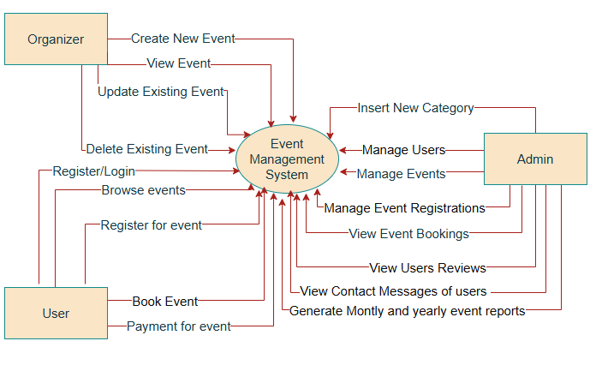
Data Flow Diagram
Context Level DFD

Slide 10
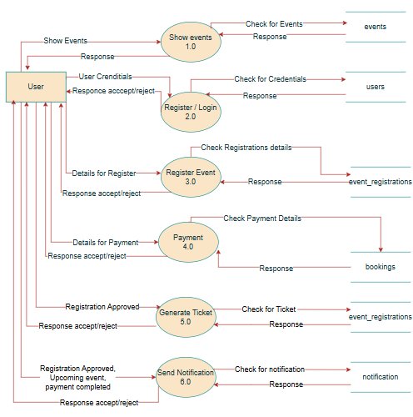
First Level DFD of users

Slide 11
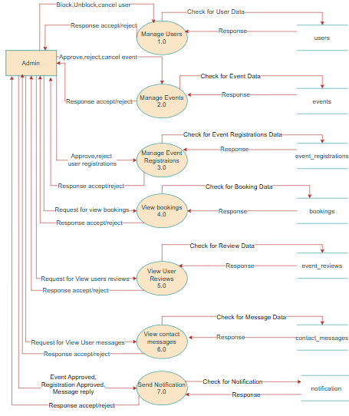
First Level DFD of admin

Slide 12
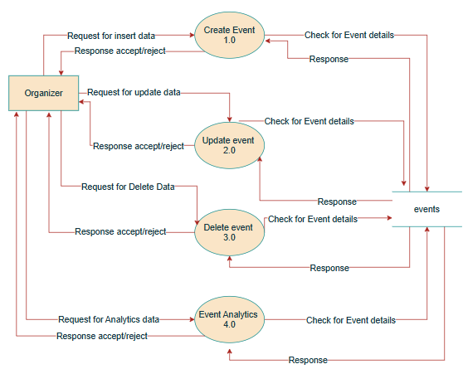
First Level DFD of organizers

Slide 13
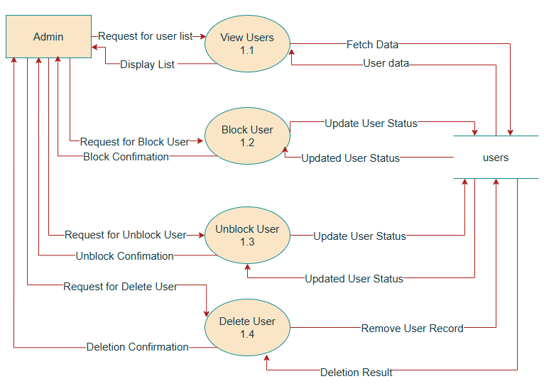
Second Level DFD of Admin

Slide 14
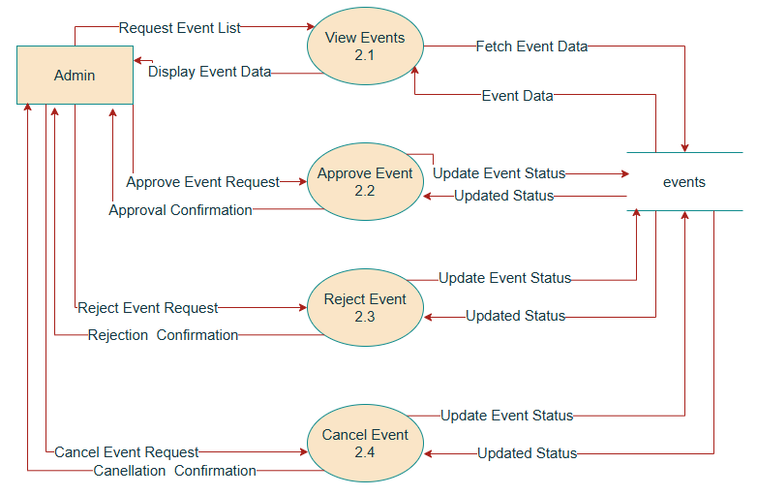
Second Level DFD of Admin

Slide 15
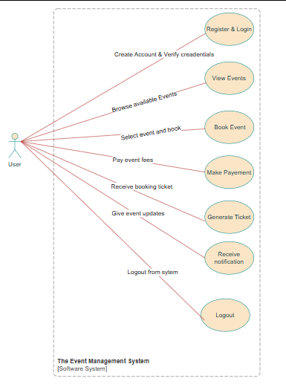
Use Case Diagram
Use Case Diagram of User

Slide 16
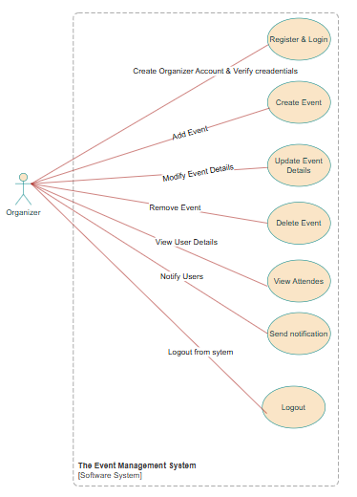
Use Case Diagram of Organizer

Slide 17
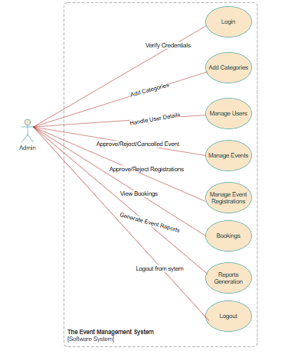
Use Case Diagram of Admin

Slide 18
Data Dictionary
Data dictionary is used to describe database tables and fields. It shows field name, data type, size, and constraints. It helps to understand how data is stored in the Event Management System database.

Slide 19
Table 1: users Purpose: To store information about users
Sr .no | Field Name | Data Type | Size | Constraints | Description
1 | id | Int | 11 | PK,Auto_Increment,Not null | Unique User identifier
2 | name | Varchar | 100 | Not null | Full name of user
3 | email | Varchar | 100 | Not null | Email of user
4 | phone | Number | 20 | Not null | Phone number of user
5 | password | Varchar | 255 | Not null | Encrypted user password
6 | role | Enum | customer, organizer ,admin | Not null, Default ‘customer’ | Role of user
7 | status | Enum | Active, blocked | Not null, Default ‘active’ | Account status
8 | created_at | Timestamp |  | Not null , Default Current_timestamp | Account creation date

Slide 20
Table 2: categories Purpose: To store event categories
Sr .no | Field Name | Data Type | Size | Constraints | Description
1 | id | Int | 11 | PK,Auto_Increment,Not null | Unique category identifier
2 | category_name | Varchar | 100 | Not null | Name of event category

Slide 21
Table 3: events Purpose: To store event details
Sr .no | Field Name | Data Type | Size | Constraints | Description
1 | id | Int | 11 | PK,Auto_Increment,Not null | Unique event identifier
2 | organizer_id | Int | 11 | FK(users), Not null | Organizer user id
3 | category_id | Int | 11 | FK(categories),Not null | Event category id
4 | title | Varchar | 255 | Not null | Event title
5 | date_time | Datetime |  | Not null | Event date & time
6 | location | Varchar | 255 | Not null | Event location
7 | city | Varchar | 100 | Not null | City of event
8 | description | Text |  | Not null | Event Description
9 | poster | Varchar | 255 | Not null | Event poster
10 | Status | Enum | pending, approved, rejected, cancelled | Not null, Default ‘pending’ | Event status
11 | event_type | Enum | Free, paid | Not null, Default ‘free’ | Event payment type
12 | price | Decimal | 10,2 | Not null, Default 0.00 | Price of ticket
13 | total_seats | Int | 11 | Not null | Total available seats
14 | available_seats | Int | 11 | Not null | Remaining available seats
15 | reminder_sent | Tinyint | 1 | Not null, Default 0 | Notification reminder
16 | created_at | timestamp |  | Not null, Default Current_timestamp | Event creation date

Slide 22
Table 4: event_registrations Purpose: To store registrations details
Sr .no | Field Name | Data Type | Size | Constraints | Description
1 | id | Int | 11 | PK, Auto_Increment ,Not null | Unique Registration id
2 | user_id | Int | 11 | FK(users),Not null | User id for identify user
3 | event_id | Int | 11 | FK(events),Not null | Event id for identify event
4 | ticket_id | Varchar | 255 | Not null | Ticket id for users
5 | status | Enum | Pending, confirmed, rejected,pending_payment ,cancelled_by_admin | Not null, Default pending | Event Registration status
6 | registered_at | timestamp |  | Not null, Default Current_timestamp | Registration date and time

Slide 23
Table 5: notification Purpose: To store notification details
Sr .no | Field Name | Data Type | Size | Constraints | Description
1 | id | Int | 11 | PK, Auto_Increment ,Not null | Unique notification id
2 | user_id | Int | 11 | FK(users),Not null | User id for identify user
3 | message | Text |  | Not null | Notification messages
4 | is_read | Tinyint | 1 | Not null | Notification readable or not
5 | created_at | timestamp |  | Not null, Default Current_timestamp | Notification creation date and time

Slide 24
Table 6: contact_messages Purpose: To store details about messages
Sr .no | Field Name | Data Type | Size | Constraints | Description
1 | id | Int | 11 | PK, Auto_Increment ,Not null | Unique contact id
2 | name | Varchar | 100 | Not null | Name of the user(sender)
3 | email | Varchar | 100 | Not null | Email of the user(sender)
4 | message | Text |  | Not null | Message content
5 | reply | Text |  | Not null | Admin reply
6 | status | Enum | New,read,replied | Not null, Default new | Message status
7 | created_at | timestamp |  | Not null, Default Current_timestamp | Message creation date

Slide 25
Table 7: event_reviews Purpose: To store event review details
Sr .no | Field Name | Data Type | Size | Constraints | Description
1 | id | Int | 11 | PK, Auto_Increment ,Not null | Unique review id
2 | user_id | Int | 11 | FK(users),Not null | User id for identify user
3 | event_id | Int | 11 | FK(events),Not null | Event id for identify event
4 | rating | Int | 11 | Not null, check(between 1 to 5) | Rating given between 1 to 5
5 | review | Text |  | Not null | Review comment
6 | created_at | timestamp |  | Not null, Default Current_timestamp | Review date

Slide 26
Table 8: bookings Purpose: To store details of paid event booking
Sr .no | Field Name | Data Type | Size | Constraints | Description
1 | id | Int | 11 | PK, Auto_Increment ,Not null | Unique booking id
2 | registration_id | Int | 11 | FK(event_registrations),Not null | Registration id
3 | ticket_id | Varchar | 255 | FK(event_registrations),Not null | Ticket id
4 | razorpay_order_id | Varchar | 100 | Not null | Razorpay order id
5 | razorpay_payment_id | Varchar | 100 |  | Razorpay payment id
6 | razorpay_signature | Varchar | 255 |  | Razorpay signature
7 | amount | Int | 11 | Not null | Booking amount
8 | payment_status | Enum | Pending, paid, failed, refunded | Not null, Default pending | Payment status
9 | booking_date | timestamp |  | Not null, Default Current_timestamp | Booking date and time
10 | razorpay_refund_id | Varchar | 100 |  | Razorpay refund id
11 | refund_amount | Int | 11 |  | Refund amount
12 | refunded_at | datetime |  | Not null, Default Current_timestamp | Refund fate and time

Slide 27
Table 9: user_tokens Purpose: To store user token
Sr .no | Field Name | Data Type | Size | Constraints | Description
1 | id | Int | 11 | PK, Auto_Increment ,Not null | Unique user token id
2 | user_id | Int | 11 | FK(users),Not null | User id for identify user
3 | token | Varchar | 255 | Not null | Generated token from Google
4 | created_at | Timestamp |  | Not null, Default Current_timestamp | Token creation date and time

Slide 28
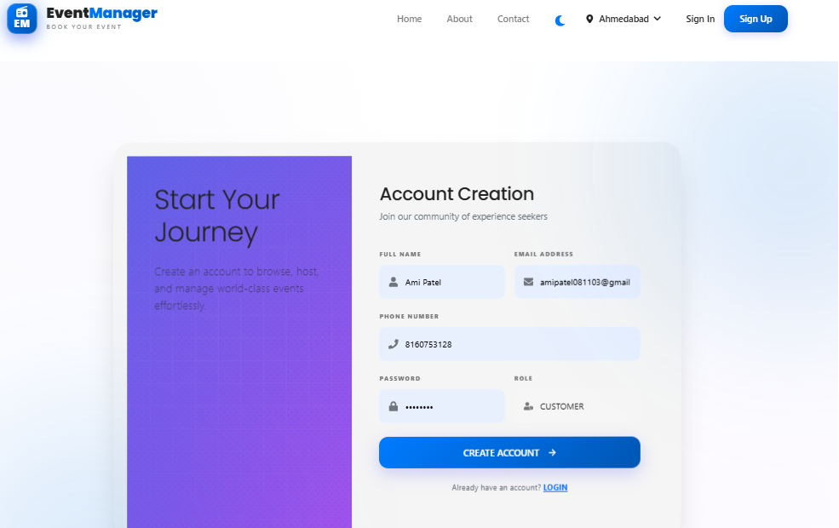
Web Interface
Register Page

Slide 29
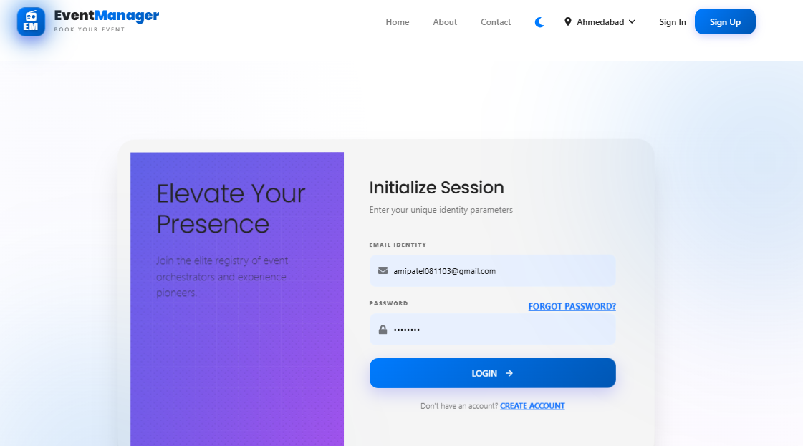
Login Page

Slide 30
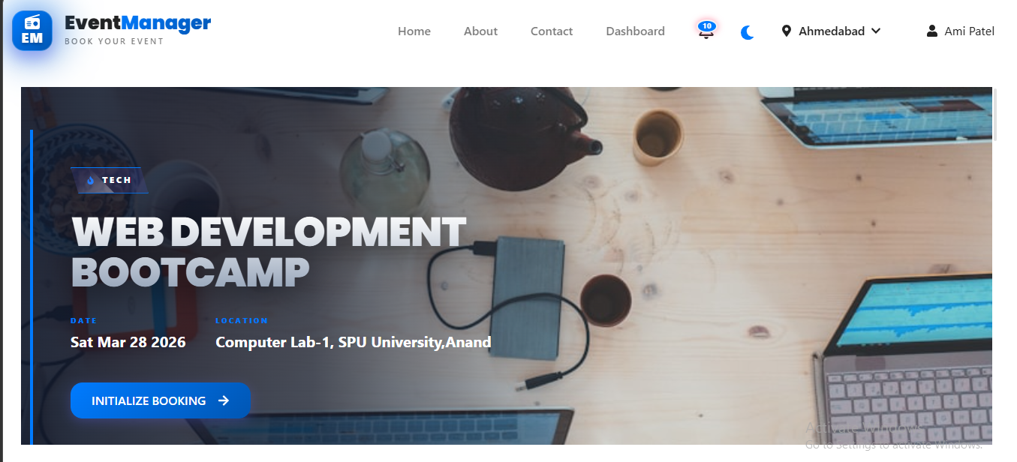
Home Page

Slide 31
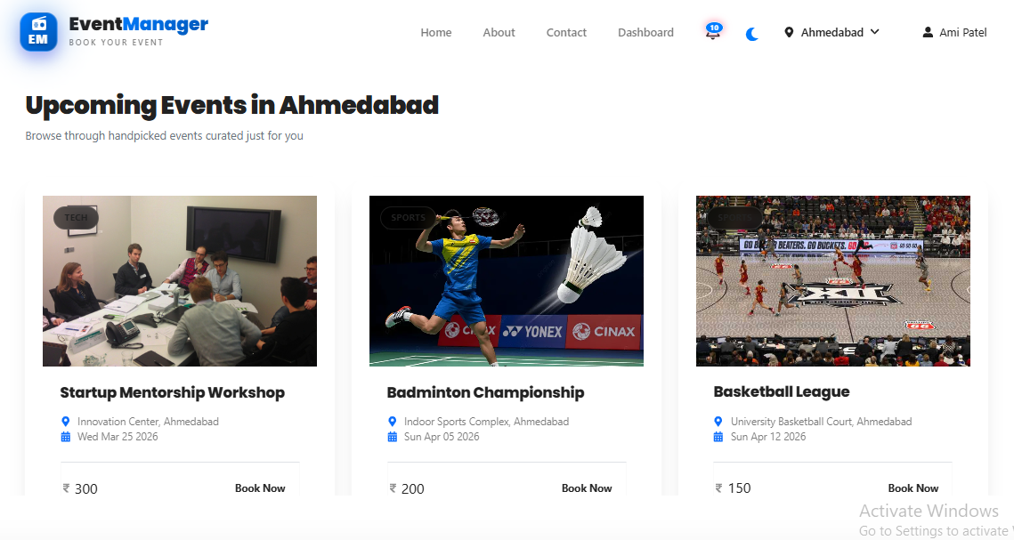
Upcoming Events

Slide 32
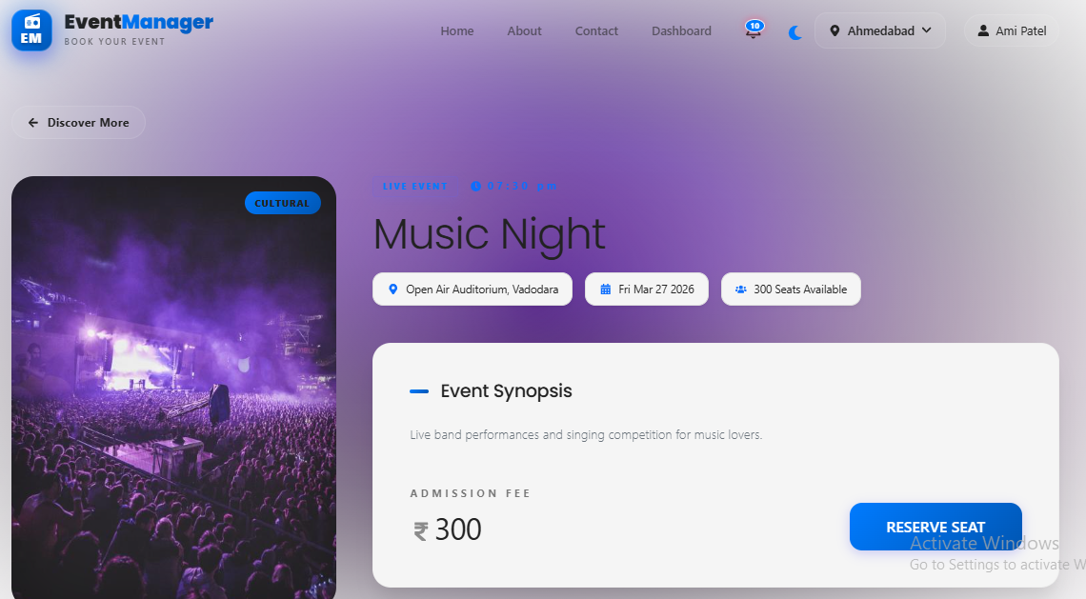
Event Details Page

Slide 33
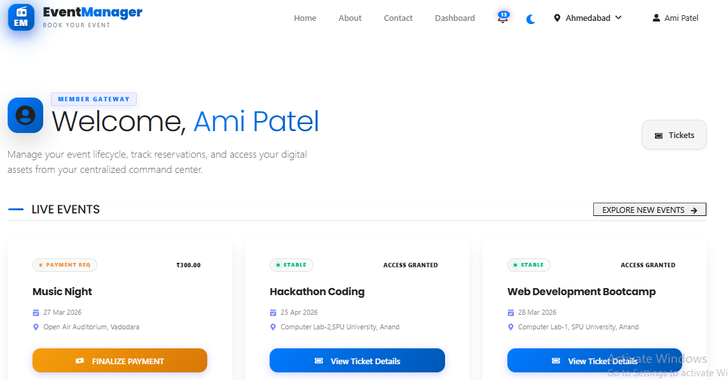
Customer Dashboard

Slide 34
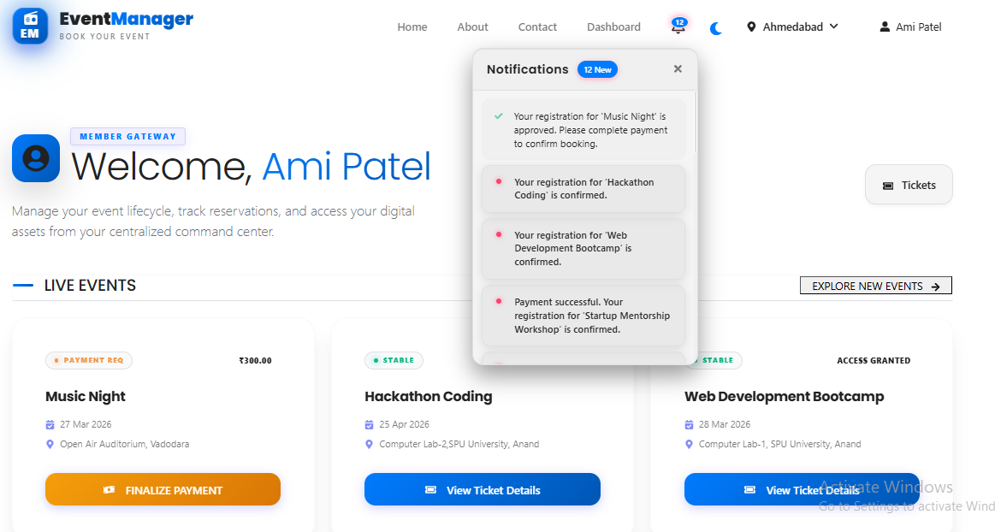
User Notification

Slide 35
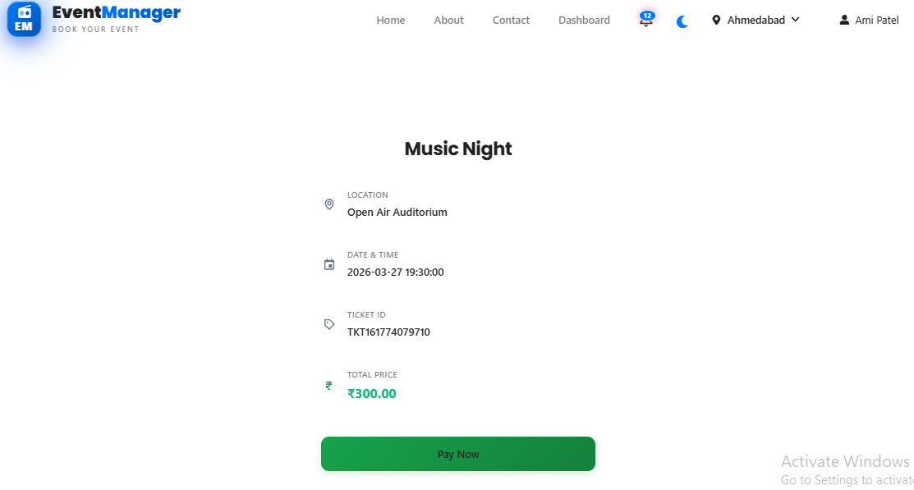
Booking Page

Slide 36
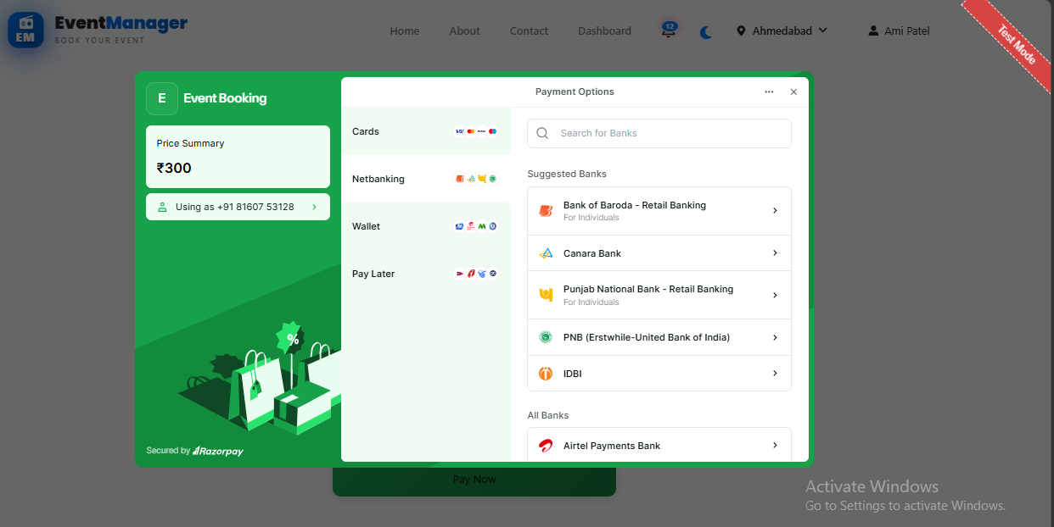
Payment Page

Slide 37
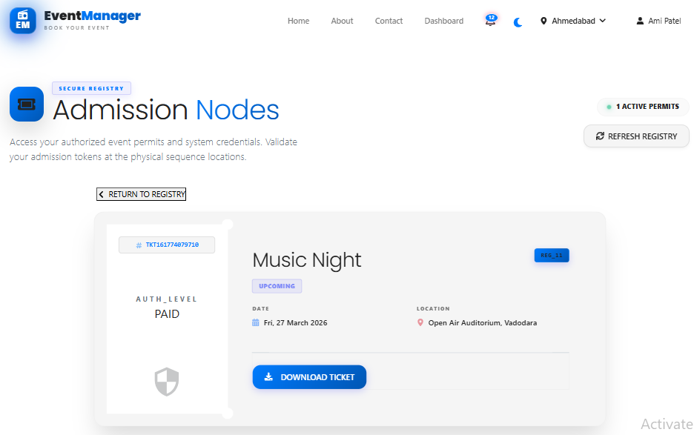
Ticket Page

Slide 38
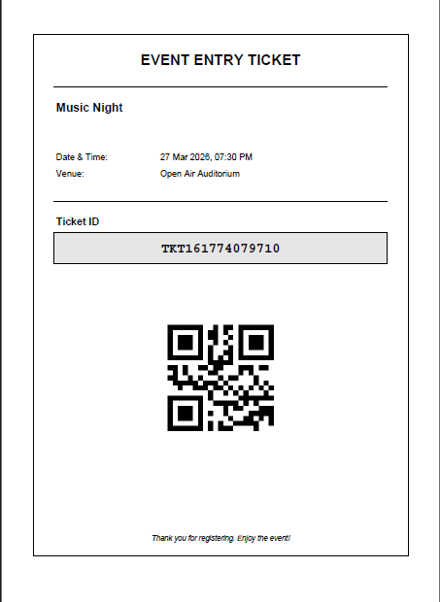
Ticket PDF Format

Slide 39
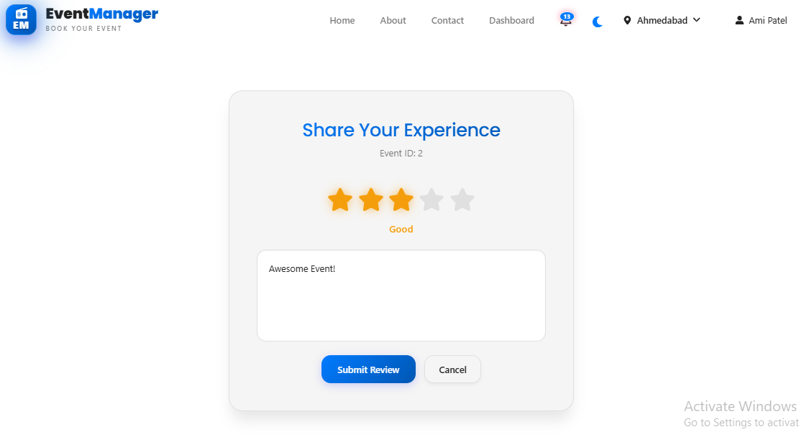
Review Page

Slide 40
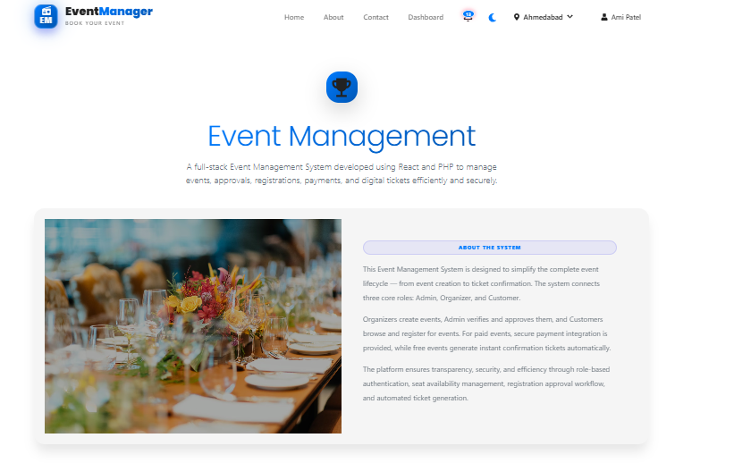
About Us Page

Slide 41
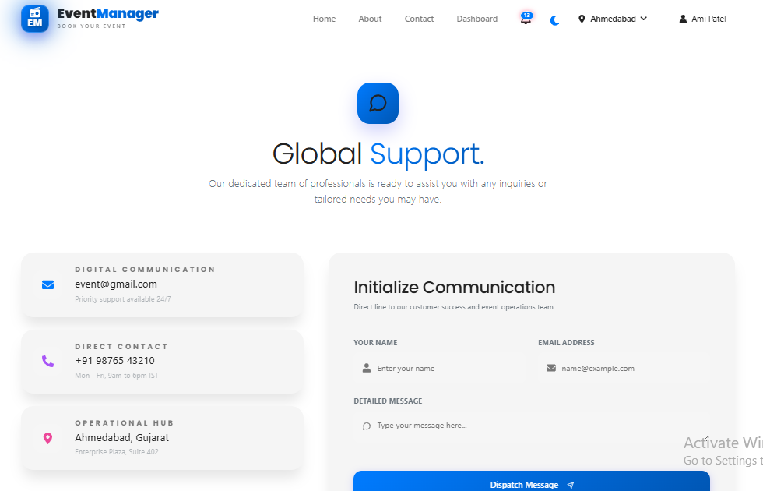
Contact Us Page

Slide 42
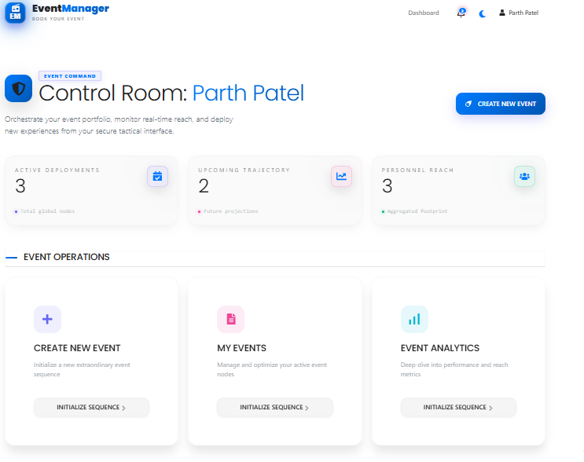
Organizer Dashboard

Slide 43
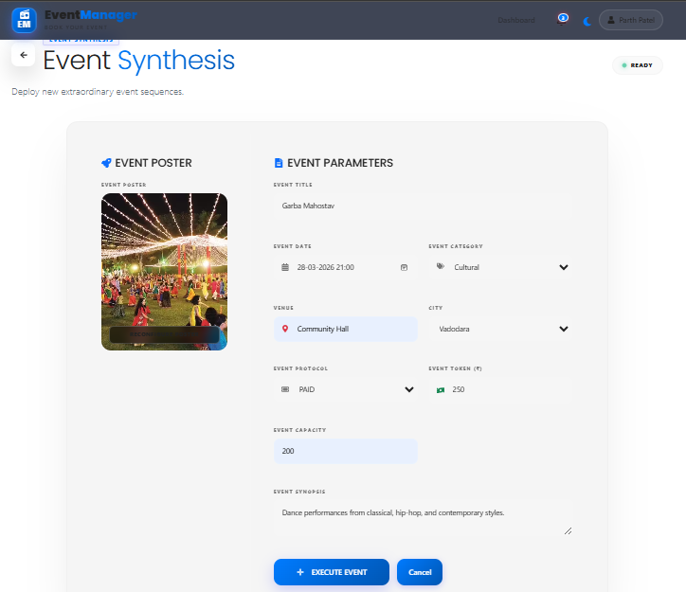
Create Event Page

Slide 44
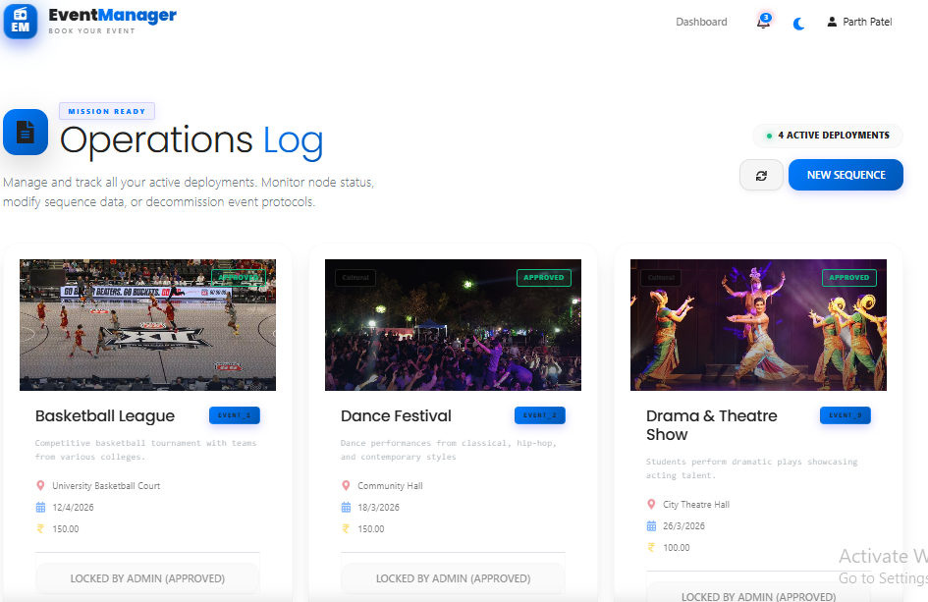
Organizer Event List Page

Slide 45
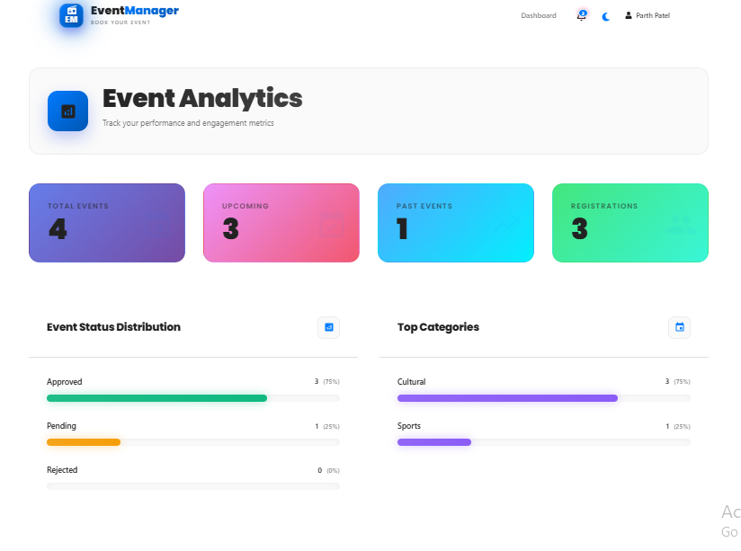
Organizer Analytics Page

Slide 46
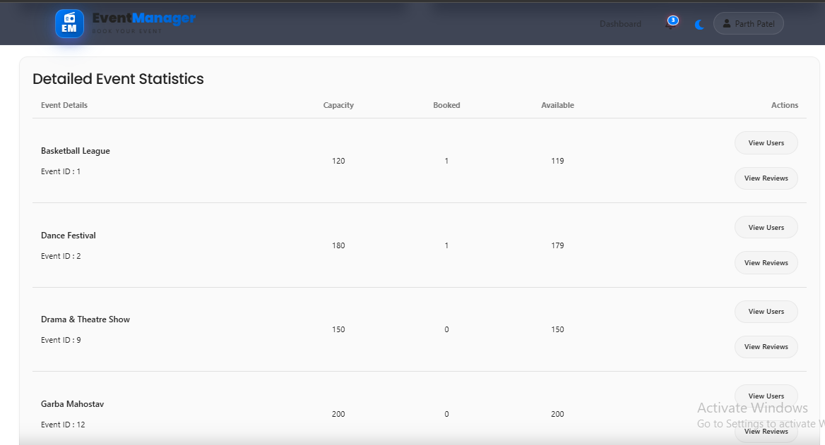
Event Attendees Details

Slide 47
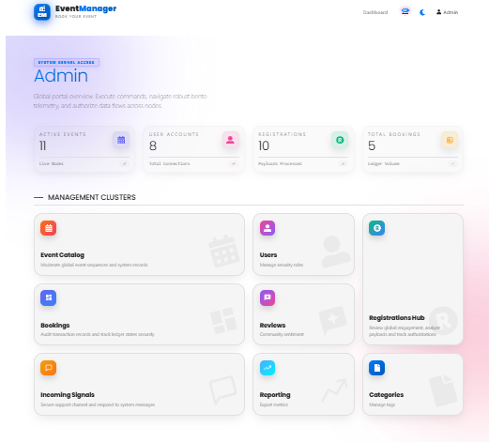
Admin Dashboard

Slide 48
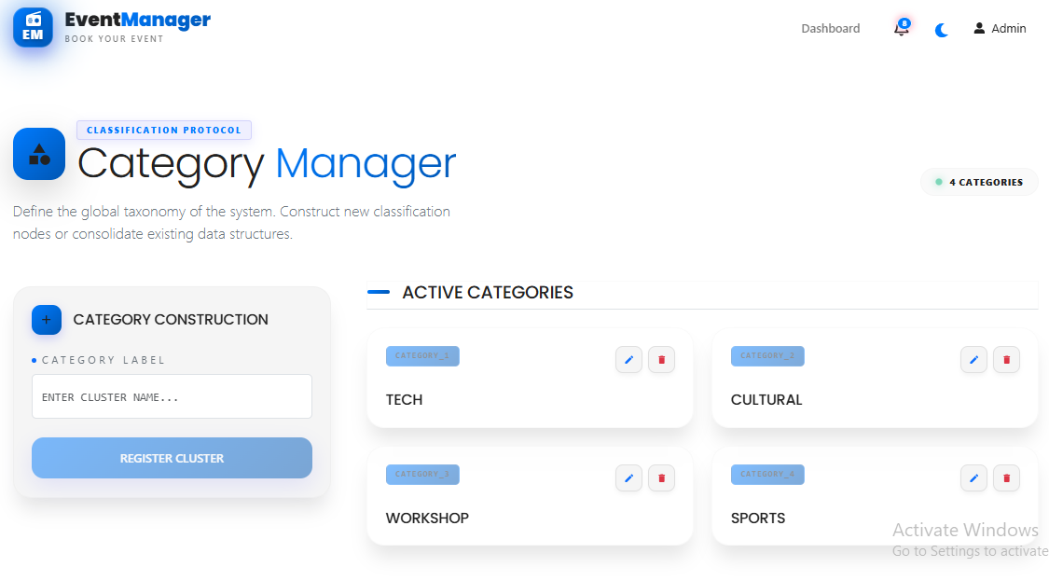
Add Categories Page

Slide 49
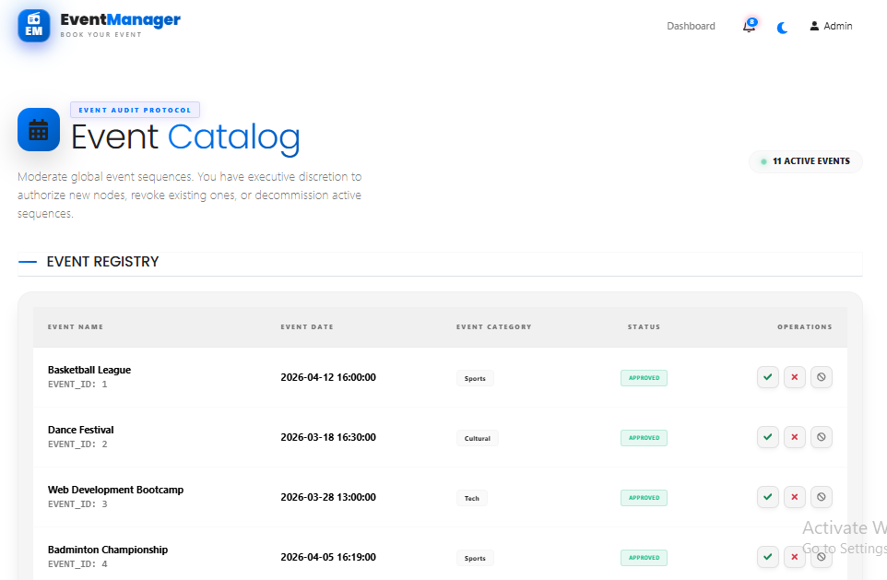
Manage Events

Slide 50
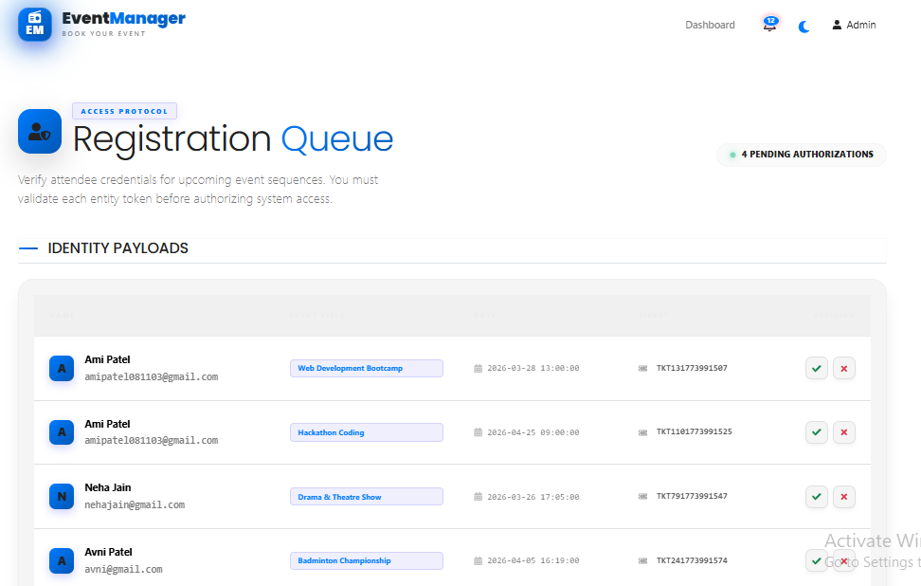
Manage Event Registrations

Slide 51
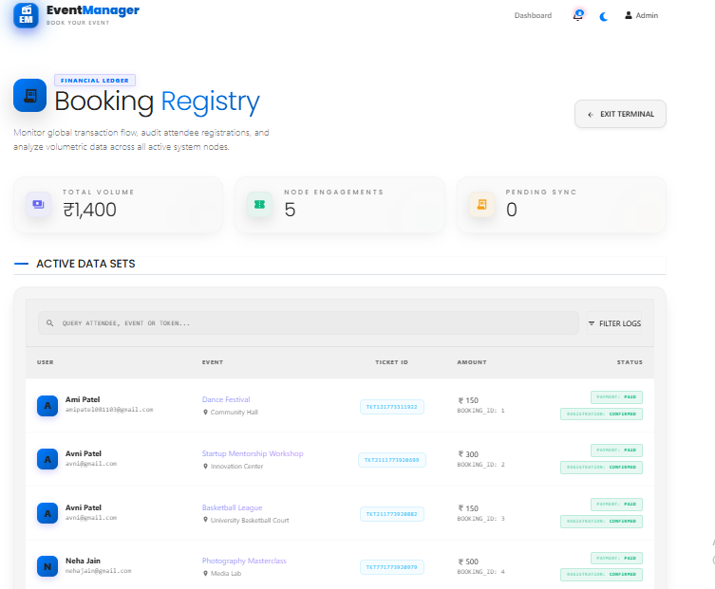
View Booking History

Slide 52
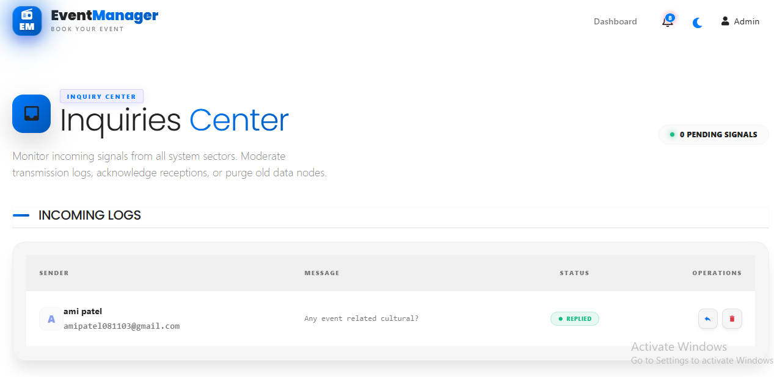
View User Messages

Slide 53
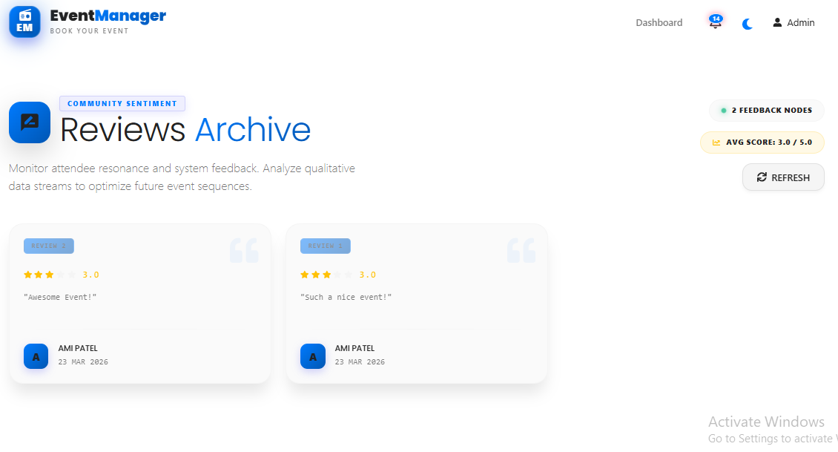
View Reviews Page

Slide 54
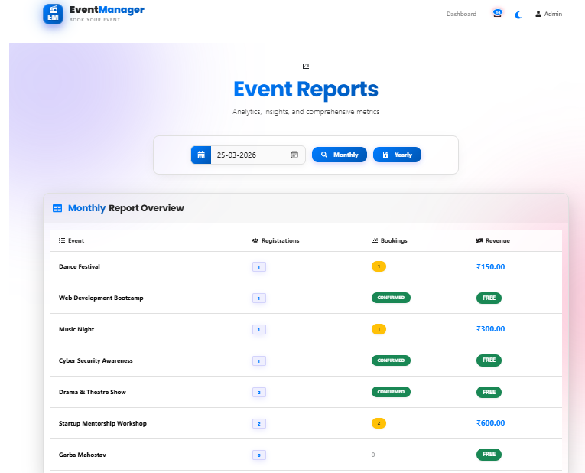
Monthly Event Report

Slide 55
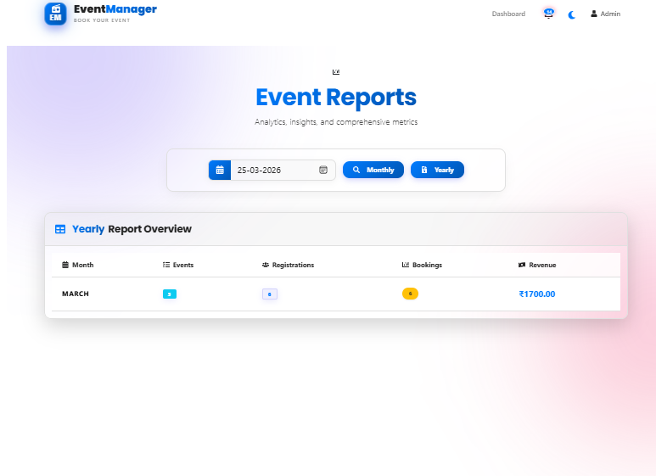
Yearly Event Report

Slide 56
Limitations
Requires a stable internet connection
Limited payment gateway support (only Razorpay)
No mobile application (only web-based system)
Limited scalability for very large number of users/events
Basic security features (can be enhanced further)
Dependency on server and notification service availability (FCM)

Slide 57
Future Enhancements
Develop a mobile application (Android/iOS)
Add multiple payment gateways (UPI, PayPal, etc.)
Implement real-time notifications (Email/SMS)
Add AI-based event recommendations
Introduce live chat support
Enhance security features (OTP, 2FA authentication)
Add advanced analytics dashboard
Enable multi-language support
Improve scalability using cloud deployment

Slide 58
References
ReactJS Official Documentation
PHP Documentation
FPDF Documentation for PDF generate
Razorpay Payment Gateway Documentation
Firebase Cloud Messaging (FCM) Documentation
Online tutorials and learning resources
https://www.w3schools.com/
https://getbootstrap.com

Slide 59
Conclusion
Event Management System simplifies event handling.
Reduces manual work.
Provides secure platform.
Easy for Admin, Organizer, and Customer.
Improves efficiency and performance.

Slide 60
Thank You

