Slide 1
The Event Management System
Presented by: Patel Ami
Guide by: Dr D.B.Choksi

Slide 2
Project Profile
Project Title | The Event Management System
Purpose | To automate event creation, registration, payment, and ticket generation
Developer | Patel Ami
Organization | 7Sisters Tech
Technologies | React JS, HTML5,CSS3,Axios,React , Bootstrap,PHP,MySQL
Development Tools | Visual Studio Code, XAMPP(server)
Objective | The objective of this project is to Simplify and manage event operations efficiently.
Project Type | Web application
Project Guide | Dr.D.B.Choksi

Slide 3
Hardware and Software Configuration
Hardware Configuration:
Processor: Intel Core i3
RAM: 12 GB
System Type: 64-bit Operating System
Input Devices: Keyboard, Mouse
Output Devices: Monitor
Software Configuration:
Operating System: Windows 11
Frontend: ReactJS
Backend: PHP
Database: MySQL
Server: XAMPP,Localhost,Apache
Browser: Google Chrome / Edge
Payment Gateway: Razorpay
Notification Service: Firebase Cloud Messaging (FCM)

Slide 4
Salient features
Role-based login (Admin, Organizer, Customer).
City-wise event filtering.
Event creation and approval system.
Secure user authentication.
Notification system.
Payment and ticket generation.
QR code ticket PDF ticket download .
Dashboard for each role.
Contact and review system

Slide 5
Introduction
Event Management System is a web-based application to manage events digitally.
It helps organize seminars, workshops, conferences, and cultural programs easily.
The system reduces manual work like paper registration and ticket management.
It provides role-based access for Admin, Organizer, and Customer.
Organizers can create events and admin approves them.
Customers can search, register, and pay for events online.
System generates tickets with QR code and PDF download.
Notifications and city-wise event filtering improve user experience.
Built using React, PHP, and MySQL for secure and efficient management.
Overall, the system makes event management simple, fast, and organized.

Slide 6
Aim and Objectives
Aim of the Project :
Develop a web-based Event Management System.
Simplify and automate event creation and management.
Provide a centralized platform for Admin, Organizer, and Customer.
Allow organizers to create and manage events easily.
Allow customers to search and register for events.
Allow admin to monitor and control the system.
Reduce manual work and improve efficiency.
Provide a secure and organized event management solution.
Include role-based dashboards, notifications, and city-wise filtering.
Provide ticket generation with QR code and payment tracking.

Slide 7
Aim and Objectives
Objectives of Project:
Develop a web-based application for event management.
Provide role-based access for Admin, Organizer, and Customer.
Implement secure user registration and login system.
Provide user-friendly home page with search and categories.
Allow city-wise event filtering.
Allow organizers to create, update, and delete events.
Allow admin to approve or reject events and registrations.
Allow customers to register and view tickets in dashboard.
Implement notification system for updates.
Generate tickets with random ticket ID and QR code.
Provide PDF ticket download feature.
Manage paid and free events with payment tracking.
Maintain event analytics and booking records.
Store data securely in MySQL database.
Provide scalable and efficient system for future use.

Slide 8
Modules
Event Management System is divided into three main modules.
Admin Module manages and controls the entire system.
Organizer Module creates and manages events.
Customer Module allows users to browse and register for events.
Admin Module:
Admin manages categories like workshops, seminars, and conferences.
Approves or rejects events created by organizers.
Manages event registrations.
Views and manages all users.
Checks bookings and payment status.
Views user reviews and feedback.
Manages contact messages.
Receives notifications for events and registrations.
Ensures system security and smooth operation.

Slide 9
Modules
Organizer Module:
Organizer can create new events.
Enters event details like title, date, venue, seats, and price.
Update events before admin approval.
Delete events before approval.
View all created events.
View event analytics.
View Total events and registered users.
Receives notifications for approval or rejection.
Organizer cannot modify event after admin approval.

Slide 10
Modules
Customer Module:
Register and log in securely.
Browse upcoming and today’s events.
Filter events city-wise.
View full event details.
Register for events.
Users complete payment for paid events.
Ticket ID and QR code are generated.
Download PDF ticket.
View registered events in dashbaord.
Receive notifications for approvals and tickets.

Slide 11
Problem statement
Traditional event management uses manual processes and paperwork.
Managing multiple events and registrations is difficult.
Organizers face problems in tracking participants and records.
Customers face difficulty in searching and registering for events.
Admin cannot monitor all activities without a centralized system.
Lack of proper communication and notifications creates confusion.
Manual ticket generation and payment tracking increase workload.
Need for a web-based Event Management System to automate and simplify the process.

Slide 12
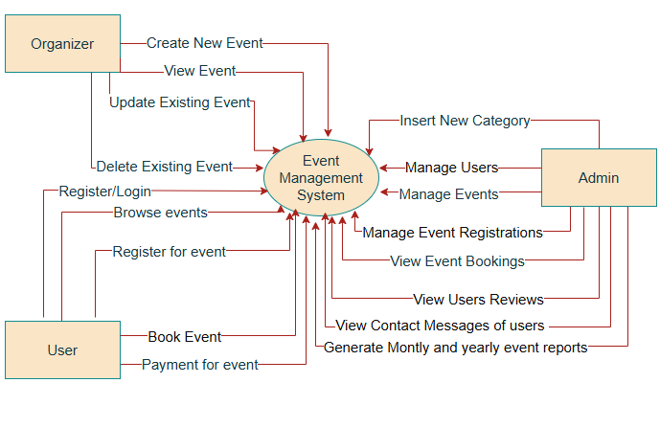
Data Flow Diagram
Context Level DFD

Slide 13
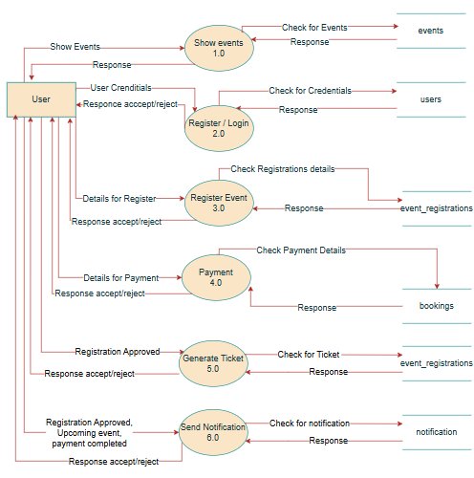
First Level DFD of users

Slide 14
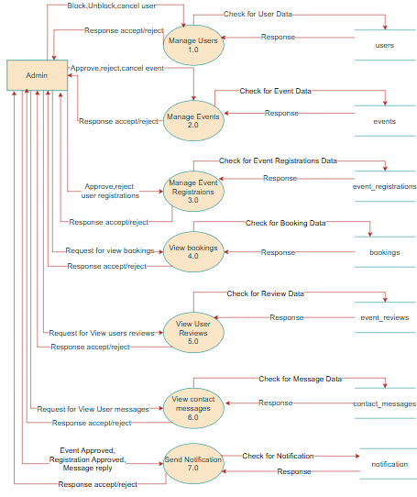
First Level DFD of admin

Slide 15
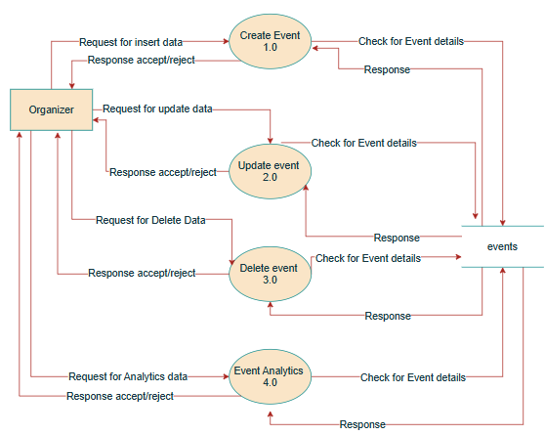
First Level DFD of organizers

Slide 16
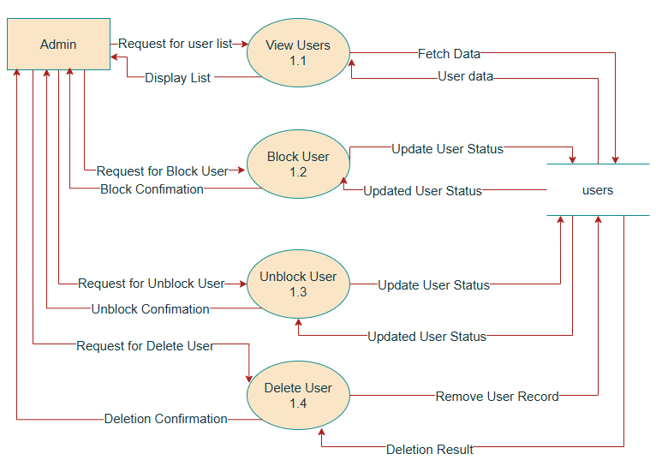
Second Level DFD of Admin

Slide 17
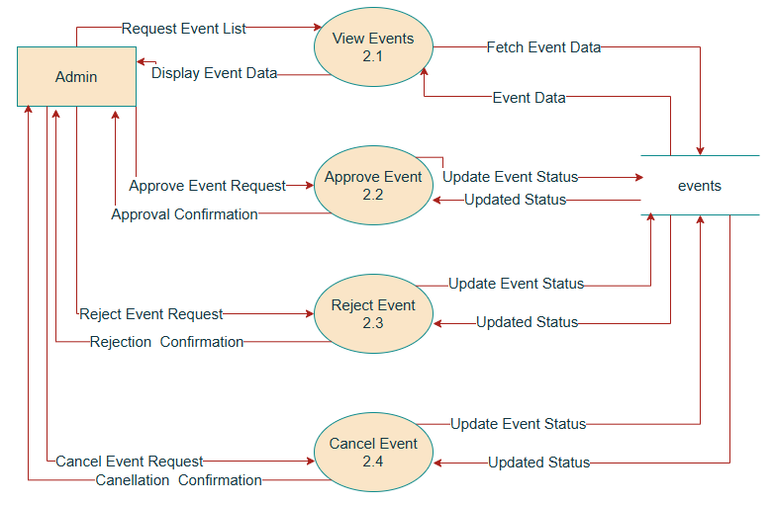
Second Level DFD of Admin

Slide 18
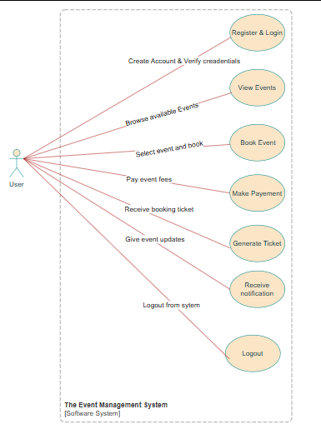
Use Case Diagram
Use Case Diagram of User

Slide 19
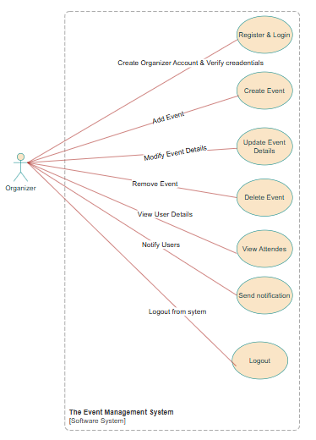
Use Case Diagram of Organizer

Slide 20
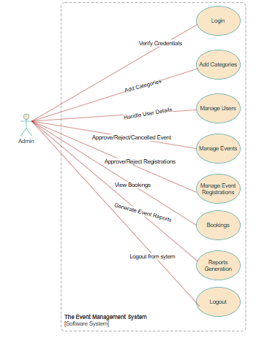
Use Case Diagram of Admin

Slide 21
Data Dictionary
Data dictionary includes information such as the number of record in file, the frequency of a process to run, security factor like password which user must enter to get access to the information. The major elements are data flows, data stores and processes. The data dictionary stores details and description.

Slide 22
Table 1: users Purpose: To store information about users
Sr .no | Field Name | Data Type | Size | Constraints | Description
1 | Id | Int | 11 | PK,Auto_Increment,Not null | Unique User identifier
2 | Name | Varchar | 100 | Not null | Full name of user
3 | Email | Varchar | 100 | Not null | Email of user
4 | Phone | Number | 20 | Not null | Phone number of user
5 | Password | Varchar | 255 | Not null | Encrypted user password
6 | Role | Enum | customer, organizer ,admin | Not null, Default ‘customer’ | Role of user
7 | Status | Enum | Active, blocked | Not null, Default ‘active’ | Account status
8 | created_at | Timestamp |  | Not null , Default Current_timestamp | Account creation date

Slide 23
Table 2: categories Purpose: To store event categories
Sr .no | Field Name | Data Type | Size | Constraints | Description
1 | Id | Int | 11 | PK,Auto_Increment,Not null | Unique category identifier
2 | category_name | Varchar | 100 | Not null | Name of event category

Slide 24
Table 3: events Purpose: To store event details
Sr .no | Field Name | Data Type | Size | Constraints | Description
1 | id | Int | 11 | PK,Auto_Increment,Not null | Unique event identifier
2 | organizer_id | Int | 11 | FK(users), Not null | Organizer user id
3 | category_id | Int | 11 | FK(categories),Not null | Event category id
4 | title | Varchar | 255 | Not null | Event title
5 | date_time | Datetime |  | Not null | Event date & time
6 | location | Varchar | 255 | Not null | Event location
7 | city | Varchar | 100 | Not null | City of event
8 | description | Text |  | Not null | Event Description
9 | poster | Varchar | 255 | Not null | Event poster
10 | Status | Enum | pending, approved, rejected, cancelled | Not null, Default ‘pending’ | Event status
11 | event_type | Enum | Free, paid | Not null, Default ‘free’ | Event payment type
12 | price | Decimal | 10,2 | Not null, Default 0.00 | Price of ticket
13 | total_seats | Int | 11 | Not null | Total available seats
14 | available_seats | Int | 11 | Not null | Remaining available seats
15 | reminder_sent | Tinyint | 1 | Not null, Default 0 | Notification reminder
16 | created_at | timestamp |  | Not null, Default Current_timestamp | Event creation date

Slide 25
Table 4: event_registrations Purpose: To store registrations details
Sr .no | Field Name | Data Type | Size | Constraints | Description
1 | id | Int | 11 | PK, Auto_Increment ,Not null | Unique Registration id
2 | user_id | Int | 11 | FK(users),Not null | User id for identify user
3 | event_id | Int | 11 | FK(events),Not null | Event id for identify event
4 | ticket_id | Varchar | 255 | Not null | Ticket id for users
5 | status | Enum | Pending, confirmed, rejected,pending_payment ,cancelled_by_admin | Not null, Default pending | Event Registration status
6 | registered_at | timestamp |  | Not null, Default Current_timestamp | Registration date and time

Slide 26
Table 5: notification Purpose: To store notification details
Sr .no | Field Name | Data Type | Size | Constraints | Description
1 | id | Int | 11 | PK, Auto_Increment ,Not null | Unique notification id
2 | user_id | Int | 11 | FK(users),Not null | User id for identify user
3 | message | Text |  | Not null | Notification messages
4 | is_read | Tinyint | 1 | Not null | Notification readable or not
5 | created_at | timestamp |  | Not null, Default Current_timestamp | Notification creation date and time

Slide 27
Table 6: contact_messages Purpose: To store details about messages
Sr .no | Field Name | Data Type | Size | Constraints | Description
1 | id | Int | 11 | PK, Auto_Increment ,Not null | Unique contact id
2 | name | Varchar | 100 | Not null | Name of the user(sender)
3 | email | Varchar | 100 | Not null | Email of the user(sender)
4 | message | Text |  | Not null | Message content
5 | reply | Text |  | Not null | Admin reply
6 | status | Enum | New,read,replied | Not null, Default new | Message status
7 | created_at | timestamp |  | Not null, Default Current_timestamp | Message creation date

Slide 28
Table 7: event_reviews Purpose: To store event review details
Sr .no | Field Name | Data Type | Size | Constraints | Description
1 | id | Int | 11 | PK, Auto_Increment ,Not null | Unique review id
2 | user_id | Int | 11 | FK(users),Not null | User id for identify user
3 | event_id | Int | 11 | FK(events),Not null | Event id for identify event
4 | rating | Int | 11 | Not null, check(between 1 to 5) | Rating given between 1 to 5
5 | review | Text |  | Not null | Review comment
6 | created_at | timestamp |  | Not null, Default Current_timestamp | Review date

Slide 29
Table 8: bookings Purpose: To store details of paid event booking
Sr .no | Field Name | Data Type | Size | Constraints | Description
1 | id | Int | 11 | PK, Auto_Increment ,Not null | Unique booking id
2 | registration_id | Int | 11 | FK(event_registrations),Not null | Registration id
3 | ticket_id | Varchar | 255 | FK(event_registrations),Not null | Ticket id
4 | razorpay_order_id | Varchar | 100 | Not null | Razorpay order id
5 | razorpay_payment_id | Varchar | 100 |  | Razorpay payment id
6 | razorpay_signature | Varchar | 255 |  | Razorpay signature
7 | amount | Int | 11 | Not null | Booking amount
8 | payment_status | Enum | Pending, paid, failed, refunded | Not null, Default pending | Payment status
9 | booking_date | timestamp |  | Not null, Default Current_timestamp | Booking date and time
10 | razorpay_refund_id | Varchar | 100 |  | Razorpay refund id
11 | refund_amount | Int | 11 |  | Refund amount
12 | refunded_at | datetime |  | Not null, Default Current_timestamp | Refund fate and time

Slide 30
Table 9: user_tokens Purpose: To store user token
Sr .no | Field Name | Data Type | Size | Constraints | Description
1 | id | Int | 11 | PK, Auto_Increment ,Not null | Unique user token id
2 | user_id | Int | 11 | FK(users),Not null | User id for identify user
3 | token | Varchar | 255 | Not null | Generated token from Google
4 | created_at | Timestamp |  | Not null, Default Current_timestamp | Token creation date and time

Slide 31
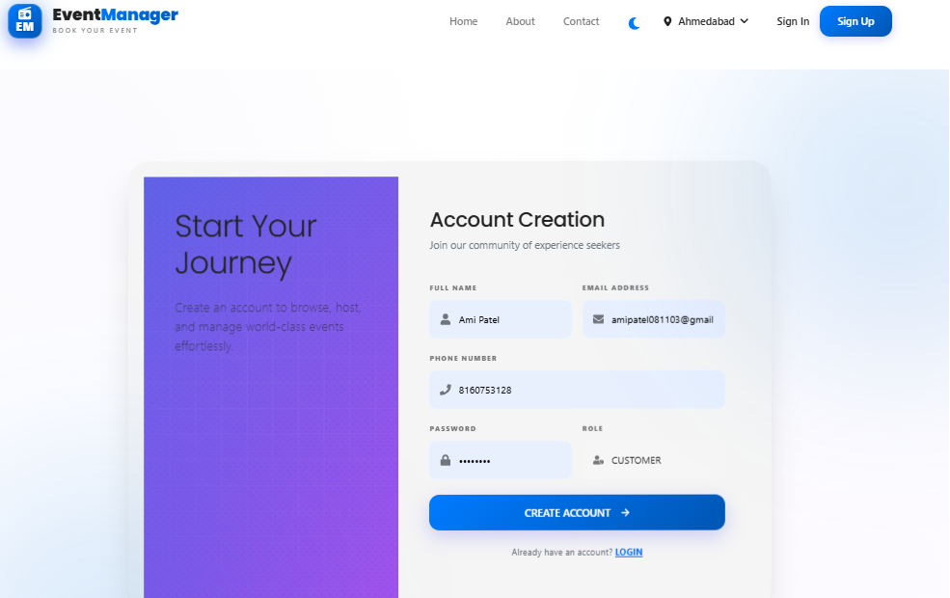
Web Interface
Register Page

Slide 32
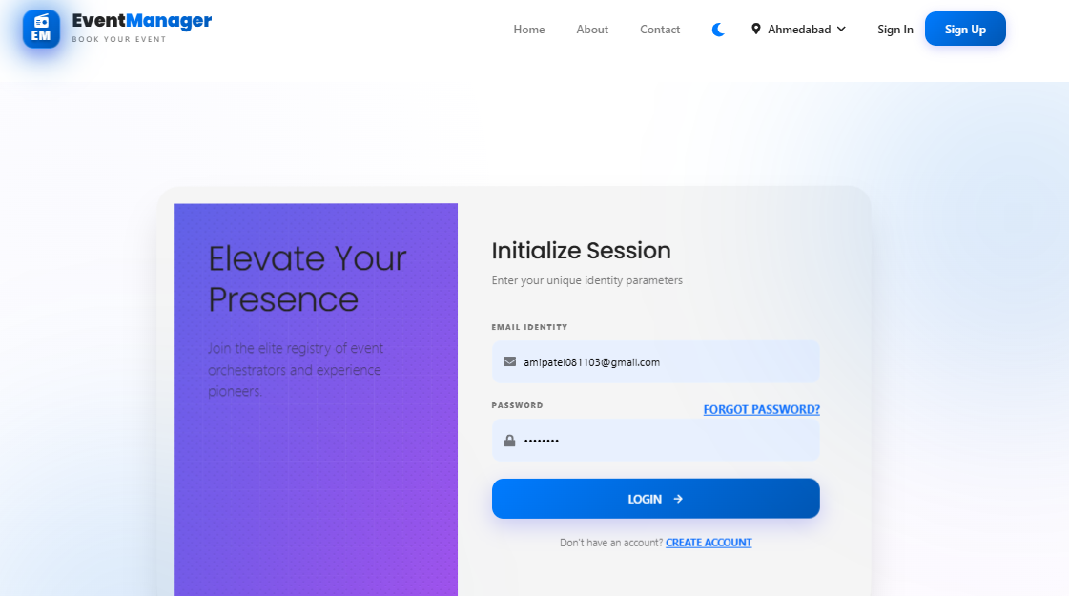
Login Page

Slide 33
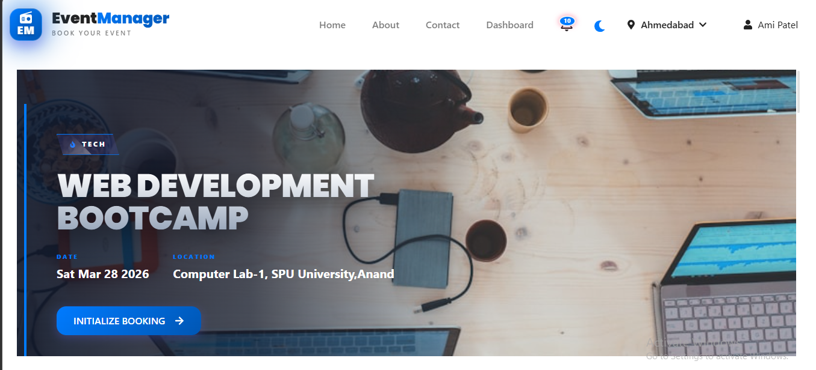
Home Page

Slide 34
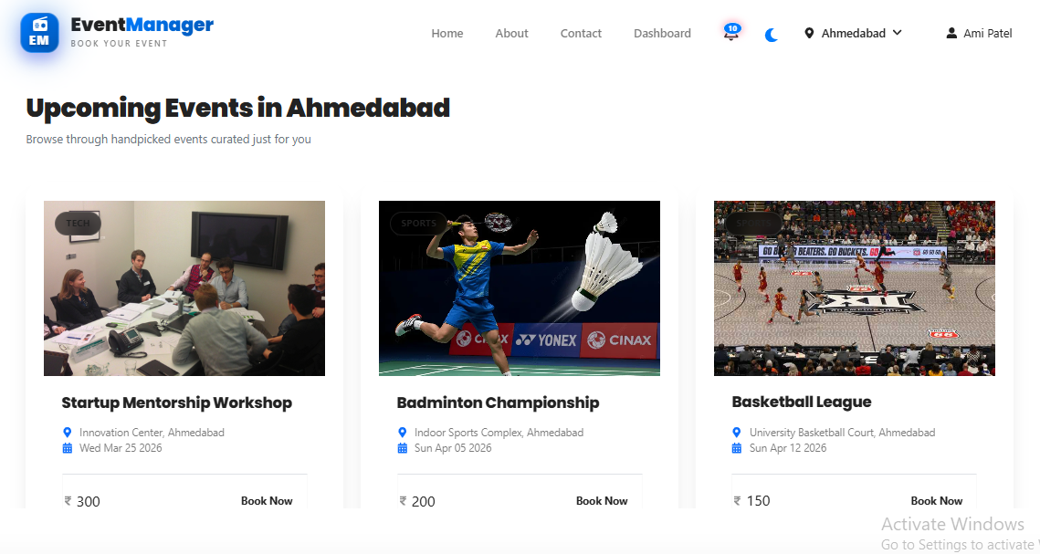
Upcoming Events

Slide 35
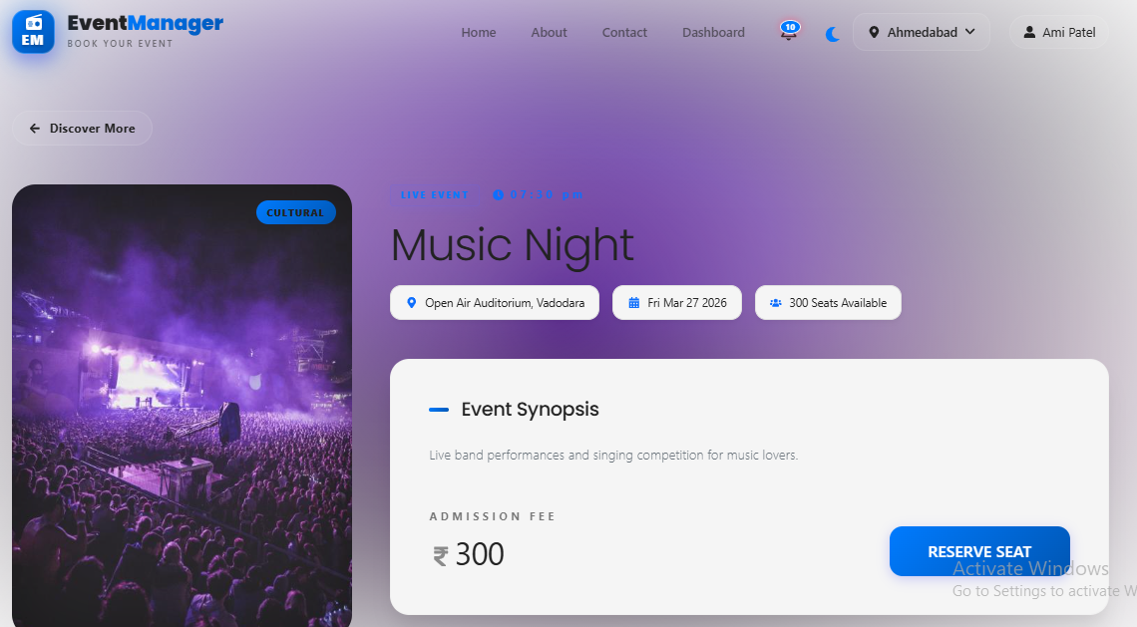
Event Details Page

Slide 36
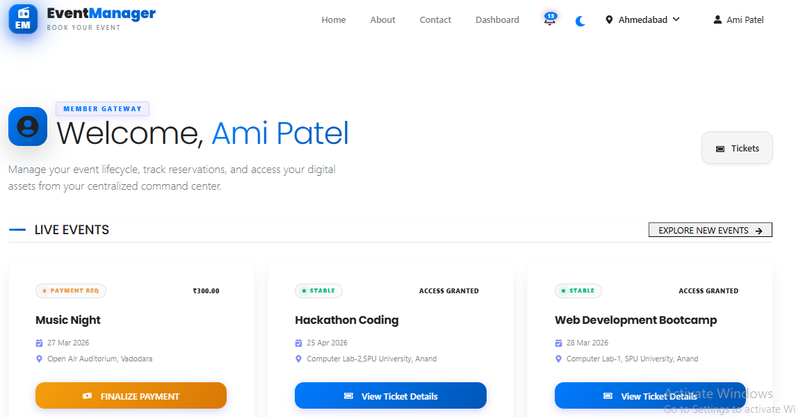
Customer Dashboard

Slide 37
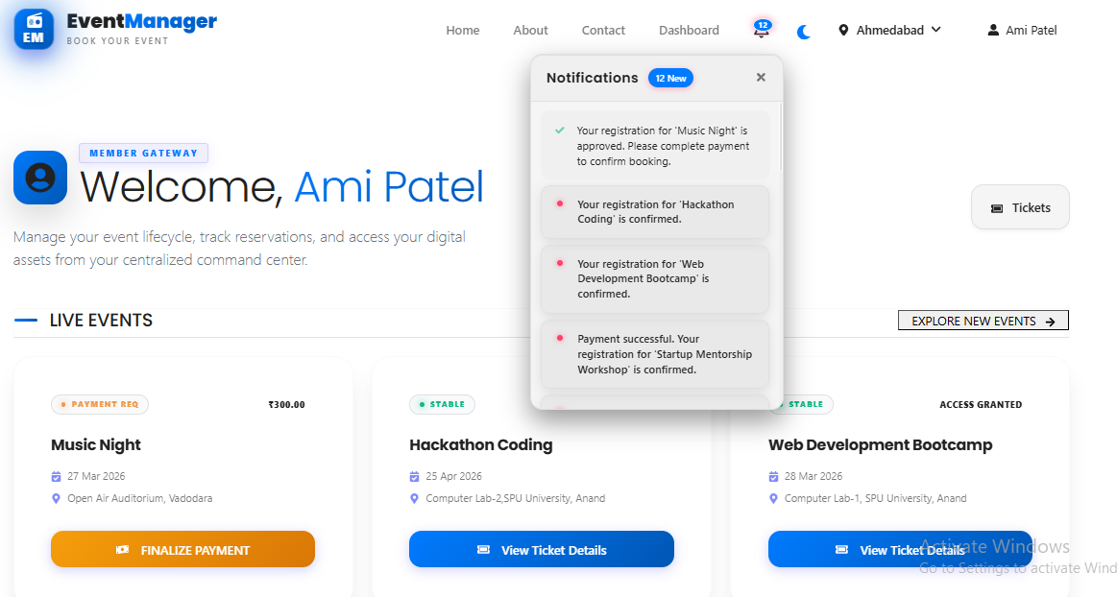
User Notification

Slide 38
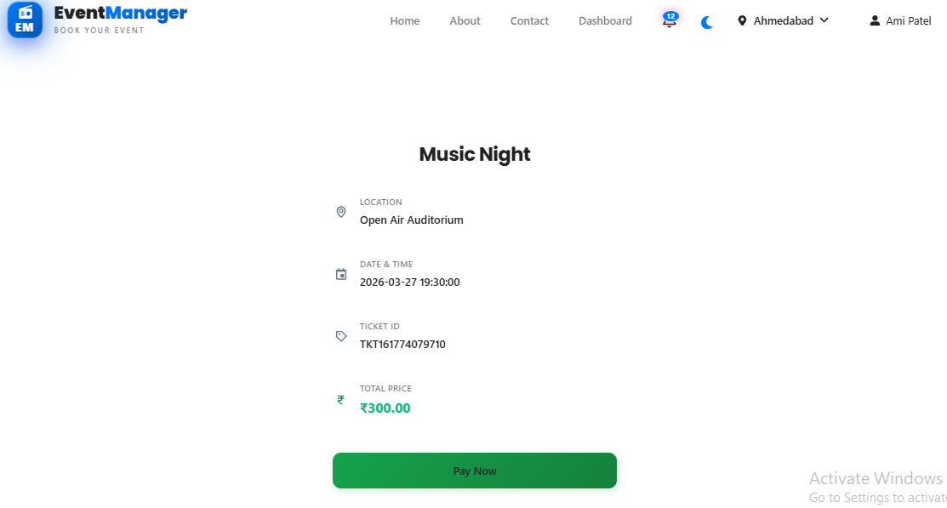
Booking Page

Slide 39
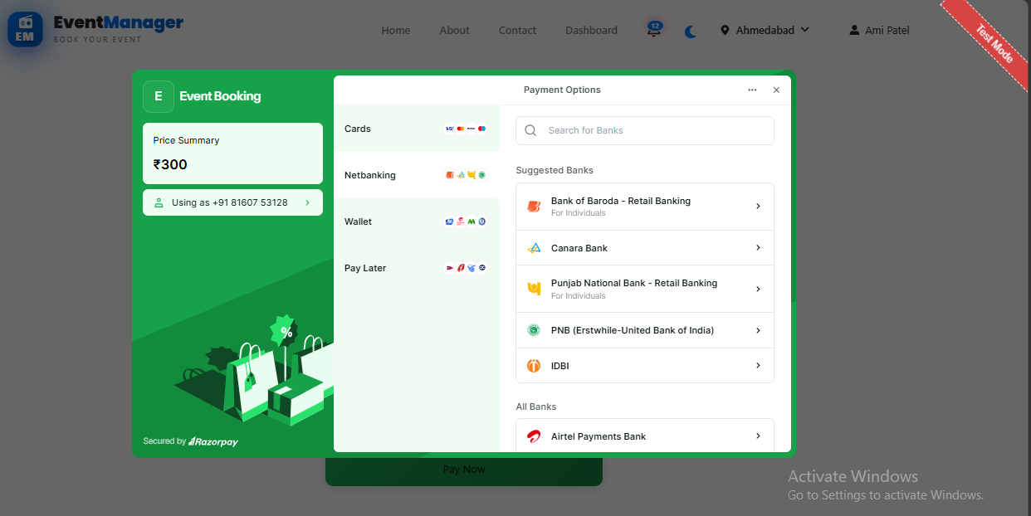
Payment Page

Slide 40
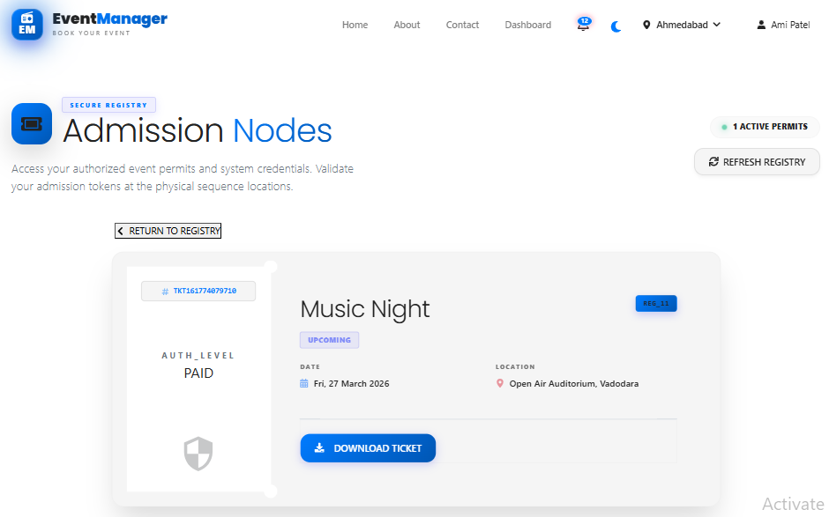
Ticket Page

Slide 41
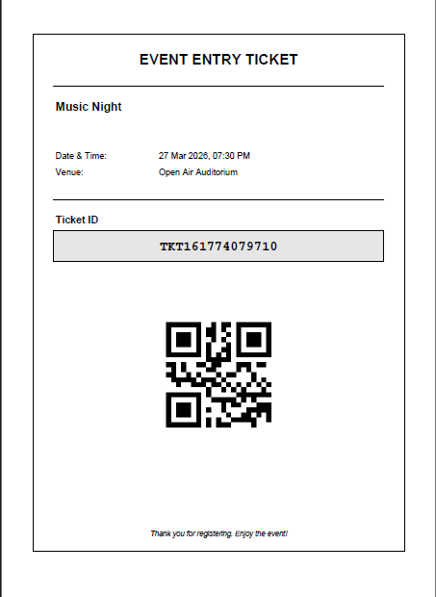
Ticket PDF Format

Slide 42
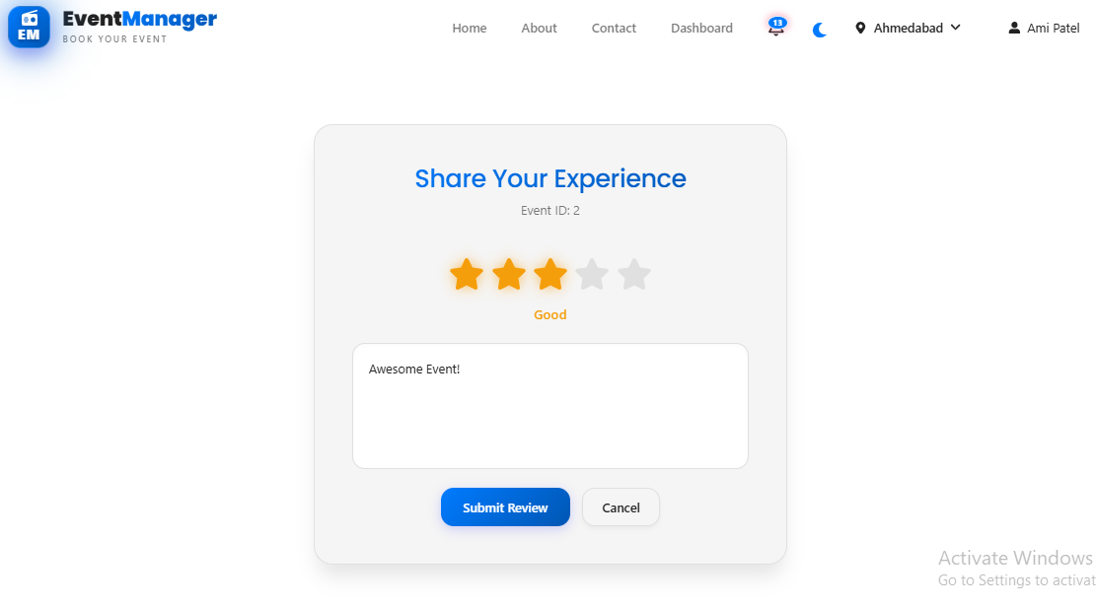
Review Page

Slide 43
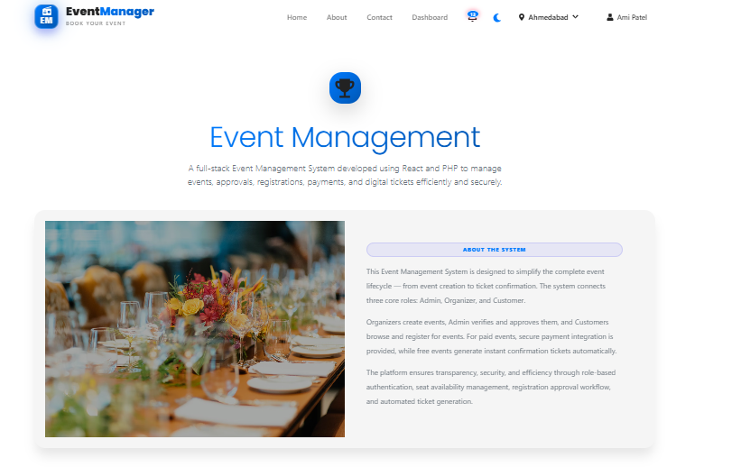
About Us Page

Slide 44
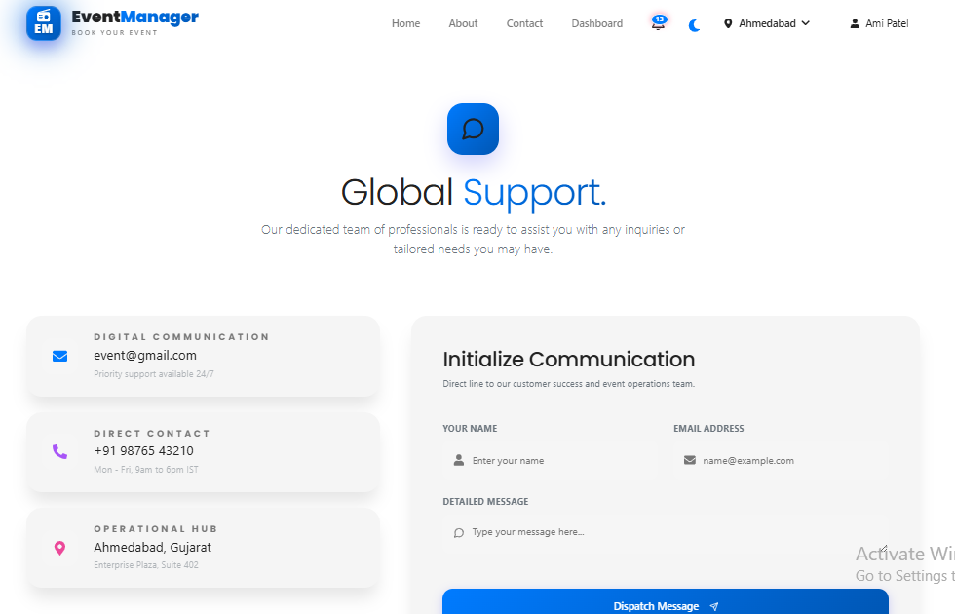
Contact Us Page

Slide 45
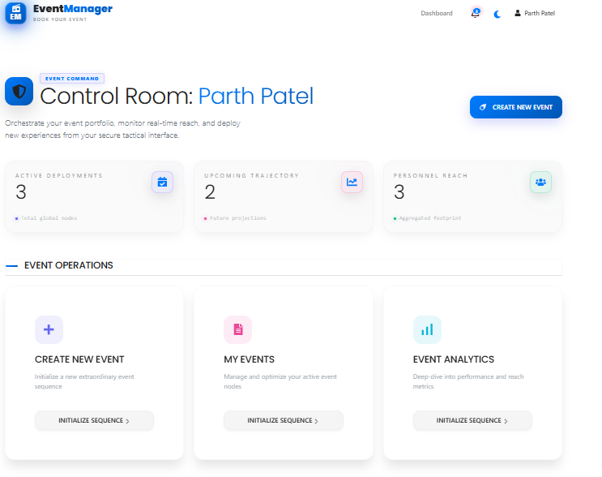
Organizer Dashboard

Slide 46
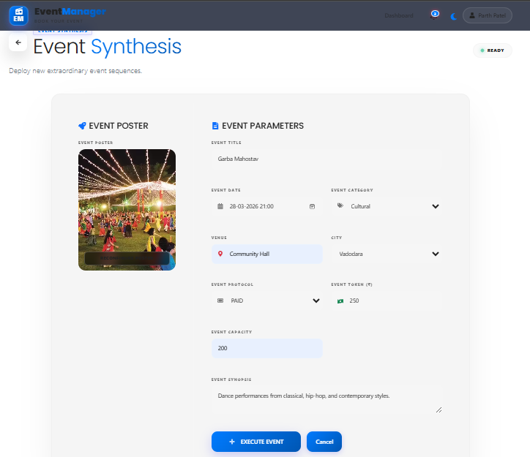
Create Event Page

Slide 47
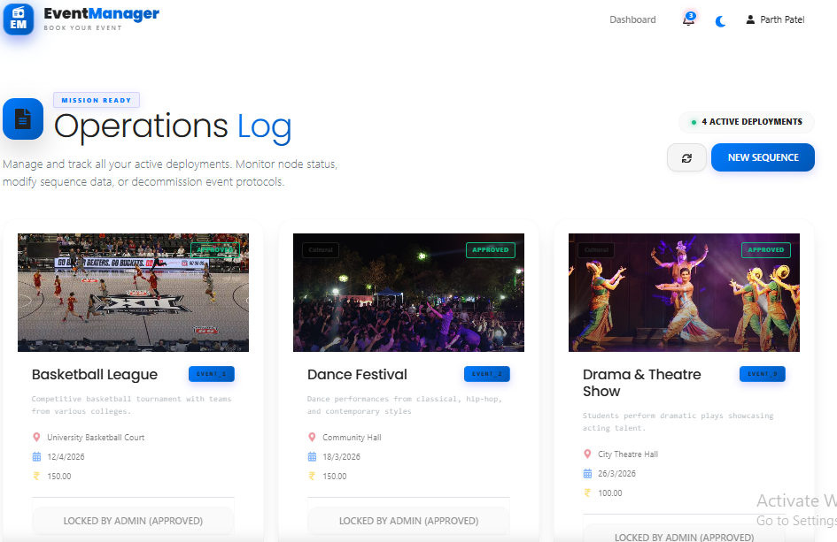
Organizer Event List Page

Slide 48
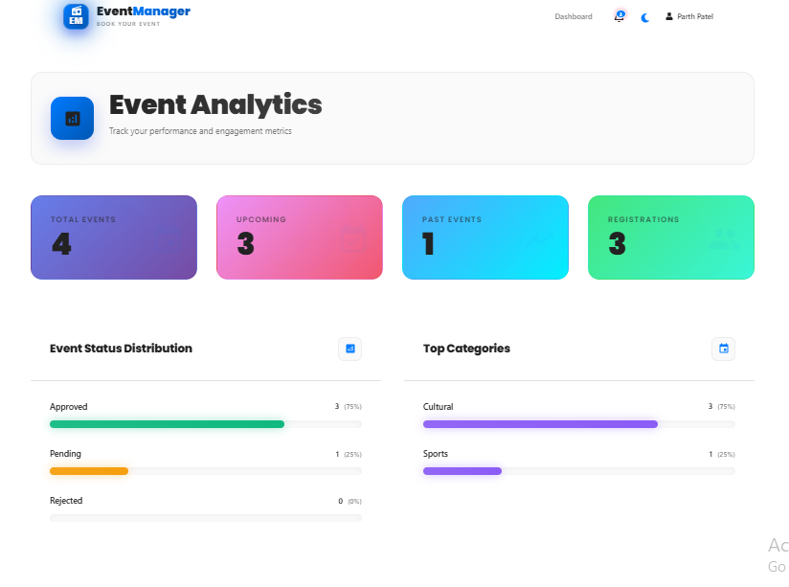
Organizer Analytics Page

Slide 49
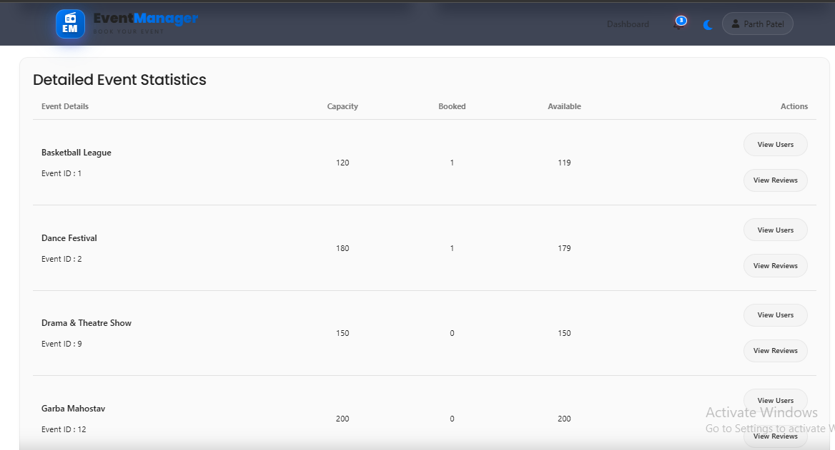
Event Attendees Details

Slide 50
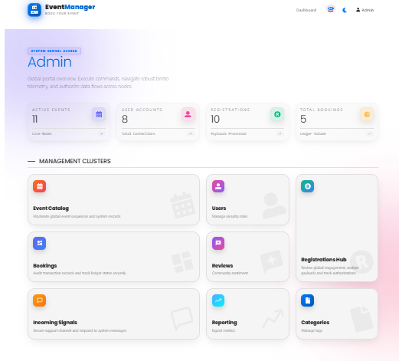
Admin Dashboard

Slide 51
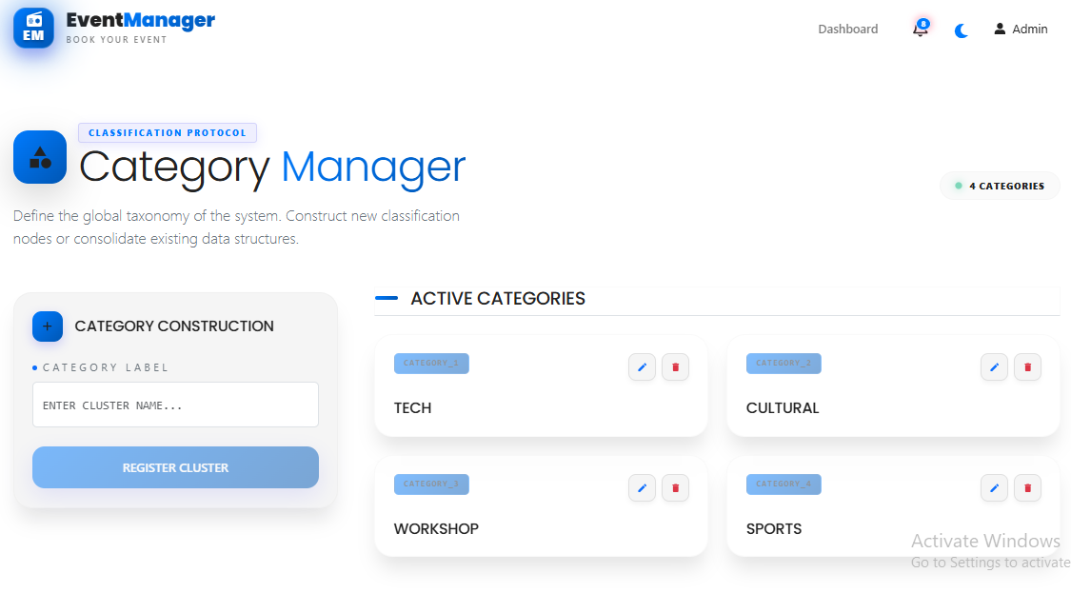
Add Categories Page

Slide 52
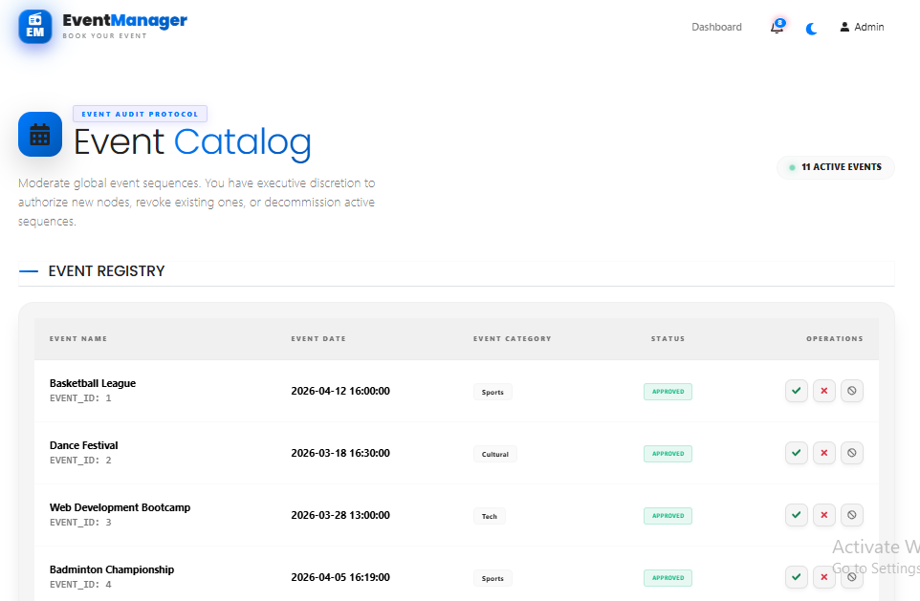
Manage Events

Slide 53
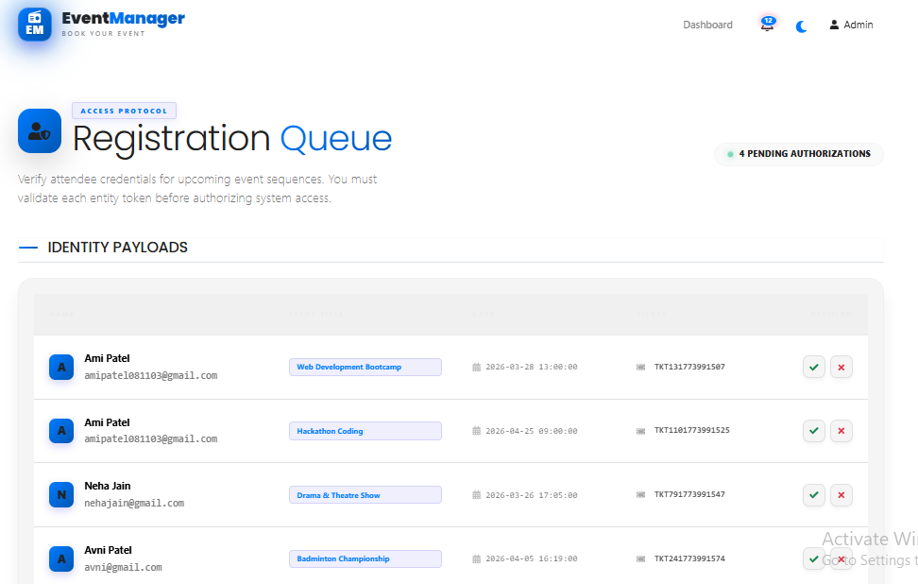
Manage Event Registrations

Slide 54
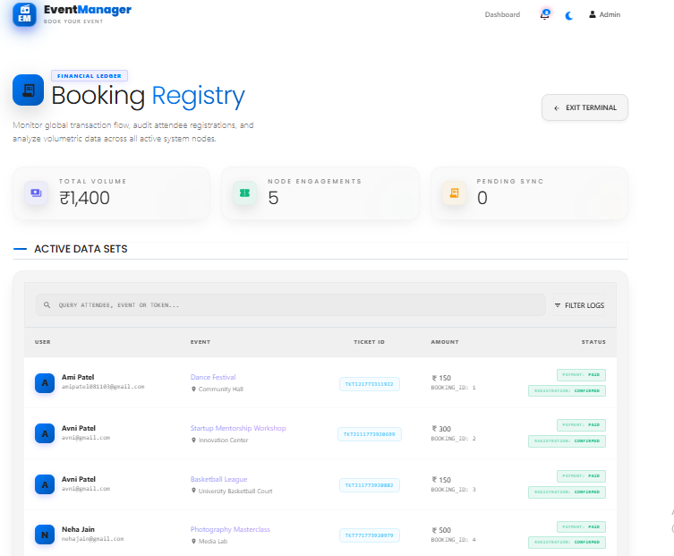
View Booking History

Slide 55
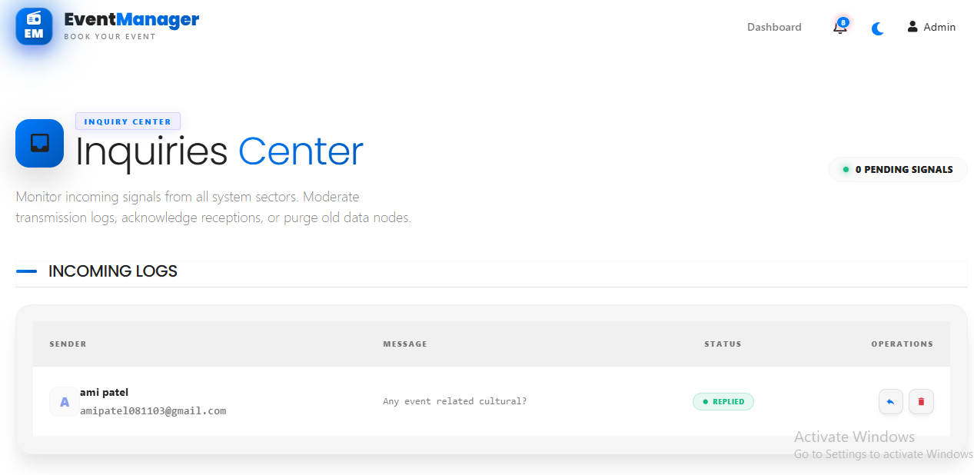
User Messages Page

Slide 56
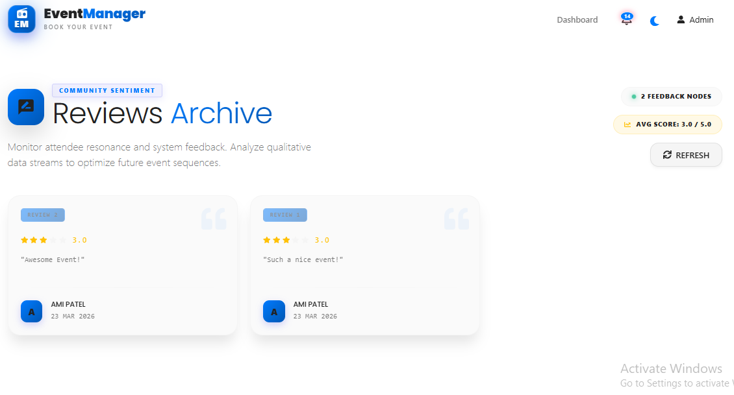
View Reviews Page

Slide 57
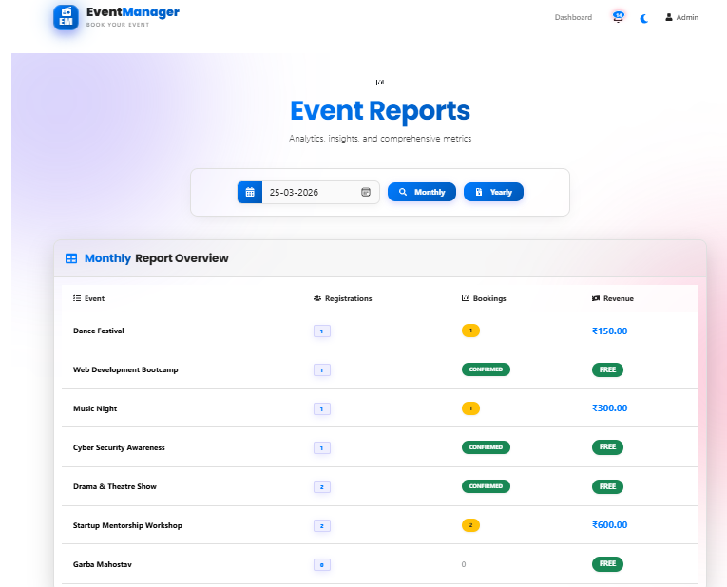
Monthly Event Report

Slide 58
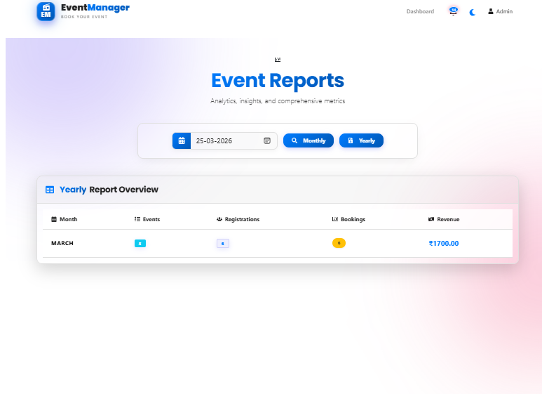
Yearly Event Report

