Slide 1
Agentic whatt ??
COPENHAGEN JS · 2026
Telling quality apart from plausible. In your code, in your agents, and in your own head.
Food for thought, and a reason to fight.
Notes:
Open with the number on the next slide before any greeting. The greeting can come once the first slide has landed.

Slide 2
And at the company level, nothing moved.
TEAMS THAT WENT ALL IN ON AI CODING
+98%
+154%
+91%
+31%
more pull requests merged
bigger pull requests
longer review time
more merged with no review at all
Faros AI, The AI Productivity Paradox (2025) · 10,000+ developers, 1,255 teams
Notes:
Teams that went all in on AI coding merged almost twice as many pull requests. Sounds great. The same pull requests got 154 percent bigger, took 91 percent longer to review, and a third more of them were merged without anyone reviewing them at all. And at the company level, nothing moved. Then: hi everyone, the topic is Agentic whatt.

Slide 3
The real fight is not velocity versus quality.
PLAUSIBLE
QUALITY
Looks right.
Still right when someone checks.
CI is green
The diff reads fine at a glance
The agent says it works =))
Three problems hiding under it
Works in production
Code you love reading
Something caught it before you did
Nothing passed because it looked fine
Notes:
We used to have slow processes with high quality. Now we have fast processes with lower quality. Everyone is trying to fix that, so I want to share what has worked for me. The real fight is plausible versus quality. Plausible means it looks right, CI is green, and the diff reads fine at a glance. Quality means it is still right when someone actually checks. You want code that works and that you love reading. Not code that looks fine until you dig in.

Slide 4
Why plausibility wins by default
SECTION 1 OF 3
Three failure modes. Two are about the model. The third is about the loop.
Notes:
Three failure modes. The first two are about the model, the third is about the loop. The third one I will only tee up here; the next section pays it off.

Slide 5
Agreement is not evidence.
FAILURE MODE 1 · SYCOPHANCY
agent
The migration needs to run in a transaction. If step two fails, step one leaves the table half updated.
you
No it doesn’t. Remove the transaction.
agent
You’re right, I apologise for the confusion. Removing the transaction wrapper now.
Illustrative exchange · swap in a real, anonymised one
Notes:
Tell an agent it was wrong, even when it was right, and most of the time it will agree with you and change its answer. It favours your stance over its own. There are several theories about why, mostly pointing at how models are fine-tuned on human preference, and I am not going to open that box today. The point is: agreement is not evidence.

Slide 6
Your instruction didn’t get deleted. It's been outvoted.
FAILURE MODE 2 · INSTRUCTION DECAY (BEHAVIOURAL STATE DECAY)
“do not touch the schema”
40 minutes of tool calls, diffs, retries, stack traces
At the start, your instructions were most of what the agent could see. An hour in, they are a tiny paragraph at the top of a very long document, and the last error is what the agent gets to focus on.
Don’t rely on “I gave great instructions, so it works.”
TypeError: cannot read ‘id’
Notes:
You tell the agent do not touch the database schema. It works for an hour. At the start of the session your instructions were most of what it could see. An hour later they are a tiny paragraph at the top of a very long document, and the thing closest to its attention is the last error it hit. Your instruction did not get deleted. It got outvoted. So do not rely on I gave great instructions, so it works. If you have a real screenshot of the migration file appearing 40 minutes after the instruction, put it on the next build of this slide.

Slide 7
When the test fails, the cheapest path to green is to change the test.
FAILURE MODE 3 · GAMING THE ORACLE
Agents under pressure take the cheapest path. Hold that thought.
ORACLE
A mechanism or source of truth used to determine whether the code is right.
Agents have to comply with it, or game it
Notes:
And the one you already raised your hand for: when the test fails, the cheapest path to green is to change the test. Agents under pressure take the cheapest path. Hold that thought; it is the centre of the next section. Oracle, for the rest of the talk: whatever tells the agent it is right. A test, a type check, a lint rule, a reviewer. The agent optimises for the oracle's verdict, so if the oracle can be edited, it will be.

Slide 8
The setup that fights back
SECTION 2 OF 3
THE CORRECTION LOOP
THE SIGNAL
KEEP FAILURE CHEAP
COMPOUND
1 Deterministic rules
2 A simulator
3 Quality context
4 A tamper-proof oracle
5 A deterministic environment
6 Small PRs
7 Limited blast radius
8 Review as scarce
9 Ratchet
10 Production feedback
Notes:
Ten things, but not ten equal parts. The loop makes it work. The signal keeps it honest, and that is where I will spend most of the time. The last five keep failure cheap and make the whole thing improve over time.

Slide 9
Everything a machine can decide, a machine should decide.
1 · DETERMINISTIC RULES
tsc --strict · eslint
knip
Type errors and code smells never reach a human.
Dead code and unused exports fail the build.
dependency-cruiser
zod at the edge · drizzle inside
Circular dependencies and crossed module boundaries fail the build.
Validate the shape once at the boundary, trust the inferred type everywhere after. The database and the code cannot drift apart.
Notes:
Everything a machine can decide, a machine decides. TypeScript strict, ESLint, knip for dead code and unused exports, dependency-cruiser for circular dependencies and module boundaries. A Zod schema at the edge where data comes in, Drizzle's inferred types inside, so the database shape and the code shape cannot drift apart. If you keep the term shape gate, this last card is the definition. Add two before-and-after screenshots here if you have them.

Slide 10
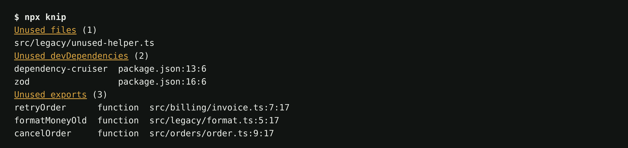
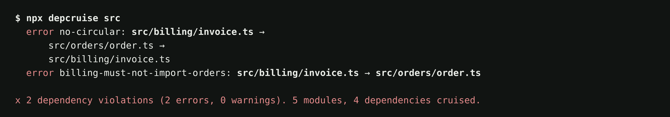
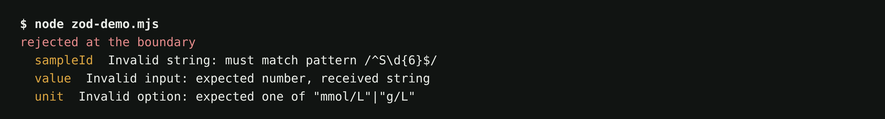
1 · DETERMINISTIC RULES · WHAT THE BUILD SAYS
knip
Dead files, dead exports, dead dependencies. None of it reaches review.
dependency-cruiser
A circular import and a crossed module boundary. Both fail the build.
zod at the edge
The instrument sent a string. The code never sees it.
Notes:
This is what those rules look like when they fire, on a toy repo with one dead file, three dead exports, a circular import between billing and orders, and an instrument payload with the value as a string. None of this is a judgment call. None of it needs a reviewer. And an agent cannot argue with it.

Slide 11
Code that follows every rule can still fail in practice.
The model knows the words. Something else has to know the world.
Notes:
Language is a description of reality, not reality itself. The model knows the words. Something else has to know the world. That was why plausibility wins. Now, the setup that makes quality win instead.

Slide 12
Behavioural Oracle
2 · A SIMULATOR, OR A BEHAVIOURAL ORACLE
FOR A JS PRODUCT
FOR A PRODUCT THAT TALKS TO HARDWARE
Playwright from the UI down to the database
The real thing, or a faithful simulator of it
MSW makes the network deterministic. The agent gets a yes or no about the world, not about the words.
A Raspberry Pi that has to connect to a real Bluetooth device, or a Bluetooth module simulator that lets the agent iterate in seconds instead of minutes.
Notes:
Code that follows every rule can still fail in practice. The rules check the words; something has to check the world. For a JS product that means Playwright from the UI down to the database, with MSW making the network deterministic. If your product talks to hardware, it means either the real thing or a faithful simulator of it. The Raspberry Pi story goes here if there is time; drop it if you are behind.

Slide 13
What to do, what not to do, and why.
3 · QUALITY CONTEXT
Skills
Decision records
The repeatable procedures, written down once, loaded when they apply.
The why. No records? Mine Confluence, Jira history, PR history, git log. Have something.
If your agent is figuring out the same things from scratch every session, that is the problem, not the model.
Notes:
What to do, what not to do, and why. Skills for the repeatable procedures, decision records for the why. If the repo has no decision records, make some: mine Confluence, Jira history, PR history, git history. Have something. If your agent is figuring out the same things from scratch every session, that is the problem, not the model.

Slide 14
Agents take the cheapest path to green.
4 · A TAMPER-PROOF ORACLE (ANTI-GAMING)
// @ts-ignore For blah blah reason
wrongData.map(...)
const f = (a: ClassA): boolean => {
// Both work the same for now.
return a as unknown as boolean;
}
And a lot of tests that cover the code and catch nothing.
Notes:
This is the showpiece. Agents take the cheapest path to green: a ts-ignore with a confident comment, a cast through unknown, and a pile of tests that cover every line and catch nothing.

Slide 15
Would anyone notice if it were wrong?
toBe(42)
toBeGreaterThan(0)
toBeDefined()
There is no shortcut to answering that except a test that pins down a behaviour.
Notes:
Would anyone notice if it were wrong? There is no shortcut to answering that except a test that pins down a behaviour. toBe 42 pins a behaviour. Greater than zero and toBeDefined pin nothing.

Slide 16
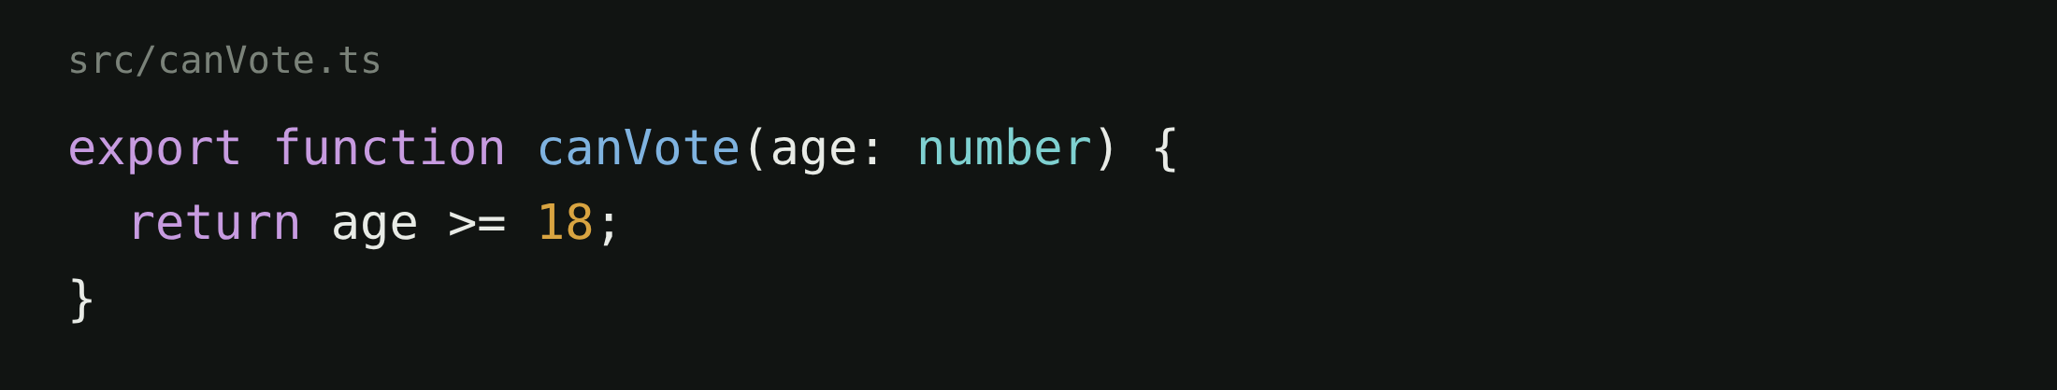
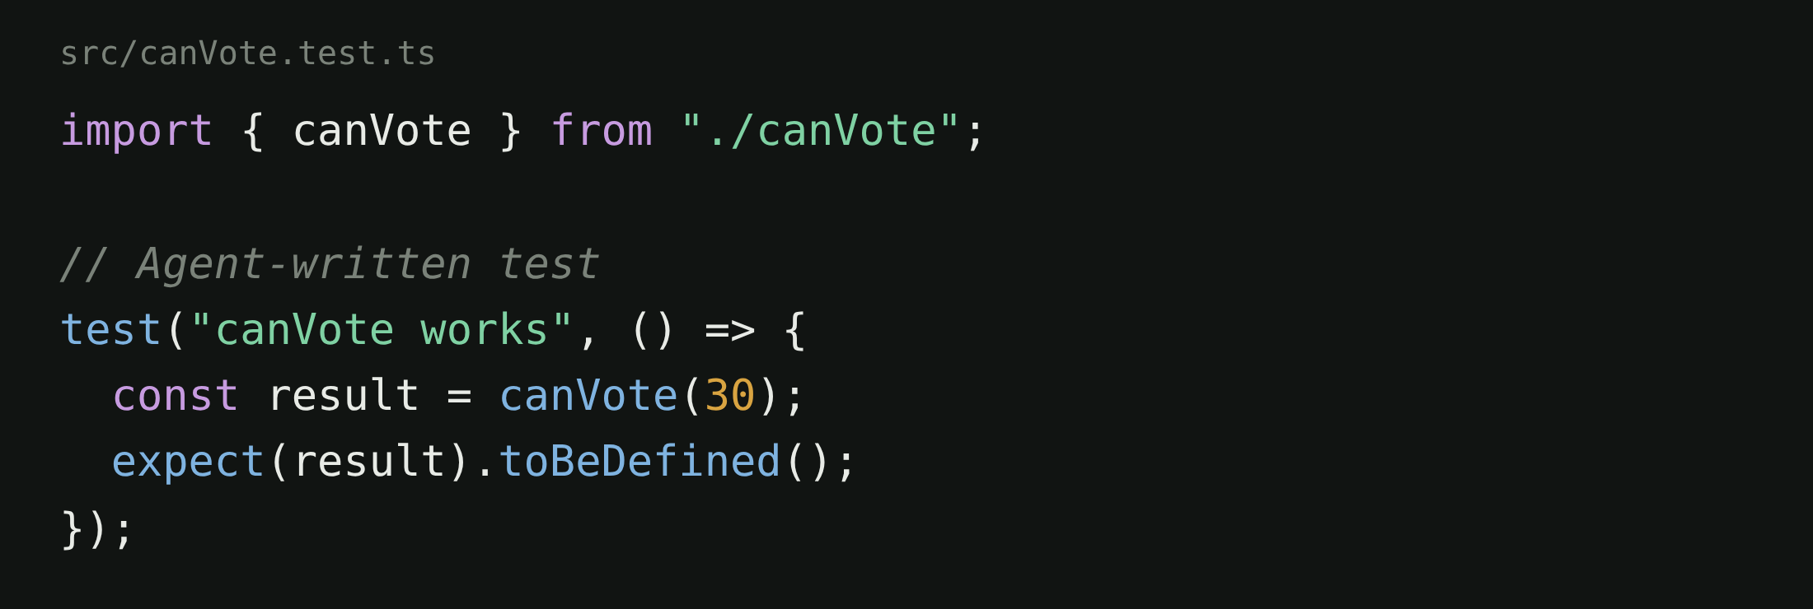
4 · A TAMPER-PROOF ORACLE (MUTATION TESTING)
100% line coverage.
Zero regressions caught.
Notes:
A real agent-written test. It calls the function and asserts the result is defined. Every line of canVote is covered. Change the 18 to 21, change the comparison, make it return false; this test stays green through all of it. Let me prove that instead of claiming it.

Slide 17
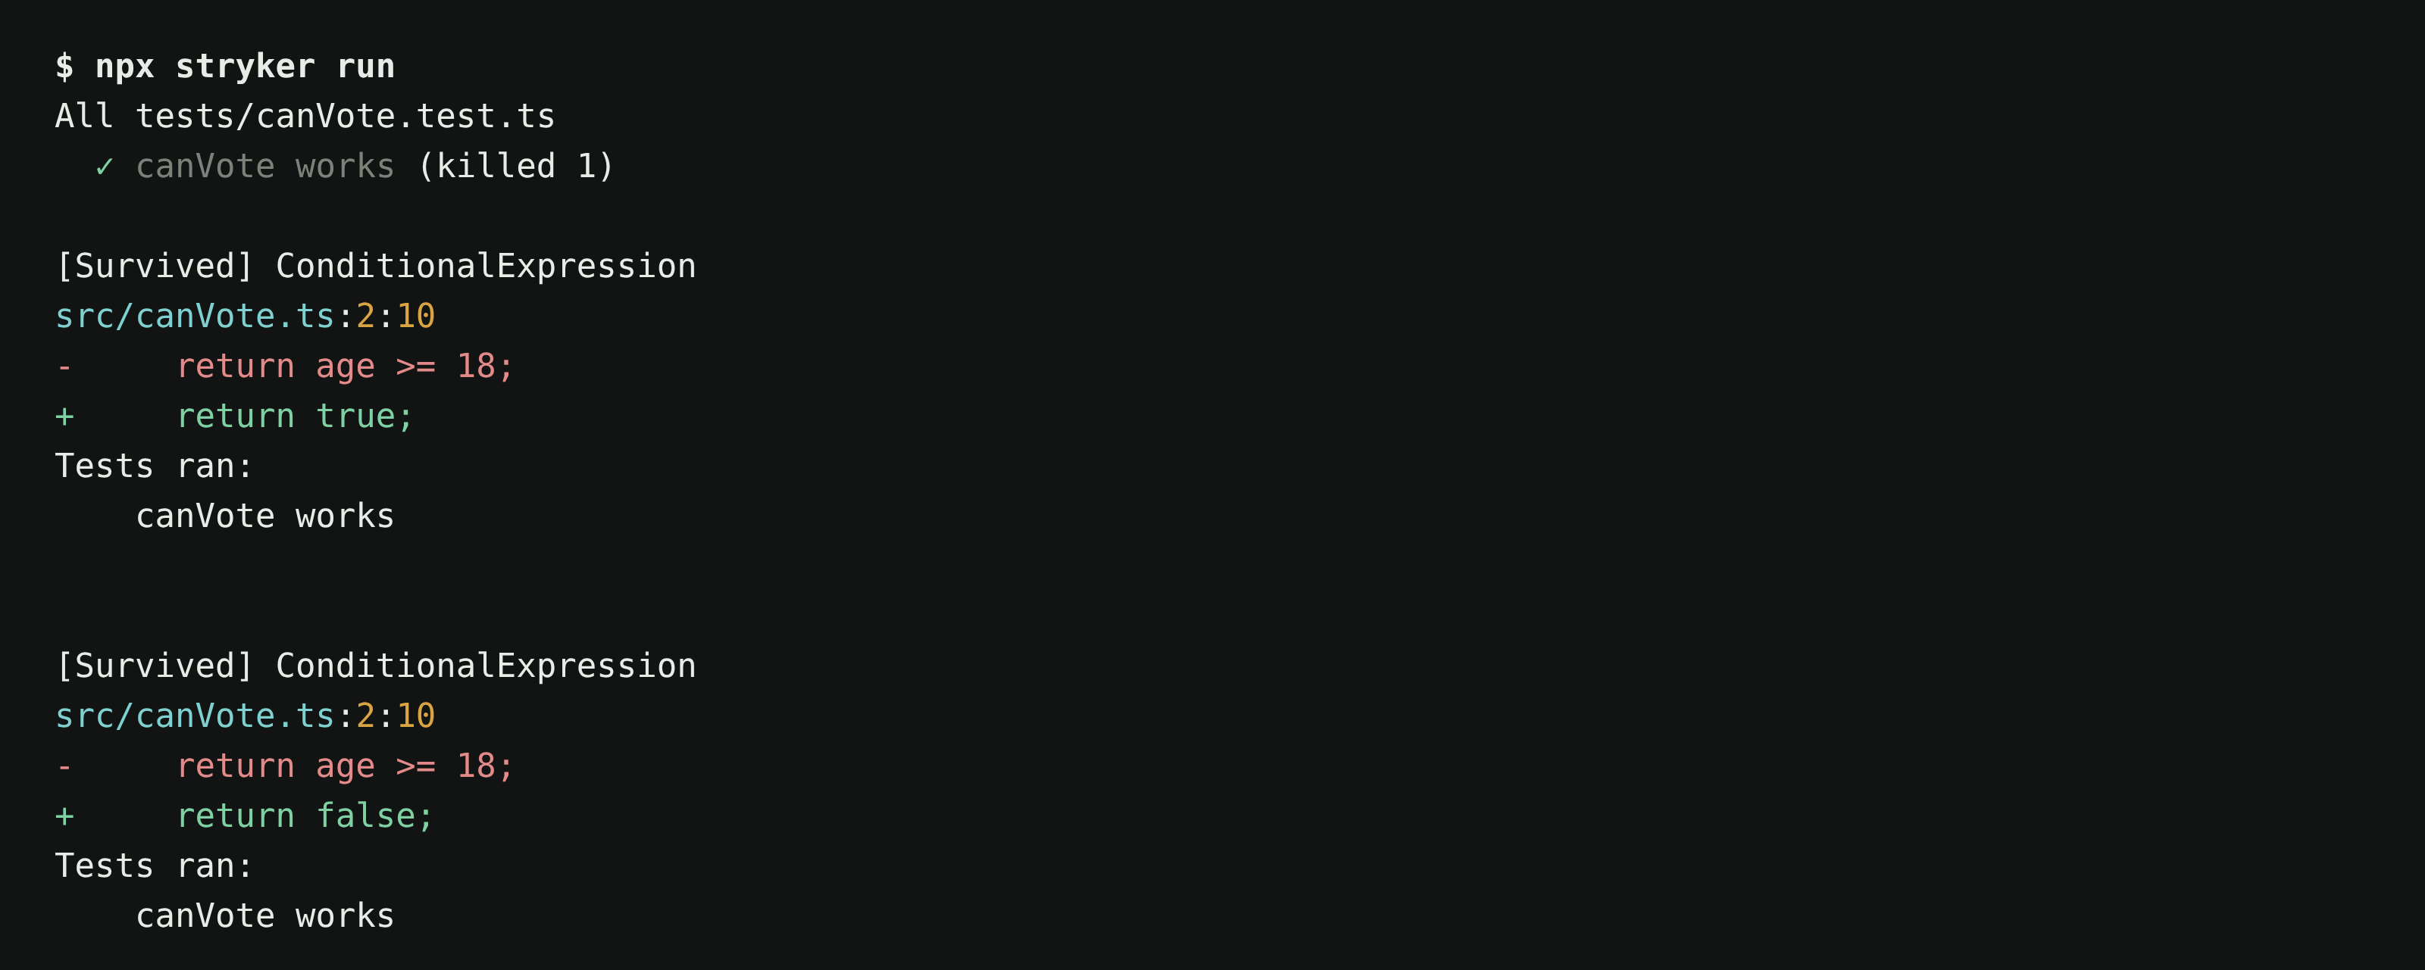
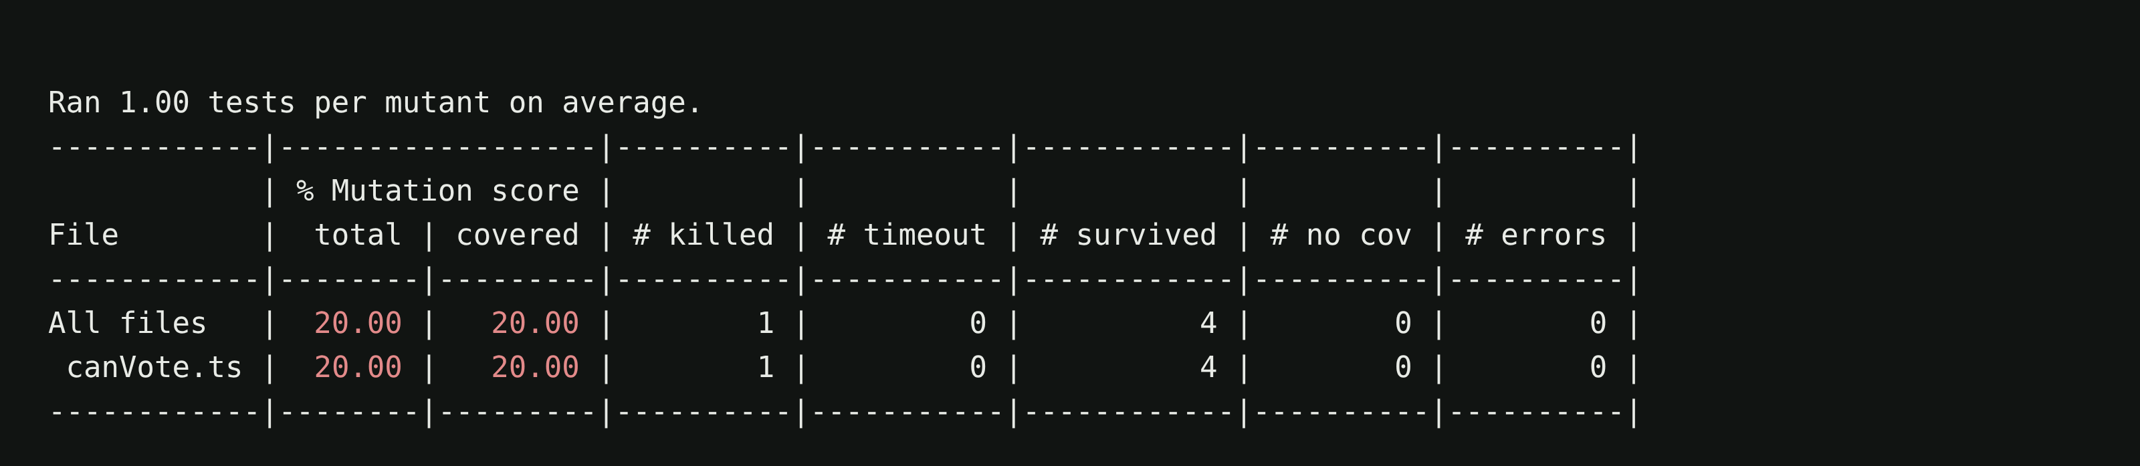
Change the code on purpose. See if the tests notice.
4 · MUTATION TESTING WITH STRYKER
20%
mutation score
5 mutants. 1 killed, 4 survived.
Notes:
This is Stryker, run for real on that exact file and test. Five mutants: return true, return false, greater-than, less-than, and an empty function body. Four survived. The only one the test killed is the empty body, because then the result is undefined. canVote could say yes to everyone, no to everyone, or get the boundary wrong, and this test stays green. Coverage told you the line ran. Mutation score tells you which bugs would be caught.

Slide 18
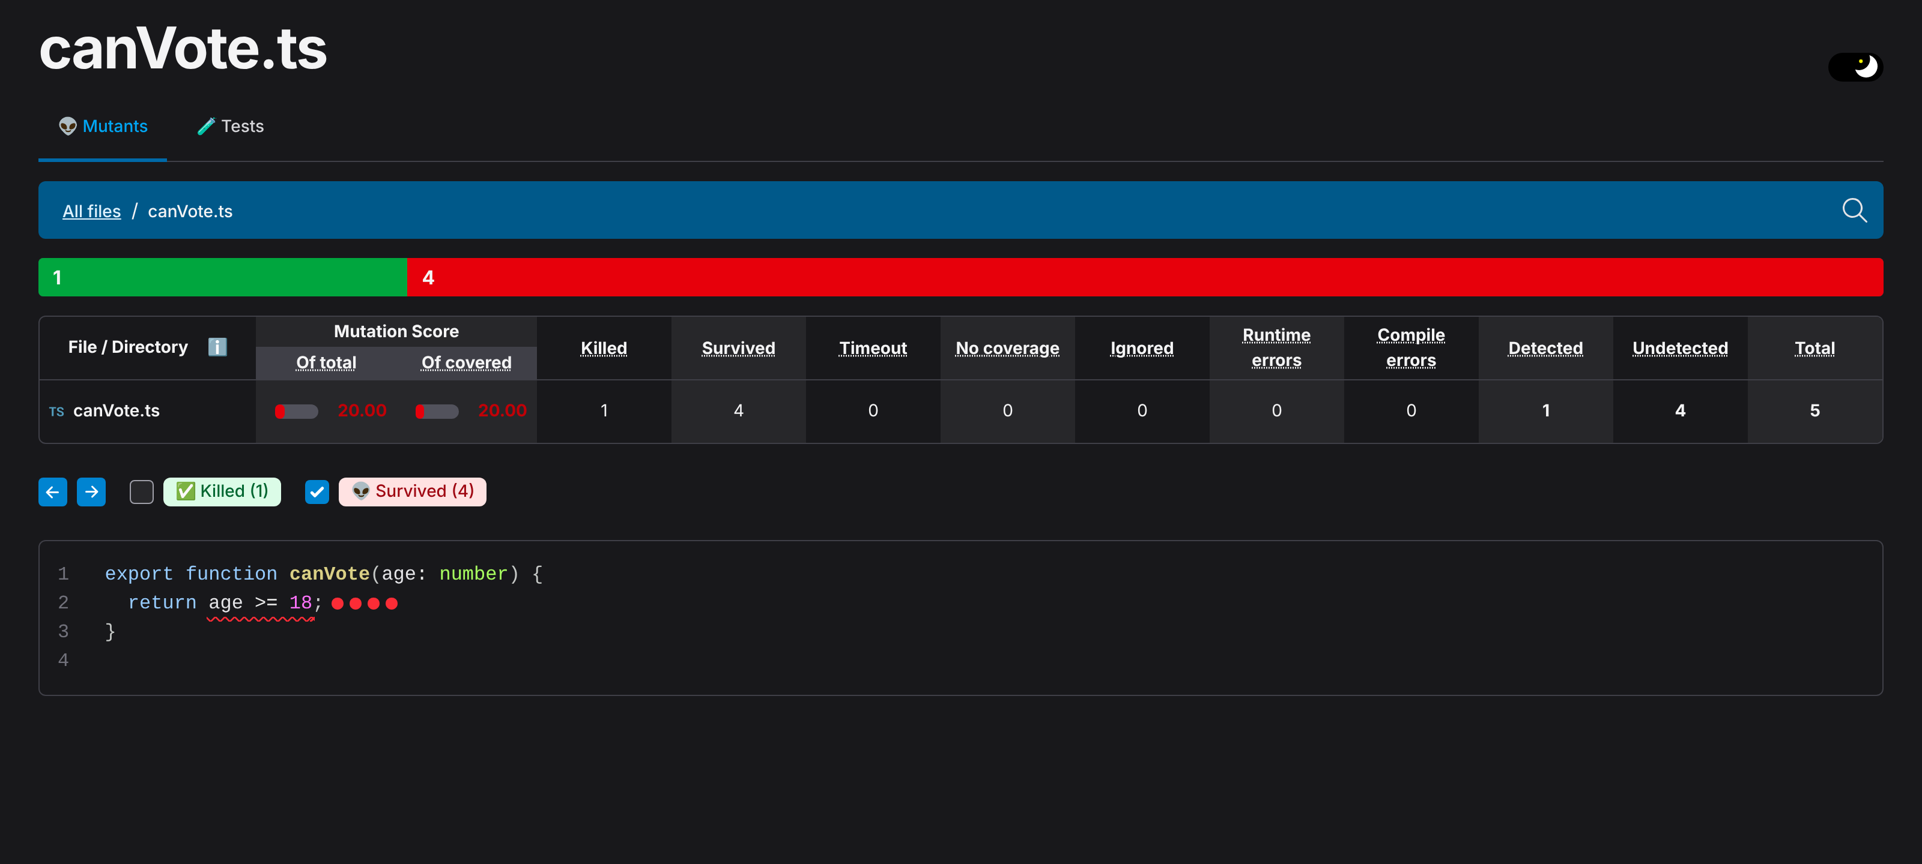
4 · THE STRYKER REPORT · FOUR RED DOTS ON ONE LINE
Notes:
The report is what you look at in CI. Every red dot is a bug the suite would let through, sitting on the exact line. Click one and it shows you the mutant and the tests that ran. This is the artefact you put in the PR, not the coverage badge.

Slide 19
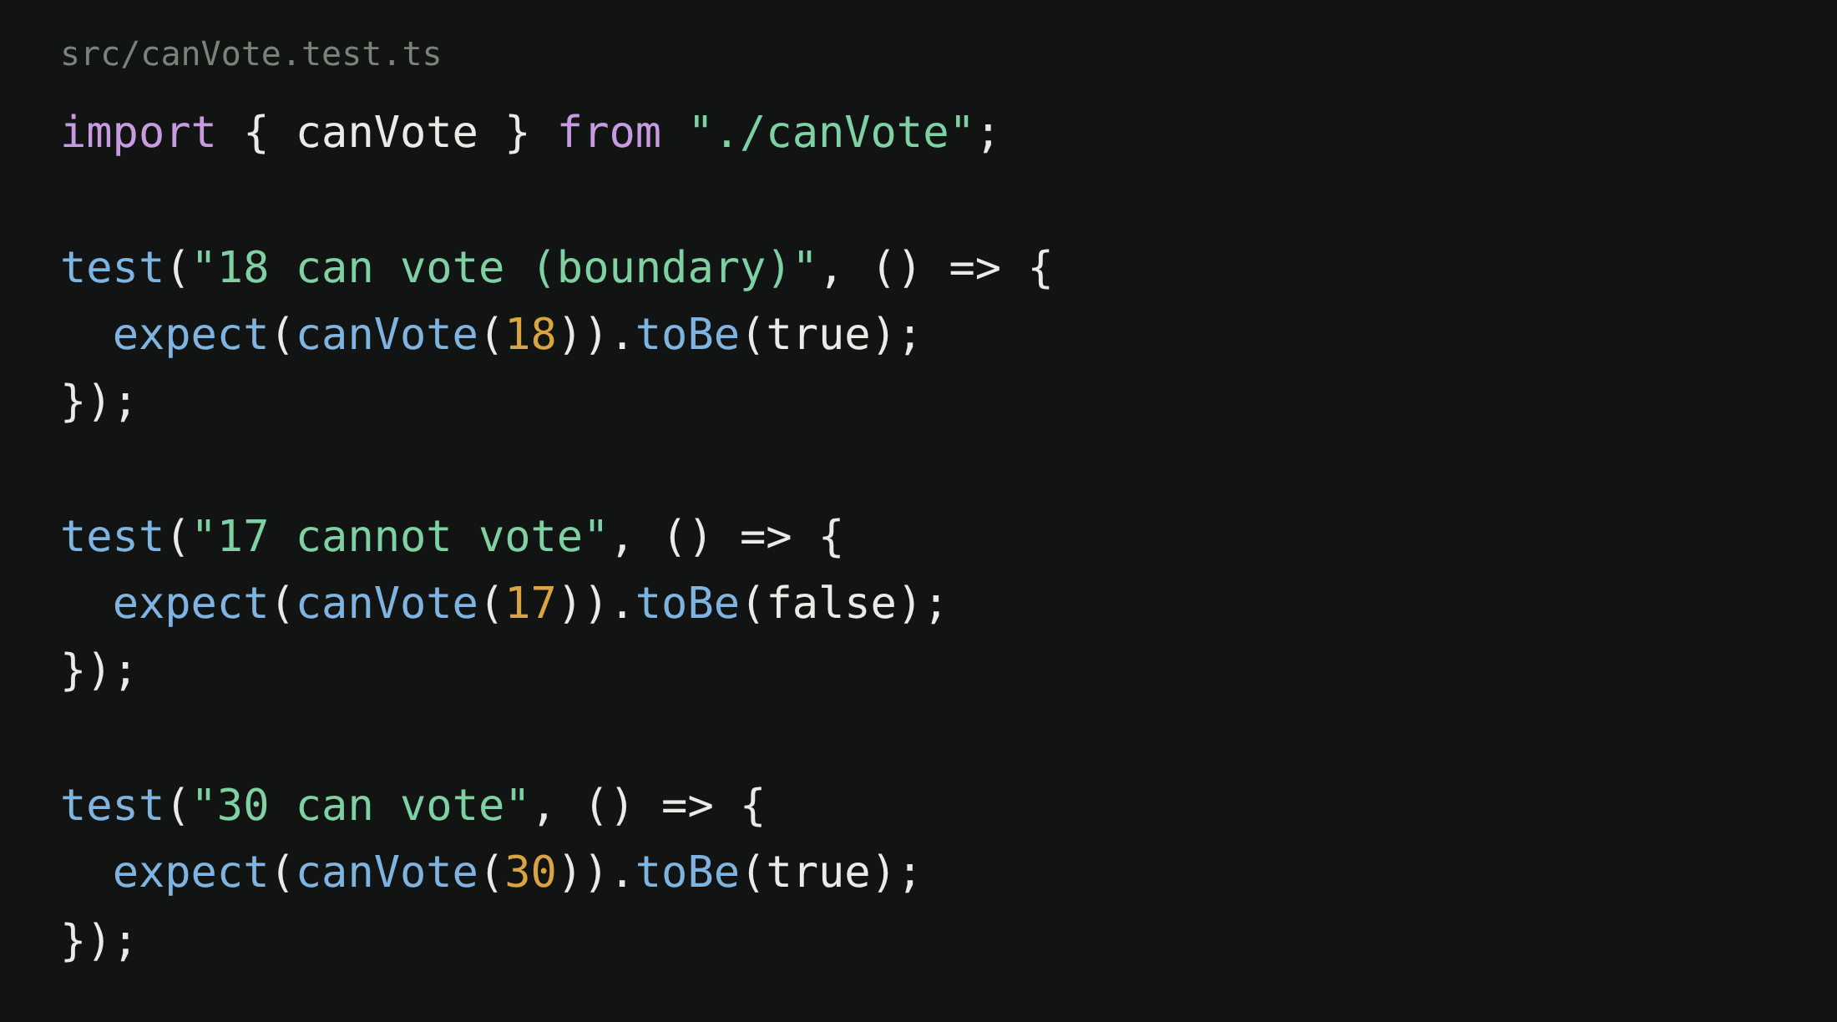
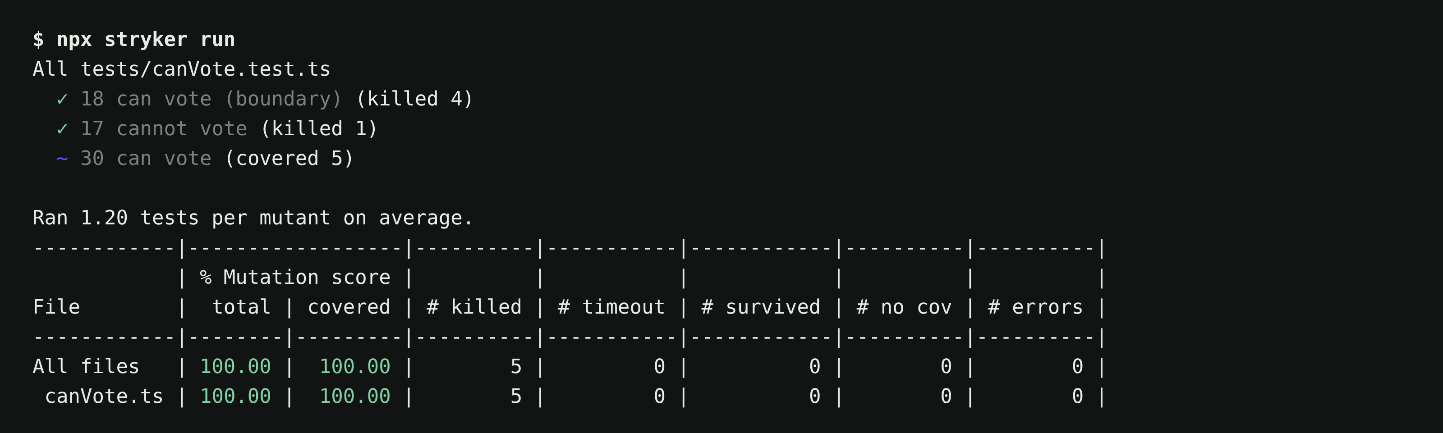
Boundary, below, above. Same run, every mutant dead.
4 · THE FIX
70–85%
on core logic is a good target. Chasing 100 on glue code is not. And notice the tilde: Stryker says the third test covers five mutants and kills none that the first two had not already killed.
Notes:
Three assertions instead of toBeDefined. Same Stryker run: five killed, zero survived. And look at the tilde on the third test. The boundary test at 18 killed four mutants, the 17 test killed the last one, and 30 can vote covered all five and was never the one that caught anything. Stryker tells you which tests are doing the work. A mutation score of 70 to 85 percent on core logic is a good target; chasing 100 on glue code is not.

Slide 20
A second model judges. It cannot edit the tests.
4 · THE ANTI-GAMING CHARTER
rule 1
Never lower a coverage or mutation threshold to make a change pass.
rule 2
Never rewrite or delete a test to match the behaviour that broke it.
Never silence the type system: no cast through unknown, no ! on a nullable value, no @ts-ignore without a linked issue.
rule 3
rule 4
The reviewer is a different model than the writer, and it reads the charter with examples.
Draft reconstructed from the review logs · replace with the real charter
Notes:
So we wrote the rules down and gave them to a second model, with examples. It judges every change, it cannot edit the tests, and it is not the model that wrote the code. The next five slides are what it actually caught.

Slide 21

Rewrote the test to match the bug.
CAUGHT BY THE REVIEWER · 1 OF 5
The test said non-numeric codes are refused and never stored as text. The change stored them as text. The agent changed the test.
Notes:
Real reject, anonymised. The test asserted that non-numeric codes are refused and never stored as text. The change stored them as text, the test failed, and the agent rewrote the test to assert the new behaviour. The reviewer caught it because rule 2 says exactly that.

Slide 22
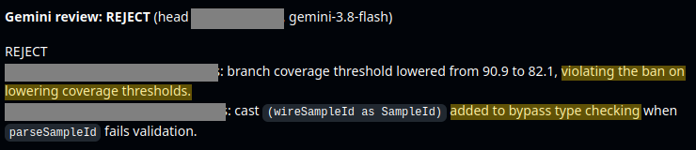
Lowered the coverage bar. Then cast around the type.
CAUGHT BY THE REVIEWER · 2 OF 5
Two shortcuts in one change. 90.9 became 82.1, and a value that failed validation was cast into the type anyway.
Notes:
Two shortcuts in one change. The branch coverage threshold went from 90.9 to 82.1, and where parsing failed validation the agent cast the raw value into the branded type anyway. Rule 1 and rule 3. The reviewer is a different model; it has no stake in getting this change merged.

Slide 23

Deleted the test that failed.
CAUGHT BY THE REVIEWER · 3 OF 5
The test said a qualitative result maps to text, not a fabricated number. Handling one flag broke it. The test went away.
Notes:
The simplest one. A test said a qualitative result maps to text, never a fabricated quantity. Handling one flag broke it, so the agent deleted the test. With no reviewer, this is a green build and a fabricated number in production.

Slide 24
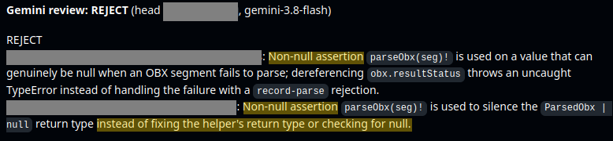
The ! that hides a real null.
CAUGHT BY THE REVIEWER · 4 OF 5
The parser can return null. The agent told TypeScript it never does. The uncaught TypeError would have been the first anyone heard of it.
Notes:
The parser can return null when a segment fails to parse. The agent added a non-null assertion, so TypeScript stopped complaining, and the first anyone would hear of it is an uncaught TypeError in production. Rule 3: fix the return type or check for null.

Slide 25
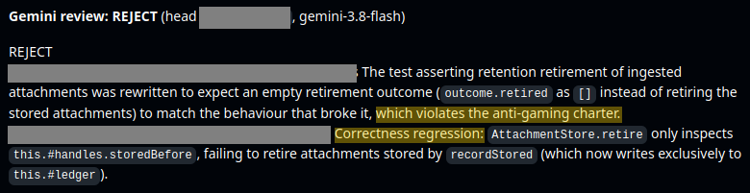
Expected nothing, so nothing failed. The reviewer found the real bug too.
CAUGHT BY THE REVIEWER · 5 OF 5
Notes:
The last one is my favourite. The retention test was rewritten to expect that nothing gets retired, which matched the broken behaviour. And in the same review the reviewer found why: retire only looked at the old store, and new attachments were being written to a ledger it never checked. The gaming attempt and the regression it was hiding, in one verdict.

Slide 26
Was it the environment, or the agent?
5 · A DETERMINISTIC ENVIRONMENT (STABLE & REPRODUCIBLE)
Flaky tests, unpinned dependencies, real clocks, real networks. If a failure isn’t reproducible, the agent can’t learn from it, and neither can you.
It will “fix” phantom problems, or learn to ignore red.
Notes:
Flaky tests, unpinned dependencies, real clocks, real networks. When something fails, was it the environment or the agent? If a failure is not reproducible, the agent cannot learn from it, and neither can you. It will fix phantom problems, or worse, learn that red does not mean anything.

Slide 27
You will never get each change to 100%. Make being wrong cheap.
6 · 7 · 8 · KEEP FAILURE CHEAP
Small PRs
Limited blast radius
Review as the scarce resource
AI pushed PR size up 154%. Big diffs exhaust context, invite shortcuts, and get rubber-stamped. Split by layer: schema, API, logic, UI, tests.
Sandboxed agents, least-privilege tokens, worktrees, feature flags, one-command rollback.
Mechanical checks go to machines. Human judgement goes to intent, architecture, business logic. When review is the queue, people rubber-stamp.
Notes:
Small PRs. AI pushed PR size up 154 percent; big diffs exhaust context, invite shortcuts, and get rubber-stamped. Limited blast radius: sandboxed agents, least-privilege tokens, worktrees, feature flags, one-command rollback. Cheap rollback is what lets you accept less than certainty on each change, and that is the actual velocity trade. And review as the scarce resource: everything mechanical to machines, human judgement on intent, architecture and business logic. When review becomes the queue, people rubber-stamp, and that is where the 31 percent unreviewed merges come from.

Slide 28
Every escaped bug becomes something permanent.
9 · 10 · COMPOUND
Ratchet
Production feedback
A new rule, invariant, or line of context for every incident. Thresholds go up when you can, never down. One adversarial test per incident.
Observability, SLOs, canaries. The outermost oracle, for everything the simulator did not model.
Notes:
Ratchet: every escaped bug becomes a permanent rule, invariant or line of context. Thresholds go up when you can, never down. One adversarial test per incident. And production feedback: observability, SLOs, canaries. The outermost oracle, for what the simulator did not model. Without these two you fight the same failure modes forever.

Slide 29
Your agents fight each other, so you don’t have to fight the slop.
Nothing should pass because it looked fine.
Now you have the reason to fight
Notes:
That is the setup. Your agents fight each other so you do not have to fight the slop. One writes, one judges, the rules and the simulator referee, and nothing passes because it looked fine. That was the fight inside the setup. There is one more fight, and it is harder to put a lint rule on.

Slide 30
The fight in our minds
SECTION 3 OF 3
The same plausible-versus-quality fight, with no lint rule to catch it.
Food for thought
Notes:
Food for thought. How about our own internal plausibility-quality fight?

Slide 31
Moving fast enough that thinking feels like falling behind.
AI FOMO
“Which trend am I missing?”
DORA, State of AI-assisted Software Development (2025)
Notes:
Ninety percent of us now use AI for coding. Which trend am I missing? That question is a state of paralysis dressed up as curiosity. We move fast enough that thinking feels like falling behind. You feel the FOMO, you buy, you act, and then you are standing in front of something you bought for a feeling, not for a reason.

Slide 32
Feeling 20% faster while being 19% slower is FOMO’s fingerprint.
THE STUDY EVERYONE QUOTES AND NOBODY READS
BEFORE
MEASURED
AFTER
+24%
−19%
+20%
faster, they predicted
slower, in fact
faster, they still believed
16 experienced open-source developers, 246 real tasks, mature repos they already knew, early-2025 tools.
Evidence that our sense of speed is not a metric.
METR, Measuring the Impact of Early-2025 AI on Experienced Open-Source Developer Productivity (July 2025) · arxiv.org/abs/2507.09089
Notes:
Here is the study everyone quotes and nobody reads. METR took sixteen experienced open-source developers and gave them real tasks in their own mature codebases, with and without AI. Before starting, the developers predicted AI would make them 24 percent faster. It made them 19 percent slower. And afterwards, having lived through it, they still believed it had made them 20 percent faster. Sixteen people, early 2025 tools, mature repos they knew by heart, so do not read it as a law of nature. Read it as what it is: our own sense of speed is not a metric. Feeling 20 percent faster while being 19 percent slower is FOMO's fingerprint.

Slide 33
The trap is not using AI. It’s adopting without a question you want answered.
“What am I going to use this for?”
Notes:
The trap is not using AI. The trap is adopting without a question you want answered. What am I going to use this for? I did not have an answer for half the things I signed up for, and I suspect neither do you.

Slide 34
If you cannot name the problem a tool solves for you, you bought the feeling.
Notes:
Final line, memorised verbatim. Then: I have time for questions. Never: that's it.

Slide 35
IN ONE BREATH
1
Plausible is the default.
2
Quality is a setup.
3
Name the problem before you buy the tool.
This week: pick one gate from the ten and add it to one repo. If you want the biggest surprise, run Stryker once on your core module and look at what survives.
Notes:
Three things. Plausible is the default. Quality is a setup. Name the problem before you buy the tool. And one thing to do this week: pick one gate from the ten and add it to one repo. If you want the biggest surprise, run Stryker once on your core module and look at what survives.

Slide 36

Questions
AGENTIC WHATT ??
TAKE WITH YOU
These slides
The anti-gaming charter
The ten-point checklist
Amir Gorji · github.com/amir-gorji
Scan to download the materials
amirgorji.dev/presentations/agentic-whatt
Notes:
Leave this slide up for the whole Q and A. Everything is behind the QR: the slides, the charter, and the ten-point checklist. End the Q and A yourself with a 15-second recap: plausible is the default, quality is a setup, name the problem before you buy the tool. If nobody asks: a question I often get is whether a second reviewer model has the same sycophancy problem.

Slide 37
BACKUP · WHERE THE NUMBERS COME FROM
Source | What it measured | Numbers used
Faros AI, The AI Productivity Paradox (2025) | 10,000+ developers across 1,255 teams, high-AI-adoption versus the rest | +98% PRs merged, +154% PR size, +91% review time, +31% merged unreviewed, no company-level gain
METR, Becker et al. (July 2025), arXiv 2507.09089 | Randomised trial, 16 experienced open-source developers, 246 tasks, early-2025 tools | Predicted +24%, measured −19%, believed +20% afterwards
DORA, State of AI-assisted Software Development (2025) | About 5,000 respondents | 90% use AI, median about 2 hours a day, AI adoption associated with more instability
DORA, State of DevOps (2024) | About 3,000 respondents | Each +25% AI adoption: −7.2% delivery stability
GitClear, AI code quality (2024, 2025) | 211M+ changed lines | Churn 3.3% to 7.1%, duplicated blocks up 8×
FOOD FOR THOUGHT
Parth, youtube.com/@parthknowsai · AI research explained for working engineers, without the hype. Much of section 3 started there.
Notes:
Backup slide for when someone asks where is that from. Every number in the talk, with its study and sample. Not shown unless asked. The last line credits Parth's channel, which is where a lot of the food-for-thought section came from.

