Slide 1

Slide 1
Data Engineering
Amir.H.Ahmadzadeh Feb. 2024

Slide 2





Data Engineering
Tabular Data
Cleaning & Preprocessing
Visualization and Exploration
ML & AI
Notes:
Flash back
Not square one
Aske where this data reached to us?
Databases(datalakes), questioners, IOT devices
My Project

Slide 3
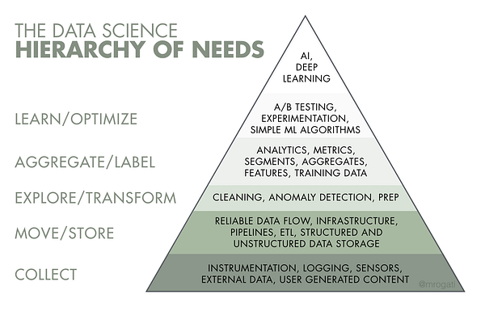
Data Engineering
“Data engineering is the development, implementation, and maintenance of systems and processes that take in raw data and produce high-quality, consistent and easy to access information that supports downstream use cases, such as analysis and machine learning.”
Notes:
It’s a good definition. Each word in this paragraph means something and refers to an actual concept of DE. We’ll get to know a couple of them.
This pyramid, illustrates how data comes up from an output of a sensor all the way to be fed to a AI model and on each level what transformations take place on the data.
The quality and performance of data analysis other use cases
systems and processes are mentioned in this definition. What are those?

Slide 4
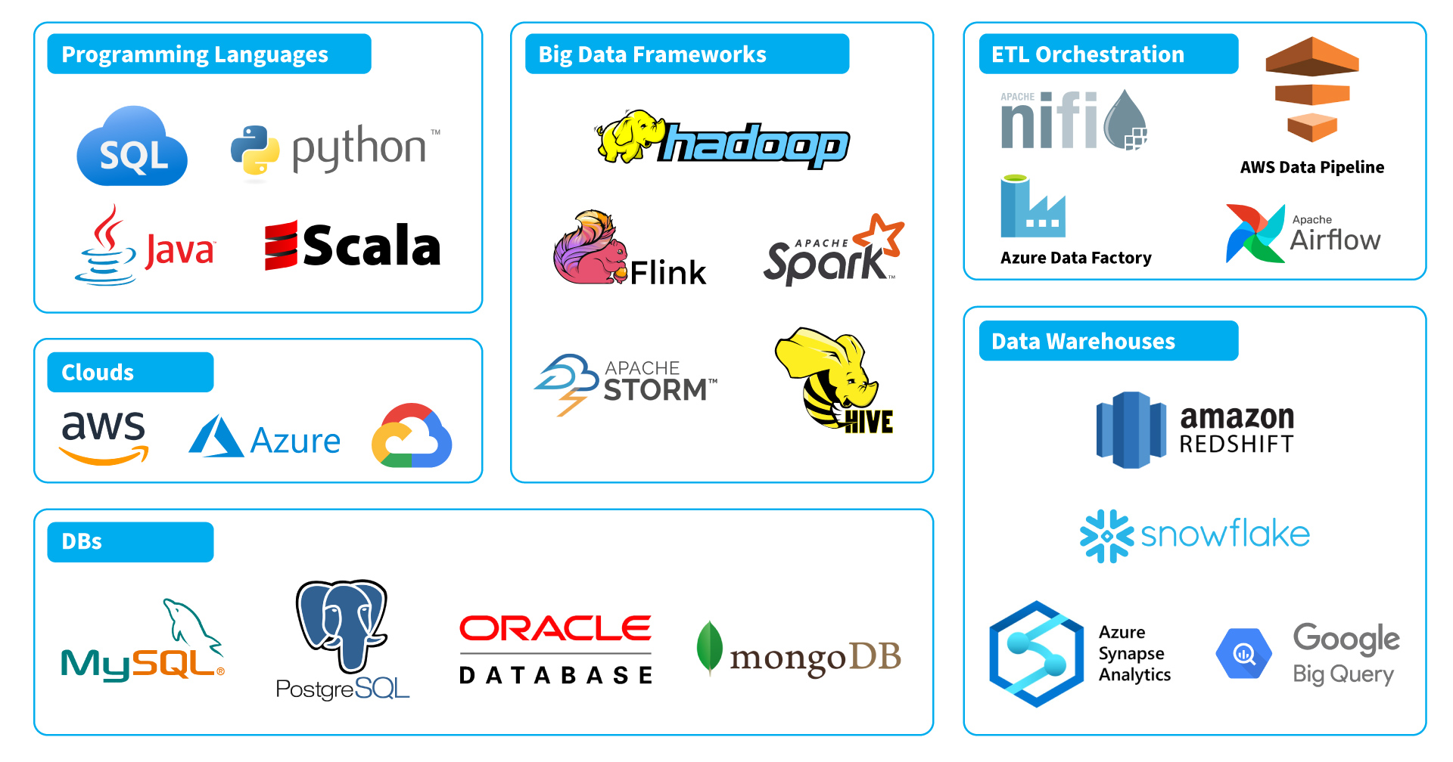
Data Engineering
Extract, Transform, Load (ETL)
Data warehouse management
Big data processing
cloud data engineering
Notes:
ETL, Data Integrity checks, Streaming, Data warehouse management, Data modeling, Big data processing, cloud data engineering, and so on,
Every company or business doesn’t need all these systems
But there are few which is fundamental for a data engineering systems
Another point is the range of tools In data engineering.

Slide 5
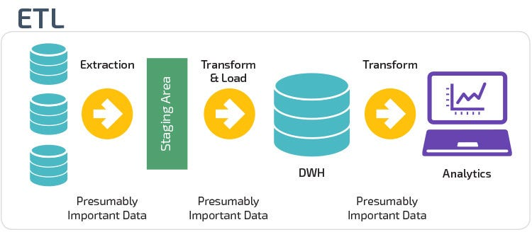
Extract, Transform, Load
…take in raw data and produce high-quality, consistent and easy to access information…
Extract
Transform
Load
The extract step involves connecting to a data source such as an API, automated reporting system or file store, and pulling the data out of it.
Standardizes data formats and structures for uniformity.
Load the transformed data into the data warehouse.
Notes:
Difinition
Points about formatting and volum of data
Transform
Load
Database Vs data lake Vs data warehouse

Slide 6
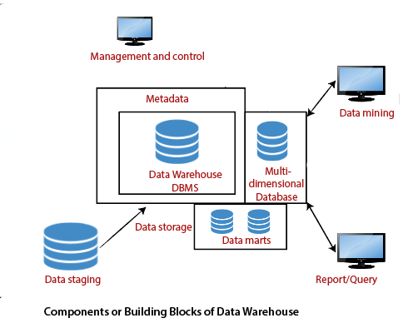


Data warehouse management
unified, structured and easy to access
Data modeling
Hierarchy of access
Amazon Redshift, Snowflake, Microsoft SQL Server Integration Services (SSIS)
Notes:
Data warehouse is a centralized storage for keeping and managing large volume of data from different department or sources inside the company. It’s technically where all the company’s information is stored.
Secirity

Slide 7
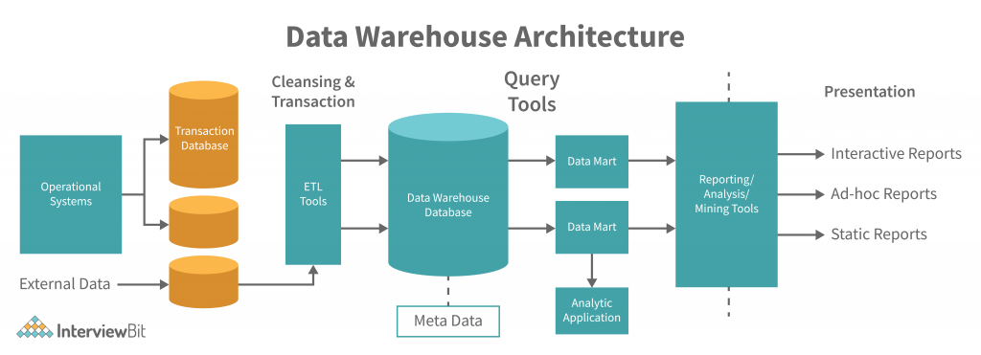
Data Engineering full orchestration
Notes:
This diagram shows the core of a data engineering pipline or what microsot data engineers love to call it, data orchestration.
End of data endinnering

Slide 8

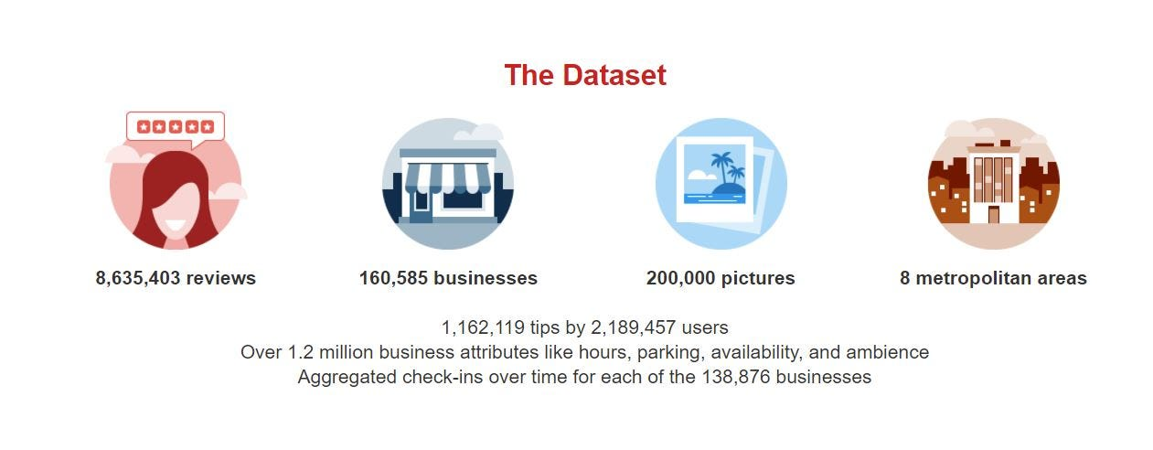
EDA on “YELp” dataset
Data Engineering
Basic D.E. Pipeline( E to V )
www.yelp.com/dataset
Choosing a right technology
Yelp Open Dataset
Notes:
Not whole the yelp because of resorcing

Slide 9


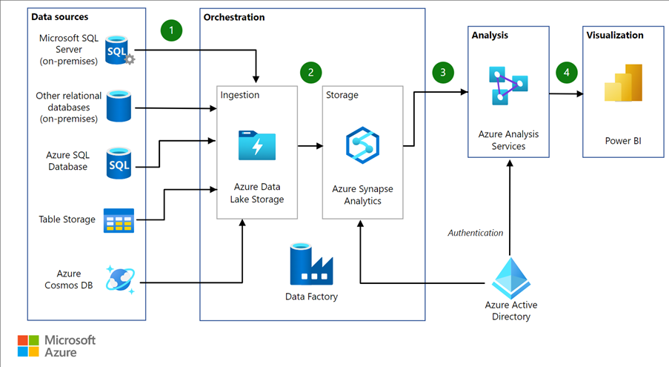


Azure
cloud computing and storage platform. Scalability and integration
Data lakes, Data bases, Data warehouses, etc.
Apache computing modules, data flows, notebooks, etc.
Active Directory
Adobe, BMW, HP, Vodafone, etc.

Slide 10
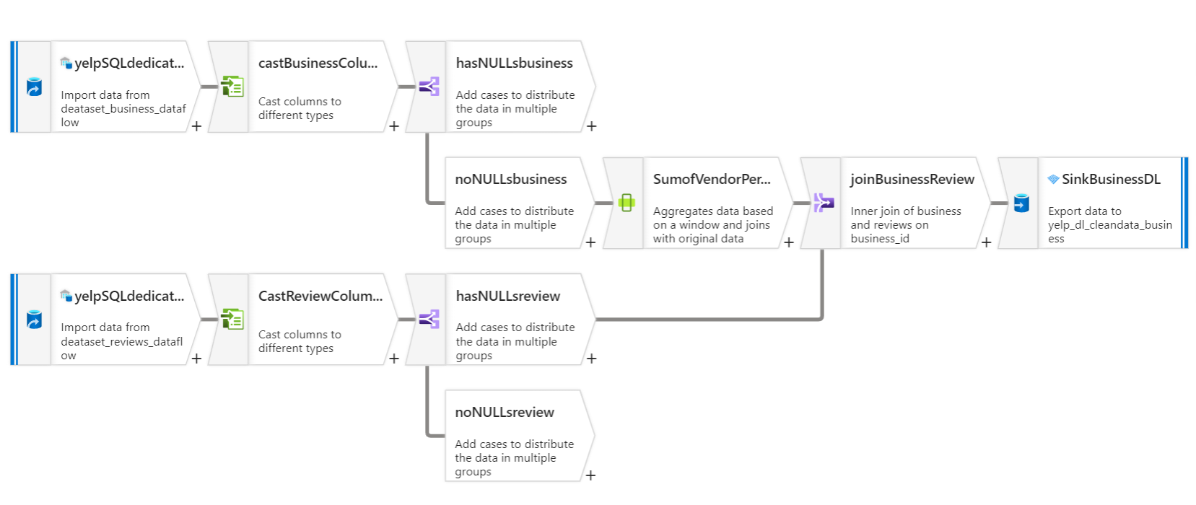
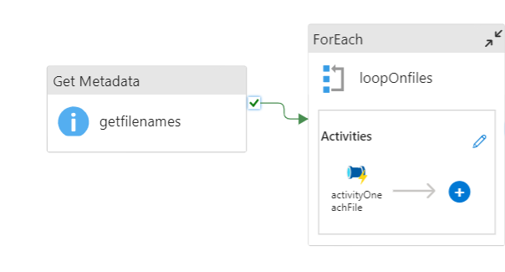


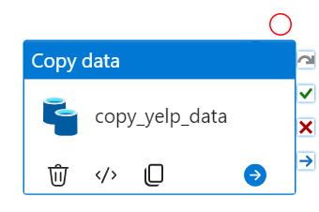
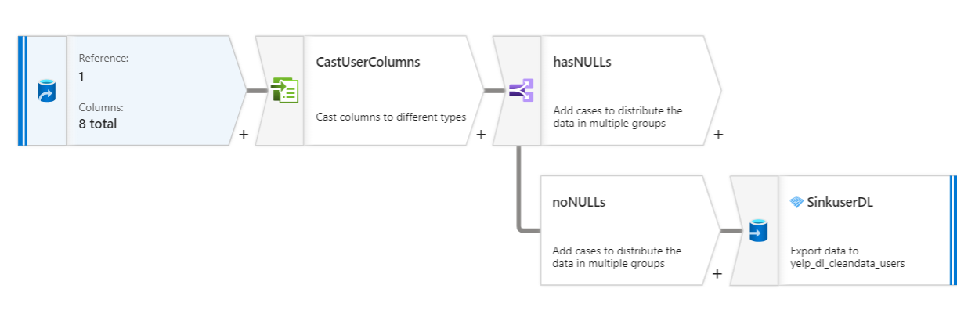



Complete Pipeline
Parquet file
Parquet file
PowerBI
Notebooks
Notes:
The quality and performance of data analysis other use cases

Slide 11

Graphical Data exploratory dashboard

Slide 12


Slide 10
THANK YOU

