Slide 1
501 Refactoring
By: Amir Hussain

Slide 2
Form template Method
Moved spike related material to its own class
Much more modulure
Fits object oriented design better
Found in commits eca5f4706a8e928040e3a5dc1c1f7927bfdbea5d, f6881b793489a3735fd7a981ee85084f8a3d549e, and 2c9ae7c9c740d6cbbfa8ff6026590cc80e082fd6

Slide 3
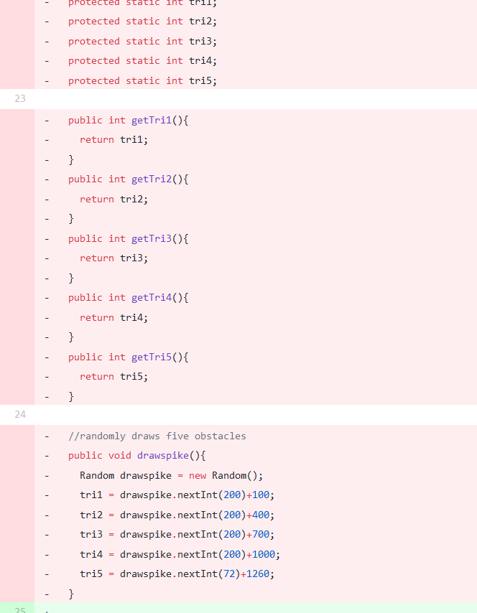
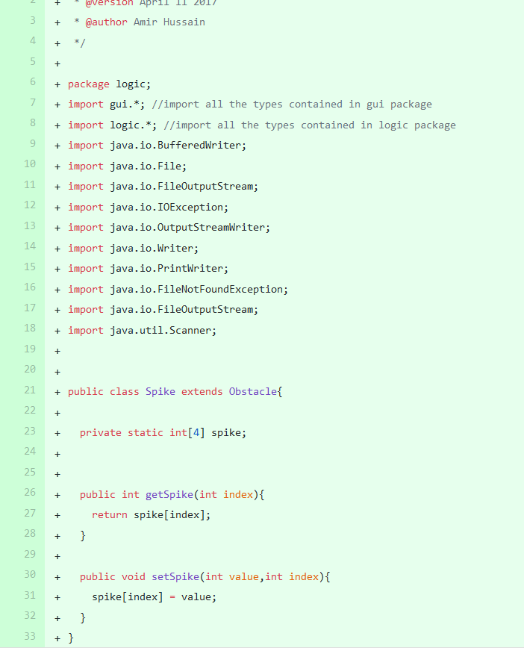
Before and after

Slide 4
Also to note
Some shotgun surgery
Better naming conventions
Overall better design

Slide 5
Inappropriate intimacy
Mainly in GUI Package
Mostly public changed most to at least protected.
Hit detection, and classes in the spike class

Slide 6
Collapsed hierarchy
Score was its own class did very minimal work
Example of a lazy class
Not fit with object oriented design

Slide 7
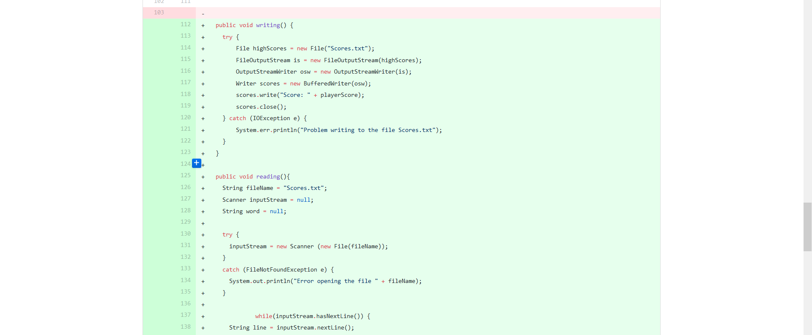
Code added into player from score

Slide 8
Generalized code
Hit detection
Very specific
Not good design

Slide 9


