Slide 1
AVR Interfacing ADC

Slide 2
Agenda
Introduction to ADC.
AVR ADC.
AVR ADC Registers.
AVR ADC Programming.

Slide 3

Introduction to ADC
In the Real World, a sensor senses any physical parameter and converts into an equivalent analog electrical signal this analog signal is converted into a digital signal using an Analog to Digital Converter (ADC).
ADC can be defined by
The ADC precision is the number of distinguishable ADC inputs that ADC can measure (e.g. 1024 alternatives for 10 bits ADC).
The ADC range is the maximum and minimum ADC input (e.g. 0 to +5V).
he ADC resolution is the smallest distinguishable change in input voltage that can be sensed by ADC. The resolution is the change in input that causes the digital output to change by 1. ex:

Slide 4
Introduction to ADC
ADC Prescaler
The ADC of the AVR converts analog signal into digital signal at some regular interval. This interval is determined by the clock frequency.
The prescaler acts as frequency division factor.
There are some predefined division factors 2, 4, 8, 16, 32, 64, and 128.
For example, a prescaler of 128 implies
F_ADC = F_CPU/8. For F_CPU = 16MHz, F_ADC = 16M/128 = 125kHz.
so time required to convert the analog signal to digital is 1/125 ms.

Slide 5

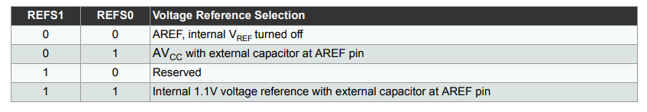

AVR ADC Registers
ADMUX - ADC Multiplexer Selection Register
Bits 7:6 – REFS1:0 – ADC $V_{ref}$ Reference Selection Bits
These bits select the voltage reference for the ADC. The internal voltage reference options may not be used if an external reference voltage is being applied to the AREF pin

Slide 6


AVR ADC Registers
Bit 5 – ADLAR – ADC Left Adjust Result The ADLAR bit affects the presentation of the ADC conversion result in the ADC Data Register. Write one to ADLAR to left adjust the result. Otherwise, the result is right adjusted.
Bits 3:0 – MUX4:0 – Analog Channel Bits
There are 6 ADC channels (PC0…PC5).

Slide 7
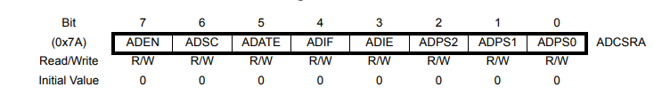
AVR ADC Registers
ADCSRA – ADC Control and Status Register A
Bit 7 – ADEN – ADC Enable This is enabled, ADC operations. Otherwise the pins behave as GPIO ports.
Bit 6 – ADSC – ADC Start Conversion 1 is written as long as the conversion is in progress, When the conversion is complete, it returns to zero.
Bit 5 – ADATE – ADC Auto Trigger Enable 1 enables auto trigger where the ADC will start a conversion on a positive edge of the selected trigger signal.
Bit 4 – ADIF – ADC Interrupt Flag
This bit is set when an ADC conversion completes and the Data Registers are updated.

Slide 8
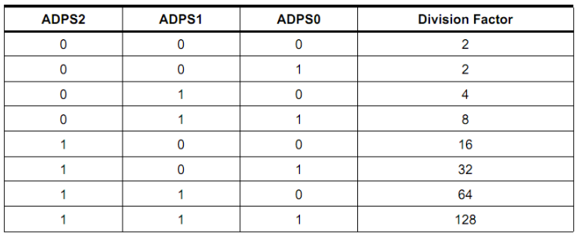
AVR ADC Registers
Bit 3 – ADIE – ADC Interrupt Enable
Bits 2:0 – ADPS2:0 – ADC Prescaler Select Bits
ADCL and ADCH – ADC Data Registers
The result of the ADC conversion is stored here.

Slide 9
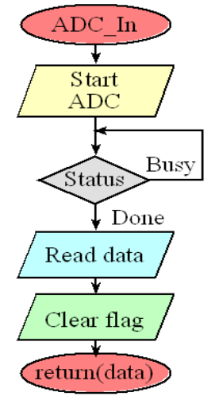
AVR ADC Programming

Slide 10
AVR ADC Programming
ADC Initialization The following code segment initializes the ADC
void adc_init()
{
// AREF = AVcc
ADMUX = (1<<REFS0);
// ADC Enable and prescaler of 128
// 16000000/128 = 125000
ADCSRA = (1<<ADEN)|(1<<ADPS2)|(1<<ADPS1)|(1<<ADPS0);
}

Slide 11
AVR ADC Programming
Reading ADC Value The following code segment reads the value of the ADC
uint16_t adc_read(uint8_t ch)
{
// select the corresponding channel 0~5
// ANDing with ’7′ will always keep the value
// of ‘ch’ between 0 and 5
ch &= 0b00000111; // AND operation with 7
ADMUX = (ADMUX & 0xF8)|ch; // clears the bottom 3 bits before ORing
// start single conversion
// write ’1′ to ADSC
ADCSRA |= (1<<ADSC);
// wait for conversion to complete
// ADSC becomes ’0′ again
// till then, run loop continuously
while(ADCSRA & (1<<ADSC));
return (ADC);
}

Slide 12
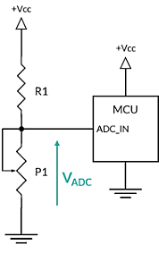
AVR ADC Programming
The following circuit describes the connection of potentiometer.
The following code reads ADC value and checks if the reading is above 500, the led will be turned on. Otherwise, the led will be turned off.
void main()
{
uint16_t adc_result0;
DDRB = 0x20; // to connect led to PB5
// initialize adc
adc_init();
while(1)
{
adc_result0 = adc_read(0); // read adc value at PC0
// condition for led to turn on or off
if (adc_result0 > 500)
PORTB = 0x20;
else
PORTB = 0x00;
}
}

Slide 13
AVR ADC Programming
Using ADC interrupt:
Replacing conversion waiting to be completed with firing a flag or signal that called “ADC interrupt”.
The main difference that will happen in the previous code to be adopted with the ADC interrupt, will be as following;
In ADC Initialization, global interrupt and ADC interrupt enable have to be set.
In Reading ADC Value, while loop which waiting for the conversion ending will be remove and global flag will checked if it comes high or not,
In case of the flag comes high the ADC read will be ready to be returned
from the function.
This flag is controlled in the interrupt function (ISR).

Slide 14
AVR ADC Programming
ADC Initialization The following code segment initializes the ADC
void adc_init()
{
// AREF = AVcc
ADMUX = (1<<REFS0);
// ADC Enable and prescaler of 128
// 16000000/128 = 125000
// (1<<ADIE)=1 → set ADC interrupt enable
ADCSRA = (1<<ADEN)|(1<<ADPS2)|(1<<ADPS1)|(1<<ADPS0)
|(1<<ADIE);
// Set global interrupt
sei();
}

Slide 15
AVR ADC Programming
Reading ADC Value
uint8_t ADC_endconversion_Flag=0;
int16_t adc_read(uint8_t ch)
{
// select the corresponding channel 0~5
// ANDing with ’7′ will always keep the value
// of ‘ch’ between 0 and 5
ch &= 0b00000111; // AND operation with 7
ADMUX = (ADMUX & 0xF8)|ch; // clears the bottom 3 bits before ORing
// start single conversion
// write ’1′ to ADSC
ADCSRA |= (1<<ADSC);
// wait for conversion to complete
// ADSC becomes ’0′ again
// till then, run loop continuously
if(ADC_endconversion_Flag==1){
ADC_endconversion_Flag=0;
return (ADC);
}
else
return(-1);
}
ISR(ADC_vect)
{
ADC_endconversion_Flag=1;
}

Slide 16
AVR ADC Programming
Main function:
void main()
{
uint16_t adc_result0;
DDRB = 0x20; // to connect led to PB5
// initialize adc
adc_init();
while(1)
{
adc_result0 = adc_read(0); // read adc value at PA0
// condition for led to turn on or off
if(adc_result0!=-1){
if (adc_result0 > 500)
PORTB = 0x20;
else if ()
PORTB = 0x00;
}
}
}

