Slide 1
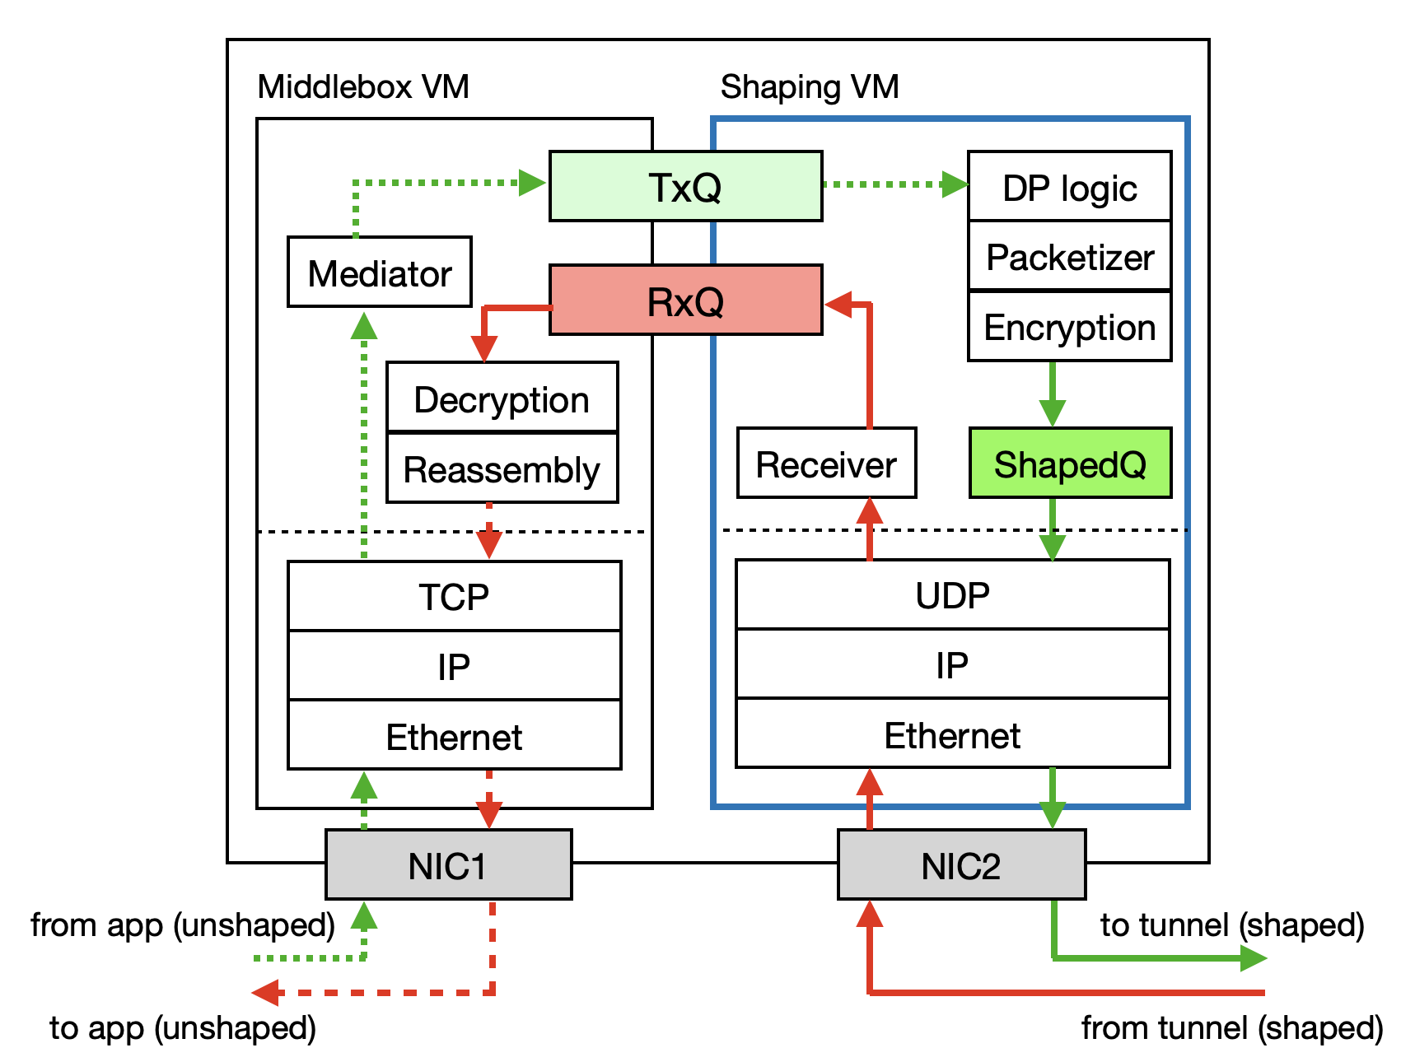

Slide 2
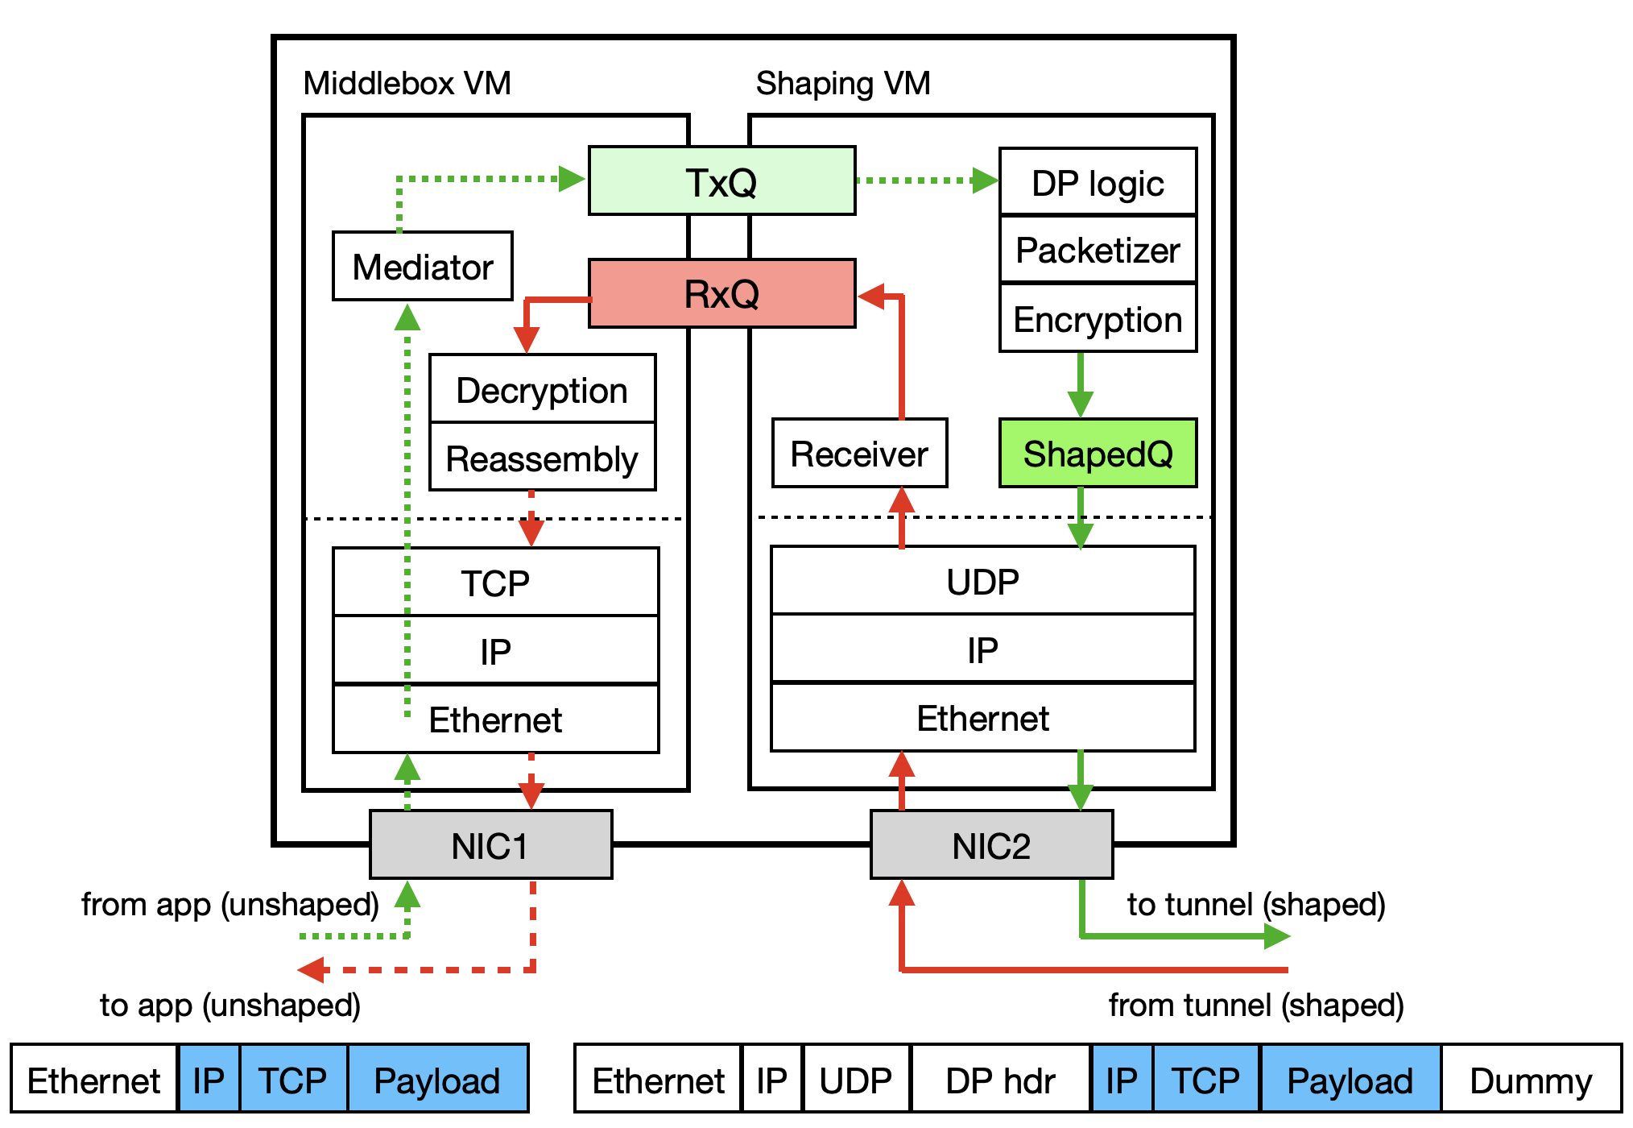

Slide 3


Slide 4
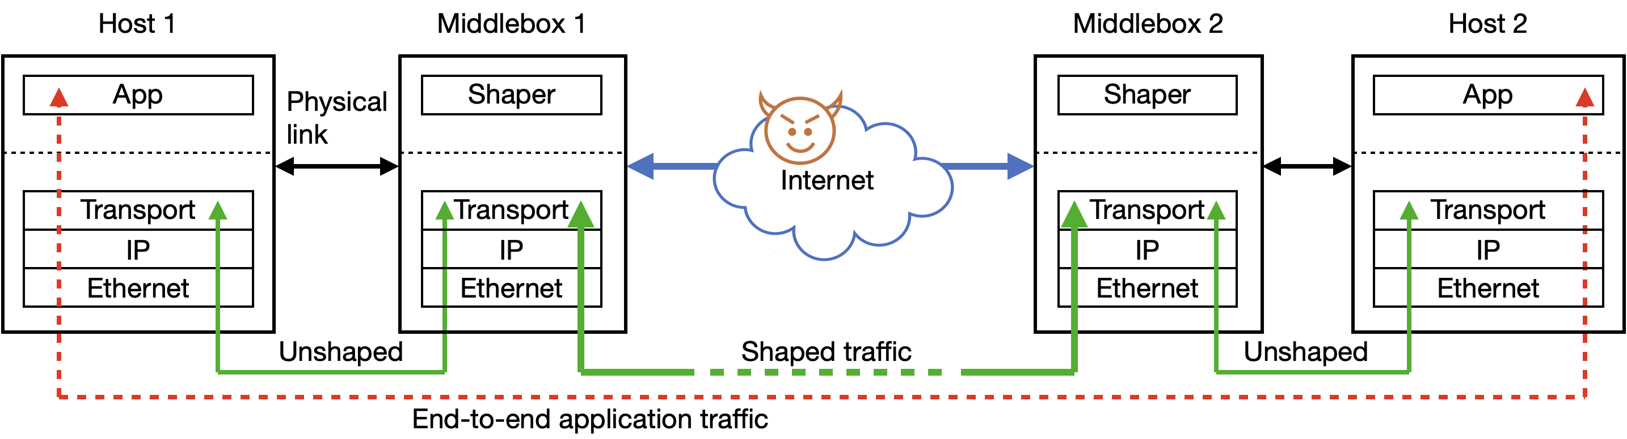

Slide 5
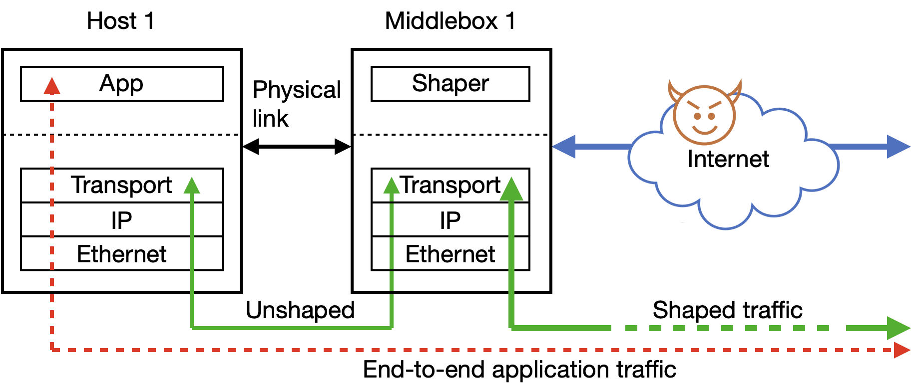

Slide 6
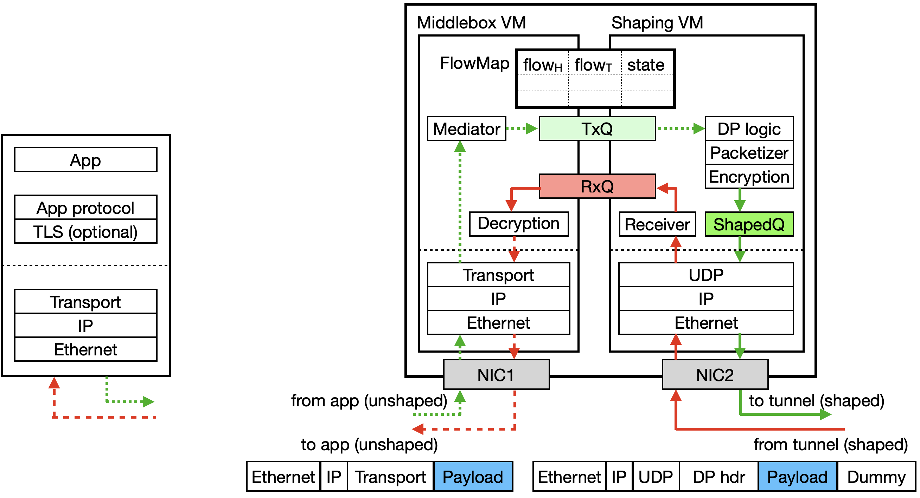

Slide 7
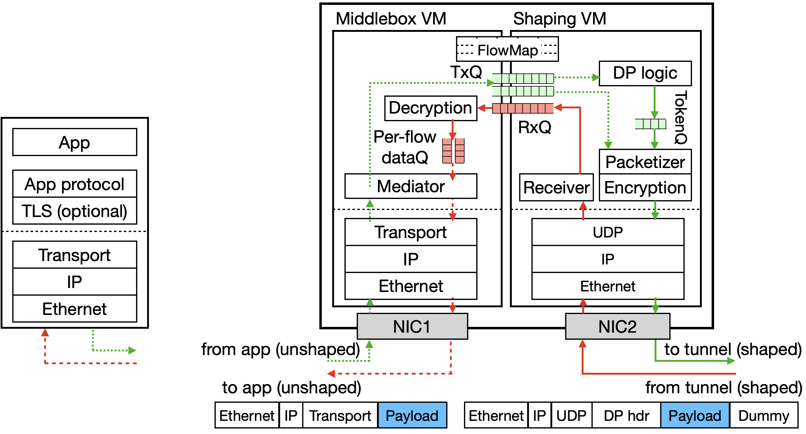

Slide 8
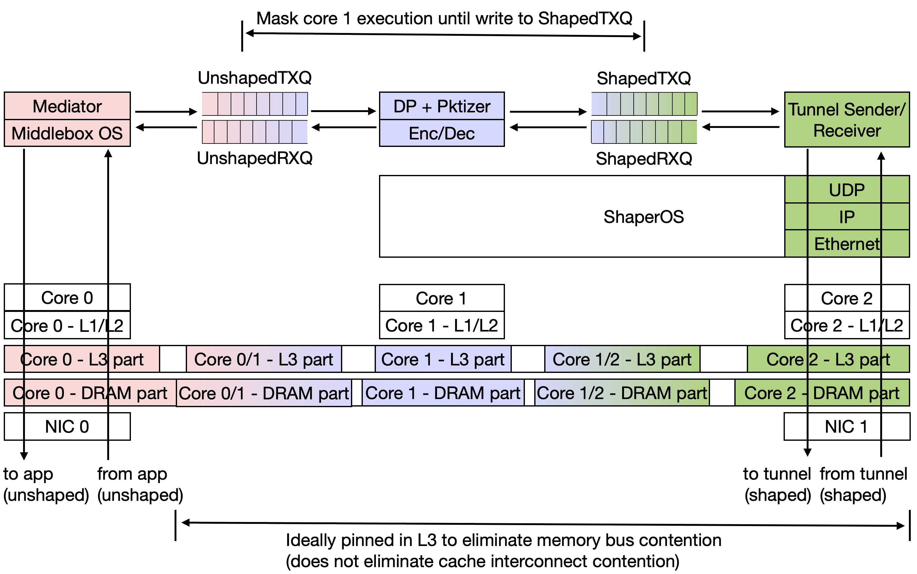

Slide 9
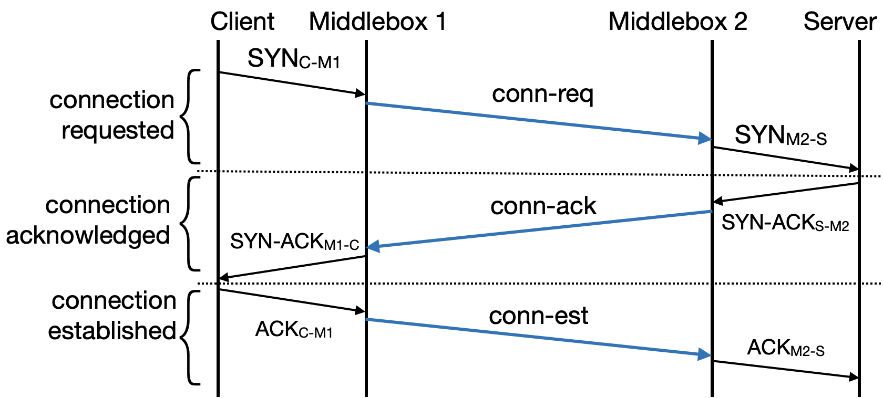

Slide 10
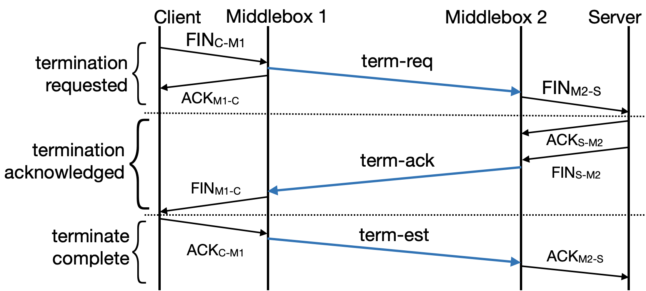

Slide 11
UR
SS
SR
US
client
server
US
SR
SS
UR
QUIC socket 1
TCP socket
TCP socket
TxQ
SS
SR
RxQ
Proxy
Proxy
server
RxQ
SR
SS
TxQ
QUIC socket 2

Slide 12
Application hosts
B1
...
Bm
Unshaped traffic
MinesVPN middlebox
M2
M1
An
Shaped traffic
S’
...
M1
M2
A1
S

Slide 13
A1
...
An
B1
...
Bm
Application hosts
M1
M2
MinesVPN proxies
From application
Per-flow Tx queues
To tunnel
Unshaped receiver
Shaped sender
QUIC
TCP/UDP
Unshaped sender
Shaped receiver
Per-flow Rx queues

Slide 14
A1
...
An
B1
...
Bm
Application hosts
Unshaped traffic
M1
Shaped traffic
M2
MinesVPN proxies
From application
Per-flow Tx queues
To tunnel
Unshaped receiver
Shaped sender
QUIC
TCP/UDP
Unshaped sender
Shaped receiver
Per-flow Rx queues

Slide 15
Application hosts
A1
...
An
B1
...
Bm
Unshaped traffic
MinesVPN proxies
Shaped traffic
M1
M2
From application
Per-flow Tx queues
To tunnel
Proxy server
Shaper
QUIC
TCP/UDP
Proxy client
Shaped receiver
Per-flow Rx queues

Slide 16
Application hosts
A1
...
An
B1
...
Bm
Unshaped traffic
MinesVPN proxies
Shaped traffic
M1
M2
From application
To QUIC tunnel
Proxy
Per-flow Tx queues
Tunnel process
Shaper
Shaped receiver
TCP/UDP
Per-flow Rx queues

Slide 17
Application hosts
A1
...
An
B1
...
Bm
Unshaped traffic
Shaped traffic
Tunnel endpoint
M1
M2
From application
To QUIC tunnel
Proxy Process
Per-flow Tx queues
Tunnel process
Shaper
Shaped receiver
TCP/UDP
Per-flow Rx queues

Slide 18
Application hosts
A1
...
An
B1
...
Bm
Unshaped traffic
Shaped traffic
Tunnel endpoint
M1
M2
From application
Per-flow Tx queues
To QUIC tunnel
UShaper
DShaper
TCP/UDP
Per-flow Rx queues

Slide 19
Application hosts
A1
...
An
B1
...
Bm
Unshaped traffic
Shaped traffic
Tunnel endpoint
M1
M2
From application
Per-flow Tx/Rx queues
U-Shaper
D- Shaper
QUIC
DP buffer
UDP
IP
To tunnel
Eth
TCP/UDP

Slide 20
Application hosts
A1
...
An
B1
...
Bm
Unshaped traffic
Shaped traffic
Tunnel endpoint
M1
M2
To/from application
Per-flow queues
Shaped buffer
U-Shaper
Prepare
QUIC
To/from tunnel
UDP
TCP/ UDP
IP
Eth

Slide 21
Application hosts
A1
...
An
B1
...
Bm
Unshaped traffic
Shaped traffic
Tunnel endpoint
M1
M2
FlowMap
DShaper
UShaper
Prepare
To/from application
(TCP/UDP)
Shaped buffer
QUIC
To/from tunnel
UDP
Per-flow queues
IP
Eth

Slide 22
Application hosts
A1
...
An
B1
...
Bm
Unshaped traffic
Shaped traffic
Tunnel endpoint
M1
M2
From application
Per-flow Tx/Rx queues
Shaped buffer
U-Shaper
D- Shaper
QUIC
UDP
TCP/UDP
IP
To tunnel
Eth

Slide 23
Application
Per-flow Tx/Rx queues
Unshaped byte stream
Shaper
DP shaped packets
QUIC
UDP
IP
To tunnel
Ethernet
Tunnel endpoint
App
Shaper
Per-flow
buffering queues
Socket interface (Unshaped byte stream)
QUIC
UDP
To tunnel (DP shaped packets)
IP
Ethernet

Slide 24
From application
UShaper
Per-flow Tx queues
DShaper
shared mem or localhost
Per-flow Rx queues
To QUIC tunnel
Application host
Application host
App
M1
App
M2
OS
QUIC
OS
QUIC
UDP
UDP
IP
IP
Eth
Eth
On-host tunnel endpoint
On-host tunnel endpoint

Slide 25
From application
Proxy Process
Per-flow Tx queues
Tunnel process
Shaper
Shaped receiver
shared mem or localhost
Per-flow Rx queues
To QUIC tunnel
Application host
Application host
App
M1
App
M2
OS
Network
OS
Network
On-host tunnel endpoint
On-host tunnel endpoint

Slide 26
<local-a-ip, local-a-port, local-p-ip, local-p-port, protocol>, <p-sock, txq, rxq> | <local-t-ip, local-t-port, remote-t-ip, remote-t-port> | tx-dummy-stream-id, tx-ctrl-stream-id, tx-data-stream-id, rx-dummy-stream-id, rx-ctrl-stream-id, rx-data-stream-id | reliability, privacy-config

Slide 27
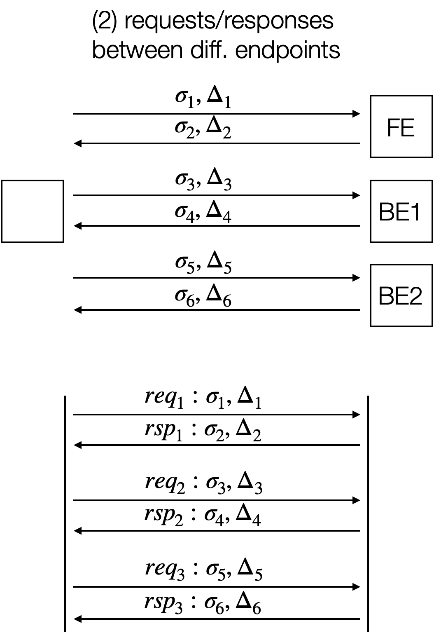
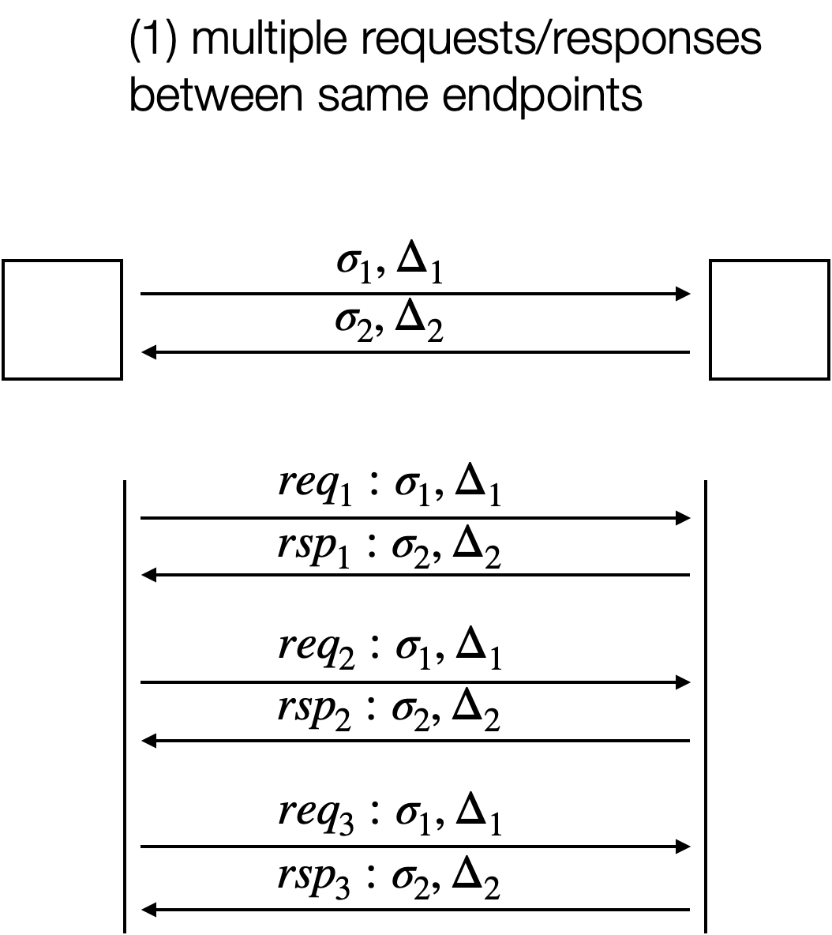

Slide 28

lock
unlock
DP noise calc.
payload prep
dummy prep
packet send
spin
Prepare thread
t
T
2T
3T
4T
5T
QUIC worker
t

Slide 29
Prepare thread
t
t₁
t₁+T
t₂
t₂+T
t₃
t₃+T
t₄
t₄+T
QUIC worker
t
DP noise calc.
payload prep
dummy prep
spin
lock
unlock
enqueue to QUIC
QUIC packet prep
UDP send

Slide 30
Prepare thread
t
T
2T
3T
4T
5T
QUIC worker
t
DP noise calc.
payload prep
dummy prep
spin
lock
unlock
enqueue to QUIC
QUIC packet prep
UDP send

Slide 31
T_{prep}
T_{enq}
Prepare thread
t
T
2T
3T
4T
5T
QUIC worker
t
shaped buffer prep
enqueue to QUIC
sleep
lock
unlock
QUIC packet prep
UDP send

Slide 32
