Slide 1
HTML-1 / CLASS-2
Preparation

Slide 2


Install VS code
This is how you can install VS Code
PLEASE DO NOT install Extensions

Slide 3





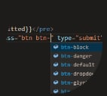

Extensions you should install
Prettier
01
Set up
HTML boilerplate
02
Live Server
03
Auto Rename Tag
04
Auto Close Tag
05
IntelliSense for CSS class names in HTML
06
Material Icon Theme
07

Slide 4

Thank you

