Slide 1
Introduction to HWD101

Slide 2
Agenda
Course Description
Course Supply
Evaluation
Promotion Policy
Plagiarism
Blackboard

Slide 3
Course Description
This subject is an introduction to computer functions and introductory networking concepts.
Through activity-based learning students will examine the relationships between computer, operating system and networking components.
Students will examine the roles of computers and networking devices and demonstrate how to deploy this equipment to achieve computer functionality and network connectivity.
Students will gain hands-on knowledge and troubleshooting capabilities in this course.

Slide 4
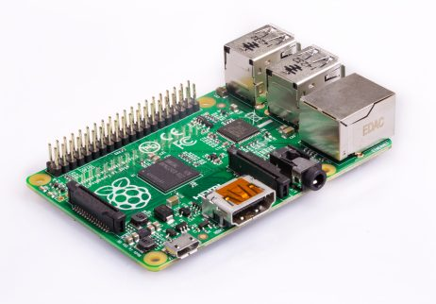
Course Supply
Raspberry Pi 2 and higher
MicroSD Card [16GB or higher]
Enclosure
Power Supply
Heat Sink
Network Port
Where do I get these supplies?
Amazon.ca
BestBuy.ca
Seneca@York Bookstore

Slide 5
Evaluation
Activities 10%
Labs 10%
Group Project 15%
Practical Test 15%
Written Tests 20%
Final Exam 30%

Slide 6
Promotion Policy
Achieve a grade of 50% or better on the final exam
Satisfactorily complete all assignments
Achieve a weighted average of 50% or better for the tests and final exam
Achieve a grade of 50% or better on the overall course

Slide 7
Plagiarism
Plagiarism is defined as using someone else’s work (words, images, ideas, phrases, signatures, or computations) and presenting it as one’s own, instead of properly documenting every source. For specific examples of plagiarism, see Appendix E.
To support Academic Honesty at Seneca College, all work submitted by students may be reviewed for authenticity and originality utilizing software tools and third party services.
In submitting their own work to a third party service, students consent to their submissions undergoing such review and being retained in a database for comparison with other work submitted by students.

Slide 8
Plagiarism Penalties
1st Offence
Grade of “0” on assessment
2nd Offence
Grade of “F” in the course
Suspension from College for minimum of 3 terms (12 months)
Placed on Academic Honesty Probation
3rd Offence
Mandatory withdrawal for 2 years
Seneca College Academic Honesty Policy

Slide 9
Blackboard
As a class, locate the following course material:
Course Slides
Activities
Labs
Group Project
Tests

Slide 10

Questions

Slide 11
Additional Resources
HWD101 Course Outline
Blackboard
Online Resources (Lynda.com)
Seneca Library

