Slide 1
OOP244 Week 0 - Debugging with VS2019

Slide 2
Overview
Debugging Intro
Visual Studio Debugging Resources
Errors
Build Errors
Error List
Linker Errors
Runtime Errors
Breakpoints, Stepping through Code, Inspecting Variables, Call Stack

Slide 3
Debugging
Today we will discuss Debugging as it will be an important facet to your studies here and in your own work.
You will have likely experienced some of the following content from IPC144 and this should serve at the least as a review
Attempt to incorporate these tools into your workflow as to avoid headaches when trying to debug code.

Slide 4
Visual Studio Debugging Resources
First look at the Visual Studio 2019 Debugger
Getting Started with Debugging in Visual Studio 2019
Skim these documents to get a first glance or a refresher at debugging facilities in VS2019.
A section to focus on would be “Debug your running code”.
Using Breakpoints
Autos and Locals Windows
Navigating through Code with the Debugger

Slide 5
Errors
For the purposes of this course we will simply categorize the kinds of errors we are likely to see as we code into 2 types:
Build Errors
Runtime Errors

Slide 6
Build Errors
Build errors typically manifest as issues that as it sounds don’t allow us to build/compile the code into a working executable.
These can be due to:
Syntax errors
Mismatched definitions
Spelling mistakes
…

Slide 7
Build Errors – Error list view
Visual Studio has a window (aka pane) called the “Error List”.
It shows a list of errors and warnings.
Errors will usually prevent you from compiling (building) the project.
Warnings typically do not prevent compilation but should be fixed.

Slide 8
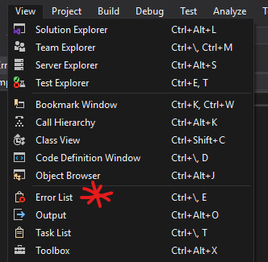
Build Errors – Error list view
Open up the Error List view in VS2019 by either using the view menu and selecting Error List or with the short cut, CTRL + \ then the letter ‘e’
This view isn’t always opened by default (particularly on the lab machines) until you start a build. It is one of most simple yet important things to use while sifting through errors in VS2019.

Slide 9
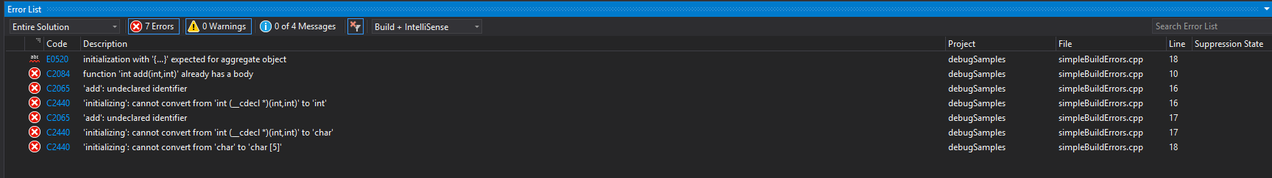
Build Errors – Error list view
Searchable error code
Details of the error
Affected file and line number

Slide 10
Build Errors – Error list view
You may double-click on an error or a warning to view the line of code that caused the message to appear.
You may click on an error code or a warning code for more details about it online (sometimes this brings up a internet search for the terms or directly to Microsoft documentation about the error).
CTRL+SHIFT+F12 allows you to cycle through the errors.

Slide 11
Build Errors – Linker Errors
A subset of build errors are linker errors.
You might have encountered them before and have been perplexed by how to deal with them initially.
Linker errors typically occur when there is a mismatch of definitions to declarations or vice versa. Something isn’t being defined correctly or that definition is missing or there is a potential conflict.

Slide 12
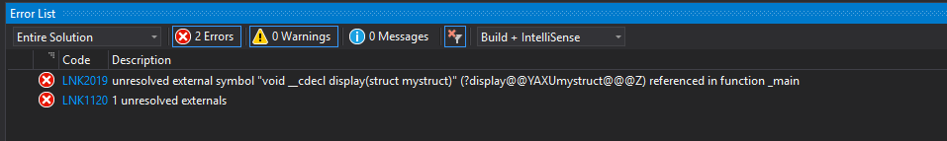
Build Errors – Linker Errors
Errors that have a code of LNK are linker errors.
They typically have some sort of description regarding “unresolved externals”. The meaning behind this here is that there is something being referenced to in the main program but we have no idea where the true definition of that is.

Slide 13
Build Errors – Linker Errors
The main tip to resolving these errors is to pay attention to the description. See what the compiler is saying is undefined.
In this case it appears a function called ‘display’ that takes in a parameter of struct mystruct is the possible culprit. Double check if this is defined properly or at all.

Slide 14
Runtime Errors
Sometimes our program builds perfectly with no build errors (?) and we can run our program.
However when it does run, the behavior isn’t as we desire. Does this sound familiar?
In cases like these we have now encountered run time errors.
In order to deal with these sorts of errors we will need to have at least the basics on how to:
Pause our code during execution and examine variables
Step through our code line by line and examine the state of things

Slide 15
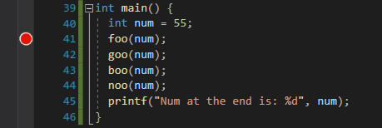
Runtime Errors - Breakpoints
A breakpoint is a line marker/indicator that will stop execution before the line of code is executed. In the code editor, it appears as a bright red dot.
These points in the code indicate to Visual Studio that when we run the program with debugging, we should break at these points during execution so it can be examined.

Slide 16
Runtime Errors - Breakpoints
There are a couple of ways to set or remove breakpoints:
In the left margin click the line of code that needs the breakpoint.
Move the cursor to the line of code and press the F9 key.
You can view a list of breakpoints and manage your breakpoints using the “Breakpoints” pane.
If the pane is not visible, click Debug > Choose Windows > Breakpoints or using the short cut CTRL + ALT + B

Slide 17
Runtime Errors - When to add Breakpoints
When you introduce new code, set a breakpoint at the beginning of the code block and step-through the code to make sure it is behaving as expected.
If you have implemented a complicated behaviour, set breakpoint(s) and inspect the values of the variables.
When something isn’t working as you expect set a breakpoint at the possible beginning of the problems and inspect from there.

Slide 18
Runtime Errors – Debugging with Breakpionts
Previously, you may have only used CTRL+F5 to run your programs.
From now on, start the with the debug environment by pressing just F5 alone. The program will run as usual.
If an exception is thrown, the debugger will pause the program and highlight the problematic line of code.
If a breakpoint is hit, the debugger will pause the program and highlight the line of code that will execute next.
Visual Studio will typically receive focus when it pauses debugging.

Slide 19
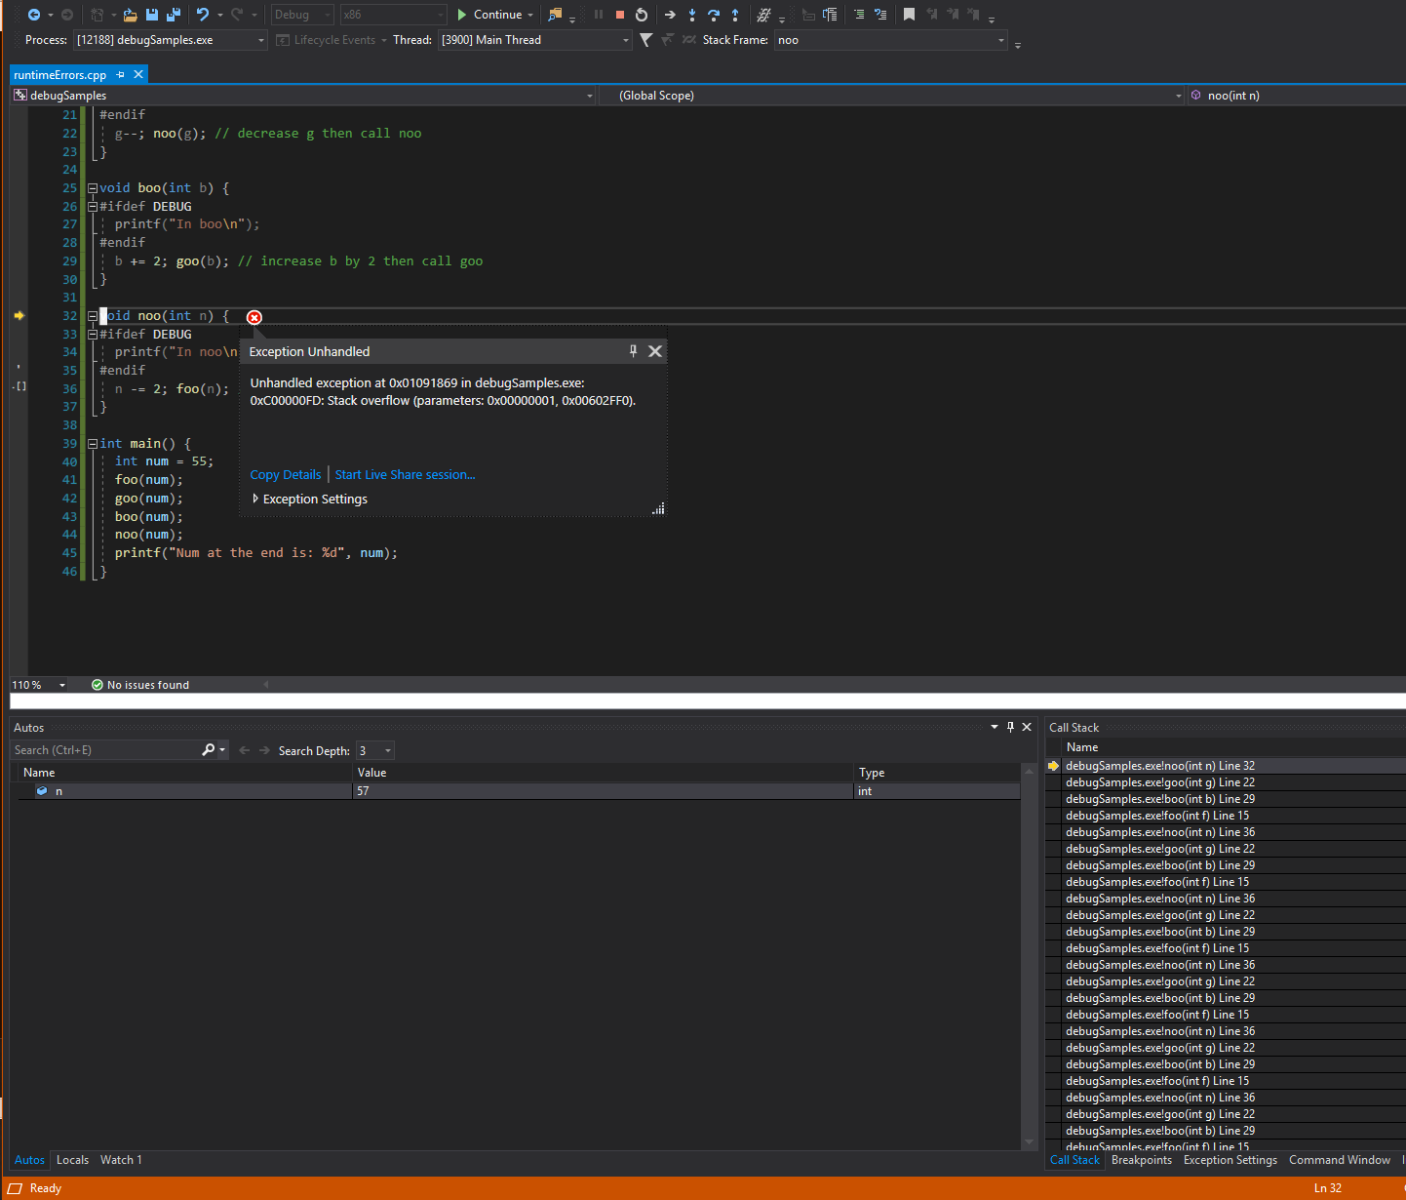
This might be an image of a typical debugging session without breakpoints.
Let’s note some important parts.
Something bad happened.
List of local variables and their values appear in the ‘Autos’ tab
Orange means we’re in debugging mode.
Call stack shows us what functions were called and in what order. Seems long!

Slide 20
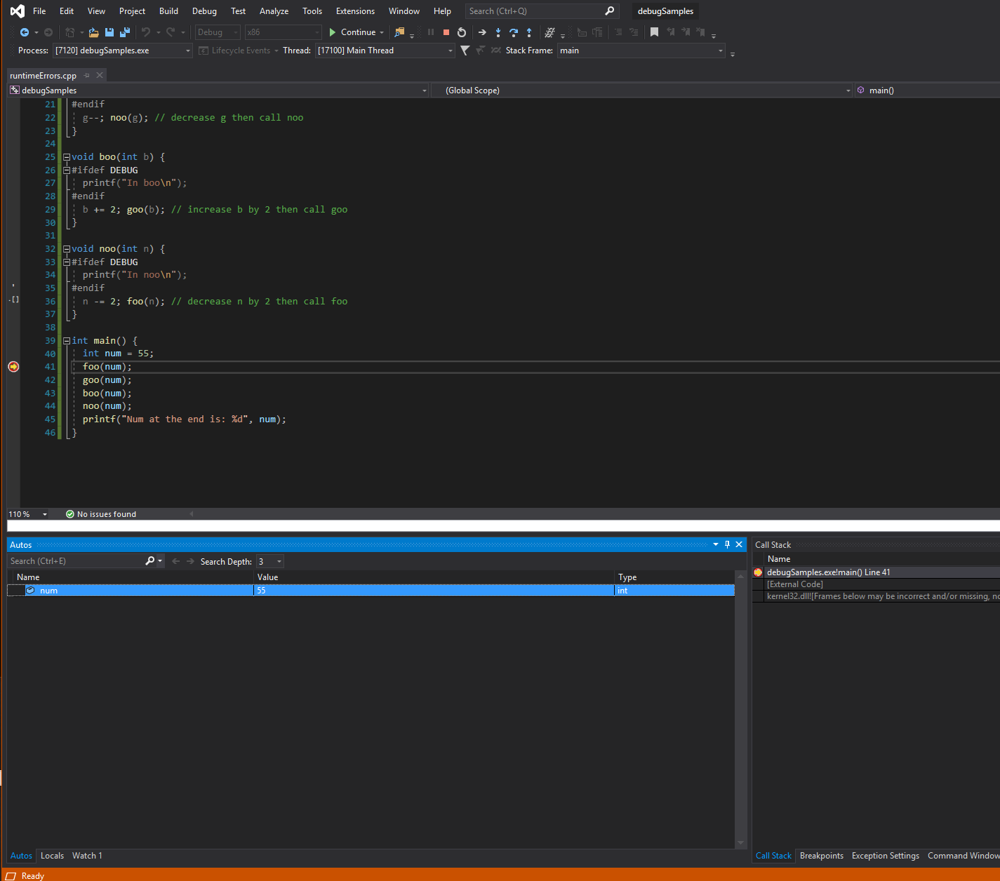
Let’s try it again but with a breakpoint. We’ve stopped here in the code!
Nothing bad happened.
Yet…
List of local variables and their values appear in the ‘Autos’ tab
Orange means we’re in debugging mode.
Call stack shows us what functions were called and in what order. Seems shorter!

Slide 21
PauseD…
At this point in time, you can do one of the following:
Continue execution (with F5 or the “Continue” toolbar button)
Stop execution (with Shift+F5 or the “Stop” toolbar button)
Inspect the value of the variables in the local scope
Execute the next line of code (Step Over)
Or, if the line of code runs a function that YOU wrote, you can jump into to the beginning of that function to inspect it (Step Into)

Slide 22

Debugging Control Panel
All of the previously listed options are accessed through a sort control panel at the top of Visual Studio while in debugging mode:
Continue running the program (until next breakpoint or something breaks)
Step into a function/block of code
Step over a line of code
Step out of a function/block of code
Stop debugging
Restart debugging

Slide 23
Step Over
“Stepping” is the process of executing code, one line at a time.
Execute the line of code by pressing the F10 function key (or by using the debug toolbar).

Slide 24
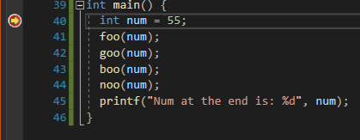
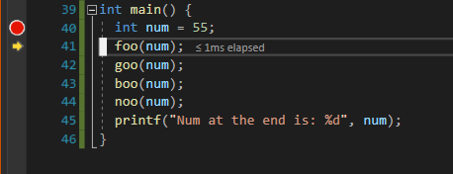
Step Over
Started at line 40 then stepped over to execute the next line, line 41

Slide 25
Step Into
If the current line of code has a function call to a function that YOU wrote, you can jump to the beginning of that function.
Press F11 to “step into” a method.

Slide 26
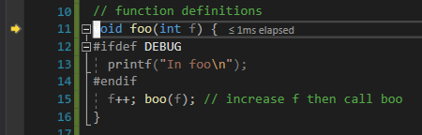
Step Into
Started at line 41 then stepped into the foo function

Slide 27
Step Out
While in the function, you can continue to F10 “step over” or F11 “step into”, if appropriate.
If/when you want to leave the method you are in, you can Shift+F11 to “step out” of the method and return to the line of code that was pointed to before entering the method.

Slide 28
Inspecting Variables
During a break in execution, you can inspect variable values:
In the code editor, hover your mouse over a variable and a popup will show its value.
Use the Locals/Autos window to see all of the variables in scope.
As you step through, inspect these values to see if something is amiss.

Slide 29
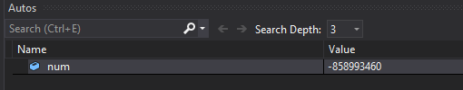
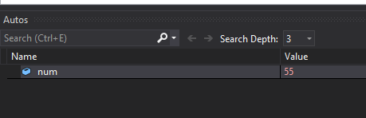
The value of num at line 40 is -858993460
The value of num at line 41 after stepping over is now 55

Slide 30
Call Stack
In addition to variables and their values, a very important piece is debugging is understanding the code path and what the traversal is as your program runs.
The best way to see this is with the Call Stack window. You can open this with CTRL+ALT+C or with the Debug -> Windows menu.
You can traverse both forwards and backwards along the Call Stack and inspect which functions were called, which functions did they call that eventually lead to an issue.

Slide 31
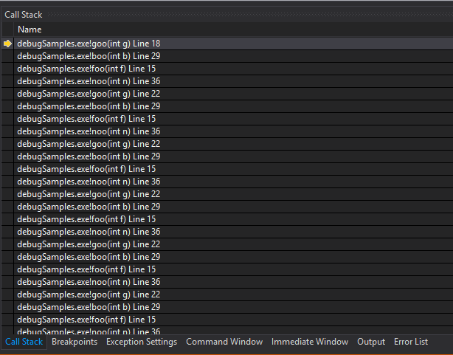
Call Stack
Look at all these functions that were called. Starting from here.
foo calls boo which calls goo which calls noo which calls foo which calls boo…

Slide 32
Practice
Try playing around with Visual Studio’s debugging tools to solve your build or runtime errors.
The code presented today is a suitable starting point but also try it out with your own code. Make some if needed.
Apply these tips as you begin working on the Workshops and Projects in OOP244

