Slide 1
Vodafone HR Analysis
Amir Reda Mohamed

Slide 2
Table of contents
01
02
03
04
05
06
Executive Summary
Data Overview
Data cleaning
Key metrics
Power bi dashboard
Summary of insights

Slide 3
AMIR
data

Slide 4
01
Executive Summary

Slide 5
Executive Summary
This report provides an in-depth analysis of Vodafone Egypt's workforce utilization. It highlights key trends in employee hours, department efficiency, and role-specific utilization across the organization. The insights focus on identifying areas for optimization in time management and workforce allocation to ensure efficient operations and improve overall employee satisfaction.

Slide 6
02
Data Overview

Slide 7
Data Overview
The dataset used for this analysis comprises 13,254 entries, including critical variables like employee work hours and department information. The key columns include:
Employee Code: Unique identifier for each Vodafone employee.
Contracted Hours: The total number of hours each employee is contracted to work.
Allocated Hours: The number of hours allocated to an employee during the reporting period.
Remaining Hours: The difference between contracted and allocated hours, indicating whether an employee is over-utilized or under-utilized.
Date: The date the data was recorded.
Hierarchical Levels (LEVEL-01, LEVEL-02, LEVEL-03): These represent the employee's role within the organization.
DEP: The department to which the employee belongs.

Slide 8
03
Data Cleaning

Slide 9
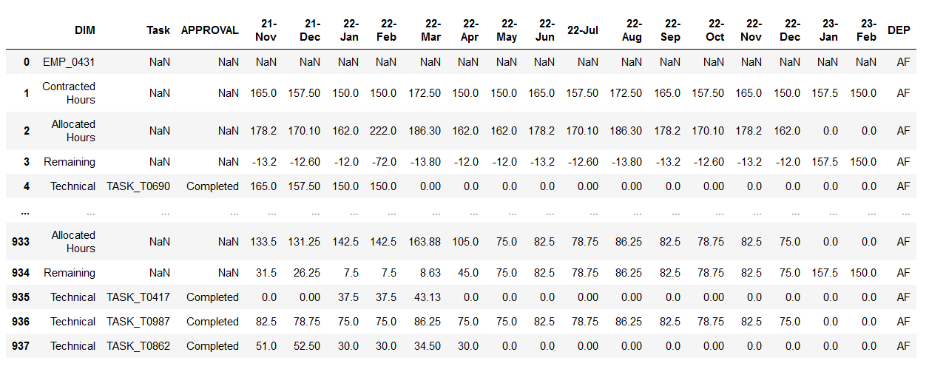
Data Cleaning
Before :

Slide 10
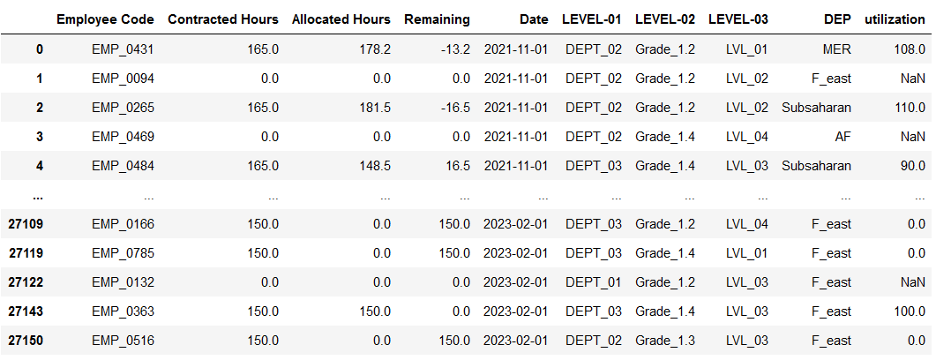
Data Cleaning
After :

Slide 11
04
Key Metrics and Calculations

Slide 12


Calculations
The following metrics have been calculated to assess Vodafone Egypt’s workforce performance:
Utilization Percentage: Calculated as:
Remaining Hours: This highlights the over- or under-utilization:

Slide 13
05
Power bi dashboard

Slide 14
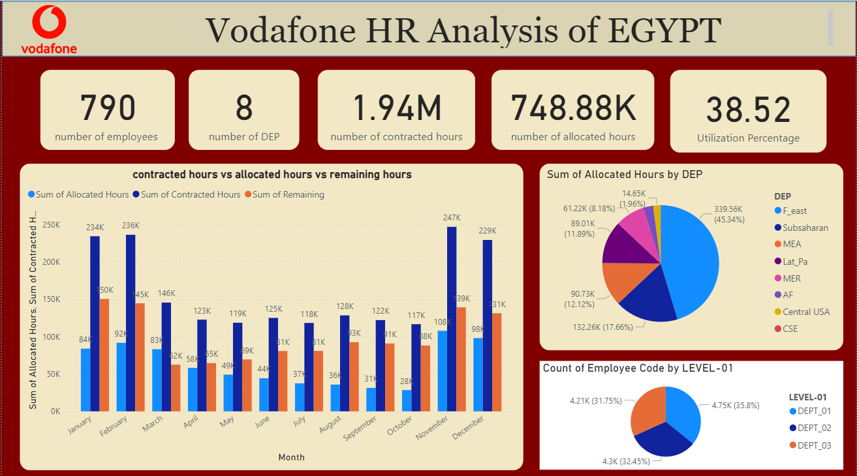
Dashboard

Slide 15
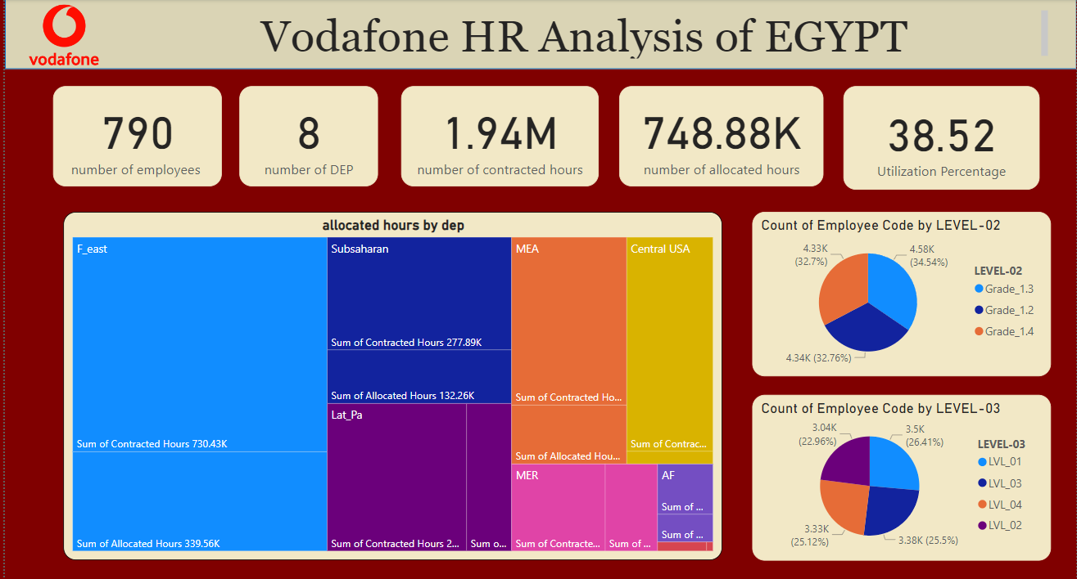
Dashboard

Slide 16
05
Summary of insights

Slide 17
insights
Departmental Utilization Insights
High Utilization Departments:
MER and Subsaharan departments exhibit strong utilization rates, where allocated hours often exceed contracted hours. These departments may need additional resources to avoid employee overwork.
Under-Utilization:
Departments such as F_east and AF show consistent under-utilization, suggesting potential inefficiencies in resource allocation or lower project demands in these areas.

Slide 18
insights
Role Efficiency:
LEVEL-01 (possibly senior-level or managerial employees) demonstrates near-optimal utilization of contracted hours.
LEVEL-02 employees show moderate fluctuations, but are generally within acceptable limits.
LEVEL-03 employees, likely at the middle management or operational level, exhibit varying utilization rates, with some being over-allocated and others under-utilized.
Actionable Insight: Roles at LEVEL-03 may require more careful workload balancing to ensure better alignment between contracted and allocated hours.

Slide 19
insights
Seasonal Utilization Patterns:
The data reveals that certain months show higher utilization rates, potentially due to project deadlines or peak business periods (e.g., year-end sales targets).
Conversely, some months exhibit under-utilization, which could coincide with national holidays or slow business periods in Egypt.
Actionable Insight: Vodafone can use these seasonal trends to optimize workforce allocation, ensuring that extra support is available during high-demand periods and under-utilized times are used for employee development or training.

Slide 20
insights
Individual Employee Utilization
Over-Utilized Employees:
Certain employees, identified by Employee Code, are consistently allocated more hours than they are contracted for. These employees may be at risk of burnout, which could impact long-term productivity.
Under-Utilized Employees:
Employees with significant remaining hours may not be fully engaged or utilized effectively, suggesting a need for reassignment or role adjustments.

Slide 21
insights
Recommendations and Actionable Insights
Enhance Resource Allocation: Departments with consistent under-utilization (like AF and F_east) may benefit from better resource distribution or a review of their project load to improve efficiency. Conversely, over-utilized departments such as MER may need additional staffing or more flexible scheduling to prevent employee fatigue.
Role-Specific Adjustments: Middle management roles (LEVEL-03) show the most fluctuation in utilization. Providing these employees with clearer workload guidelines or adjusting expectations could lead to better performance and employee satisfaction.
Seasonal Workforce Planning: Anticipating busy months and shifting under-utilized employees to high-demand departments can improve Vodafone’s overall efficiency while reducing the risk of overworking key staff members during peak periods.
Employee Development: For employees consistently under-utilized, Vodafone can implement training and development programs to better align their skills with organizational needs, increasing engagement and productivity.
.

Slide 22
Thank you

