Slide 1
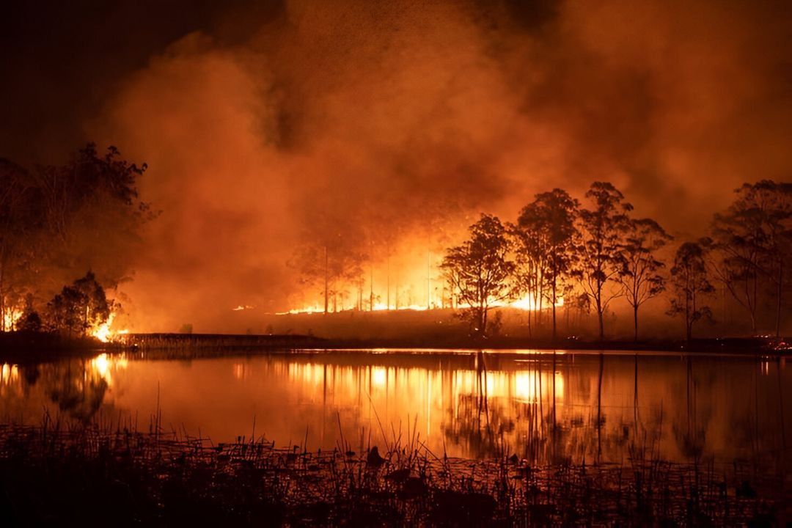
NATURAL CALAMITIES
CAUSE, EFFECTS, AND PREPAREDNESS

Slide 2
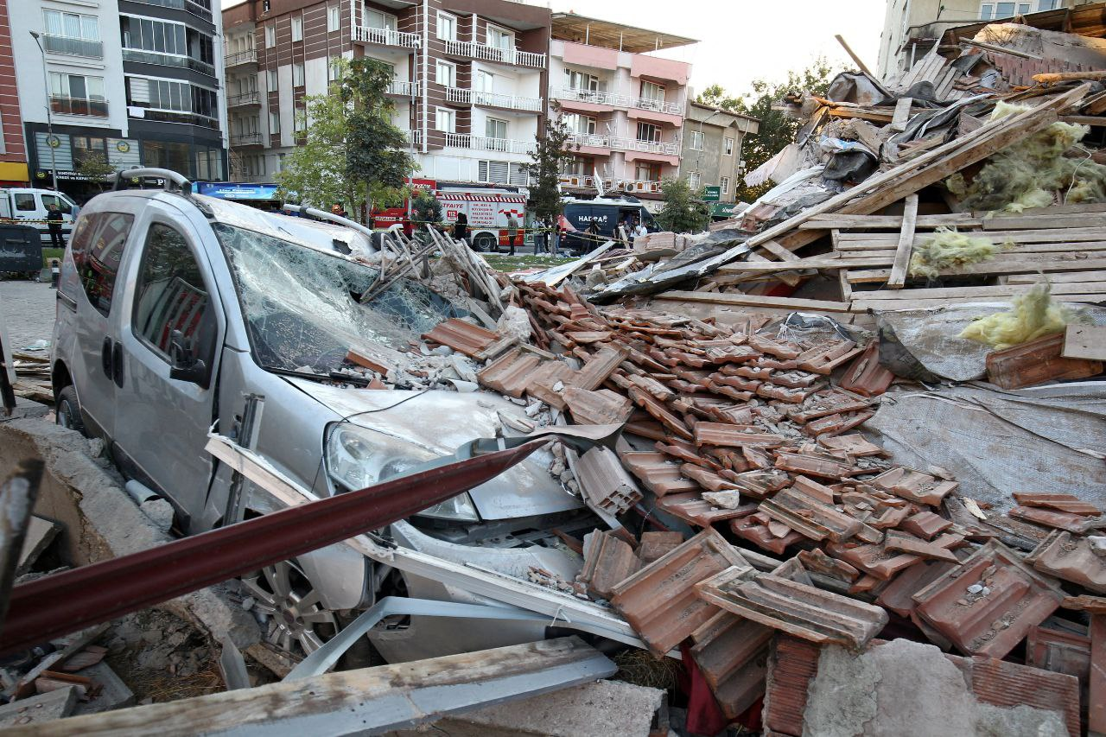
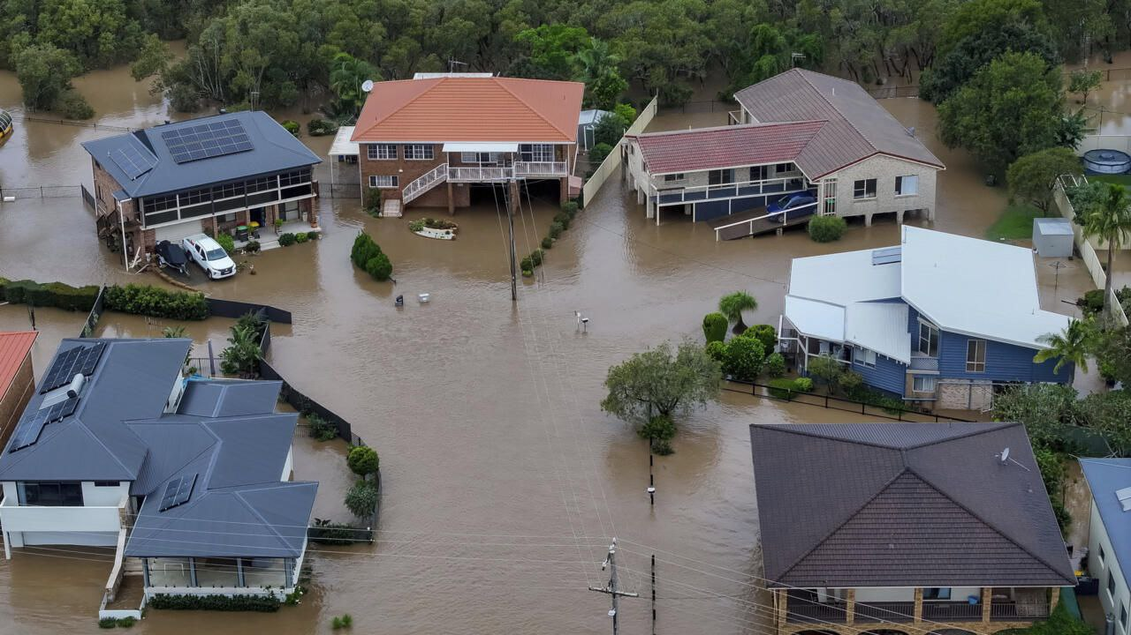
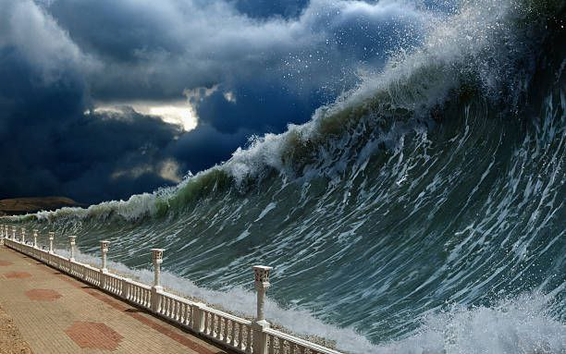
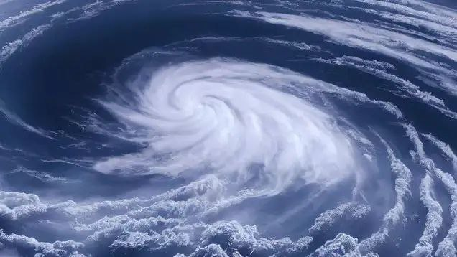
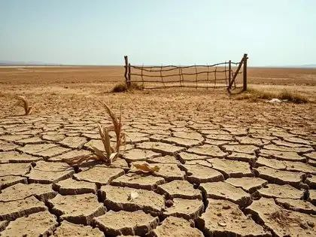
Types of Natural Disasters
Earthquake
Flood
Tsunami
Cyclone
Drought

Slide 4
Disaster | Year | Death Toll

