Slide 1
THE GEORGE WASHINGTON UNIVERSITY
School of Engineering and Applied Science
Department of Computer Science
Critical Design Review
for the
Design of a Discrete User-Dependent
Speech Recognition Program
By
Amir Raminfar
CSci 195-10
Senior Computer Science Design Project
November 10, 2004

Slide 2
Very Short Abstract
This project uses speech recognition to allow users to launch applications of their choice using only voice commands.
It will support up to fifteen words which the user can choose.

Slide 3
Specifications of the Project
  Microphone
  Speakers (Not required but recommended)
  Windows XP (C and C++ are operating system dependent languages)
  At least 800 MHz Processor
  At least 256 MB RAM
  Keyboard
  Java Virtual Machine
  Enough disk space to save the WAV files (Less than one megabyte per wav file)

Slide 4
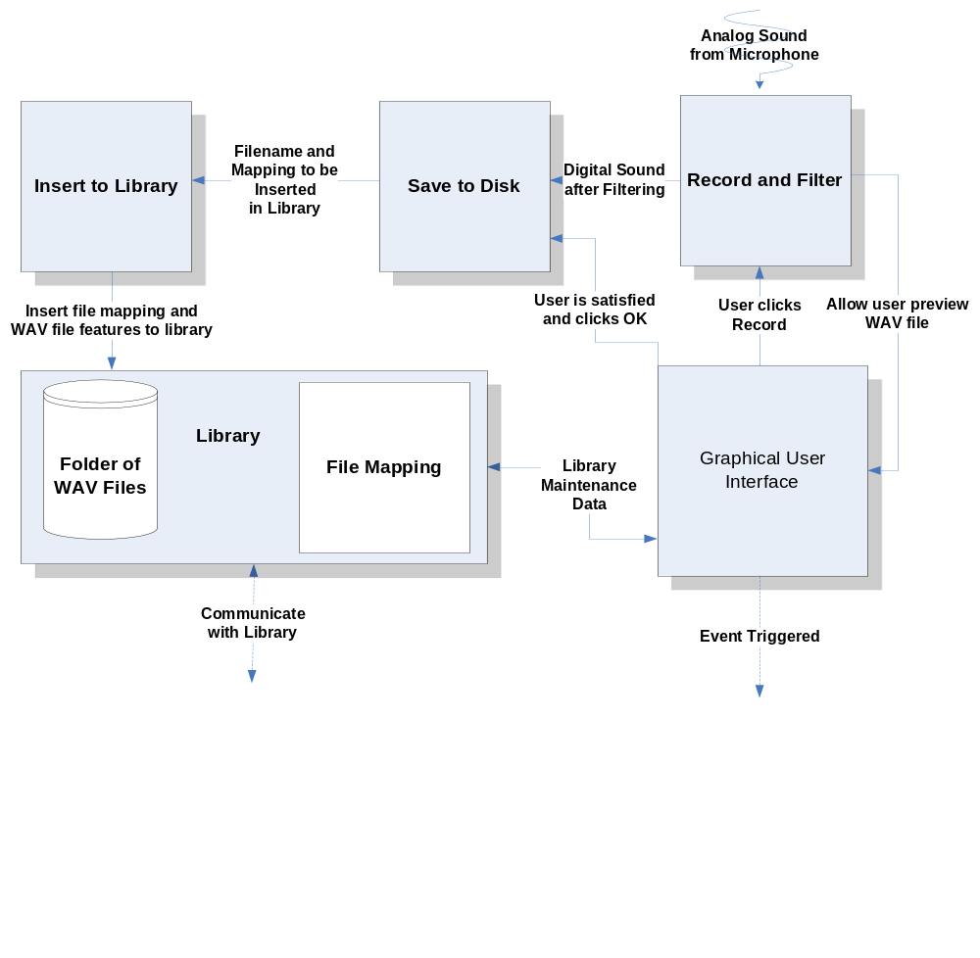
BLOCK DIAGRAM

Slide 5
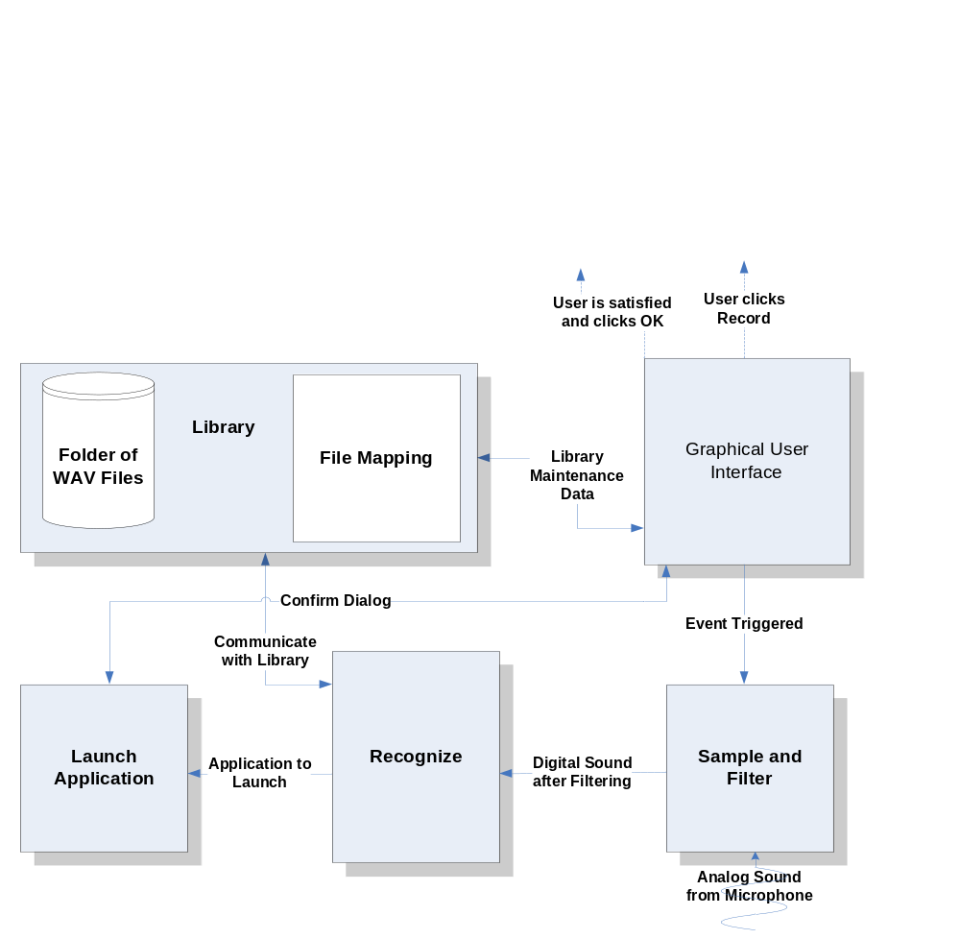
BLOCK DIAGRAM

Slide 6
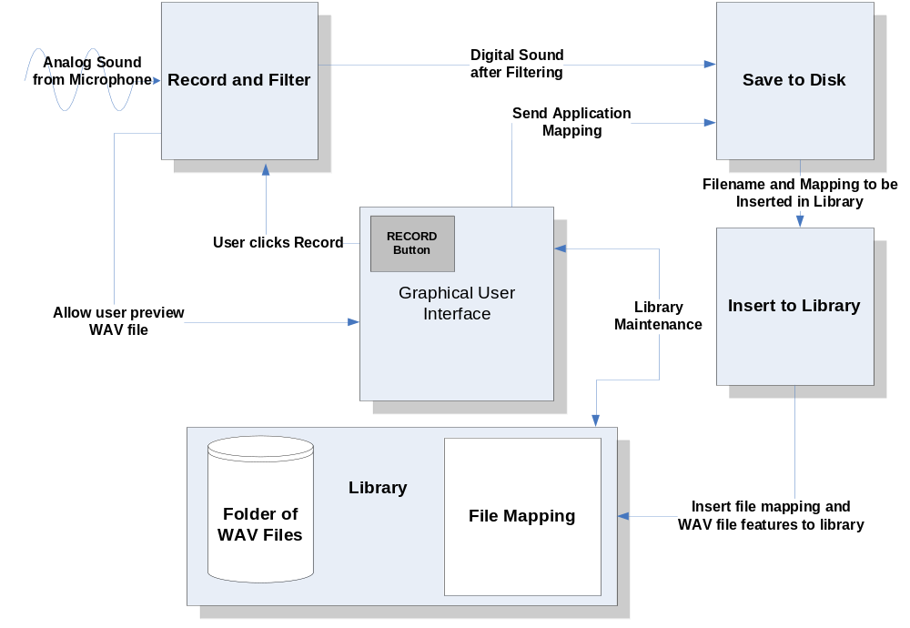
DATA FLOW DIAGRAM

Slide 7
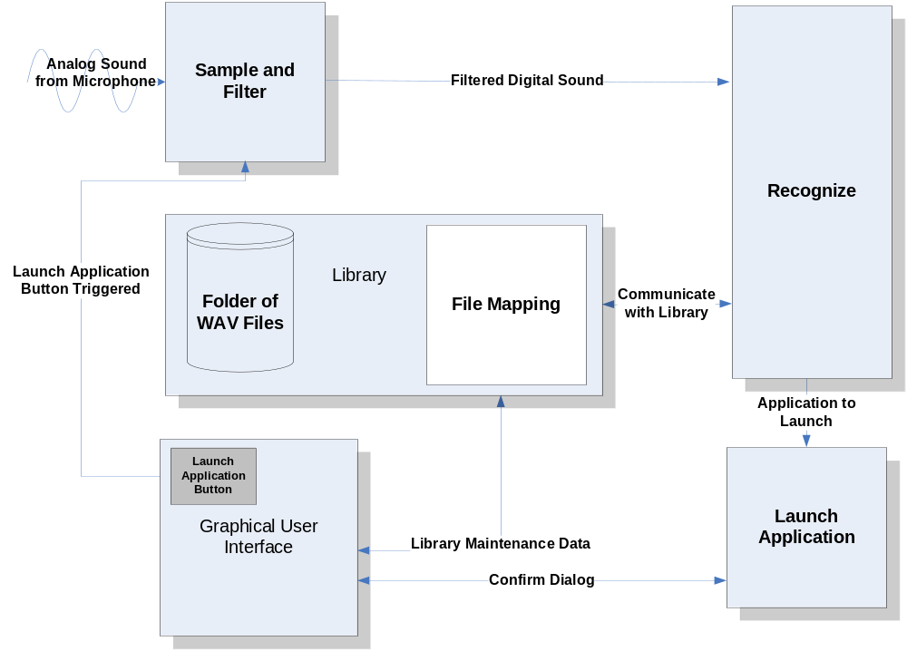
DATA FLOW DIAGRAM

Slide 8
MODULE LIST
Module Name | Called By | It Calls | Lines of Code | Hours to Code | $ to Code
INPUT FROM MIC | - | - | - | - | -
RECORD AND FILTER | GUI | Save to File | 1,500 | 30 | $ 1,200
SAVE TO FILE | Record and Module | Insert to Library | 750 | 15 | $ 600
INSERT TO LIBRARY | Save to File | - | 2,400 | 48 | $ 1,920
SAMPLE | GUI | Recognize | 500 | 10 | $ 400
RECOGNIZE | Sample | Launch Application | 3,000 | 60 | $ 2,400
LAUNCH APPLICATION | Recognize | - | 100 | 2 | $ 80
LIBRARY | - | - | 200 | 4 | $ 160
GUI | User | - | 1,650 | 33 | $ 1,320
TOTAL |  |  | 10,100 | 202 | $8,080

Slide 9
Record and Filter
Parameters: IN (Nothing)
OUT (AudioInputStream: audioInputStream)
Initialize AudioInputStream
Create instance of AudioFormat(16000.0, 16, 2, true, true)
Create DataLine.Info from DataLine.Info(TargetDataLine.class, AudioFormat);
If AudioSystem.isLineSupported(info) is false, return with error
Create a new TargetDataLine instance called line with given info from earlier
Open line
Start recording on line
While line.getMicrosecondPosition()/1000/1000 < 2
Read data from line into a temporary buffer
Place the temporary buffer into a ByteArrayOutputStream
End while
Stop and close line
Flush and close ByteArrayOutputStream
Convert ByteArrayOutputStream to ByteArrayInputStream
Convert ByteArrayInputStream to AudioInputStream
Return AudioInputStream to GUI so that user can preview

Slide 10
Save to Disk
Parameters: IN (AudioInputStream: audioInputStream, Application Filename: filename)
OUT (WAV file, Application Filename: filename)
Check to see audioInputStream is not null
audioInputStream.reset()
Parse the name of the application
Create a new file with the same name of application
AudioSystem.write(audioInputStream, AudioFileFormat.WAVE, file)
If AudioSystem.write returns -1 then throw exception
Insert to library with new created WAV file and application mapping

Slide 11
Insert to Library
Parameters: IN (Recorded Sample File: sample, Application Filename: filename)
OUT (Nothing)
Open sample file
Divide sample into n intervals
For every interval
Compute number of zero-crossings
Compute average time between each zero-crossing
End for
Open database file
Append n features to database file and application that it is mapped to
Close file
Update GUI if needed

Slide 12
Sample
Parameters: IN (Nothing)
OUT (AudioInputStream: audioInputStream)
Initialize AudioInputStream
Create instance of AudioFormat(16000.0, 16, 2, true, true)
Create DataLine.Info from DataLine.Info(TargetDataLine.class, AudioFormat)
If AudioSystem.isLineSupported(info) is false, return with error
Create a new TargetDataLine with given info from earlier
Open line
Start recording on line
While line.getMicrosecondPosition()/1000/1000 < 2
Read data from line into a temporary buffer
Place the temporary buffer into a ByteArrayOutputStream
End while
Stop and close line
Flush and close ByteArrayOutputStream
Convert ByteArrayOutputStream to ByteArrayInputStream
Convert ByteArrayInputStream to AudioInputStream
Call recognize module with AudioInputStream as a parameter

Slide 13
Recognize
Parameters: IN (Recorded Sample: sample)
OUT (String: Best matched application)
Extract features from sample
Divide sample into n intervals
For every interval
Compute number of zero-crossings
Compute average time between each zero-crossing
End for
Get all templates from library
For every template
Create n x n matrix, called M, where n is the size of features in each template
Continued on next slide...

Slide 14
Recognize
For i features in sample
For j features in each template
M(i,j) = |sample_feature(i) – template_feature(j)|
End for
End for
Cost = 0
While i != 1 OR j != 1
Start from top right of matrix M
Step through from the top corner
Cost += M (i,j)
For every step M(i,j) look at M(i-1,j), M(i,j-1), and M(i-1,j-1)
M(i,j) = min(M(i-1,j), M(i,j-1), M(i-1,j-1))
End while
End for
Find the template with the least cost
Get which application correlates to the least cost template
Return the application address as a string

Slide 15
Launch Application
Parameters: IN (Application address: filename)
OUT (Nothing)
Check if filename exists
If filename does not exist then show warning and return
Get runtime class
Check to see if user wants a confirm dialog, and if yes show confirm dialog
Call runtime.exec(filename)
Minimize window

Slide 16
Library
Parameters: IN (Nothing)
OUT (Templates)
Open database file
For every template
Read template features and application mappings
Save each template into an array of n features
End for
Close database files
Return a matrix of size m by n where n is size of features and m is number
of templates

Slide 17
Graphical User Interface
Parameters: IN (Nothing)
OUT (Nothing)
Get all templates from library for library maintenance
For each template add a new row to JTable
If use clicked preview, fetch file and play
Create global hotkeys in C++
Add JButtons and JPanels to tabbed windows(Not Shown)

Slide 18
Graphical User Interface
Parameters: IN (Nothing)
OUT (Nothing)
Get all templates from library for library maintenance
For each template add a new row to JTable
If use clicked preview, fetch file and play
Create global hotkeys in C++
Add JButtons and JPanels to tabbed windows(Not Shown)

Slide 19
Tests to Verify the Design
Module Name | Input | Expected Result | Status
Record and Filter | Analog Sound | To be digitized and played successfully after recording. | Not Tested
Save to File | Sound from record and filter module | Digital sound to be saved on disk and played through a third-party WAV player. | Not Tested
Insert to Library | WAV file from save to disk module | Library must extract zero-crossings and save application mapping for each WAV file. | Not Tested
Sample | Analog Sound | Digitized and played successfully after recording. | Not Tested
Recognize | Digital sound from sample module | Template with best match and within threshold is returned. | Not Tested
Launch Application | Application address from recognize module | Application should be launched. | Not Tested
Library | WAV files | All templates should be returned in a matrix. When needed it should return all WAV files to the GUI. | Not Tested
GUI | Events are triggered by user | Buttons can trigger a number of events ranging from recording to recognition. | Not Tested

Slide 20
GANTT CHART
See MS-Project File

Slide 21
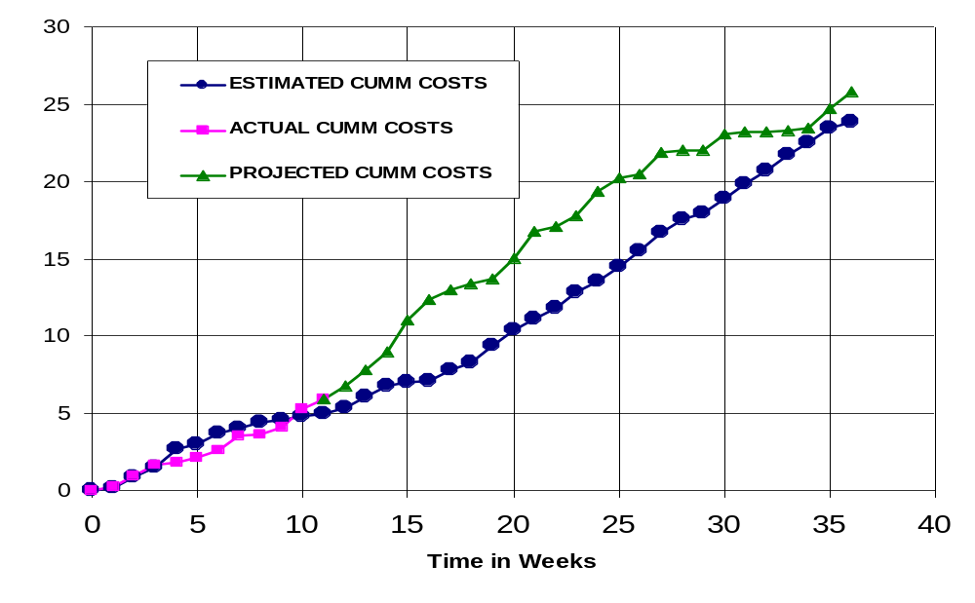
CUMULATIVE LABOR COSTS

Slide 22
ECONOMIC ANALYSIS
PROTOTYPE COSTS
 | Labor Rate | Current Est. Hours | Current Est. Cost | Initial Est. Hours | Initial Est. Cost
System Analyst | $45.00 | 118 | $5,321 | 215 | $9,686
Programmer | $40.00 | 198 | $7,920 | 268 | $10,720
Test Programmer | $35.00 | 174 | $6,090 | 31 | $1,085
Technical Writer | $35.00 | 185 | $6,475 | 67 | $2,345
TOTAL |  | 675 | $25,806 | 581 | $23,836
DIRECT OVERHEAD @ 100% |  |  | $25,806 |  | $23,836
SUBTOTAL |  |  | $51,613 |  | $47,673
A&G COSTS @ 40% |  |  | $20,645 |  | $19,069
SUBTOTAL |  |  | $72,258 |  | $66,742
PROFIT @ 20% |  |  | $14,452 |  | $13,348
TOTAL COST OF PROTOTYPE |  |  | $86,709 |  | $80,090

Slide 23
UNITS COSTS SOLD
UNIT COSTS SOLD BY CORPORATION AS A RETAILER ON THE INTERNET
 | Current Estimate |  | Initial Estimate
PROTOTYPE COSTS | $86,709 |  | $80,090
INSTALL MACHINE AND SOFTWARE | $50,000 |  | $50,000
SUBTOTAL | $136,709 |  | $130,090
OVERHEARD @ 200% | $273,418 |  | $260,180
SUBTOTAL | $410,127 |  | $390,269
DOCUMENTATION | $0 |  | $0
PACKAGING SUBTOTAL | $0 |  | $0
SUBTOTAL | $410,127 |  | $390,269
A&G @ 40% | $164,051 |  | $156,108
SUBTOTAL | $574,178 |  | $546,377
PROFIT @ 20% | $114,836 |  | $109,275
SUBTOTAL | $689,013 |  | $655,653

Slide 24
UNITS COSTS SOLD
 |  | Current Estimate |  | Initial Estimate
 | # of copies | Price/Copy | Total Profit | Price/ Copy | Total Profit
Total to Sell | 1,000,000
Recoup Prototype Costs | 100,000 | $6.89 | $114,836 | $6.56 | $109,275
Profit from Recoup | 100,000 | $11.71 | $1,170,987 | $12.04 | $1,204,347
Remainder to Sell | 900,000 | $18.60 | $16,740,000 | $18.60 | $16,740,000
 |  | Minus 40% for A&G | $6,696,000 | Minus 40% for A&G | $6,696,000
Subtotal |  |  | $10,044,000 |  | $10,044,000
Total Profit |  |  | $11,329,822 |  | $11,357,623

Slide 25
COMPARATIVE PRODUCTS
Product Name | Cost | Units Sold | Publisher | System Requirements
HAL 2.0 | $19.95 | 1,144 | David Henry Company | Windows 98/Me/2000/XP
iListen 1.6.3 | $140.00 | - | MacSpeech | PowerMacintosh G3, 256MB RAM
Naturally Speaking | $150.00 | - | ScanSoft | Intel® Pentium® III / 500 MHz processor, 128 MB RAM, 300 MB free hard disk
Realize Voice Lite 4.0 | $49.00 | 253,432 | Realize Software | Windows 98SE/ME/NT/2000/XP, a noise-canceling microphone
ViaVoice | $200.00 | - | IBM | Pentium II 300 MHz, 510 MB Hard drive, 96 MB RAM
Voice Studio 1.4.2 | $49.97 | 41,914 | Ultimate Interactive Desktops | Windows 98/Me/NT/2000/XP
Voice Tools 7.0 | $300.00 | 51,157 | Wizzard Software | Not Provided

Slide 26
OUTLINED MATRIX
OUTLINED
MODULE NAME | INIT. EST. HRS. | CUR. EST. HRS. | HRS SPENT TO DATE | % COMPT. | EST. HRS TO COMP.
RECORD AND FILTER | 8 | 8 | 8 | 100.0% | 0
SAVE TO FILE | 7 | 7 | 7 | 100.0% | 0
INSERT TO LIBRARY | 5 | 5 | 5 | 100.0% | 0
SAMPLE | 3 | 3 | 3 | 100.0% | 0
RECOGNIZE | 12 | 12 | 12 | 100.0% | 0
LAUNCH APPLICATION | 2 | 2 | 2 | 100.0% | 0
LIBRARY | 2 | 2 | 2 | 100.0% | 0
GUI | 2 | 2 | 2 | 100.0% | 0
TOTALS | 41 | 41 | 41 | 100.0% | 0

Slide 27
DESIGNED MATRIX
DESIGNED
MODULE NAME | INIT. EST. HRS. | CUR. EST. HRS. | HRS SPENT TO DATE | % COMPT. | EST. HRS TO COMP.
RECORD AND FILTER | 6 | 8 | 8 | 100.0% | 0
SAVE TO FILE | 7 | 10 | 10 | 100.0% | 0
INSERT TO LIBRARY | 6 | 8 | 8 | 100.0% | 0
SAMPLE | 4 | 5 | 5 | 100.0% | 0
RECOGNIZE | 12 | 36 | 36 | 100.0% | 0
LAUNCH APPLICATION | 3 | 4 | 4 | 100.0% | 0
LIBRARY | 2 | 2 | 2 | 100.0% | 0
GUI | 4 | 4 | 4 | 100.0% | 0
TOTALS | 44 | 77 | 77 | 100.0% | 0

Slide 28
CONSTRUCTED MATRIX
CONSTRUCTED
MODULE NAME | INIT. EST. HRS. | CUR. EST. HRS. | HRS SPENT TO DATE | % COMPT. | EST. HRS TO COMP.
RECORD AND FILTER | 40 | 30 | 0 | 0.0% | 30
SAVE TO FILE | 20 | 15 | 0 | 0.0% | 15
INSERT TO LIBRARY | 28 | 28 | 0 | 0.0% | 28
SAMPLE | 40 | 10 | 0 | 0.0% | 10
RECOGNIZE | 120 | 80 | 0 | 0.0% | 80
LAUNCH APPLICATION | 20 | 2 | 0 | 0.0% | 2
LIBRARY | 4 | 4 | 0 | 0.0% | 4
GUI | 15 | 33 | 0 | 0.0% | 33
TOTALS | 287 | 202 | 0 | 0.0% | 202

Slide 29
TESTED MATRIX
TESTED
MODULE NAME | INIT. EST. HRS. | CUR. EST. HRS. | HRS SPENT TO DATE | % COMPT. | EST. HRS TO COMP.
RECORD AND FILTER | 6 | 14 | 0 | 0.0% | 14
SAVE TO FILE | 4 | 9 | 0 | 0.0% | 9
INSERT TO LIBRARY | 4 | 9 | 0 | 0.0% | 9
SAMPLE | 4 | 6 | 0 | 0.0% | 6
RECOGNIZE | 10 | 18 | 0 | 0.0% | 18
LAUNCH APPLICATION | 3 | 7 | 0 | 0.0% | 7
LIBRARY | 2 | 2 | 0 | 0.0% | 2
GUI | 4 | 4 | 0 | 0.0% | 4
TOTALS | 37 | 69 | 0 | 0.0% | 69

Slide 30
INTEGRATED MATRIX
INTEGRATED
MODULE NAME | INIT. EST. HRS. | CUR. EST. HRS. | HRS SPENT TO DATE | % COMPT. | EST. HRS TO COMP.
RECORD AND FILTER | 4 | 12 | 0 | 0.0% | 12
SAVE TO FILE | 4 | 9 | 0 | 0.0% | 9
INSERT TO LIBRARY | 3 | 11 | 0 | 0.0% | 11
SAMPLE | 1 | 5 | 0 | 0.0% | 5
RECOGNIZE | 6 | 21 | 0 | 0.0% | 21
LAUNCH APPLICATION | 2 | 4 | 0 | 0.0% | 4
LIBRARY | 2 | 3 | 0 | 0.0% | 3
GUI | 20 | 20 | 0 | 0.0% | 20
TOTALS | 42 | 85 | 0 | 0.0% | 85

Slide 31
DOCUMENTED MATRIX
DOCUMENTED
MODULE NAME | INIT. EST. HRS. | CUR. EST. HRS. | HRS SPENT TO DATE | % COMPT. | EST. HRS TO COMP.
RECORD AND FILTER | 15 | 24 | 9 | 37.5% | 15
SAVE TO FILE | 13 | 12 | 5 | 41.7% | 7
INSERT TO LIBRARY | 15 | 16 | 4 | 25.0% | 12
SAMPLE | 15 | 13 | 5 | 38.5% | 8
RECOGNIZE | 25 | 24 | 10 | 41.7% | 14
LAUNCH APPLICATION | 15 | 12 | 6 | 50.0% | 6
LIBRARY | 1 | 5 | 3 | 60.0% | 2
GUI | 2 | 8 | 5 | 62.5% | 3
TOTALS | 101 | 114 | 47 | 41.2% | 67

Slide 32
TOTAL MATRIX
TOTAL
MODULE NAME | INIT. EST. HRS. | CUR. EST. HRS. | HRS SPENT TO DATE | % COMPT. | EST. HRS TO COMP.
RECORD AND FILTER | 79 | 96 | 25 | 26.0% | 71
SAVE TO FILE | 55 | 62 | 22 | 35.5% | 40
INSERT TO LIBRARY | 61 | 97 | 17 | 17.5% | 80
SAMPLE | 67 | 42 | 13 | 31.0% | 29
RECOGNIZE | 185 | 171 | 58 | 33.9% | 113
LAUNCH APPLICATION | 45 | 31 | 12 | 38.7% | 19
LIBRARY | 13 | 18 | 7 | 38.9% | 11
GUI | 47 | 71 | 11 | 15.5% | 60
CLASS TIME | 87 | 87 | 30 | 34.5% | 57
TOTALS | 639 | 675 | 195 | 28.9% | 480

