Slide 1
THE GEORGE WASHINGTON UNIVERSITY
School of Engineering and Applied Science
Department of Computer Science
Final Design Review
for the
Design of a User-Dependent Discrete
Speech Recognition Program
By
Amir Raminfar
CSci 195-10
Senior Computer Science Design Project
Sunday, November 8, 2026

Slide 2
Description
This project uses speech recognition to allow users to launch applications of their choice using only voice commands.
It will support up to fifteen words which the user can choose.
The user may confirm by saying “yes” or “no”

Slide 3
History
Added modules:
  Graphical User Interface
  Library Module
  Feature Extractor
Reduced project from 10,000 lines of code to 7,100
Users can confirm with saying ‘yes’ or ‘no’
Less time to construct and more time to test and integrate
Hotkey must be implemented in C++ (OS dependent)

Slide 4
Specifications of the Project
Microphone
Speakers (Not required but recommended)
Windows XP (C and C++ are operating system dependent languages)
At least 800 MHz Processor
At least 256 MB RAM
Keyboard
Java Virtual Machine
Enough disk space to save the WAV files (Less than one megabyte per wav file)
Estimated less than 1000 ms for computation time

Slide 5
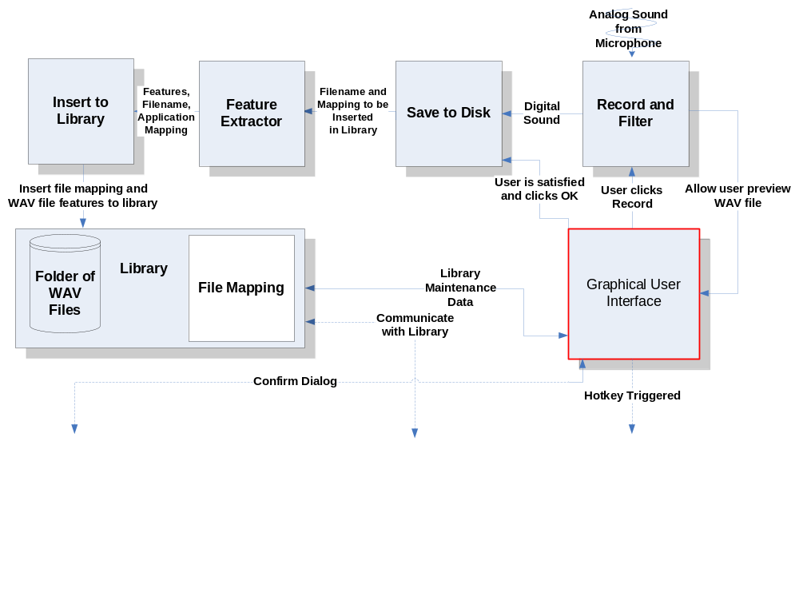
BLOCK DIAGRAM

Slide 6
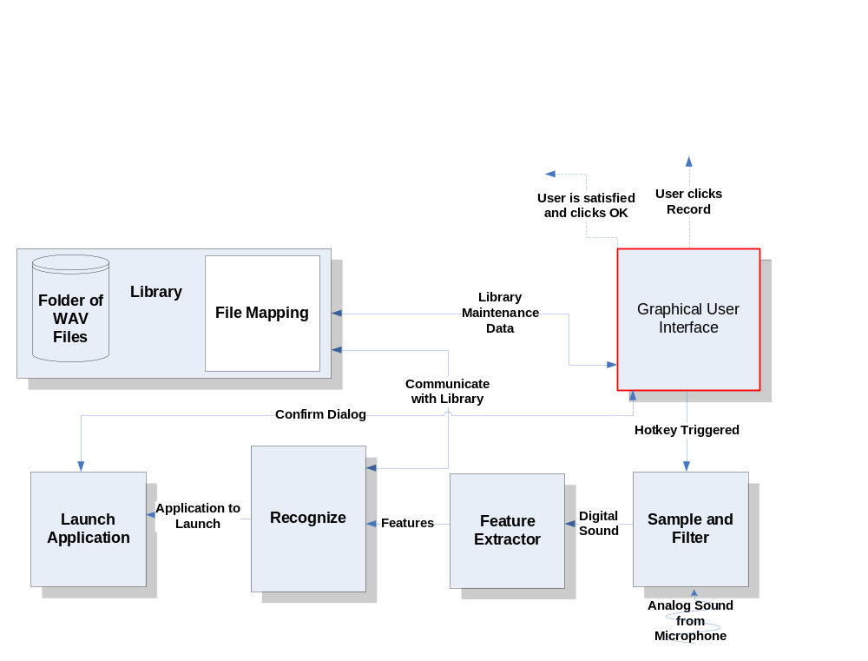
BLOCK DIAGRAM

Slide 7
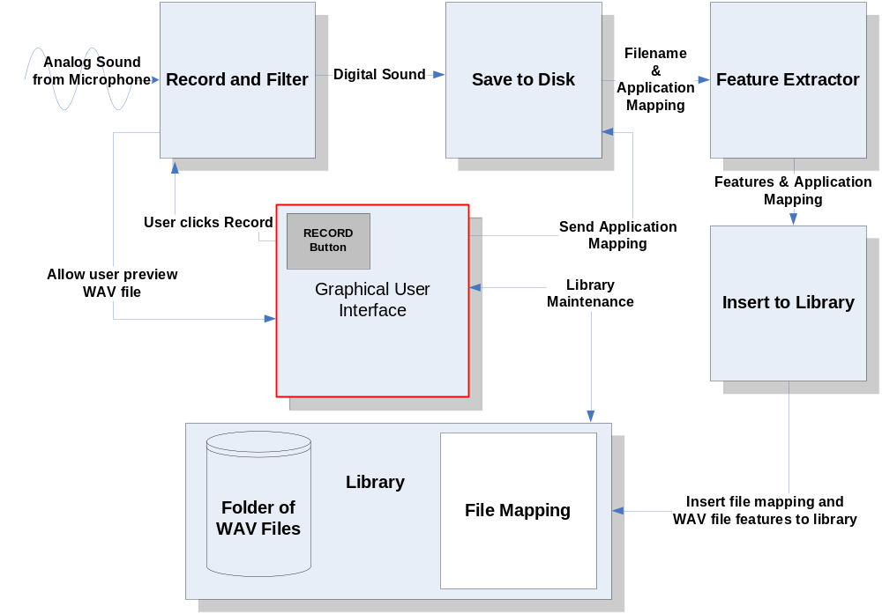
DATA FLOW DIAGRAM

Slide 8
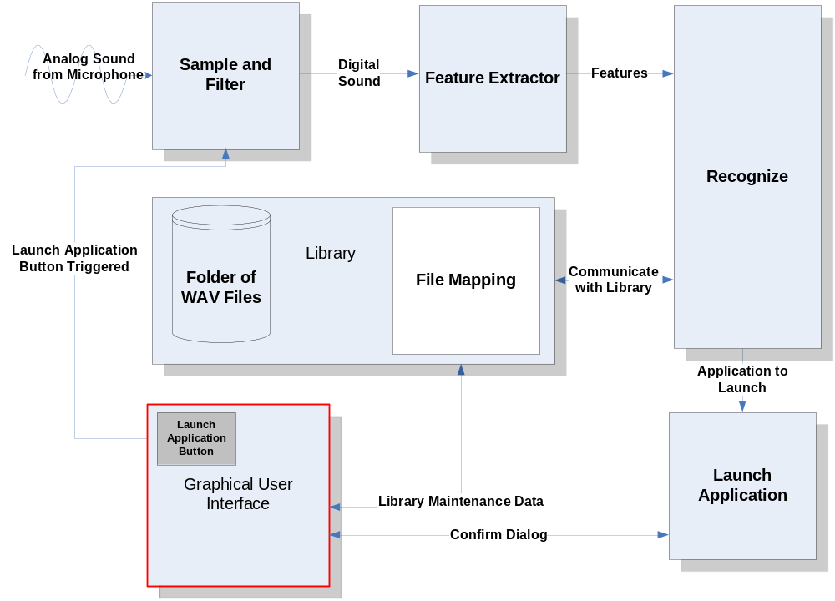
DATA FLOW DIAGRAM

Slide 9
Theory
S1 = {1, 6, 9, 6, 5}
S2 = {2, 6, 8, 9, 8}
        |2 – 1| = 1,
        |2 – 6| = 4
        |2 – 9| = 7
        |2 – 6| = 4
        |2 – 5| = 3.
i-1,j
i,j
7 | 2 | 1 | 2 | 3
8 | 3 | 0 | 3 | 4
7 | 2 | 1 | 2 | 3
5 | 0 | 3 | 0 | 1
1 | 4 | 7 | 4 | 3
i-1,j-1
i,j-1
7 | 2 | 1 | 2 | 3
8 | 3 | 0 | 3 | 4
7 | 2 | 1 | 2 | 3
5 | 0 | 3 | 0 | 1
1 | 4 | 7 | 4 | 3
Final cost is: 3+2+0+1+0+1=7

Slide 10
MODULE LIST
Module Name | Called By | It Calls | Lines of Code | Hours to Code | $ to Code
RECORD AND FILTER | GUI | Save to Disk | 500 | 10 | $ 400
SAVE TO DISK | Record and Filter | Feature Extractor | 600 | 12 | $ 480
INSERT TO LIBRARY | Save to Disk | - | 1,000 | 20 | $ 800
SAMPLE | GUI | Recognize | 500 | 2 | $ 80
RECOGNIZE | Sample | Launch Application | 1,500 | 30 | $ 1,200
LAUNCH APPLICATION | Recognize | - | 100 | 2 | $ 80
FEATURE EXTRACTOR | Save to Disk/Sample | Recognize/Insert to Library | 1,000 | 20 | $ 800
LIBRARY | - | - | 300 | 6 | $ 240
GUI | User | - | 1,600 | 32 | $ 1,280
TOTAL |  |  | 7,100 | 134 | $5,360

Slide 11
Feature Extractor
Parameters: IN (WAV File)
OUT (Feature Array)
Divide sample into n intervals
For every interval
Compute number of zero-crossings
Compute average time between each zero-crossing
End for

Slide 12
Tests to Verify the Design
Module Name | Input | Expected Result | Status
Record and Filter | Analog Sound | To be digitized and played successfully after recording. | Pass
Record and Filter | Analog Sound | Test with a quiet room. | Pass
Record and Filter | Analog Sound | Record with microphone. | Pass
Record and Filter | Analog Sound | Record with other sources besides a microphone. | Pass
Save to File | Sound from record and filter module | Digital sound to be saved on disk and played through a third-party WAV player. | Not Tested
Feature Extractor | WAV file | Successfully divided into 64 uniform intervals. | Not Tested
Feature Extractor | WAV file | The correct number of zero-crossings for 500 samples should be extracted. | Not Tested
Feature Extractor | WAV file | The correct number of zero -crossings for all interval should be extracted successfully. | Not Tested
Feature Extractor | WAV file | The correct number of average time for each interval is returned. | Not Tested
Insert to Library | WAV file from save to disk module | Open and write to file successfully. | Not Tested

Slide 13
Tests to Verify the Design
Module Name | Input | Expected Result | Status
Insert to Library | WAV file from save to disk module | Extract should be successfully written to file. | Not Tested
Sample | Analog Sound | Digitized and played successfully after recording. | Not Tested
Recognize | Digital sound from sample module | Stepped through the matrix successfully. | Not Tested
Recognize | Digital sound from sample module | Matrix created successfully. | Not Tested
Recognize | Digital sound from sample module | Template with best match and within threshold is returned. | Not Tested
Launch Application | Application address from recognize module | Application should be launched. | Not Tested
Library | WAV files | All templates should be returned in a matrix. When needed it should return all WAV files to the GUI. | Not Tested
GUI | Events are triggered by user | Buttons can trigger a number of events ranging from recording to recognition. | Not Tested
GUI | Hotkey | Hotkey should trigger the recording to being | Pass
GUI | Events are triggered by user | Buttons can trigger a number of events ranging from recording to recognition. | Not Tested

Slide 14
GANTT CHART
See MS-Project File

Slide 15
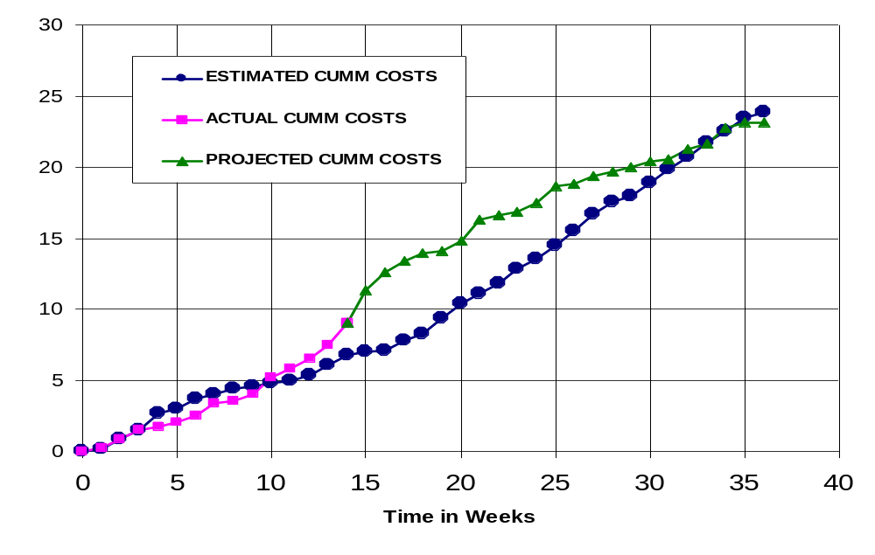
CUMULATIVE LABOR COSTS

Slide 16
ECONOMIC ANALYSIS
PROTOTYPE COSTS
 | Labor Rate | Initial Est. Hours | Initial Est. Cost | Current Est. Hours | Current Est. Cost
System Analyst | $45.00 | 215 | $9,686 | 113 | $5,085
Programmer | $40.00 | 268 | $10,720 | 144 | $5,760
Test Programmer | $35.00 | 31 | $1,085 | 168 | $5,880
Technical Writer | $35.00 | 67 | $2,345 | 184 | $6,440
TOTAL |  | 581 | $23,836 | 609 | $23,165
DIRECT OVERHEAD @ 100% |  |  | $23,836 |  | $23,165
SUBTOTAL |  |  | $47,673 |  | $46,330
A&G COSTS @ 40% |  |  | $19,069 |  | $18,532
SUBTOTAL |  |  | $66,742 |  | $64,862
PROFIT @ 20% |  |  | $13,348 |  | $12,972
TOTAL COST OF PROTOTYPE |  |  | $80,090 |  | $77,834

Slide 17
UNIT COSTS SOLD
UNIT COSTS SOLD BY CORPORATION AS A RETAILER ON THE INTERNET
 | Initial Estimate |  |  | Current Estimate
PROTOTYPE COSTS | $80,090 |  |  | $77,834
INSTALL MACHINE AND SOFTWARE | $50,000 |  |  | $50,000
SUBTOTAL | $130,090 |  |  | $127,834
OVERHEARD @ 200% | $260,180 |  |  | $255,669
SUBTOTAL | $390,269 |  |  | $383,503
DOCUMENTATION | $0 |  |  | $0
PACKAGING SUBTOTAL | $0 |  |  | $0
SUBTOTAL | $390,269 |  |  | $383,503
A&G @ 40% | $156,108 |  |  | $153,401
SUBTOTAL | $546,377 |  |  | $536,904
PROFIT @ 20% | $109,275 |  |  | $107,381
SUBTOTAL | $655,653 |  |  | $644,285

Slide 18
UNIT COSTS SOLD
 |  | Initial Estimate |  | Current Estimate
 | # of copies | Price/Copy | Total Profit | Price/Copy | Total Profit
Total to Sell | 1,000,000
Recoup Prototype Costs | 100,000 | $6.56 | $109,275 | $6.44 | $107,381
Excessive Profit from Recoup | 100,000 | $12.04 | $1,204,347 | $12.16 | $1,215,715
Remainder to Sell | 900,000 | $18.60 | $16,740,000 | $18.60 | $16,740,000
 |  | Minus 40% for A&G | $6,696,000 | Minus 40% for A&G | $6,696,000
Subtotal |  |  | $10,044,000 |  | $10,044,000
Total Profit |  |  | $11,357,623 |  | $11,367,096

Slide 19
COMPARATIVE PRODUCTS
Product Name | Cost | Units Sold | Publisher | System Requirements
HAL 2.0 | $19.95 | 1,144 | David Henry Company | Windows 98/Me/2000/XP
iListen 1.6.3 | $140.00 | - | MacSpeech | PowerMacintosh G3, 256MB RAM
Naturally Speaking | $150.00 | - | ScanSoft | Intel® Pentium® III / 500 MHz processor, 128 MB RAM, 300 MB free hard disk
Realize Voice Lite 4.0 | $49.00 | 253,432 | Realize Software | Windows 98SE/ME/NT/2000/XP, a noise-canceling microphone
ViaVoice | $200.00 | - | IBM | Pentium II 300 MHz, 510 MB Hard drive, 96 MB RAM
Voice Studio 1.4.2 | $49.97 | 41,914 | Ultimate Interactive Desktops | Windows 98/Me/NT/2000/XP
Voice Tools 7.0 | $300.00 | 51,157 | Wizzard Software | Not Provided

Slide 20
OUTLINED MATRIX
OUTLINED
MODULE NAME | INIT. EST. HRS. | CUR. EST. HRS. | HRS SPENT TO DATE | % COMPT. | EST. HRS TO COMP.
RECORD AND FILTER | 8 | 8 | 8 | 100.0% | 0
SAVE TO DISK | 7 | 5 | 5 | 100.0% | 0
INSERT TO LIBRARY | 5 | 5 | 5 | 100.0% | 0
SAMPLE | 3 | 3 | 3 | 100.0% | 0
RECOGNIZE | 12 | 10 | 10 | 100.0% | 0
LAUNCH APPLICATION | 2 | 2 | 2 | 100.0% | 0
FEATURE EXTRACTOR | 0 | 2 | 2 | 100.0% | 0
LIBRARY | 2 | 2 | 2 | 100.0% | 0
GUI | 2 | 2 | 2 | 100.0% | 0
TOTALS | 41 | 39 | 39 | 100.0% | 0

Slide 21
DESIGNED MATRIX
DESIGNED
MODULE NAME | INIT. EST. HRS. | CUR. EST. HRS. | HRS SPENT TO DATE | % COMPT. | EST. HRS TO COMP.
RECORD AND FILTER | 6 | 8 | 8 | 100.0% | 0
SAVE TO DISK | 7 | 4 | 4 | 100.0% | 0
INSERT TO LIBRARY | 6 | 8 | 8 | 100.0% | 0
SAMPLE | 4 | 5 | 5 | 100.0% | 0
RECOGNIZE | 12 | 30 | 30 | 100.0% | 0
LAUNCH APPLICATION | 3 | 4 | 4 | 100.0% | 0
FEATURE EXTRACTOR | 0 | 6 | 6 | 100.0% | 0
LIBRARY | 2 | 2 | 2 | 100.0% | 0
GUI | 4 | 4 | 4 | 100.0% | 0
TOTALS | 44 | 71 | 71 | 100.0% | 0

Slide 22
CONSTRUCTED MATRIX
CONSTRUCTED
MODULE NAME | INIT. EST. HRS. | CUR. EST. HRS. | HRS SPENT TO DATE | % COMPT. | EST. HRS TO COMP.
RECORD AND FILTER | 40 | 10 | 6 | 60.0% | 4
SAVE TO DISK | 20 | 10 | 0 | 0.0% | 10
INSERT TO LIBRARY | 28 | 20 | 0 | 0.0% | 20
SAMPLE | 40 | 2 | 1 | 50.0% | 1
RECOGNIZE | 120 | 30 | 0 | 0.0% | 30
LAUNCH APPLICATION | 20 | 2 | 0 | 0.0% | 2
FEATURE EXTRACTOR | 0 | 20 | 0 | 0.0% | 20
LIBRARY | 4 | 6 | 0 | 0.0% | 6
GUI | 15 | 32 | 3 | 9.4% | 29
TOTALS | 287 | 132 | 10 | 7.6% | 122

Slide 23
TESTED MATRIX
TESTED
MODULE NAME | INIT. EST. HRS. | CUR. EST. HRS. | HRS SPENT TO DATE | % COMPT. | EST. HRS TO COMP.
RECORD AND FILTER | 6 | 14 | 2 | 14.3% | 12
SAVE TO DISK | 4 | 9 | 0 | 0.0% | 9
INSERT TO LIBRARY | 4 | 9 | 0 | 0.0% | 9
SAMPLE | 4 | 2 | 1 | 50.0% | 1
RECOGNIZE | 10 | 15 | 0 | 0.0% | 15
LAUNCH APPLICATION | 3 | 7 | 0 | 0.0% | 7
FEATURE EXTRACTOR | 0 | 15 | 0 | 0.0% | 15
LIBRARY | 2 | 2 | 0 | 0.0% | 2
GUI | 4 | 4 | 3 | 75.0% | 1
TOTALS | 37 | 77 | 6 | 7.8% | 71

Slide 24
INTEGRATED MATRIX
INTEGRATED
MODULE NAME | INIT. EST. HRS. | CUR. EST. HRS. | HRS SPENT TO DATE | % COMPT. | EST. HRS TO COMP.
RECORD AND FILTER | 4 | 12 | 1 | 8.3% | 11
SAVE TO DISK | 4 | 9 | 0 | 0.0% | 9
INSERT TO LIBRARY | 3 | 11 | 0 | 0.0% | 11
SAMPLE | 1 | 5 | 1 | 20.0% | 4
RECOGNIZE | 6 | 15 | 0 | 0.0% | 15
LAUNCH APPLICATION | 2 | 4 | 0 | 0.0% | 4
FEATURE EXTRACTOR | 0 | 6 | 0 | 0.0% | 6
LIBRARY | 2 | 3 | 0 | 0.0% | 3
GUI | 20 | 20 | 2 | 10.0% | 18
TOTALS | 42 | 85 | 4 | 4.7% | 81

Slide 25
DOCUMENTED MATRIX
DOCUMENTED
MODULE NAME | INIT. EST. HRS. | CUR. EST. HRS. | HRS SPENT TO DATE | % COMPT. | EST. HRS TO COMP.
RECORD AND FILTER | 15 | 24 | 10 | 41.7% | 14
SAVE TO DISK | 13 | 10 | 6 | 60.0% | 4
INSERT TO LIBRARY | 15 | 16 | 5 | 31.3% | 11
SAMPLE | 15 | 13 | 6 | 46.2% | 7
RECOGNIZE | 25 | 20 | 11 | 55.0% | 9
LAUNCH APPLICATION | 15 | 12 | 7 | 58.3% | 5
FEATURE EXTRACTOR | 0 | 10 | 5 | 50.0% | 5
LIBRARY | 1 | 5 | 4 | 80.0% | 1
GUI | 2 | 8 | 6 | 75.0% | 2
TOTALS | 101 | 118 | 60 | 50.8% | 58

Slide 26
TOTAL MATRIX
TOTAL
MODULE NAME | INIT. EST. HRS. | CUR. EST. HRS. | HRS SPENT TO DATE | % COMPT. | EST. HRS TO COMP.
RECORD AND FILTER | 79 | 76 | 35 | 46.1% | 41
SAVE TO DISK | 55 | 47 | 15 | 31.9% | 32
INSERT TO LIBRARY | 61 | 69 | 18 | 26.1% | 51
SAMPLE | 67 | 30 | 17 | 56.7% | 13
RECOGNIZE | 185 | 120 | 51 | 42.5% | 69
LAUNCH APPLICATION | 45 | 31 | 13 | 41.9% | 18
FEATURE EXTRACTOR | 0 | 59 | 5 | 8.5% | 54
LIBRARY | 13 | 20 | 8 | 40.0% | 12
GUI | 47 | 70 | 20 | 28.6% | 50
CLASS TIME | 87 | 87 | 48 | 55.2% | 39
TOTALS | 639 | 609 | 230 | 37.8% | 379

