Slide 1
THE GEORGE WASHINGTON UNIVERSITY
School of Engineering and Applied Science
Department of Computer Science
Preliminary Design Review
for the
Design of a Discrete User-Dependent
Speech Recognition Program
By
Amir Raminfar
CSci 195-10
Senior Computer Science Design Project
October 13, 2004

Slide 2
SPECIFICATIONS
Microphone
Speakers (Not required but recommended)
800 MHz Processor
256 MB RAM
Keyboard
Java Virtual Machine
Enough disk space to save the WAV files

Slide 3
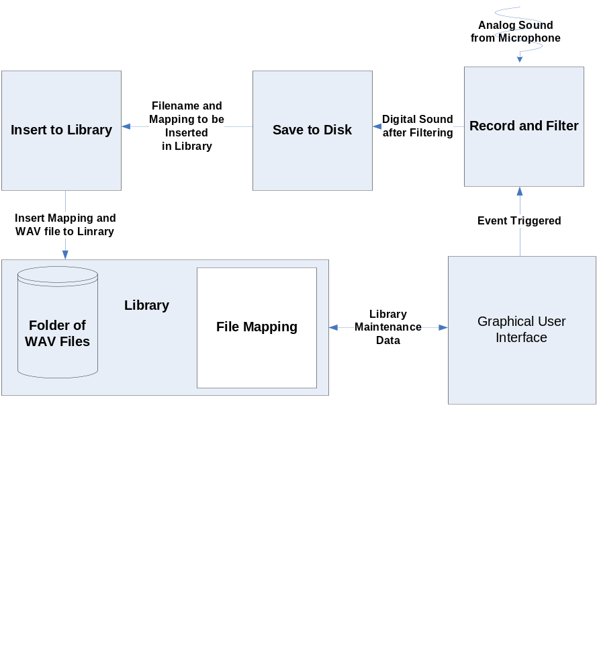
BLOCK DIAGRAM

Slide 4
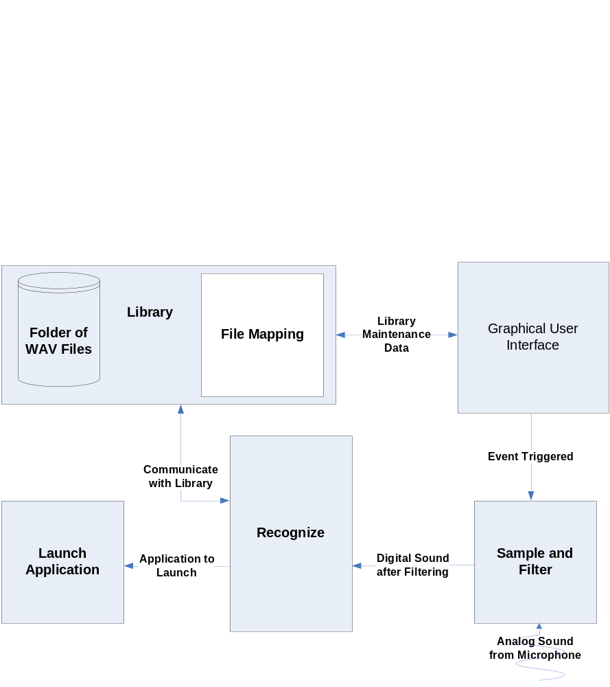
BLOCK DIAGRAM

Slide 5
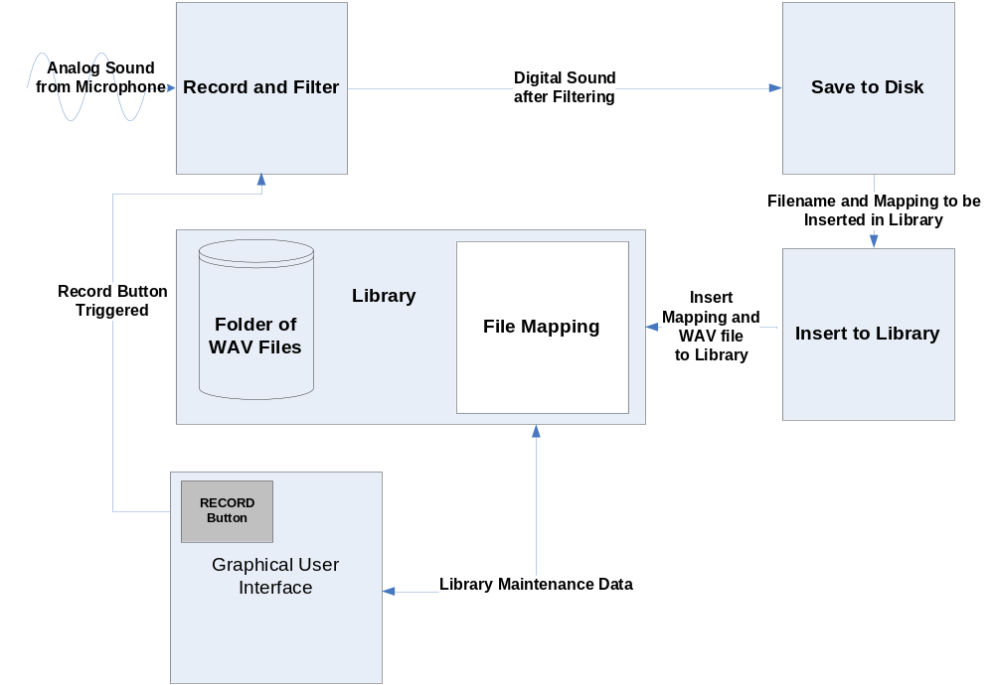
DATA FLOW DIAGRAM

Slide 6
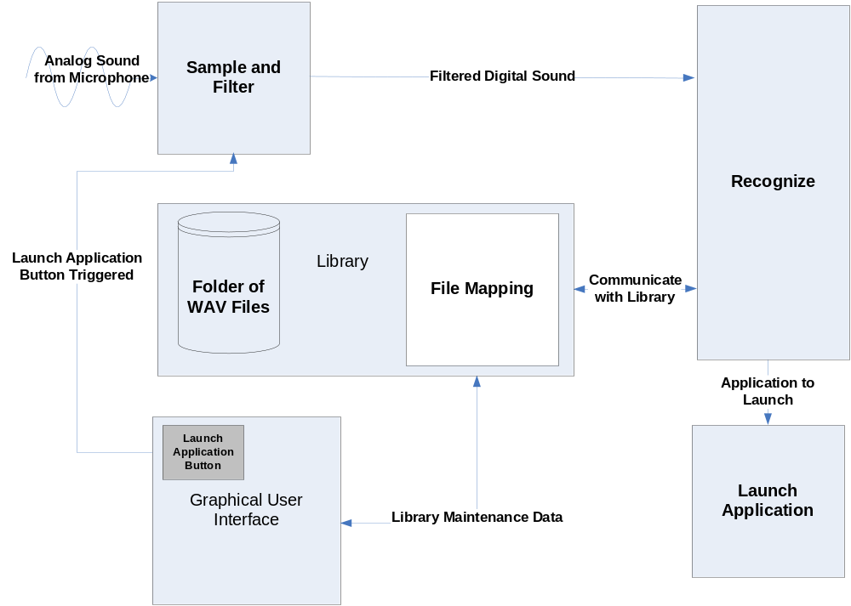
DATA FLOW DIAGRAM

Slide 7
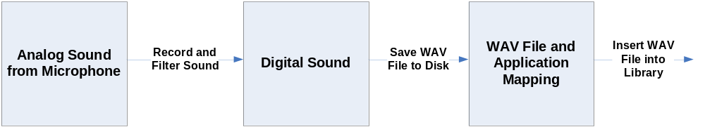
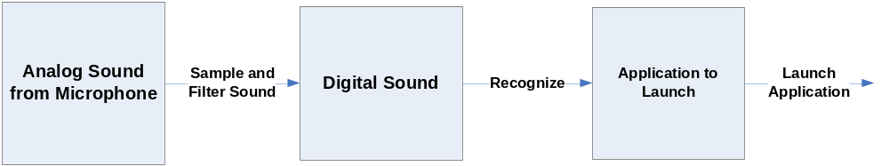
CONTROL FLOW DIAGRAM

Slide 8
MODULE LIST
Module Name | Called By | It Calls | Lines of Code | Hours to Code | $ to Code
INPUT FROM MIC | - | - | - | - | -
RECORD AND FILTER | GUI | Save to File | 1,500 | 30 | $ 1,200
SAVE TO FILE | Record and Module | Insert to Library | 750 | 15 | $ 600
INSERT TO LIBRARY | Save to File | - | 1,400 | 28 | $ 1,120
SAMPLE | GUI | Recognize | 500 | 10 | $ 400
RECOGNIZE | Sample | Launch Application | 4,000 | 80 | $ 3,200
LAUNCH APPLICATION | Recognize | - | 1,000 | 20 | $ 800
LIBRARY | - | - | 200 | 4 | $ 160
GUI | User | - | 750 | 15 | $ 600
TOTAL |  |  | 10,100 | 202 | $8,080

Slide 9
VERIFICATION TEST
Test Phrase | Expected Result
Email | OK
Internet | OK
Music | OK
Word Processor | OK
Address Book | OK
Show Desktop | OK
My Computer | OK
G-Mail compared with C-Mail | NOT OK
Cannot Make OS calls like:
Copy and Paste | NOT OK
Close/Create New Email | NOT OK

Slide 10
GANTT CHART
See MS-Project File

Slide 11
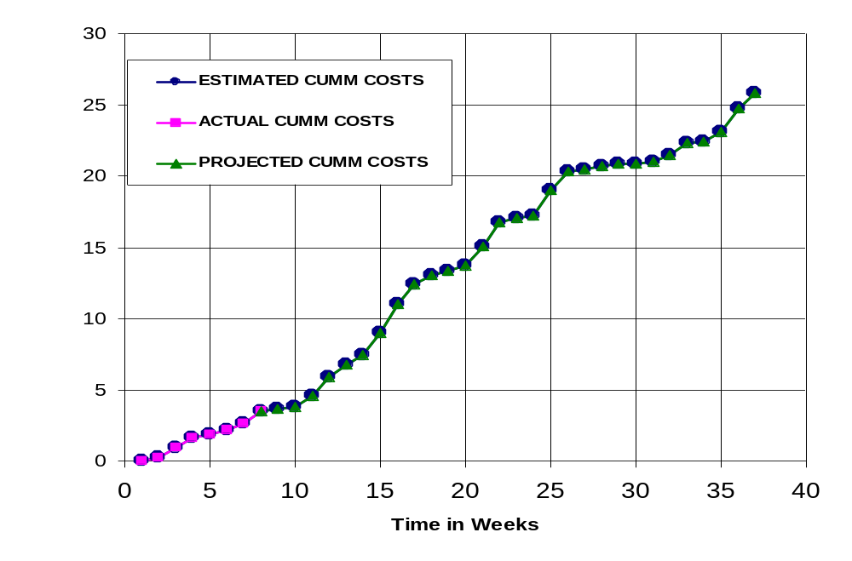
CUMULATIVE LABOR COSTS

Slide 12
ECONOMIC ANALYSIS
PROTOTYPE COSTS
 | Labor Rate | Current Est. Hours | Current Est. Cost | Initial Est. Hours | Initial Est. Cost
System Analyst | $45.00 | 118 | $5,321 | 215 | $9,686
Programmer | $40.00 | 195 | $7,800 | 268 | $10,720
Test Programmer | $35.00 | 174 | $6,090 | 31 | $1,085
Technical Writer | $35.00 | 188 | $6,580 | 67 | $2,345
TOTAL |  | 675 | $25,791 | 581 | $23,836
DIRECT OVERHEAD @ 100% |  |  | $25,791 |  | $23,836
SUBTOTAL |  |  | $51,583 |  | $47,673
A&G COSTS @ 40% |  |  | $20,633 |  | $19,069
SUBTOTAL |  |  | $72,216 |  | $66,742
PROFIT @ 20% |  |  | $14,443 |  | $13,348
TOTAL COST OF PROTOTYPE |  |  | $86,659 |  | $80,090

Slide 13
UNITS COSTS SOLD
UNIT COSTS SOLD BY CORPORATION AS A RETAILER ON THE INTERNET
PROTOTYPE COSTS |  | $86,659
INSTALL MACHINE AND SOFTWARE |  | $50,000
SUBTOTAL |  | $136,659
OVERHEARD @ 200% |  | $273,317
SUBTOTAL |  | $409,976
DOCUMENTATION |  | $0
PACKAGING SUBTOTAL |  | $0
SUBTOTAL |  | $409,976
A&G @ 40% |  | $163,990
SUBTOTAL |  | $573,966
PROFIT @ 20% |  | $114,793
SUBTOTAL |  | $688,759

Slide 14
UNITS COSTS SOLD
 | # of copies | Price/Copy | Total Profit
Total to Sell | 1,000,000
Recoup Prototype Costs | 20,000 | $18.60 | $114,793
Remainder to Sell | 980,000 | $18.60 | $18,228,000
 |  | Minus 40% for A&G | $7,291,200
Subtotal |  |  | $10,936,800
Total Profit |  |  | $11,051,593

Slide 15
COMPARATIVE PRODUCTS
Product Name | Cost | Units Sold | Publisher
Voice Studio 1.4.2 | $50 | 41,914 | Ultimate Interactive Desktops
HAL 2.0 | $20 | 1,144 | David Henry Company
Voice Tools 7.0 | $300 | 51,157 | Wizzard Software
Realize Voice Lite 4.0 | $49 | 253,432 | Realize Software
ViaVoice | $200 | Not Provided | IBM
Natuallry Speaking | $150 | Not Provided | ScanSoft
iListen 1.6.3 | $140 | Not Provided | MacSpeech

Slide 16
OUTLINED MATRIX
OUTLINED
MODULE NAME | INIT. EST. HRS. | CUR. EST. HRS. | HRS SPEND TO DATE | % COMPT. | EST. HRS TO COMP.
RECORD AND FILTER | 8 | 8 | 8 | 100.0% | 0
SAVE TO FILE | 7 | 7 | 7 | 100.0% | 0
INSERT TO LIBRARY | 5 | 5 | 5 | 100.0% | 0
SAMPLE | 3 | 3 | 3 | 100.0% | 0
RECOGNIZE | 12 | 12 | 12 | 100.0% | 0
LAUNCH APPLICATION | 2 | 2 | 2 | 100.0% | 0
LIBRARY | 2 | 2 | 2 | 100.0% | 0
GUI | 2 | 2 | 2 | 100.0% | 0
TOTALS | 41 | 41 | 41 | 100.0% | 0

Slide 17
DESIGNED MATRIX
DESIGNED
MODULE NAME | INIT. EST. HRS. | CUR. EST. HRS. | HRS SPENT TO DATE | % COMPT. | EST. HRS TO COMP.
RECORD AND FILTER | 6 | 8 | 7 | 87.5% | 1
SAVE TO FILE | 7 | 10 | 9 | 90.0% | 1
INSERT TO LIBRARY | 6 | 8 | 7 | 87.5% | 1
SAMPLE | 4 | 5 | 5 | 100.0% | 0
RECOGNIZE | 12 | 36 | 20 | 55.6% | 16
LAUNCH APPLICATION | 3 | 4 | 3 | 75.0% | 1
LIBRARY | 2 | 2 | 2 | 100.0% | 0
GUI | 4 | 4 | 3 | 75.0% | 1
TOTALS | 44 | 77 | 56 | 72.7% | 21

Slide 18
CONSTRUCTED MATRIX
CONSTRUCTED
MODULE NAME | INIT. EST. HRS. | CUR. EST. HRS. | HRS SPENT TO DATE | % COMPT. | EST. HRS TO COMP.
RECORD AND FILTER | 40 | 30 | 0 | 0.0% | 30
SAVE TO FILE | 20 | 15 | 0 | 0.0% | 15
INSERT TO LIBRARY | 28 | 28 | 0 | 0.0% | 28
SAMPLE | 40 | 10 | 0 | 0.0% | 10
RECOGNIZE | 120 | 80 | 0 | 0.0% | 80
LAUNCH APPLICATION | 20 | 20 | 0 | 0.0% | 20
LIBRARY | 4 | 4 | 0 | 0.0% | 4
GUI | 15 | 15 | 0 | 0.0% | 15
TOTALS | 287 | 202 | 0 | 0.0% | 202

Slide 19
TESTED MATRIX
TESTED
MODULE NAME | INIT. EST. HRS. | CUR. EST. HRS. | HRS SPENT TO DATE | % COMPT. | EST. HRS TO COMP.
RECORD AND FILTER | 6 | 14 | 0 | 0.0% | 14
SAVE TO FILE | 4 | 9 | 0 | 0.0% | 9
INSERT TO LIBRARY | 4 | 9 | 0 | 0.0% | 9
SAMPLE | 4 | 6 | 0 | 0.0% | 6
RECOGNIZE | 10 | 18 | 0 | 0.0% | 18
LAUNCH APPLICATION | 3 | 7 | 0 | 0.0% | 7
LIBRARY | 2 | 2 | 0 | 0.0% | 2
GUI | 4 | 4 | 0 | 0.0% | 4
TOTALS | 37 | 69 | 0 | 0.0% | 69

Slide 20
INTEGRATED MATRIX
INTEGRATED
MODULE NAME | INIT. EST. HRS. | CUR. EST. HRS. | HRS SPENT TO DATE | % COMPT. | EST. HRS TO COMP.
RECORD AND FILTER | 4 | 12 | 0 | 0.0% | 12
SAVE TO FILE | 4 | 9 | 0 | 0.0% | 9
INSERT TO LIBRARY | 3 | 11 | 0 | 0.0% | 11
SAMPLE | 1 | 5 | 0 | 0.0% | 5
RECOGNIZE | 6 | 21 | 0 | 0.0% | 21
LAUNCH APPLICATION | 2 | 4 | 0 | 0.0% | 4
LIBRARY | 2 | 3 | 0 | 0.0% | 3
GUI | 20 | 20 | 0 | 0.0% | 20
TOTALS | 42 | 85 | 0 | 0.0% | 85

Slide 21
DOCUMENTED MATRIX
DOCUMENTED
MODULE NAME | INIT. EST. HRS. | CUR. EST. HRS. | HRS SPENT TO DATE | % COMPT. | EST. HRS TO COMP.
RECORD AND FILTER | 15 | 24 | 7 | 29.2% | 17
SAVE TO FILE | 13 | 12 | 5 | 41.7% | 7
INSERT TO LIBRARY | 15 | 16 | 6 | 37.5% | 10
SAMPLE | 15 | 13 | 5 | 38.5% | 8
RECOGNIZE | 25 | 24 | 10 | 41.7% | 14
LAUNCH APPLICATION | 15 | 12 | 5 | 41.7% | 7
LIBRARY | 1 | 5 | 2 | 40.0% | 3
GUI | 2 | 8 | 5 | 62.5% | 3
TOTALS | 101 | 114 | 45 | 39.5% | 69

Slide 22
TOTAL MATRIX
TOTAL
MODULE NAME | INIT. EST. HRS. | CUR. EST. HRS. | HRS SPENT TO DATE | % COMPT. | EST. HRS TO COMP.
RECORD AND FILTER | 79 | 96 | 22 | 22.9% | 74
SAVE TO FILE | 55 | 62 | 21 | 33.9% | 41
INSERT TO LIBRARY | 61 | 77 | 18 | 23.4% | 59
SAMPLE | 67 | 42 | 13 | 31.0% | 29
RECOGNIZE | 185 | 191 | 42 | 22.0% | 149
LAUNCH APPLICATION | 45 | 49 | 10 | 20.4% | 39
LIBRARY | 13 | 18 | 6 | 33.3% | 12
GUI | 47 | 53 | 10 | 18.9% | 43
CLASS TIME | 87 | 87 | 18 | 20.7% | 69
TOTALS | 639 | 675 | 160 | 23.7% | 515

