Slide 1
THE GEORGE WASHINGTON UNIVERSITY
School of Engineering and Applied Science
Department of Computer Science
Project Proposal Report
for the
Design of a Discrete User-Dependent Speech Recognition Program
By
Amir Raminfar
CSci 195-10
Senior Computer Science Design Project
September 22, 2004

Slide 2
SPECIFICATIONS
  Microphone needed to record voice
  Speakers (Not required but recommended)
  800 MHz Processor
  256 MB RAM
  Keyboard and Mouse
  Java Virtual Machine
  Enough disk space to save the wave files
  80% accuracy
  Targeting a selection of 10 to 15 words

Slide 3
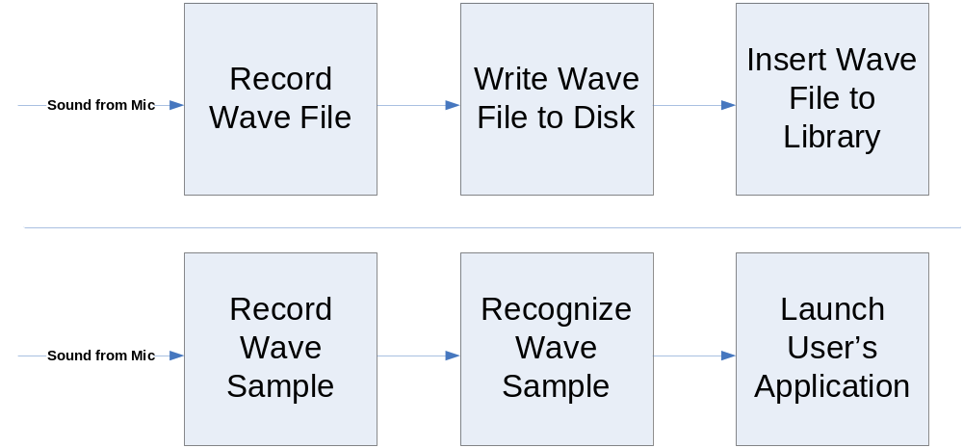
BLOCK DIAGRAM

Slide 4
MODULE LIST
Module Name | Called By | It Calls | Lines of Code | Hours to Code | $ to Code
Input from Microphone | - | Recording | - | - | -
1: Recording | Input | Writing | 1000 | 40.00 | $ 1,600.00
2: Writing | Module 1 | Inserting | 500 | 20.00 | $ 800.00
3: Inserting | Module 2 | - | 700 | 28.00 | $ 1,120.00
4: Sampling | Input | Distinguishing | 1000 | 40.00 | $ 1,600.00
5: Recognizing | Module 4 | Launching Application | 3000 | 120.00 | $ 4,800.00
6: Launching Application | Module 5 | - | 500 | 20.00 | $ 800.00
TOTALS |  |  | 6700 | 268.00 | $ 10,720.00

Slide 5
VERIFICATION TESTS
Should be able to recognize words like:
Email
Internet
Music
Word Processor
Address Book
Show Desktop
My Computer
Not expected to recognize words like:
Email or Gmail
Stab or Stub

Slide 6
GANTT CHART
See MS-Project File

Slide 7
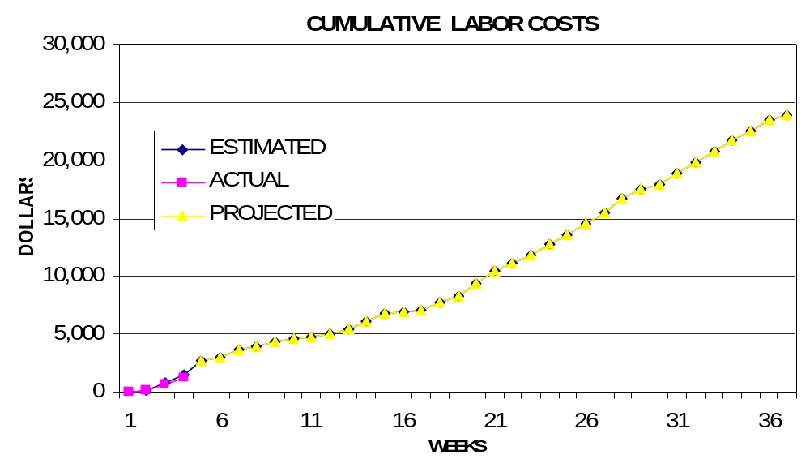
CUMULATIVE LABOR COSTS

Slide 8
ECONOMIC ANALYSIS
 | Labor Rate | Initial Est. Hours | Initial Est. Cost
System Analyst | $45.00 | 215.25 | $9,686.25
Programmer | $40.00 | 268 | $10,720.00
Test Programmer | $35.00 | 31 | $1,085.00
Technical Writer | $35.00 | 67 | $2,345.00
TOTAL |  | 581.25 | $23,836.25
DIRECT OVERHEAD @ 100% |  |  | $23,836.25
SUBTOTAL |  |  | $47,672.50
A&G COSTS @ 40% |  |  | $19,069.00
SUBTOTAL |  |  | $66,741.50
PROFIT @ 20% |  |  | $13,348.30
TOTAL COST OF PROTOTYPE |  |  | $80,089.80

Slide 9
UNITS COSTS SOLD
UNIT COSTS SOLD BY CORPORATION AS A RETAILER ON THE INTERNET
PROTOTYPE COSTS |  |  | $80,090
INSTALL MACHINE AND SOFTWARE |  |  | $50,000
SUBTOTAL |  |  | $130,090
OVERHEARD @ 200% |  |  | $260,180
SUBTOTAL |  |  | $390,269
DOCUMENTATION |  |  | $0
PACKAGING SUBTOTAL |  |  | $0
SUBTOTAL |  |  | $390,269
A&G @ 40% |  |  | $156,107.76
SUBTOTAL |  |  | $546,377
PROFIT @ 20% |  |  | $109,275.4
SUBTOTAL |  |  | $655,653
 |  | # of copies | Price/Copy | Total Profit
Total to Sell |  | 1,000,000
Recoup Prototype Costs |  | 20,000 | $18.60 | $109,275.4
Remainder to Sell |  | 980,000 | $18.60 | $18,228,000.00
 |  |  | Minus 40% for A&G | $7,291,200.00
Subtotal |  |  |  | $10,936,800.00
Total Profit |  |  |  | $11,046,075.43

Slide 10
COMPARATIVE PRODUCTS
Product Name | Cost | Units Sold | Publisher | System Requirements
Voice Studio 1.4.2 | $49.97 | 41,914 | Ultimate Interactive Desktops | Windows 98/Me/NT/2000/XP
HAL 2.0 | $19.95 | 1,144 | David Henry Company | Windows 98/Me/2000/XP
HomeGallery 2.5 | $25.00 | 4,596 | GRR Systems, Inc. | Windows 98/Me/NT/2000/XP, sound card, microphone
Voice Tools 7.0 | $300.00 | 51,157 | Wizzard Software | Not Provided
Realize Voice Lite 4.0 | $49.00 | 253,432 | Realize Software | Windows 98SE/ME/NT/2000/XP, a noise-canceling microphone

Slide 11
PROJECT MATRICES
OUTLINED
DESIGNED
CONSTRUCTED
TESTED
DOCUMENTED
INTEGRATED
TOTAL

Slide 12
OUTLINED MATRIX
MODULE NAME | INIT. EST. HRS. | CUR. EST. HRS. | HRS SPENT TO DATE | % COMPT. | EST. HRS TO COMP.
RECORDING | 5 | 5 | 0.5 | 10.0% | 4.5
SAVING TO FILE | 5 | 5 | 0.4 | 8.0% | 4.6
INSERTING TO LIBRARY | 5 | 5 | 0.2 | 4.0% | 4.8
SAMPLING | 3 | 3 | 0.5 | 16.7% | 2.5
RECOGNIZING | 10 | 10 | 0.5 | 5.0% | 9.5
LAUNCHING APPLICATION | 2 | 2 | 0.5 | 25.0% | 1.5
TOTALS | 30 | 30 | 2.6 | 8.7% | 27.4

Slide 13
DESIGNED MATRIX
MODULE NAME | INIT. EST. HRS. | CUR. EST. HRS. | HRS SPENT TO DATE | % COMPT. | EST. HRS TO COMP.
RECORDING | 6 | 6 | 1 | 16.7% | 5
SAVING TO FILE | 7 | 7 | 0 | 0.0% | 7
INSERTING TO LIBRARY | 6 | 6 | 0 | 0.0% | 6
SAMPLING | 4 | 4 | 0 | 0.0% | 4
RECOGNIZING | 12 | 12 | 1 | 8.3% | 11
LAUNCHING APPLICATION | 3 | 3 | 0 | 0.0% | 3
TOTALS | 38 | 38 | 2 | 5.3% | 36

Slide 14
CONSTRUCTED MATRIX
MODULE NAME | INIT. EST. HRS. | CUR. EST. HRS. | HRS SPENT TO DATE | % COMPT. | EST. HRS TO COMP.
RECORDING | 40 | 40 | 0 | 0.0% | 40
SAVING TO FILE | 20 | 20 | 0 | 0.0% | 20
INSERTING TO LIBRARY | 28 | 28 | 0 | 0.0% | 28
SAMPLING | 40 | 40 | 0 | 0.0% | 40
RECOGNIZING | 120 | 120 | 0 | 0.0% | 120
LAUNCHING APPLICATION | 20 | 20 | 0 | 0.0% | 20
TOTALS | 268 | 268 | 0 | 0.0% | 268

Slide 15
TESTED MATRIX
MODULE NAME | INIT. EST. HRS. | CUR. EST. HRS. | HRS SPENT TO DATE | % COMPT. | EST. HRS TO COMP.
RECORDING | 6 | 6 | 0 | 0.0% | 6
SAVING TO FILE | 4 | 4 | 0 | 0.0% | 4
INSERTING TO LIBRARY | 4 | 4 | 0 | 0.0% | 4
SAMPLING | 4 | 4 | 0 | 0.0% | 4
RECOGNIZING | 10 | 10 | 0 | 0.0% | 10
LAUNCHING APPLICATION | 3 | 3 | 0 | 0.0% | 3
TOTALS | 31 | 31 | 0 | 0.0% | 31

Slide 16
INTEGRATED MATRIX
MODULE NAME | INIT. EST. HRS. | CUR. EST. HRS. | HRS SPENT TO DATE | % COMPT. | EST. HRS TO COMP.
RECORDING | 4 | 4 | 0 | 0.0% | 4
SAVING TO FILE | 4 | 4 | 0 | 0.0% | 4
INSERTING TO LIBRARY | 3 | 3 | 0 | 0.0% | 3
SAMPLING | 1 | 1 | 0 | 0.0% | 1
RECOGNIZING | 6 | 6 | 0 | 0.0% | 6
LAUNCHING APPLICATION | 2 | 2 | 0 | 0.0% | 2
TOTALS | 20 | 20 | 0 | 0.0% | 20

Slide 17
DOCUMENTED MATRIX
MODULE NAME | INIT. EST. HRS. | CUR. EST. HRS. | HRS SPENT TO DATE | % COMPT. | EST. HRS TO COMP.
RECORDING | 15 | 15 | 5 | 33.3% | 10
SAVING TO FILE | 13 | 13 | 3 | 23.1% | 10
INSERTING TO LIBRARY | 15 | 15 | 4 | 26.7% | 11
SAMPLING | 15 | 15 | 3 | 20.0% | 12
RECOGNIZING | 25 | 25 | 9 | 36.0% | 16
LAUNCHING APPLICATION | 15 | 15 | 3 | 20.0% | 12
TOTALS | 98 | 98 | 27 | 27.6% | 71

Slide 18
TOTAL MATRIX
MODULE NAME | INIT. EST. HRS. | CUR. EST. HRS. | HRS SPENT TO DATE | % COMPT. | EST. HRS TO COMP.
RECORDING | 76 | 76 | 6.5 | 8.6% | 69.5
SAVING TO FILE | 53 | 53 | 3.4 | 6.4% | 49.6
INSERTING TO LIBRARY | 61 | 61 | 4.2 | 6.9% | 56.8
SAMPLING | 67 | 67 | 3.5 | 5.2% | 63.5
RECOGNIZING | 183 | 183 | 10.5 | 5.7% | 172.5
LAUNCHING APPLICATION | 45 | 45 | 3.5 | 7.8% | 41.5
CLASS TIME | 75 | 75 | 3 | 4.0% | 72
TOTALS | 560 | 560 | 34.6 | 6.2% | 525.4

