Slide 1
Salayze
Amir Raminfar
The George Washington University
Thursday, April 26, 2007

Slide 2
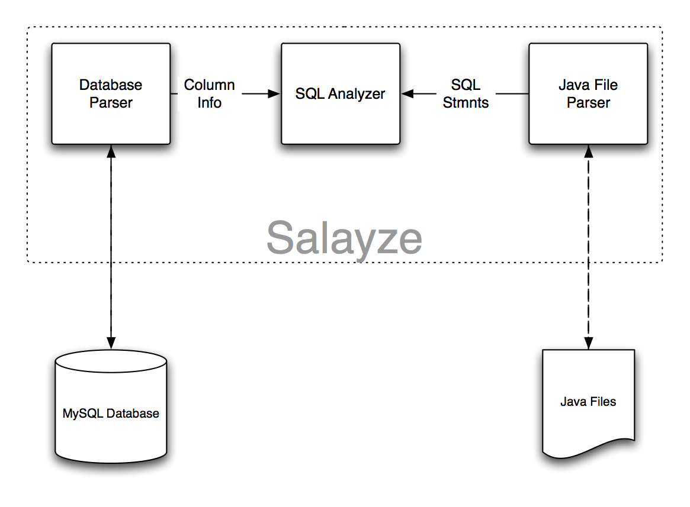
High-level Diagram

Slide 3
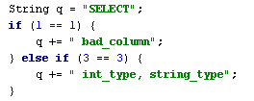
Example Code
Three possible queries
Why three?

Slide 4
Lines of Code
./Salayze.java | 91
./Salayzer/DBParser/ColumnInfo.java | 65
./Salayzer/DBParser/DatabaseInfo.java | 106
./Salayzer/DBParser/Info.java | 44
./Salayzer/JavaParser/JavaLexer.java | 2256
./Salayzer/JavaParser/JavaRecognizer.java | 6746
./Salayzer/JavaParser/JavaTokenTypes.java | 173
./Salayzer/JavaParser/JavaTreeParser.java | 4067
./Salayzer/JavaParser/JavaTreeParserTokenTypes.java | 174
./Salayzer/JavaParser/Parameter.java | 105
./Salayzer/JavaParser/ParseFile.java | 153
./Salayzer/JavaParser/ParseQueryVariable.java | 221
./Salayzer/JavaParser/QueryParameters.java | 95
./Salayzer/SQLParser/SQLError.java | 18
./Salayzer/SQLParser/SQLStatement.java | 167
TOTAL | 14481
Total new code | 1065

