Slide 1



UWM Now!
CS-743: Intelligent User Interfaces class project
Prof. Mcroy
Created by UWM students for UWM students
Communicate with fellow students
Have an effective class discussion
Be successful in studies. Work Smarter, Not Harder
Amir, B.S. in C.S. from UWM
Sean, working toward B.S. in C.S. from UWM

Slide 2

Technical aspects of UWM Now!
This is a proof of concept work, and does not follow best coding practices in software engineering (e.g. time complexity, efficiency, dynamic programing and more)
Components:
Node.js: Event-driven I/O server-side JavaScript environment based on V8 which is chrome engine (minimum requirement of 512 MB / 1GB for 32 / 64 bit)
Express.js: RESTful web framework for Node.js
ORM: Sequelize.js, supporting dialects: sqlite, mysql, mariadb, postgres, mssql
Perfect starting point:
~ 5000 lines of code
Modular design
Cluster ready
Flexible thanks to ORM
Time frame:
November 1, created git repository
November 25, last commit
Repository:
https://github.com/amir734jj/UWMNow

Slide 3
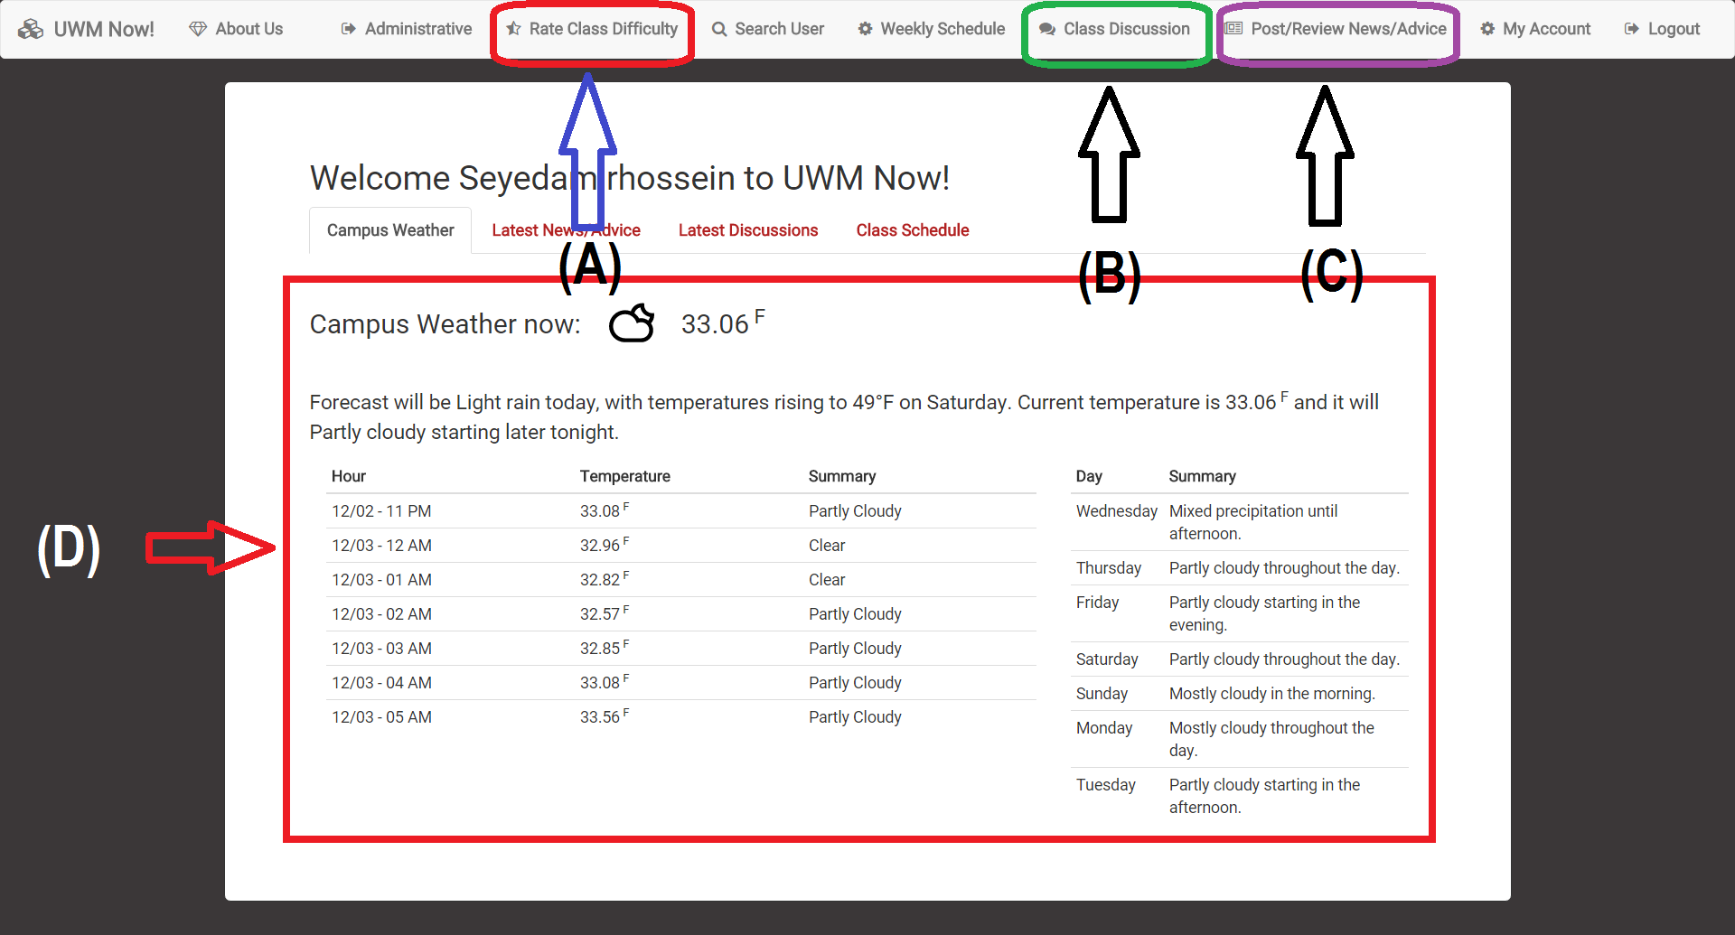
System Architecture p.1
Students rate class difficulty, to be used for schedule evaluation
Discussion threads for a specified class
General news item or friendly advice
Weekly and daily weather forecast

Slide 4
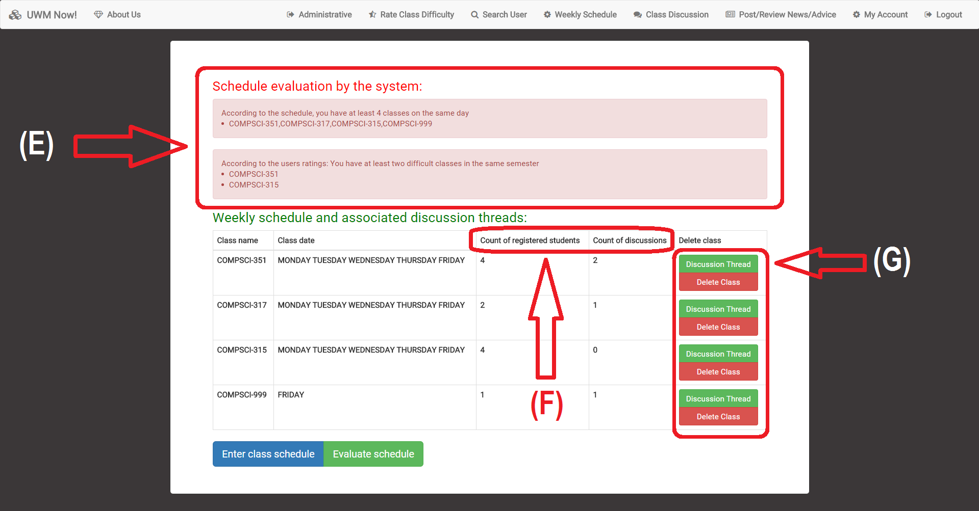
System Architecture p.2
E. Evaluate difficulty of schedule based on user ratings and weekly dates
F. Information about class, including number of registered students and count discussion posts
G. Quick access to discussion thread
Notes:
‹#›

Slide 5
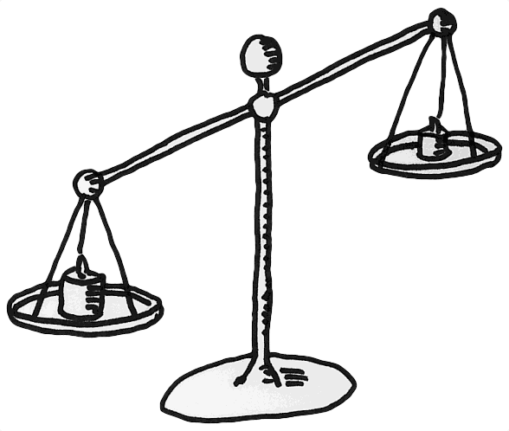
Random Students feedback (10 students) ← Biased
Positive:
A neat website.
It is very responsive.
The different uses of the site are interesting and relevant to students here at UWM.
Rating the classes...if a sizeable amount of students use that feature could, in my opinion, be one of the most useful.
The site looks very useful and can be utilized by many students from any major.
Suggestions:
Add a sort function for rating the classes.
Add the ability to add a description as to why you rated the class difficulty that would be cool.
Tips to help other students succeed in that class would be a good addition.
The layout and design is great and easy to use but it did take me a minute to understand the purpose of the website.
Homework tracker, input all of their homework and upcoming tests and order them by closest date or highest importance.
Notes:
‹#›

Slide 6

Classmate feedback (4 participants) ← Fair
Suggestion:
Populate more data to prove concept
Have an option for a short / anonymous comment to justify class rating
Include a guide on how to use the system in the activation email
Future improvements
More evaluation with larger set of participants
Add optional comment section to class rating
Include a link, in the activation email, to introductory videos.

