Slide 1
Comparator

Slide 2
2-Bit Comparator
A B C D LT EQ GT
0 0 0 0 0 1 0
0 1 1 0 0
1 0 1 0 0
1 1 1 0 0
0 1 0 0 0 0 1
0 1 0 1 0
1 0 1 0 0
1 1 1 0 0
1 0 0 0 0 0 1
0 1 0 0 1
1 0 0 1 0
1 1 1 0 0
1 1 0 0 0 0 1
0 1 0 0 1
1 0 0 0 1
1 1 0 1 0
N1
A
LT EQ GT
A B < C D A B = C D A B > C D
B
N2
C
D
block diagram
and
truth table
We'll need a 4-variable Karnaugh map for each of the 3 output functions

Slide 3
2-Bit Comparator (Cont’d)
A
A
A
0 0
1 0
0 0
0 0
1 0
0 1
0 0
0 0
0 1
0 0
1 1
1 1
D
D
D
1 1
1 1
0 1
0 0
0 0
0 0
1 0
0 1
0 0
0 0
0 0
1 0
C
C
C
B
B
B
K-map for LT
K-map for EQ
K-map for GT
LT =
EQ =
GT =
A' B' D + A' C + B' C D
A'B'C'D' + A'BC'D + ABCD + AB'CD’
= (A xnor C) • (B xnor D)
B C' D' + A C' + A B D'

Slide 4
Equality Comparator
XNOR
X Y Z
0 0 1
0 1 0
1 0 0
1 1 1
X
Z
Y
Z = X XNOR Y

Slide 5
4-Bit Equality Comparator
A[3..0]
Equality
Comparator
A_EQ_B
B[3..0]

Slide 6
4-Bit Equality Comparator: Internal Circuit
A0
C0
B0
A1
C1
B1
A_EQ_B
A2
B2
C2
A3
B3
C3

Slide 7
4-Bit Magnitude Comparator
A_LT_B
A[3..0]
Magnitude
Comparator
A_EQ_B
B[3..0]
A_GT_B
Important assumption: both A and B are unsigned numbers

Slide 8
4-Bit Magnitude Comparator: Internal Circuit
How can we find A_GT_B?
How many rows would a truth table have?
2⁸ = 256
Too many to draw the whole table!

Slide 9
4-Bit Magnitude Comparator: Finding A_GT_B
If A = 1XXX and B = 0XXX,
then A > B
Therefore, one term in the
logic equation for A_GT_B is
A3 . B3’
In this case: A3 > B3
i.e., A3 . B3’ = 1

Slide 10
4-Bit Magnitude Comparator: Finding A_GT_B
A_GT_B = A3 . B3’
+ …..
Because A3 = B3 and A2 > B2,
i.e., C3 = 1 and A2 . B2’ = 1
If (A = 11XX and B = 10XX) or (A = 01XX and B = 00XX),
then A > B
Therefore, the next term in the
logic equation for A_GT_B is
C3 . A2 . B2’

Slide 11
4-Bit Magnitude Comparator: Finding A_GT_B
A_GT_B = A3 . B3’
+ C3 . A2 . B2’
+ …..
If A3 = B3 and A2 = B2 and A1 > B1,
then A > B
This means C3 = 1 and C2 = 1 and
A1 . B1’ = 1
Therefore, the next term in the logic equation for A_GT_B is
C3 . C2 . A1 . B1’

Slide 12
4-Bit Magnitude Comparator: Finding A_GT_B
A_GT_B = A3 . B3’
+ C3 . A2 . B2’
+ C3 . C2 . A1 . B1’
+ …..
If (A3 = B3 and A2 = B2 and A1 = B1 and A0 > B0), then A > B
This means C3 = 1 and C2 = 1 and C1 = 1 and A0 . B0’ = 1
Therefore, the last term in the logic equation for A_GT_B is
C3 . C2 . C1 . A0 . B0’

Slide 13
4-Bit Magnitude Comparator: A_GT_B Circuit
A_GT_B = A3 . B3’
+ C3 . A2 . B2’
+ C3 . C2 . A1 . B1’
+ C3 . C2 . C1 . A0 . B0’

Slide 14
4-Bit Magnitude Comparator: Finding A_LT_B
A_LT_B = A3’ . B3
+ C3 . A2’ . B2
+ C3 . C2 . A1’ . B1
+ C3 . C2 . C1 . A0’ . B0

Slide 15
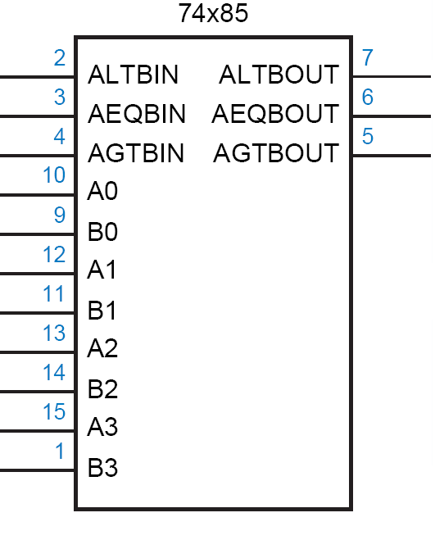
TTL 74x85
4
A
B
7485
4
lt
l
eq
e
gt
g

Slide 16
TTL 74x85
if (A>B) lt=0, eq=0, gt=1
if (A<B) lt=1, eq=0, gt=0
if (A=B) lt=l, eq=e, gt=g
The three l, e and g inputs are used when cascading
4
A
B
7485
4
lt
l
eq
e
gt
g

Slide 17
Comparator (continued…)
Cascade four 74x85’s to construct a 16-bit comparator

Slide 18
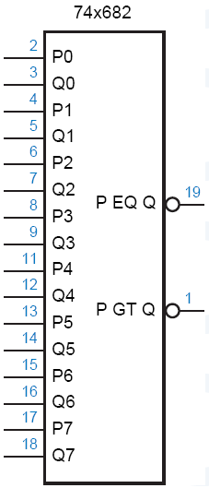
TTL 74x682
8-bit Comparator
Arithmetic conditions derived from 74x682 outputs?
And their circuits?

Slide 19
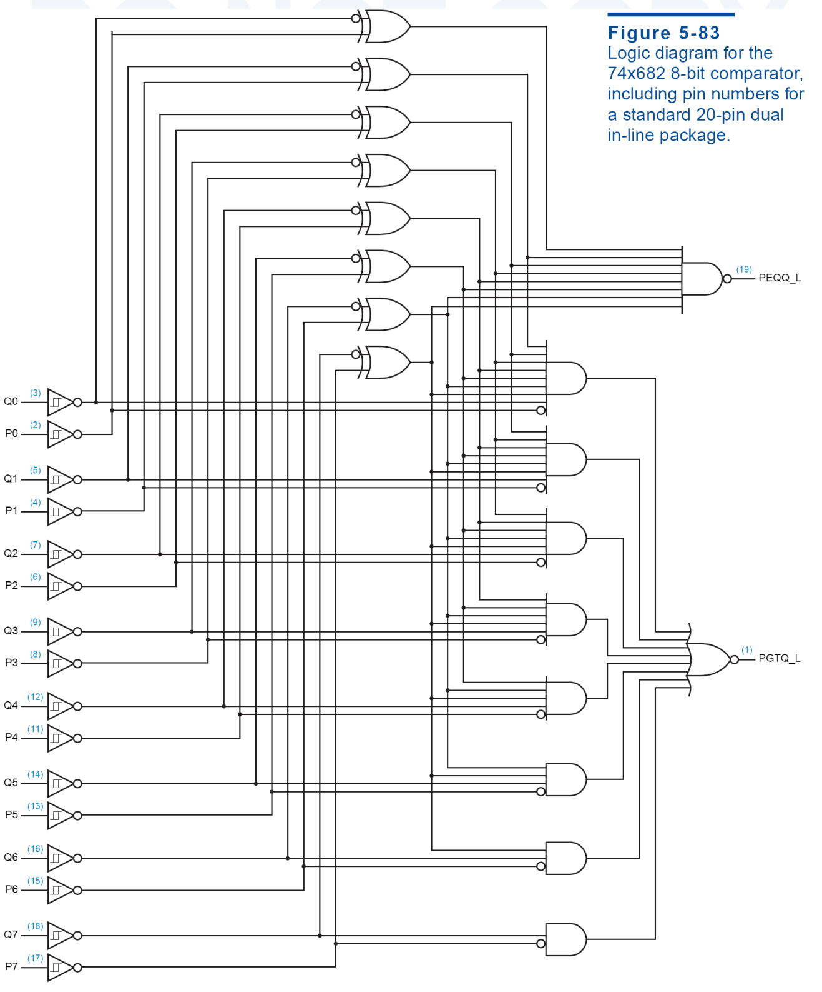

Slide 20
Maximum Finder
Design a maximum finder
7485

Slide 21
Adder

Slide 22
Adder
Review 01_numbers.ppt

Slide 23
Half Adder (HA)
Adds single bits
Ai
0
1
Ai
0
1
Ai
Bi
Sum
Carry
Bi
Bi
0
0
0
0
0
0
1
0
0
0
0
1
1
0
1
0
1
0
1
1
0
1
0
1
1
1
0
1
Sum = Ai Bi + Ai Bi
Carry = Ai . Bi
= Ai⊕Bi

Slide 24
Full Adder
Adds three bits

Slide 25
Full Adder (FA)
A B
A
B
CI
S
CO
CI
00
01
11
10
0
0
0
0
0
0
0
1
0
1
0
0
1
1
0
S
0
1
0
1
0
1
1
0
1
0
0
1
1
0
1
1
0
0
1
0
1
0
1
0
1
A B
1
1
0
0
1
CI
00
01
11
10
1
1
1
1
1
0
0
0
1
0
CO
S = CI xor A xor B
CO = B CI + A CI + A B = CI (A + B) + A B
1
0
1
1
1

Slide 26
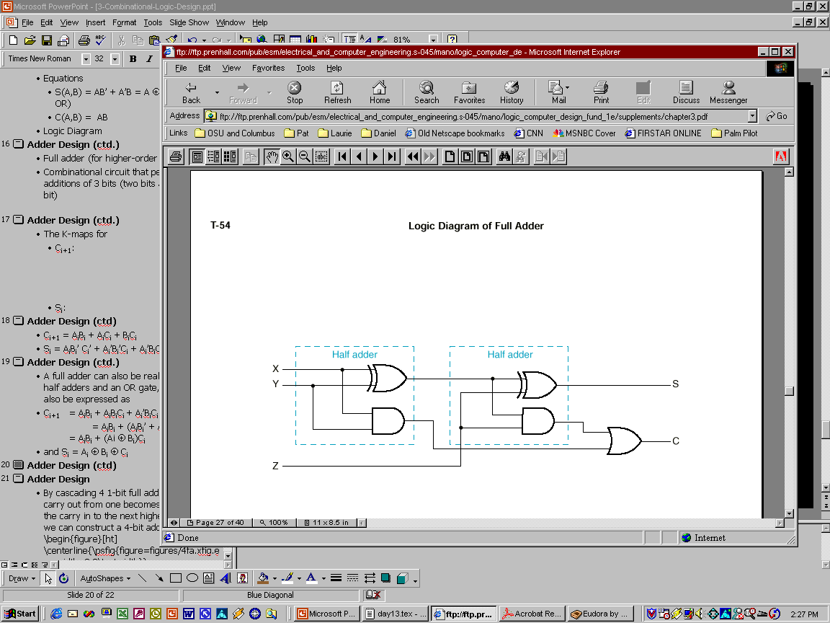
Full Adder Using 2 Half Adders
A full adder can also be realized with two half adders and an OR gate, since C_{i+1} can also be expressed as:
C_{i+1} = A_{i}B_{i} + (Ai ⊕ B_{i})C_{i}
and S_{i} = (A_{i} ⊕ B_{i}) ⊕ C_{i}
A B
CI
00
01
11
10
0
0
0
1
0
1
0
1
1
1
A_{i}
B_{i}
S_{i}
C_{i+1}
C_{i}

Slide 27
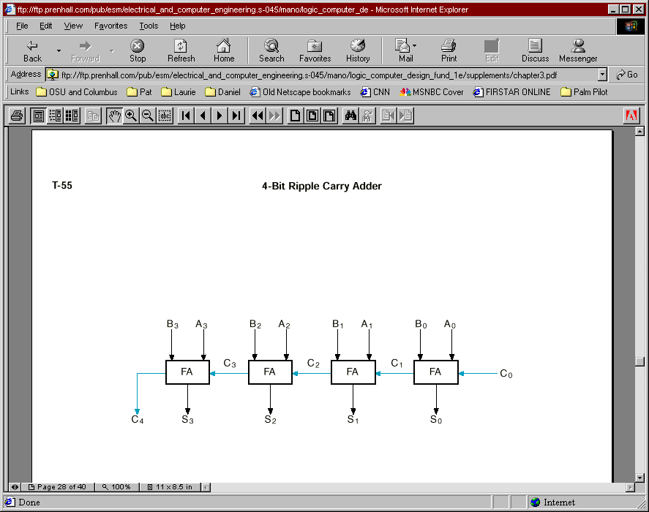
Example: 4-bit Ripple Carry Adder
C₄ C3 C2 C1 C0 A3 A2 A1 A0 +B3 B2 B1 B0 -------------- S3 S2 S1 S0

Slide 28
Delay Analysis of RCA
Carry out of a single stage can be implemented in 2 gate delays after CI is ready.
For a 16 bit adder, the 16th bit carry is generated after about 16 * 2 = 32 gate delays.
The sum bit takes one additional gate delay to generate the sum of the 16th bit after 15th bit carry
~ 15 * 2 + 1 = 31 gate delays
Takes too long - need to find FASTER adders!

Slide 29
Delay Analysis of RCA
late
arriving
signal
@0
A
@1
@N+1
@0
B
2 gate delays
to compute CO
(N>0)
@N
CI
CO
@0
A
@N+2
@0
B
@1
1 gate delay
to compute S
(N>0)
C
0
A
0
S
0
@2
@0
A
0
@0
B
0
C
@3
B
4 stage
adder
1
S
A
1
S
@4
@N
CI
@N+1
1
1
B
C
@5
1
2
A
2
S
@6
2
2
B
C
@7
2
3
A
3
S
3
@8
B
3
C
@9
3
4

Slide 30
Carry Lookahead Adder
Again, RCA delay can be too long for some applications
Need a faster adder
Idea: can we “look ahead” at (foresee, predict) the carry and not have to wait so long?
Carry Generate
Gi = Ai Bi must generate carry when Ai = Bi = 1
Carry Propagate
Pi = Ai xor Bi carry-in will equal carry-out here
Sum and Carry can be reexpressed in terms of carry generate and carry propagate:
Si = Ai xor Bi xor Ci = Pi xor Ci
Ci+1 = Ai Bi + Ci (Ai xor Bi)
= Gi + Ci Pi

Slide 31
Carry Lookahead Adder
C1 = G0 + P0 C0
C2 = G1 + P1 C1
= G1 + P1 G0 + P1 P0 C0
C3 = G2 + P2 C2
= G2 + P2 G1 + P2 P1 G0 + P2 P1 P0 C0
C4 = G3 + P3 C3
= G3 + P3 G2 + P3 P2 G1 + P3 P2 P1 G0 + P3 P2 P1 P0 C0
Each of the carry equations can be implemented in a two-level logic network
Each carry equation only needs the adder inputs and carry in for its own stage

Slide 32
Carry Lookahead Adder: Internal Circuit
C0
C0
C0
P0
C1
P0
P0
G0
P1
P1
P2
P2
G0
P3
C0
P1
G0
P0
P2
P1
P1
P2
G1
C3
P3
G0
C2
P2
G1
P1
P2
G2
P3
G1
G2
C4
P3
G3
Increasingly complex logic
High fan-in gates are very hard to make
Therefore, CLA is expensive

Slide 33
Delay Analysis of CLA
For i = 0:
@0
Ai
@0
Bi
Pi
@1
Ci
Si
@2
@0
Gi
@1
For i = 0:
@0
Ci
@1
Pi
Ci+1
@3
@1
Gi
For i > 0:
@0
Ai
@0
Bi
Pi
@1
Ci
Si
@t+1
@t
Gi
@1
For i > 0:
@0
@1
C0
@1
P0
P1
@1
G0
@1
P1
C2
@3
@1
G1

Slide 34
Delay Analysis of CLA
Ci’s are generated independent of N
C
0
@0
Ai
A
S
@2
@0
Bi
Pi
@1
0
0
0
B
0
C
@3
Si
@t+1
1
@0
Ci
A
1
S
@4
1
1
Gi
@1
B
C
@3
1
2
4 stage
adder
A
2
S
@4
2
2
B
C
@3
2
3
A
3
S
3
@4
B
3
C
@3
final sum and
carry
3
4
Note that FA’s are not directly connected!
Assumption: all gate delays are the same
Not true, delays depend on fan-ins and fan-out

Slide 35
Cascaded CLA
CLA
CLA
CLA

Slide 36
4-Bit Adder/Subtractor (with MUX)
A - B = A + (-B) = A + B’ + 1 (2’s complement)

Slide 37
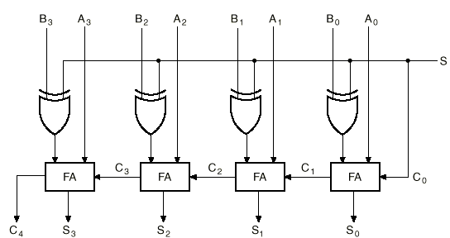
4-Bit Binary Adder/Subtractor (with XOR)
S=0
B₃
B₂
B₁
B₀
0
S=0 selects addition

Slide 38
4-bit Binary Adder/Subtractor (cont.)
S=1
B₃’
B₂’
B₁’
B₀’
1
S=1 selects subtraction

Slide 39
Overflow
Overflow can occur ONLY when both numbers have the same sign.
Unsigned numbers:
This condition can be detected when the carry out (C_{n}) is 1.
Signed numbers:
This condition can be detected when the carry out (C_{n}) is different than the carry at the previous position (C_{n-1}).

Slide 40
Overflow Detection in Signed 2’s Complement
Overflow condition is detected by comparing the carry values into and out of the sign bit (C_{n} and C_{n-1}).
n-bit Adder/Subtractor with Overflow Detection Logic
V
C_{n-1}
C_{n}
C
n-bit Adder/Subtractor
C =1 indicates overflow condition when adding/subtr. unsigned numbers.
V=1 indicates overflow condition when adding/subtr. signed (2’s complement) numbers

Slide 41
2x2-Bit Multiplier
It is small enough to use the truth table to design
A2 A1 B2 B1 P8 P4 P2 P1
0 0 0 0 0 0 0 0
0 1 0 0 0 0
1 0 0 0 0 0
1 1 0 0 0 0
0 1 0 0 0 0 0 0
0 1 0 0 0 1
1 0 0 0 1 0
1 1 0 0 1 1
1 0 0 0 0 0 0 0
0 1 0 0 1 0
1 0 0 1 0 0
1 1 0 1 1 0
1 1 0 0 0 0 0 0
0 1 0 0 1 1 1 0 0 1 1 0
1 1 1 0 0 1
A1
A2 B1
B2
P1
P2 P4
P8
block diagram
4-variable K-map
for each of the 4
output functions

Slide 42
2x2-Bit Multiplier (cont’d)
A2
A2
K-map for P8
K-map for P4
0 0
0 0
0 0
0 0
0 0
0 0
0 0
0 0
P4 = A2B2B1' + A2A1'B2
B1
B1
0 0
0 0
1 0
0 0
0 0
0 0
0 1
1 1
B2
P8 = A2A1B2B1
B2
A1
A1
A2
A2
K-map for P2
K-map for P1
0 0
0 0
0 0
1 1
0 0
0 1
0 0
1 0
P1 = A1B1
B1
B1
0 1
0 1
0 1
1 0
0 1
0 0
1 0
0 0
B2
P2 = A2'A1B2 + A1B2B1' + A2B2'B1 + A2A1'B1
B2
A1
A1

Slide 43
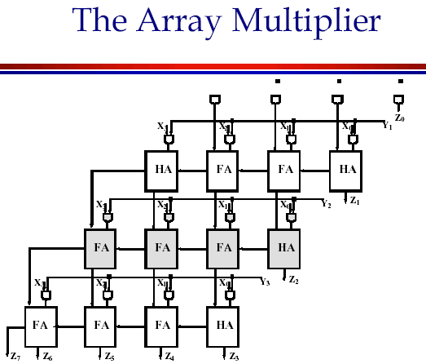

4x4-Bit Multiplier
Y0
Not small enough to use the truth table to design
X3 Y3
X3 Y2
X2 Y3
X3 Y1
X2 Y2
X1 Y3
X3
Y3
X3Y0
X2 Y1
X1 Y2
X0 Y3
X2
Y2
X2 Y0
X1 Y1
X0 Y2
X1
Y1
X1 Y0
X0 Y1
X0
Y0
X0 Y0
Z7
Z6
Z5
Z4
Z3
Z2
Z1
Z0

Slide 44
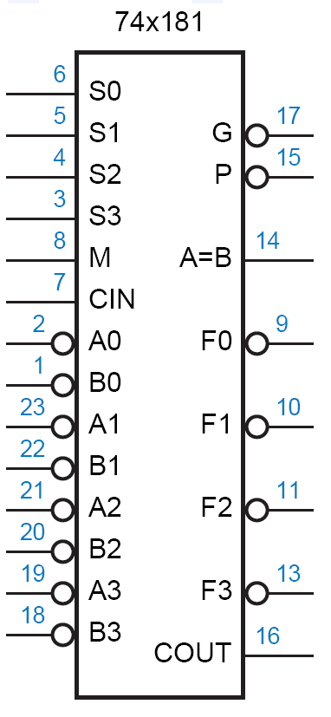
4-Bit ALU

Slide 45
4-Bit ALU
74181 TTL ALU
Arithmetic-Logic Unit

Slide 46
BCD Addition
Addition:
5 = 0101
3 = 0011
1000 = 8
5 = 0101
8 = 1000
1101 = 13
Problem
when digit
sum exceeds 9
Solution: add 6 (0110) if sum exceeds 9
5 = 0101
8 = 1000
1101
6 = 0110
1 0011 = 1 3 in BCD
9 = 1001
7 = 0111
1 0000 = 16 in binary
6 = 0110
1 0110 = 1 6 in BCD

Slide 47
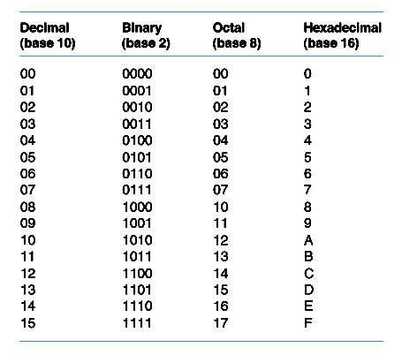
اعداد در مبناهاي مختلف
Add 0110 to sum whenever it exceeds 1001 (11XX or 1X1X)

Slide 48
BCD Adder
A
3
B
3
A
2
B
A
B
A
B
2
1
1
0
0
CO
F
A
CI
CO
F
A
CI
CO
F
A
CI
CO
F
A
CI
Cin
S
S
S
S
1
1XX
A1
1X1X
A2
CO
F
A
CI
CO
F
A
CI
0
S
S
Cout
S
S
S
S
3
2
1
0
Add 0110 to sum whenever it exceeds 1001 (11XX or 1X1X)

