Slide 1
Sequential Circuit Analysis

Slide 2
Synchronous vs. Asynch.
Synchronous sequential circuit:
  Its behavior can be determined knowing its input signals at discrete instants of time.
  Achieves synchronization among components by using a timing signal called the clock:
    Its outputs change synchronized with the clock
Asynchronous sequential circuit:
  Its behavior depends on the order of input signals changes over a continuous time
  There is no need for synchronization:
    No clock signal
    Its outputs can change at any time

Slide 3
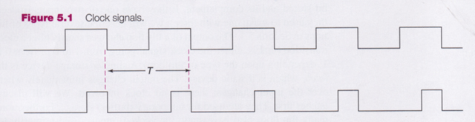
Clock Signal
Rising Clock Edge
Clock generator: Periodic train of clock pulses
Different duty cycles
Falling Clock Edge

Slide 4
Clock Signal
  Clock is distributed throughout the entire design
  Each component synchronizes itself with it

Slide 5
Synchronous Circuits
Combinational
Logic
clk
time

Slide 6
Sequential Circuit Analysis
Analysis:
  Obtaining a suitable description that demonstrates the time sequence of inputs, outputs, and states

Slide 7
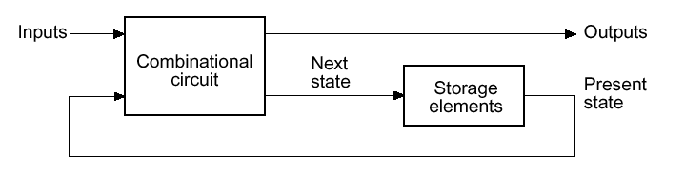
Sequential Circuits
  At each clock edge, the present state of the system is stored in storage elements (FFs)

Slide 8
Example 1
Input: x(t)
Output: y(t)
State: (A(t), B(t))
What is the Output Function?
What is the Next State Function?
x
D
Q
A
C
Q
A
D
Q
B
CP
C
Q
y

Slide 9
Example 1 (Cont’d)
Boolean equations for the functions:
  A(t+1) = A(t)x(t) + B(t)x(t)
  B(t+1) = A’(t)x(t)
  y(t) = x’(t) [B(t) + A(t)]
x
Q
A
D
C
Q
A’
Next State
D
Q
B
CP
C
Q'
y
Output

Slide 10
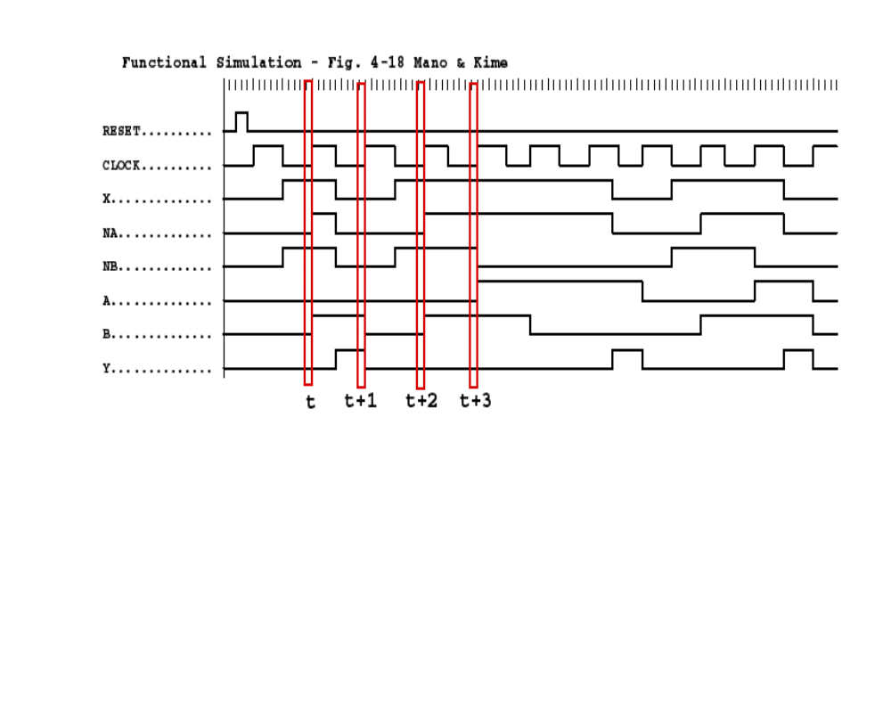
Example 1 (Cont’d)
  A(t+1) = A(t)x(t) + B(t)x(t)
  B(t+1) = A’(t)x(t)
  y(t) = x’(t) [B(t) + A(t)]
A(t), B(t)
A(t+1), B(t+1)
A(t), B(t)
1
A(t+1)
0
B(t+1)
1
0
0
0
1
0

Slide 11
State Table Definition
State table
  A multiple variable table with the following four sections:
  Present State
    the values of the state variables for each allowed state
  Input
    the input combinations allowed
  Next-state
    the value of the state at time (t+1) based on the present state and the input
  Output
    the value of the output as a function of the present state and (sometimes) the input

Slide 12
State Table Characteristics
From the viewpoint of a truth table:
  the inputs: Input, Present State
  the outputs: Output, Next State

Slide 13
State Table
Example:
  The state table can be filled in using the next state and output equations:
    A(t+1) = A(t)x(t) + B(t)x(t)
    B(t+1) =‾A (t)x(t)
    y(t) =‾x (t) [B(t) + A(t)]
Present State
Input
Next State
Output
A(t) B(t)
x(t)
A(t+1) B(t+1)
y(t)
0 0
0
0 0
0
0 0
1
0 1
0
0 1
0
0 0
1
0 1
1
1 1
0
1 0
0
0 0
1
1 0
1
1 0
0
1 1
0
0 0
1
1
1
1
1 0
0

Slide 14
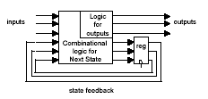
General Forms of Sequential Circuits (1)

Slide 15
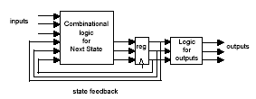
General Forms of Sequential Circuits (2)
Outputs depend on present state and inputs (Mealy machine)
Outputs depend on present state only (Moore machine)

Slide 16
Mealy vs. Moore Machines
Mealy model:
  Both outputs and next state depend on primary inputs AND present state
    Out = f(inputs, state)
    Top diagram in the previous slide
Moore model:
  Only next state depends directly on primary inputs AND present state. Outputs depend only on present state
    Out = f(state)
    Bottom diagram in the previous slide

Slide 17
Mealy/Moore Comparison
  Mealy machines react faster to inputs
    React in same cycle – don't need to wait for clock
    In Moore machines, more logic may be necessary to decode state into outputs – more gate delays after
  Moore machines are easier and safer to use
    Outputs change at clock edge (always one cycle later)
    In Mealy machines, input change can cause output change as soon as logic is done – a big problem when two machines are interconnected – asynchronous feedback

Slide 18
State Diagram
  The sequential circuit function can be represented in graphical form as a state diagram with the following components:
    A circle with the state name in it for each state
    A directed arc from the Present State to the Next State for each state transition
    A label on each directed arc with the Input values which causes the state transition, and
    A label:
      In each circle with the output value produced (Moore), or
      On each directed arc with the output value produced (Mealy).

Slide 19
State Diagram
Label form:
  In circle (for Moore machines):
    state/output
    Moore type output depends only on state
  On directed arc (for Mealy machines):
    input/output
    Mealy type output depends on state and input

Slide 20
Example: Mealy Model
State Diagram
0/0
1/0
I/O
00
01
S1
S2
0/1
Reads as:
When at state s1 and apply
input I, we get output O
and proceed to state s2.
0/1
0/1
1/0
10
1/0
11
1/0

Slide 21
Example: Moore Model
State Diagram
I
00,11
S1/O1
S2/O2
01,10
0/0
1/1
Reads as:
When at state s1 with output
O1 and apply input I,
we proceed to state s2 with
output O2.
01,10
00,11

Slide 22
State Diagram Example
x=0/y=0
x=0/y=1
  Which type?
x=1/y=0
A B
0 0
x=0/y=1
1 0
x=1/y=0
x=1/y=0
x=0/y=1
0 1
1 1
x=1/y=0

Slide 23
Example of a M…(?) Machine
Obtain the logic expression and state table for this circuit:
X
D_{A}
A
D
Z
Y
C
clock

Slide 24
Moore Machine Reminder
C2
C1
s(t+1)
z(t)
State Register(s)
next
state
s(t)
x(t)
present
state
present
inputs
clock

Slide 25
Example of a Moore Machine
Obtain the logic expression and state table for this circuit:
X
D_{A}
A
D
Z
Y
C
clock
  D_{A} = A ⊕ X ⊕ Y
  Z = A

Slide 26
Example of a Moore Machine (cont.)
State Table
Alternative State Table
Present State | Inputs |  | Next State | Output
A(t) | X | Y | A(t+1) | Z
0 | 0 | 0 | 0 | 0
0 | 0 | 1 | 1 | 0
0 | 1 | 0 | 1 | 0
0 | 1 | 1 | 0 | 0
1 | 0 | 0 | 1 | 1
1 | 0 | 1 | 0 | 1
1 | 1 | 0 | 0 | 1
1 | 1 | 1 | 1 | 1
Present State | Next State |  |  |  | Output
 | XY=00 | XY=01 | XY=10 | XY=11
A(t) | A(t+1) | A(t+1) | A(t+1) | A(t+1) | Z
0 | 0 | 1 | 1 | 0 | 0
1 | 1 | 0 | 0 | 1 | 1
X
D_{A}
A
Y
D
Z
  D_{A} = A ⊕ X ⊕ Y
  Z = A
C
clock

Slide 27
Mealy Machine Reminder
C1
C2
s(t+1)
State Register(s)
next
state
s(t)
x(t)
present
state
z(t)
present
inputs
clock

Slide 28
Example: Mealy Model
Draw the state diagram of the machine whose state table is like this:
State Table
Present State |  | Input | Next State |  | Output
A(t) | B(t) | X | A(t+1) | B(t+1) | Y
0 | 0 | 0 | 0 | 0 | 0
0 | 0 | 1 | 0 | 1 | 0
0 | 1 | 0 | 0 | 0 | 1
0 | 1 | 1 | 1 | 1 | 0
1 | 0 | 0 | 0 | 0 | 1
1 | 0 | 1 | 1 | 0 | 0
1 | 1 | 0 | 0 | 0 | 1
1 | 1 | 1 | 1 | 0 | 0
Possible states = {00, 01, 10, 11}
→ 4 nodes in state diagram

Slide 29
Example: Mealy Model (cont.)
State Diagram
Present State |  | Input | Next State |  | Output
A(t) | B(t) | X | A(t+1) | B(t+1) | Y
0 | 0 | 0 | 0 | 0 | 0
0 | 0 | 1 | 0 | 1 | 0
0 | 1 | 0 | 0 | 0 | 1
0 | 1 | 1 | 1 | 1 | 0
1 | 0 | 0 | 0 | 0 | 1
1 | 0 | 1 | 1 | 0 | 0
1 | 1 | 0 | 0 | 0 | 1
1 | 1 | 1 | 1 | 0 | 0
0/0
1/0
00
01
0/1
0/1
0/1
1/0
10
1/0
11
1/0

Slide 30
Example: Moore Model
State Table
Present State | Inputs |  | Next State | Output
A(t) | X | Y | A(t+1) | Z
0 | 0 | 0 | 0 | 0
0 | 0 | 1 | 1 | 0
0 | 1 | 0 | 1 | 0
0 | 1 | 1 | 0 | 0
1 | 0 | 0 | 1 | 1
1 | 0 | 1 | 0 | 1
1 | 1 | 0 | 0 | 1
1 | 1 | 1 | 1 | 1
Possible states = {0, 1}
→ 2 nodes in state diagram

Slide 31
Example: Moore Model (cont.)
Present State | Inputs |  | Next State | Output
A(t) | X | Y | A(t+1) | Z
0 | 0 | 0 | 0 | 0
0 | 0 | 1 | 1 | 0
0 | 1 | 0 | 1 | 0
0 | 1 | 1 | 0 | 0
1 | 0 | 0 | 1 | 1
1 | 0 | 1 | 0 | 1
1 | 1 | 0 | 0 | 1
1 | 1 | 1 | 1 | 1
State Diagram
00,11
01,10
0/0
1/1
01,10
00,11

Slide 32
State Tables for JK Flip-Flops
Two-step procedure:
  Obtain binary values of each FF input equation in terms of present state and input variables.
  Use corresponding FF characteristic table to determine the next state.

Slide 33
Example
  J_{A} = B, K_{A} = BX’
  J_{B} = X’, K_{B} = AX’ + A’X = A ⊕ X
→ 2 JK-FFs:
JK-FF Characteristic Table
J | K | Q(t+1)
0 | 0 | Q(t)
0 | 1 | 0
1 | 0 | 1
1 | 1 | Q(t)’
J_{A}
J
A
J_{B}
J
B
C
C
K_{A}
K
A’
K_{B}
K
B’

Slide 34
Example (cont.)
Present State |  | Input | Next State |  | FF inputs
A(t) | B(t) | X | A(t+1) | B(t+1) | J_{A} | K_{A} | J_{B} | K_{B}
0 | 0 | 0 |  |  | 0 | 0 | 1 | 0
0 | 0 | 1 |  |  | 0 | 0 | 0 | 1
0 | 1 | 0 |  |  | 1 | 1 | 1 | 0
0 | 1 | 1 |  |  | 1 | 0 | 0 | 1
1 | 0 | 0 |  |  | 0 | 0 | 1 | 1
1 | 0 | 1 |  |  | 0 | 0 | 0 | 0
1 | 1 | 0 |  |  | 1 | 1 | 1 | 1
1 | 1 | 1 |  |  | 1 | 0 | 0 | 0
  J_{A} = B, K_{A} = BX’
  J_{B} = X’, K_{B} = AX’ + A’X = A ⊕ X
Step 1:
Use FF input equations

Slide 35
Example (cont.)
Present State |  | Input | Next State |  | FF inputs
A(t) | B(t) | X | A(t+1) | B(t+1) | J_{A} | K_{A} | J_{B} | K_{B}
0 | 0 | 0 | 0 | 1 | 0 | 0 | 1 | 0
0 | 0 | 1 | 0 | 0 | 0 | 0 | 0 | 1
0 | 1 | 0 | 1 | 1 | 1 | 1 | 1 | 0
0 | 1 | 1 | 1 | 0 | 1 | 0 | 0 | 1
1 | 0 | 0 | 1 | 1 | 0 | 0 | 1 | 1
1 | 0 | 1 | 1 | 0 | 0 | 0 | 0 | 0
1 | 1 | 0 | 0 | 0 | 1 | 1 | 1 | 1
1 | 1 | 1 | 1 | 1 | 1 | 0 | 0 | 0
Step 2:
Use FF inputs and JK characteristic table

Slide 36
Example 2: Sequential Circuit Analysis
A
  Logic Diagram:
  Mealy or
  Moore?
D
Q
Z
C
R
Q
B
D
Q
C
R
Q
C
D
Q
Clock
C
R
Q
Reset

Slide 37
Example 2: Flip-Flop Input Equations
Variables
  Inputs: None
  Outputs: Z
  State Variables: A, B, C
Initialization:
  Reset to (0,0,0)
Equations
  A(t+1) = ?
  B(t+1) = ?
  C(t+1) = ?
  Z = ?
  BC
  B’C+BC’
  A’C’
  A
Notes:
A(t+1) = BC B(t+1) = B’C + BC’ C(t+1) = A’C’ Z = A

Slide 38
Example 2: State Table
A B C | A⁺B⁺C⁺ | Z
0 0 0
0 0 1
0 1 0
0 1 1
1 0 0
1 0 1
1 1 0
1 1 1
S⁺=S(t+1)
Notes:
A’B’C’: 0 0 1, 0 1 0, 0 1 1, 1 0 0, 0 0 0, 0 1 0, 0 1 0, 1 0 0
Z: 0 0 0 0 1 1 1 1

Slide 39
Example 2: State Diagram
ABC
Reset
000
111
100
001
011
010
101
Which states are used?
What is the function of
the circuit?
110
Notes:
Only states reachable from the reset state 000 are used: 000, 001, 010, 011, and 100.
The circuit produces a 1 on Z after four clock periods and every five clock periods thereafter:
000 -> 001 -> 010 -> 011 -> 100 -> 000 -> 001 -> 010 -> 011 -> 100 …
1 1

Slide 40
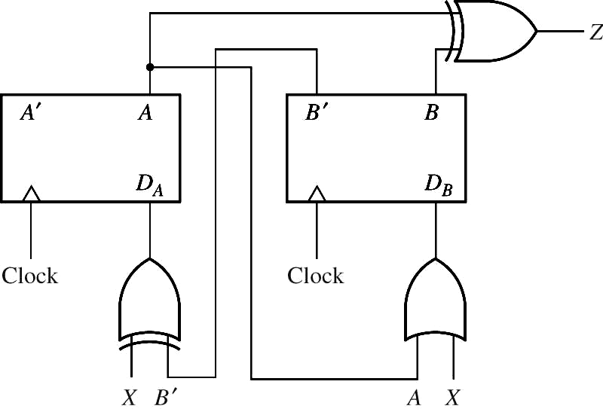











Example 3
Mealy or Moore?
00 01 11 10 | 01 00 11 01 11 11 01 | 0 1 0 1
Present
State
Next state
Present
Output(z)

Slide 41
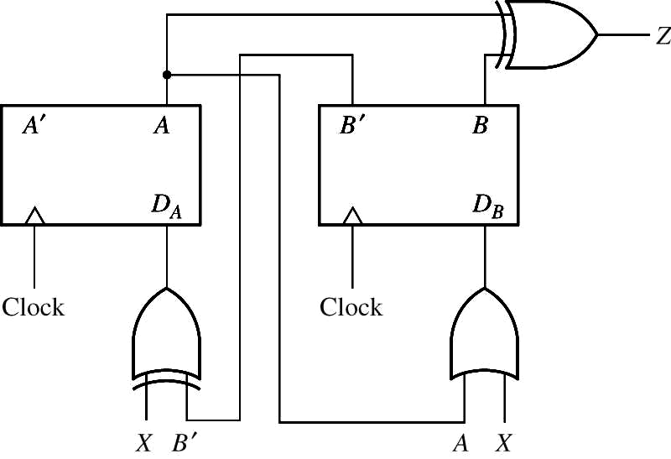
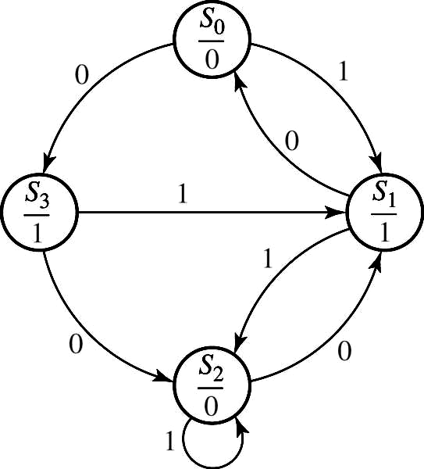
Example 3
Present State | Next state | Present Output(z)

Slide 42
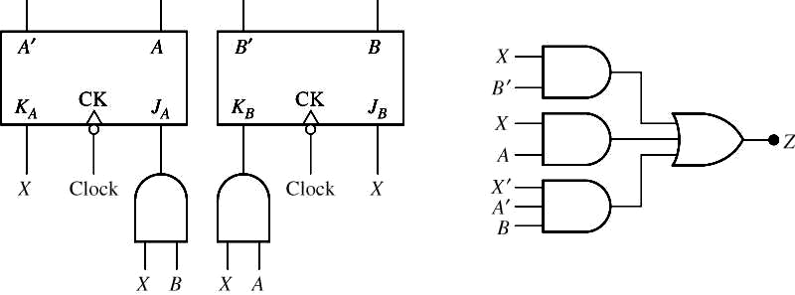



Example 4
  Mealy or Moore?
Present
State
Next state
Present
Output(z)
00
01
11
10
00 01
01 11
11 00
10 01
0 1
1 0
0 1
0 1

Slide 43
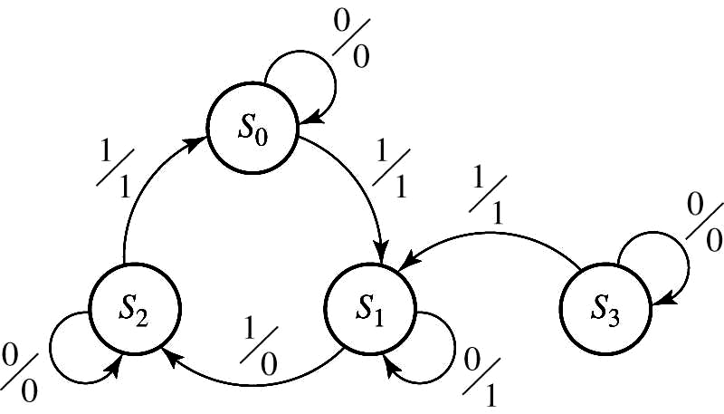
Example 4
Present State | Next state | Present Output(z)

Slide 44
Circuit Analysis by Signal Tracing
Waveforms

Slide 45
Analysis by Signal Tracing
Output tracing
  Assume an initial state of FF
  For the first input in the given sequence, determine the output and FF inputs
  Determine the new sets of FF states after the next clock edge
  Determine the output that corresponds to the new states
  Repeat 2,3,4 for each in the given sequence

Slide 46
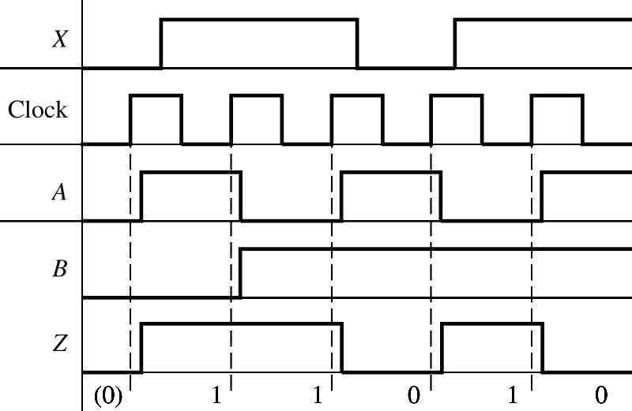
Example
Timing Chart for a Moore Machine
X = 0 1 1 0
A = 0 1 0 1 0 1
B = 0 0 1 1 1 1
Z = (0) 1 1 0 1 0

Slide 47
Timing Chart
Construction and interpretation of a timing chart:
  A state change can only occur after the rising (or falling) edge of the clock.
  The input will normally be stable immediately before and after the active clock edge.
  For a Mealy circuit, the output can change when the input changes as well as when the state changes.
    A false output may occur between the state changes and the time the input changes to its new value.
  False outputs are difficult to determine from the state diagram, so sometimes have to use signal tracing (timing chart).

Slide 48
Timing Charts
  When using a Mealy state table for constructing timing charts, the procedure is as follows:
    For the given input value, read the present output and plot it.
      If the input changes many times before clock edge, plot the effects on output.
    After the active clock edge, change the state according to the next state function.
    Repeat steps (a) and (b).
  For Mealy circuits, the best time to read the output is just before the active edge of the clock, because the output should always be correct at that time.

Slide 49
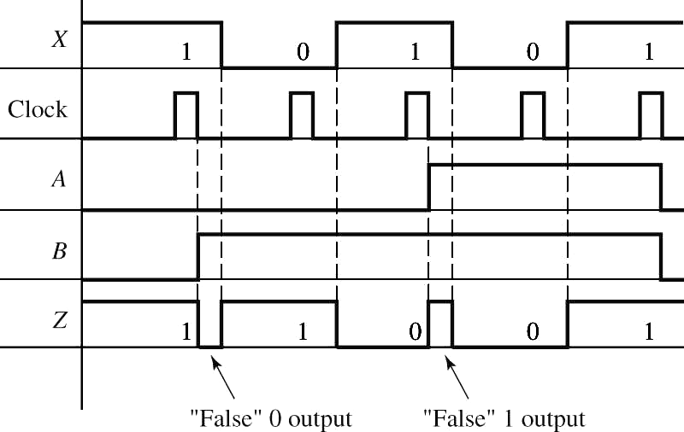
Example
Timing Chart for a Mealy Machine
J_{A}=0
K_{A}=1
J_{B}=1
K_{B}=0
➔ Reset A, Set B
(False outputs are indicated in parentheses)
X = 1 0 1 0 1
A = 0 0 0 1 1 0
B = 0 1 1 1 1 0
Z = 1(0) 1 0(1) 0 1

Slide 50
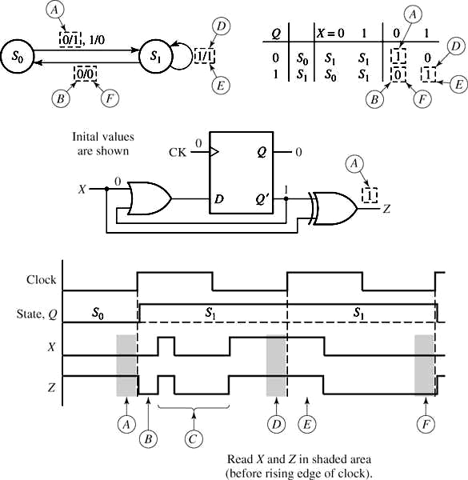
Example

Slide 51
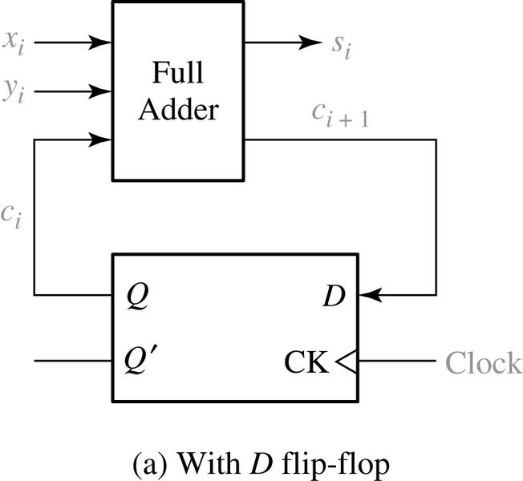
Example: Serial Adder
x_{i} y_{i} c_{i} | c_{i+1} s_{i}
0 0 0 0 0 1 0 1 0 0 1 1 1 0 0 1 0 1 1 1 0 1 1 1 | 0 0 0 1 0 1 1 0 0 1 1 0 1 0 1 1
(b) Truth table
What kind of machine (Mealy or Moore)?

Slide 52
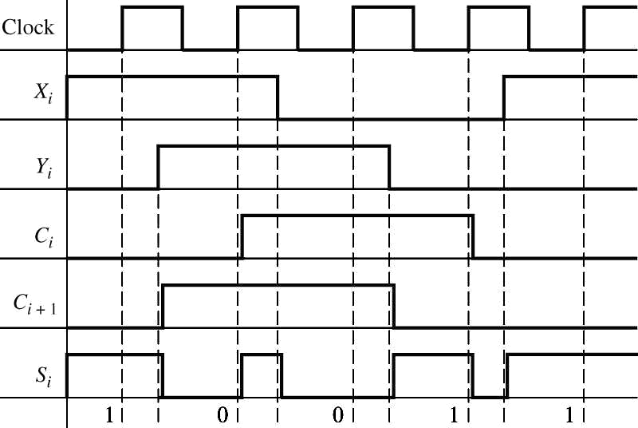
Serial Adder Timing Diagram
  S_{i} can be read before the rising edge of clock
    Before 2nd clock edge: X_{i}=Y_{i}=1, C_{i}=0 → S_{i}=0, C_{i+1}=1
    After clock: C_{i+1} → C_{i} , X_{i} still has its old value → S_{i}
  momentarily changes to a wrong value

Slide 53
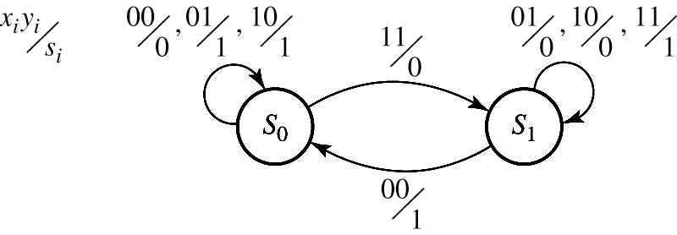
Serial Adder
State Diagram
S₀: Q = 0
S₁: Q = 1

Slide 54





State Tables
Example of a state table with multiple inputs and outputs:
(2 state variables => 4 states, 2 inputs, 2 outputs)
Present State | Next state | Outputs

Slide 55
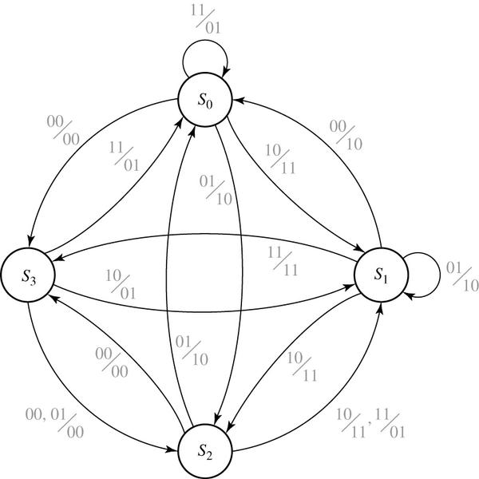
State Diagram
The state diagram of the previous example

Slide 56
Mealy Machine State Diagrams
A CLARIFICATION:
  The state diagram notation for output values in Mealy machines is a little misleading:
    You should remember that the listed output value is produced continuously when the machine is in the indicated state and has the indicated input, not just during the transition to the next state.

