Slide 1
Hazard

Slide 2
شکل موج ها
  تا به حال تاخير گيت ها در نظر گرفته نمي شدند:
    تاخير صفر: غير واقعي
    يا علاقه به دانستن رفتار حالت پايدار
      فرض: ورودي ها براي مدت طولاني (نسبت به تاخيرالمان هاي مدار) پايدار بوده اند.
t₀
t₁
t₂
t₃
t₄
t₅
t₆
A
1
0
1
B
0
F=A•B
1
0
G=A+B
1
0
H=A’
1
0

Slide 3
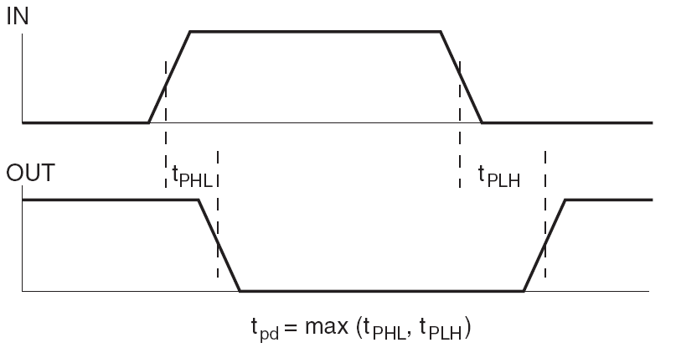
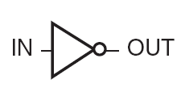

تاخير
تاخير در مدارها

Slide 4
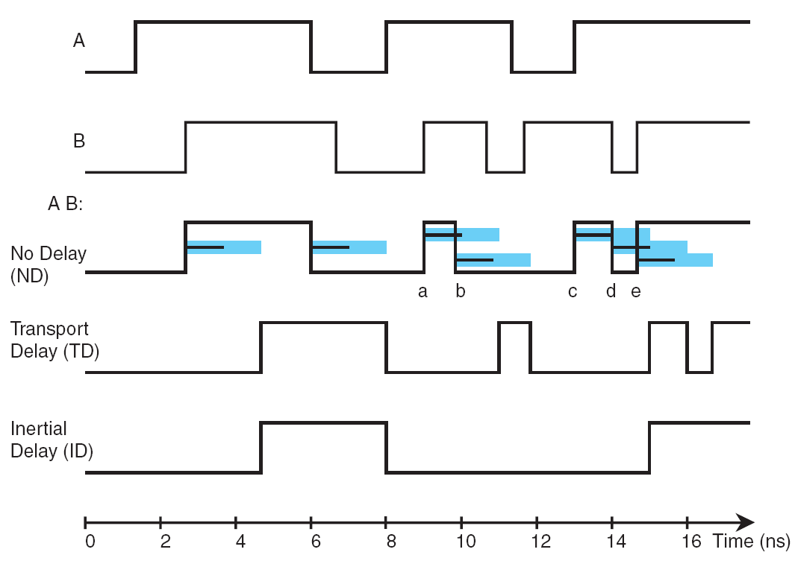
تاخيرها
Inertial Delay
Transport Delay

Slide 5
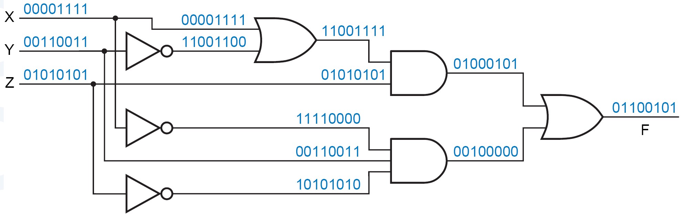
شکل موج ها
t₀
t₁
t₂
t₃
t₄
t₅
t₆
x
1
0
1
y
0
z
1
0
F
1
0

Slide 6
Hazard
  تاخيرها ممکن است باعث پالس‌هاي ناخواسته شوند
    Glitch
هازارد:
  مداري که احتمال ايجاد glitch در آن هست، هازارد دارد.
دو نوع:
  استاتيک
  ديناميک

Slide 7
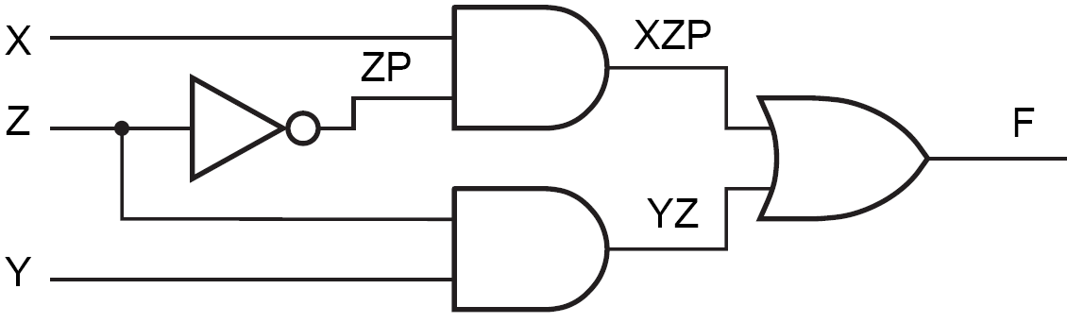
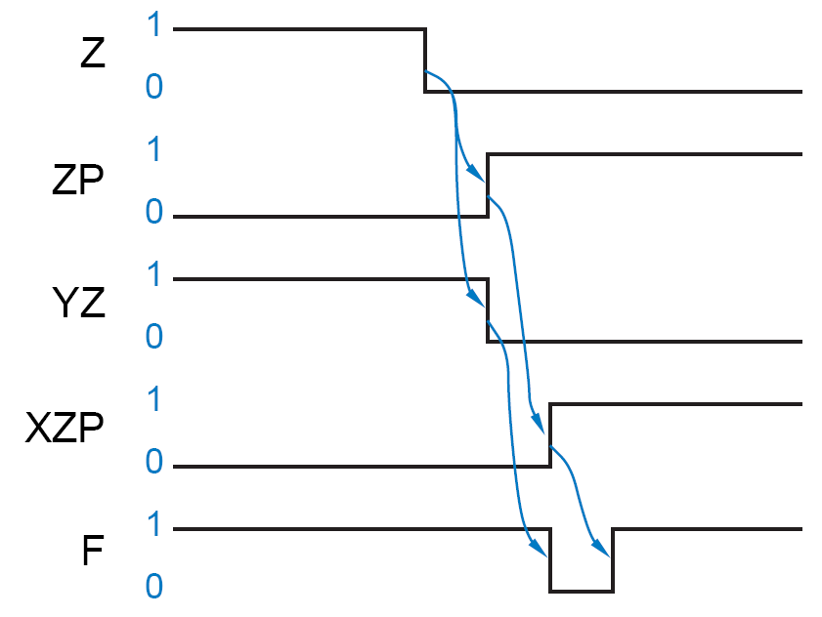
مثال
Initially:
X=Y=Z=1

Slide 8
Static Hazard
Informal Definition:
  A static-1 hazard is the possibility of a 0 glitch when we expect the output to remain at a nice steady 1 based on a static analysis
Formal Definition:
  A static-1 hazard is a pair of input combinations that:
    (a) differ in only one input variable and
    (b) both give a 1 output such that it is possible for a momentary 0 output to occur during a transition in the differing input variable.

Slide 9
مثال
  Even though “static” analysis predicts that the output is 1 for both input combinations
  X,Y,Z = 111 and X,Y,Z = 110,
  F goes to 0 for one time unit.

Slide 10
Static-0 Hazard
  A static-0 hazard is just the dual of a static-1 hazard
  A properly designed two-level sum-of-products (AND-OR) circuit can have no static-0 hazards
  An OR-AND circuit that is the dual of the example circuit could potentially have a static-0 hazard

Slide 11
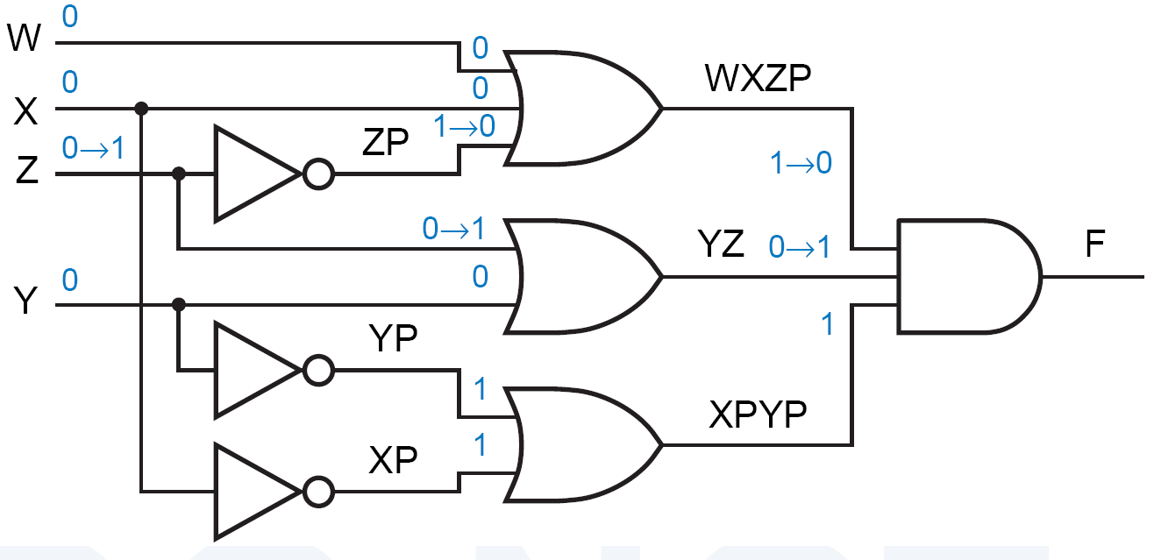
مثال
تحليل کنيد:

Slide 12
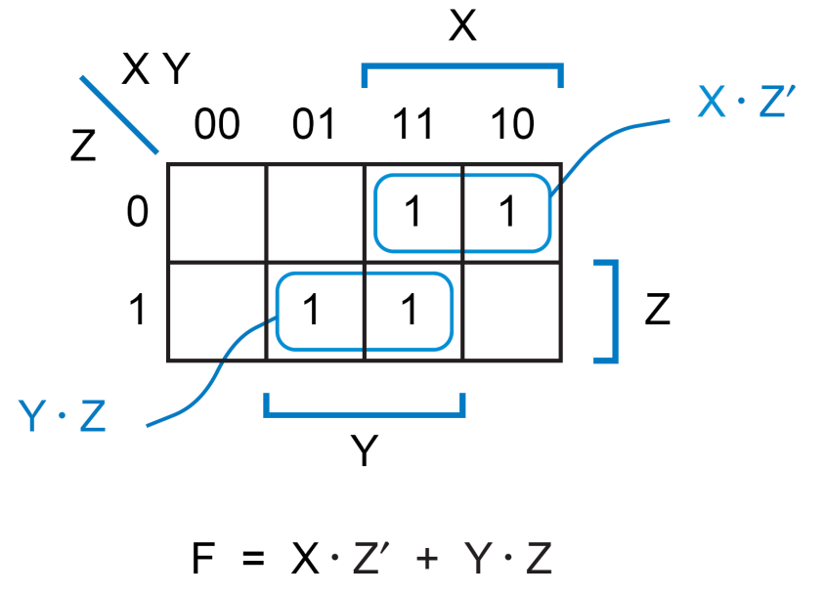
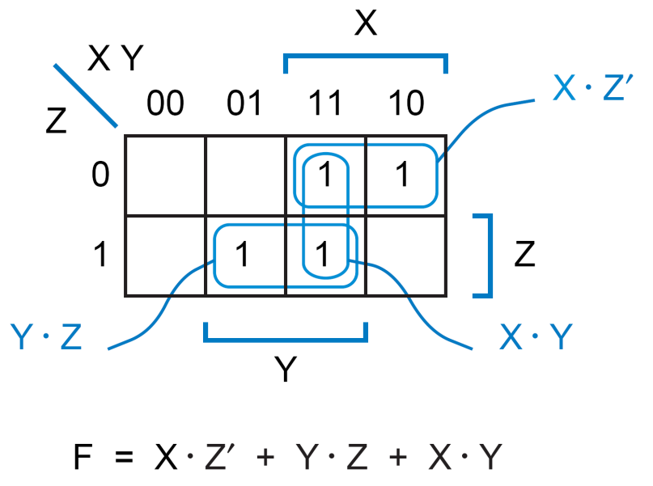
تشخيص هازارد
  A Karnaugh map can be used to detect static hazards in a two-level SoP or PoS circuit:

Slide 13
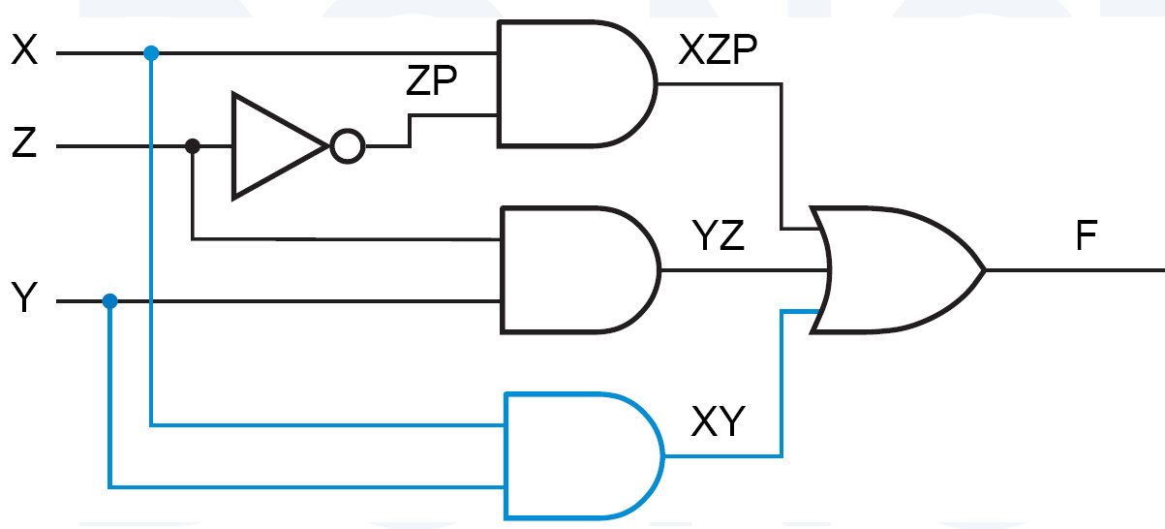

رفع هازارد
  Note the tradeoff between determinism and cost (number of gates)!

Slide 14
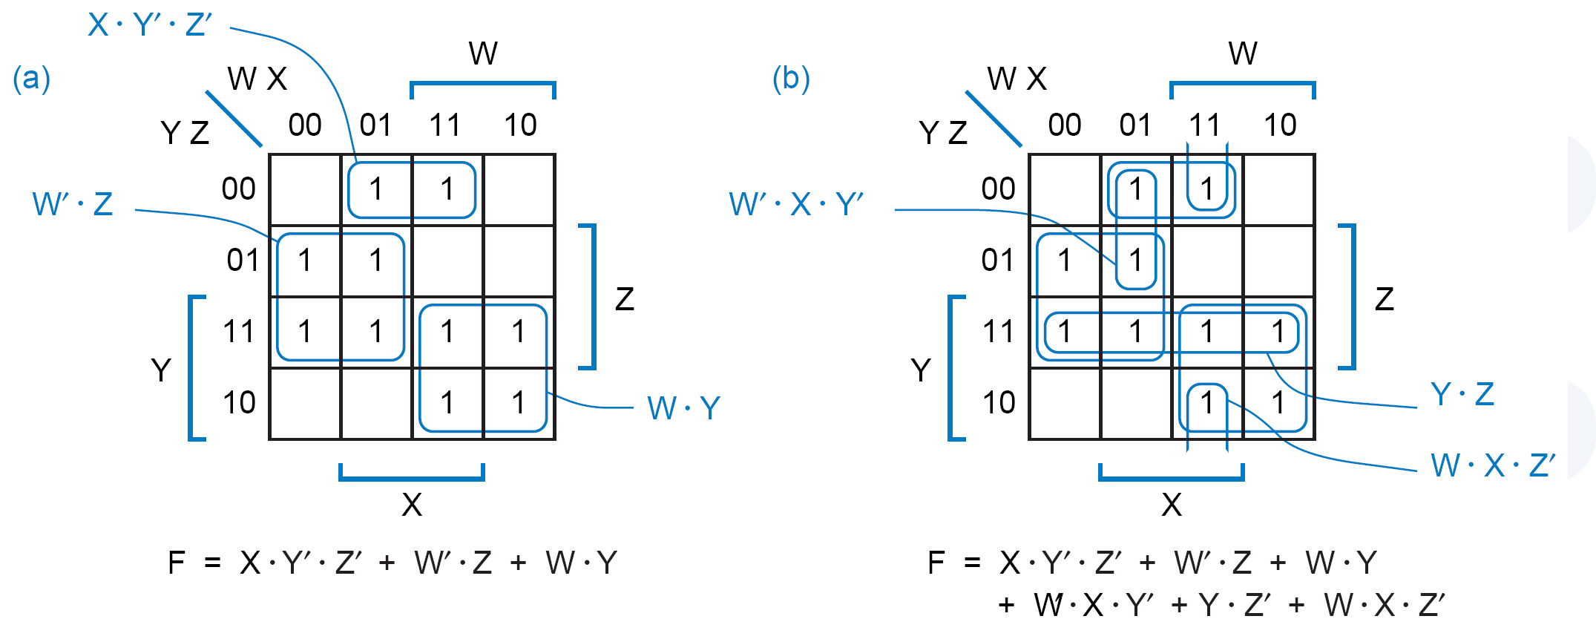
مثال

Slide 15
Dynamic Hazard
Dynamic hazard:
  The possibility of an output changing more than once as the result of a single input transition.
    Multiple output transitions can occur if there are multiple paths with different delays from the changing input to the changing output.

Slide 16
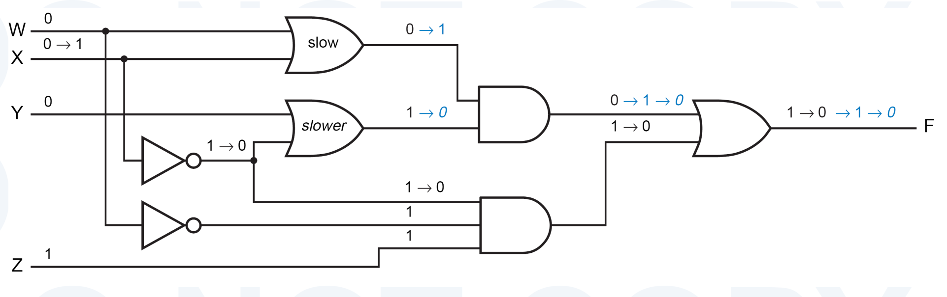
مثال
  سه مسير از X به F با سه تاخیر مختلف
  W,X,Y,Z = 0,0,0,1 ← F=1
  فرض: X يک شود.
  فرض: دو OR میانی کند و بقيه گيت‌ها عادی هستند.
    اول تغييرات مشکي ← F=0
    بعد آبي غير ايتاليک
    بعد آبي ايتاليک

Slide 17
Hazard-Free Design
  Techniques for finding hazards in arbitrary circuits, are rather difficult to use.
    → when you require a hazard-free design, it’s best to use a circuit structure that is easy to analyze.
  In particular, two-level AND-OR circuit has no static-0 or dynamic hazards.
  Static-1 hazards may exist in such a circuit but they can be found and eliminated using K-map.

Slide 18
نکته
Most Hazards are not hazardous:
  A well-designed, synchronous digital system is structured so that hazard analysis is not needed for most of its circuits.
  In a synchronous system, all of the inputs to a combinational circuit are changed at a particular time, and the outputs are not “looked at” until they have had time to settle to a steady-state value.
  Hazard analysis and elimination are typically needed only in the design of asynchronous sequential circuits.
  Asynchronous circuits are not the mainstream but if you want to design them, an understanding of hazards will be absolutely essential for a reliable result.

Slide 19
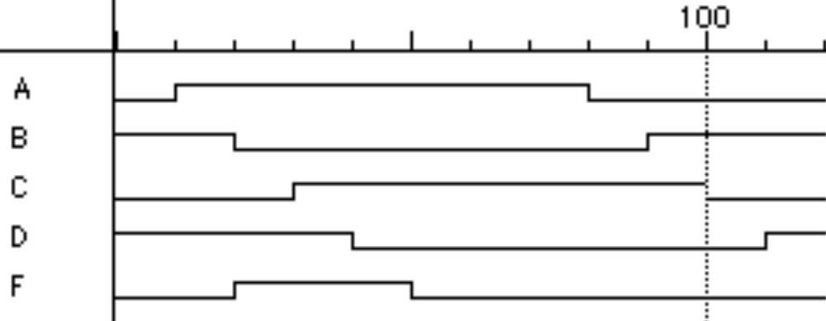
Pulse-Shaping Circuit
A
B
C
D
F
A' •A = 0
3 gate delays
D remains high for
three gate delays after
A changes from low to high
F is not always 0!

