Slide 1


Assignment #3
Password Cracking
Dr: Nabil Ismail By :Amira Mohamed Menshawy

Slide 2
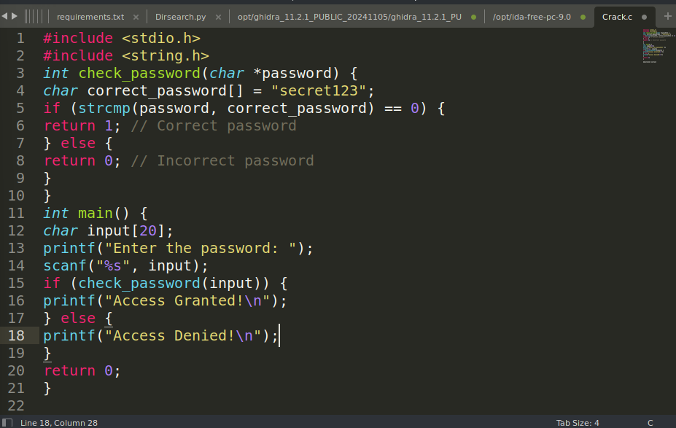
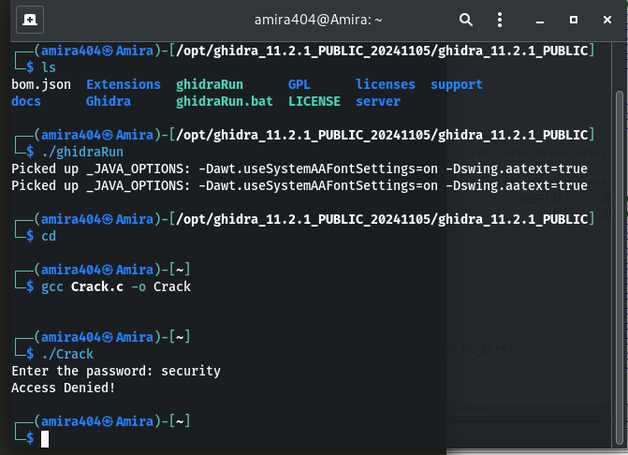
the main function initializes the program, manages user input, and interprets the result of the password check to determine access.
you need to compile the Crack.c source code into an executable file. This can be done using the gcc compiler .
Access Denied
I could not access (By normal way )because I do not know the password!

Slide 3
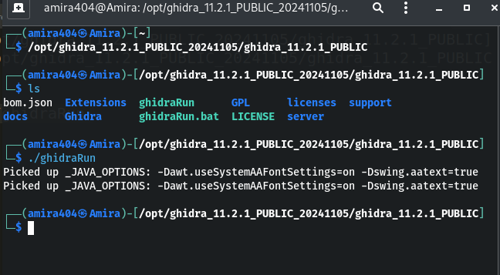
Let's use a reverse engineering tool to crack the password.
After Instullation Let’s Run Ghidra tool
/opt/ghidra_11.2.1_PUBLIC_20241105/ghidra_11.2.1_PUBLIC
./ghidraRun
Path to Ghidra
Run Ghidra

Slide 4
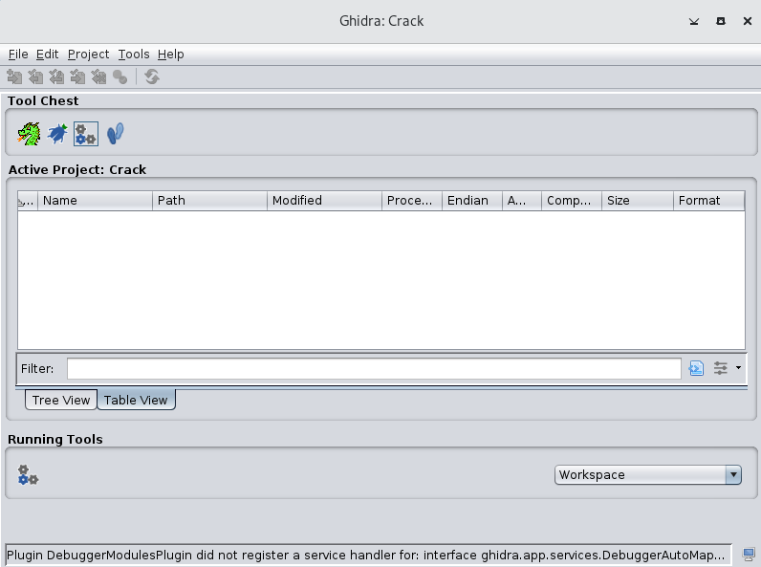
Now the Ghidr tool is ready to use.

Slide 5
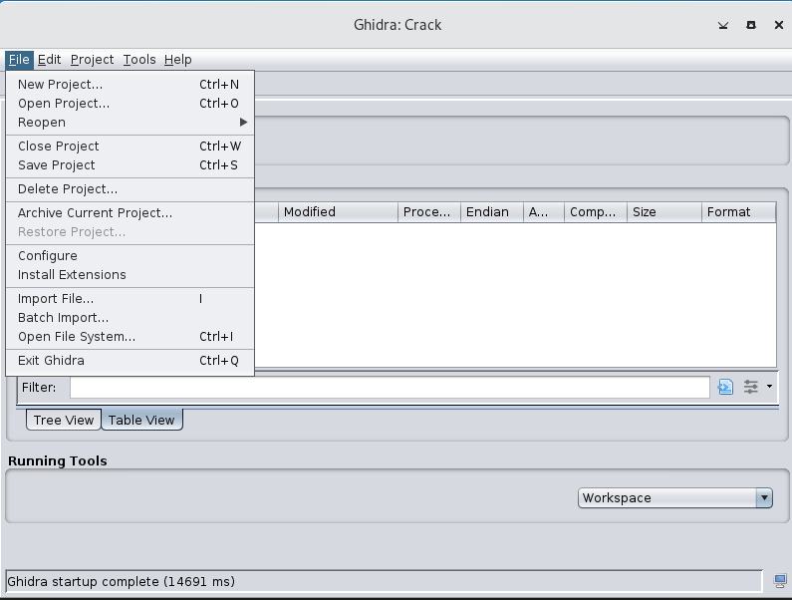
Let’s Crack the password on Ghaidra
1) File 2)New Project

Slide 6
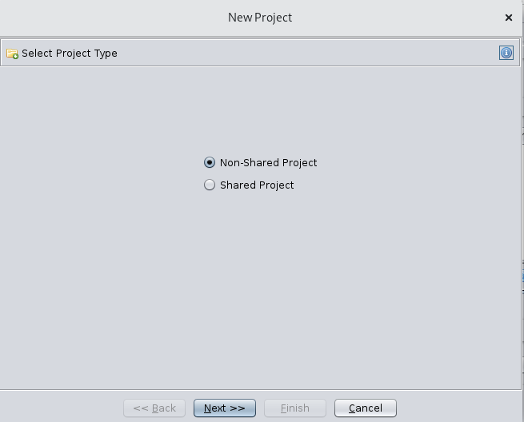

Slide 7
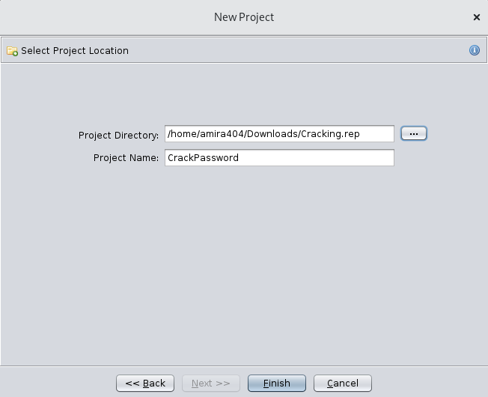
Enter a project name and select where to save it, Then Click Finish

Slide 8
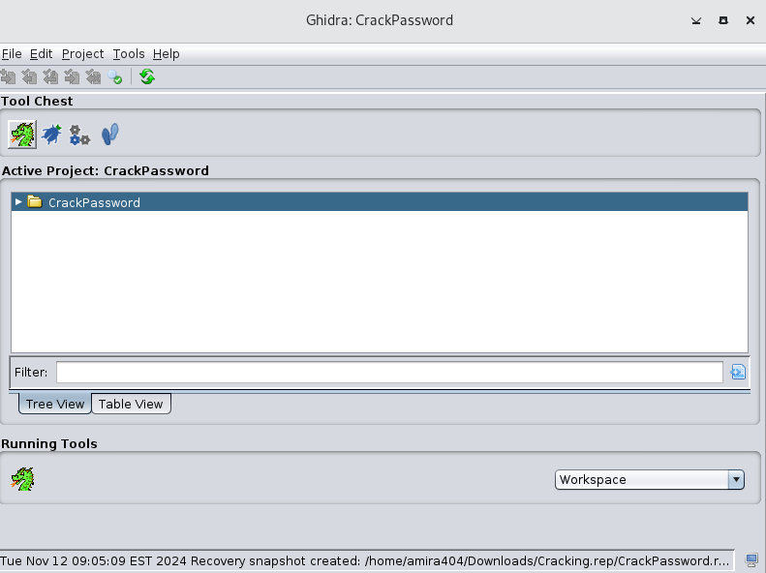

Slide 9
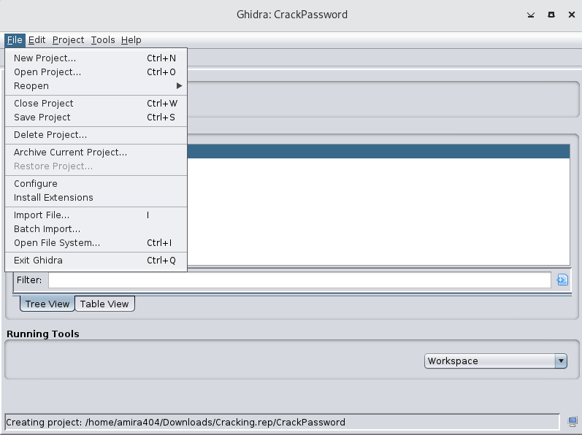

Slide 10
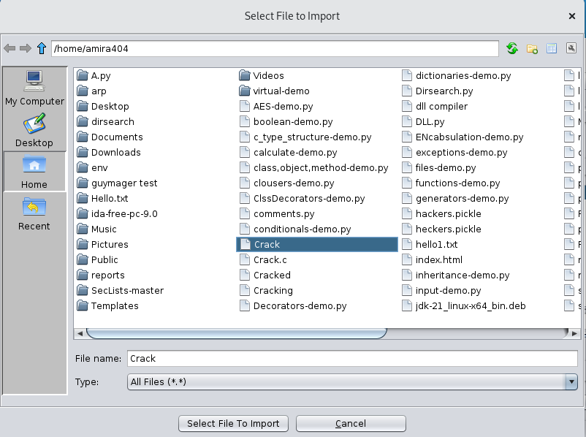

Slide 11
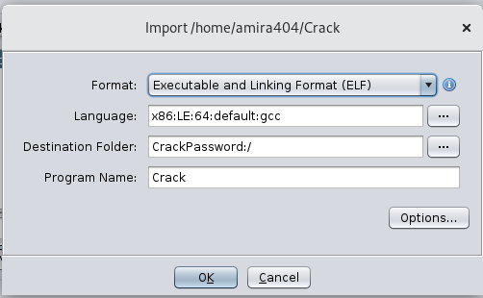
Format selected outomatic Due to Using gcc

Slide 12
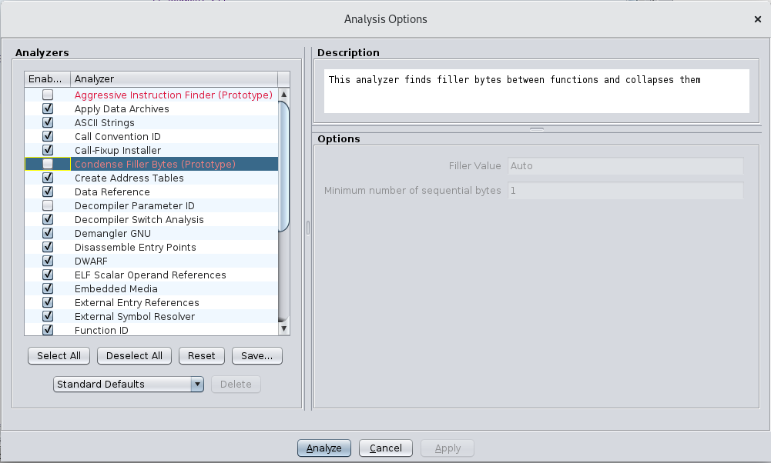

Slide 13
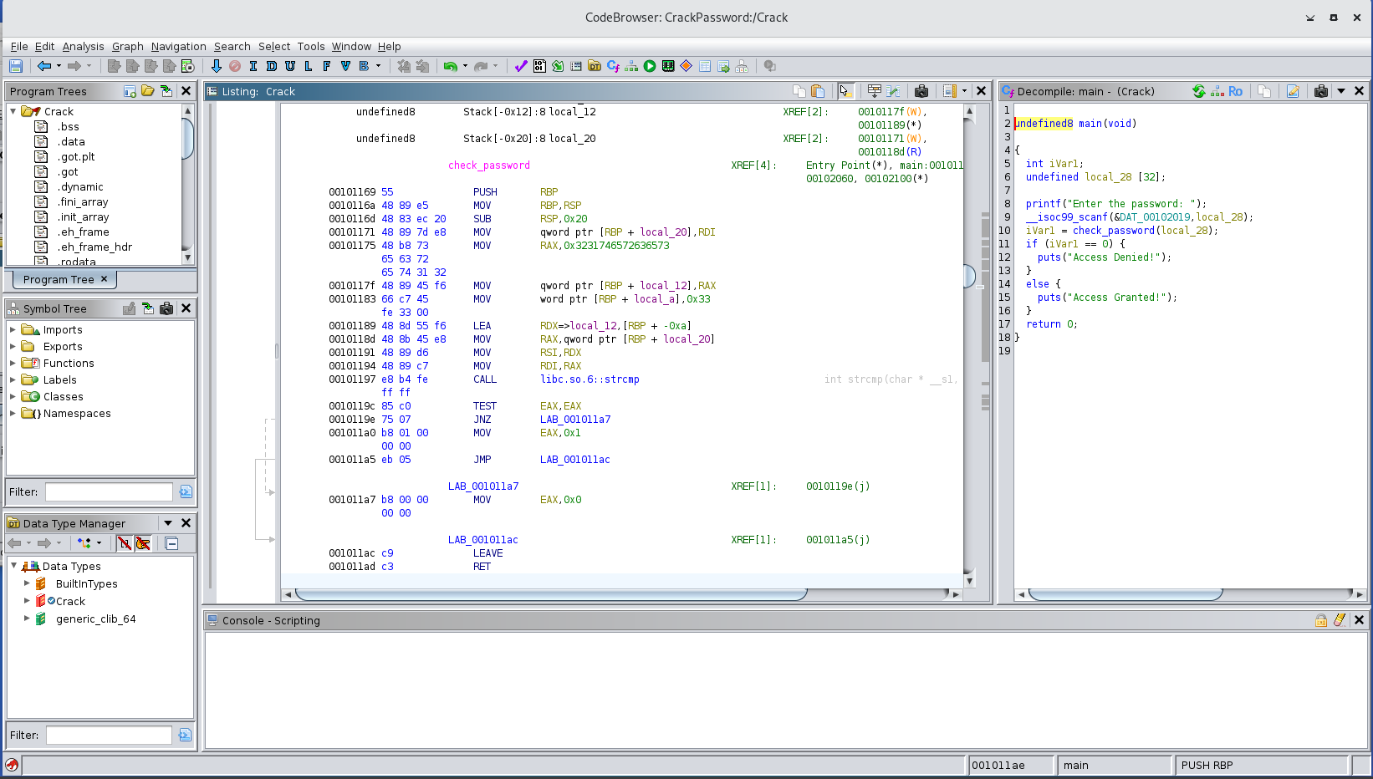
Search For Check_Password Function

Slide 14
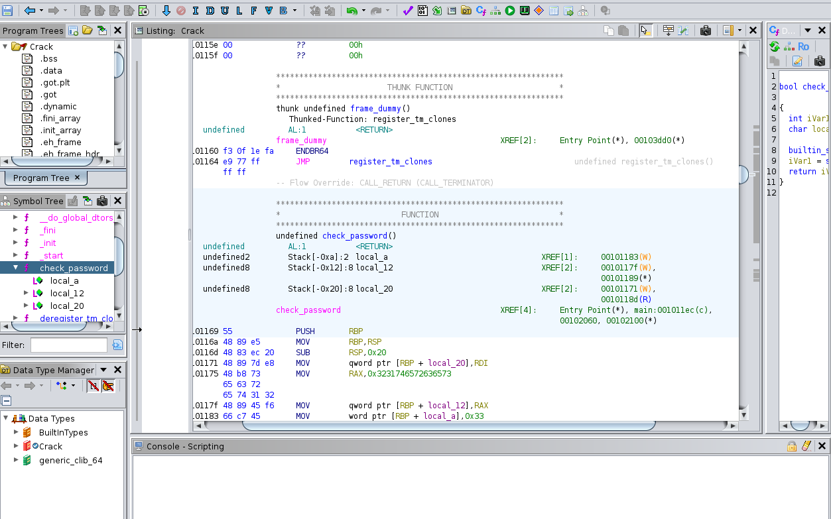

Slide 15
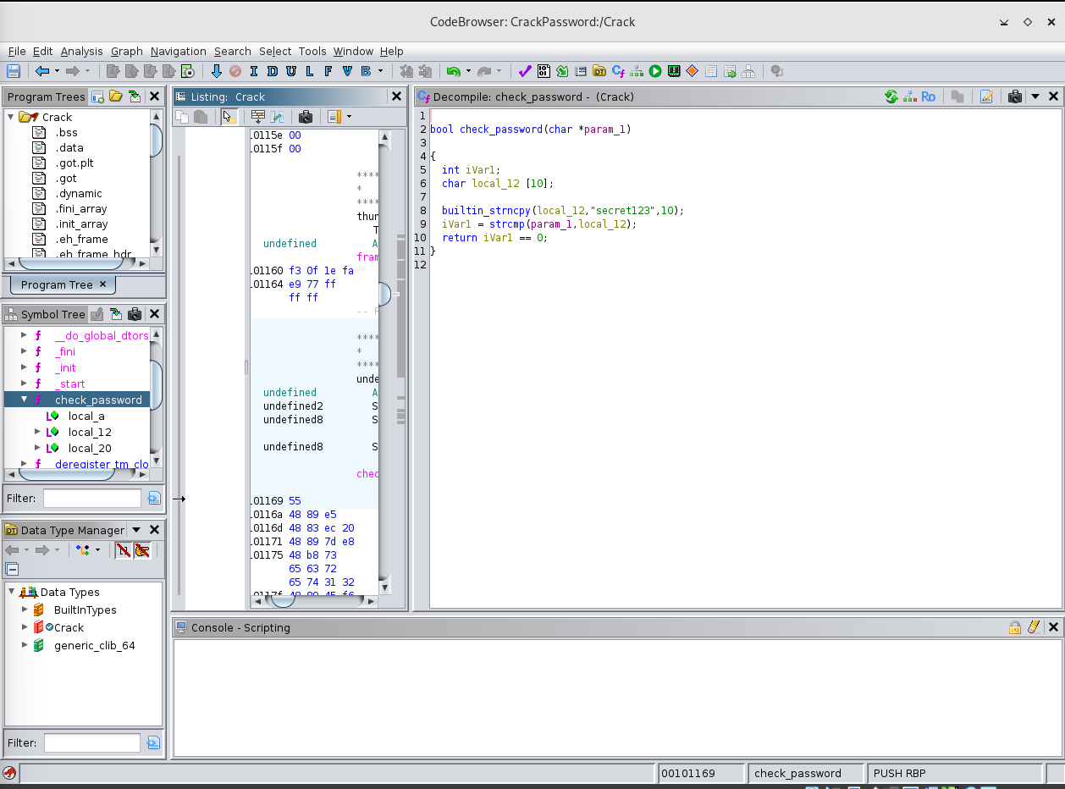
Password Cracked by decompiler

Slide 16
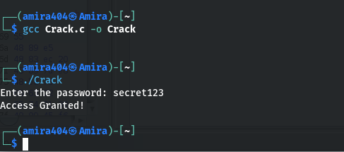
Access Granted
It works we have successfully cracked the password

Slide 17
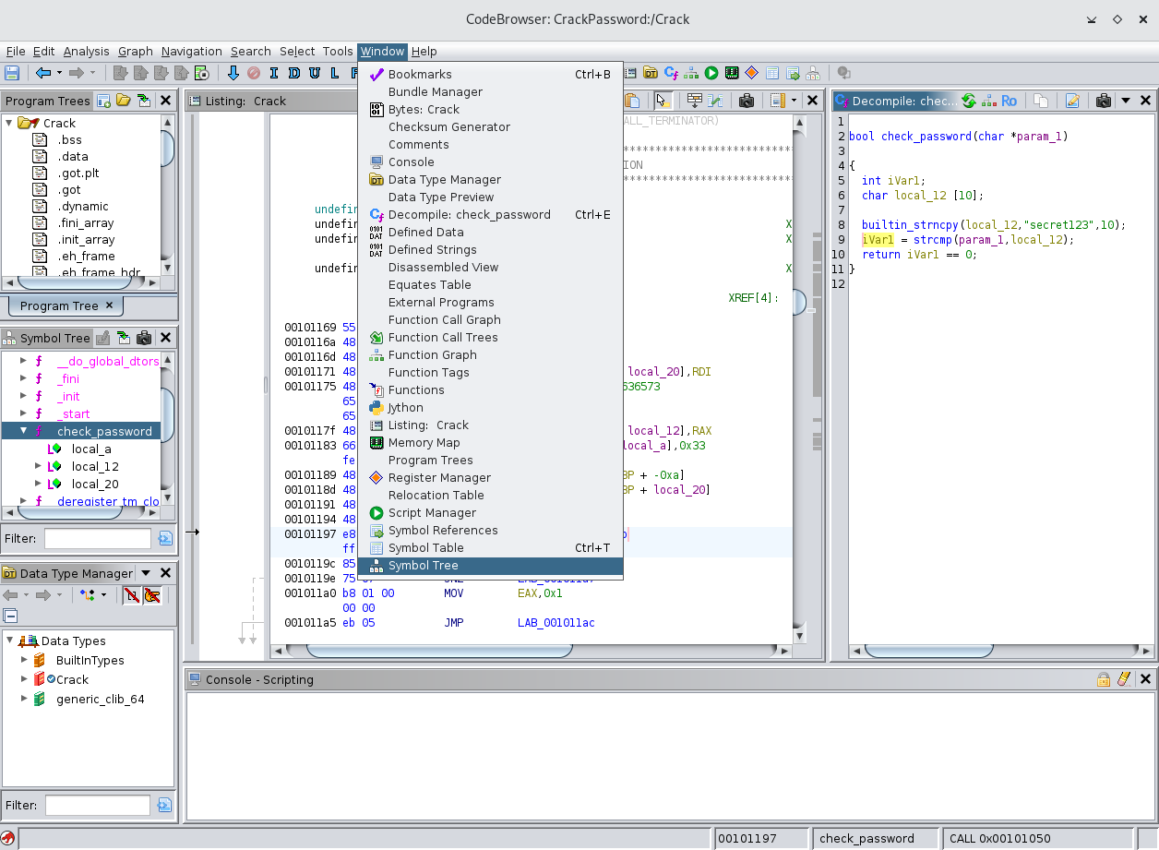
Control Flow Graph of Check_Password Function
1)Window 2)Function Graph

Slide 18
